Slide 1


Global Educational Network for
Emergency Resilience and Training Excellence
(GENERATE)
TIEMS 2016 Annual Conference
San Diego, CA

Slide 2
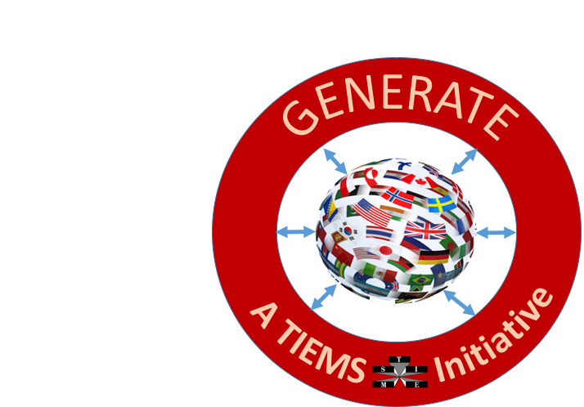
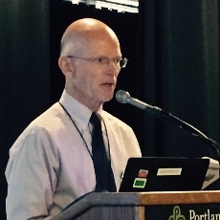
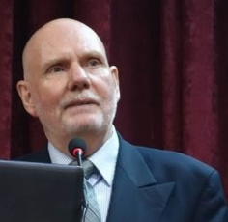


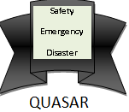
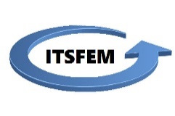
A TIEMS RTD Project Proposal
GENERATE
Global Education Network for Emergency Resilience and Training Excellence
Developed and Sponsored by:
Thomas Robertson
K. Harald Drager
Connie White
ITSFEM

Slide 3

Increasing need for
Disaster Preparedness Worldwide
Resilience to Emergencies is a Global Problem
Education is the Foundation for Resilience
A RTD Proposal to Improve Access to Education
Resources to Build Upon

Slide 4
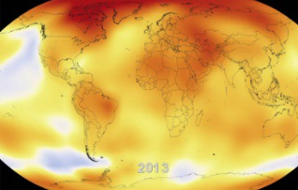
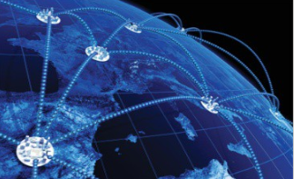
We are Interconnected
Climate Change
Global Economy
Energy Interdependence
Cyber Connectivity
Global Travel and Epidemics and Pandemics

Slide 5

We can learn from each other
Some Nations may have more Experience with the Disasters we may Face in the Future than Others
Vast Worldwide Experience can be used to Develop an Education and Certification Scheme Useful to All
Shared Knowledge and Terminology makes International Cooperation Easier
New Lessons are Learned every Day

Slide 6
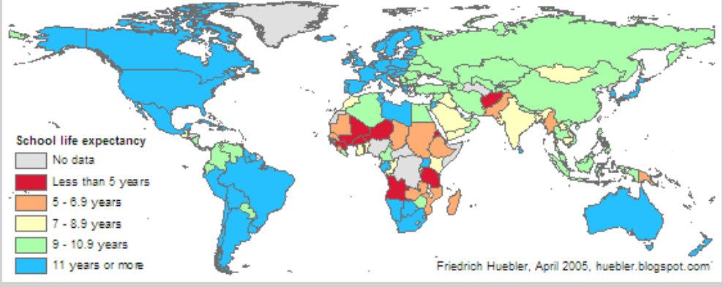
The education access problem

Slide 7
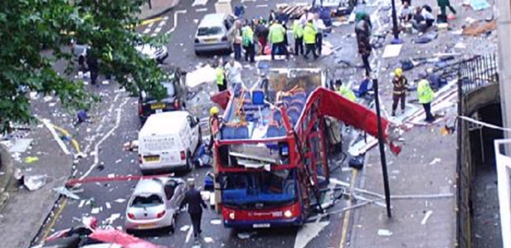
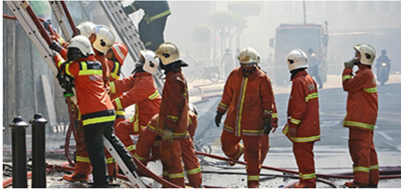
GENerate project objectives
Develop an Internationally Shared Understanding of Emergency Management Elements, Qualifications and Terminology
Help Students Find and Connect with Useful Online and Live Education Resources
Make Increasing Amounts of Emergency Management Knowledge Available Online, Especially to Vulnerable Societies
Provide a Platform to Share Critical Lessons Learned

Slide 8
What is GENERATE?
An International Community of emergency management organizations, educators, practitioners, and students
  GENERATE Centers of Excellence
An eLearning and Certification platform promoting shared understanding of EM elements, standards and terminology
A Directory of live and online degree programs, courses, workshops, and knowledge bases
An online Community of Practice to share lessons learned
TIEMS International Centre of Excellence Module
TIEMS
Universities/
Training Institutions Catalogue
Module
GENERATE Global Education Network
TIEMS WEB-Site
GENERATE Core Module
TIEMS Comunity of Practise
COP
Module
GENERATE Nucleus, Community of Practise and Mobile application
TIEMS On-line, Education, Exam and Certification Module
TIEMS Wikipedia of Lessons Learned Module
GENERATE On-line Learning and Education, Exam and Certification
TIEMS Mobile Application

Slide 9
GENERATE Development Plan
WP0
WP2
WP3
Start-up
Development
Finalization
WP1
Kick-Off
WP6
WP4
WP5
WP6
WP6
WP7
WP6
Structure
and
Design
University
Network
Documentation
And
Workshop
Preparations
And
Workshop
GENERATE
System
Management
And
Control
GENERATE
Administration
Student
Tests
12 Months

Slide 10
GENerate project ORGANIZATION STRUCTURE
Project Board
(Including those giving financial support to the project)
Advisory Board of Partners
(Including those participating in the project as partners, like universities)
Advisory Board of Supporters
(Including those supporting the project and its outcome without actively participating in the project)
Project Management
Project Responsible
Project Manager
Quality Manager
WP 5
WP 3
WP 2
WP 0
WP 1
WP 4
WP 7
WP 6
Advisory Group of Students

Slide 11
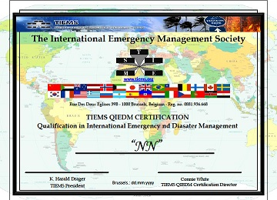
TIEMS QIEDM CERTIFICATION
Application Requirements
QIEDM – Qualifications in International Emergency and Disaster Management
Being Certified in Emergency Management/Disaster Response or Similar by Another Certifying Institution Approved by TIEMS
Document a Practical or Theoretical Background in Emergency and Disaster Management for a minimum of 4 years
Provide a Letter of Recommendation to TIEMS QIEDM Program from a Current or Former Employer
OR

Slide 12
QIEDM Certification OBJECTIVES
Availability Globally
Web-based On-Line
Low Cost
A Common Understanding of Emergency and Disaster Management
The Common Language is English, but local language adaption in TIEMS Chapter Countries
Lessons Learned Focus
State-of-the-Art and Up-to-Date

Slide 13
GENERATE Discussion topics
Validation and specification of need
  International perspective
    Improved education
    Certification
  Better access
    Western world
    Vulnerable areas
Availability of sources and partners
  Partner institutions
  Online
Other?

