Slide 1
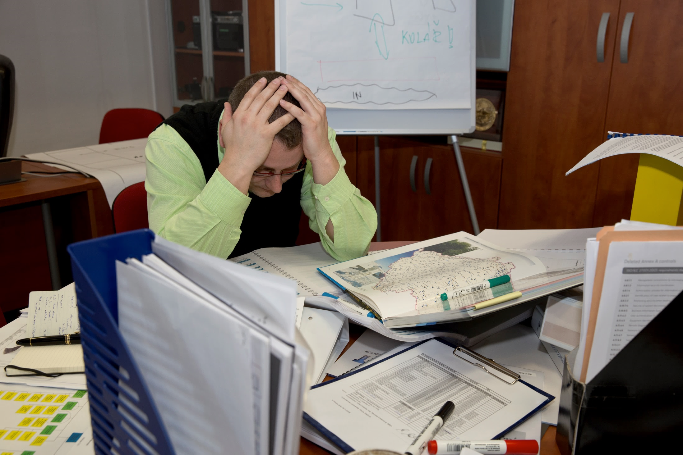


www.tsoft.cz,
pejcoch@tsoft.cz
PREPARED?
Jaroslav Pejčoch, T-SOFT, Praha, CZ

Slide 2

Tailored IT solutions
Mission critical systems
Crisis management and Security

Slide 3
STRESS
TESTS

Slide 4
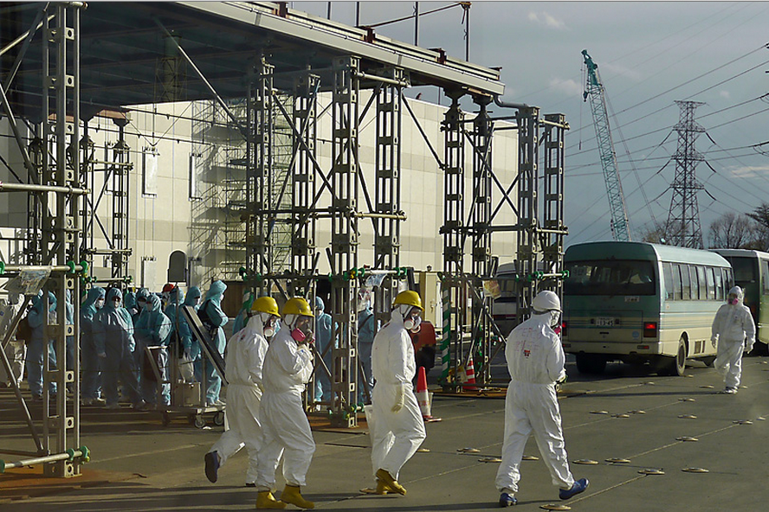
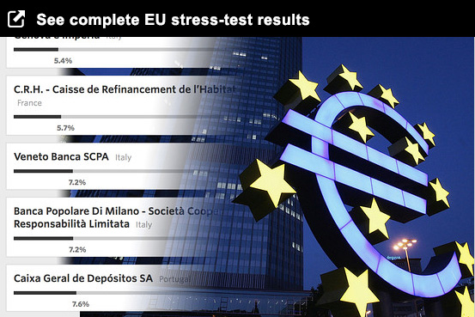
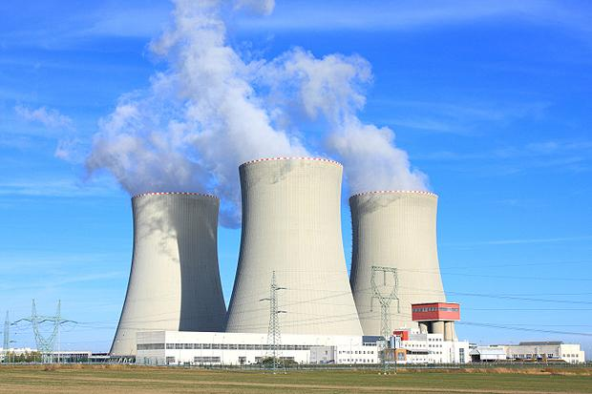
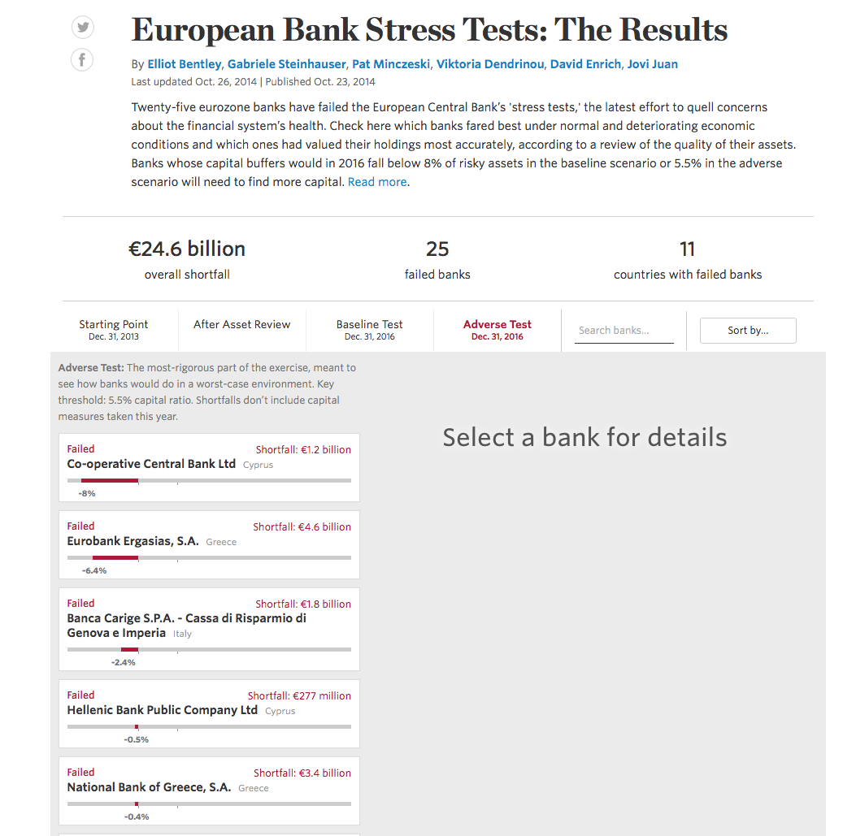
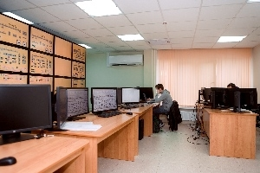
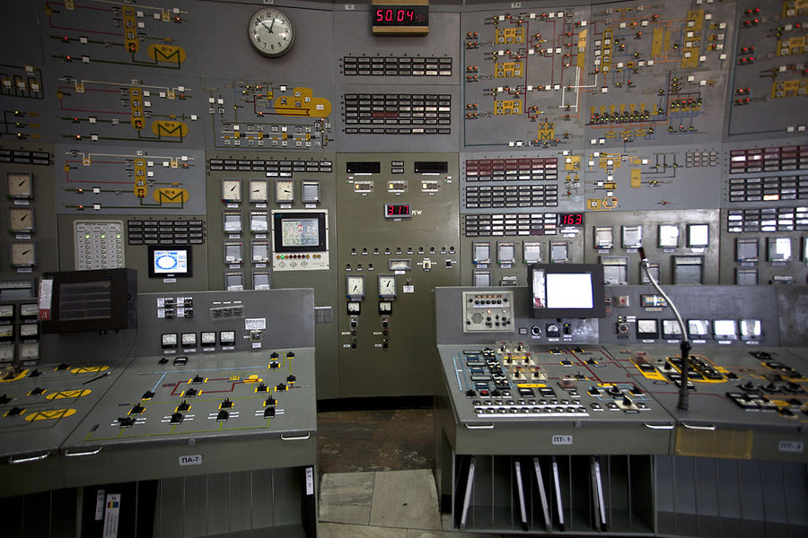

Slide 5

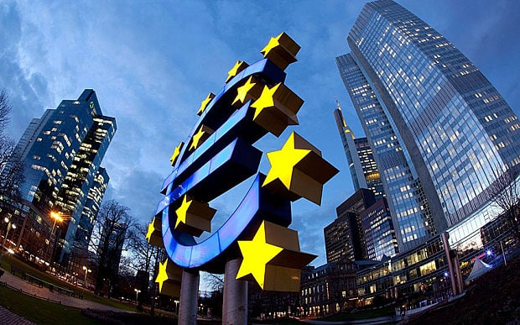
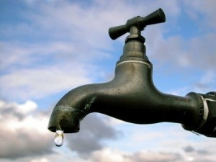
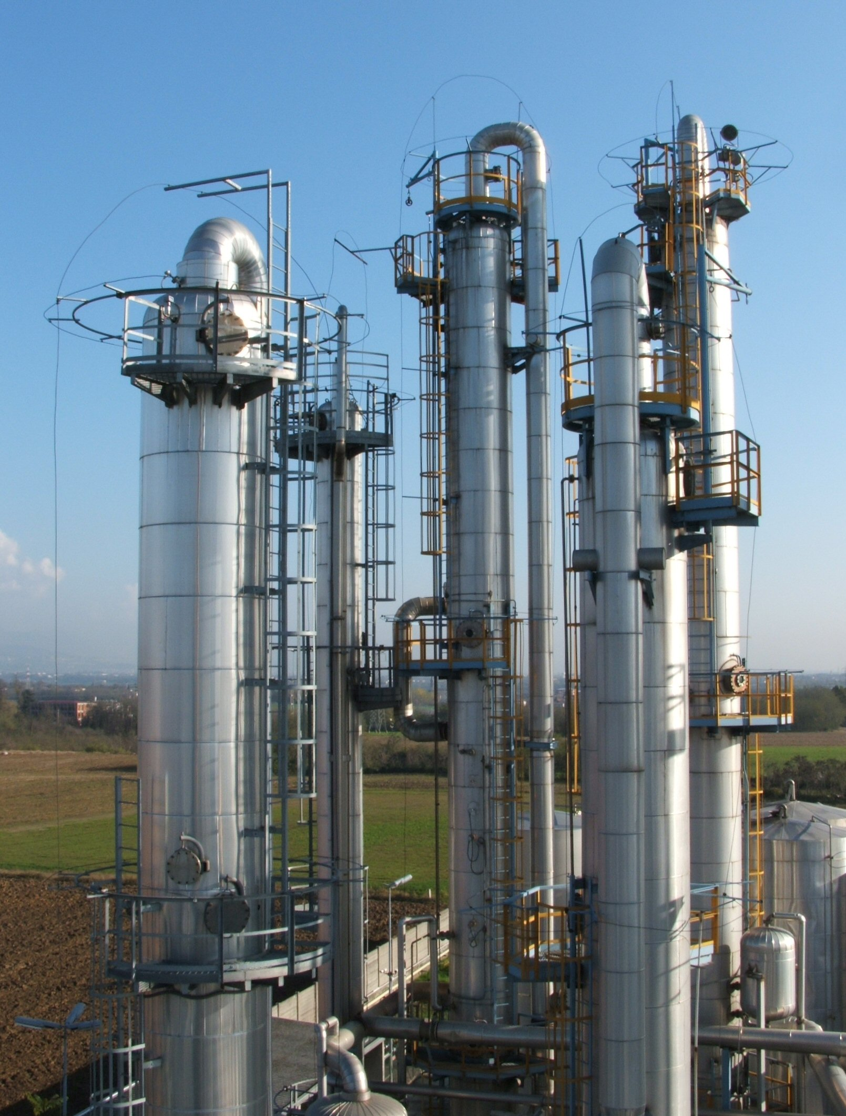
bank

Slide 6
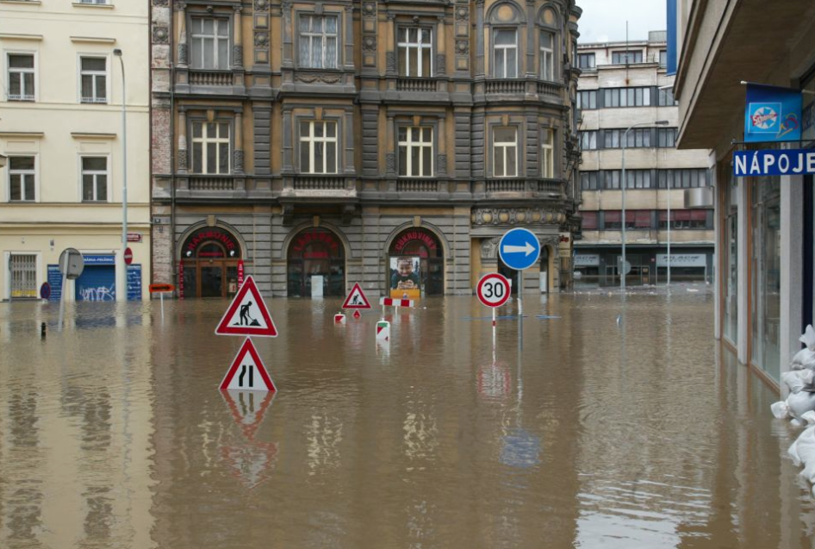
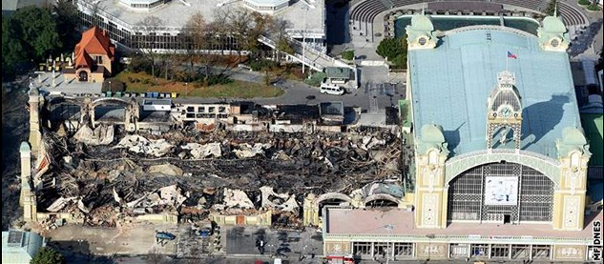
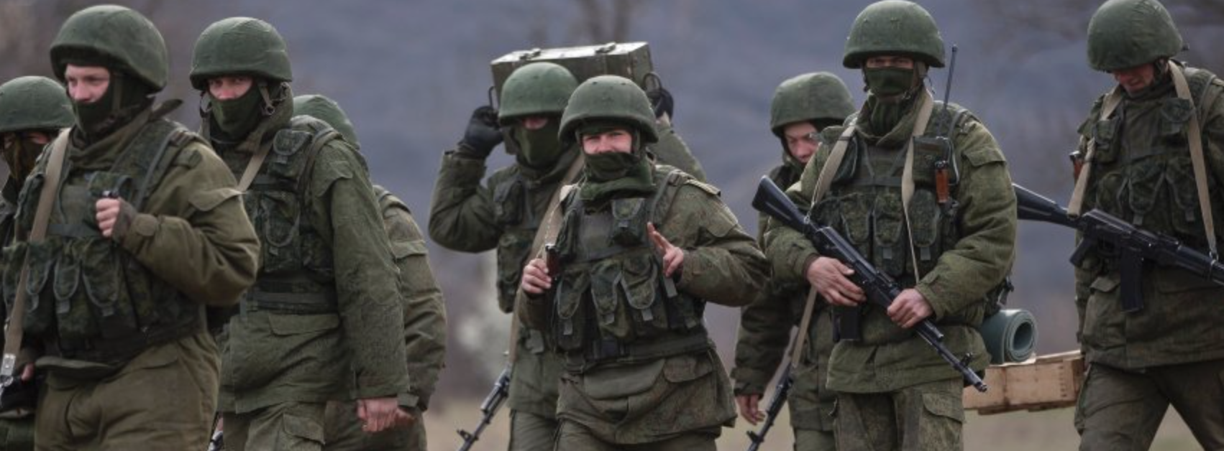
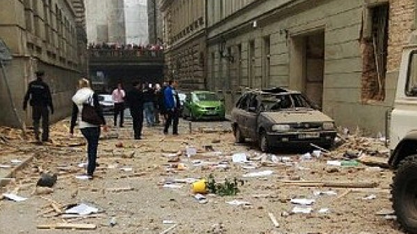
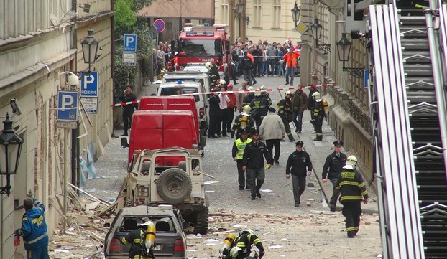


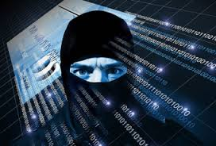
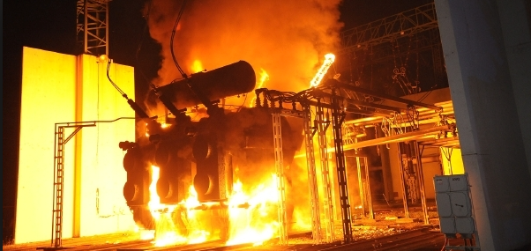

Slide 7
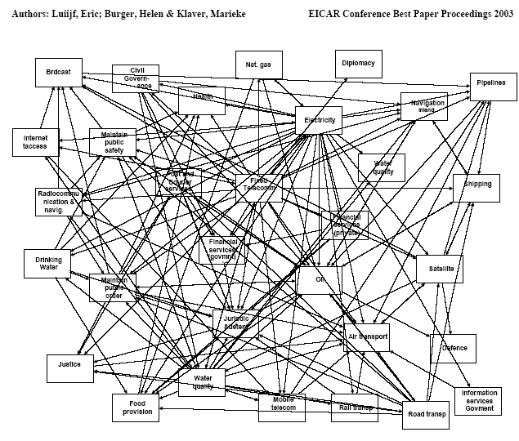

Slide 8
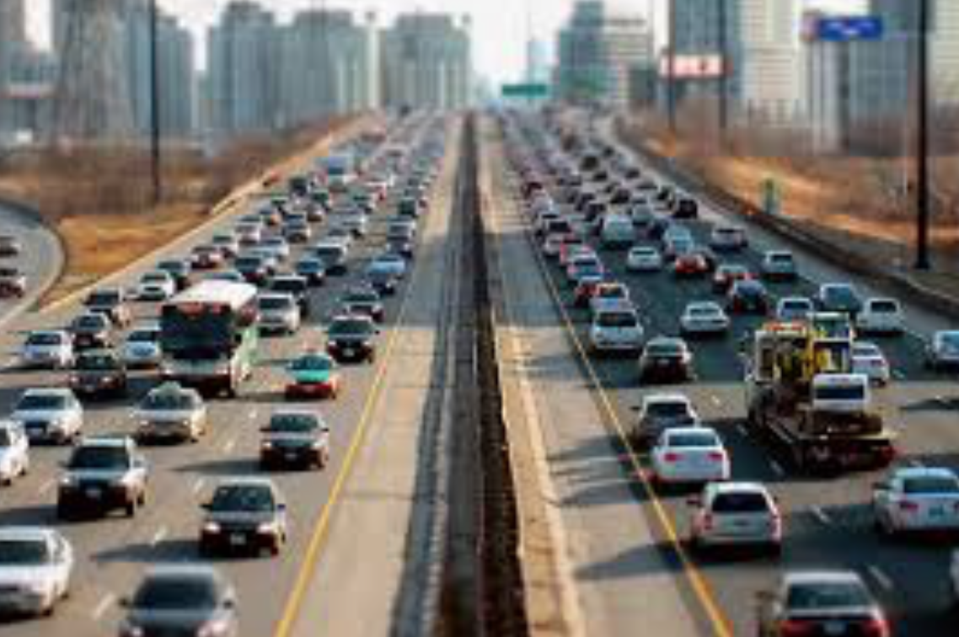
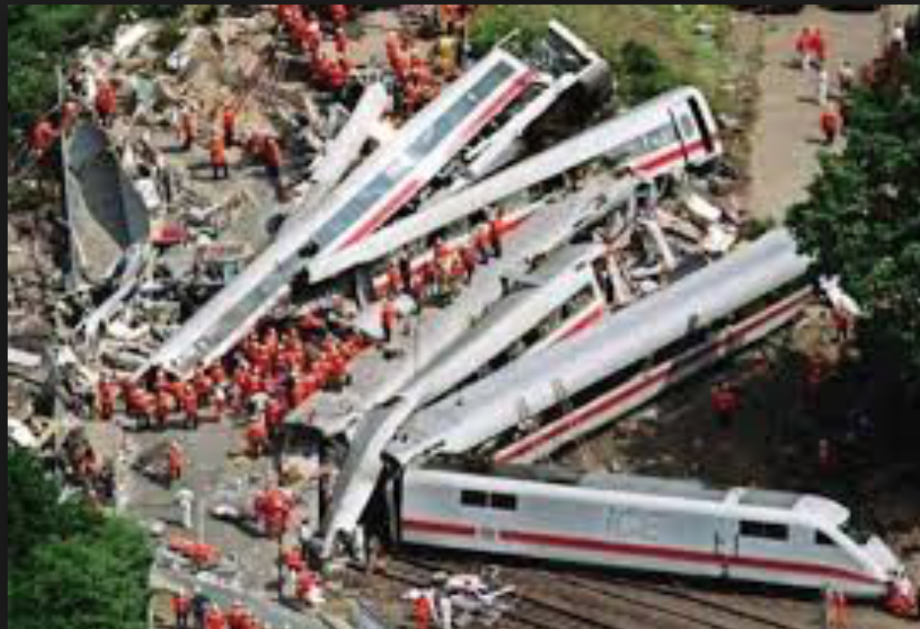
Order
… and collapse

Slide 9

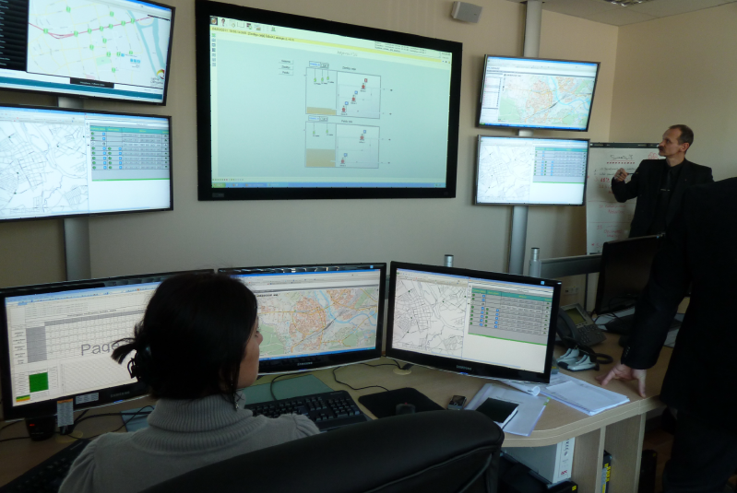
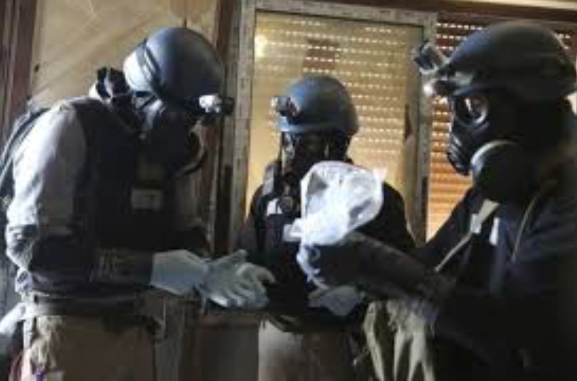
Management in troubles
Collapse of infrastructure
Loss of functionality
Escalation

Slide 10

How to prepare for that?

Slide 11
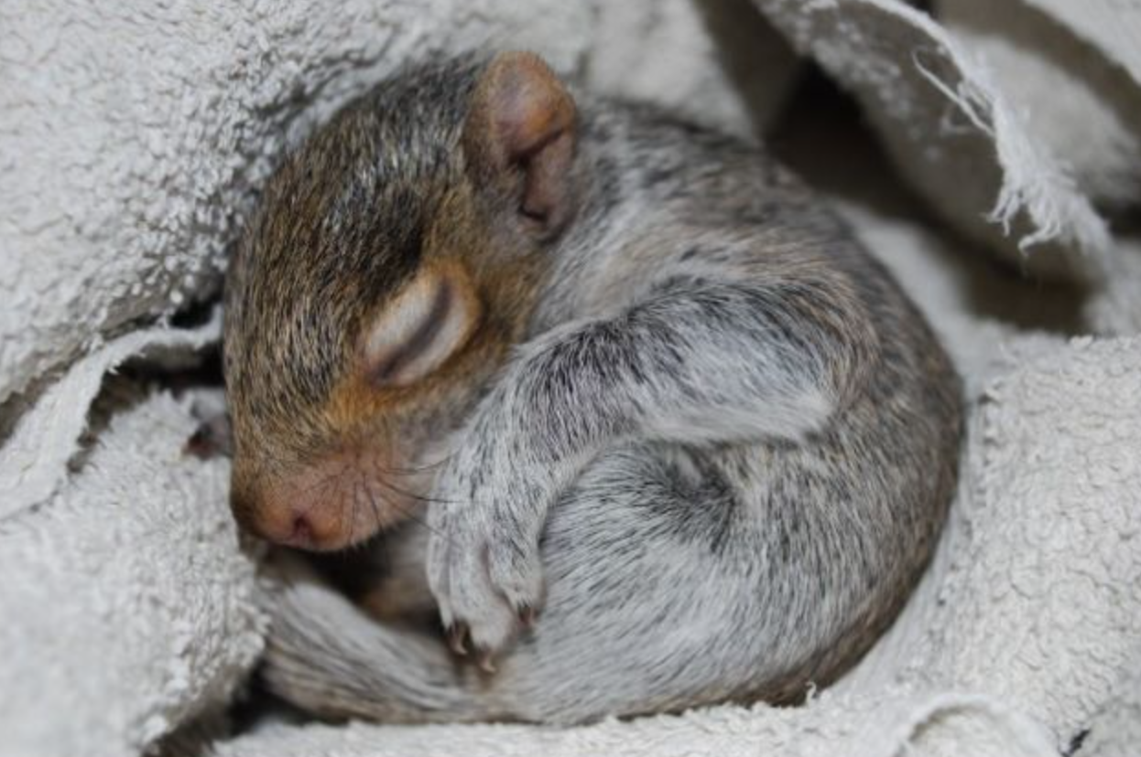
How are we doing?

Slide 12

We have everything under control

Slide 13
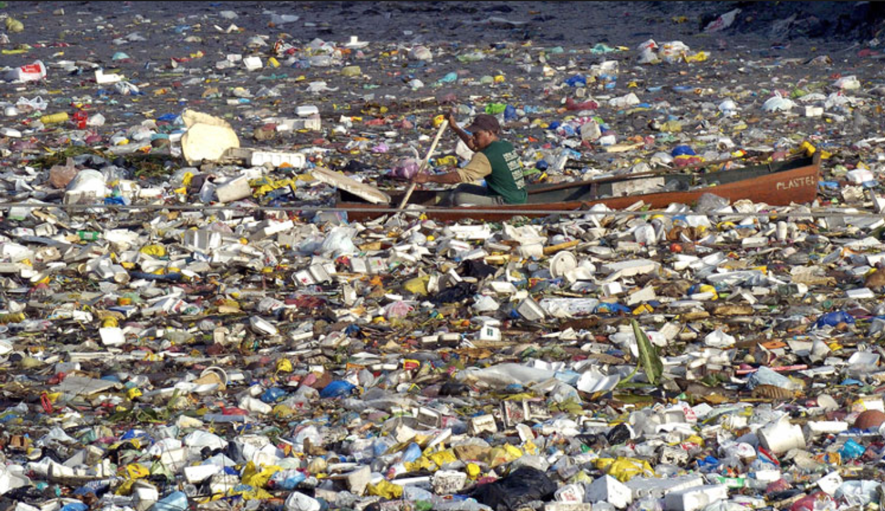
We have all information

Slide 14

We have plans for everything

Slide 15

… and when it comes …

Slide 16
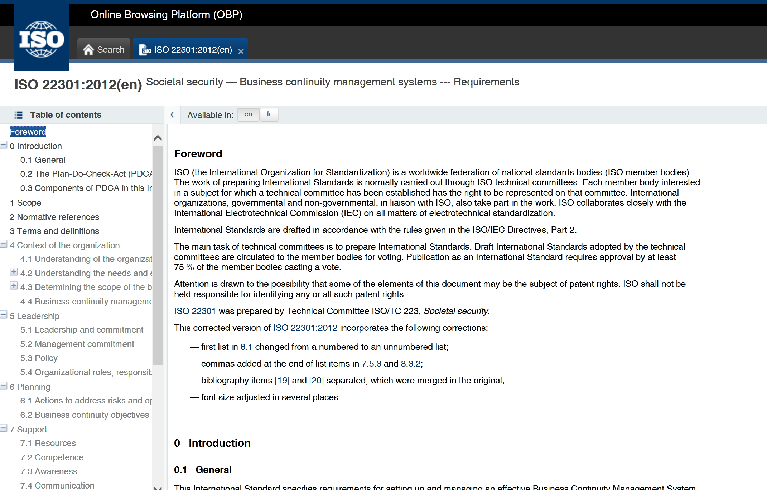
ISO 22301:2012

Slide 17
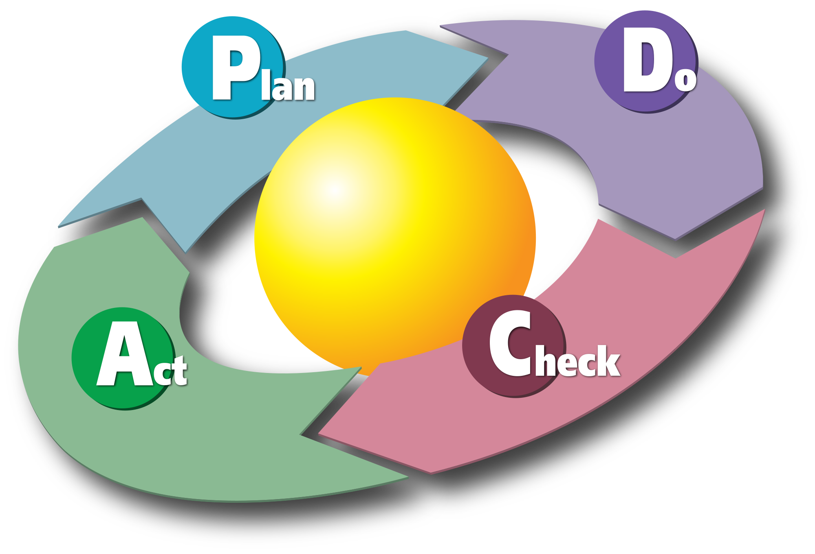
ISO 22301:2012
Documentation assessment
Personal assessment
Process audit

Slide 18
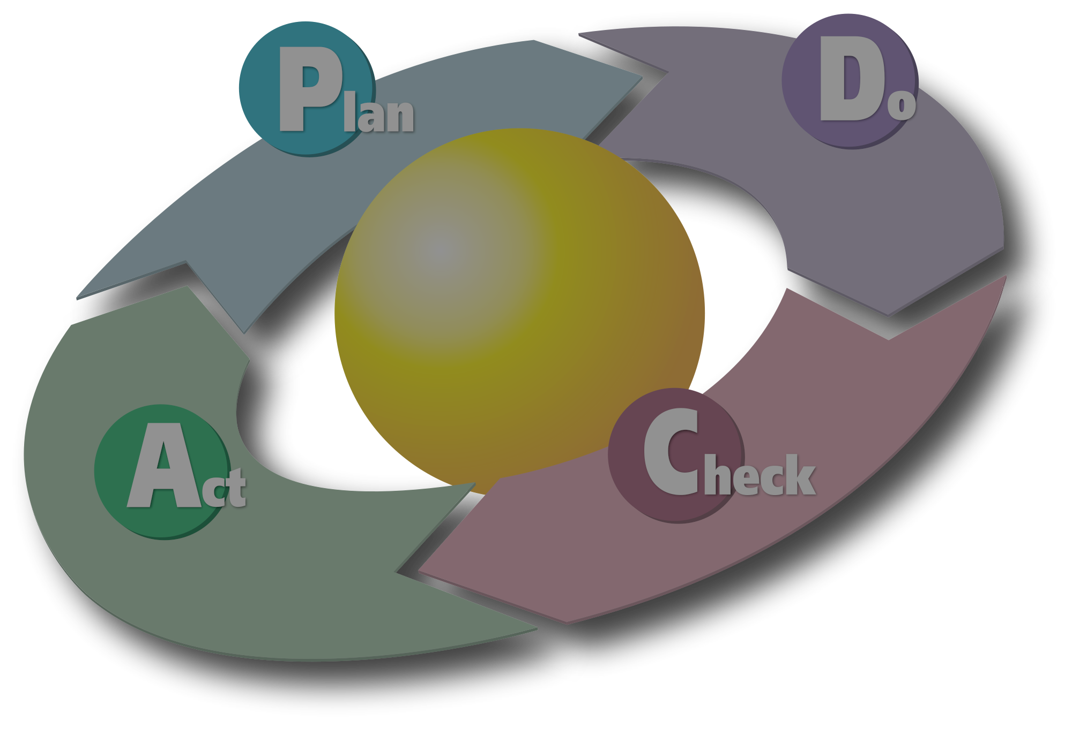
STRESS TEST

Slide 19
Stress test phases
1. Preparation
2. Execution (exercise)
3. Evaluation

Slide 20
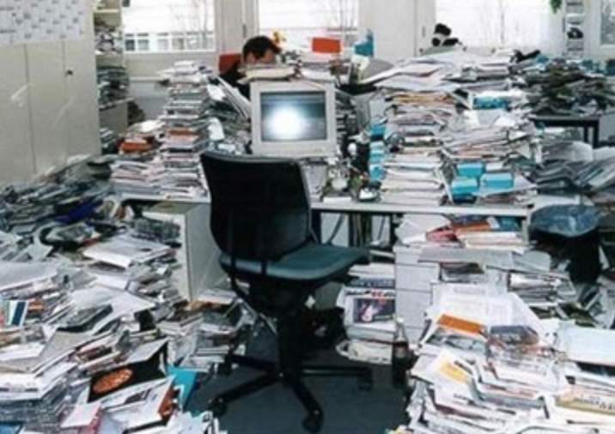
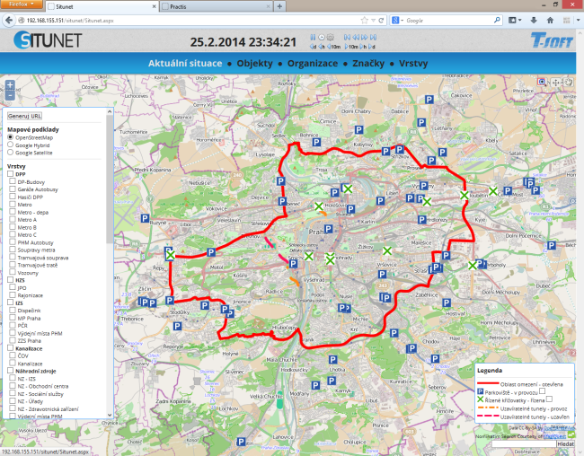
Preparatory phase
    Scenario preparation
    Information collection
    Unification, integration, preparation of the Common situation picture
    Visualisation

Slide 21

Execution - Exercising

Slide 22
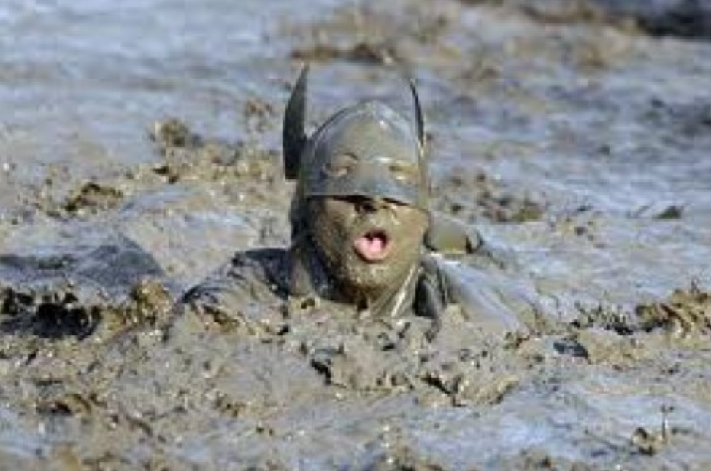
General Suvorov
"What is difficult in training will become easy in a battle"

Slide 23
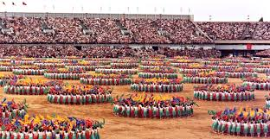
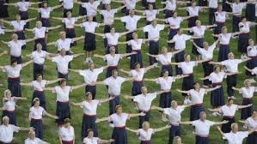
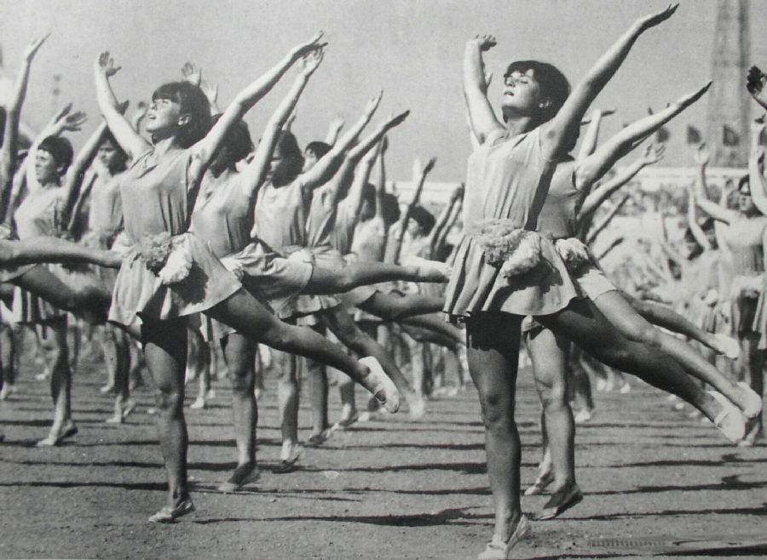
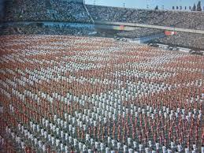
Exercising

Slide 24
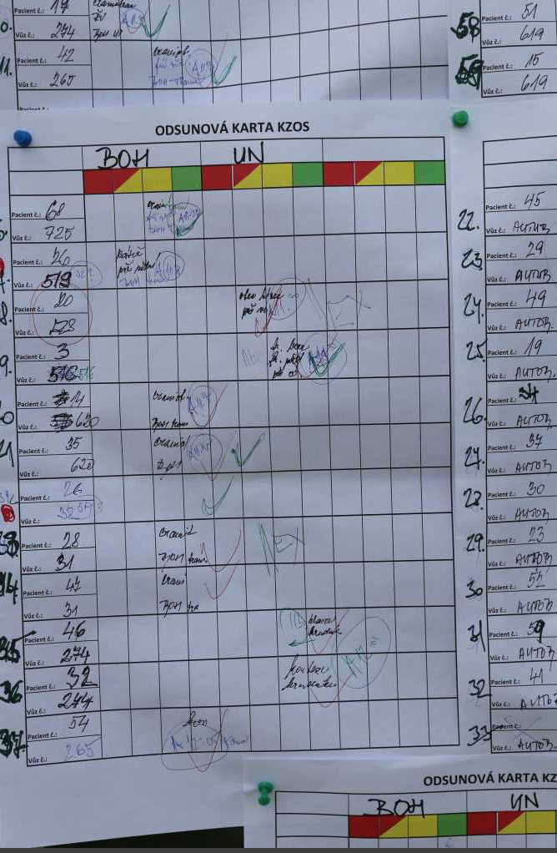
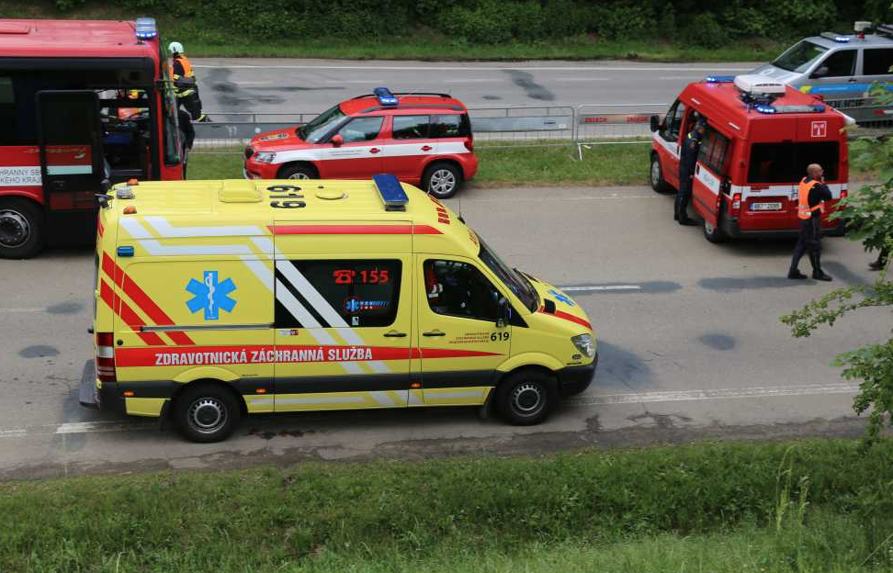
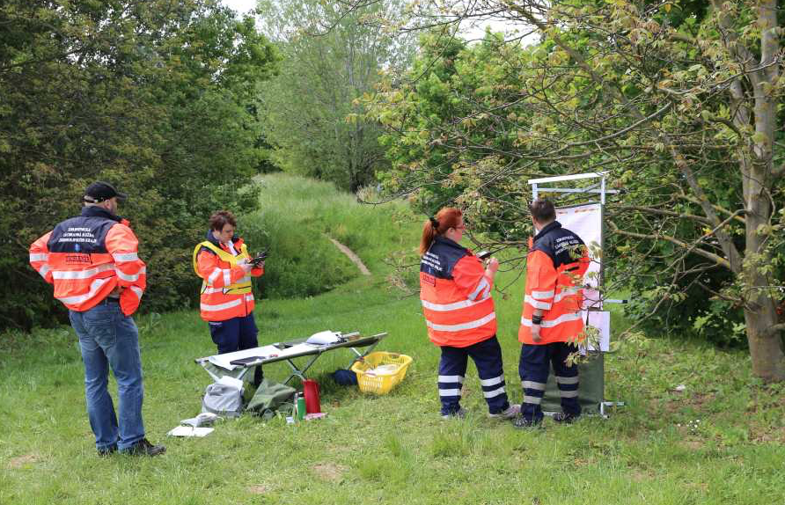

Slide 25
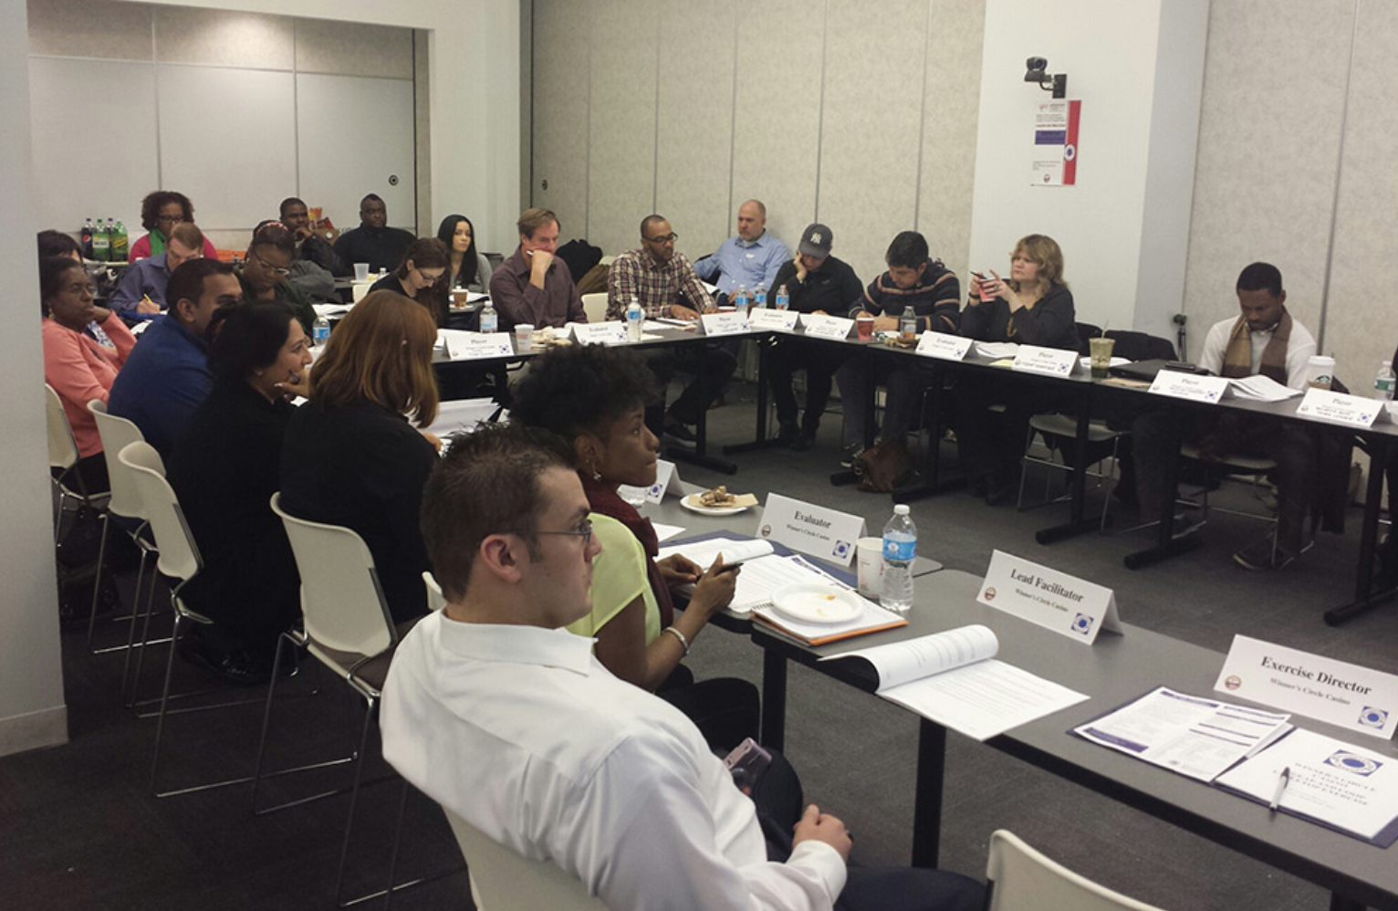

Slide 26
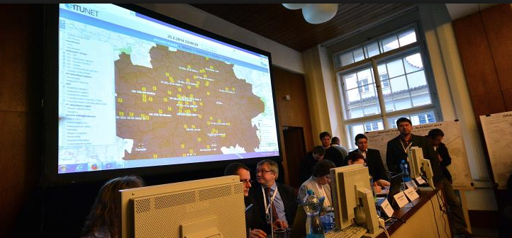
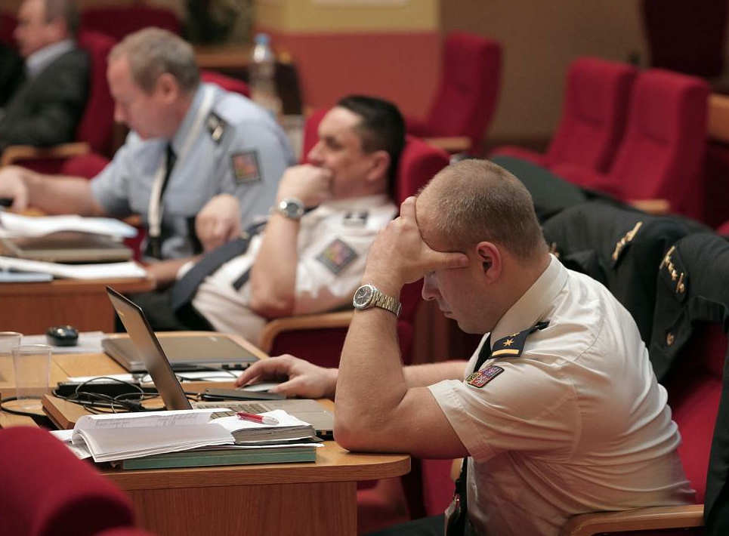
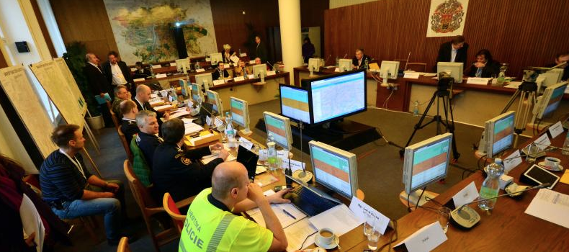
Tabletop exercise – Exciting game

Slide 27
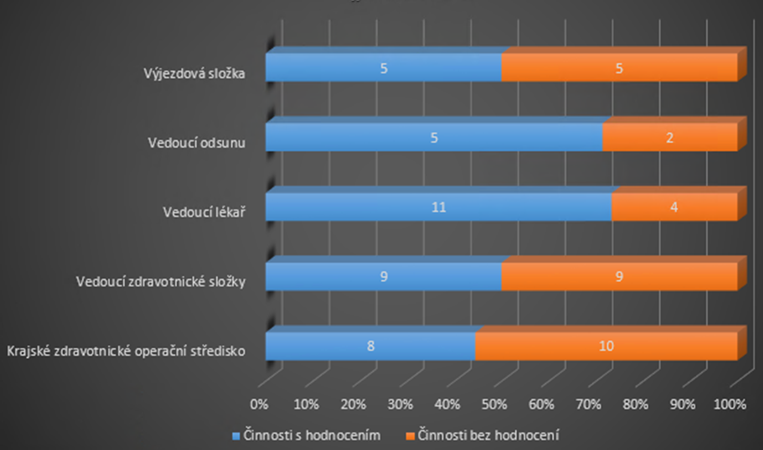
Evaluation

Slide 28
Stress test?

Slide 29
PDCA all-in-one
All important players present – confrontation of „planned“ or „expected“ to „realistic“
Instant ideas, improvements, cross-checks of real capabilities and responsibilities
Full and comprehensive documentation
Experience and knowledge remains in minds
Optimization of Common operation picture and procedures

Slide 30
PDCA all-in-one
Comparation of results (metrics)
Regular repetition
  Performance improvement
  Capabilities maintenance
  New team members introduction and adaptation
  Change of external conditions (legislation, technology, economy …

Slide 31
Tools
PRACTIS – www.tsoft.cz/PRACTIS
SITUNET – www.tsoft.cz/SITUNET
Team assessment tools

Slide 32
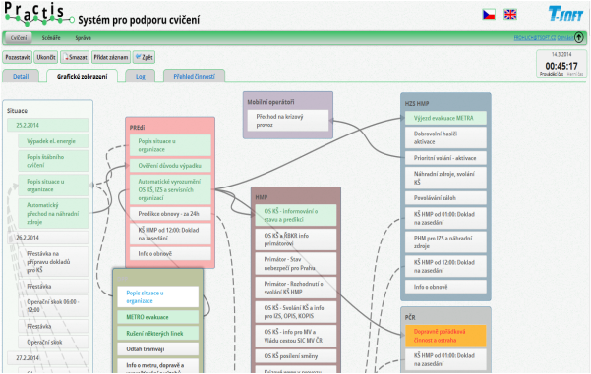
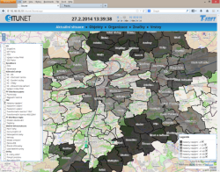
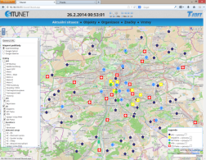
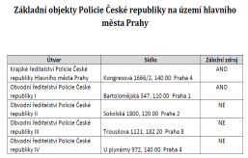
Scenario
32

Slide 33






Timeline, models, simulation...

Slide 34
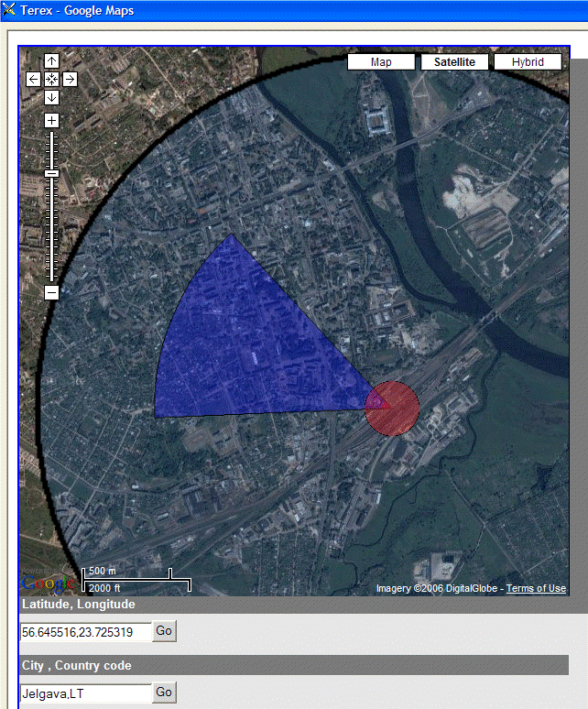
TEREX – explosion model

Slide 35
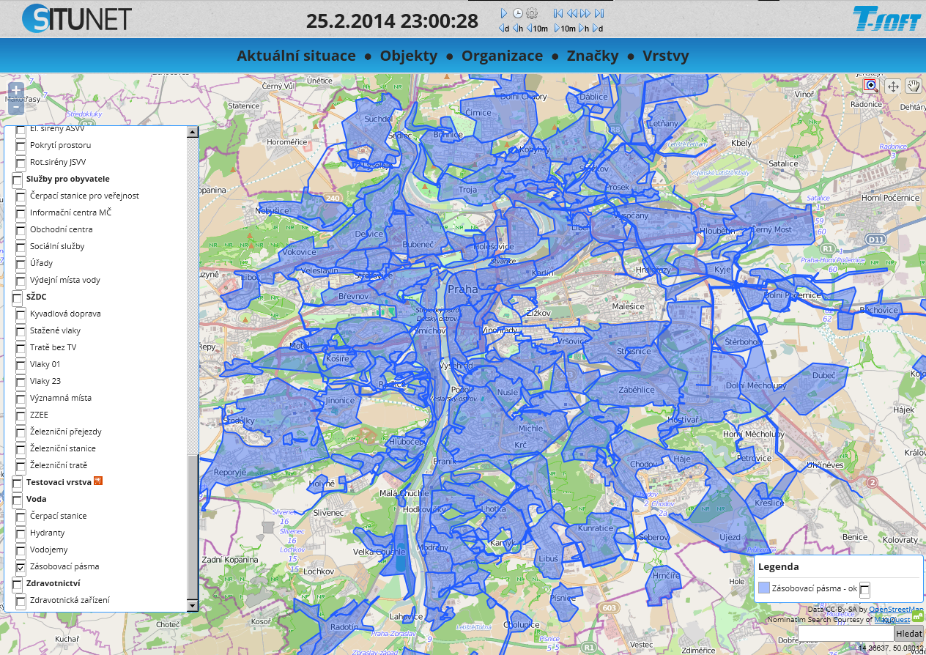
SITUNET – water supply model
20

Slide 36
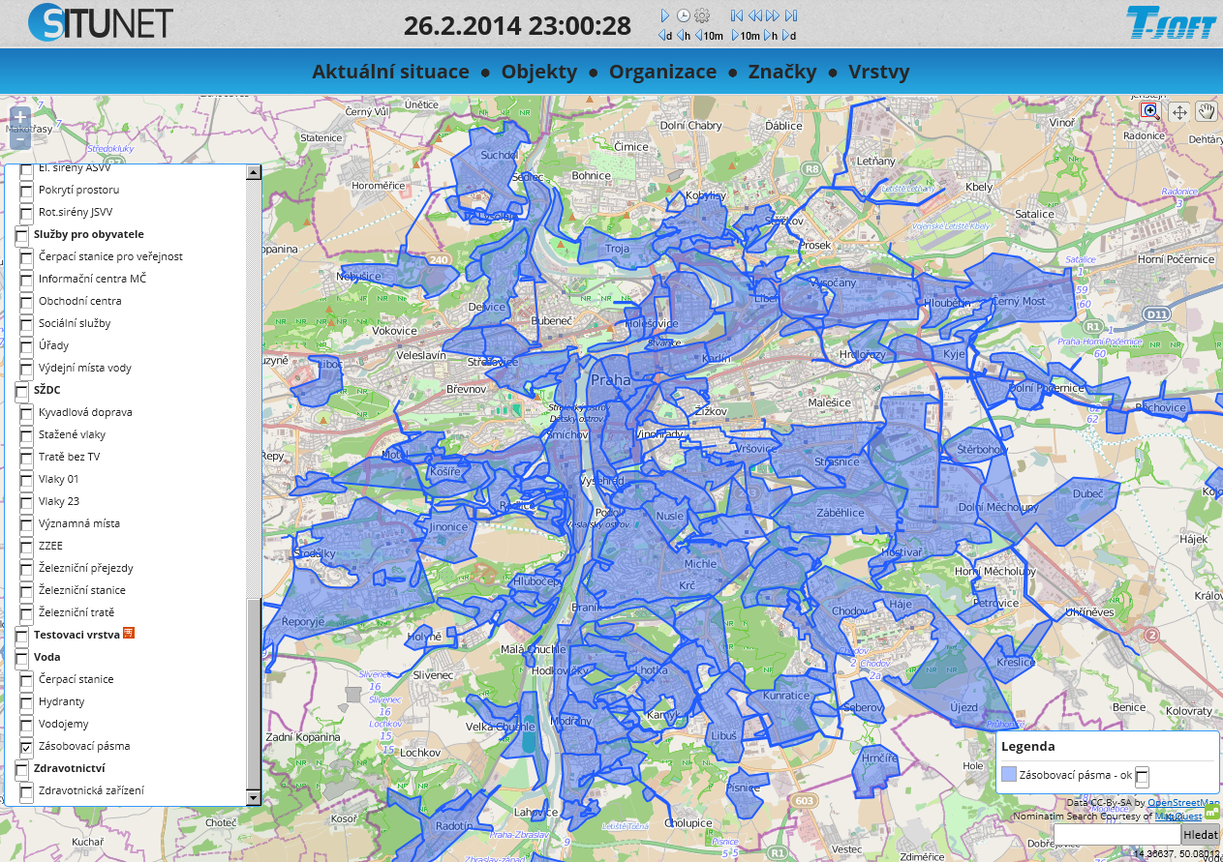
SITUNET – water supply model
21

Slide 37
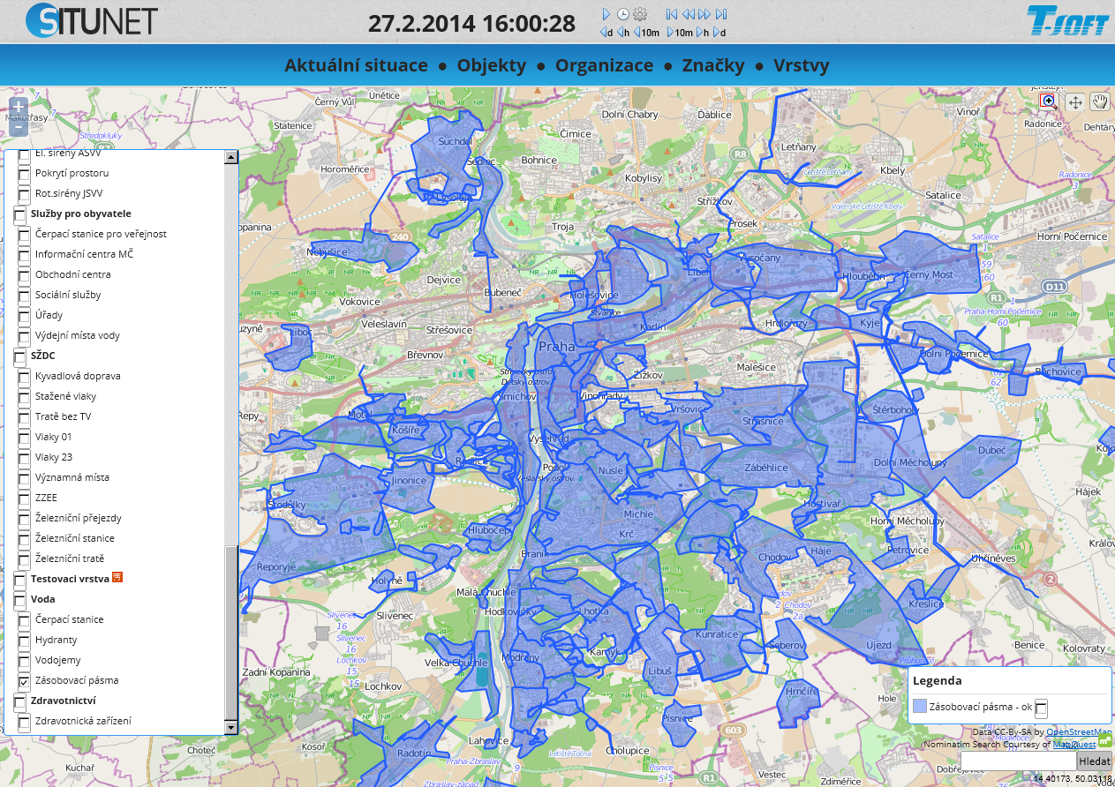
SITUNET – water supply model
22

Slide 38

SITUNET – water supply model
23

Slide 39


SITUNET – Fuel stations in operation
For rescue system
For public
30

Slide 40









Prague Blackout 2014 - Scene
Crisis staff
Experts
(auditorium)
Press centre
Video
Notification
Public info
Scenario timeline
Documents
Situation
Mail room
5

Slide 41
Personal assessment scenario tuning
Ad-hoc team
Social mapping
Tailoring of scenarios to the team
Customised scenarios by personal profiles

Slide 42

CWAT
Colour-Word Association Technique
www.engagehill.com

Slide 43

CWAT

Slide 44

PurposeFly - Team Management

Slide 45
Questions
Which 3 people contribute the most to the results?
Which 3 people give you the most energy?
Which 3 people are the best experts?
Which 3 people do you feel best with?
Which 3 people you would trust in crisis situation?

Slide 46

Personal relations

Slide 47

Reputation

Slide 48
Cyber Example

Slide 49

Example - cyber

Slide 50


Slide 51







Procedures and advisory at hand
All instructions what to do in my mobile
Select procedure
Check completion of steps in checklist
Plans, forms, documents …
After the event is over, evaluate and update of procedure

Slide 52

What do we get after ?
Awareness
Correct procedures
Actual information and knowledge
Status „How are we doing“
Preparedness to crisis situations
Documentation ... How was it that time
Crisis plans in minds of people and in Practis

Slide 53
Integrated Security
Awareness
PROCESSES
What may (should) happen
ANOMALIES
EXPERIENCE
RESILIENCY
WHAT IS HAPPENING
WHAT HAPPENS, WHEN....
MONITORING
AND CONTROL
PREPAREDNESS
REACTION

Slide 54

CONCLUSIONS

Slide 55
PEOPLE ARE THE KEY
Informed, educated and prepared management
Common awareness
Periodical stresstests as a method
Stresstests experts capable to design, manage and moderate the exercise

Slide 56

TIEMS GENERATE
Global Educational Network for
Emergency Resilience
And Training Excellence

Slide 57

Thank you.
ww.tsoft.cz , pejcoch@tsoft.cz

