Slide 1
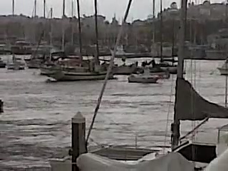
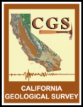



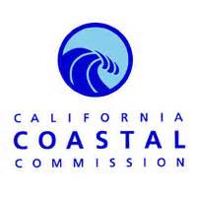
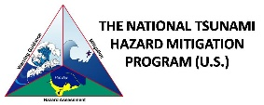




The FASTER Approach: A New Tool for Calculating Real-Time Tsunami Flood Hazards
Hazard Assessment
Preparedness
Mitigation
Response
Recovery
Disaster Planning Cycle
February 2010
Chile Tsunami in San Diego Bay
Kevin Miller, California Governor’s Office of Emergency Services
Rick Wilson, California Geological Survey
Mike Davis, San Diego County Office of Emergency Services
Partners =
Notes:
California tsunami planning is not just about “mitigation” It involves all portions of the Disaster Planning Cycle. * I’d like to acknowledge all of our partners in California * We rely on everyone’s separate expertise * These collaborations are what provide the opportunity to implement a fully developed program.

Slide 2
Topics
  Local Tsunami Threat
  Alert & Warning in California
  Evacuation Response Tools
  (Maps, Plans, Playbooks, FASTER)

Slide 3
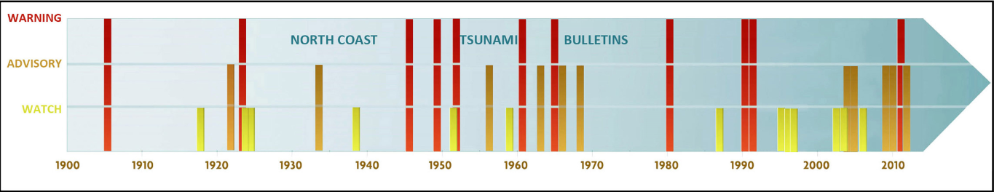
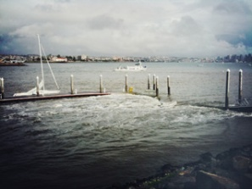
History of Tsunamis in California
5:00

Slide 4
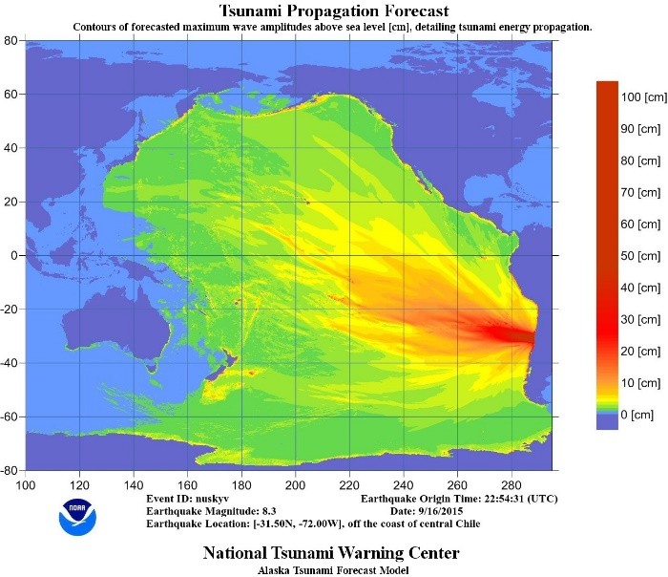
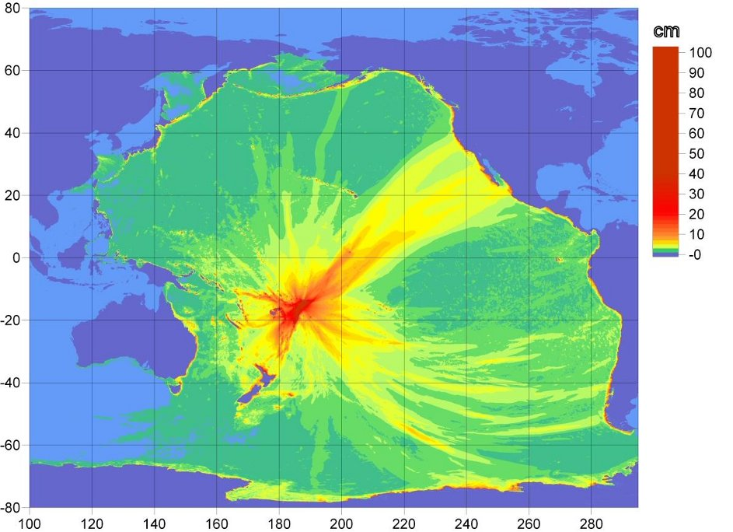
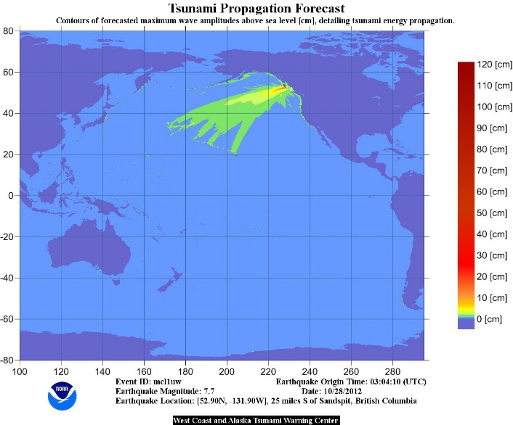
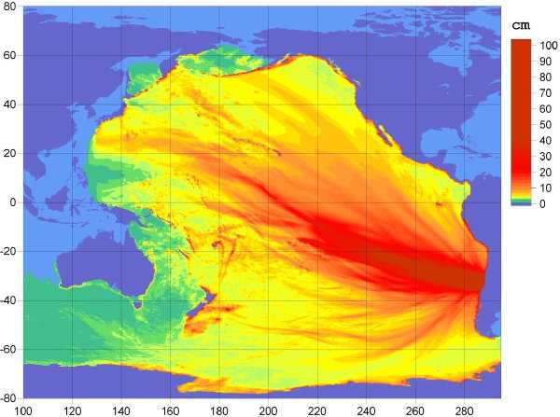
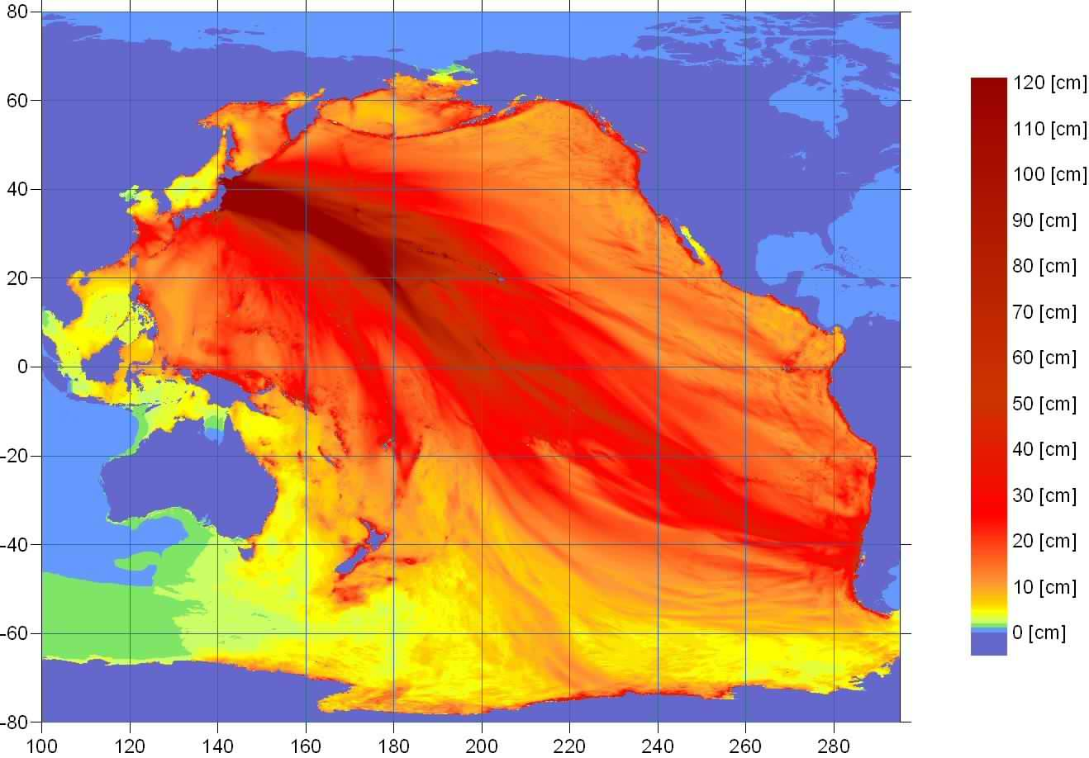
Chile
Sept ’15
ADVISORY
Samoa
Sept ’09
ADVISORY
Recent California Tsunami
Advisory and Warning level Events
5 in Last 7 Years
British Columbia
Oct ’12
ADVISORY
Chile
Feb ’10
ADVISORY
Japan
March ’11
WARNING & ADVISORY

Slide 5
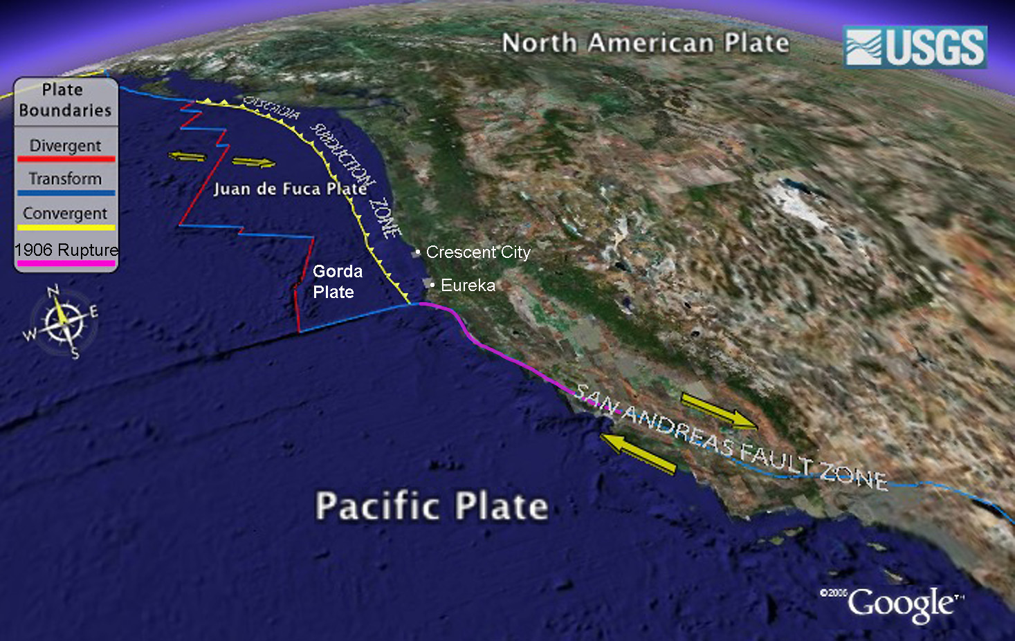
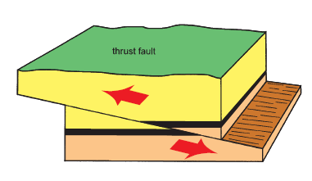
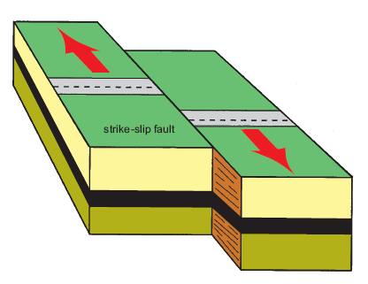
For tsunamis the San Andreas is good news

Slide 6
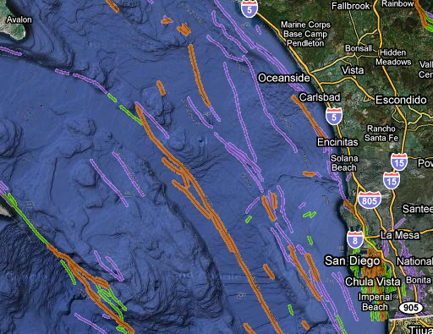
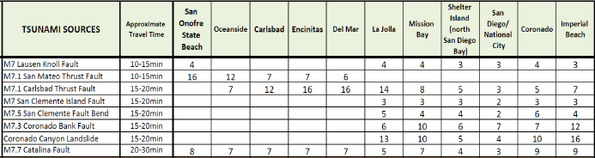
Local Tsunami Source Scenarios for San Diego County
Fault Activity
Lasuen Knoll Fault
San Mateo
Thrust Fault
Historical
Active
Potentially active to not active
Catalina Fault
Carlsbad Thrust Fault
Coronado Bank Fault
Oceanside Thrust Fault
San Clemente Fault
Coronado Canyon Submarine Landslide
Notes:
Numbers represent offshore wave-heights in feet above MSL…
Carlsbad and San Mateo Thrust faults, and Coronado Canyon landslides are worst cases locally…

Slide 7
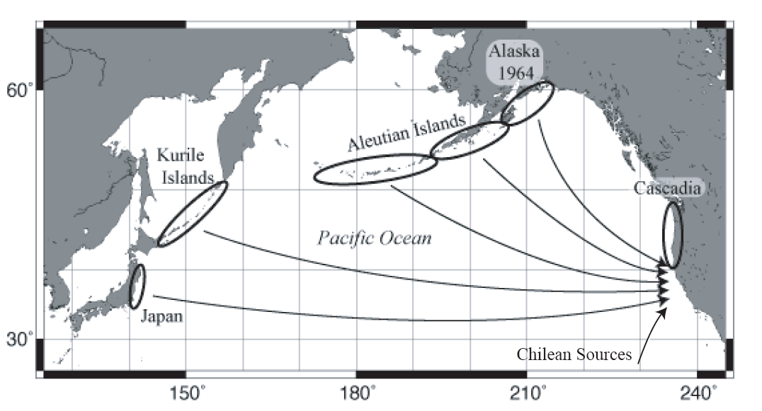
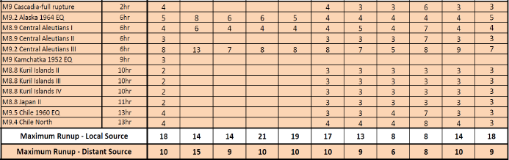
Distant Source Tsunami Scenarios
Kamchatka
CALIFORNIA
Columbia-Ecuador and
Izu-Bonin Mariana
Notes:
Distant source tsunami occur more often but we typically get 4 to 14 hours of notice before they hit CA.
For our tsunami inundation maps, we evaluated sources from all over the Pacific…
Eastern Aleutians and Chilean sources are worst case…

Slide 8
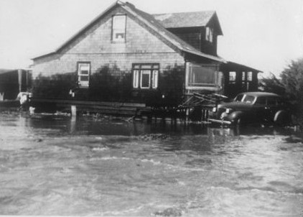
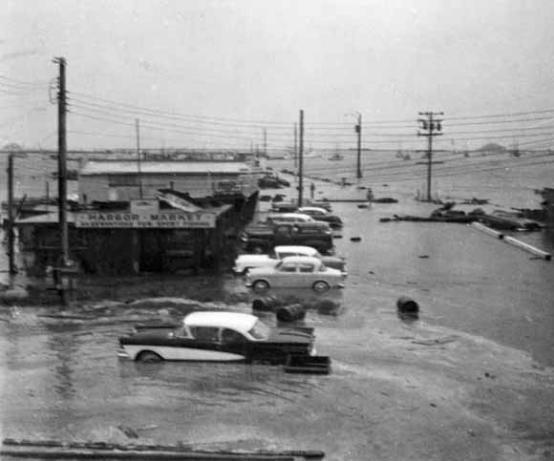
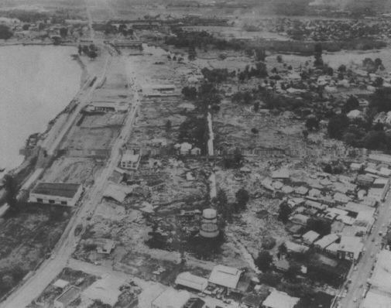
Significant Historical Tsunamis in California
Eight significant trans-Pacific damaging tsunamis (1946, 1952, 1957, 1960, 1964, 2006, 2010, and 2011) over past 70 years.
12 deaths in 1964
Three of these, 1946, 1960, and 1964 causing inundation of dry land.
March 11, 2011 (1 death, $100M Statewide)
  Mission Bay: $136K damage to bait dock, 13 boats, 26 pilings
  Shelter Island: $110 damage to docks, boat sunk
  San Diego Bay: damage to docks
1946 – Half Moon Bay
1960 – Crescent City
1964 – Crescent City

Slide 9
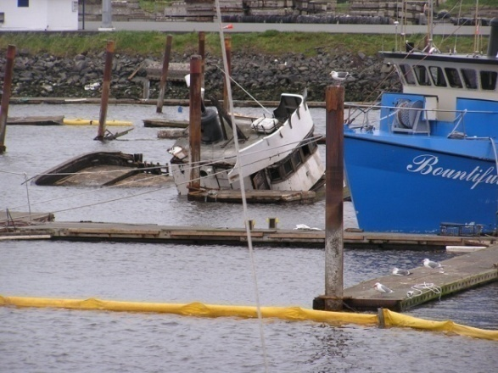
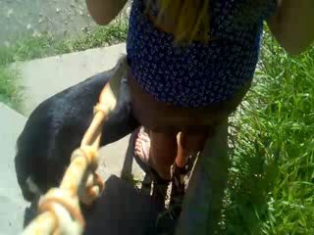
Lessons Learned from Recent Tsunamis in California
Evacuation Issues
  Inconsistent evacuation/response statewide
  How can tides be incorporated/considered?
  NTWC information highly accurate and time available to respond but evacuation options are all or nothing: What to do in a minor “Warning” level alert?
Maritime Community Issues
  Inconsistent response activities, including If/When/Where to reposition boats?
  Educate boat owners about tsunami hazards to help them make better decisions
  Ongoing recovery issues: What can be done to improve tsunami resistance and resiliency in harbors?
  **Potential Solutions**
  Simple and straightforward (non-public) response playbooks for various size events that improve real-time decisions/response options
  March 2011: Post tsunami; Boats sunk; recovery efforts in Crescent City Harbor
  March 2011 Santa Cruz Harbor

Slide 10
Alert & Warning

Slide 11


Official NOAA Alert Bulletins
Tsunami WARNING* (waves >3 feet)
Widespread inundation is imminent or occurring
Full evacuation suggested, move to higher ground
Tsunami ADVISORY (waves 1 foot to 3 feet)
Strong currents are imminent or occurring
Move away from the shore, harbors, marinas
Tsunami WATCH*
There is a potential tsunami which may later impact the area
Stay alert for more information
May be upgraded to Warning/Advisory
Tsunami INFORMATION
Minor Waves at Most
No action suggested
*Activates EAS
http://wcatwc.arh.noaa.gov/?page=message_definitions
Notes:
West Coast Alaska Tsunami Warning Center
Tsunami Warning: A potential tsunami with significant widespread inundation is imminent or expected. First wave is expected within three hours or less. Widespread, dangerous coastal flooding accompanied by powerful currents is possible and may continue for several hours after arrival of the initial wave. Warnings may be updated, adjusted geographically, downgraded, or canceled. Highest level of alert bulletin. A Warning may be changed to an Advisory after the main series of waves is believed to have passed.
Tsunami Advisory: A tsunami capable of producing strong currents or waves dangerous to those in or near the water is imminent or expected. The threat may continue for several hours after the arrival of the initial wave, but significant widespread inundation is not expected for areas under an advisory. Advisories are normally updated to continue the advisory, expand/contract affected areas, upgrade to a warning, or cancel the advisory.
Tsunami Watch: A potentially tsunami-generating earthquake has occurred but that the level of risk is uncertain and the arrival of first waves is not imminent. Arrival of the first wave surge is more than three hours away. May be upgraded to a warning, changed to an advisory, adjusted geographically or cancelled as further information becomes available.

Slide 12
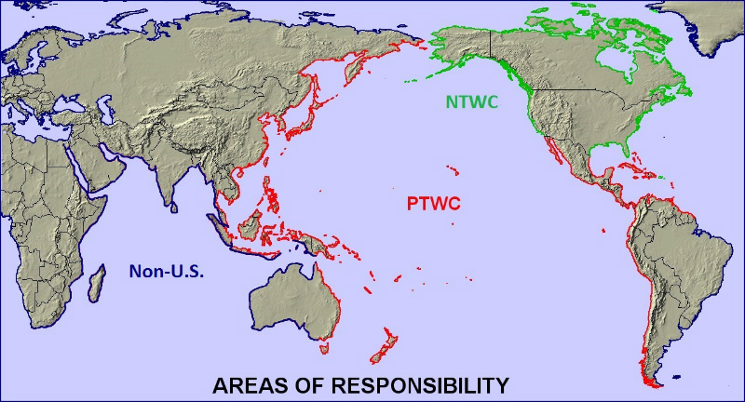
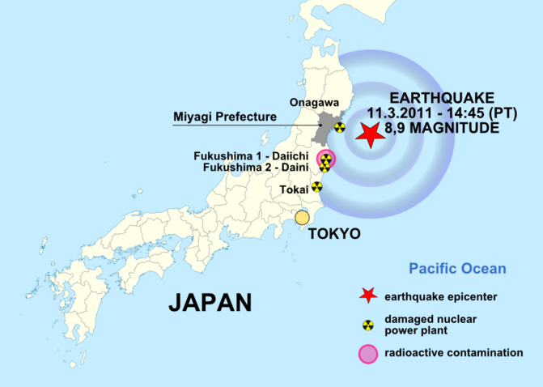
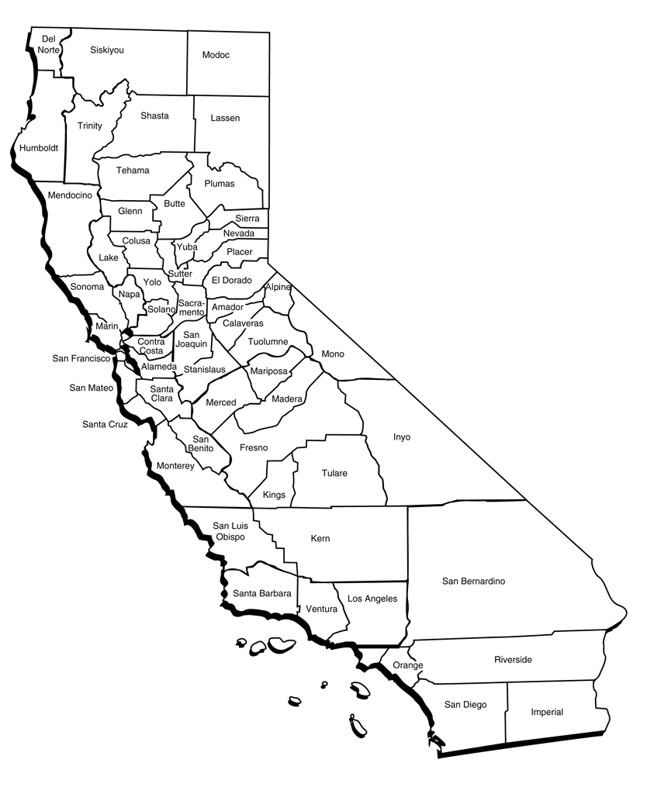
Tohoku
2011
California Statewide Response to: WARNING and/or ADVISORY
  ACTIVATE STATE EOC’s (SOC / REOC)
  PARTICIPATE in CALLS WITH NATIONAL TSUNAMI WARNING CENTER
  CONDUCT CALLS WITH EMERGENCY MANAGERS IN 20 COASTAL COUNTIES (EOC / DOC)
Notes:
THE FOLLOWING IS HOW STATE RESPONDED TO THIS EVENT BEGINNING VERY EARLY LATE NIGHT & EARLY MORNING OF MARCH 11 & 12TH
EXCHANGE OF VITAL UPDATES WERE GOING ON IN PARALLEL TO AUTOMATIC NOTIFICATIONS THROUGH REDUNTANT SYSTEMS TO FIRST RESPONDERS AND DISPATCH CENTERS UP AND DOWN THE COAST
WHAT THIS DOES IS ALLOW EARLY AND ACCURATE DAMAGE ASSESSMENTS TO HOPEFULLY, EVENTUALLY RELEASE STATE AND FEDERAL FUNDING TO COUNTIES
ENABLED A REQUEST TO GO FORWARD FROM THE GOVERNOR FOR SIX COUNTIES (Del Norte, Humboldt, Mendocino, San Mateo, Santa Cruz, and San Luis Obispo)
One person swept out to sea at mouth of Klamath River
Statewide Damage: $40-$50+ Million
90 coastal locations surveyed
Boats Sunk and/or Docks/Piers Damaged AT MANY LOCATIONS FROM CRESCENT CITY TO CATALINA ISLAND

Slide 13
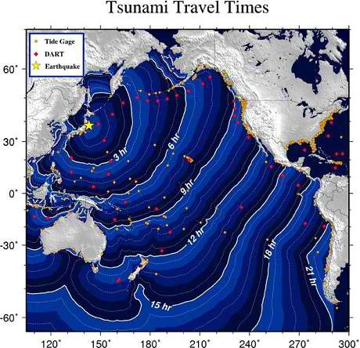
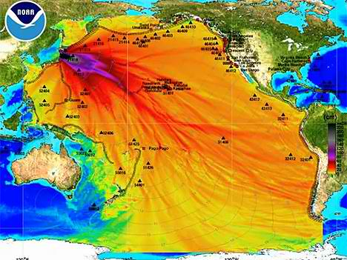
Information exchanged during NTWC calls:
Specific areas/locations of heightened concern based on
  “Start of Tsunami” Times
  Expected Wave Heights
  Concurrent Tide Conditions
Current & projected status of WARNING / ADVISORY / WATCH
What will be in the next bulletin? When it will come out?
Any specific questions or clarifications from states and entities

Slide 14
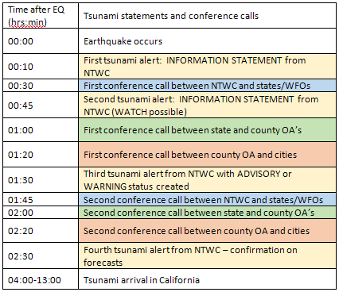
Sample timeline for information exchanged during tsunami activation:
NOAA Alert
Fed-State Call
State-County Call
County-City Call
00:05
Notes:
THE FOLLOWING IS HOW STATE RESPONDED TO THIS EVENT BEGINNING VERY EARLY LATE NIGHT & EARLY MORNING OF MARCH 11 & 12TH
EXCHANGE OF VITAL UPDATES WERE GOING ON IN PARALLEL TO AUTOMATIC NOTIFICATIONS THROUGH REDUNTANT SYSTEMS TO FIRST RESPONDERS AND DISPATCH CENTERS UP AND DOWN THE COAST
WHAT THIS DOES IS ALLOW EARLY AND ACCURATE DAMAGE ASSESSMENTS TO HOPEFULLY, EVENTUALLY RELEASE STATE AND FEDERAL FUNDING TO COUNTIES
ENABLED A REQUEST TO GO FORWARD FROM THE GOVERNOR FOR SIX COUNTIES (Del Norte, Humboldt, Mendocino, San Mateo, Santa Cruz, and San Luis Obispo)
One person swept out to sea at mouth of Klamath River
Statewide Damage: $40-$50+ Million
90 coastal locations surveyed
Boats Sunk and/or Docks/Piers Damaged AT MANY LOCATIONS FROM CRESCENT CITY TO CATALINA ISLAND

Slide 15
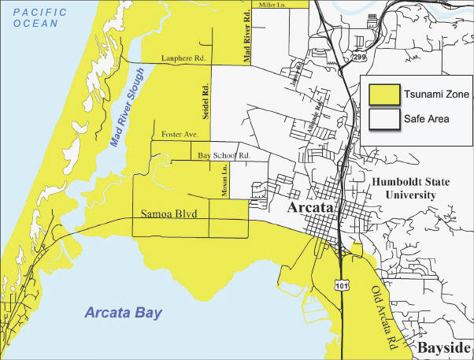
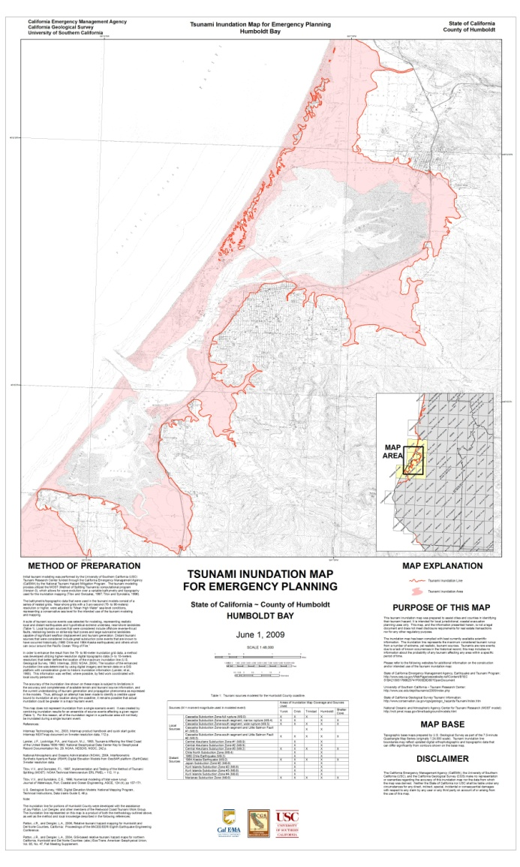
EXISTING: Evacuation Map / Plan
Evacuation Map
City Evacuation Plan/ConOps
“Evacuate Sector (1) South of Main Street and West of First Street”
“Evacuate Sector (2) West of PCH between Newport Blvd. and 60th St.”
…
Inundation Map

Slide 16
Tsunami Evacuation & Maritime Response Playbook
And FASTER Approach

Slide 17
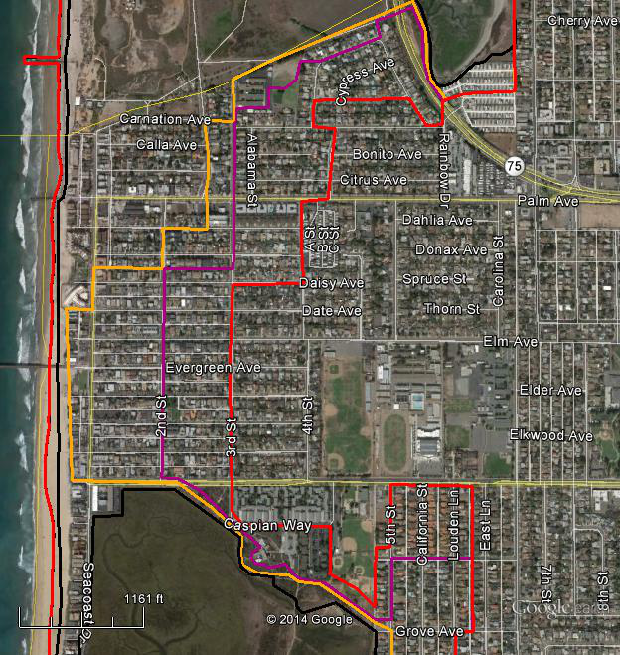
Evacuation Playbooks for Scenario Tsunami Events
(less than “worst case” scenario)
Elevation-Based Playbook
Phase 1 = beaches/harbors
Phase 2 (1.0-1.5m MSL)
Phase 3 (1.5-2.5m MSL)
Maximum Evacuation Phase
Two types of tsunami evacuation playbooks:
  Elevation-based Evacuation Playbooks - Smaller distant-source events with time to prepare secondary/smaller evacuation; like March 11, 2011 event (more than 4-5 hours to prepare)
  Scenario-based Evacuation Playbooks – Local, regional, or distant-source events with little time to prepare (less than 4-5 hours)
Phase 1
Phase 2
Phase 3
Maximum
  Draft tsunami evacuation “playbook” lines based on elevation for City of Imperial Beach

Slide 18
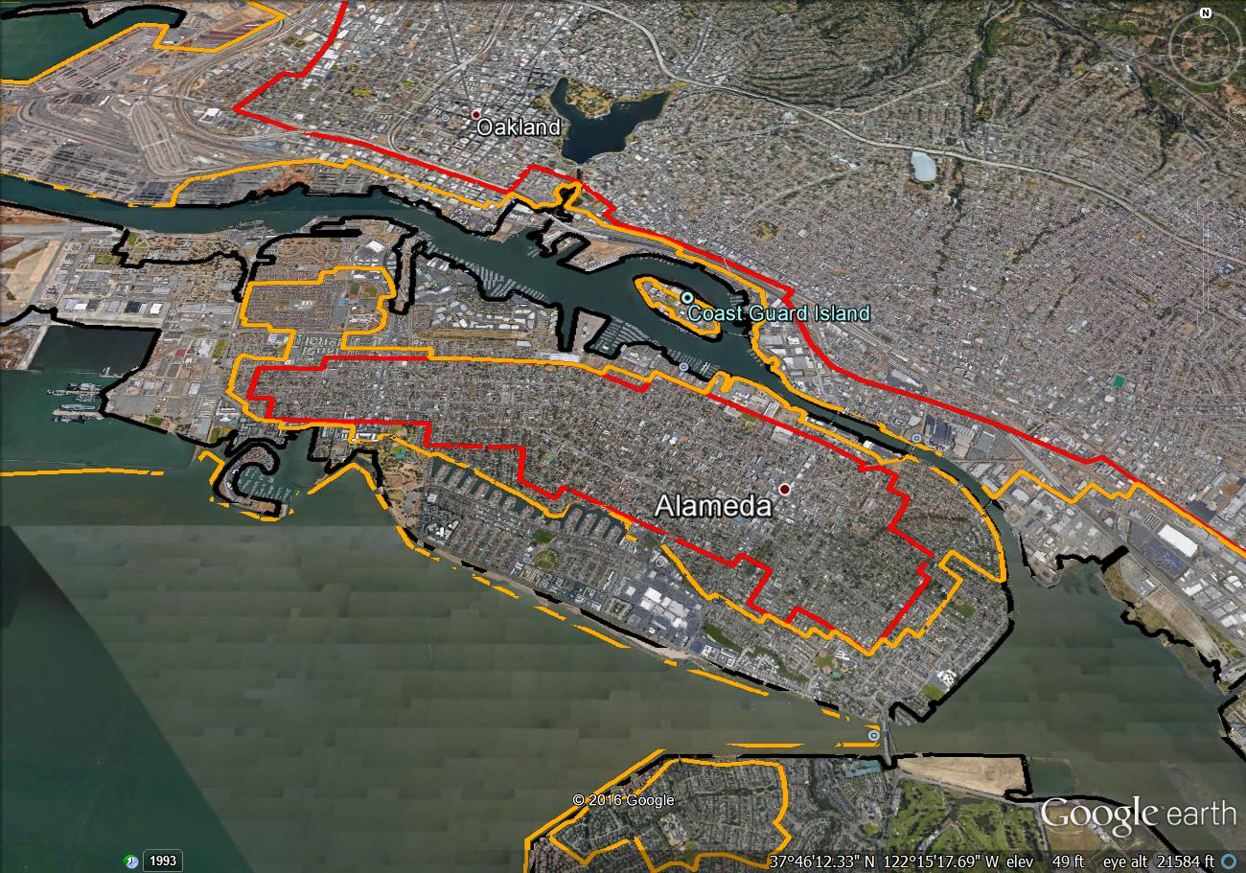
Tsunami Evacuation Playbooks
  Secondary tsunami evacuation options other than “all or nothing” approach
  Only used during distant-source events with greater than 4 hours of travel time
  Address large Advisory (1-3 feet) and minor Warning (3-8 feet) distant-source tsunami events
  “FASTER” Incorporates storm, tides, and other localized environmental factors influencing flooding
  Provide real-time Playbook recommendations from State, NWS, and NTWC for “minimum” evacuations
  Communities make final decision on evacuations
Elevation-Based Playbook
Phase 1 = beaches/harbors
Phase 2 (1.0-1.5meters above Mean Sea Level)
Phase 3 (1.5-2.5meters above Mean Sea Level)
Maximum Evacuation Phase
Phase 1
Phase 2
Phase 3
Maximum
  Draft tsunami evacuation “Playbook” lines based on elevation for central Alameda Island

Slide 19
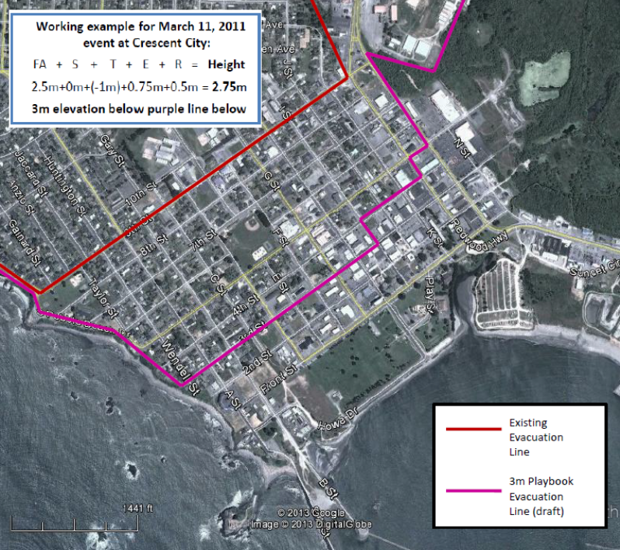
Evacuation Planning Playbooks
Example of use ( FASTER )
    Working example: Formula for determining playbook evacuation line to use ( FA-S-T-E-R ):
  FA: Forecasted Amplitude (Wave Height) from
  Warning Center
  +
  S: Storm surge or existing ocean conditions
  +
  T: Maximum tidal height (first 5-6 hours of tsunami)
  +
  E: Forecast error potential (30%; analysis of 2010-11 events)
  +
  R: Site amplified run-up potential (from existing modeling, unique to each location; applied if inundation expected)
  +
  Non-storm and non-tidal anomaly in sea level will be added
  _________________________________
  = Maximum potential tsunami flood elevation (above MSL)
  = Tsunami Playbook evacuation line
    Working example for March 11, 2011 event at Crescent City:
  FA + S + T + E + R = Height
  2.5m+0m+(-1m)+0.75m+0.5m = 2.75m
  Phase 4 (3.5m) purple line below

Slide 20
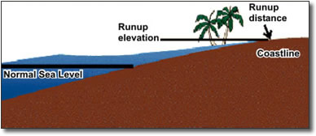
How tsunami run-up potential is calculated
Near-shore tsunami height
R
N
Runup potential = (R - N) / N
Existing tsunami modeling data is used to calculate tsunami Run-up potential at each location along the coast. This number typically ranges from 0% to 30% and is multiplied times the tsunami Forecast Amplitude, which is provided in the near-shore area (N).

Slide 21
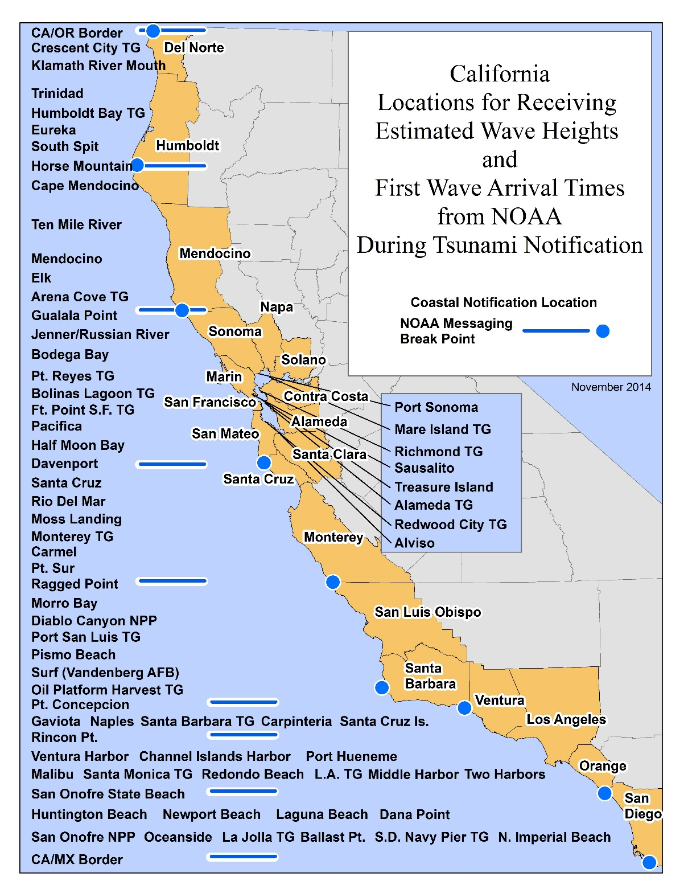
Locations for Tsunami Forecast Start Times and Amplitudes
National Tsunami Warning Center will send out forecasts for tsunami
start time and
maximum tsunami amplitudes (wave heights)
for over 60 communities in California
These locations correspond to tide gauge locations as well as highly populated communities vulnerable to tsunamis. There are several locations within each of the 20 counties in the state.
Notes:
FORECAST SLIDE

Slide 22
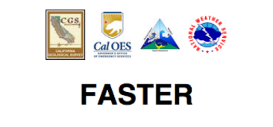
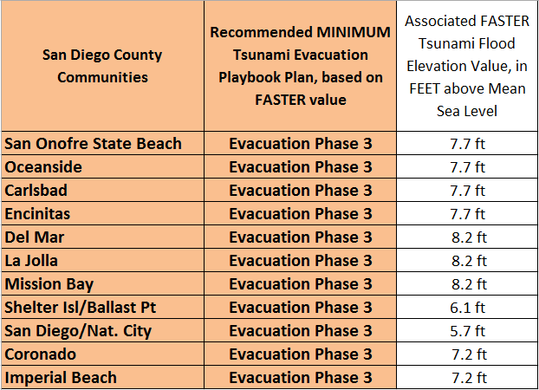
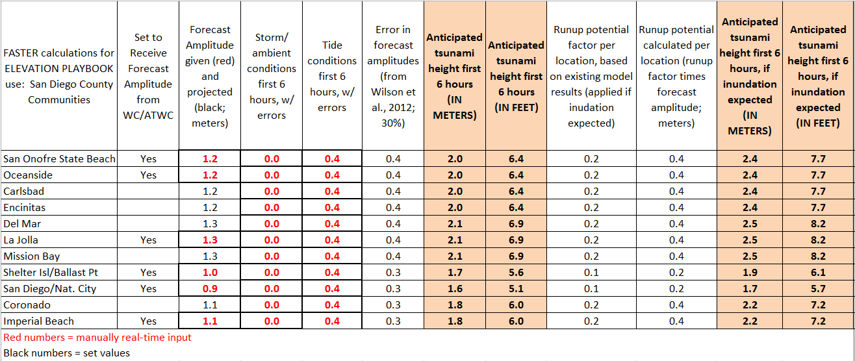
Detailed FASTER information may be available via web link

Slide 23
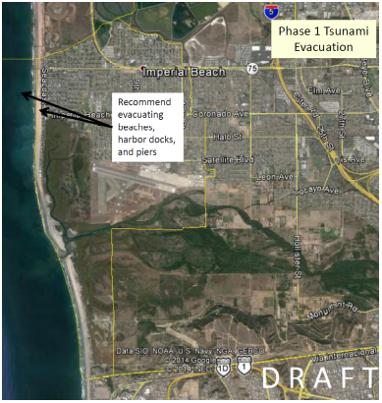
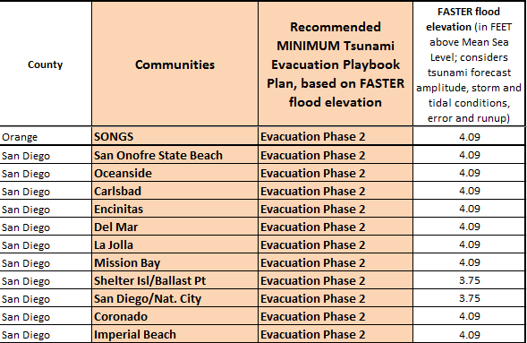
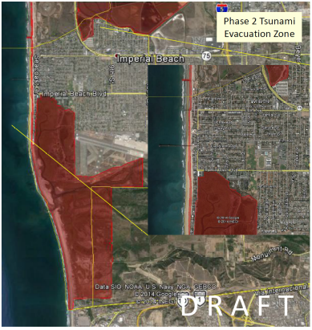
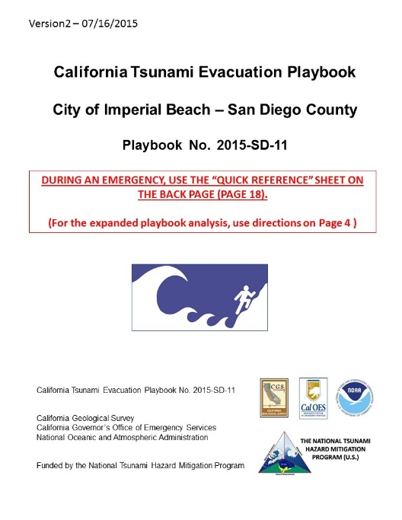
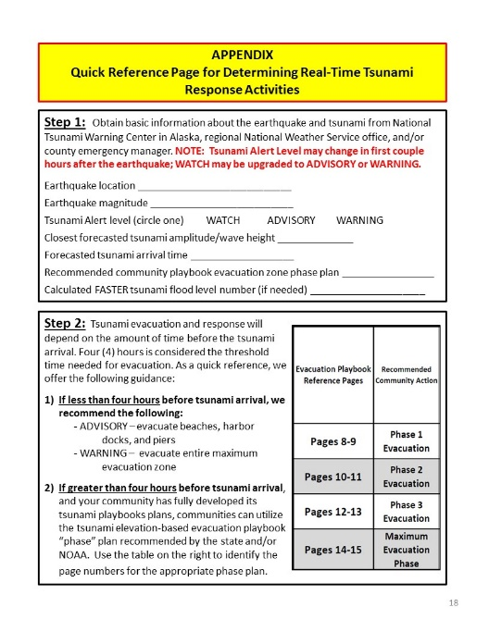
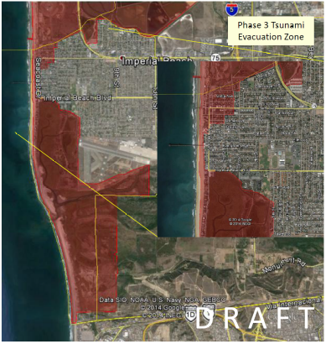
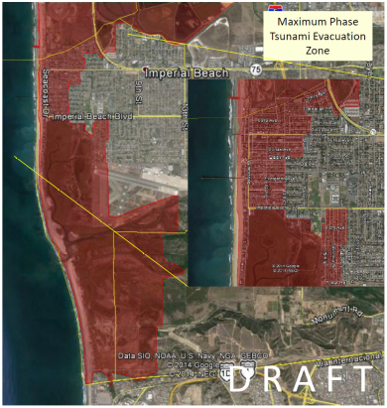
Secondary Evacuation Plans
Tsunami Evacuation Playbooks
Evacuation maps based on elevation using streets and landmarks
Real-time recommendation from State and NWS:

Slide 24
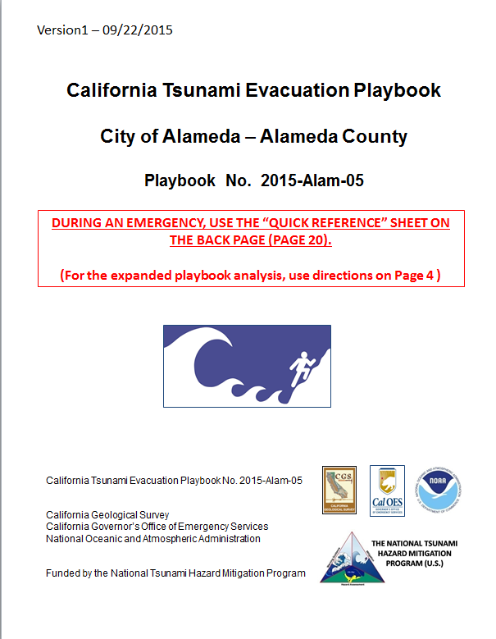
Individual Playbook Documents for Each Community
Page 2: Purpose and use of Tsunami Playbooks
Page 3: Tsunami Alert Bulletins and FASTER info
Page 4: Expanded real-time response page
Page 5: Tsunami evacuation/response “Decision Tree”
Page 6: Tsunami elevation-based Playbook info
Page 7: Tsunami scenario-based Playbook info
Pages 8-15: Tsunami elevation-based evacuation Playbook plans and maps
Page 16-17: Notable historical tsunamis and state tsunami program modeling results
Page 18: APPENDIX – Quick Reference Page for real-time response activities

Slide 25
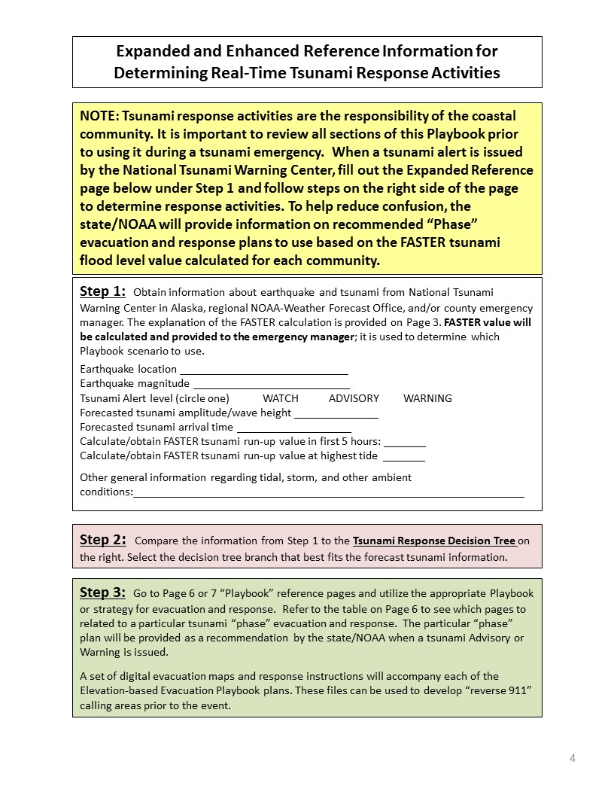
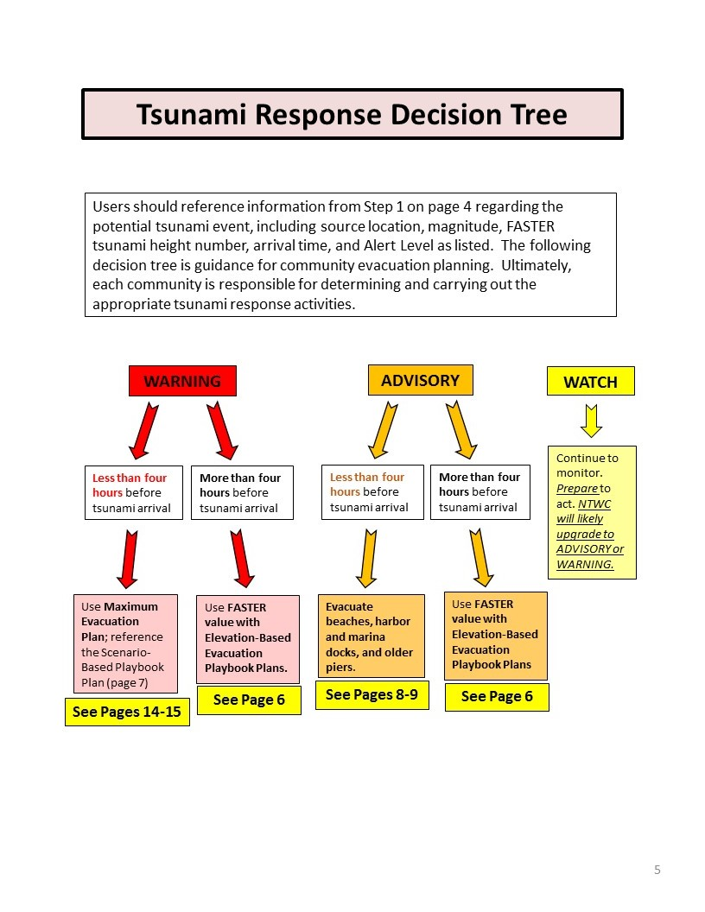
YES
YES

Slide 26
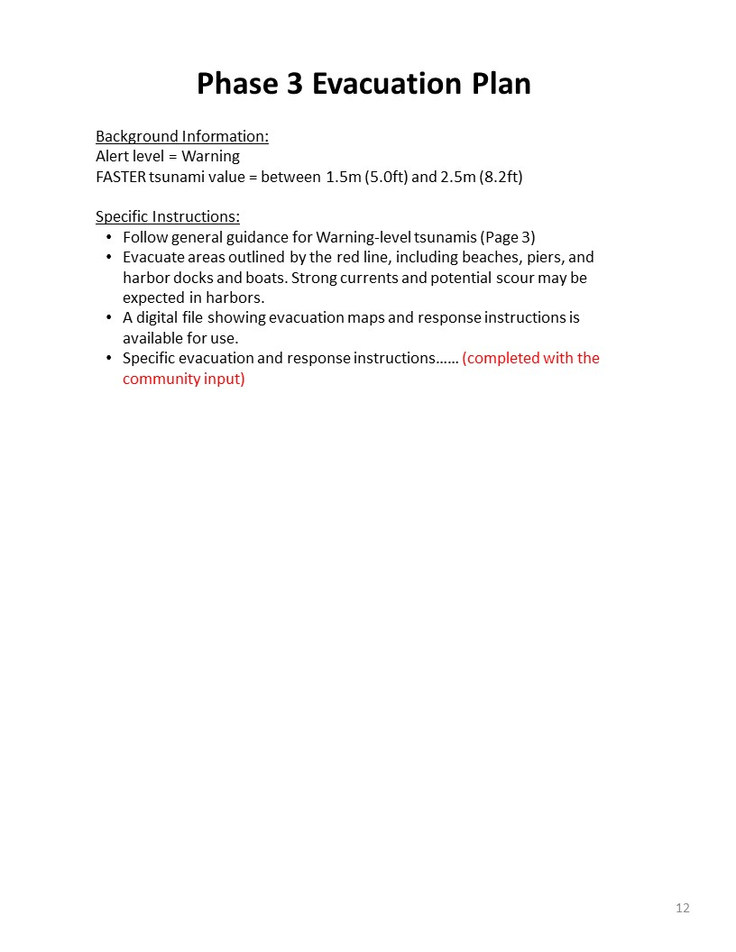


Slide 27


Slide 28
Maritime Response Playbooks

Slide 29





Maritime Tsunami Response Playbooks
Real-time recommendation from State and NOAA/WFOs:

Slide 30



REAL-TIME USE OF PLAYBOOKS
September 16-17, 2015 Tsunami from Chilean M8.3 EQ
North
15 ports and harbors within 5 county Tsunami Advisory zone
State recommended potential Playbook and actions in real-time
All harbors in Advisory zone below lowest Playbook Plan (Plan A ~ 0.4-0.6m) because highest forecast wave height 0.3m
Many harbors surveyed indicated using Maritime Response and Mitigation Playbooks during event
Harbors monitored and controlled activity around projected areas of moderate-to-high currents
5-County Tsunami Advisory Section of Coast
Tsunami currents and eddies from post-processed video by Dr. Pat Lynett.

Slide 31


State of California Collaboration with State of Hawaii on Playbooks A National Tsunami Hazard Mitigation Program Project
Feb/Aug 2016 – Invited and met with State of Hawaii and Pacific Tsunami Warning Center, and spoke at Hawaiian Resilience Conference
Similarities between states:
  Moderate to high tsunami hazard statewide from distant source events
  Large difference between people affected by Advisory or small-Warning level flood potential events, and maximum evacuation limit elevations
  Large residential, business, and visitor population exposure in low-lying coastal regions
  Vulnerable ports with large ships, and harbors with both recreational and commercial vessels
  Issues with over- and under-evacuations for relatively small/moderate tsunami events
Produced example Playbooks for and met with Hawaii and Honolulu Counties
PTWC to help implement Playbooks in real time
Honolulu
San Diego

Slide 32

SUMMARY - Benefits of Using Playbook (FASTER) Approach
Improves capabilities and standardizes response for emergency managers, harbor officials, and U.S. Coast Guard
Provides MINIMUM; alternative to “all or nothing” approach to evacuation/response
Tailors tsunami response activities to the size/location of the tsunami threat
Helps facilitate use of real-time forecast inundation products and maps
Limits over-evacuation which reduces potential for evacuation injuries, saves money and other issues
Prioritize reverse-911 notification polygons for high hazard areas
Can be used for multiple coastal flood hazards (tsunamis, storms, sea-level rise, etc.)
Evacuation Playbook for Richardson Bay
Phase 2 Area
Maximum Evacuation Area

Slide 33

Thank You!
Kevin.Miller@CalOES.ca.gov
www.TsunamiZone.ca.gov
www.myHazards.CalOES.ca.gov

