Slide 1



Great ShakeOut Earthquake Drills: Awareness to Action
Mark Benthien
Southern California Earthquake Center

Slide 2
Southern California Earthquake Center
Nation’s leading earthquake science
consortium, headquartered at the
University of Southern California
700+ scientists and students from more
than 100 research institutions
Funded by the National Science Foundation and U.S. Geological Survey to synthesize research on earthquake system science
Coordinates Great ShakeOut Earthquake Drills with support from FEMA, USGS, and many other public, private and community partners
SCEC.org

Slide 3
SCEC Communication, Education, and Outreach (CEO)
Coordinates education, training, and partnerships in California, nationwide, and internationally
Focus Areas:
  Public Education and Preparedness
  K-14 Education Initiative
  Experiential Learning and Career Advancement
  Knowledge Implementation
Supported by:
  National Science Foundation
  United States Geological Survey,
  Federal Emergency Management Agency, and
  other countries (for ShakeOut)
Partner Globally, Prepare Locally

Slide 4
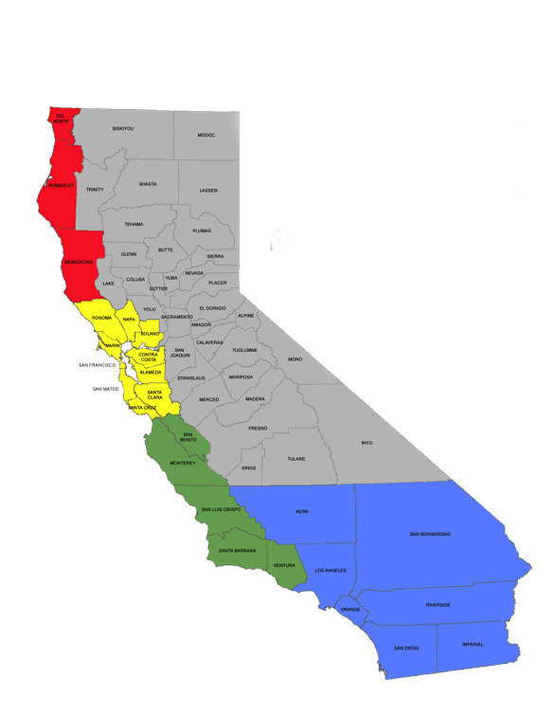
Earthquake Country Alliance
Organizations and community leaders coordinate efforts to reduce losses
Regional alliances organize local
activities and messaging
Sector-based committees develop resources and programs
California’s Office of Emergency Services requests FEMA support for ECA
Join today:
earthquakecountry.org/alliance
Follow ECA: twitter.com/eca
facebook.com/earthquakecountryalliance
Redwood Coast
Tsunami Workgroup
ECA Bay Area
Future Alliance
ECA Southern California
Notes:
[OPTIONAL comments]
ECA began in 2003 in Southern California, and in 2009 was expanded statewide in partnership with similar efforts in the Bay Area and North Coast.
Committees: Schools, businesses, non-profit organizations, evaluation, museums, people with access and functional needs, and many others

Slide 5
ECA Sector-Based Outreach Committees
  Businesses
  Schools (K-12)
  Communications
  EPIcenters (museums, parks, libraries, etc.)
  Evaluation
  Fire Advisory
  Healthcare
  Non-Profits and Faith-Based
  Public Sector (Government EM & Elected Officials)
  Seniors and People with Disabilities
  Planned:
    Higher Education
    Multi-Cultural

Slide 6
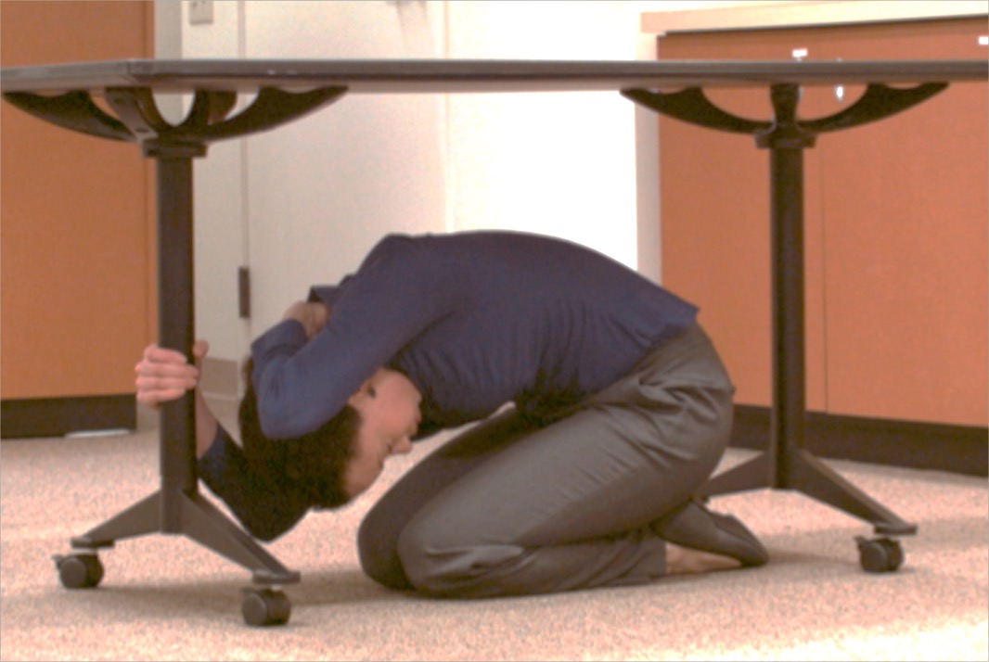
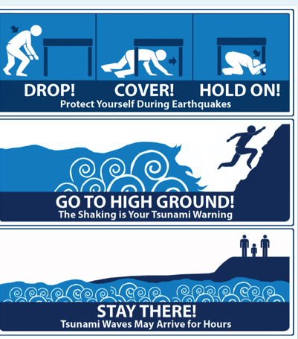
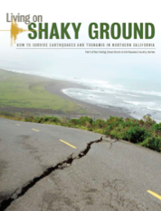

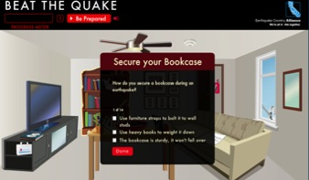
ECA Major Activities
The Great California ShakeOut:
Register today at www.ShakeOut.org
Support for Tsunami Preparedness Week
Register today at www.TsunamiZone.org
Communications platform for and among stakeholders and the public
Development of consistent, statewide messaging and resources
Available at www.EarthquakeCountry.org

Slide 7
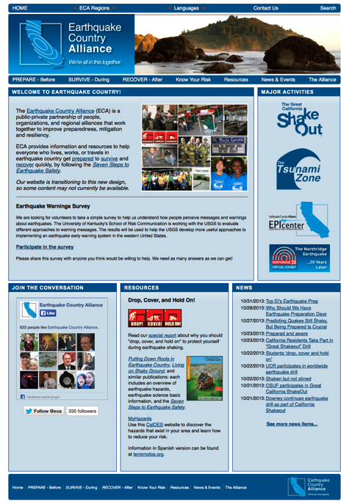
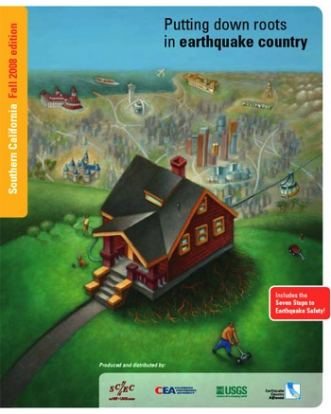
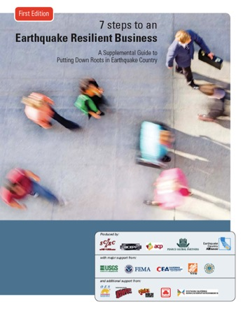
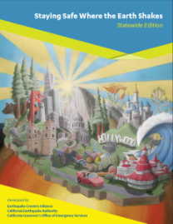
EarthquakeCountry.org
  How to Prepare to Survive and Recover
  Key programs and activities
  Downloadable booklets, materials, videos, games, and more
  Seven Steps to Earthquake Safety

Slide 8
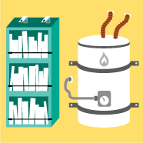
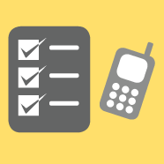
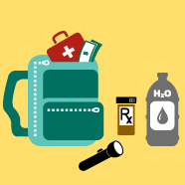


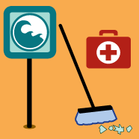
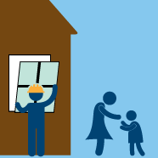
Seven Steps to Earthquake Safety
1. Secure
Your Space
2. Plan
To Be Safe
3. Organize
Disaster Supplies
4. Minimize
Financial Hardship
BEFORE
5. Drop,
Cover, and Hold On
6. Improve
Safety
7. Reconnect
and Restore
DURING
AFTER

Slide 9
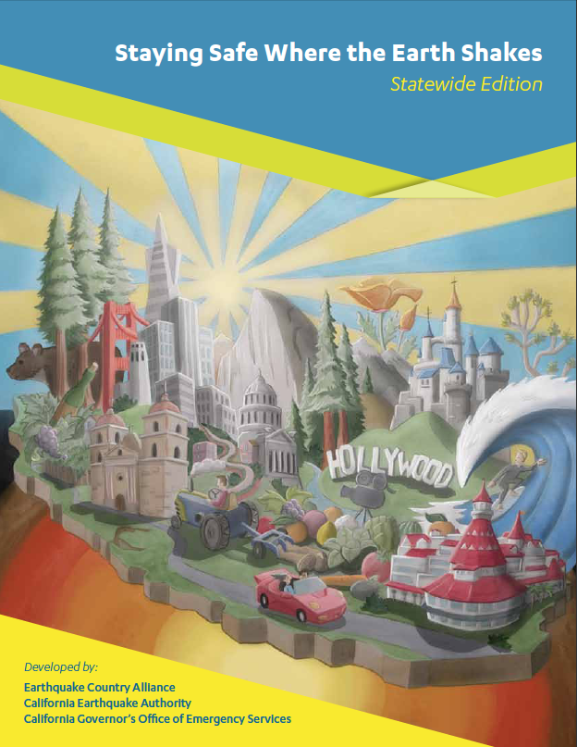


Staying Safe Where the Earth Shakes
Project of CEA & CalOES with input from ECA subject matter experts
Updated “Seven Steps to Earthquake Safety”
Simple, multi-language booklet in the family of “Putting Down Roots in Earthquake Country” and “Living on Shaky Ground” materials
  Spanish and Chinese already translated
10 Regional versions:
  ShakeOut Regions
  Statewide
EarthquakeCountry.org/stayingsafe

Slide 10
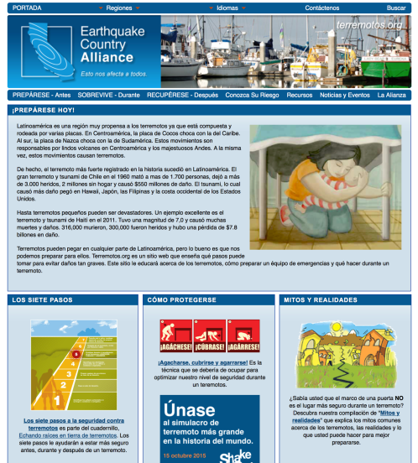
Terremotos.org
Includes “Seven Steps to Earthquake Safety”
Downloadable materials
Intended as a global resource
Notes:
10

Slide 11
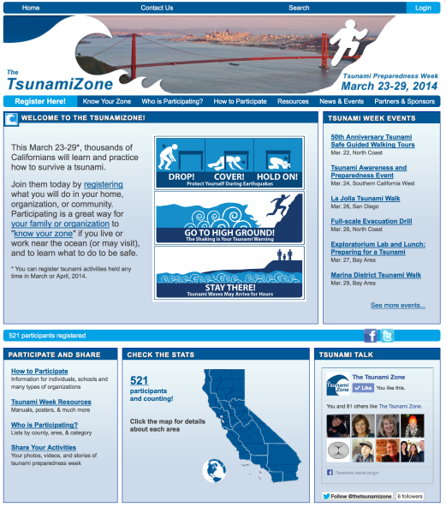
TsunamiZone.org
Know Your Zone: Maps for all coastal areas to know if you are in a tsunami inundation zone
Tsunami Preparedness Week: Register your activities to be counted
Event Calendar: Learn about drills, presentations, and other events near you
Resources: Movies, manuals, posters, etc.

Slide 12
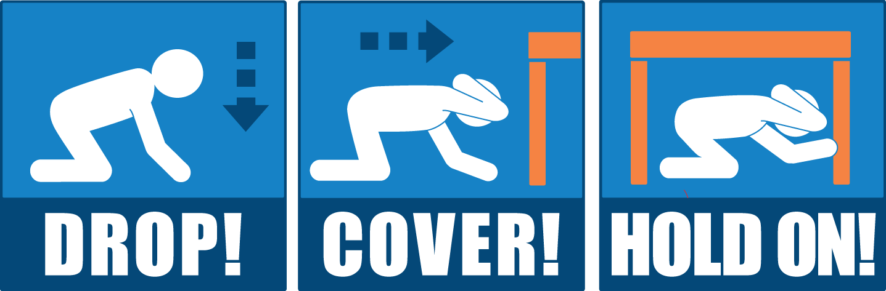


Great ShakeOut Earthquake Drills
In 2015 more than 43 million people worldwide (21 million U.S.) in schools, organizations, and homes practiced…
Many did much more!
2016 International ShakeOut Day: October 20
ShakeOut.org

Slide 13
Created in So. California in 2008
Based on the “ShakeOut Scenario”
research study for a 7.8 magnitude
earthquake on the San Andreas fault
5.4 million Southern California participants in a
“one time only event” created by the Earthquake Country Alliance, a public-private partnership also led by SCEC.
CERT teams, fire agencies, schools, companies, emergency managers, scientists, and many others have helped expand ShakeOut participation across the country, and worldwide!

Slide 14
Based on Social Science Research
Research by Dennis Mileti, Linda Bourque, and others on what motivates people to get prepared:
They see and hear consistent information about what to do frequently, in many forms, and from many sources
They see others like themselves getting prepared
They talk about preparedness with people they know
They learn potential consequences, and how to avoid them
ShakeOut puts these findings into practice
Notes:
14

Slide 15
Mission
Everyone, Everywhere
should know how
to protect themselves
during earthquakes

Slide 16
Goals
Encourage people worldwide to practice earthquake safety
  Register at www.ShakeOut.org
Shift the culture about earthquakes and preparedness
  Inspire discussions about being prepared to
  survive and recover quickly
Increase earthquake readiness at all levels
  Whole Community: family, community, school, business, government…

Slide 17
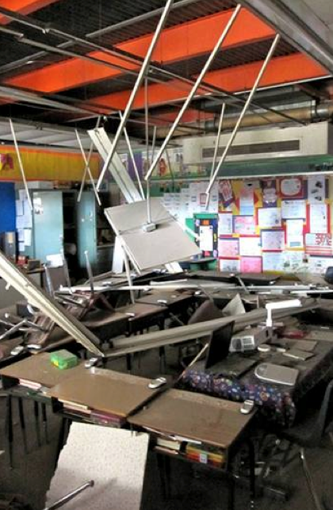
Why Drop, Cover, and Hold On?
Get down before being thrown to the ground
Buildings rarely collapse in the United States
Provides protection from falling items… including structural elements
Classroom in Calexico, CA
April 2010 M7.2
Notes:
[read the slide]

Slide 18
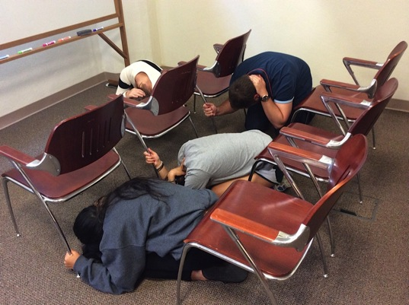
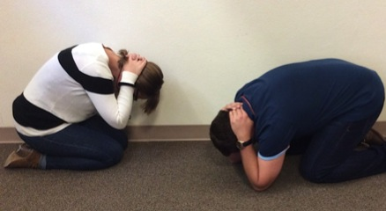
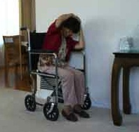
Know How to Protect Yourself
Drop to the floor where you are.
Cover your head and neck with one arm and hand.
If a sturdy table or desk is nearby, crawl underneath it for shelter.
OR crawl against a wall (away from windows) or next to low furniture for sideways protection
Hold On to your shelter until shaking stops
Be ready to move with your shelter
If not under something, hold on to your head/neck with both arms and hands.
This is appropriate for most situations and building types

Slide 19
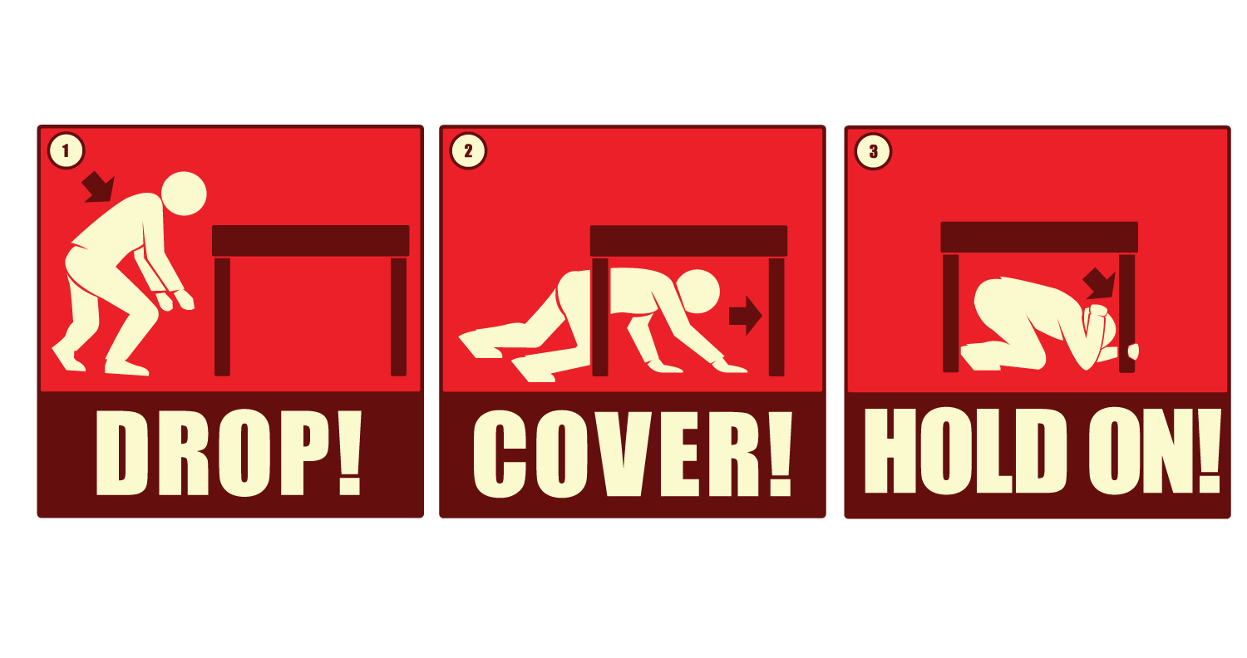
Message Evolution
2008
2016

Slide 20
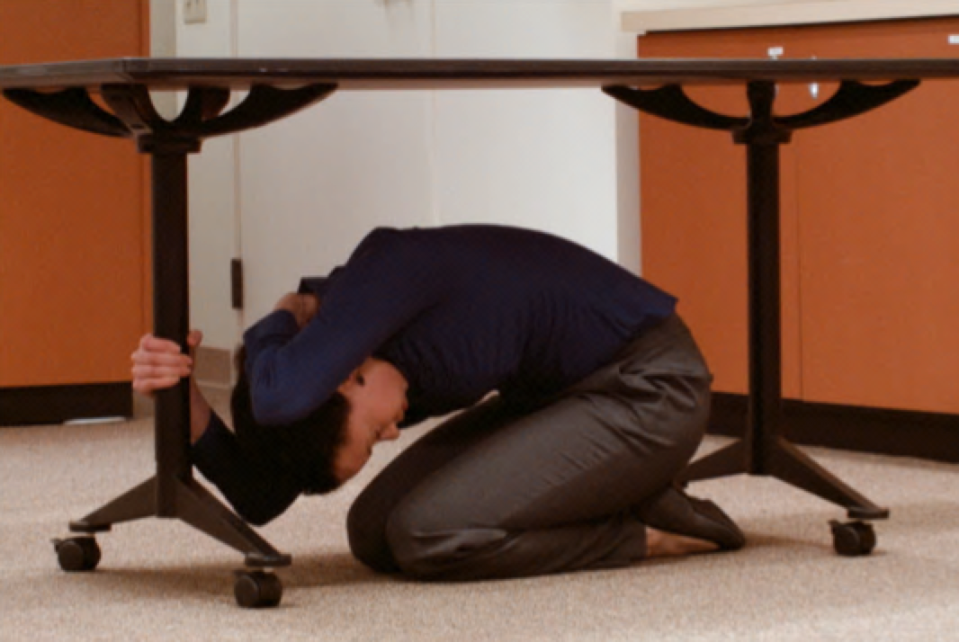
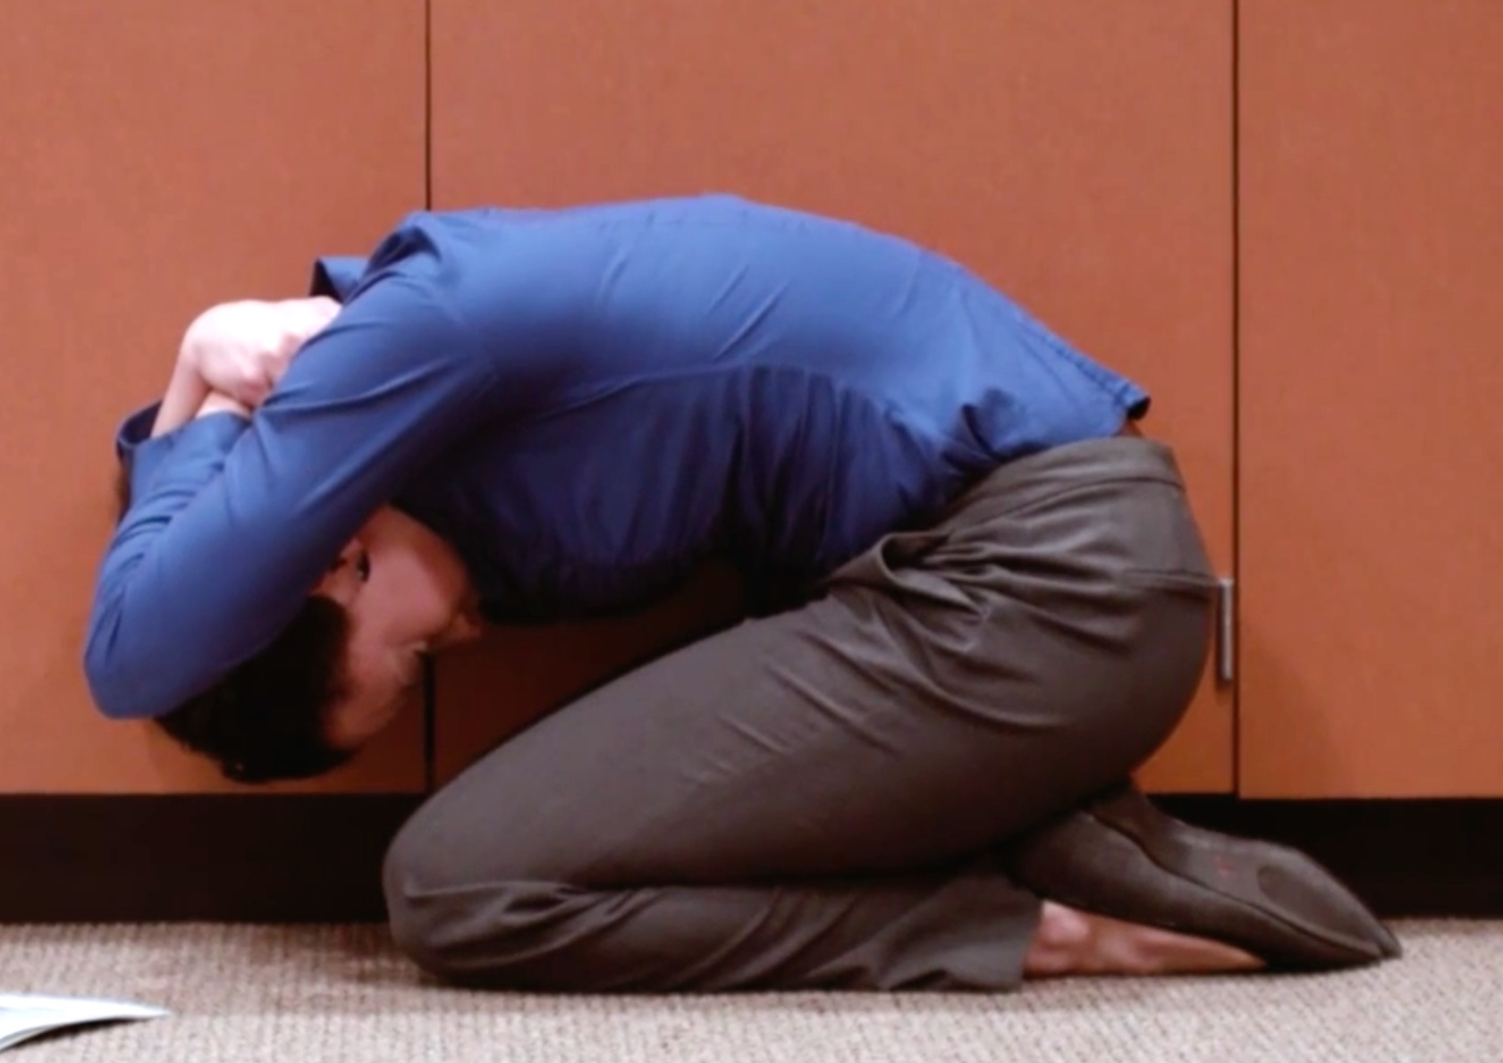
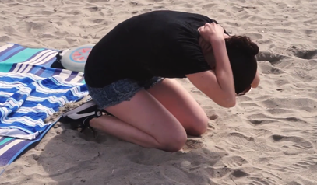
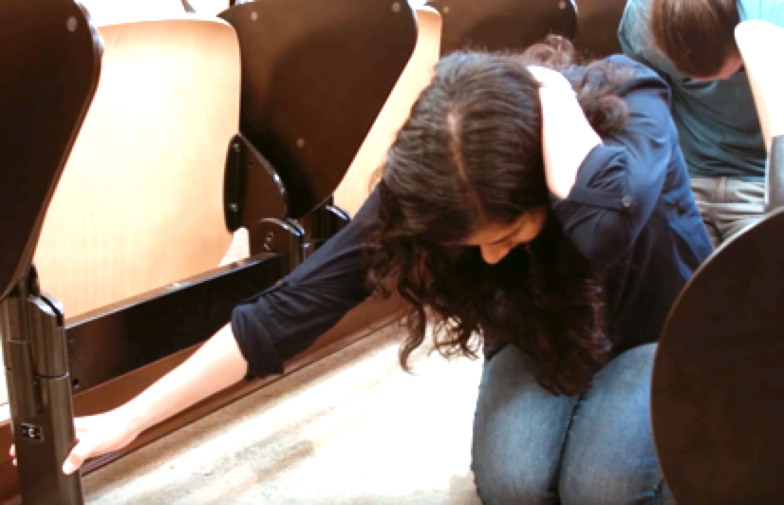
Earthquake Safety Video Series
Youtube.com/greatshakeout
Separate short videos for how to protect yourself if…
  indoors, a table/desk is nearby
  indoors, no table/desk
  in a theater/stadium
  near the shore
Soon:
  in a car
  if you use a wheelchair, walker,
  or cane
  in bed
  in a store

Slide 21
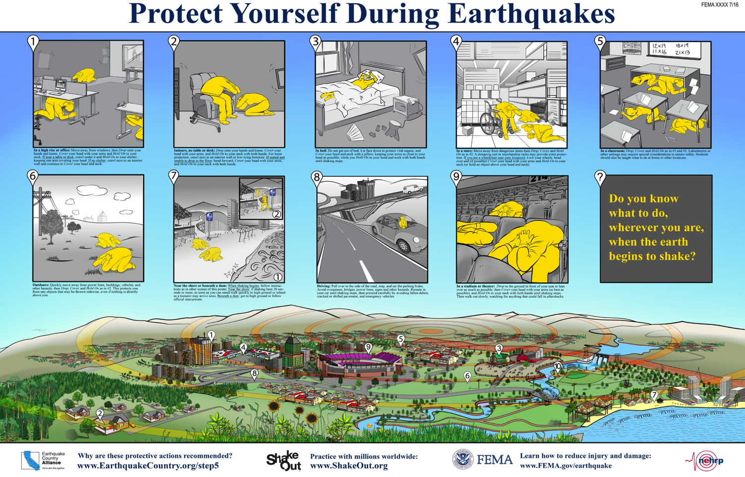
Multi-Situation Poster

Slide 22
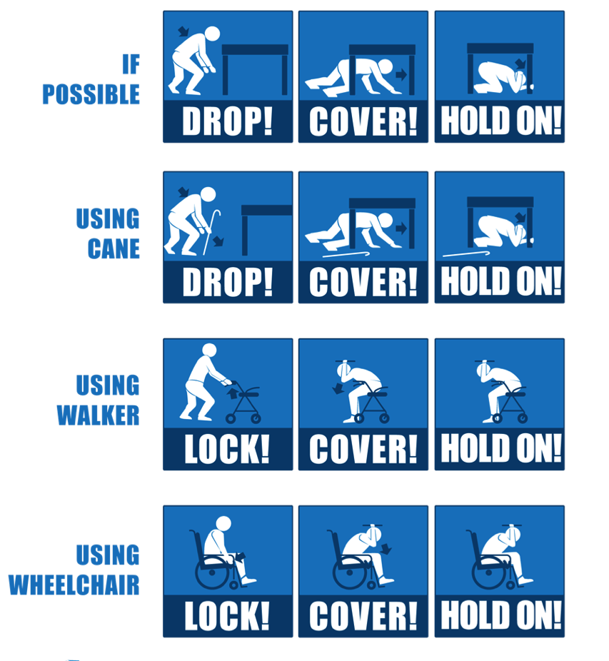
Adapt to Your Situation
If you can’t get back up, don’t get down
Know what you need so you can instruct others on how to assist you
Practice is key
EarthquakeCountry.org/
disability

Slide 23
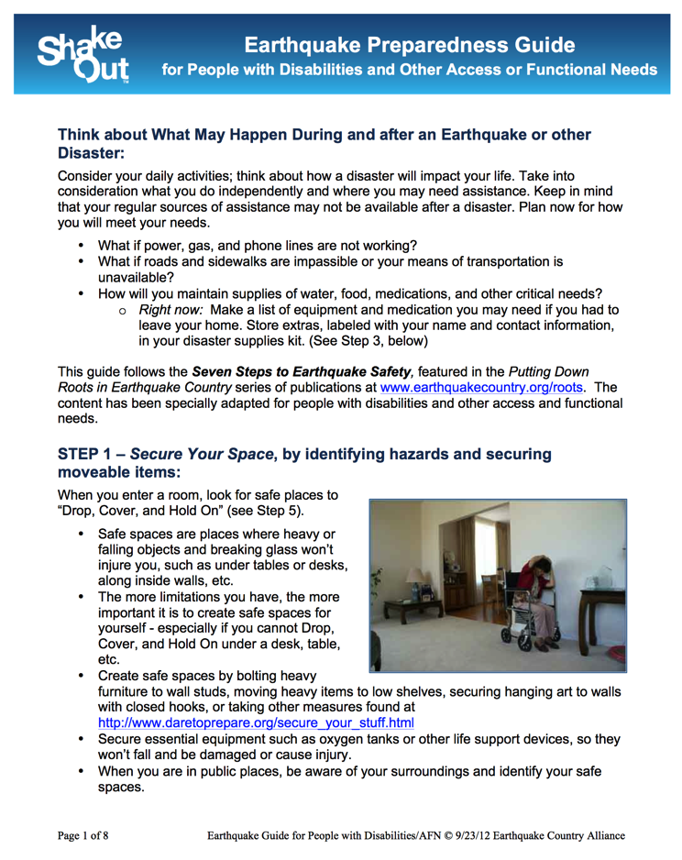
Resources for Seniors and People with Disabilities
Earthquake Preparedness
Guide for People with
Disabilities or Other
Access or Functional
Needs
Organized according to
Seven Steps to
Earthquake Safety
EarthquakeCountry.org/
disability

Slide 24
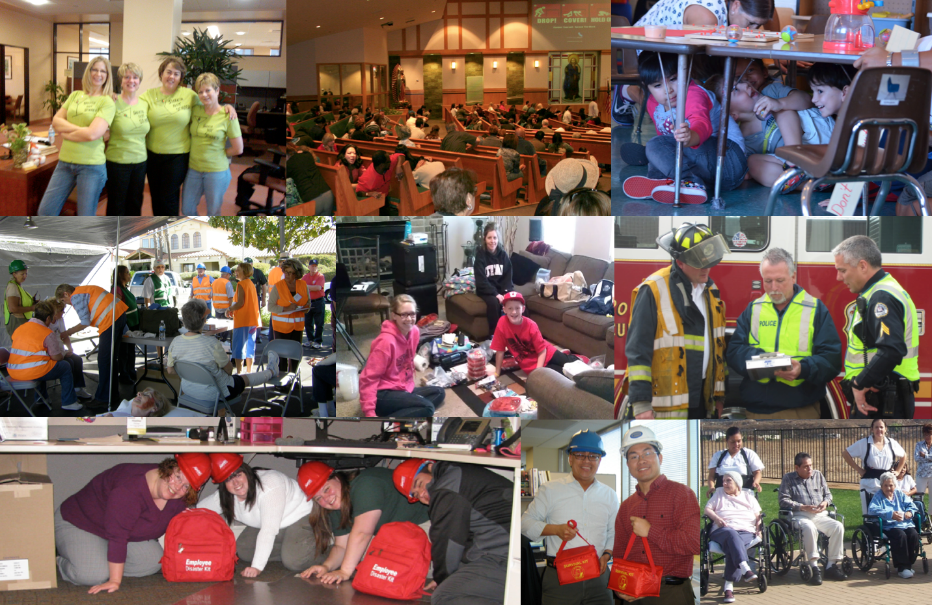
Everyone Can ShakeOut

Slide 25

Everyone HERE, Right now…

Slide 26
Everyone… Everywhere, & Growing!
More participants and additional states/countries each year
  2008: 5.4 million (Southern California)
  2009: 6.9 million (all California)
  2010: 8 million (California, Nevada, and Guam)
  2011: 12.1 million (15 states/territories & British Columbia)
  2012: 19.4 million (26 states/territories, 5 countries with official drills)
  2013: 24.9 million (44 states/territories, expansion worldwide)
  2014: 26.5 million (47 states/territories, participation in 60 countries)
  2015: 43.9 million (51 states/territories, 70+countries, including
  New Zealand’s second drill, and Iran)

Slide 27
Participation Categories
    Category 2015 2014
    K-12 Schools 29,719,551 14,494,225
    Colleges and Universities 3,751,392 3,368,835
    Businesses 1,222,078 992,011
    Local Government 940,856 774,518
    National Government 732,934 605,309
    State Government 397,396 457,098
    Non-Profit Organizations 465,773 450,527
    Healthcare 479,938 383,514
    Faith-based Organizations 213,529 238,950
    Childcare and Pre-Schools 288,024 129,708
    Preparedness Organizations 68,887 41,919
    Individuals/Families 57,204 39,296
    Senior Facilities/Communities 42,861 37,654
    Neighborhood Groups 39,434 37,296
    Tribes/Indigenous 21,055 20,948
    Media Organizations 27,705 18,000
    Museums, Libraries, Parks, etc. 14,705 15,019
    Science/Engineering Organizations 24,147 12,181
    Other categories: 92,464 95,293
    These totals do not include participation in Japan,
    for which participation is not provided by category.

Slide 28
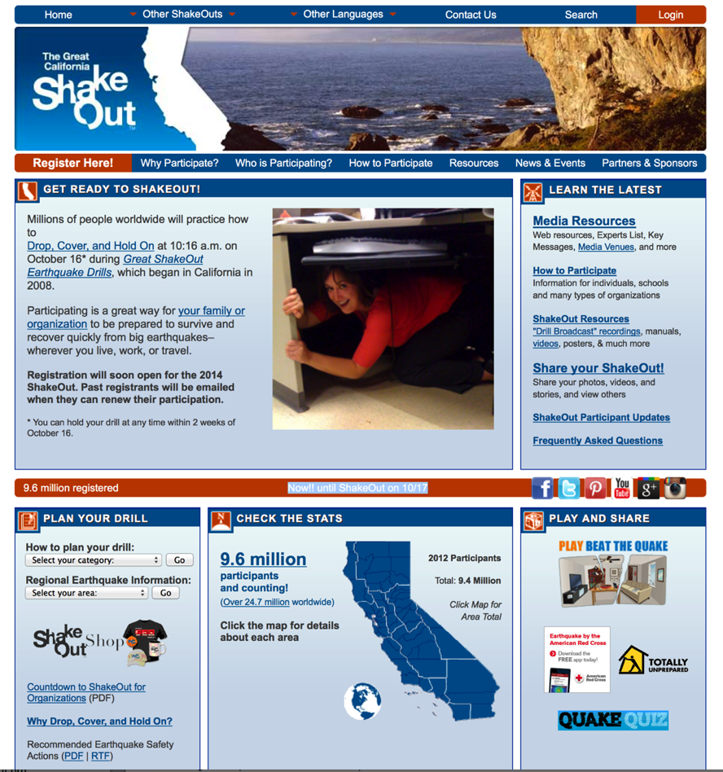
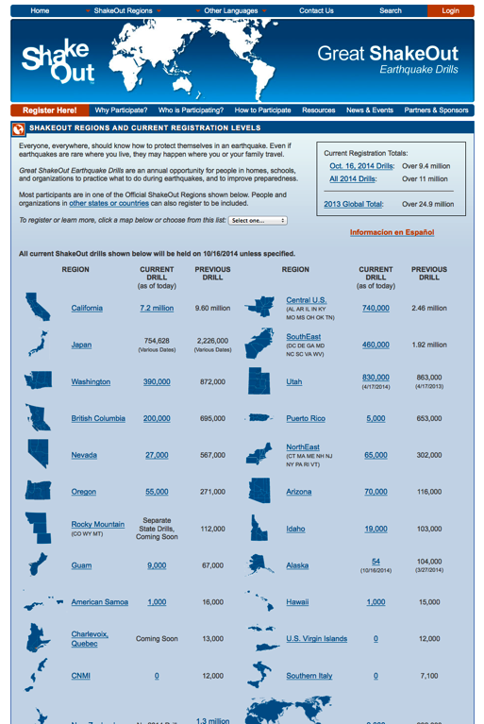
www.shakeout.org & www.shakeout.org/california

Slide 29
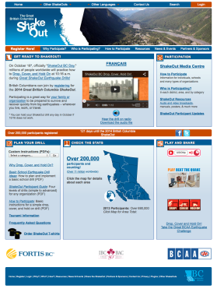
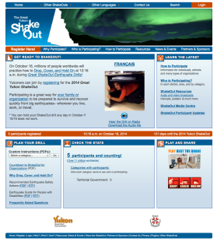
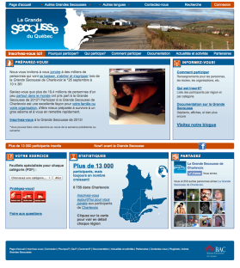
Canada
Shakeout.org/yukon
(Yukon)
New for 2014
Shakeoutbc.ca
(British Columbia)
Since 2011
grandesecousse.org
(Quebec)
Expanded from local drill
in 2013 (Charlevoix)

Slide 30
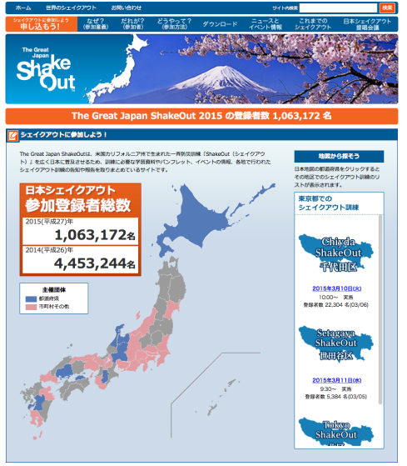
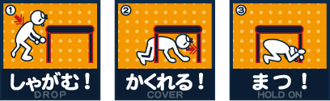
Japan
2015: 5.3 million participants
Many local and prefecture-based drills on various dates
Website and registration managed independently of other ShakeOut regions
www.shakeout.jp

Slide 31
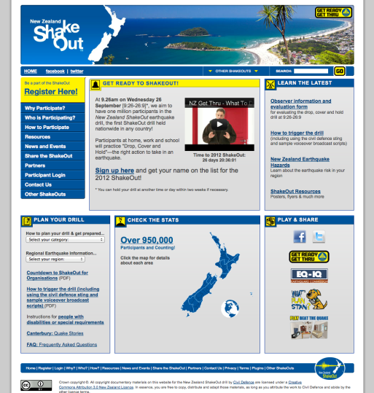

New Zealand
2015: 1.3 million participants
First nationwide ShakeOut
Next drill: 2018
www.shakeout.govt.nz

Slide 32
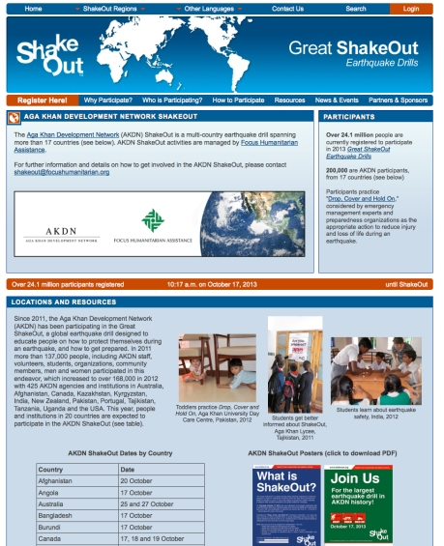
AKDN: Schools, Colleges & Hospitals
Country Participation
Afghanistan 32,336
Angola 215
Australia 447
Bangladesh 350
Burundi 95
Canada 22,919
India 96,470
Kenya 2,706
Kyrgyzstan 1,496
Madagascar 55
Mozambique 1,755
New Zealand 100
Pakistan 119,860
Portugal 906
South Africa 125
Switzerland 10
Tajikistan 4,306
Tanzania 4,999
USA 21,172
TOTAL 310,322
www.shakeout.org/akdn

Slide 33


www.ShakeOut.org/espanol
Global site for all Spanish-speaking participants
Registrants are counted
in their state or country
Terremotos.org has additional earthquake safety information

Slide 34
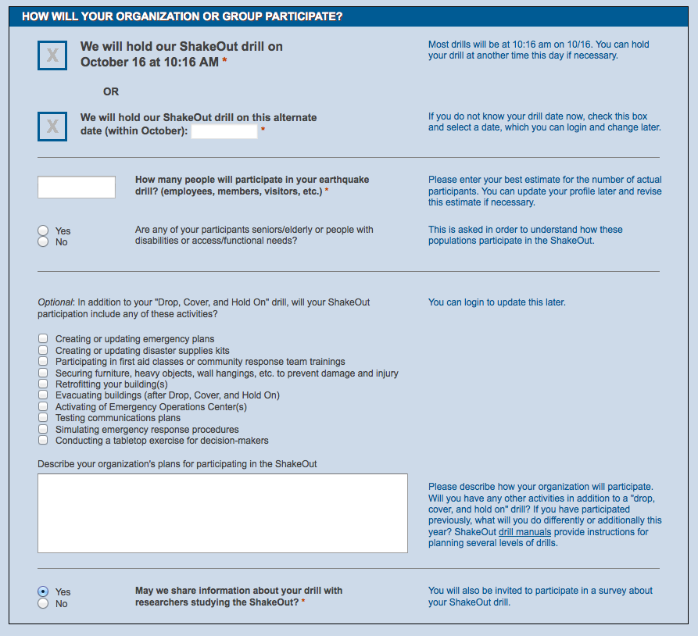
Registration Form

Slide 35
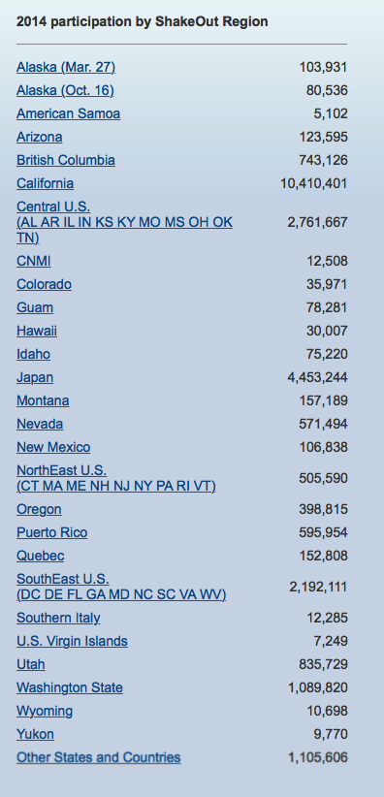
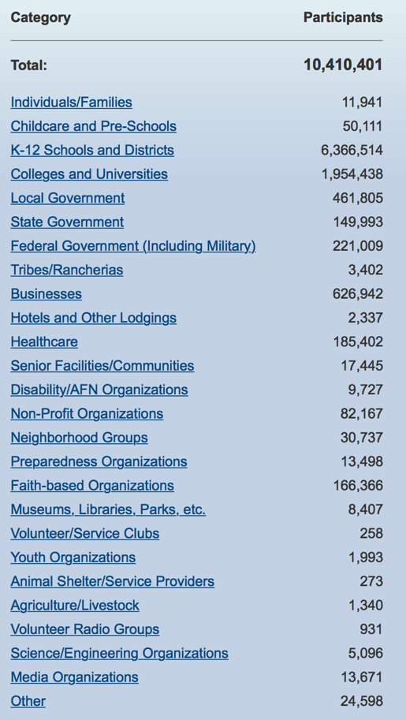
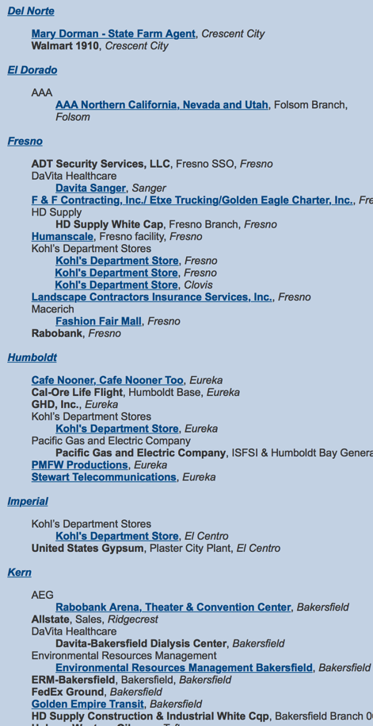
Example Statistics
All Regions
California
Businesses
Notes:
35

Slide 36

Benefits of Registering
    Be counted in the world’s largest earthquake drill
    Be updated with news and safety tips
    Be listed with other participants
    Be an example that motivates others
    Have peace of mind that you have taken action and helped others
    Be better prepared to survive and recover!

Slide 37
How has participation benefitted you?
I have been able to point to the widespread implementation of the ShakeOut throughout our state and our nation to show our local regional leaders that we need to do more to become prepared.
Once I showed what our district does to become prepared, there was greater appreciation for the need for community-wide preparedness for earthquakes and other disasters.
Notes:
How to use evaluation data to help frame future marketing…

Slide 38
How has participation benefitted you?
Our family knows our earthquake plan now, thanks to the shakeout! I have also encouraged our work office to participate and we did participate.
It organized what needed to be done and how we needed to be prepared. This was a perfect starting point for us.
We are more aware of how to prepare and have taken steps to have food, water, and supplies on hand, and have ensured we have adequate insurance.
We found out that we need to separate 6th grade students from preschool while exiting the classroom building.

Slide 39
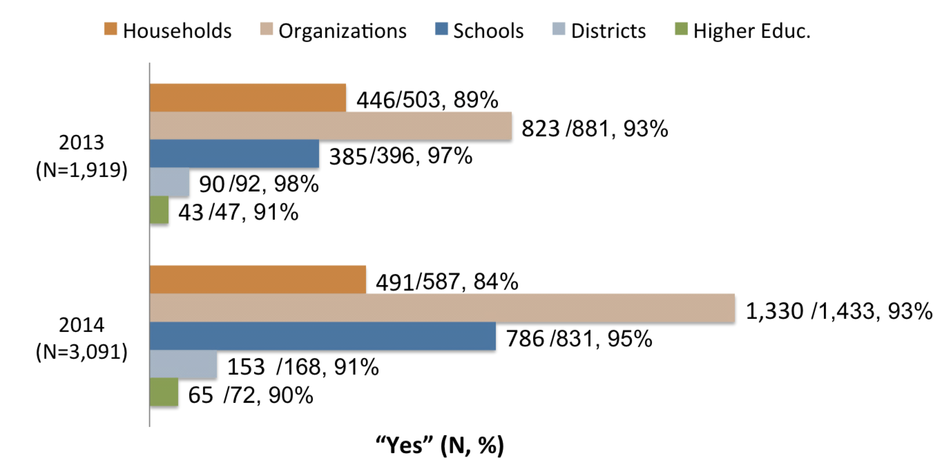
Plans for Future Participation

Slide 40
Increased Participation Each Year
Hinds Community College, Raymond MS
The past 2 years we have had an instructor conducting the drills in her classroom. Fall 2016 we are going to push a district wide drill for all 6 of our campuses. We are planning to hold informational training session prior to the drill that will be open to all students, faculty, and staff. These sessions will also be open to the general public. We will test our emergency communications to alert and message. Prior to the drill we will review the EOP for earthquakes and make any needed changes.
October 2015: 1 instructor, 32 students
October 2015: 2200 staff, 17000 students (6 campuses)

Slide 41
Did your ShakeOut Participation lead to improvement in any of the following areas?
Survey Results: Organizations
% Yes

Slide 42
Which things has your institution done to prepare for earthquakes?
Did you do them because of the ShakeOut?
Survey Results: Organizations

Slide 43
Survey Results: Individuals/Families
Which things have you or your household done to prepare for earthquakes? Did you do them because of the ShakeOut?

Slide 44

What SCEC Provides
  Manages the California ShakeOut, and the websites of 27 other customized ShakeOut websites on behalf of state or regional partners
  Creates and distributes regionally customized monthly/weekly Participant Update emails
  Sends regular emails to people who haven’t renewed their registration for the current year
  Call larger organizations nationwide to invite them to renew or register (school districts, etc.)
  Frequent Social Media posts, new content, etc.
  Provides resources and training to ShakeOut Regional Coordinators
Notes:
44

Slide 45

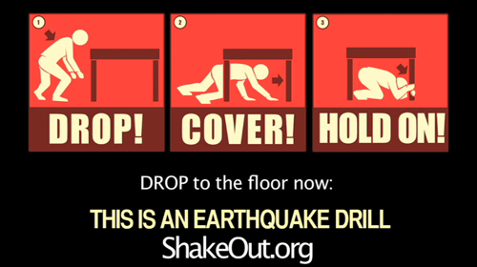
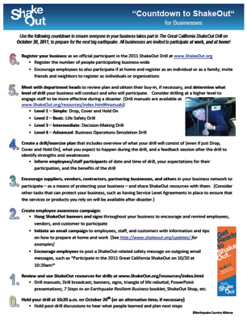
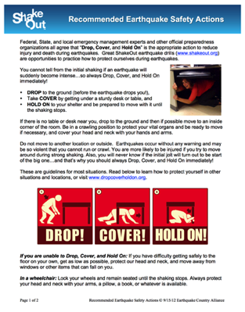
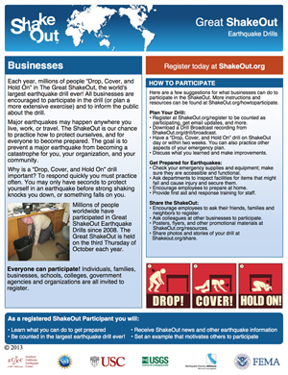
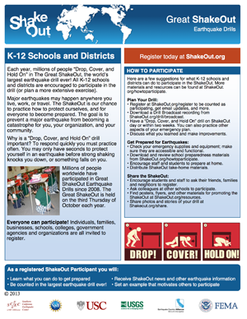



Example ShakeOut Resources

Slide 46

ShakeOut Drill Manuals
Each has instructions for multiple levels of earthquake drills:
  Simple Drop, Cover, Hold On drill
  Life Safety (including evacuation)
  Decision-Making Table Top drill
  Advanced Exercise
Available for schools, businesses/organizations, government agencies, and healthcare facilities

Slide 47

Options for Government Agency Participation
Options for how to hold a ShakeOut Drill
Options for coordinating participation of agencies/ departments
Options for promoting ShakeOut to constituents
Examples of government organized ShakeOut drills
www.ShakeOut.org/resources

Slide 48



College ShakeOut Resources
Messaging templates, instructor’s guide, and PowerPoint slides (with link to Drill Broadcast):
ShakeOut.org/colleges
Notes:
ShakeOut is using Facebook and Twitter to interact with participants and recruit new registrants.
Visit facebook.com/greatshakeout and twitter.com/shakeout to follow the ShakeOut.

Slide 49

America’s PrepareAthon!
ShakeOut is a major activity of “America’s PrepareAthon!”
Assessment of preparedness
activities (drills, fairs, media campaigns, and other activities) for all hazards
National PrepareAthon Days: April 30 and September 30
ready.gov/prepare
@PrepareAthon

Slide 50

You Can Help Increase Participation
Register your organization’s drill at
Shakeout.Org
Host a ShakeOut Media event in
your community
Distribute or use drill manuals,
flyers, posters, videos, & more:
ShakeOut.org/resources
Post content from
ShakeOut.org/messaging
Notes:
50
Note: It is ok to direct people to www.shakeout.org, as it is “one click” to the California site from the new global site.
People can register themselves, their household, their work, school, or any other organization

Slide 51
Connect with the ECA & ShakeOut
213-740-3262
info@earthquakecountry.org
info@shakeout.org
Twitter.com/eca @eca
Twitter.com/shakeout @shakeout
Twitter.com/thetsunamizone @thetsunamizone
Facebook.com/earthquakecountryalliance
Facebook.com/greatshakeout
Facebook.com/thetsunamizone
www.youtube.com/user/greatshakeout

Slide 52
Great ShakeOut Earthquake Drills: Awareness to Action
Mark Benthien
Southern California Earthquake Center
benthien@usc.edu
+1 213-740-0323

