Slide 1

Total Systematic Field Solution for Emergency Cases
Longyan Haidexin Automobile Co., Ltd.
July 12, 2016

Slide 2
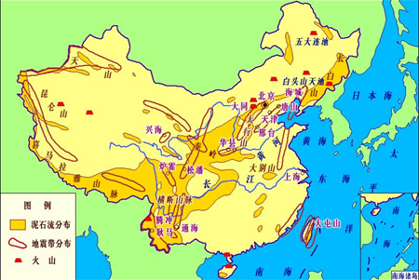
1. The complexity and perniciousness in emergency cases
Distribution map of main geological hazards in China

Slide 3
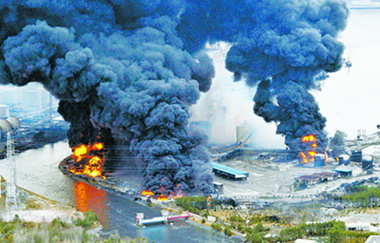
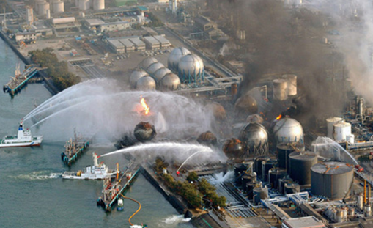
1. The complexity and perniciousness in emergency cases
The Japan earthquake leaded to 100 thousand deaths in 2011, people disappeared included. Resulted in 350-billion US dollars direct financial loss and over 500 private industries were bankrupt. It’s reported that Japanese government had allocated 180-billion US dollars to help reconstruct the disaster areas. The influence of nuclear leak in Fukushima is going to be inestimable even the earthquake has passed for 5 years. Fukushima is still regarded as a Ghost Town in people’s eyes.

Slide 4
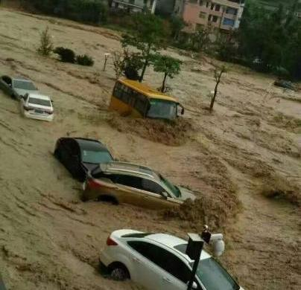
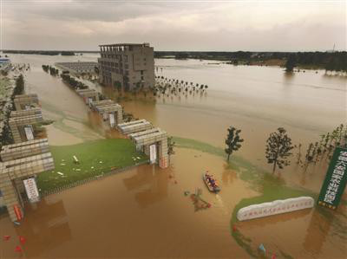
1. The complexity and perniciousness in emergency cases
A total of 27 typhoons in 2015, there are 6 landing in China , 4 landing strength reached above the level of the typhoon. "Soudelor" affected 11 provinces, which is the biggest typhoon caused casualties in 2015; "Rainbow" is the strongest typhoon landing Guangdong in October with the weather records, more than 24 billion yuan of direct economic loss, which is typhoon that economic loss is the most serious last year.

Slide 5
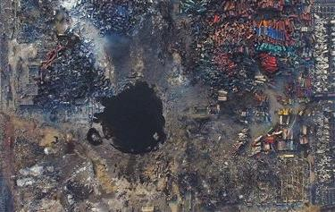
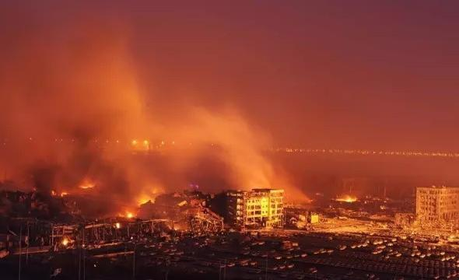
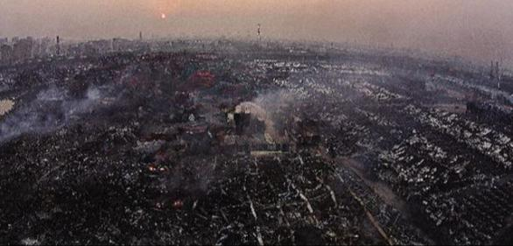
1. The complexity and perniciousness in emergency cases
On 12 August 2015, there is a fire explosion accident in Tianjin Port of Binhai New District, Tianjin, caused 165 people dead, 8 people missing, 798 people injured, 304 buildings, 12428 commercial automobile and 7533 container damaged. Direct economic losses have been approved 6.87 billion yuan.

Slide 6
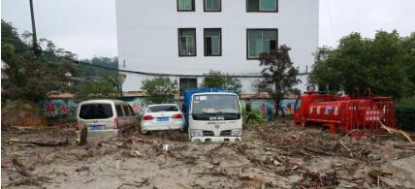
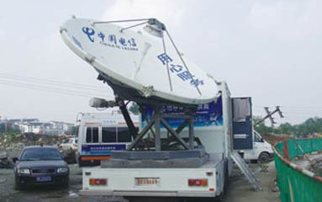
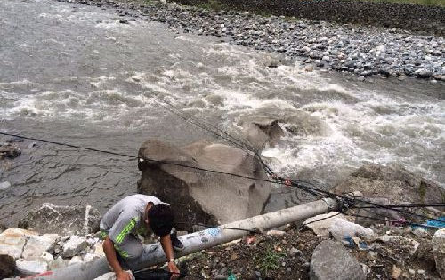
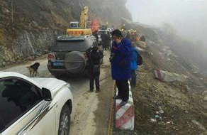
1. The complexity and perniciousness in emergency cases
The communication outage and traffic stop seriously affect the judgment and reactions from the external emergency rescue teams.

Slide 7
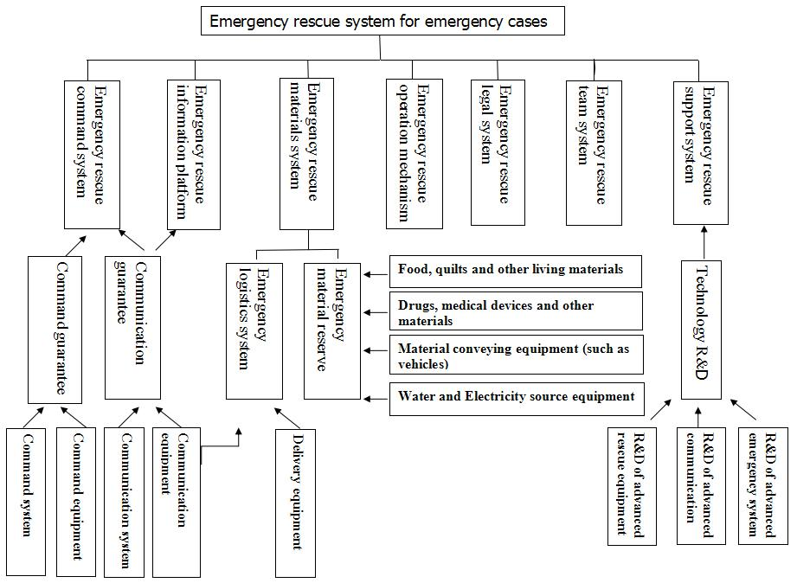
2. Early warning and rescue system in emergency cases
The formation of emergency response system

Slide 8
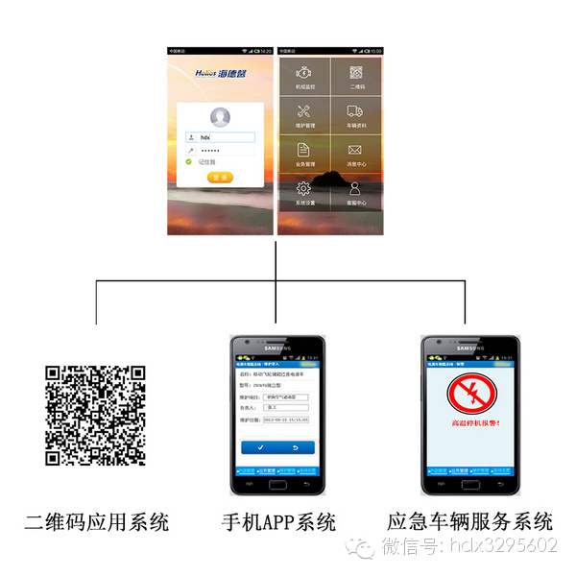
2. Early warning and rescue system in emergency cases
Two-dimensional Code System
Mobile APP System
Intellectual Service System
Utilize “Internet Plus” thought to integrate the latest technologies can accelerate the response speed in emergency rescue.

Slide 9
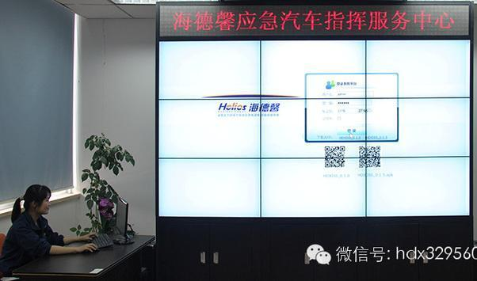
2. Early warning and rescue system in emergency cases
It is very important to provide basic necessities of life for the people afflicted by a natural disaster, which refers to that the unimpeded communication should be guaranteed. The forewarning function occurs during the rescue process if the emergency rescue platform realizes information sharing.

Slide 10
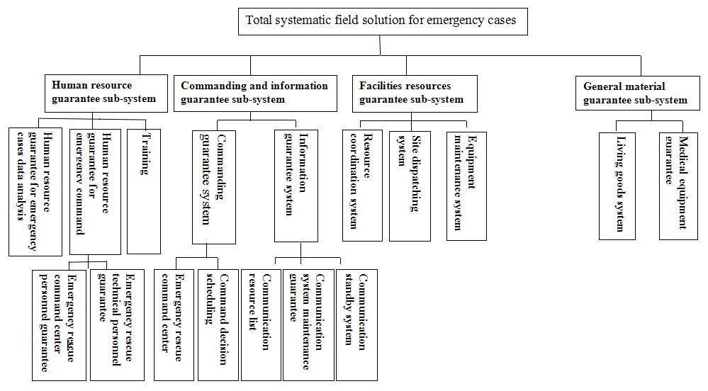
3. Haidexin systematic total field solution

Slide 11
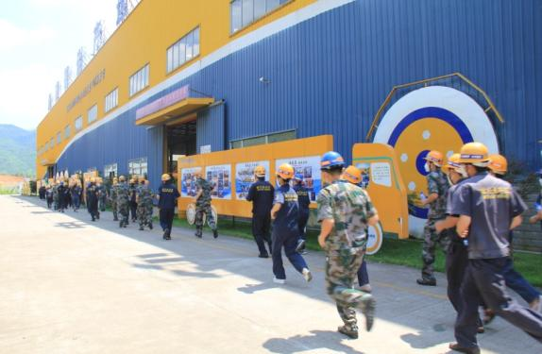
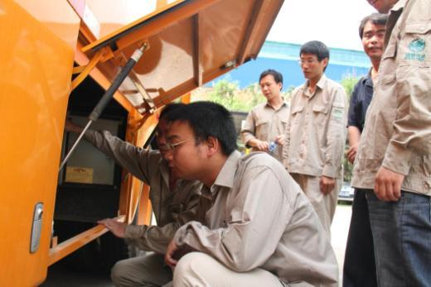
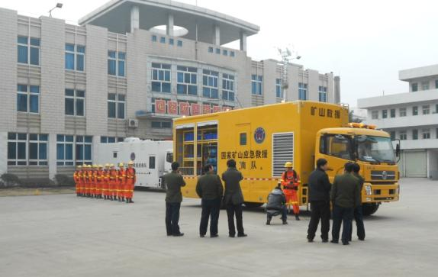
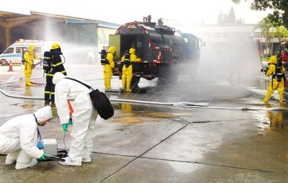
3. Haidexin systematic total field solution
3.1 Human Resource Guarantee Sub-system
应急培训及演练
All of the rescue activities should be commanded and implemented by people.
The functions of human resource guarantee system include the manning, technology level, assignment of responsibility, districts, contact information.

Slide 12
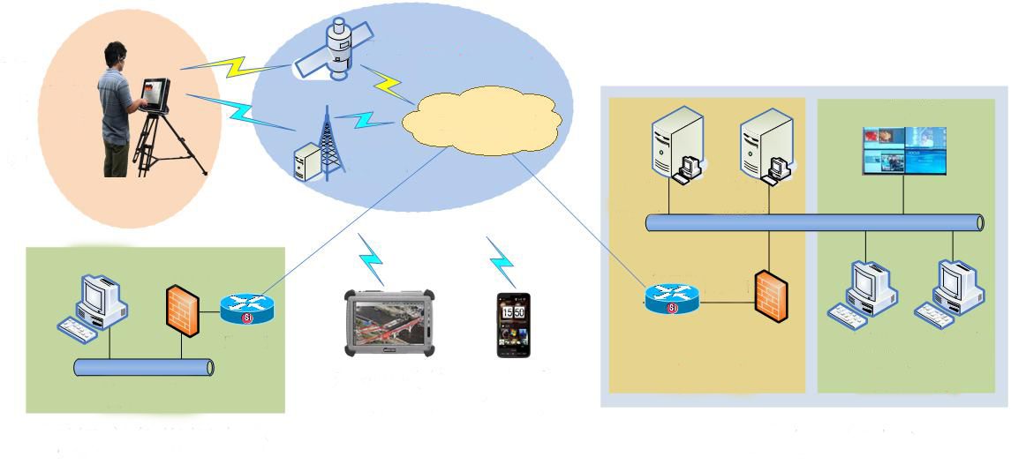
3. Practical application areas and field cases
3.2 Commanding and Information Guarantee Sub-system
Satellite
Small mobile emergency platform
CN
Emergency cases field
Internet/
private network
Display screen
Front end
3G base station
Image server
Application server
Conference end
Router
Router
Firewall
Firewall
Conference end
Mobile Internet Bnline
Consultation Terminal
Mobile Work Platfore
Center end
Client
Client
Inferior Emergency Command Center
Superior Emergency Command Center
Information is the basic element of decision-making. Meanwhile, commanding is the “heart” of emergency system.
The sufficient information communication and efficient commanding system are the key point to enhance the efficiency of emergency rescue.

Slide 13
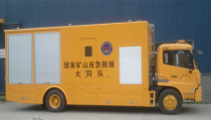
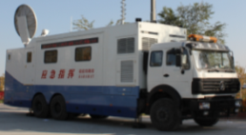
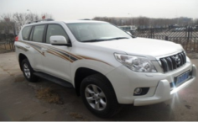
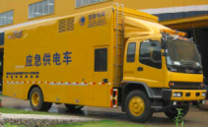
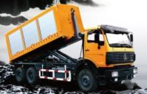
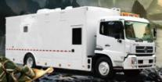
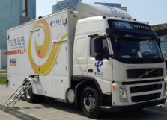
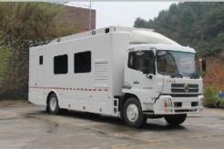
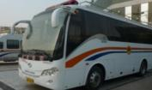
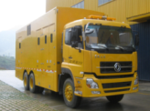
3. Practical application areas and field cases
3.3 Facilities Resources Guarantee Sub-system
Emergency Rescue
Communication Guarantee
Command Guarantee
Logistic Service
Integrated Detector Vehicle
Power Supply Vehicle
Emergency Communication Vehicle
Emergency Command Vehicle
Kitchen Vehicle
Rescue Equipment Tools Vehicle
Communication Support Vehicle
Mobile Command Platform
Rescue Camping Vehicle
Drainage Power Supply Vehicle

Slide 14
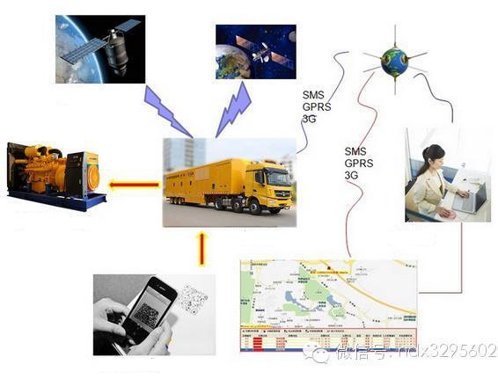
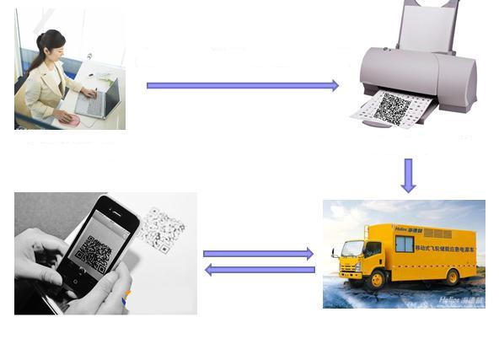
3. Practical application areas and field cases
Key technology and equipment:
Intelligent service system of mobile emergency vehicle
Two-dimensional code is made and printed by product management system
Remote monitoring
Factory workers
Two-dimension code for product information printing
Emergency equipment (generator set)
Emergency vehicle
Office workers
Site personnel scan two-dimensional code through mobile phone
Two-dimensional code is pasted on power supply vehicle
Mobile APP two-dimension code
The Internet technology is successfully applied to the mobile emergency vehicle service system, R&D the Intellectual Service System. The system applied mobile emergency vehicle analysis and back office services, making the intellectual service and depth of application for emergency special vehicles from data acquisition, real-time online analysis, abnormal alarm, running status detection, record of events and remote communication.

Slide 15
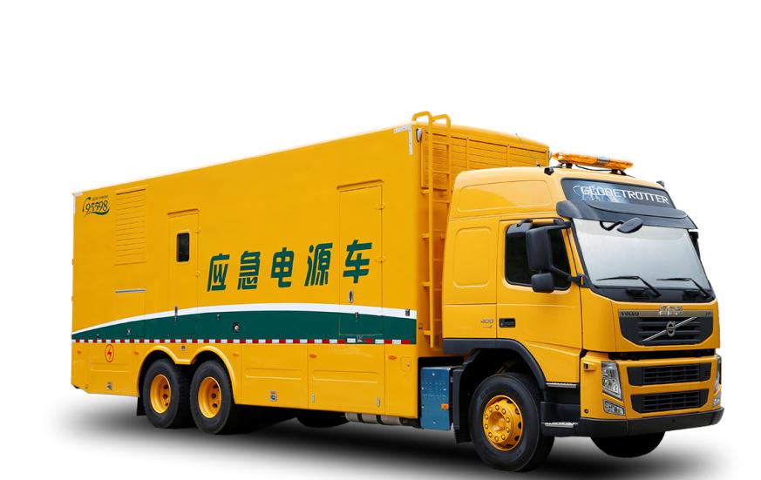
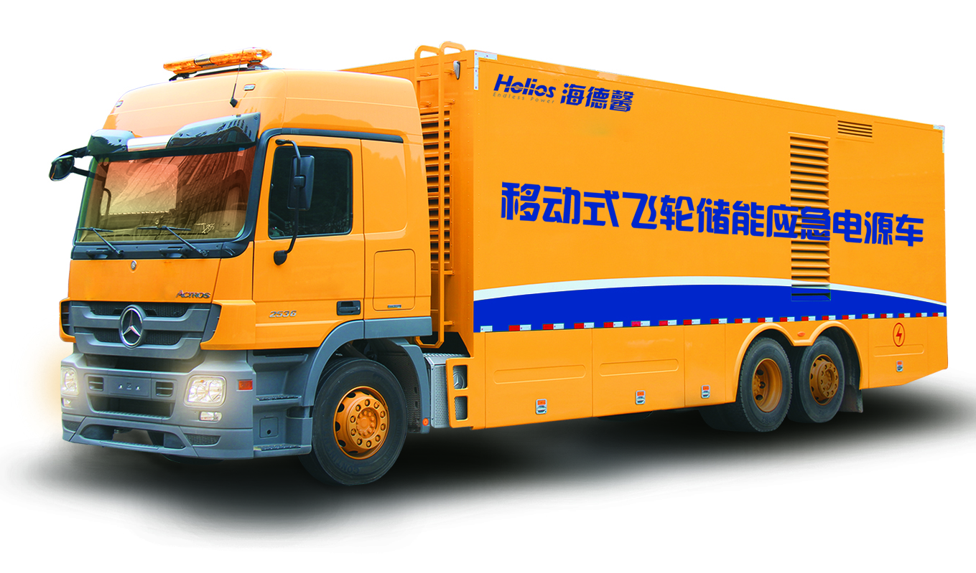
3. Practical application areas and field cases
Key technology and equipment:
Haidexin brand magnetic suspension flywheel energy storage UPS vehicle
The vehicle is divided into a split type and integrated type, which uses the world's most advanced physical storage flywheel UPS as the core component, providing zero milliseconds not intermittent and high quality power supply for load, to realize running at the same time the magnetic suspension flywheel and generator set on a vehicle. It is characterized in that the system uses physical storage mode, no pollution, low carbon energy saving, constant flywheel speed, low friction and low noise.

Slide 16
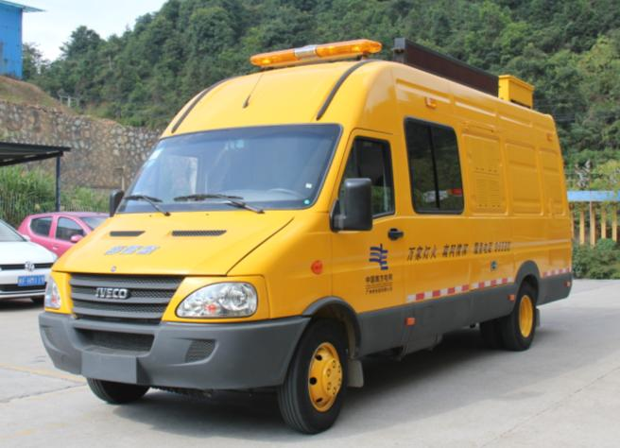
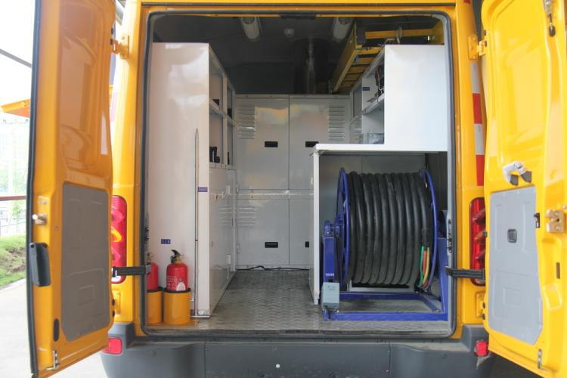
3. Practical application areas and field cases
Key technology and equipment:
65kW Microturbine Rescue Vehicle
Main Features:
a. C65 Microturbine unit- less maintenance, fast start, restore the power supply the first time;
b. Small vehicle body, strong passability- it adapt to implement electrical repair tasks in the narrow streets;
c. Fast parallel machine-it can rapid capacity expansion expension to meet the more complex power requirements;
d. Easy maintenance-the only moving part of generator set is supported by air bearings, and the main components are 20 thousand hours maintenance free;
e. Professional emergency repair tool storage system - various tool box style, storage order, safety, meet the humanized demand, easy access and improving work efficiency;

Slide 17
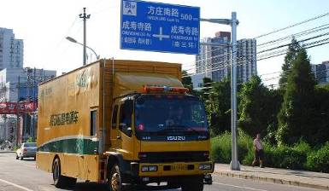
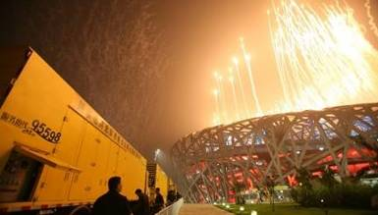
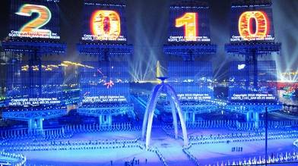
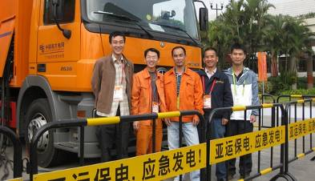
4. Practical application areas and field cases
Power supply for Olympic Games in 2008
The 2010 Guangzhou Asian Games

Slide 18
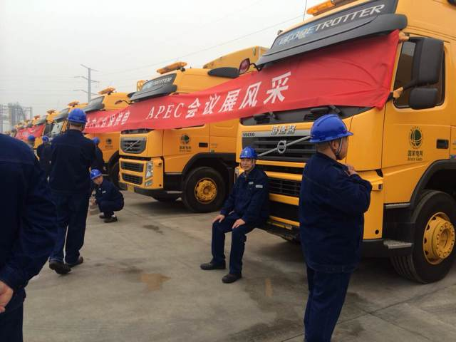
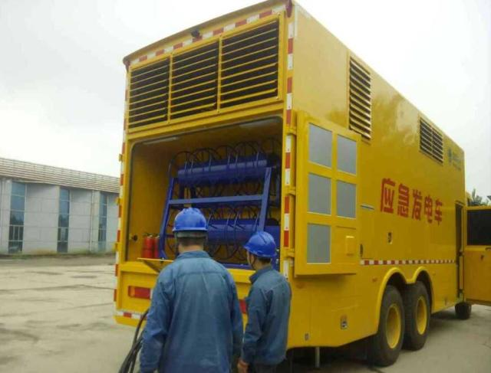
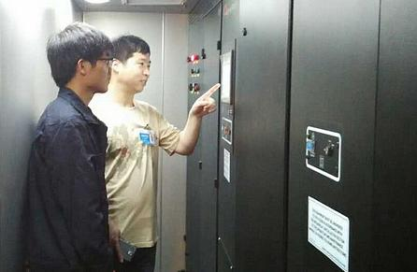
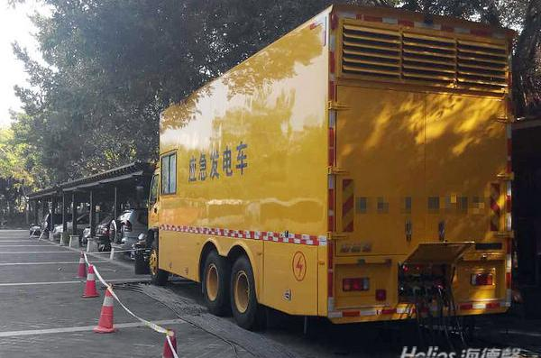
4. Practical application areas and field cases
APEC China 2014

Slide 19
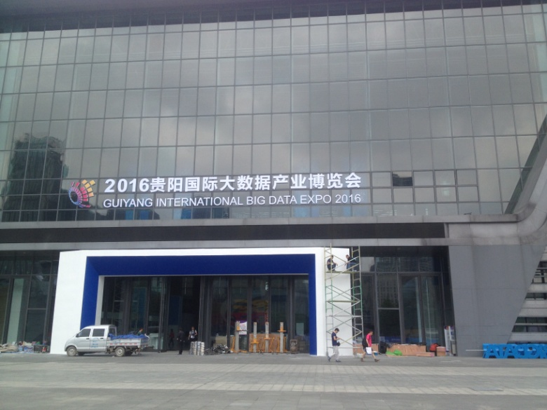
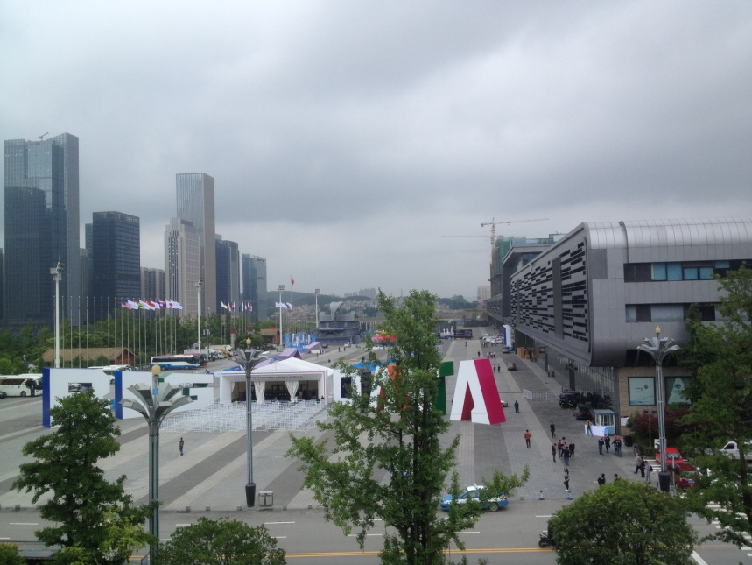
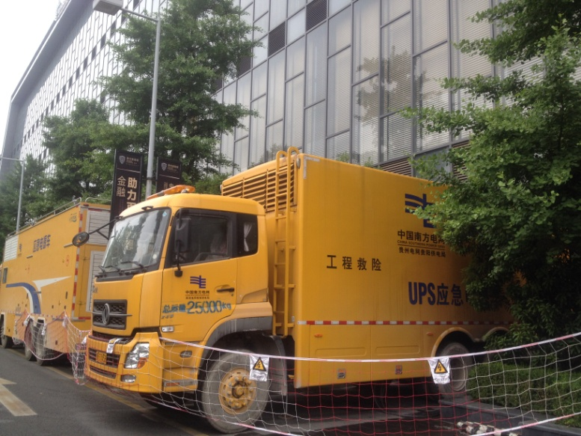
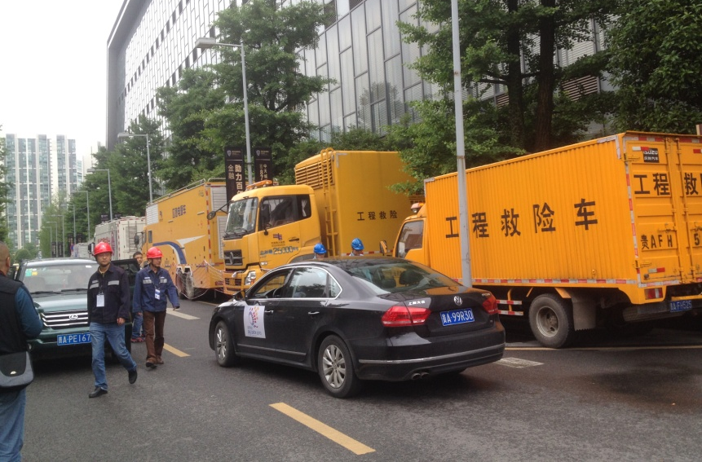
4. Practical application areas and field cases
China Big Data Summit 2016

Slide 20
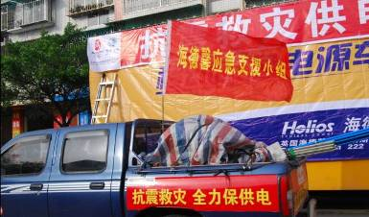



4. Practical application areas and field cases
5·12 Wenchuan Earthquake
Yushu, we are together

Slide 21




4. Practical application areas and field cases
Anti-icing and power supply protection in southern China in 2008
Wangjialing Mine Accident in 2010

Slide 22




4. Practical application areas and field cases
Funing tornado rescue in 2016

Slide 23




4. Practical application areas and field cases
Flood disaster rescue in southern China in 2016

Slide 24




4. Practical application areas and field cases
Nepartak typhoon in 2016

Slide 25

Thank you！

