Slide 1
San Bernardino Mass Shooting
December 2, 2015

Slide 2

San Bernardino Mass Shooting
Two shooters armed with AR-15 style assault rifles enter the Inland Regional Center in San Bernardino and open fire on a group of San Bernardino County employees gathered at the Center for a training meeting and holiday luncheon.
  14 people killed
  22 people wounded
  Determined to be a “terrorist event”.

Slide 3
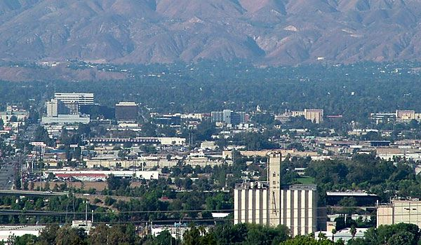
City of San Bernardino
70 square miles – One hour east of Los Angeles.
Population – 215K
“All American City” in 1977
Former Norton AFB, steel industry, railroad town.
Declared bankruptcy in 2012
Among the poorest communities in the US
High crime rate
Among the Most “under-policed” communities in the United States
  UC Berkeley Study

Slide 4
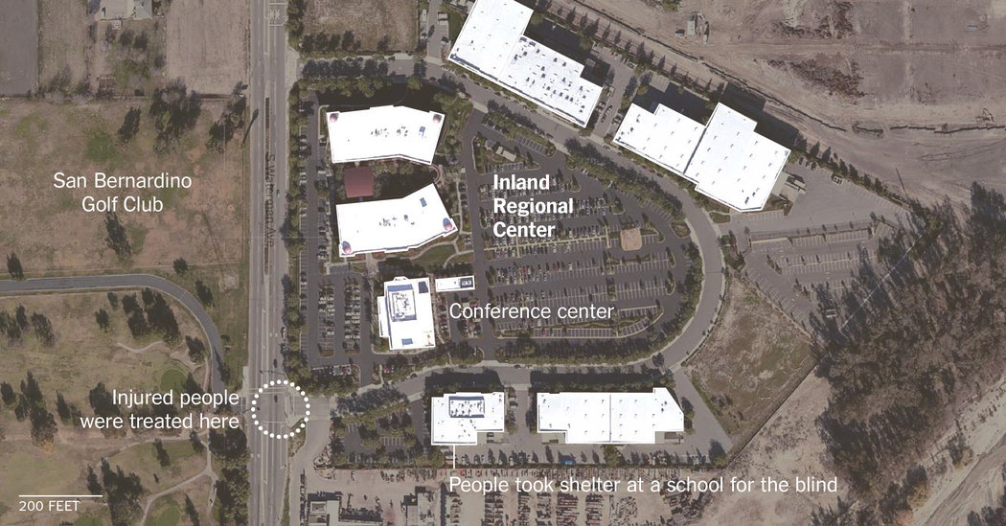
Inland Regional Center

Slide 5
December 2nd, 2015
SB County Department of Public Health training and end of year event.
  80 + County Employees present
Syed Farook was present all morning - alone
  Left the gathering sometime around 10:36AM
  Left a bag on a table – center of the room
    Later determined to contain a homemade RC IED
  Two Suspects enter at approximately 10:58 and open fire (100+ rounds)

Slide 6

Original Shooting Timeline
First 911 call at 10:58 – “Shots heard in the area”
  Almost immediately followed up by multiple calls of a shooting – elevated to an active shooter
Multiple suspect descriptions were given…
  1-3 suspects (+possible get away driver)
  White or Hispanic male suspects
Suspects were in and out in about 2-3 minutes
  100+ .223 rounds fired (2 guns used)

Slide 7
IRC Building 3 layout

Slide 8
Police Response
Approximately 4 minutes
  1st team assembled (lieutenant, homicide detective, patrol officer, motor officer)
    Made entry expecting to take fire
  2nd team assembled (SBPD officer, Fontana PD detectives)
  Response grows (100+ in less than 30 minutes)
  SBPD SWAT – Training – 11 minute response
  SBSD SWAT – Training nearby as well

Slide 9
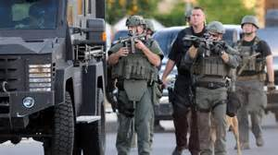
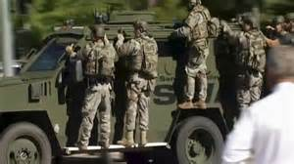
Police Response
1st team enters – encounters hiding survivors
  Exchange – Distrust – Fear – Unstoppable Flood
All teams reacted to “active shooter” training
Tactical teams assumed search operations
  Started getting info suspects fled in dark SUV

Slide 10
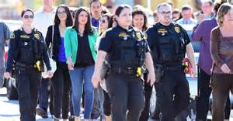
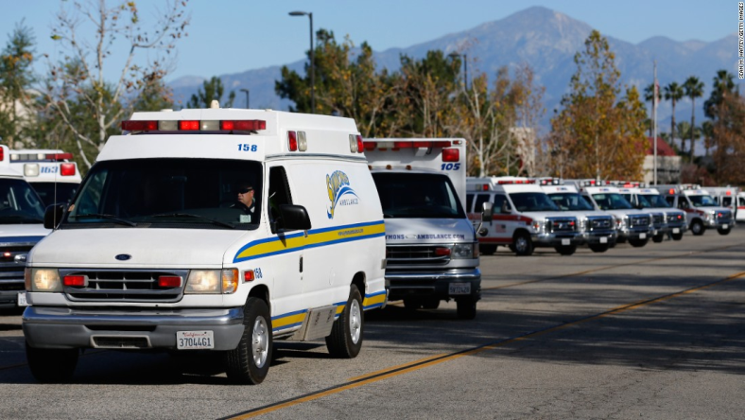
Police Response
Most wounded victims extracted by police officers
Pick-up truck transport – Triage center across the street
All but two victims extracted from the building are transported and survive (2 died in triage area).
Hundreds are evacuated from the three buildings.

Slide 11
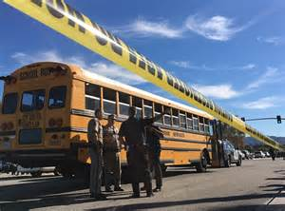
Early Command Decisions
Sealed the area off – 1/2 mile +
Ordered public and school buses to pick up witness survivors
Secured “The Rock Church” for witnesses
Established a media staging area (nearby hotel)
Opened Hernandez Center for family – Parks and Rec.

Slide 12
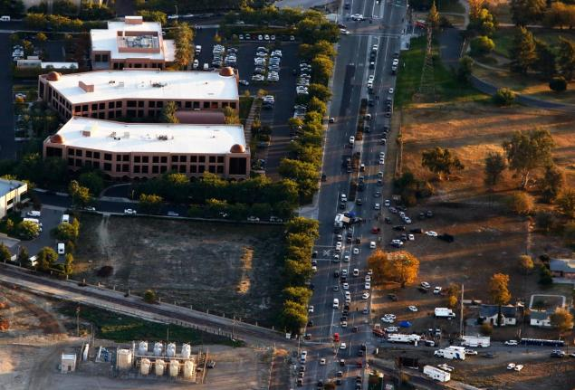
Police Response
Nearly 300 officers within 2 hours
  10 local police agencies
  4 FD’s responded
FBI
ATF
DHS
US Attorney
Regional Task Force Teams

Slide 13
Investigation
One witness from the County event (SB County Employee) noticed Syed Farook was at the gathering and left a short time before the shooting.
  Did not see the face of the shooter (masked)
    Body structure / Body language
Rookie Cop took his statement as the witness was being directed to a witness staging area
Suspects name broadcasted (Media Concerns)
  Analyst at the station started the workup through various databases.
Witness calls with SUV information
  Found rental car info attached to the suspect – black SUV – Redlands address

Slide 14
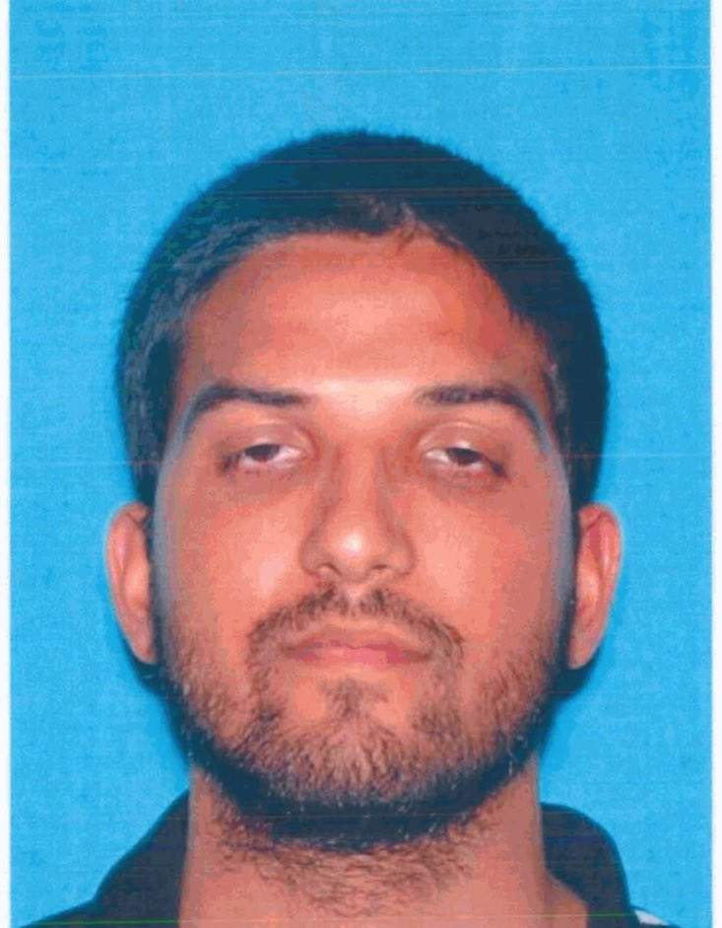
Suspect – Syed Rizwan Farook
28 years old (6-17-1987)
Born in the Illinois
Raised locally in the IE
CSUSB College Grad
5 year employee of SB County (Health Inspector)
Radicalized over several years

Slide 15
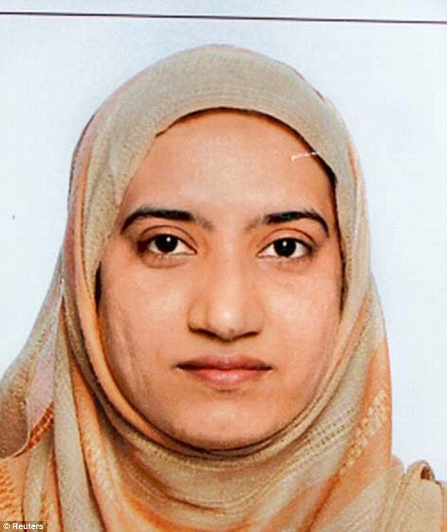
Suspect – Tashfeen Malik
29 years old 7-13-86
Born: Karorr Lal Eesun, Pakistan
Educated
Immigrated to the US with a “fiancée” visa in 2013. Legal US Resident.
Married Syed and had a 6 month old child at the time of the shooting.

Slide 16
Investigation
Two San Bernardino PD Homicide Detectives are the first to arrive at the Redlands townhome address and attempt to watch the house.
  Narcotic officers are close behind
Black SUV seen leaving the location alleyway almost immediately as narcotic officers arrive.
  Suspect vehicle followed from the location, head back to the City of San Bernardino
    Trailing SBPD officer (Narc) flags a Redlands PD unit down and both attempt to catch the following officers. (various radio channels in use)
Marked unit arrives – Tippecanoe Avenue – short pursuit
  Suspect – Malik – opens fire at following units through the back window of the SUV (back seat).

Slide 17
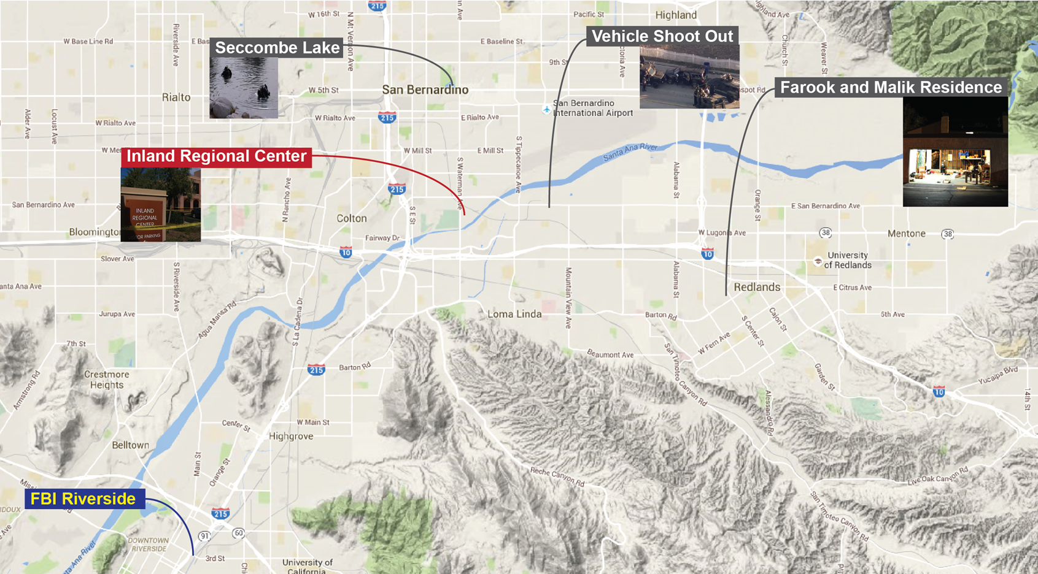
Key Locations

Slide 18
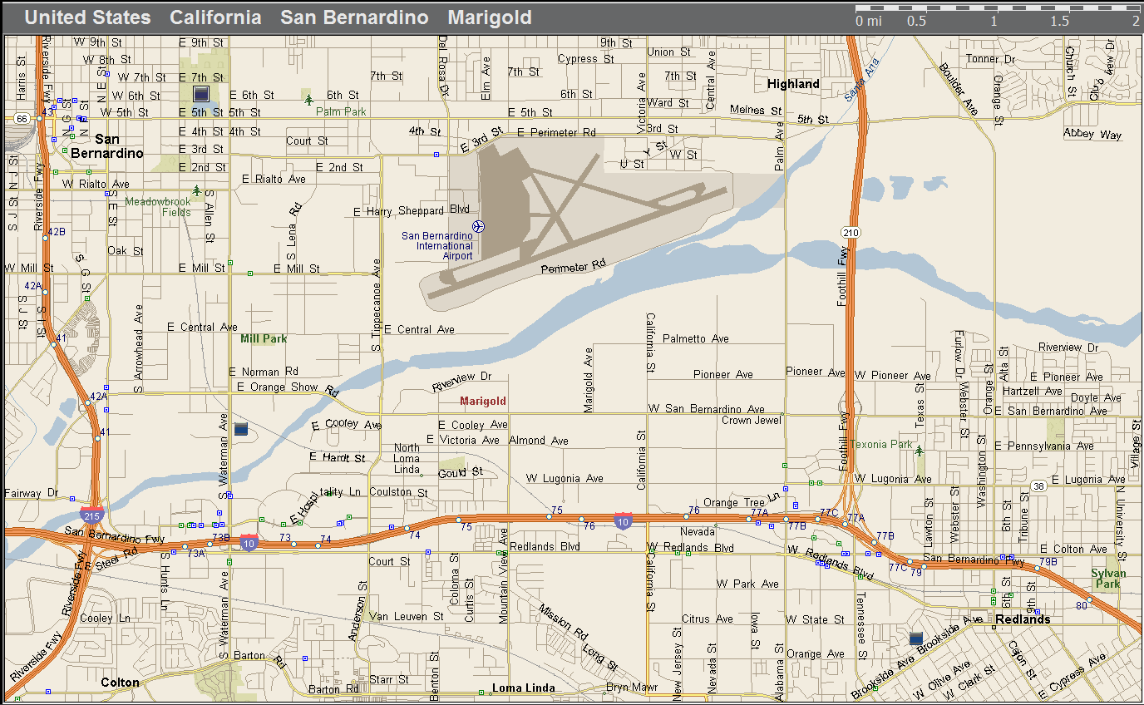
Subject Movement

Slide 19
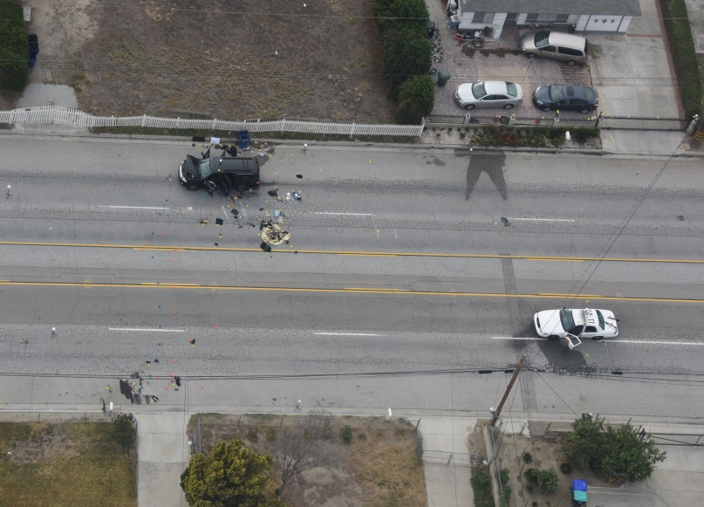
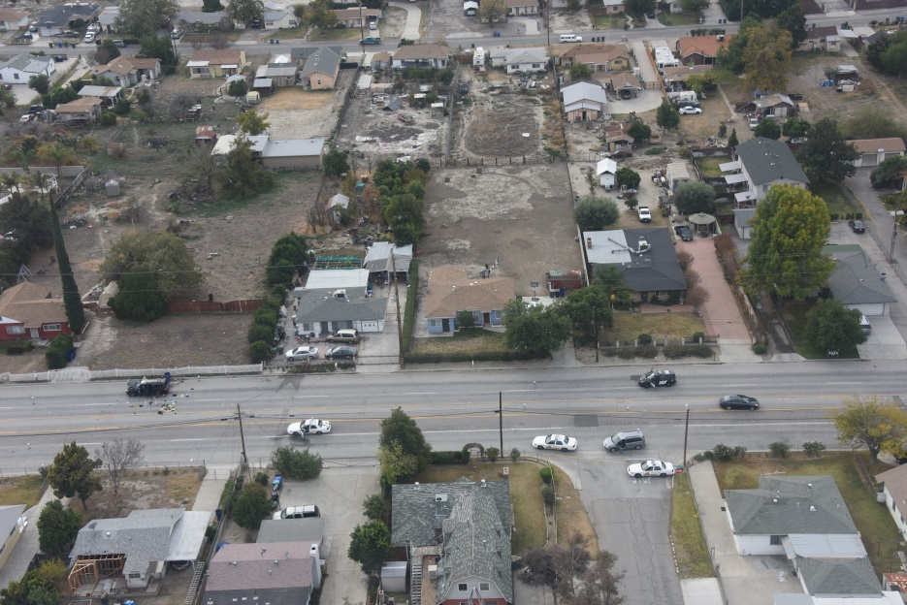
Gun battle
Suspect vehicle stops after a couple thousand feet – Farook exits and engages officers.
  Limited marked units at this time – supplemented by unmarked vehicles
  68 feet / 195 feet / 210 feet +

Slide 20
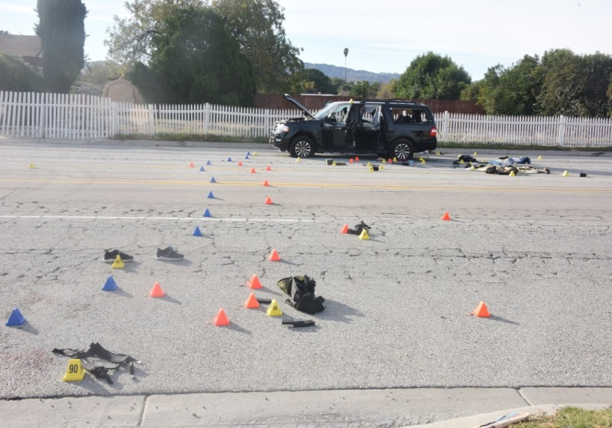
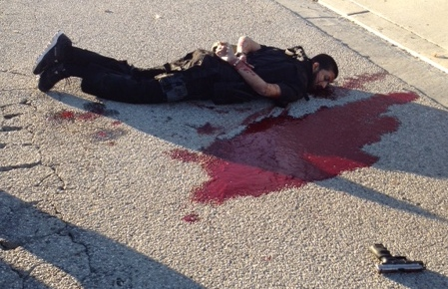
Gun battle
Farook’s Movement
Farook dies in the street
Malik dies in the SUV
Fear of IED’s

Slide 21
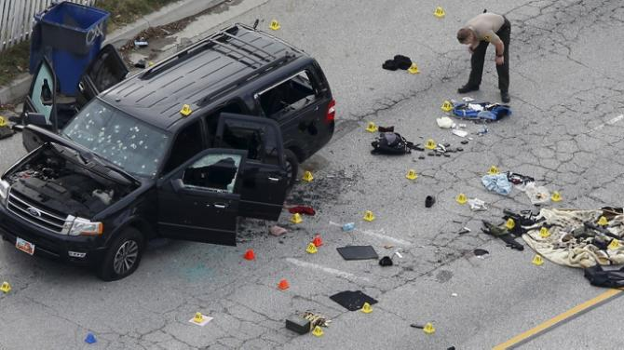
Gun battle
Approximately 6 ½ minutes – “Shots Fired” till gunfire ends
Both suspects killed
Two officers injured (leg wound and shrapnel)
Suspects Fired 80 rounds at officers
  1879 .223 / 484 9mm – available
23 officers fired – 440 rounds
  Rifle / Shotgun / Handgun

Slide 22
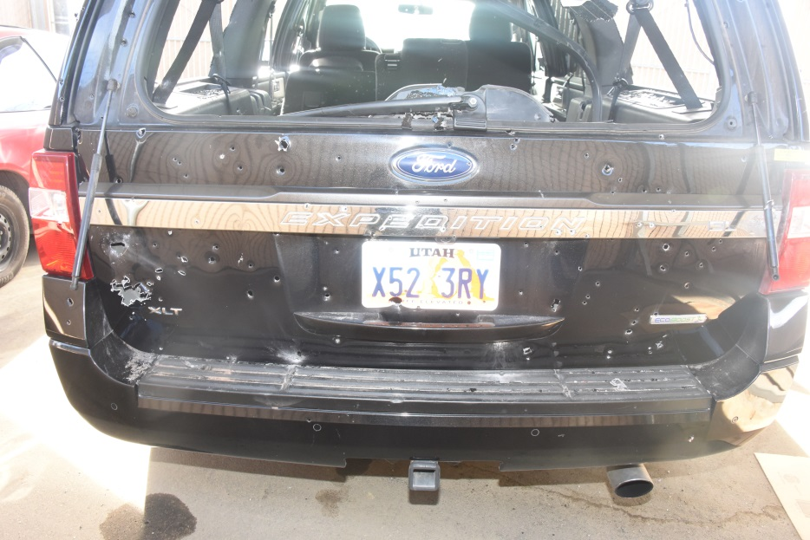
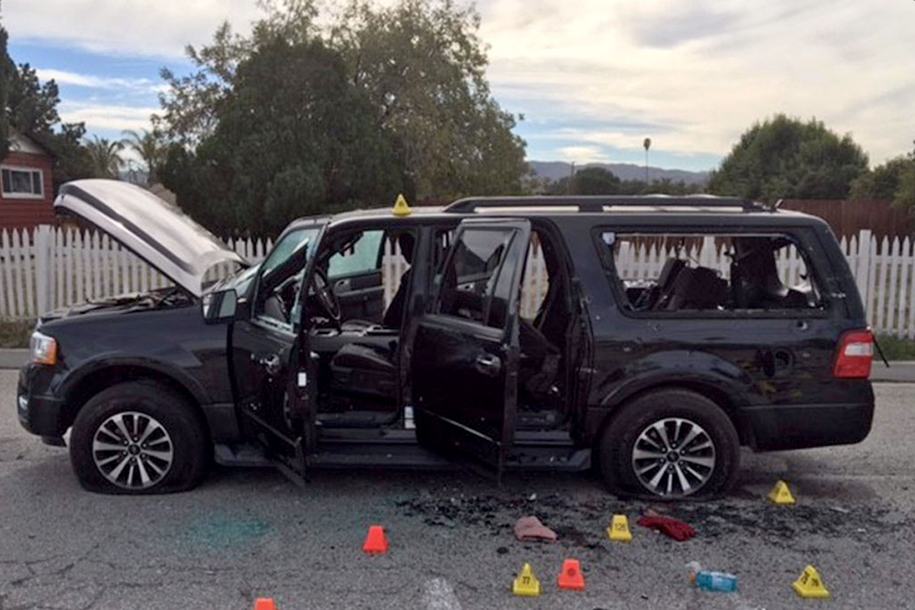
Suspect’s
Rented SUV

Slide 23
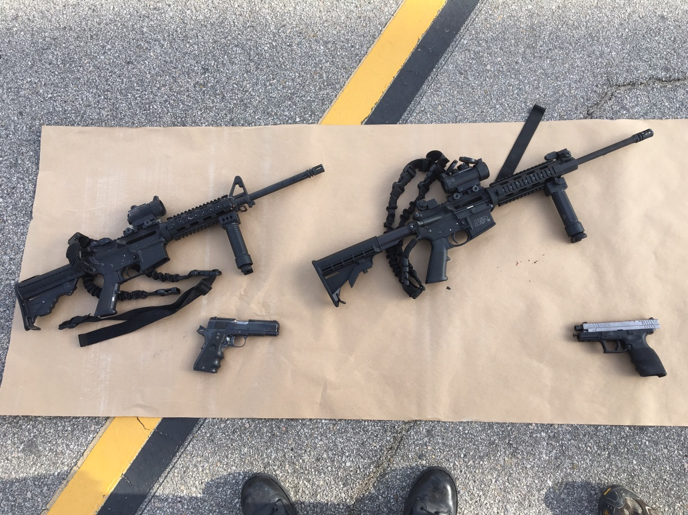
Suspect’s Weapons
Springfield XD 9mm
Registered to Farook
Found next to Farook
Llama Government 9mm
Registered to Farook
Found next to Malik
DPMS Oracle 5.56
Registered to Marquez
Found next to Malik
Smith & Wesson M&P15 5.56
Registered to Marquez
Found next to Farook

Slide 24
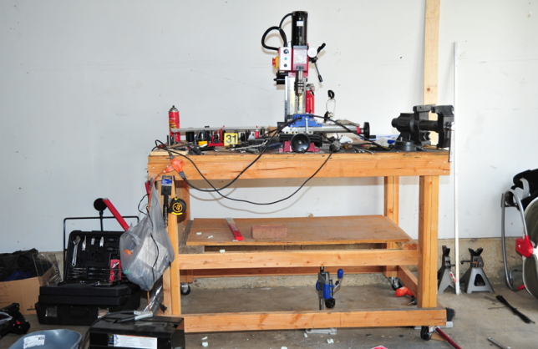
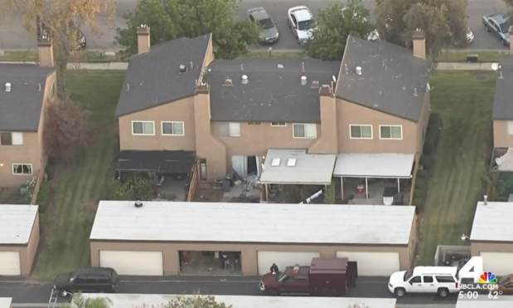
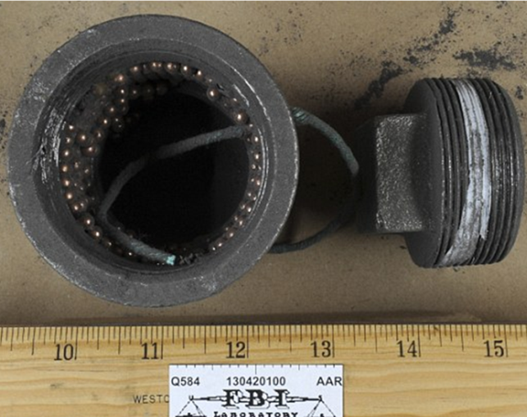
Explosives
IED at the IRC (RC Controlled)
IED thrown during the pursuit?
IED manufacturing at the house in Redlands

Slide 25
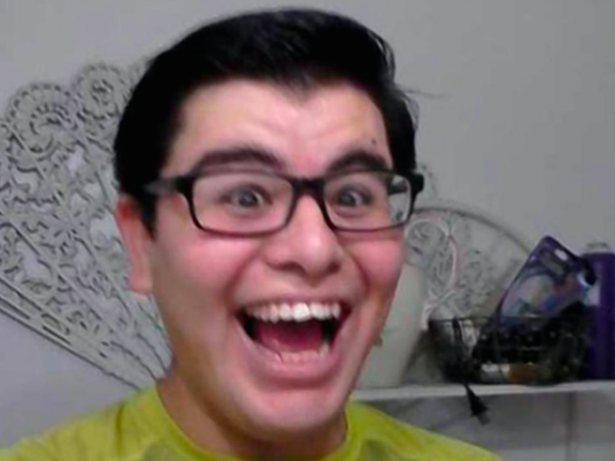
Suspect – Enrique Marquez
2004 - Met Syed Farook
2005 - Introduced to Islam
2007 - Converted to Islam, and almost immediately was introduced to Radical Islam
2010 – Listened to “The Hereafter” by Anwar al-Awlaki Researched Imran Hosein; Continued to consume radical materials – (Inspire Magazine, Videos, etc.)

Slide 26
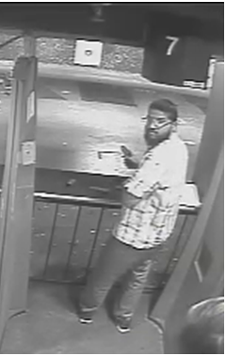
Timeline Pre-Attack
2011-2012 – Weapons are legally purchased by Farook and Marquez.
Late 2011 – RCC / Freeway Attack Plans
November 2012 – Broken Banner Case
2013-2014 – Online Chats between Farook and Malik about jihad (Yahoo)
July 2014 – Farook travels to Saudi Arabia – Returns with Malik
December 2014 – Online posts – Muslims should avoid Non-Muslim Holiday Celebrations (Malik)
Nov/Dec 2015 – Pipe Bomb Assembly – Gets rid of Computer and Smart TV
November 2015 – Cash withdrawals – Loans (10K-29K)
November 2015 – Malik deletes several Facebook friends
Nov 27, 2015 – Range Practice
Nov 30, 2015 – SUV Rental
Dec 1, 2015 – All e-mails deleted

Slide 27
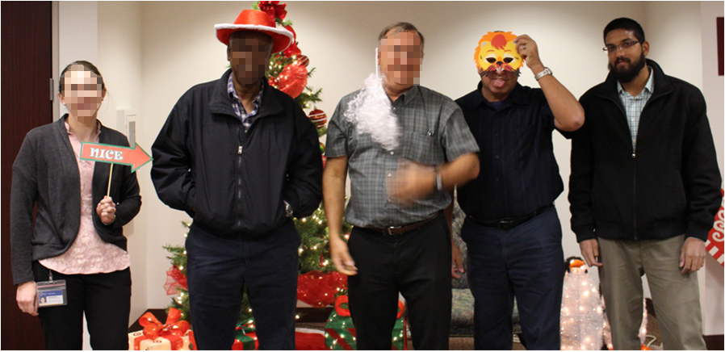
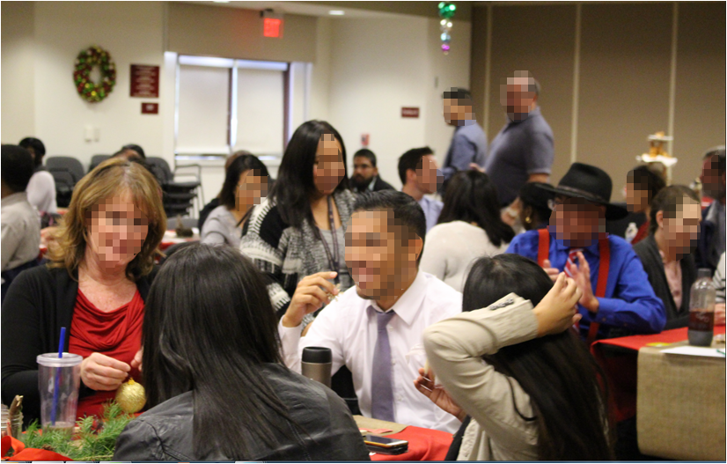
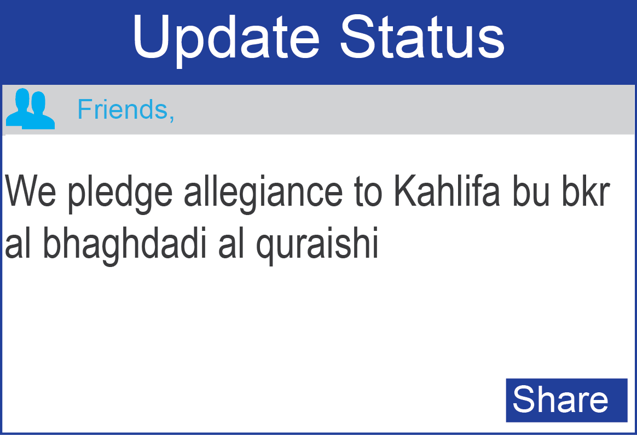
Timeline - Attack
0843 – Facebook research regarding the Islamic State
0848 – Arrival at the IRC
0905 – Farook observed entering the event – Places the bag on the table
0924 - 0951 – Farook poses with Co-Workers - Pictures
1036 – Farook leaves the room – IRC
1058 – Shooting begins
1114 – Facebook Posts

Slide 28
Issues Raised during Internal Debriefs
Medical Aid Response
  Fire Department – Police Department cross training
  Regional Debate – Fire Industry Standards
  Tactical Medic Program
Law Enforcement Medical Training
  Litters
  EMT training

Slide 29
Debrief - Equipment
Body Armor Enhancements
  Plate Carrier Systems
Rifles
  First 8 officers in the door / 1 Rifle / 1 Shotgun
Lack of Breeching Tools
  Protocol for marking doors following a search
Radio Earpieces
  Loud Environment / Fire Alarm Etc…
  Some units did not hear the traffic of a potential IED
    Witness Info

Slide 30
Debrief - communication
Various departments and units using various communication systems
  CHP not on local channels
  County System – All Local Agencies
  Push to Talk communication systems
Internal Communication
  Homicide and Narcotics both pursuing a lead without knowing the other was working the same lead.
  Not all information was communicated to CP Operations

Slide 31
What went right
Officers reacted to training
  Different ‘police’ agencies understood the basics of an Active Shooter Response
Medical Extractions (volume of LE officers)
Isolation of witnesses – triage interviews
Quick CP Established
Federal / Local LE Relationships

Slide 32
Media relationships
Local relationships have traditionally been good
  Philosophical approach of transparency
In this case we made ‘honest attempts” to keep the media informed
Media Staging Area developed quickly and became the ‘only’ place they would get information from us.
  Immediate PIO was assigned to isolate media involvement
Set Ground Rules
  Made ourselves available
Public Perception
  Lack of Knowledge = Fear

Slide 33
Media Relationships (Continued)
Used the pressers to send signals to the public and the families of the victims
Inserted first responders when we needed to give them something when we had no significant investigative updates. This allowed us to give the media something, while also acknowledging the great work by those who put their lives on the line.
United Front – Even to the point of walking together to the podium when at all possible
Transition Discussion between Chief, Sheriff, ADIC. That discussion formed the foundation for the public handoff with the media.

Slide 34
Interagency Relationships
Kept each other informed and ensured that we always appeared to be/were unified
Almost nightly for first few weeks we would have teleconferences to discuss investigative updates, trending issues, media, etc.
Anticipated leaks, talking heads, etc., some of which became red herrings (Example: one news outlet reporting that Syed Farouk was an FBI Informant gone bad.)
Strong communication allowed us to discuss issues which came up with no notice (Examples: Shooting at Riverside Mall, UPS Shutdown/Evacuation)
Discussions of substance prior to pressers allowed us to send the necessary signals by agency to our constituents
89 search warrants, 370 subpoenas, 500+ pieces of evidence, and over 550 interviews conducted

Slide 35
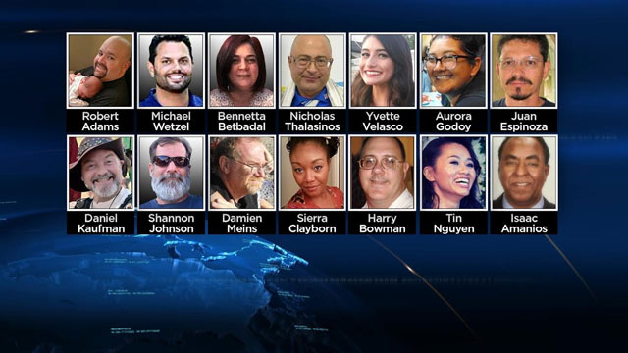
Victims
14 were killed
22 victims wounded – several critical

