Slide 1


    Building Community Resilience
                Innovation
                Collaboration
                Sustainability
                Results

Slide 2
Bridging the Gap
Early Warning - Preparedness – Mitigation - Response - Recovery
Business, Academic, Faith Based, Non-profit
and Community Sector Capabilities
Innovation
Communication
Collaboration
Support Systems
Commitment
Expanding Gap
Needs of Community Stakeholders.
Demand
Government Agency
Capabilities
Government Capacity to respond.
Time

Slide 3
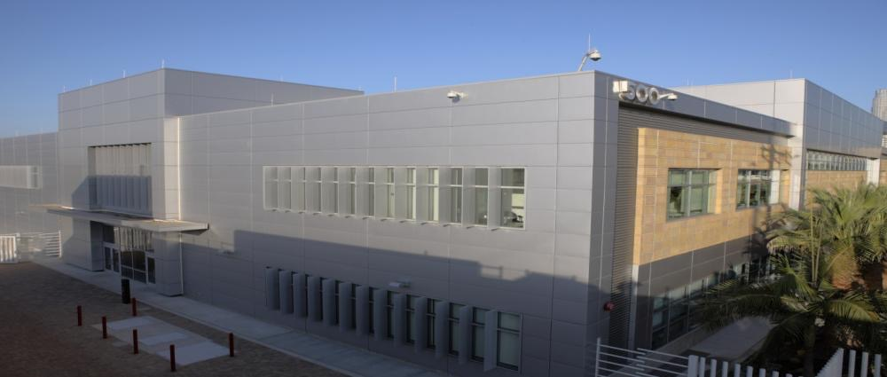
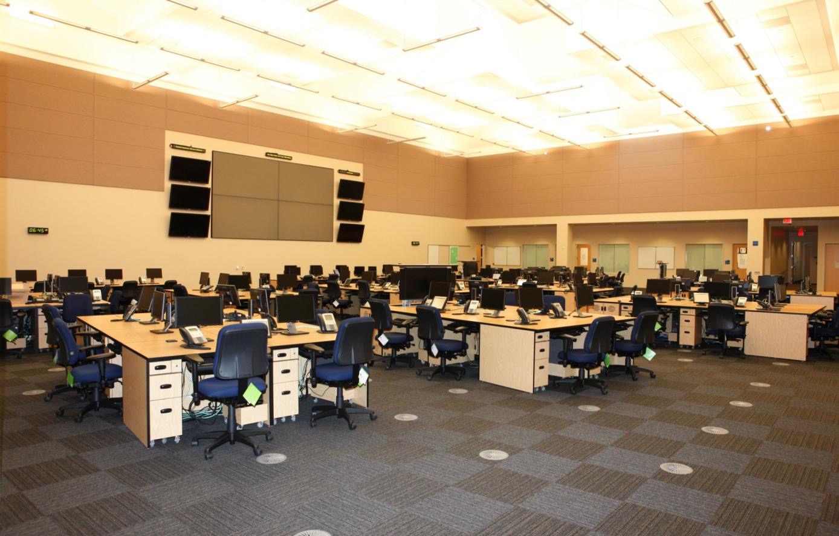
Los Angeles Emergency Operations Center (EOC)
and Business Operations Center (BOC)
Dedicated Seat for each Community Stakeholder Sector

Slide 4
About Us
LA Emergency Preparedness Foundation
LA based 501c3 Charitable Nonprofit Organization
Supporting community resilience throughout the Los Angeles region
Founded: 2008 in cooperation with the City of Los Angeles
OBJECTIVES:
  Coordinate BOC operations with community stakeholder representatives
  Support local community preparedness, response, and recovery
  programs (education, awareness, response)
  Identify the unique capabilities and linkages across community stakeholder sectors
  Promote information sharing and collaboration
  Meet with stakeholder sector groups and government agencies
  Adapt to changing community needs, provide leadership

Slide 5

The Community Resiliency Initiative Process
1
2
Develop tools for Collaboration and Coordination
3
Develop Operational Standards
Build the Community

Slide 6

Community Stakeholder Sectors
Retail
Transportation
Communications
Professional Services
Finance
Health
Hospitality
Academic
Non-Profit
Local Government
Manufacturing
Infrastructure
Faith-based
Entertainment
Industry

Slide 7
15 Community Stakeholder Sectors
Critical Infrastructure – Utilities, Voice, Data, Highways, Services
Healthcare - Hospitals, Pharmacies, Clinics
Finance - Finance, Insurance, Legal
Entertainment - Arts, Media, Sports, Recreation
Manufacturing-Process - Heavy Industry, Chemicals , Oil and Gas
Construction - Development, Facility Management, Real Estate,
Hospitality - Food and Beverage, Lodging, Tourism
Information Technology - Computers, Servers, Software
Transportation - Automotive, Postal / Shipping, Supply Chain, Warehousing
Associations - Professional Services, Labor, Associations, Consulting
Retail-Commodities - Wholesale, Grocery, Consumer Goods and Services
Faith Based – Houses of Worship and Organizations
Academic – Universities, Colleges, Schools
Non-profits - NGO’s, Foundations
Government - Local, State, Federal

Slide 8
The Community Resiliency Initiative Process
1
2
Develop tools for Collaboration and Coordination
3
Develop Operational Standards
Build the Community

Slide 9
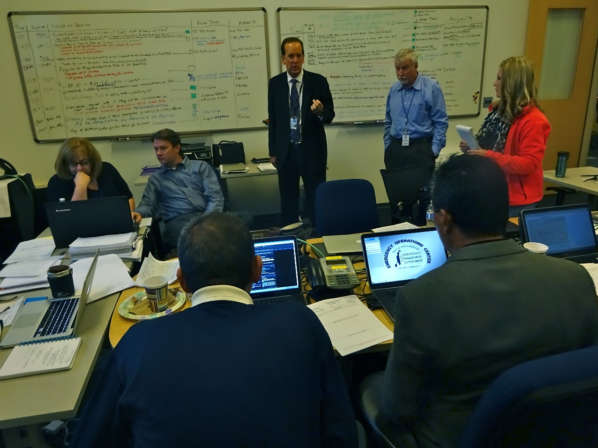
BOC - Incident Management Support System
Provides structure and stability to effectively
manage a high stress situation.
• Common operating picture
• Incident tracking and reporting forms
• Incident assessment forms
• Personnel tracking forms
• News and social media feeds
• Access to emergency management plans
• Critical contact lists
• Information feeds and links
• PDF creation and sharing
• Local and federal situation reports
• Proximity alerts
• Mobile data reporting (mapped)

Slide 10
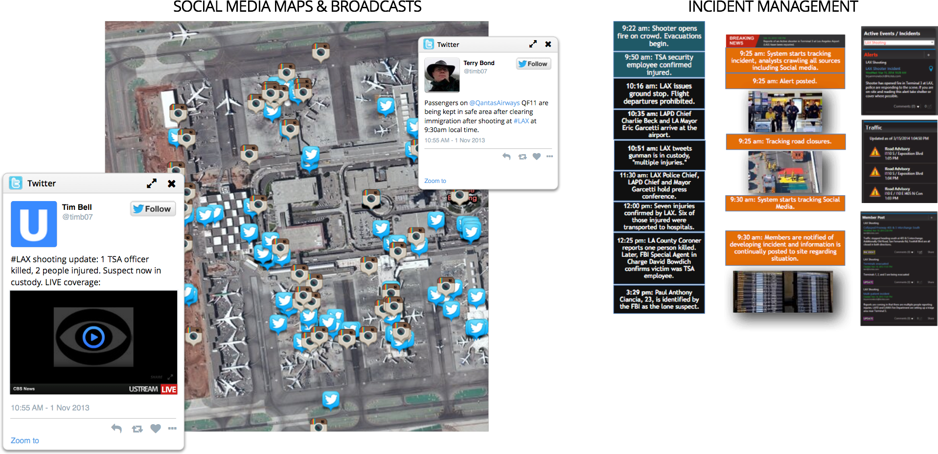
Social Media
Simultaneously watch any number of local and national news broadcasts from over 90 US stations.

Slide 11
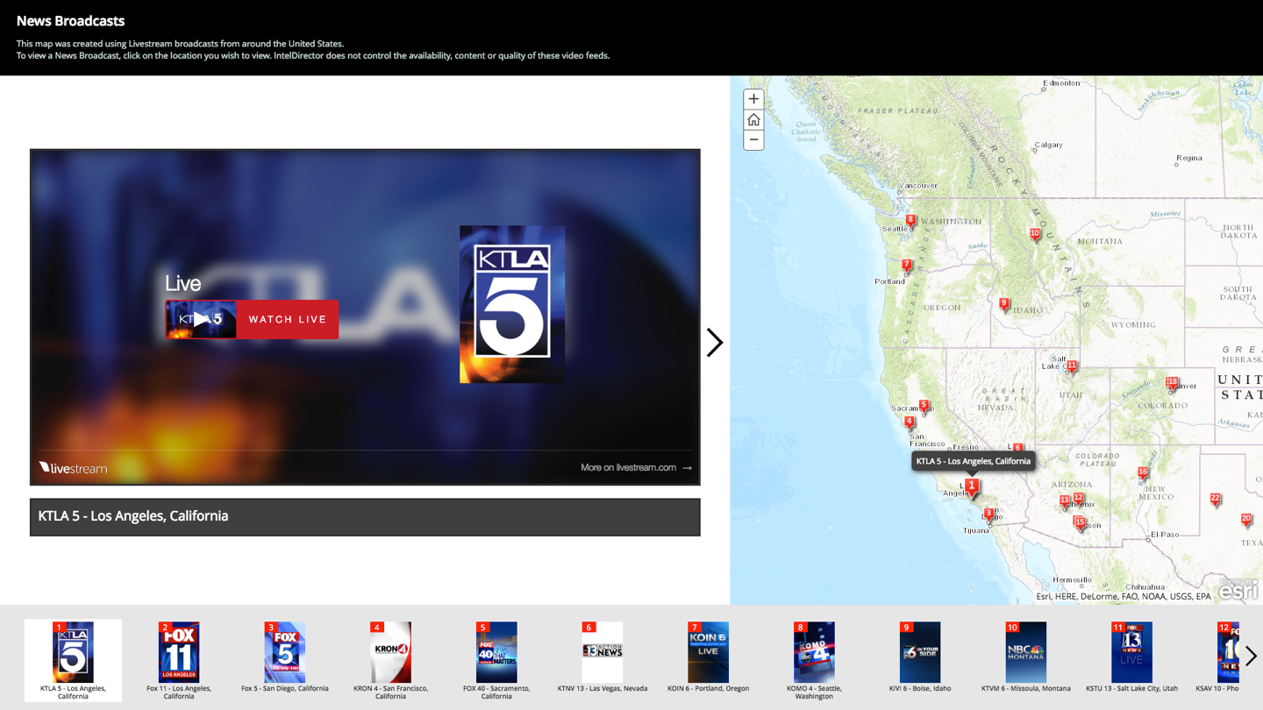

Slide 12

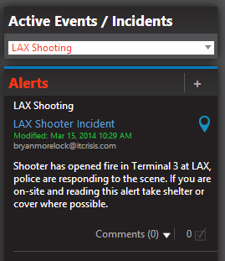

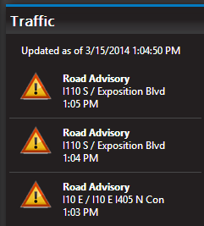


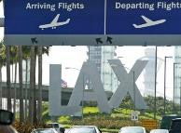
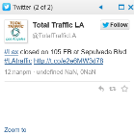
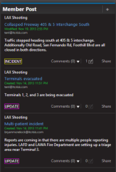

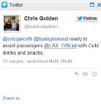

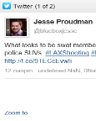
LAX Shooting
9:22 am: Shooter opens fire on crowd. Evacuations begin.
9:50 am: TSA security employee confirmed injured.
9:25 am: system starts tracking incident, analysts crawling all sources including Social media.
10:16 am: LAX issues ground stop. Flight departures prohibited.
9:25 am: Alert posted on.
10:35 am: LAPD Chief Charlie Beck and LA Mayor Eric Garcetti arrive at the airport.
10:51 am: LAX tweets gunman is in custody, "multiple injuries."
9:25 am: tracking road closures.
11:30 am: LAX Police Chief, LAPD Chief and Mayor Garcetti hold press conference.
12:00 pm: Seven injuries confirmed by LAX. Six of those injured were transported to hospitals.
9:30 am: system starts tracking Social Media.
12:25 pm: LA County Coroner reports one person killed. Later, FBI Special Agent in Charge David Bowdich confirms victim was TSA employee.
9:30 am: Members are notified of developing incident and information is continually posted to site regarding situation.
3:29 pm: Paul Anthony Ciancia, 23, is identified by the FBI as the lone suspect.

Slide 13
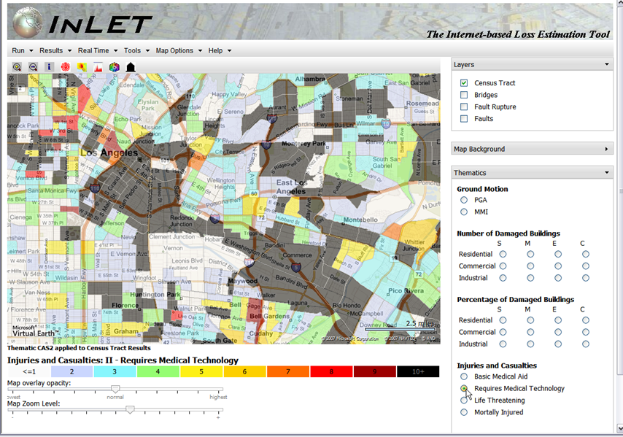
Earthquake Modeling and Analysis

Slide 14
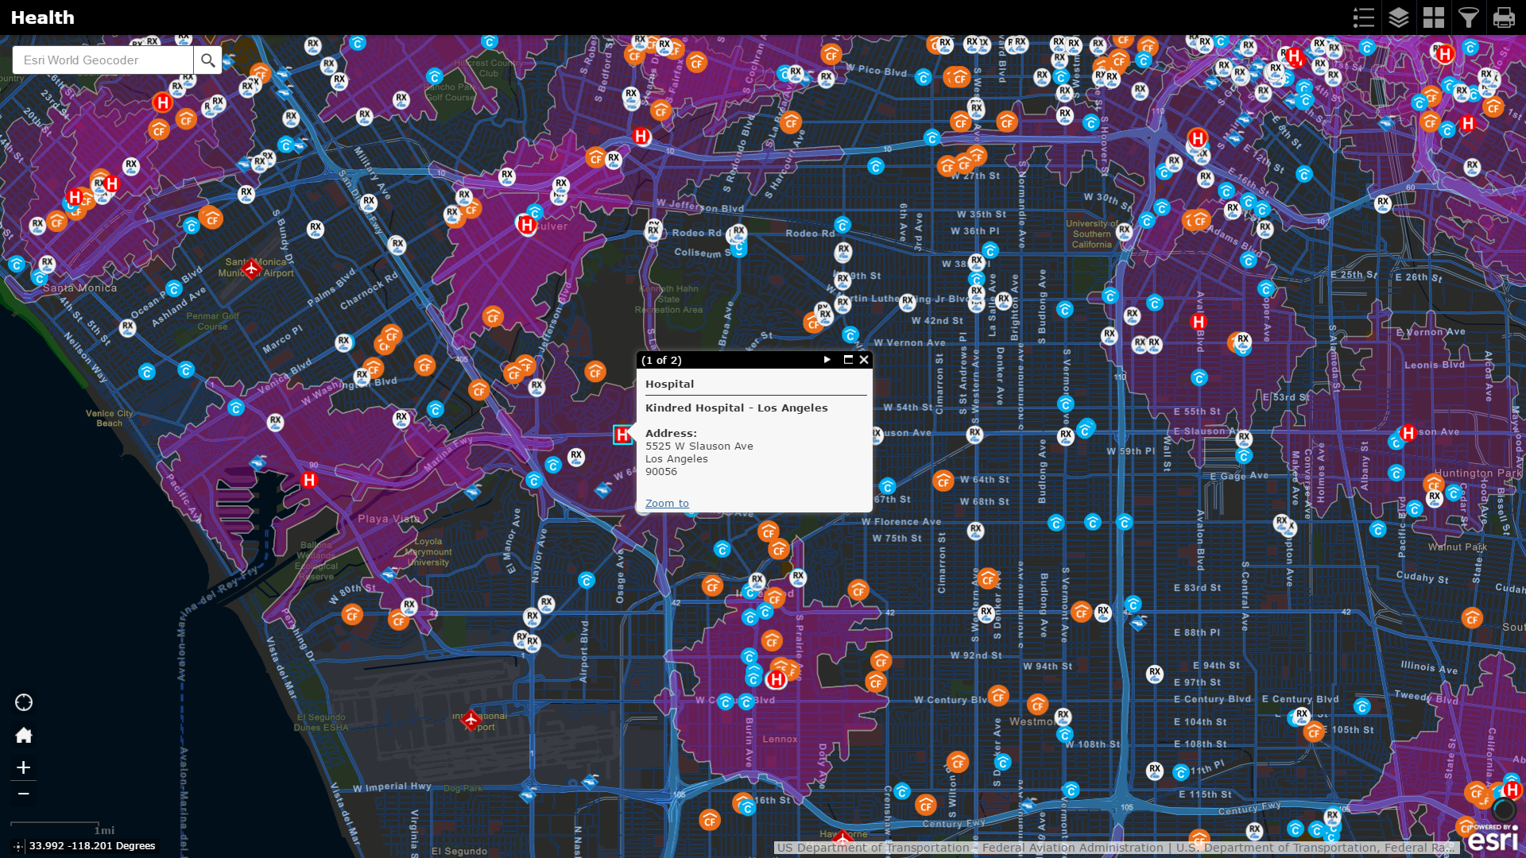
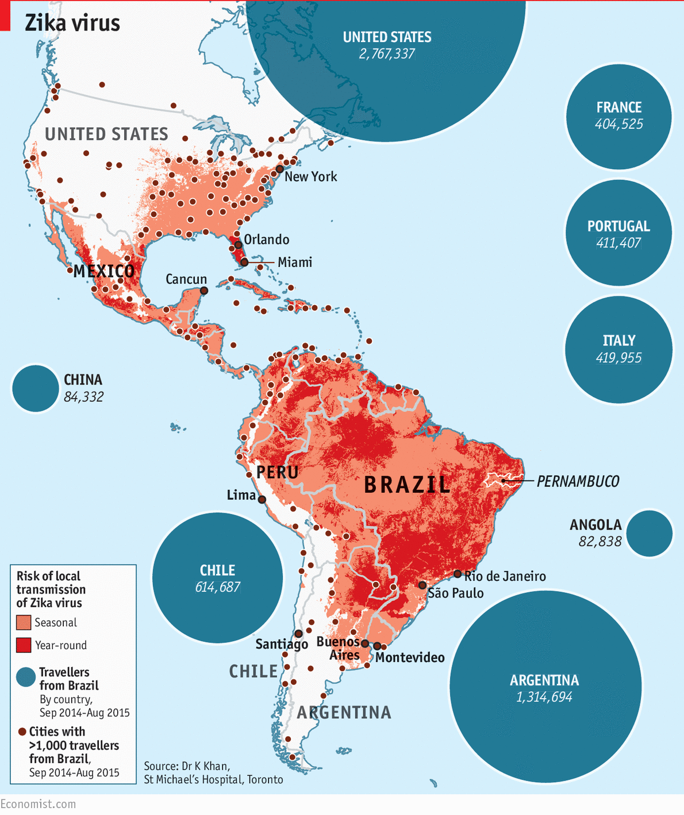
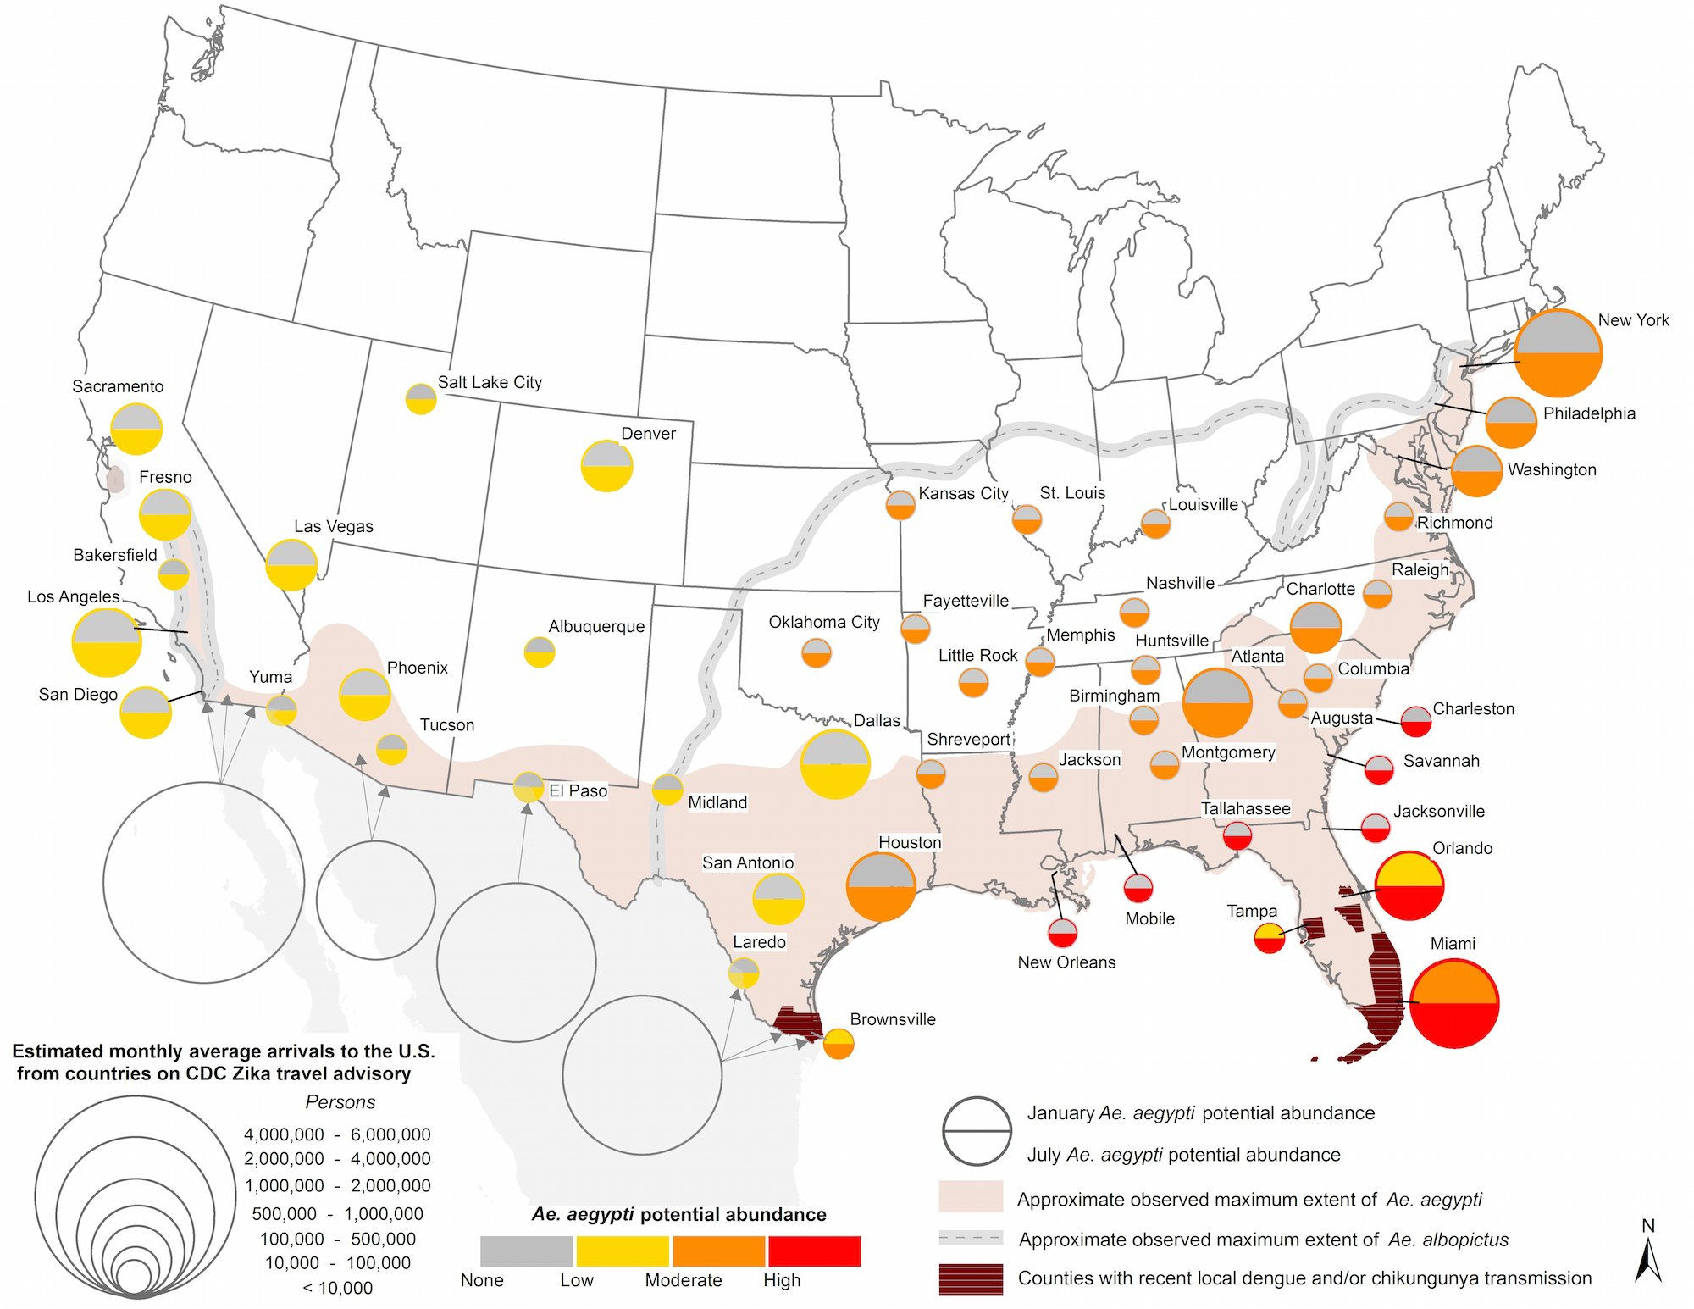
Health Mapping Data

Slide 15
MAP GALLERY
Over 30 interactive maps
200+ data layers included

Slide 16
The Community Resiliency Initiative Process
1
2
Develop tools for Collaboration and Coordination
3
Develop Operational Standards
Build the Community

Slide 17

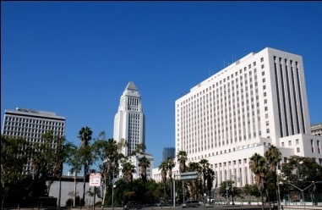
City of Los Angeles
Emergency Operations Plan
Business Operations Center (BOC)
Operational Guidelines
CREATED
JANUARY 2013

Slide 18
San Bernardino Shooting

Slide 19
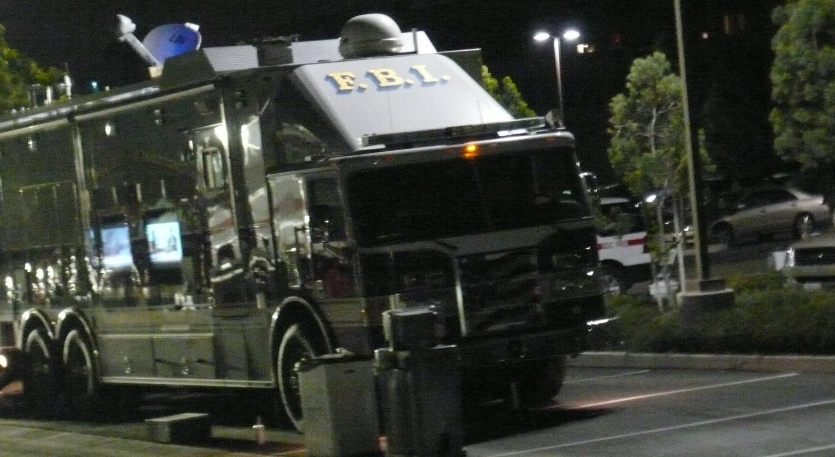
San Bernardino Shooting 12/2/2015

Slide 20
San Bernardino Timeline
Bringing the local community together to respond, contribute, and start the healing process.
4:30PM In-N-Out truck arrives with capacity for 330 double/doubles – fed 1st responders and obtained permission from FBI incident commander to distribute food along with San Bernardino PD Asst. Chief McBride to members of the Press Corps.
Departed – 9PM
FBI Special Agent Maureen O’Connell calls LAEFP saying it was a “go” requesting
3 meals per day at Waterman Command Post for 100 responders starting this evening (Dec 3rd).
LAEPF gathers internal response team
LAEPF buys at Costco for Dec 4th Breakfast and Lunch.
LAEPF continues to call hospitality sector and obtains commitments from In-N-Out, Panda Express and Red Lobster.
Be-More-Prepared drops off 7-11 certificates, Coffee, Soft drinks.
Incident
Occurred
December 2nd
12:30 PM
December 3rd
2:00 PM
December 4th
3:30 PM
6:00 AM
11:30 AM
2:30 PM
4:30 PM
Call received from FBI Special Agent Maureen O’Connell
asking if LAEPF could potentially provide the resources to feed approximately 100 responders if needed.
LAEPF agrees to do our best in fulfilling this need if requests to do so. LAEPF representative (Terri Pond) remained in contact with Special Agent O’Connell pending any change in status.
LAEPF responds by identifying and contacting potential food service / hospitality providers in the San Bernardino area.
Mill Creek - BBQ Restaurant agrees to bring food for 100 by 4:30PM to the Waterman Command Post.
FBI Special Agent O’Connell is notified and directions / instructions for access to the site are obtained.
LAEPF confirms the delivery, receives a 10% discount from Mill Creek – and pays for the balance.
LAEPF – Creates BOC Incident Awareness Page for the San Bernardino Shooting which includes the following:
        Map of area with key locations highlighted – regional center, street closures, shooter vehicle, house, hospital.
Running incident facts list – posted as validated info became available.
Social Media – raw feed for twitter, instagram, - feeds constantly updated and re-validated
LAEPF team picks up donated coffee (Starbucks) and arrives at Waterman Command Post at 6:00 AM.
Additional donations arrive from RockStar energy drinks, and local Winchell's Donuts in support of San Bernardino County General Services Department.
Walgreens arrives with donated water, snacks, Ice, and drinks from 3 local stores. Walgreens offers to open any store to get supplies along with general office space – with internet connection to any responding agency that might need it.
LAEPF obtains and finalizes meal donations for all deliveries through Sunday evening.
Panda Express provides on-site lunch
InfraGard – DSAC call – data provided by LAEPF (Brian Carlson CTO)

Slide 21
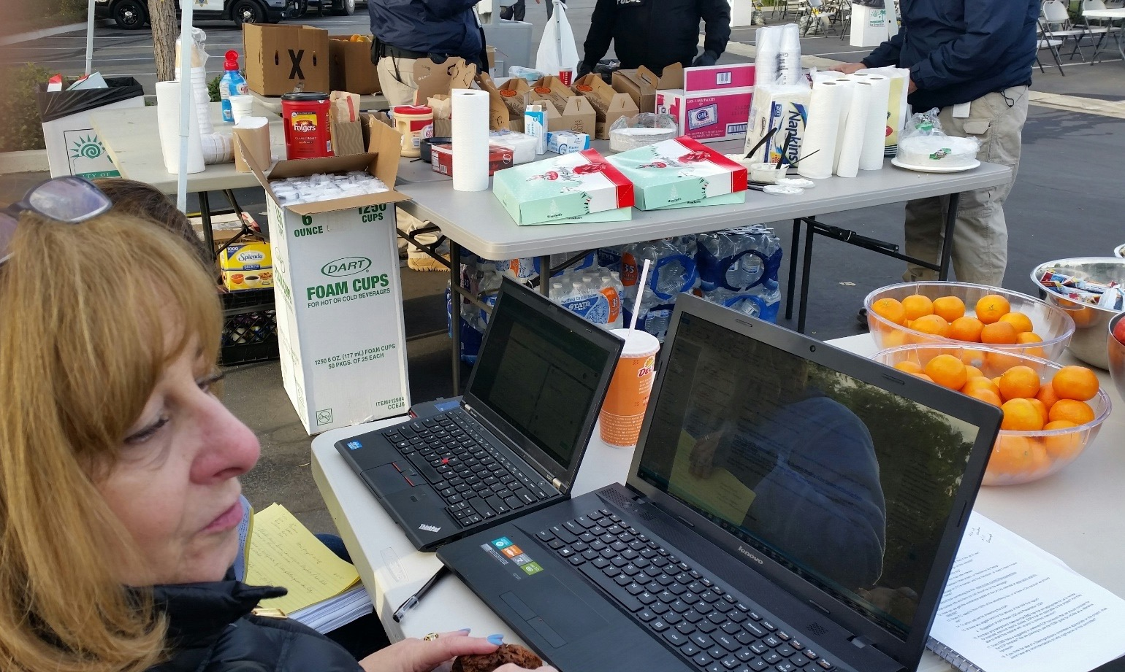


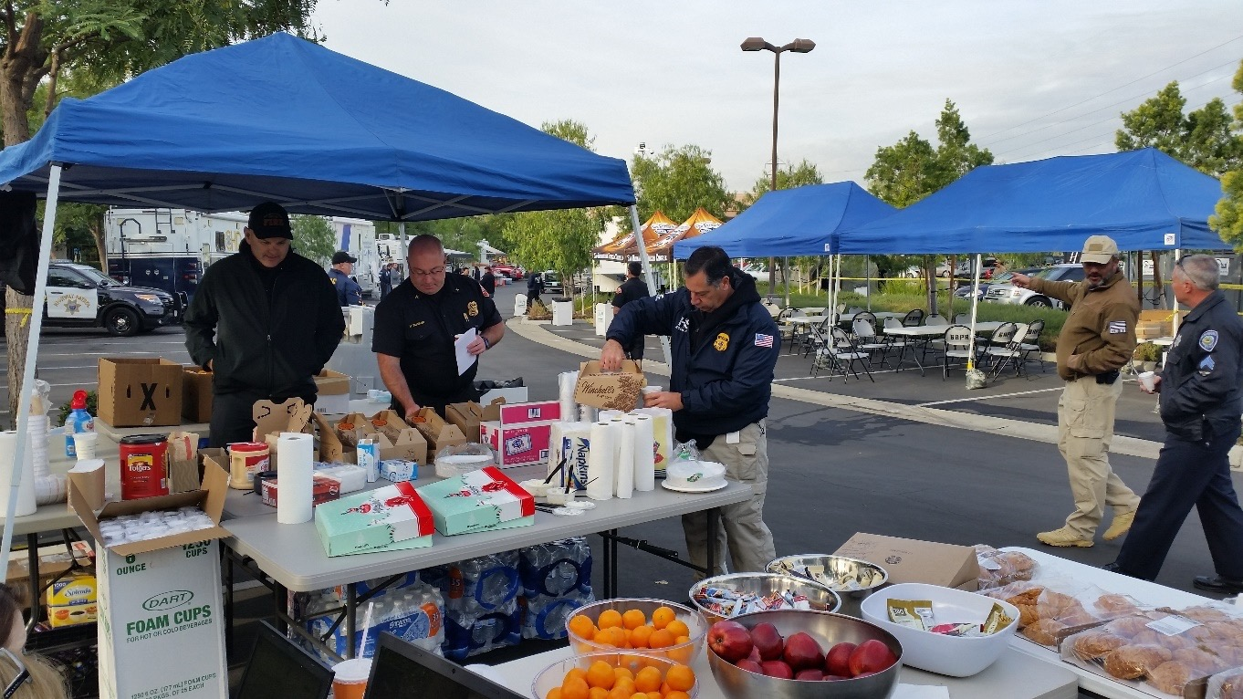


V
San Bernardino Shooting 12/4/2015

Slide 22

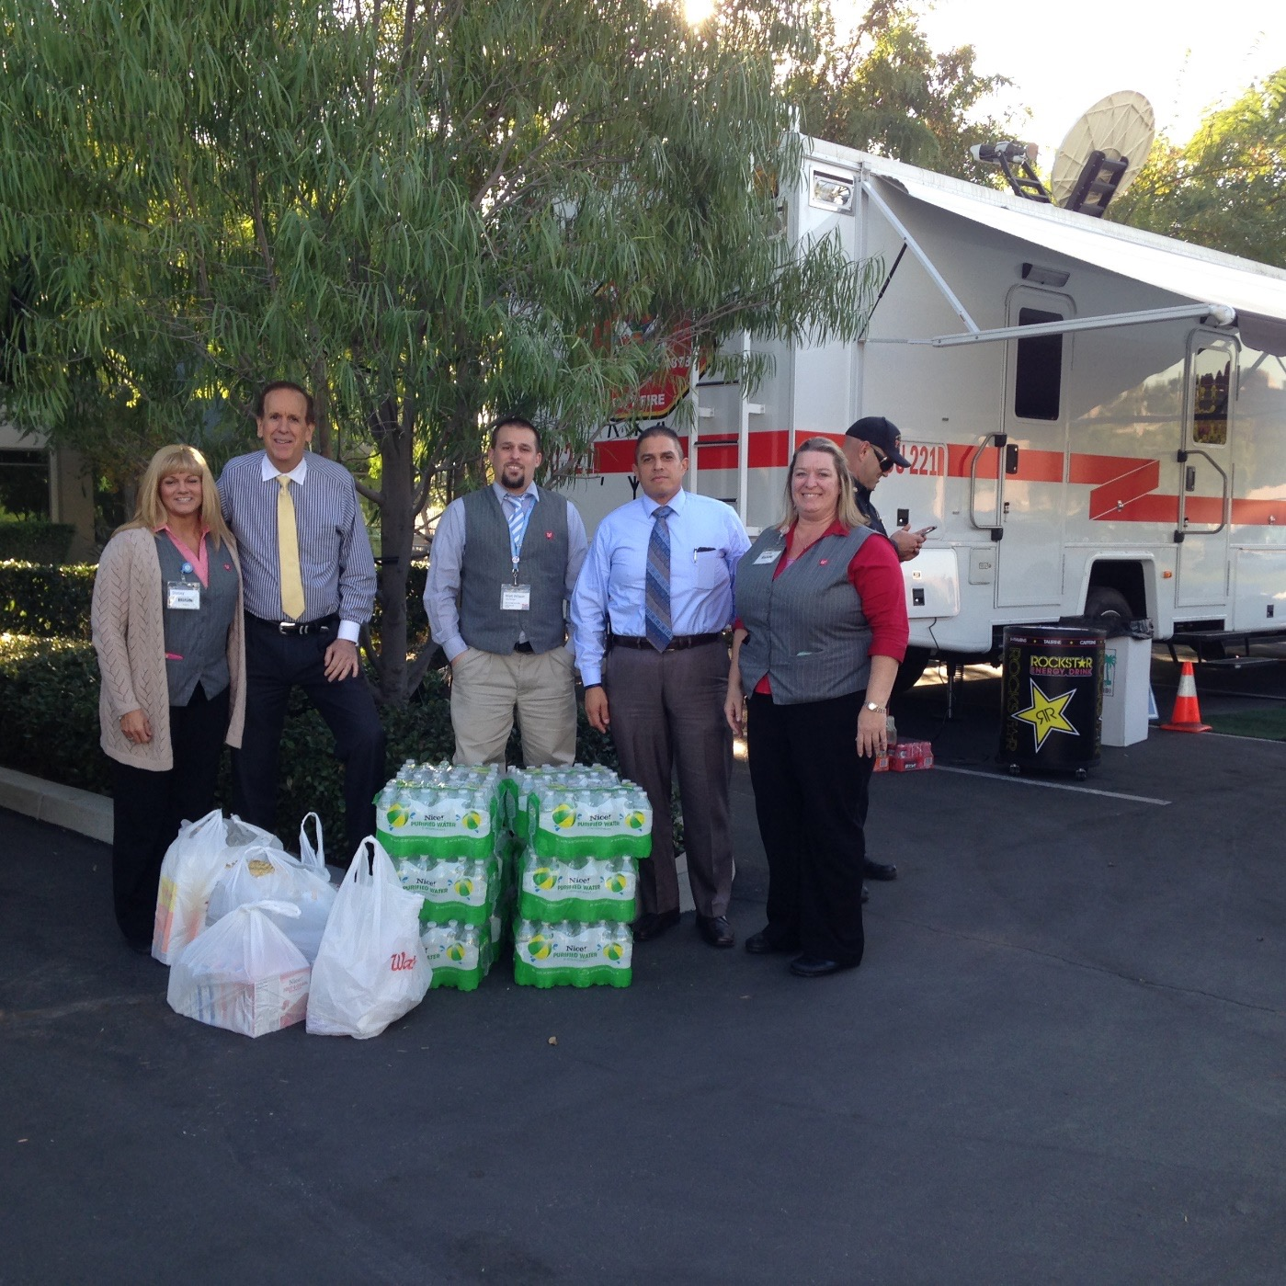
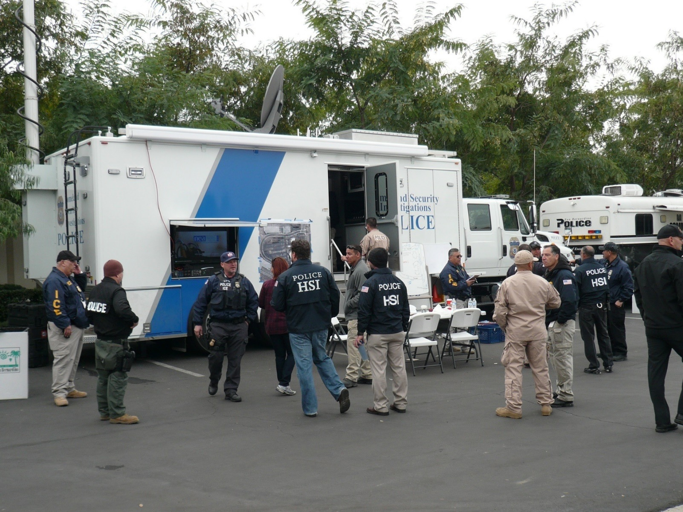
San Bernardino Shooting 12/4/2015

Slide 23
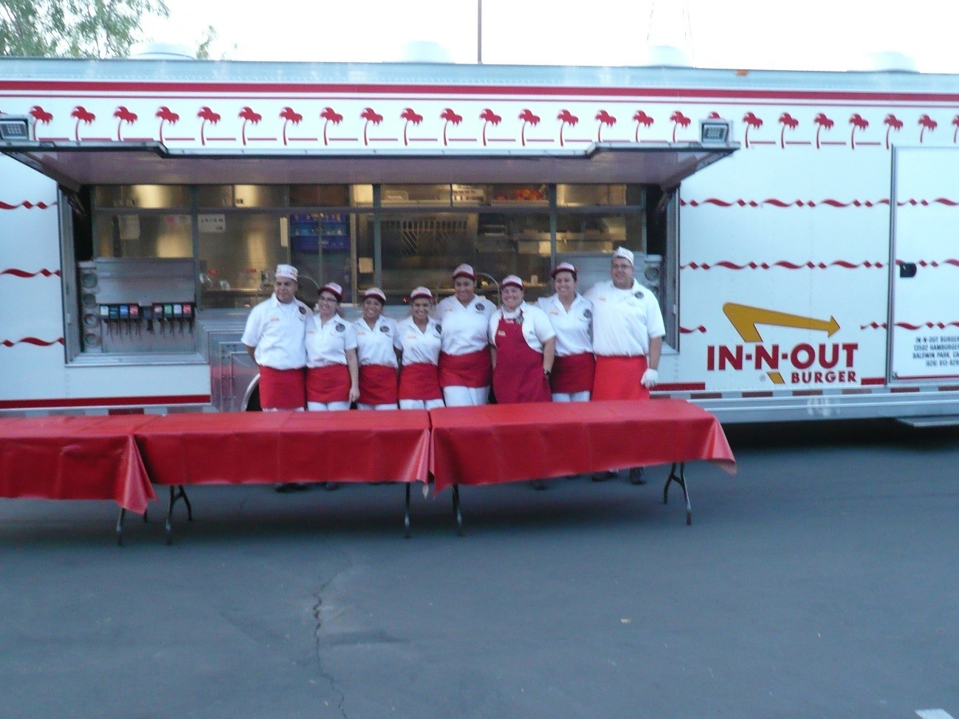
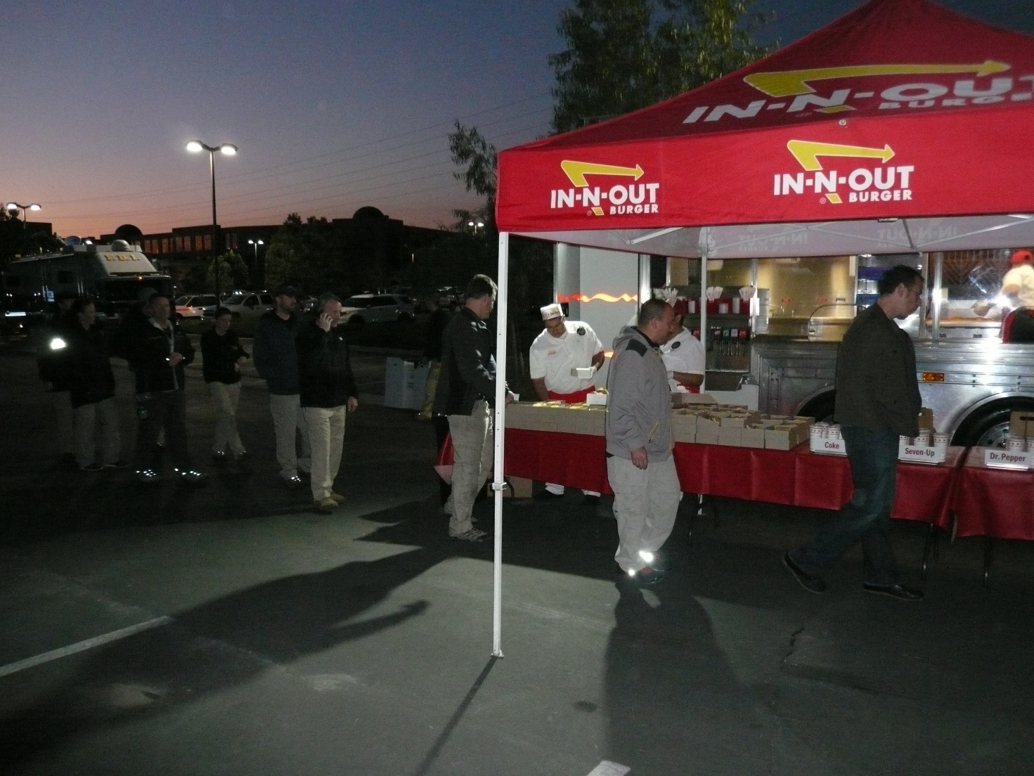
San Bernardino Shooting 12/4/2015
330 “Double Double” hamburgers served!

Slide 24
San Bernardino Timeline
Bringing the local community together to respond, contribute, and start the healing process.
LAEPF arrives on-site at 8AM
Coordinates all food – Coffee and donuts donated by Winchell’s
Lunch provided by Red Lobster
Snacks provided by Walgreens
Dinner provided by Subway.
Lunch and Dinner provided by LAEPF hospitality donors
LAEPF arranges for pick-up of needed items on Dec 6th.
LAEPF food provided for Breakfast and Lunch
Dinner provided by Farmer Boys
LAEPF food provided for Breakfast
Lunch and Dinner – sandwich's
LAEPF Transition out.
December 5th
December 6th
December 7th
December 8th
December 9th
December 10th
December 11th
Dec 12th
December 14th
6:00 AM
7:00 AM
7:00 AM
7:00 AM
4:00 PM
8:00 AM
7:00 AM
7:00 AM
Dec 13th
LAEPF team provides breakfast.
Fresh Coffee donated by local Starbucks.
Terri (LAEPF Representative) meets with Asst. Chief McBride to offer help in filling any requests for support items.
Asst. Chief McBride announces offer at morning briefing. Terri meets individually with each responding agency to develop a list of needed items (extension cords, tables, chairs, etc.)
LAEPF breakfast food provided
SB County Fire picks up donated items from Costco including:
Lunch (Pizza) USB’s, Paper, Bottled Water, Tables, Chairs, Trash liners, Pens, etc.
Dinner provided by LAEPF hospitality donor.
Special Agent O’Connell asks LAEPF to provide meal support to Riverside RA (Terrorism Task Force) office beginning Dec 7th.
LAEPF team purchases 2 large coffee makers, fruit, pastry, pre-packaged snacks, nuts, etc.
Food restocked from Smart & Final
Lunch – fresh made sandwich's
Dinner – “Grill-a-Dog” truck on-site
Transition local coordination to FBI Special Agent Heather Newberry.
LAEPF food provided for Breakfast
Lunch provided by Panda Express
Dinner provided by Yard House
LAEPF delivers snacks, water, health food plus sundry items including hand lotion.
Final delivery from LAEPF

Slide 25
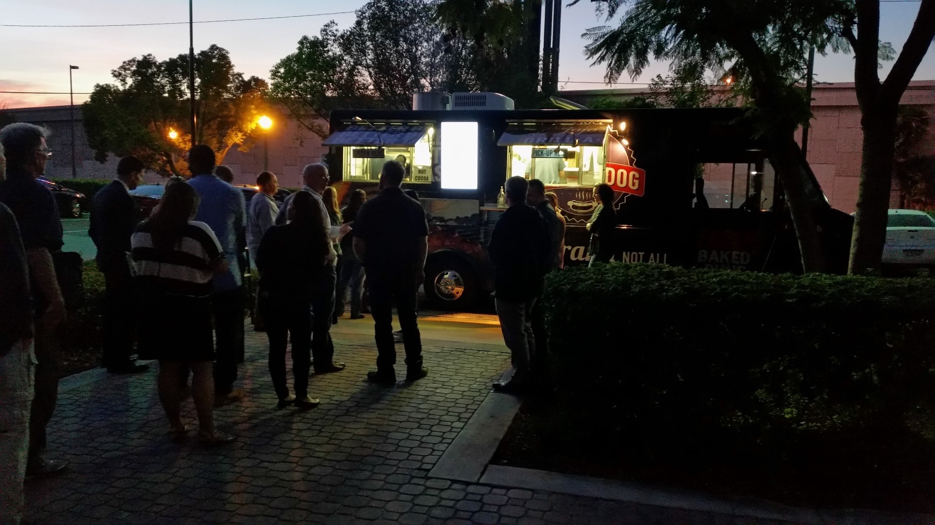
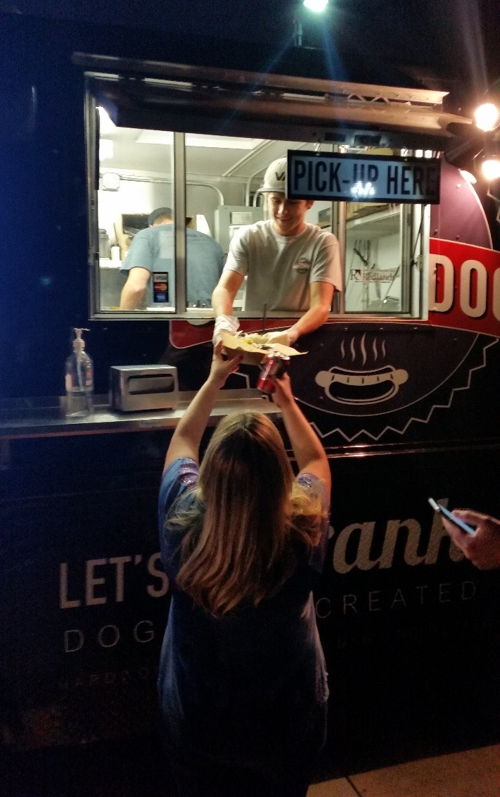
San Bernardino Shooting 12/8/2015
Riverside FBI office

Slide 26
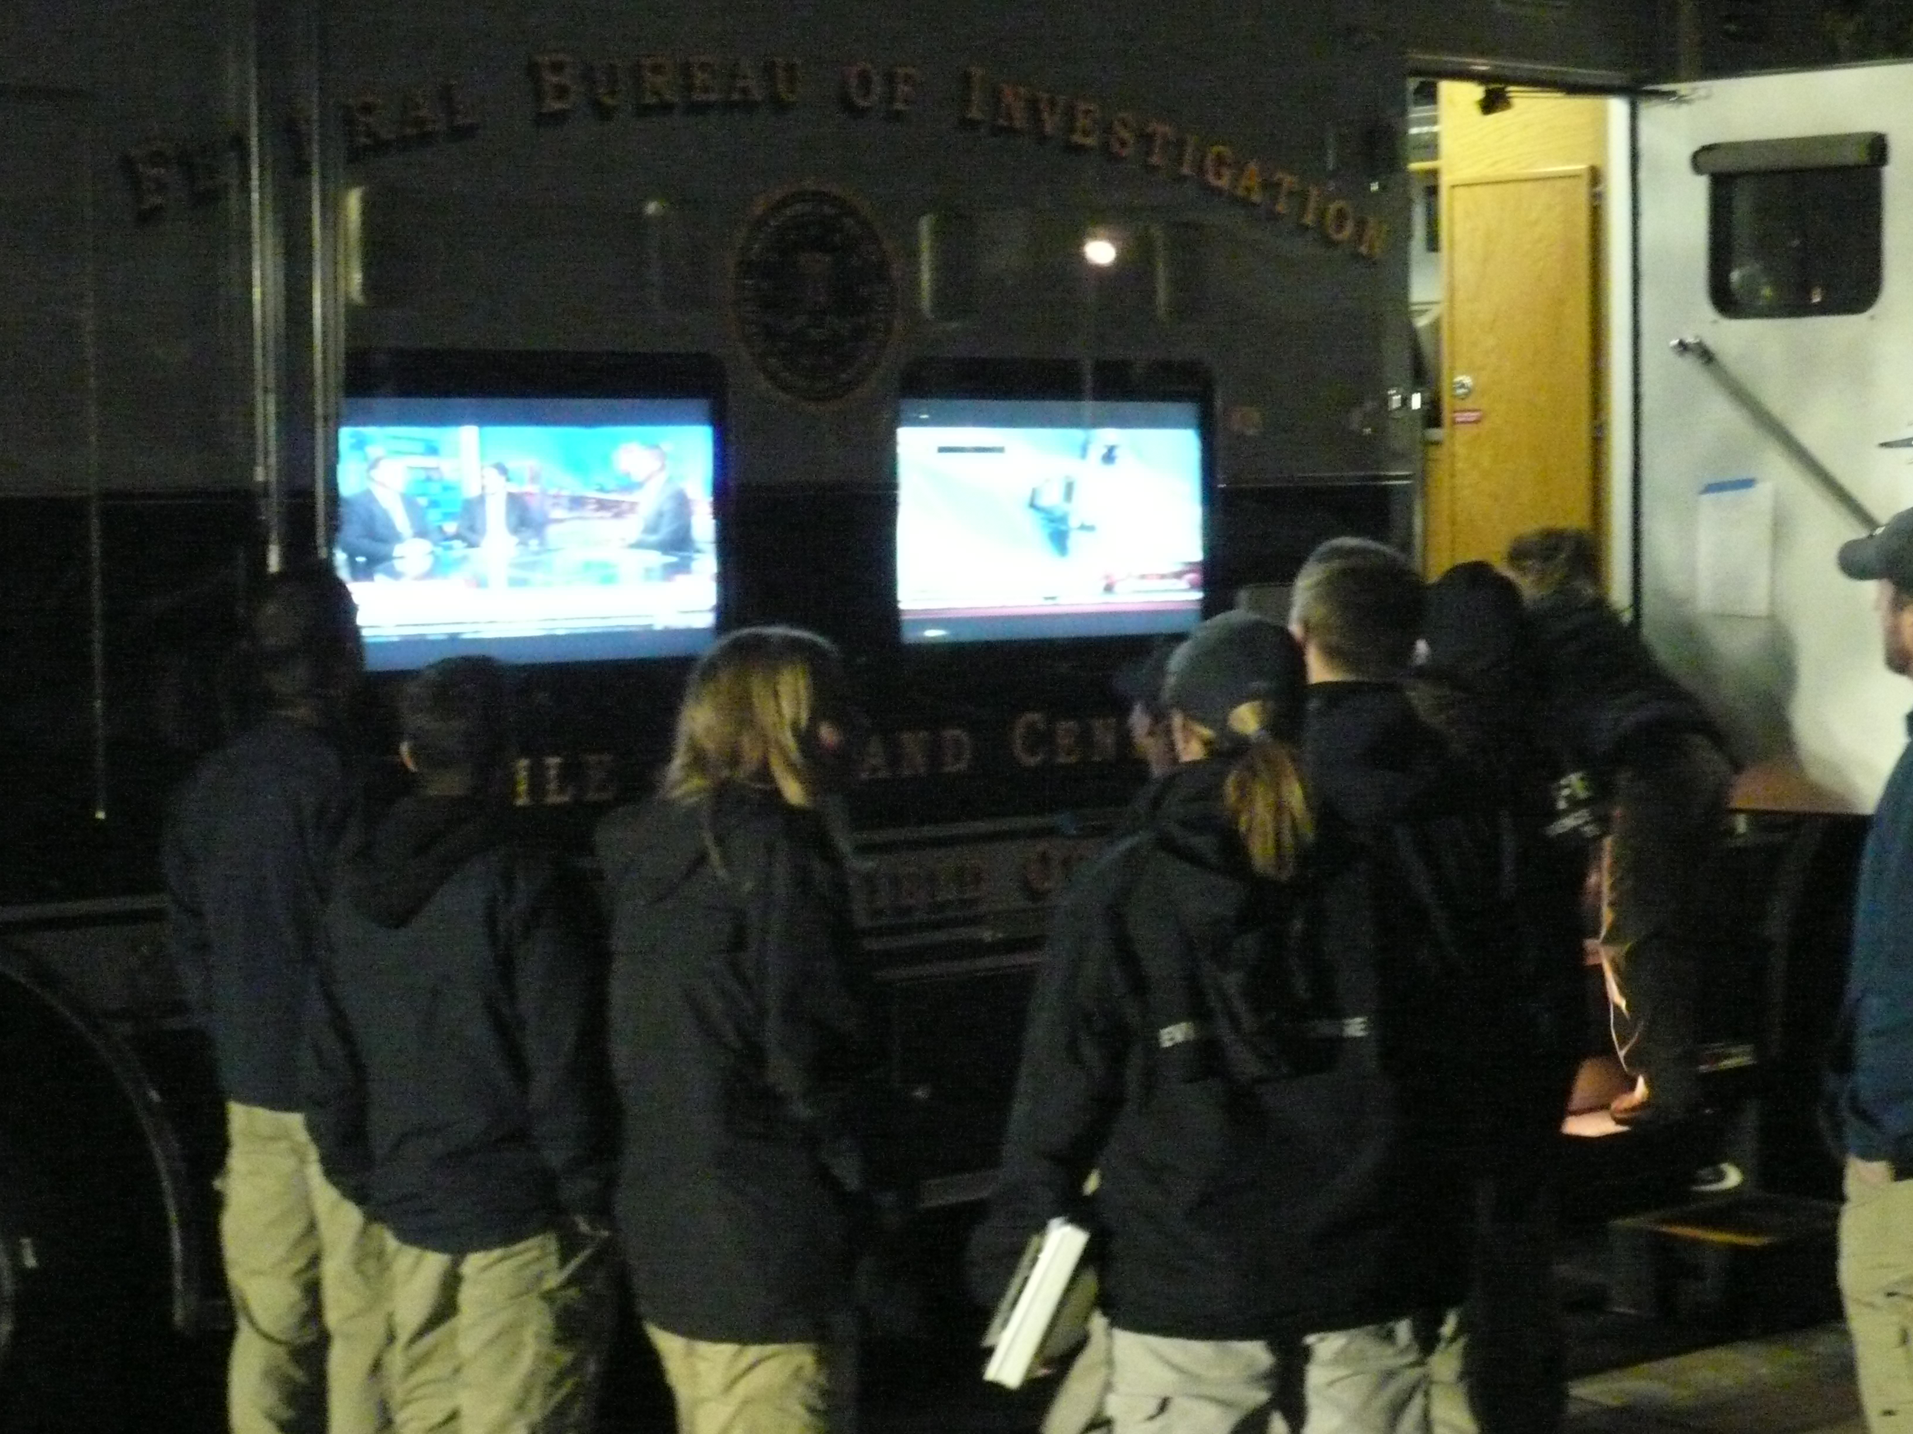
LAEPF San Bernardino Donors
Mill Creek BBQ | In-N-Out Burgers, Inc.
Be Prepared, Inc. | Red Lobster Corporation
I.T. Crisis Services, Inc. | Starbucks Corporation
Rockstar Energy Drink | Costco, Inc.
7-Eleven Corporation | Winchell’s Donut House
Walgreens Corporation | Subway Corporation
Panda Express | Farmer Boy’s Food, Inc.
Global Crisis Services, Inc. | Jojo’s Grill-A-Dog
Plant Fusion | West Coast Natural Sales
Clarks Nutrition | Yard House

Slide 27
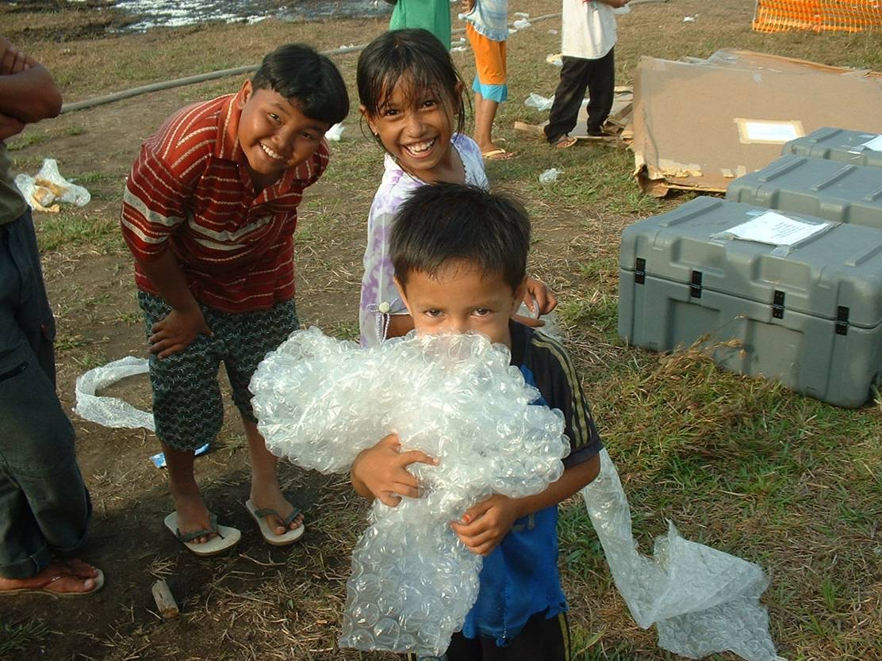
Thank You
Brent Woodworth
President and CEO
Brent.Woodworth@ LAEPF.org
818-585-5995
32

