Slide 1
An Urban Vulnerability Study
Based on Historical Flood Data
Li Yi & Yang PeiGuo
liyi@ndrcc.gov.cn
National Disaster Reduction Center of China
2016.9.14

Slide 2
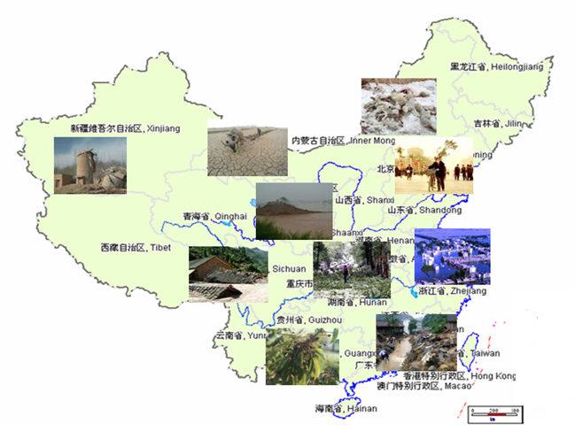
1.Background
China is one of the countries with the most serious natural disasters.
Most types of disasters
High frequency
Regional and seasonal
Serious disaster losses
5 most serious disaster:
floods, droughts, earthquakes, typhoons and landslides

Slide 3
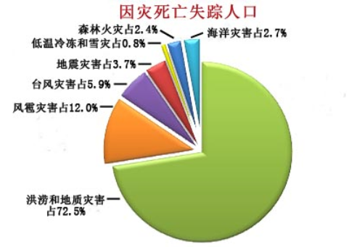
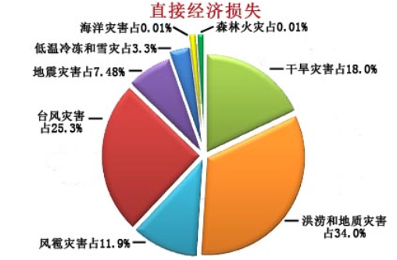
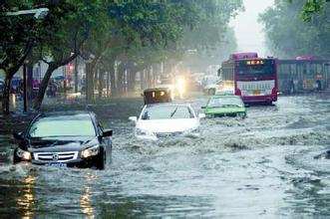
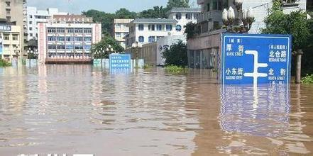
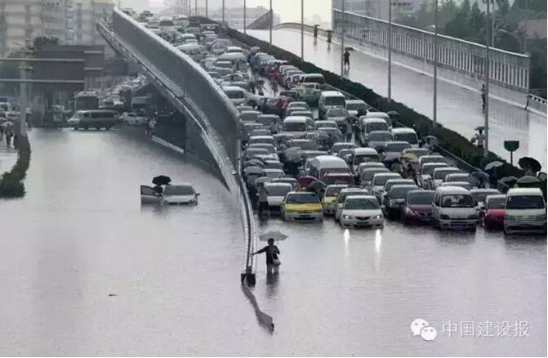
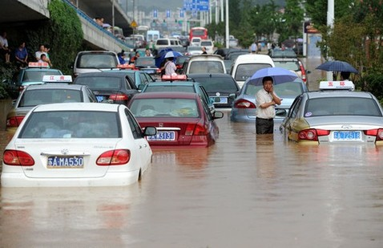
1.Background
Disaster losses of China in 2015
Death & missing
Economic loss

Slide 4

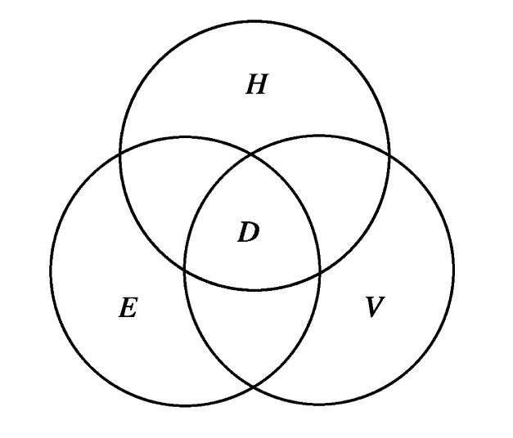
1.Background
Hazard
Hazard and exposure have clear physical meaning
What is “vulnerability” ?
Physical vulnerability, Social vulnerability, Comprehensive vulnerability …
Exposure
Vulnerability
Key words of this work: flood, vulnerability, risk
Done by Dr. Yang PeiGuo

Slide 5
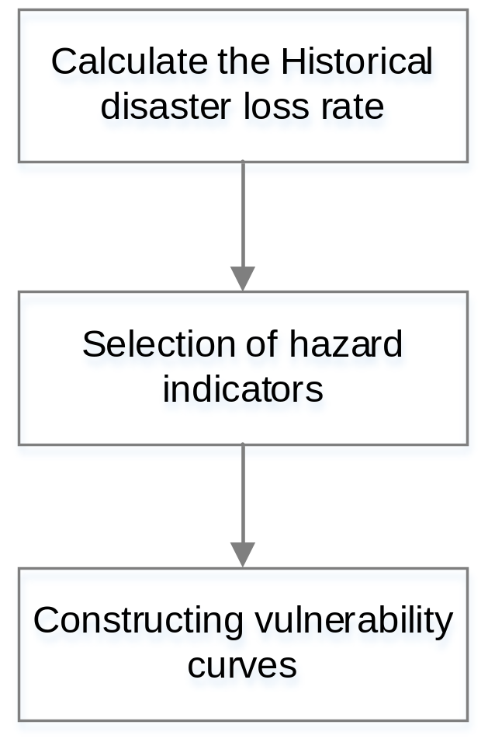
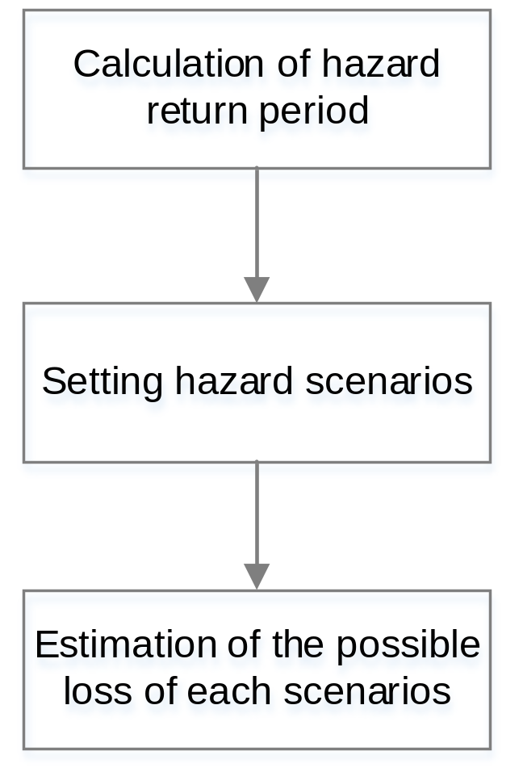
2.Methord
Vulnerability curve construction Risk scenario analysis

Slide 6
2.1Vulnerability curve construction
Calculate the disaster annuel loss rate:
population affected rate
Missing & death rate
crop affected rate
house collapse rate
house damage rate
direct economic loss rate
Loss rate =
the absolute amount of loss / social and economic stock data

Slide 7
2.1Vulnerability curve construction
Calculate hazard indicators:
maximum 1 day rainfall
maximum 2 days rainfall
……
maximum 7 days rainfall
total rainfall from June to August
Correlation analysis:
flood disaster loss rate data rainfall indicators
Choose the best rainfall indicator to describe loss rates
Constructing vulnerability curves (V):
fitting nonlinear curve based on rainfall indicator and loss rates

Slide 8
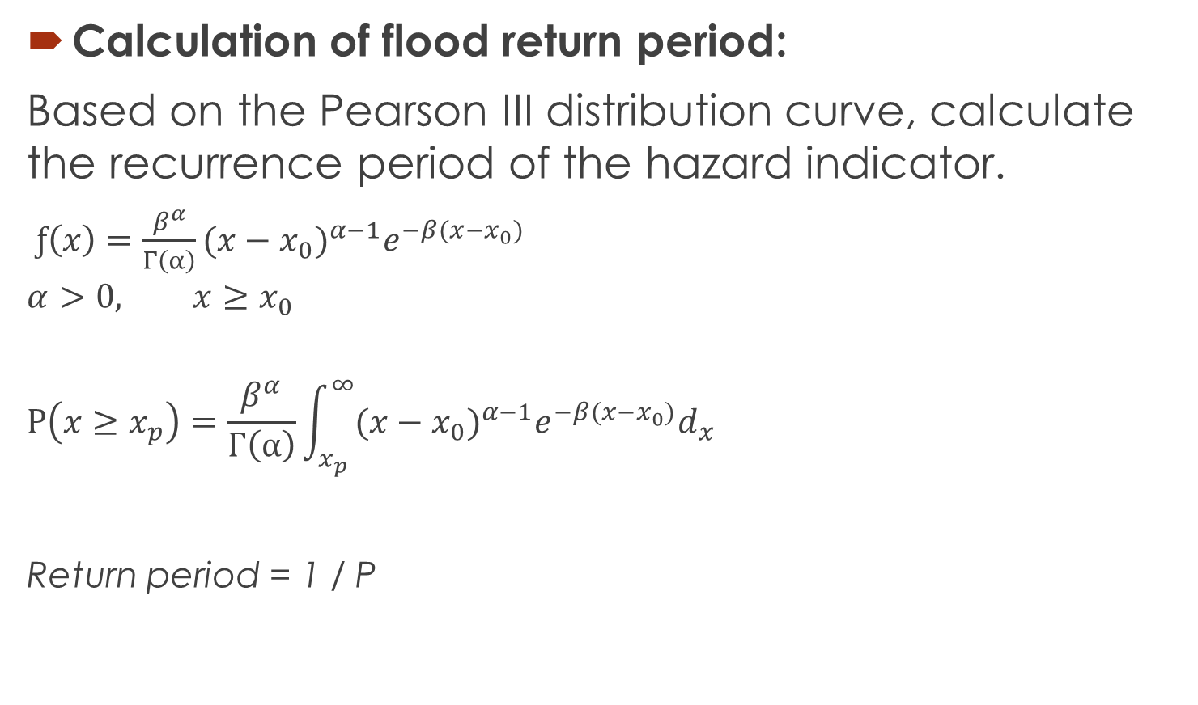
2.2 Risk scenario analysis
Calculation of flood return period:
Based on the Pearson III distribution curve, calculate the recurrence period of the hazard indicator.
$ƒ\left(x\right)=\frac{β^{α}}{Γ\left(α\right)}{(x−x_{0})}^{α−1}e^{−β(x−x_{0})}$
$$α>0, x≥x_{0}$$
$$P\left(x≥x_{p}\right)=\frac{β^{α}}{Γ\left(α\right)}\int_{x_{p}}^{∞}{{(x−x_{0})}^{α−1}e^{−β(x−x_{0})}d_{x}}$$
Return period = 1 / P
For example:
If P(x>200)=0.01
(Possibility of rainfall over 200mm is 1%) then
200mm rainfall will happen once per 100 years.

Slide 9

2.2 Risk scenario analysis
Setting hazard scenarios:
when P=20%,10%,5%,2%,1%,
x is the 5,10,20,50,100 years maximum rainfall indicator
Estimation of the possible loss:

Slide 10
3. Case study: Beijing
Data:
Historical disaster data from 1990-2012, from the "natural disaster report" published by National Disaster Reduction Committee office of China, and “the China Meteorological Disaster Dictionary: Beijing volume “
Daily rainfall, from National Climate Center, China Meteorological Administration
Social and economic data including the total population, cultivated land area, GDP, and so on, from the Chinese social and economic development statistics database

Slide 11
3. Case study: Beijing
Conclusion:
There was a strong correlation between the maximum 2 days rainfall and the loss rates in Beijing.
The degree of fitting and the equation of vulnerability curves:
X | Y | R² | Significance | vulnerability curves
maximum 2 days rainfall | population affected rate | 0.774 | 0.004 | Y=1/(0.01+ 102.6620× 0.9969^{x} )
 | missing & death rate | 0.773 | 0.009 | Y=1/(0.01+949913.1033×0.9974^{x} )
 | crop affected rate | 0.813 | 0.000 | Y=-1.6243-8.1440×10⁻⁴×x + 7.5657×10⁻⁶× x²
 | house collapse rate | 0.961 | 0.000 | Y =1 / ( 0.01 + 61328.4182× 0.9955^{x} )
 | house damage rate | 0.960 | 0.001 | Y =1 / ( 0.01 + 3939.6546×0.9955^{x} )
 | direct economic loss rate | 0.709 | 0.001 | Y =1 / ( 0.01 + 13121.8740× 0.9952^{x} )

Slide 12
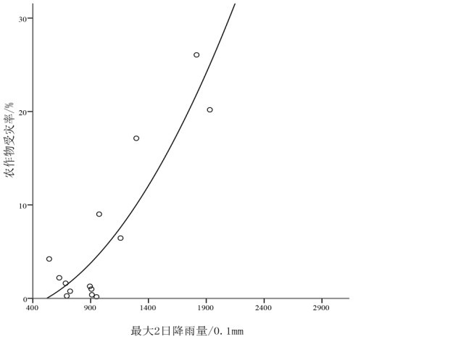
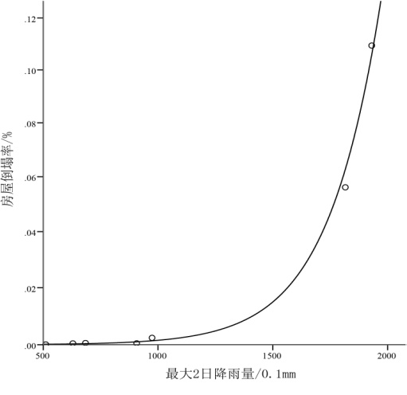
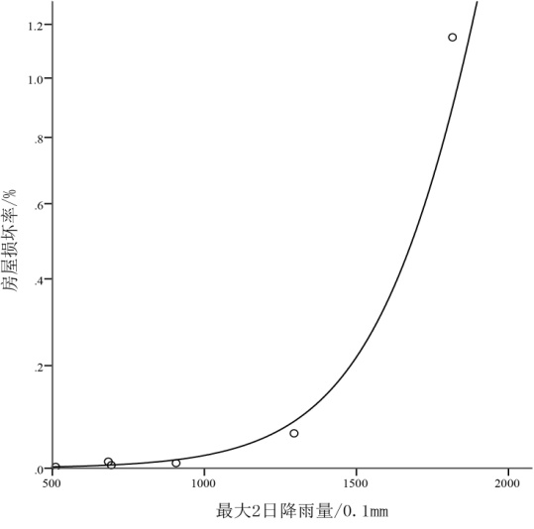
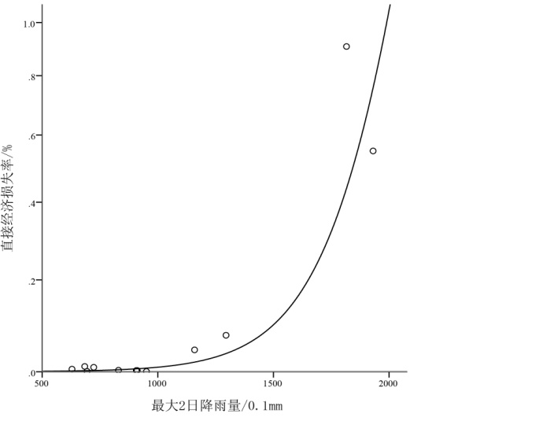
3. Case study: Beijing
Conclusion:
There was a strong correlation between the maximum 2 days rainfall and the loss rates in Beijing.
The degree of fitting and the equation of vulnerability curves:
X | Y | R² | Significance | vulnerability curves
maximum 2 days rainfall | population affected rate | 0.774 | 0.004 | Y=1/(0.01+ 102.6620× 0.9969^{x} )
 | missing / death rate | 0.773 | 0.009 | Y=1/(0.01+949913.1033×0.9974^{x} )
 | crop affected rate | 0.813 | 0.000 | Y=-1.6243-8.1440×10⁻⁴×x + 7.5657×10⁻⁶× x²
 | house collapse rate | 0.961 | 0.000 | Y =1 / ( 0.01 + 61328.4182× 0.9955^{x} )
 | house damage rate | 0.960 | 0.001 | Y =1 / ( 0.01 + 3939.6546×0.9955^{x} )
 | direct economic loss rate | 0.709 | 0.001 | Y =1 / ( 0.01 + 13121.8740× 0.9952^{x} )

Slide 13
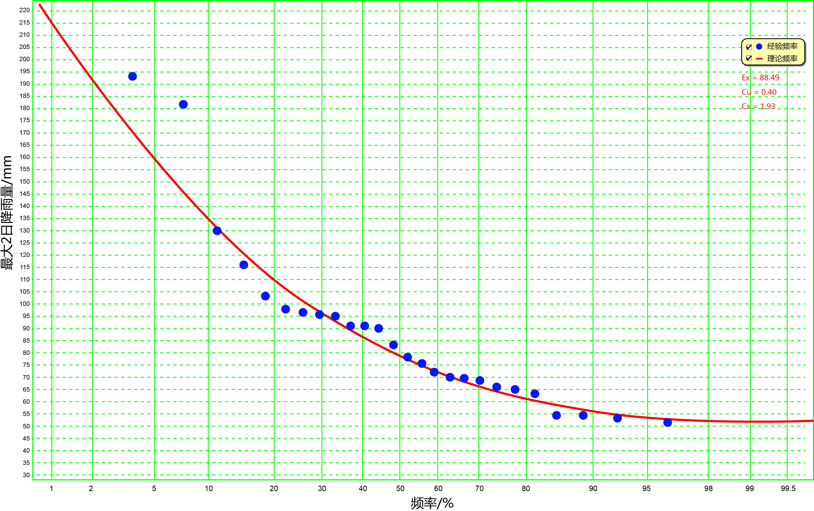
3. Case study: Beijing
According to the results of P-III curve fitting, Beijing’s maximum 2 days rainfall once every 5,10,20,50,100 years is 110.5, 134.8, 159.0, 190.8, 214.8 mm.
The P-Ⅲ curves for maximum 2-day rainfall

Slide 14
3. Case study: Beijing
Based on the exposure characteristics of Beijing in 2012, the flood disaster risk scenarios in Beijing were calculated:
maximum 2 day rainfall （mm） | Affected population（thousand person） | Missing and death（person） | affected crop（thousand ha.） | house collapse（thousand rooms） | house damage（thousand rooms） | direct economic loss（billion RMB）*
110.5 (5y) | 62 | 4 | 2 | 0.3 | 0.5 | 0.3
134.8 (10y) | 132 | 7 | 27 | 1 | 1.6 | 0.9
159.0 (20y) | 277 | 14 | 38 | 3 | 4.7 | 2.9
190.8 (50y) | 727 | 31 | 57 | 12 | 19.5 | 13.1
214.8 (100y) | 1474 | 58 | 73 | 37 | 56.0 | 41.0

Slide 15
4. Discussion
Disadvantage: limited data -> accuracy, uncertainty. Based on the more detailed loss data, the method can be used to calculate more accurate vulnerability curves, for example, the annual vulnerability curve, or the vulnerability curve of special buildings, projects, crops etc.
The method can be used to calculate the macro vulnerability of a number of cities or regions, and to analysis the spatial distribution of vulnerability and risk.

Slide 16
4. Discussion
The method can be used to analysis the effect of exposure change to the disaster risk.

Slide 17
Thank you !

