Slide 1
An Urban Vulnerability Study
Based on Historical Flood Data
Li Yi & Yang PeiGuo
liyi@ndrcc.gov.cn
National Disaster Reduction Center of China (NDRCC)
2016.9.14

Slide 2
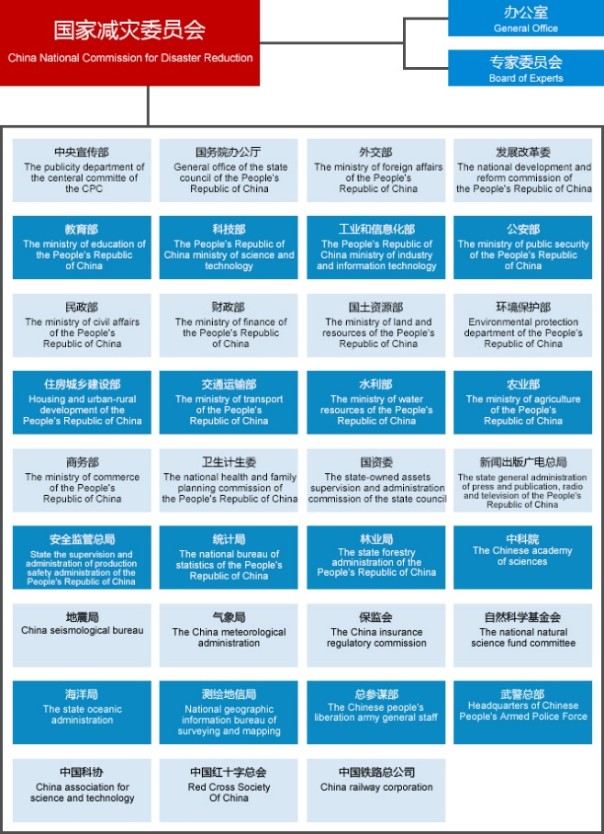
0. Introduction of NDRCC - NCDR
National Commission for Disaster Reduction (NCDR) is a deliberation and coordination agency of China.
It has 35 ministries, including Ministry of Civil Affairs (MCA).
NDRCC is a technical support institution of MCA.

Slide 3





0. Introduction of NDRCC - NCDR
Telephone
Informatiom Management
Analysis of disaster trend
Verification of disaster losses
Consultative meeting
of Civil affairs system
Consultative Meeting of NCDR
Prediction of disaster trend
Discussion on disaster relief
meetings

Slide 4

0. Introduction of NDRCC – Function and Objective
Function:
Responsibility of disaster reduction such as information management, disaster risk assessment and product service, space technology application, research on scientific technology and policies, research and development of technical equipment and disaster relief materials, publicity and education, training, and international cooperation.
Objective(3C+2W):
  Information exchange Center
  Technology service Center
  Decision-making support Center
  Exchange and Cooperation Windows
  Propagate and education Windows

Slide 5
0. Introduction of NDRCC – Construction
Director General
Deputy Director General
Chief Engineer
Administrative Department
Satellite Operating Management Center
Data Center
Assessment and Emergency Response
Satellite Remote Sensing
Airborne Remote Sensing
Science and Standard Department
Technology and Equipment
Policy Study and Research
Key Lab of Disaster Reduction and Emergency Response Engineering
Key Lab of Integrated Disaster Evaluation and Risk Prevention
International Cooperation
Finance Department
Publicity and Education Center
Logistics Department
Secretariat of Expert Committee of NCDR
China Disaster Reduction Magazine Company
Academy of Disaster Reduction and Emergency Management
International Center for Drought Risk Reduction
Secretariat of National Committee on Technical Standardization
of Disaster Reduction and Relief
Application and Research Center of
National Space Technology for Disaster Reduction
Charter
Disaster Risk Science
UN-SPIDER Beijing Office

Slide 6
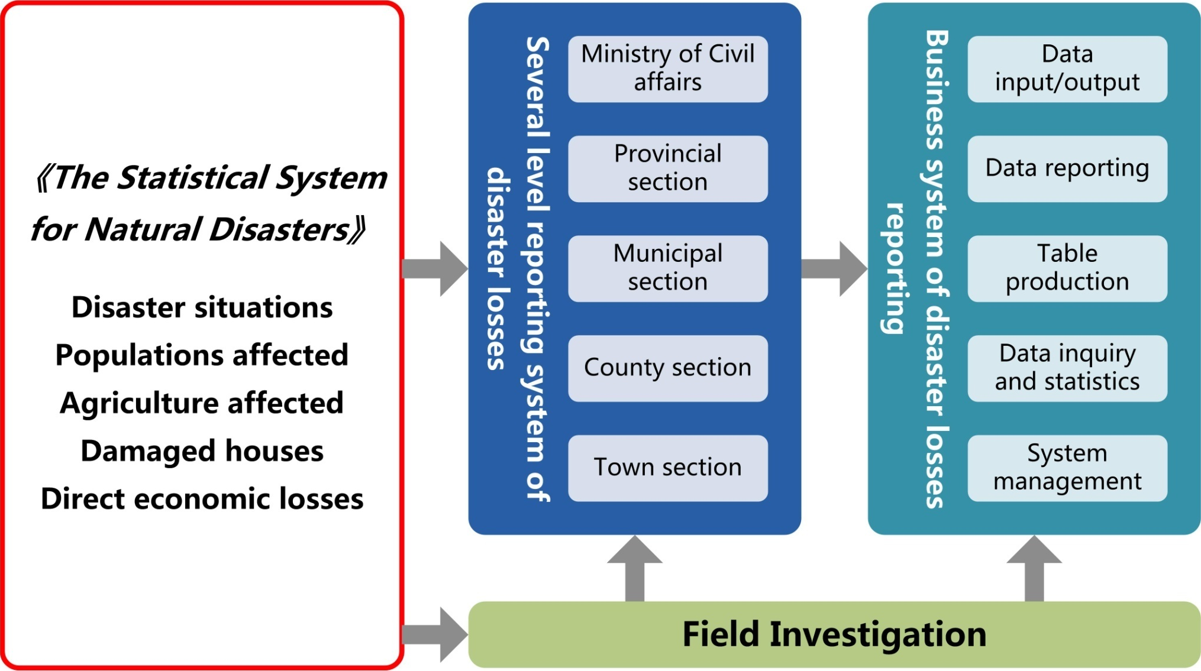
0. Introduction of NDRCC – Loss Data management

Slide 7
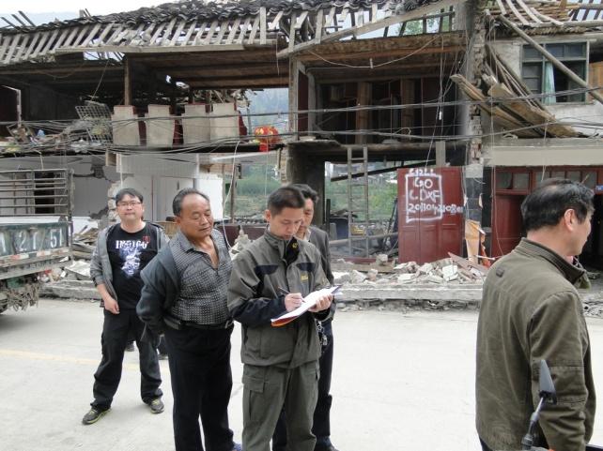
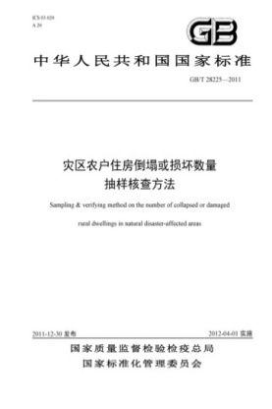
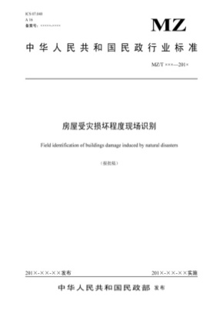

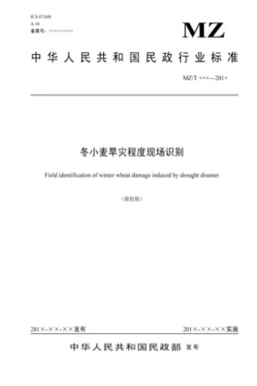
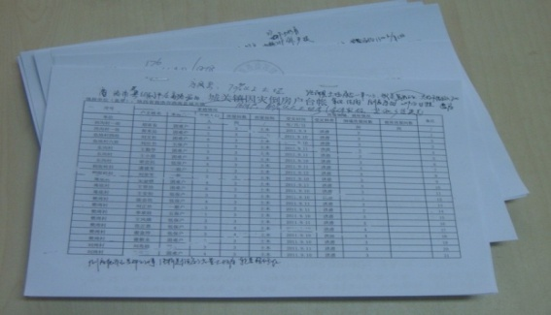

0. Introduction of NDRCC – Loss Data management

Slide 8
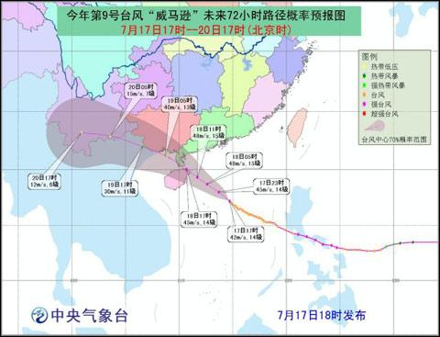
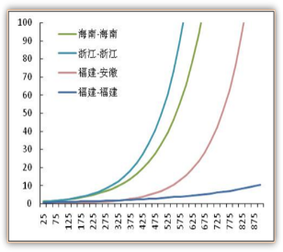
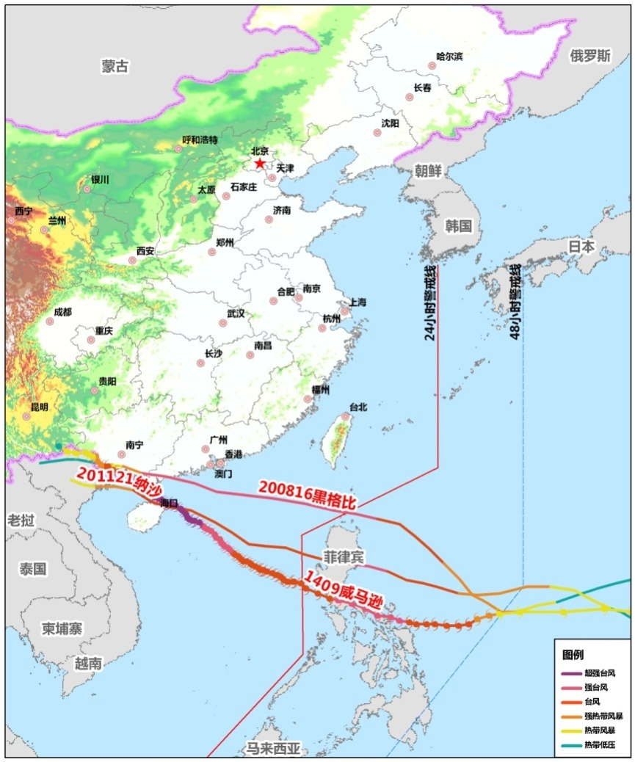
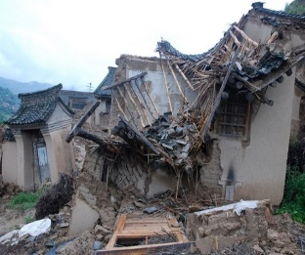
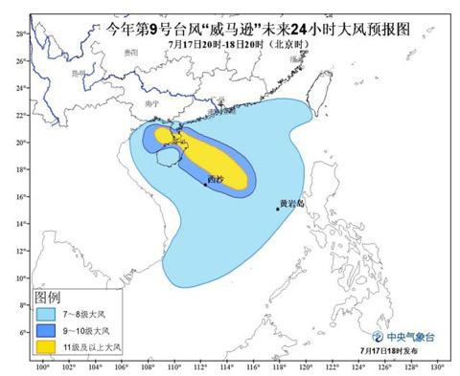
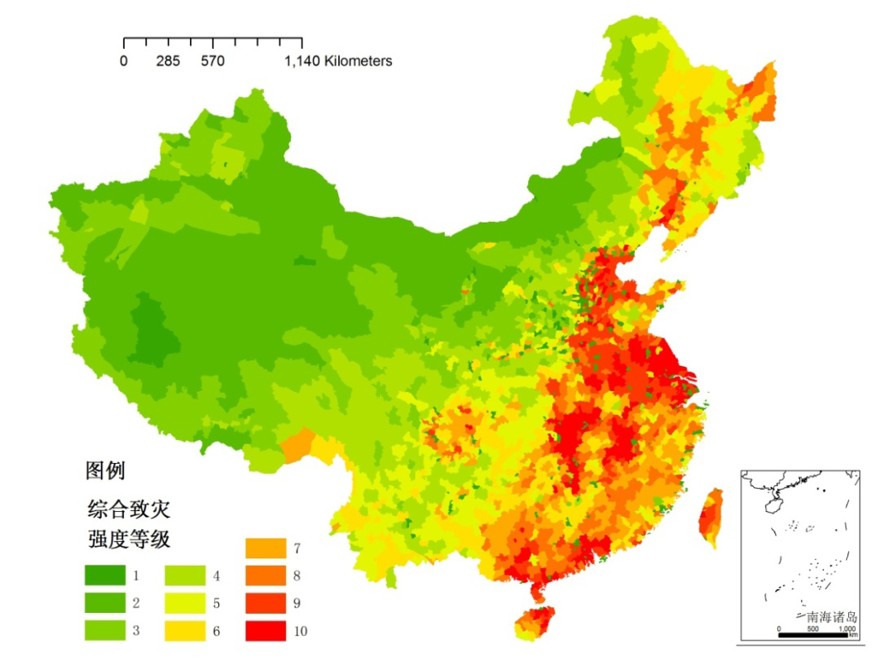
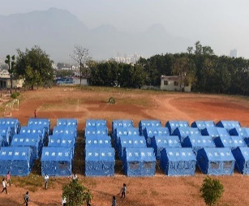
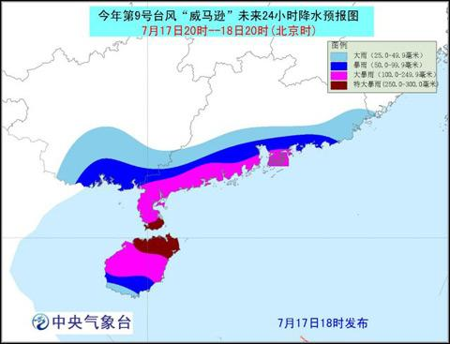
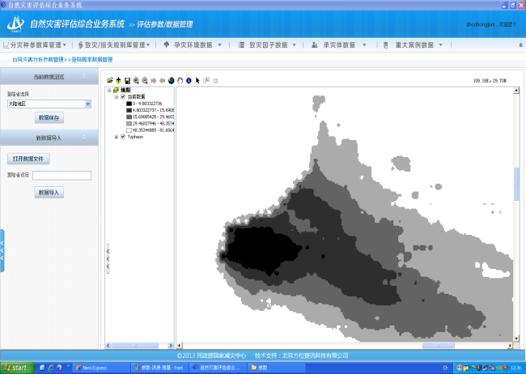
0. Introduction of NDRCC – Disaster assessment
Before the disaster: pre-assessment for disaster scope and losses
During the disaster: rapid loss assessment for disaster losses
After the disaster: comprehensive loss assessment
Inputs
Models
Outputs
    Risk areas
    Risk & losses
    Collapsed houses and evacuated population
    Forecasting/real data …
Similar route
Vulnerability curves……
Notes:
及

Slide 9
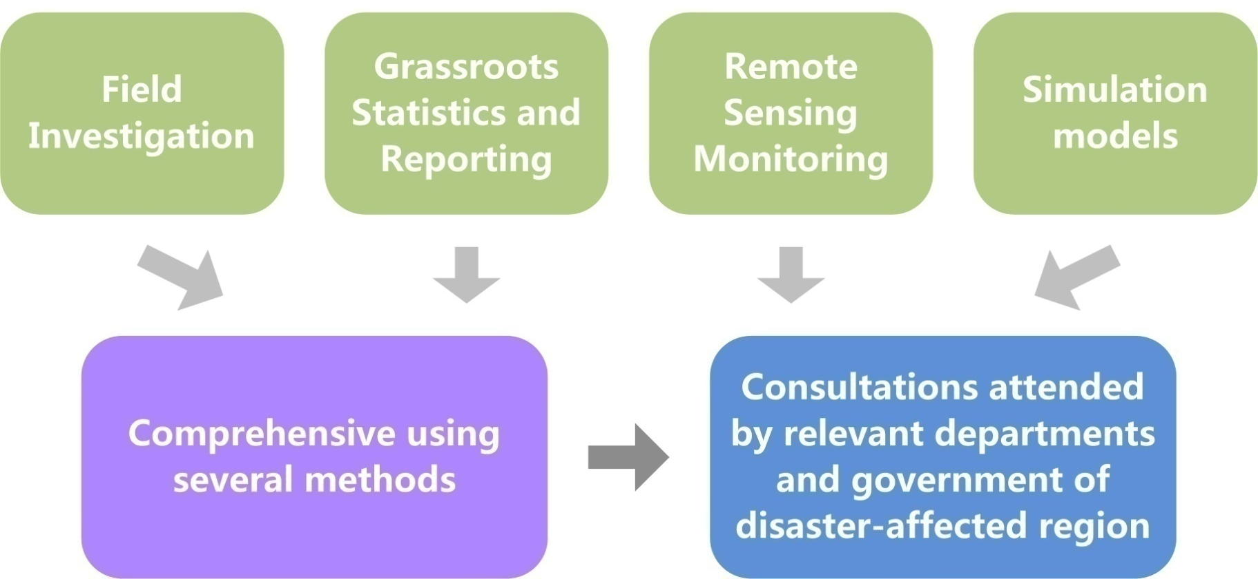
0. Introduction of NDRCC – Disaster assessment
In recent years, the comprehensive assessment is an important basis for the Ministry of Finance to allocate relief funds.

Slide 10
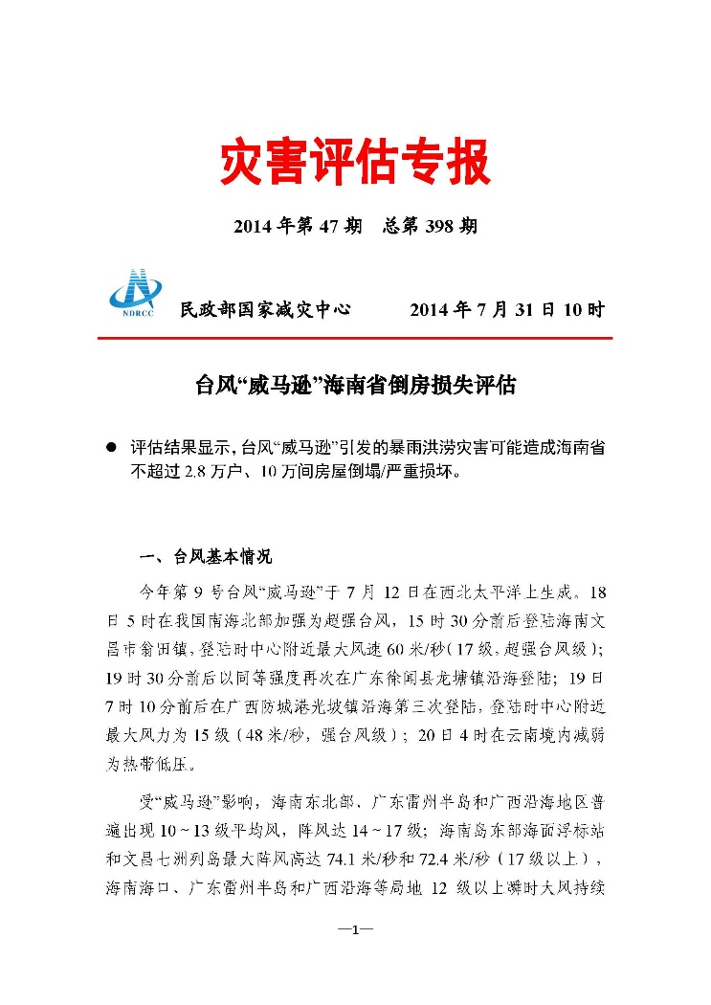
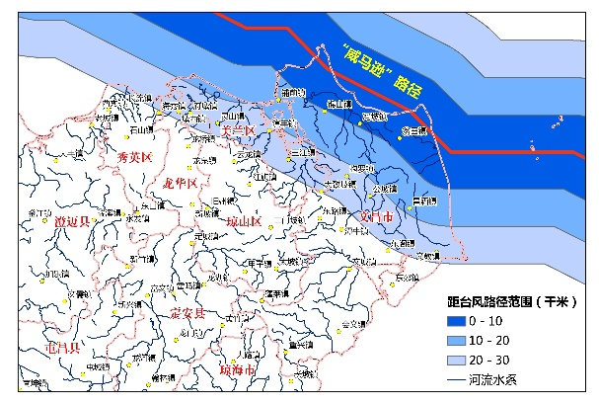
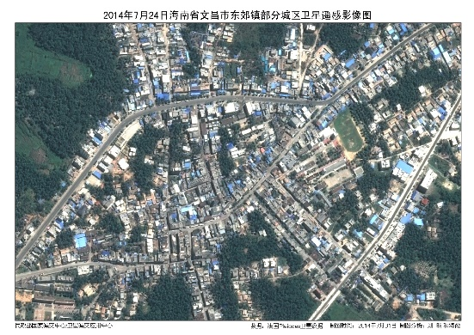
0. Introduction of NDRCC - Loss assessment
The reports of assessments will be provided to the decision-makers for the preparedness and emergency of the relief work.
区域 | 受灾人口 | 紧急转移安置人口 | 需紧急生活救助人口 | 倒塌房屋间数 | 严重损坏房屋间数 | 一般损坏房屋间数 | 直接经济损失
海南省合计 | 321.7 | 18.9 | 6.9 | 2.4 | 10.1 | 14.5 | 122.4
文昌市 | 42.4 | 6.7 | 1.5 | 1.7 | 6.5 | 10.8 | 59.7
海口市美兰区 | 44.6 | 2.8 | 0.9 | 0.3 | 2.6 | 0.0 | 16.8
Notes:
及

Slide 11
0. Introduction of NDRCC - Disaster relief work
Before the disaster
Initiating early warning response for disaster relief
After the disaster
Transitional resettling the affected people living hard
Launching the rehabilitation and reconstruction operations
No disasters
(peace time)
Developing disaster prevention publicity and education activities in communities
Building the relief materials reserves at different levels
During the disaster
Initiating emergency responses for disaster relief
Evacuating people in high-risk zones
Dispatching the working group to the severe disaster areas
Disbursing the disaster relief funds and materials
Notes:
及

Slide 12





0. Introduction of NDRCC - Propagate and education
National Disaster Reduction website: make overall introduction to China’s disaster reduction policies and related regulations, dissimulate disaster information, and promulgate disaster reduction knowledge.
China’s Disaster Reduction Magazine: comprehensively displays all kinds’ disaster information of China and the development of disaster prevention, reduction and relief.
Conduct trainings for disaster management personnel to improve their capacities.

Slide 13
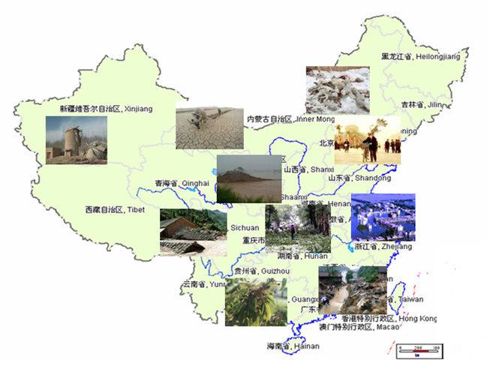
1.Background
China is one of the countries with the most serious natural disasters.
Most types of disasters
High frequency
Regional and seasonal
Serious disaster losses
5 most serious disaster:
floods, droughts, earthquakes, typhoons and landslides

Slide 14
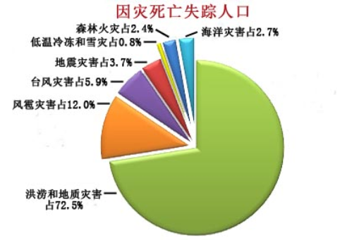
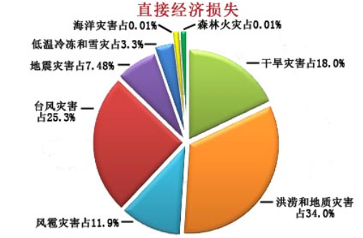
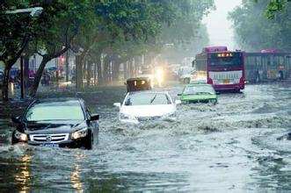
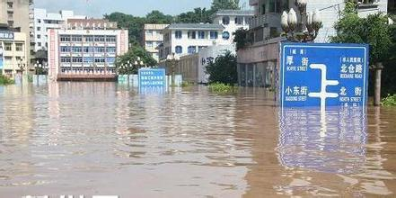
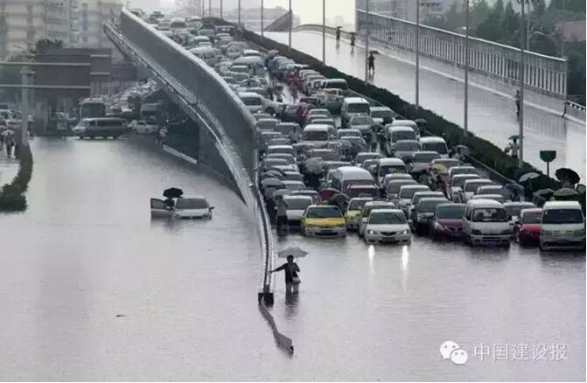
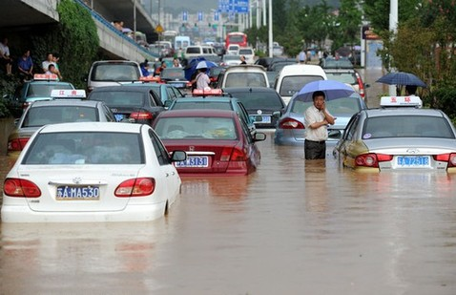
1.Background
Disaster losses of China in 2015
Death & missing
Economic loss

Slide 15

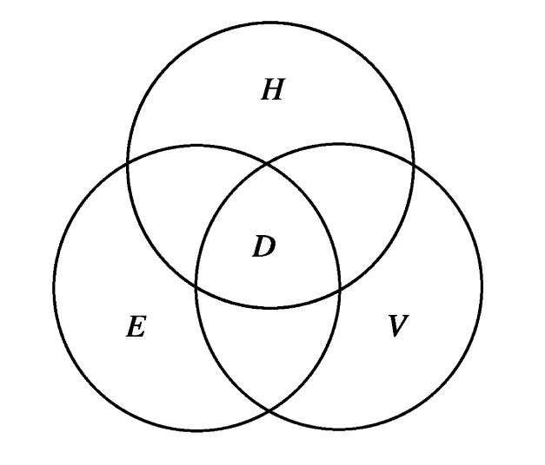
1.Background
Hazard
Hazard and exposure have clear physical meaning
What is “vulnerability” ?
Physical vulnerability, Social vulnerability, Comprehensive vulnerability …
Exposure
Vulnerability
Key words of this work: flood, vulnerability, risk
Done by Dr. Yang PeiGuo

Slide 16
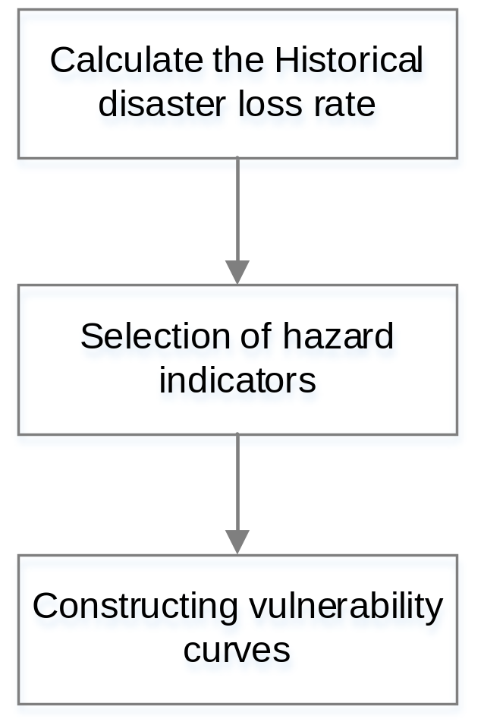
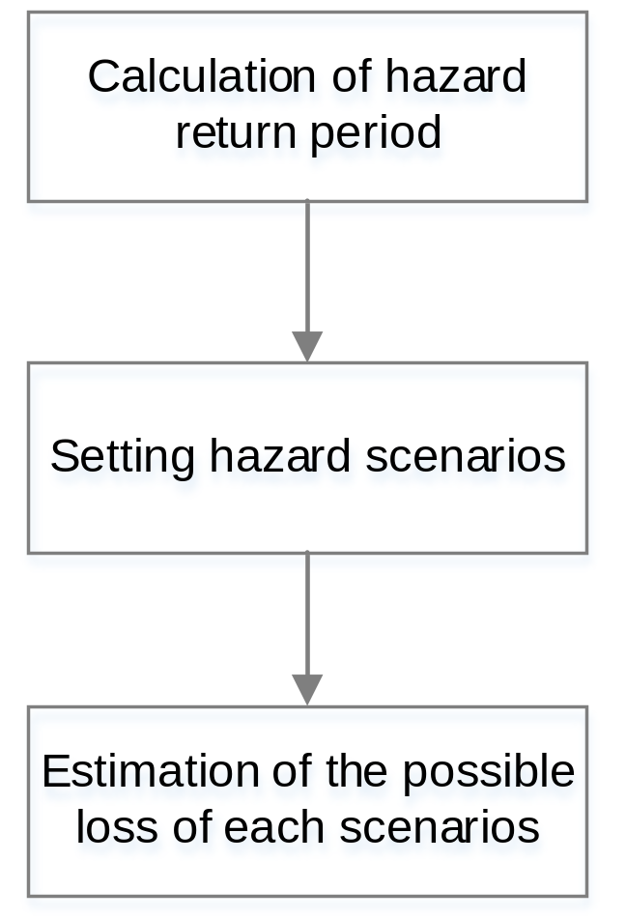
2.Methord
Vulnerability curve construction Risk scenario analysis

Slide 17
2.1Vulnerability curve construction
Calculate the disaster annual loss rate:
population affected rate
Missing & death rate
crop affected rate
house collapse rate
house damage rate
direct economic loss rate
Loss rate =
the absolute amount of loss / social and economic stock data

Slide 18
2.1Vulnerability curve construction
Calculate hazard indicators:
maximum 1 day rainfall
maximum 2 days rainfall
……
maximum 7 days rainfall
total rainfall from June to August
Correlation analysis:
flood disaster loss rate data rainfall indicators
Choose the best rainfall indicator to describe loss rates
Constructing vulnerability curves (V):
fitting nonlinear curve based on rainfall indicator and loss rates

Slide 19
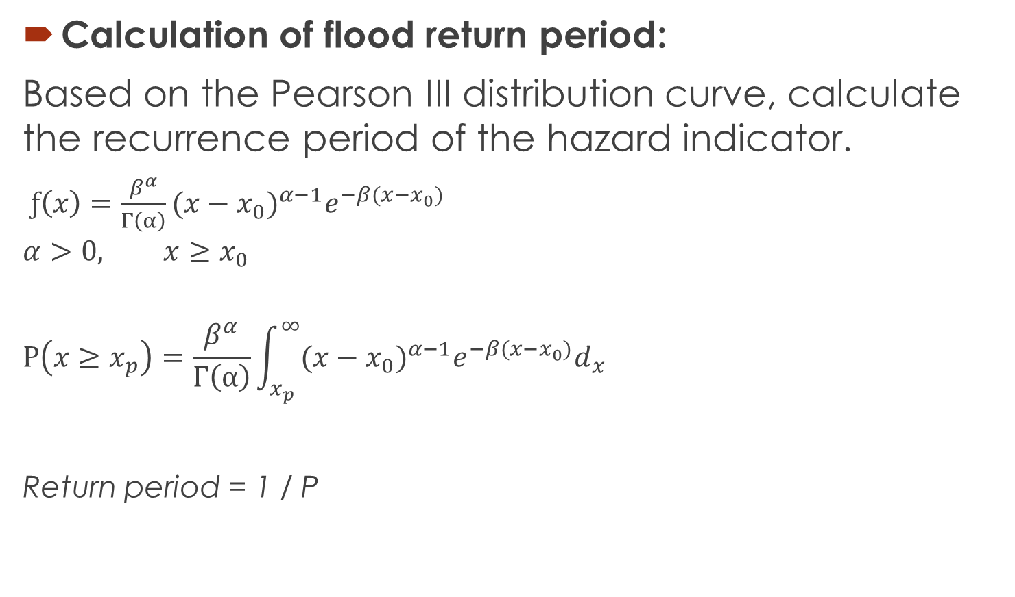
2.2 Risk scenario analysis
Calculation of flood return period:
Based on the Pearson III distribution curve, calculate the recurrence period of the hazard indicator.
$ƒ\left(x\right)=\frac{β^{α}}{Γ\left(α\right)}{(x−x_{0})}^{α−1}e^{−β(x−x_{0})}$
$$α>0, x≥x_{0}$$
$$P\left(x≥x_{p}\right)=\frac{β^{α}}{Γ\left(α\right)}\int_{x_{p}}^{∞}{{(x−x_{0})}^{α−1}e^{−β(x−x_{0})}d_{x}}$$
Return period = 1 / P
For example:
If P(x>200)=0.01
(Possibility of rainfall over 200mm is 1%) then
200mm rainfall will happen once per 100 years.

Slide 20

2.2 Risk scenario analysis
Setting hazard scenarios:
when P=20%,10%,5%,2%,1%,
x is the 5,10,20,50,100 years maximum rainfall indicator
Estimation of the possible loss:

Slide 21
3. Case study: Beijing
Data:
Historical disaster data from 1990-2012, from the "natural disaster report" published by National Disaster Reduction Committee office of China, and “the China Meteorological Disaster Dictionary: Beijing volume “
Daily rainfall, from National Climate Center, China Meteorological Administration
Social and economic data including the total population, cultivated land area, GDP, and so on, from the Chinese social and economic development statistics database

Slide 22
3. Case study: Beijing
Conclusion:
There was a strong correlation between the maximum 2 days rainfall and the loss rates in Beijing.
The degree of fitting and the equation of vulnerability curves:
X | Y | R² | Significance | vulnerability curves
maximum 2 days rainfall | population affected rate | 0.774 | 0.004 | Y=1/(0.01+ 102.6620× 0.9969^{x} )
 | missing & death rate | 0.773 | 0.009 | Y=1/(0.01+949913.1033×0.9974^{x} )
 | crop affected rate | 0.813 | 0.000 | Y=-1.6243-8.1440×10⁻⁴×x + 7.5657×10⁻⁶× x²
 | house collapse rate | 0.961 | 0.000 | Y =1 / ( 0.01 + 61328.4182× 0.9955^{x} )
 | house damage rate | 0.960 | 0.001 | Y =1 / ( 0.01 + 3939.6546×0.9955^{x} )
 | direct economic loss rate | 0.709 | 0.001 | Y =1 / ( 0.01 + 13121.8740× 0.9952^{x} )

Slide 23
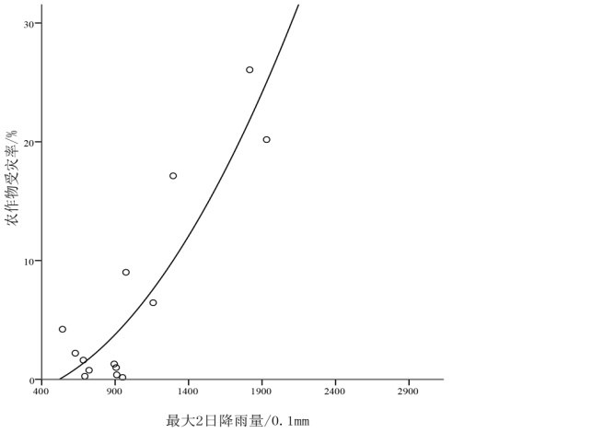
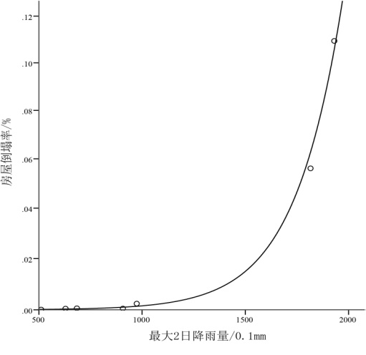
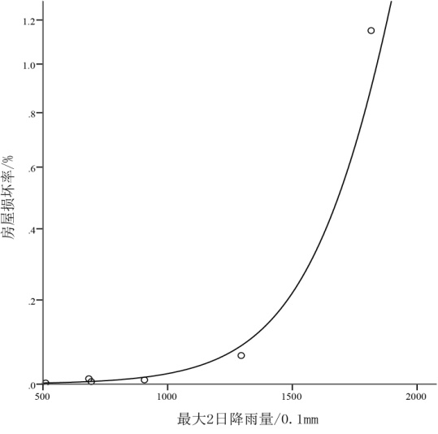
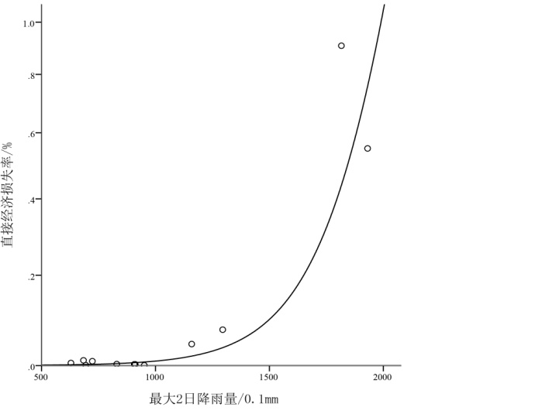
3. Case study: Beijing
Conclusion:
There was a strong correlation between the maximum 2 days rainfall and the loss rates in Beijing.
The degree of fitting and the equation of vulnerability curves:
X | Y | R² | Significance | vulnerability curves
maximum 2 days rainfall | population affected rate | 0.774 | 0.004 | Y=1/(0.01+ 102.6620× 0.9969^{x} )
 | missing / death rate | 0.773 | 0.009 | Y=1/(0.01+949913.1033×0.9974^{x} )
 | crop affected rate | 0.813 | 0.000 | Y=-1.6243-8.1440×10⁻⁴×x + 7.5657×10⁻⁶× x²
 | house collapse rate | 0.961 | 0.000 | Y =1 / ( 0.01 + 61328.4182× 0.9955^{x} )
 | house damage rate | 0.960 | 0.001 | Y =1 / ( 0.01 + 3939.6546×0.9955^{x} )
 | direct economic loss rate | 0.709 | 0.001 | Y =1 / ( 0.01 + 13121.8740× 0.9952^{x} )

Slide 24
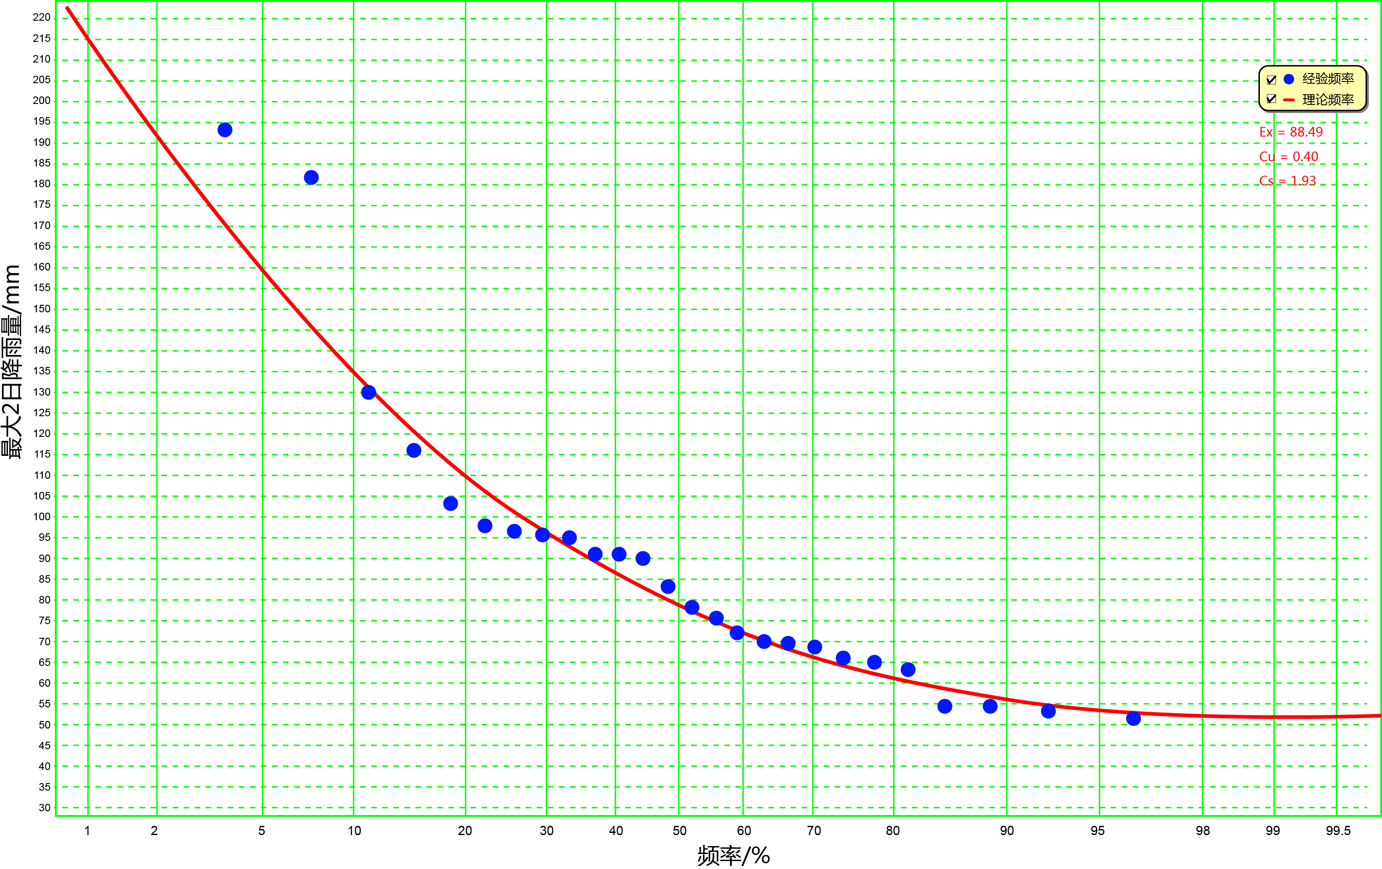
3. Case study: Beijing
According to the results of P-III curve fitting, Beijing’s maximum 2 days rainfall once every 5,10,20,50,100 years is 110.5, 134.8, 159.0, 190.8, 214.8 mm.
The P-Ⅲ curves for maximum 2-day rainfall

Slide 25
3. Case study: Beijing
Based on the exposure characteristics of Beijing in 2012, the flood disaster risk scenarios in Beijing were calculated:
maximum 2 day rainfall （mm） | Affected population（thousand person） | Missing and death（person） | affected crop（thousand ha.） | house collapse（thousand rooms） | house damage（thousand rooms） | direct economic loss（billion RMB）*
110.5 (5y) | 62 | 4 | 2 | 0.3 | 0.5 | 0.3
134.8 (10y) | 132 | 7 | 27 | 1 | 1.6 | 0.9
159.0 (20y) | 277 | 14 | 38 | 3 | 4.7 | 2.9
190.8 (50y) | 727 | 31 | 57 | 12 | 19.5 | 13.1
214.8 (100y) | 1474 | 58 | 73 | 37 | 56.0 | 41.0

Slide 26
4. Discussion
Disadvantage: limited data -> accuracy, uncertainty. Based on the more detailed loss data, the method can be used to calculate more accurate vulnerability curves, for example, the annual vulnerability curve, or the vulnerability curve of special buildings, projects, crops etc.
The method can be used to calculate the macro vulnerability of a number of cities or regions, and to analysis the spatial distribution of vulnerability and risk.

Slide 27
4. Discussion
The method can be used to analysis the effect of exposure change to the disaster risk.

Slide 28
Thank you
for your attention!

