Slide 1
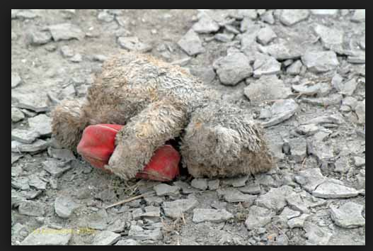
The Unexpected Nature of Disasters
Carl W. Taylor
XCH Global

Slide 2
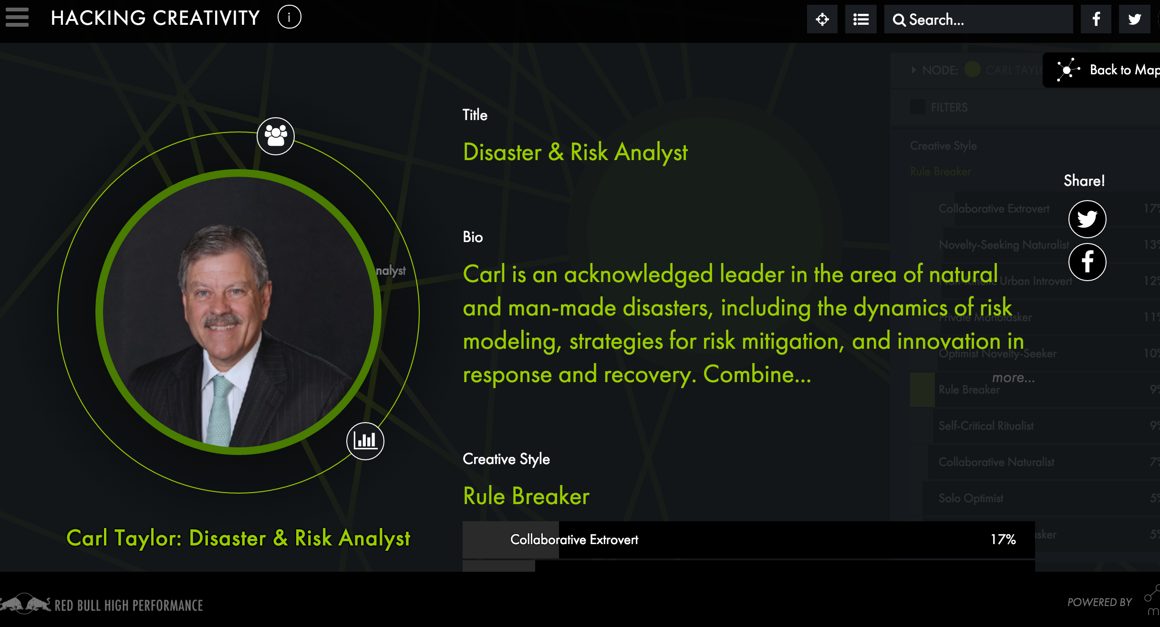
About Me

Slide 3
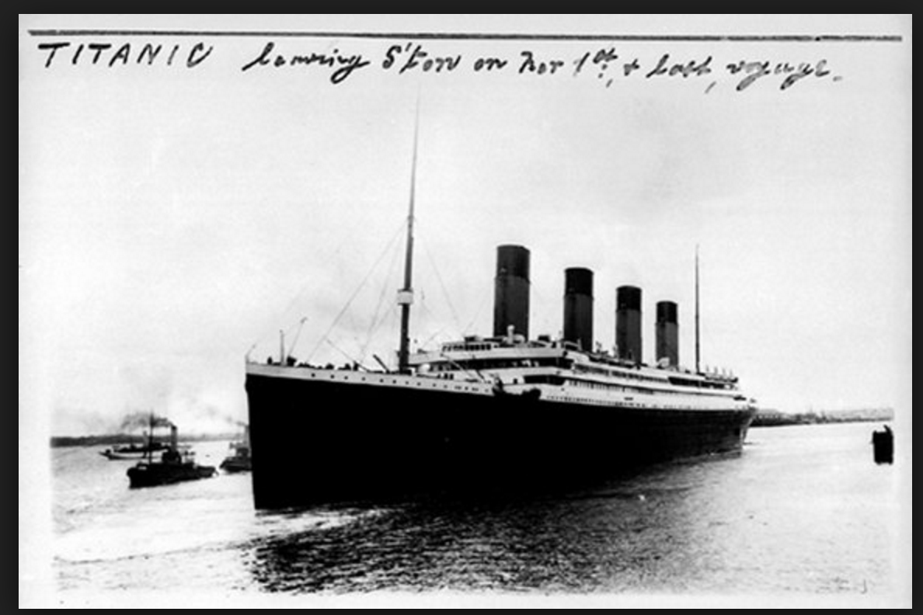
A Belief In Invincibility Based On Motive

Slide 4
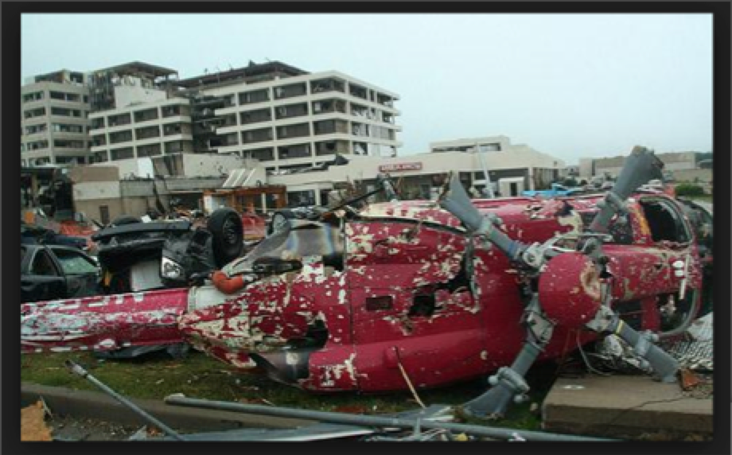
A Belief Of Invincibility Based On Myth

Slide 5
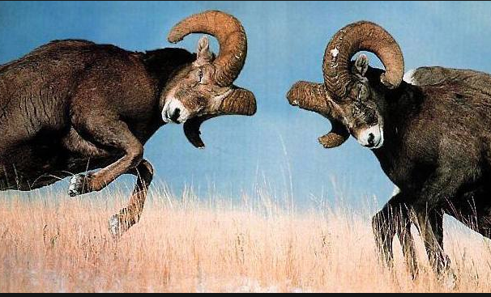
We Misunderstand The Actors

Slide 6
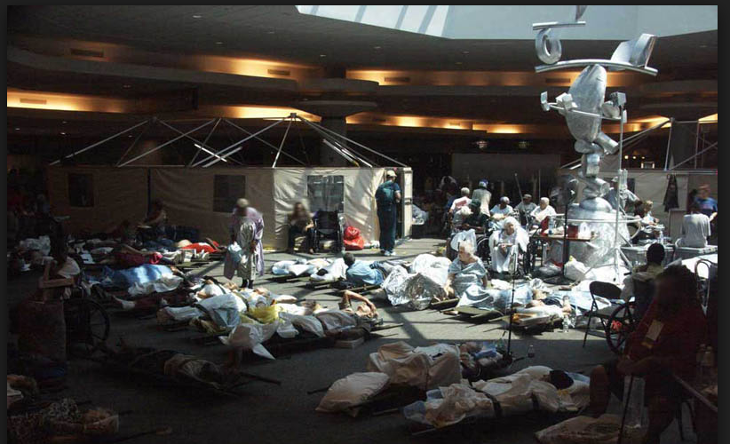
That Misunderstanding Leads To Regulatory/Command Challenges
What is Missing?

Slide 7
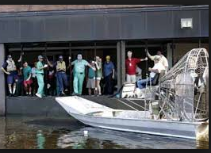
Transportation Will Have To Be Created

Slide 8
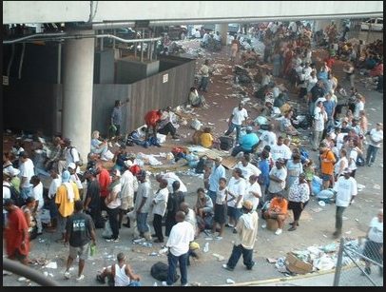
Surge Capacity Will Exceed Your Plans and Your Fears

Slide 9
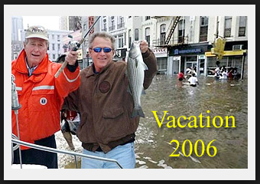
The Press Will Be Critical

Slide 10
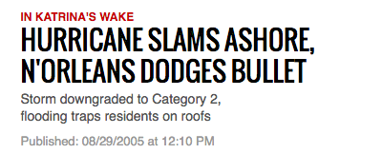
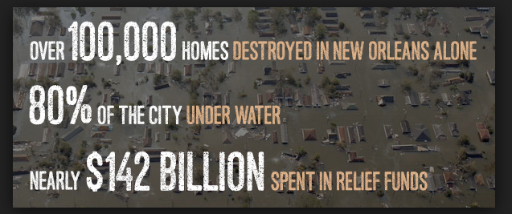
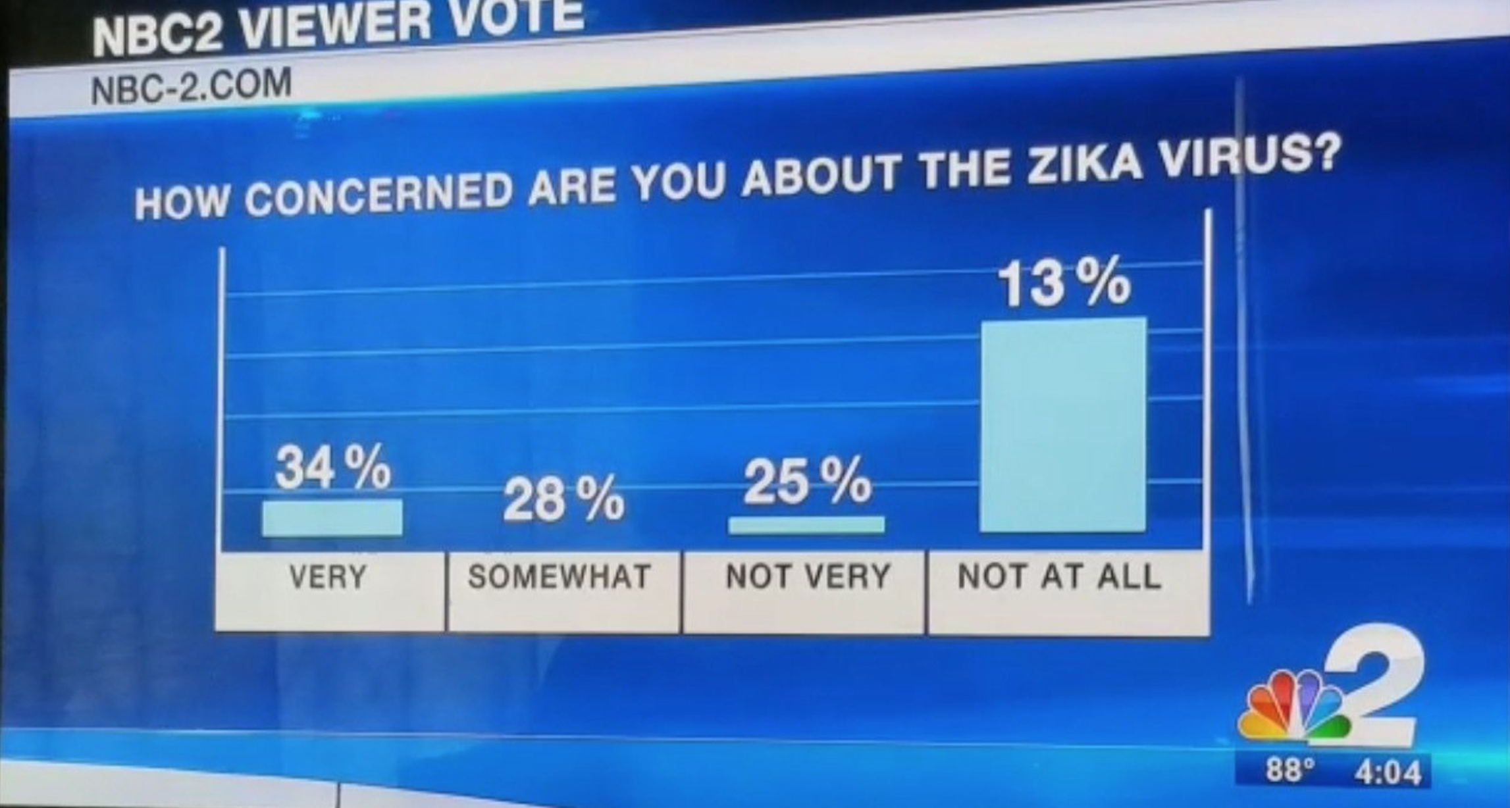
The Press Will Be Wrong or Confusing

Slide 11
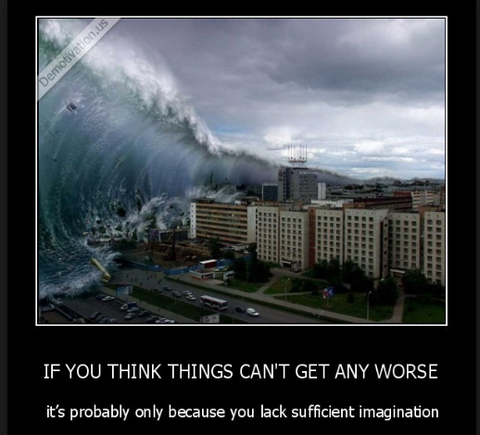
Lack of Imagination Will Cause Us To Miss Cascades
We Never Imagined---

Slide 12

Volunteers Are Not Always Helpful

Slide 13
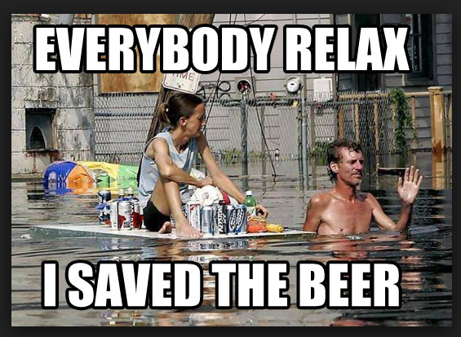
Your Citizens Plan May Not Be Ideal

Slide 14
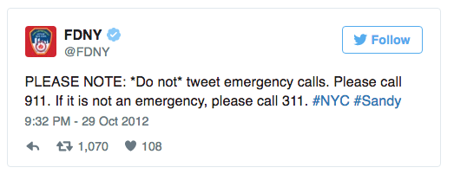
Social Media Has Yet To Be Fully Harnessed

Slide 15
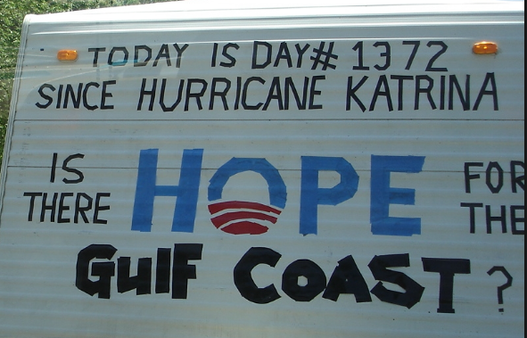
There Is A Long Tail To Natural Disasters

Slide 16

Free Is The Enemy of Recovery

Slide 17
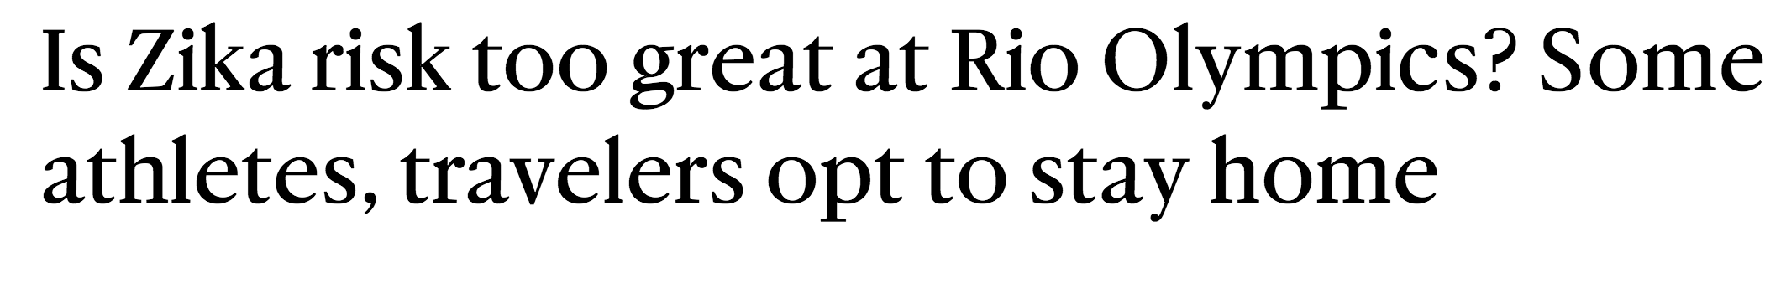
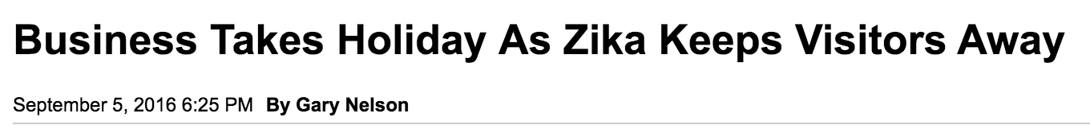

There Is A Long Nose To A Virus

Slide 18
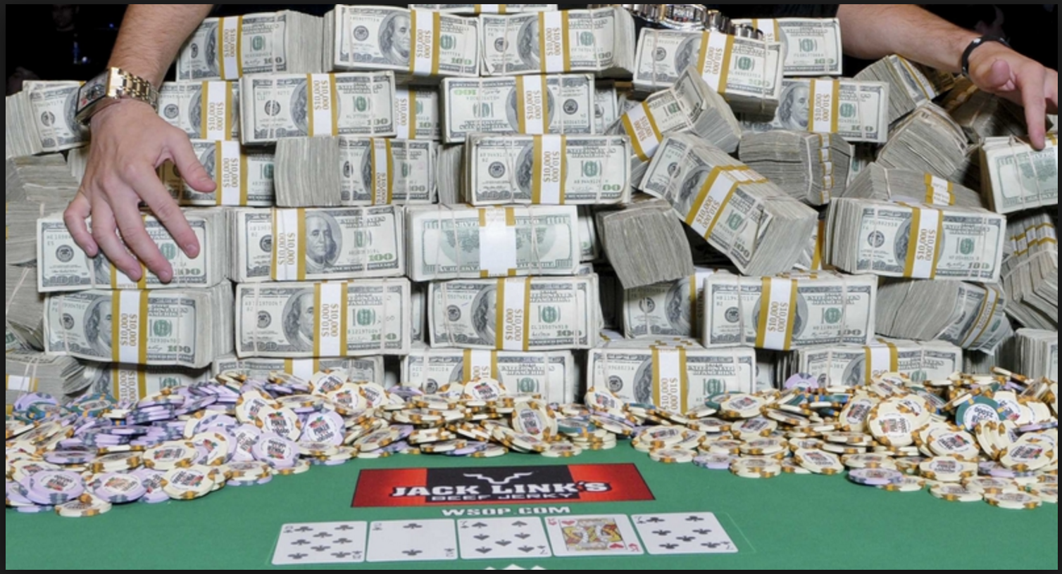
You Must Plan To Raise Money-But How and Who Do You Trust?

Slide 19

Help Comes From The Strangest Places and In The Strangest Forms

Slide 20
9 Pieces of Advice
Be flexible and innovative
Ask forgiveness rather than permission
Repeat the words –”This too shall pass” frequently
Save The Willing First

Slide 21
Advice
Done is better than perfect
When the sun is out- build trust
What worked yesterday may not work tomorrow, but what didn’t work yesterday may work today…...
Record, Remember, Share

Slide 22
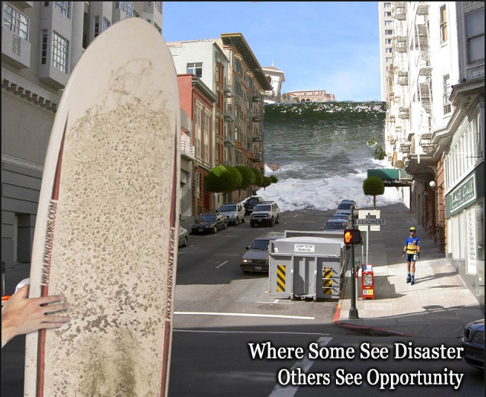
Build Back Better Resonates Hope

Slide 23
Thank You
Carl Taylor XCH Global cwtaylor1@gmail.com or skype at carl.taylor1226

