Slide 1

Matt Campbell
U.S. Federal Emergency Management Agency
Washington, DC
National Coordinator for Community Planning and Capacity Building matt.campbell@fema.dhs.gov

Slide 2

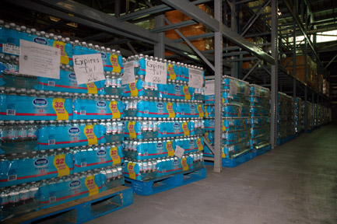
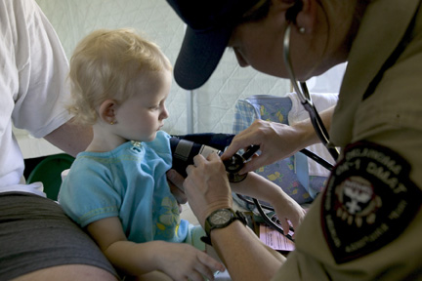
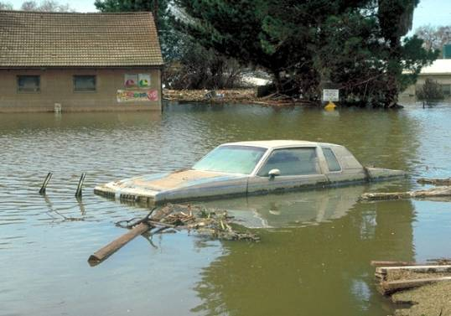
FEMA Mission Statement
“FEMA's mission is to support our citizens and first responders to ensure that as a Nation we work together to build, sustain, and improve our capability to prepare for, protect against, respond to, recover from, and mitigate all hazards.”

Slide 3

National Preparedness System
  National Response Framework
  National Mitigation Framework
    Mitigation Core Capabilities:
      Coordination Planning
      Public Information Community Resilience
      Long-Term Vulnerability Reduction Risk and Disaster Resilience Assessment
      Threats and Hazards Identification
  National Disaster Recovery Framework
    Recovery Core Capabilities:
      Coordination Planning
      Public Information Economic
      Housing Infrastructure
      Health and Social Services Natural and Cultural Resources

Slide 4
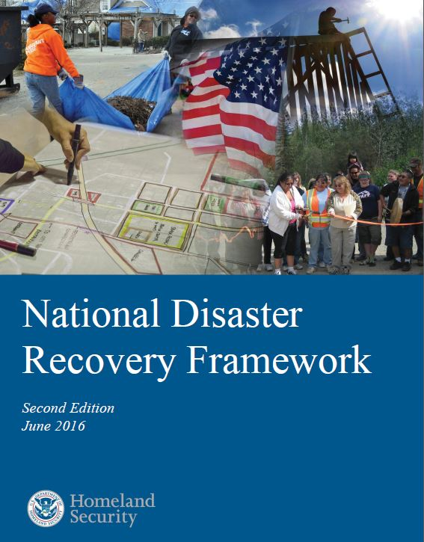
National Disaster Recovery Framework
  Elevates focus on recovery
  Sets national policy and doctrine
  Recommended recovery roles:
    Federal, State, Local, Business, Non-Profit, Public
  Defines Leadership
  Coordination Structure
  Planning
  Resilience and Mitigation

Slide 5
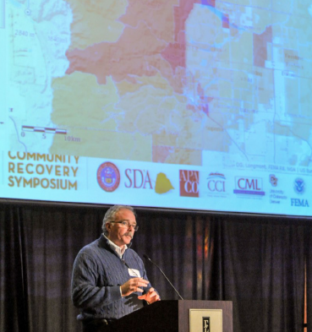

Recovery Leadership:
Federal Disaster Recovery Coordinator
State Disaster Recovery Coordinator
Local Disaster Recovery Management

Slide 6
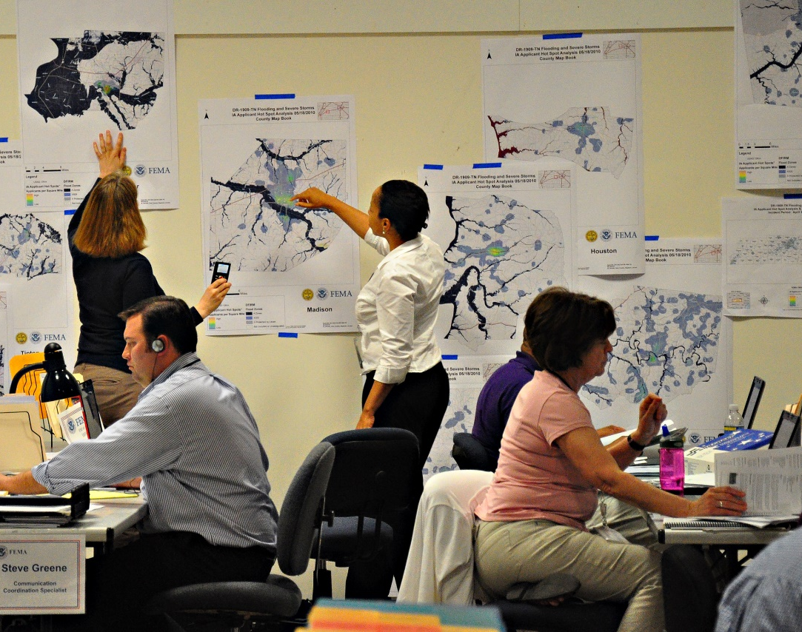
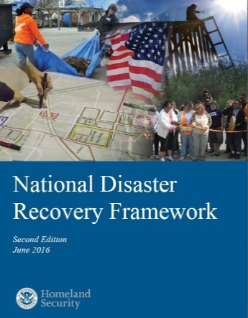
Coordination
Recovery Support Functions (RSF) and Interagency Coordination
  Community Planning & Capacity Building RSF (FEMA)
  Economic RSF (Economic Development Administration)
  Health & Social Services RSF (Health and Human Services)
  Housing RSF (Department of Housing and Urban Development)
  Natural & Cultural Resources RSF (Department of Interior)
  Infrastructure RSF (US Army Corps of Engineers)
Mitigation and Sustainability Advisors
Primary and Support Agencies
Recovery Support Strategy

Slide 7
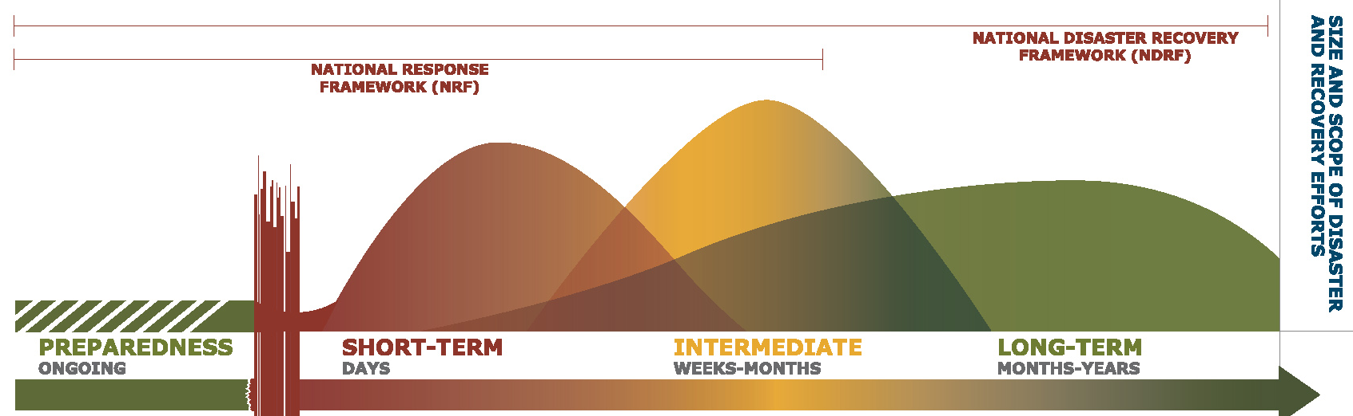
Expanding Disaster Management
Emergency Managers cannot possibly handle all disaster management
Long-term resilience requires urban planners, health professionals, economic and international developers, social services professionals, etc to take responsibility for mitigating risks, reshaping disaster recovery

Slide 8
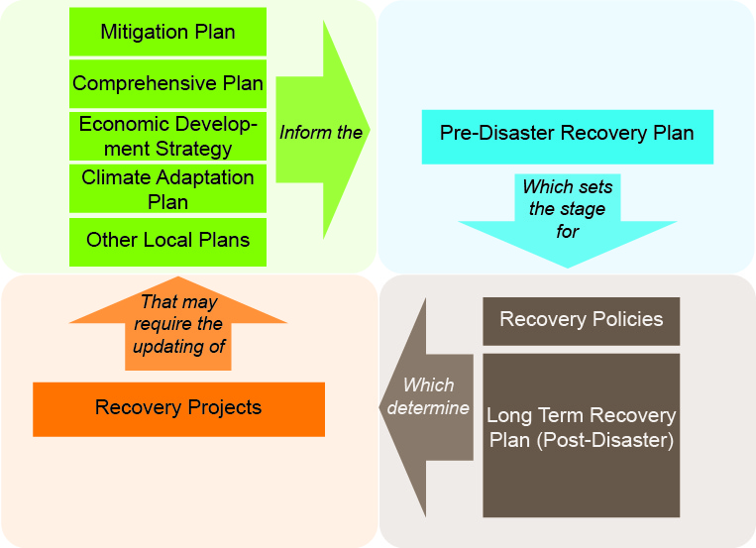

Planning
Pre-Disaster Planning
Post-Disaster Planning

Slide 9
Pre-Planning for Disasters
Response Planning: traditional focus of Emergency Management – roles and procedures for saving lives and immediate stabilization
Recovery Planning: policies, roles, procedures for rebuilding that would be activated in time of disaster
Hazard Mitigation Planning: evaluation of hazards and risks and identification of corrective actions and policies to reduce existing and future risk.
Comprehensive Plans and Land-Use Plans: Community level planning for new development that ideally integrates evaluation of hazards.
Economic Development and Economic Resilience Planning: Plans for local and regional economic expansion and diversification to increase capability to address shocks to local and regional economies
Site, System or Area Mitigation Plans – such as watershed or flood control
Policies and Regulations: set-back requirements, investment zones

Slide 10
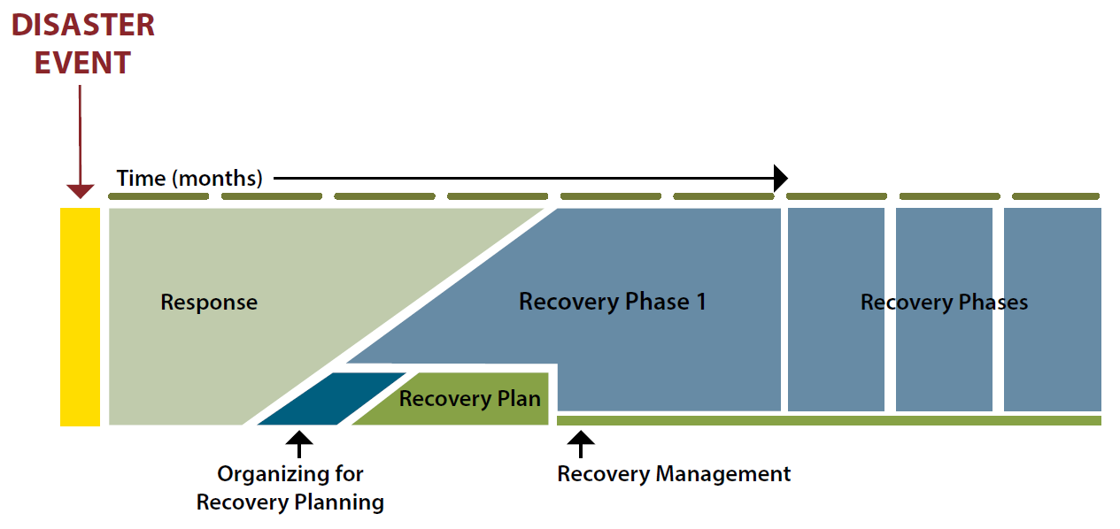
Post Disaster Recovery Planning
Engages community in the public recovery process
Enables integration of long term strategic changes and mitigation measures

Slide 11
Post Disaster Recovery Planning
Regional or Community-Level Long-Term Recovery Plans – Rapid adaptation. Development of community goals, objectives, policies, priorities and major reconstruction projects. Key is leadership and community participation.
Site, Facility or System Specific Plans - such as downtown redevelopment plan, school district recovery plan, or urban redesign plan
Updates to Pre-Existing Comprehensive, Land Use, Economic Development and Hazard Mitigation Plans
Policies and Requirements that Drive Investments – Executive Order 13690 Federal Flood Risk Management Standard

Slide 12
Challenges of Planning in the Post Disaster Environment
Will to rebuild quickly, as before, in all but the worst disasters
Pre-existing trends and problems worsen
  Economy, loss of population, social problems
Distraction and short term thinking
Governments focused on spending and action - limited resources for planning
Struggle of public support and overwhelmed leadership

Slide 13
Advantages of Planning in the Post Disaster Environment
Awareness of hazards and willingness to accept changes not feasible before disaster
Leadership and owners forced to re-think investments in major infrastructure that is destroyed or majorly damaged
Opportunity, if efforts focused, and planning occurs early, to address pre-existing trends and problems
Funding available to implement plans
Gaining public support and application of strong leadership

Slide 14

Community Planning and Capacity Building RSF
Enable local level post-disaster planning for recovery
Organize technical assistance, funding, education, data, guidance
Integrate resilience, sustainability and risk considerations into recovery plans
Build local capacity to manage recovery
Encourage community engagement in the recovery process

Slide 15
Selected Elements and Examples of U.S. Urban Planning After Disaster
Katrina, Louisiana and Coastal Planning
Greensburg Kansas Long Term Community Recovery Plan, Rebuilding an Energy Efficient Green Town
Long Island Smart Growth Partnership – Resilience Codes and Health Impact Assessment
Galveston Texas Long Term Community Recovery Plan and Historic District Redevelopment
Geographic Information Systems and Scenario Planning

Slide 16
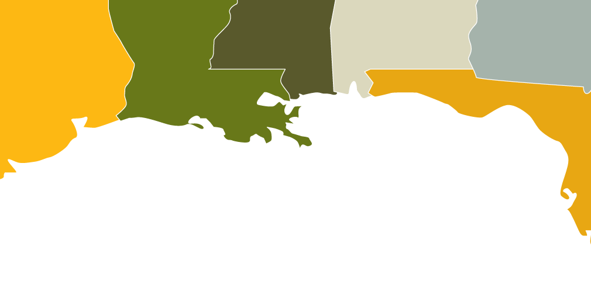
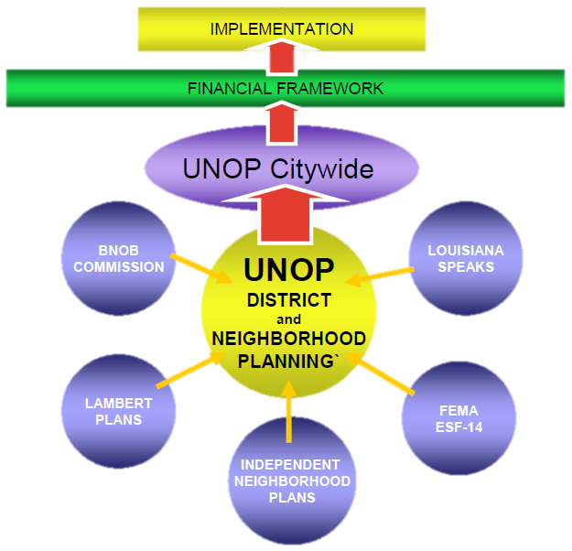
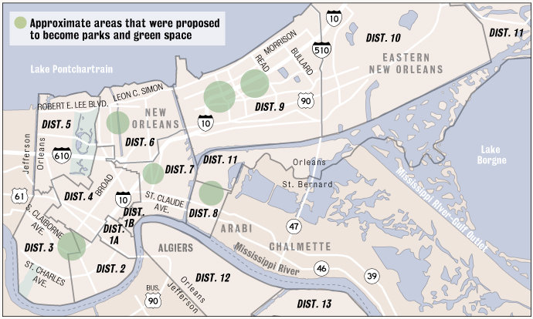
Hurricane Katrina and Planning
Total damage for Katrina is estimated at $108 billion.
Costliest Hurricane in US history.“
1577 Fatalities in Louisiana
Major loss of population in New Orleans
Multiple Planning Efforts in New Orleans
caused problems for rebuilding
BNOB PLAN

Slide 17
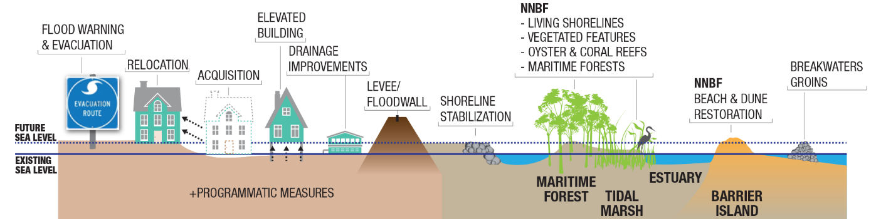
Recovery Planning for Coastal Protection and Mitigation
Managed Retreat
Relocation
Clustered re-development
Green infrastructure and ecosystem restoration

Slide 18
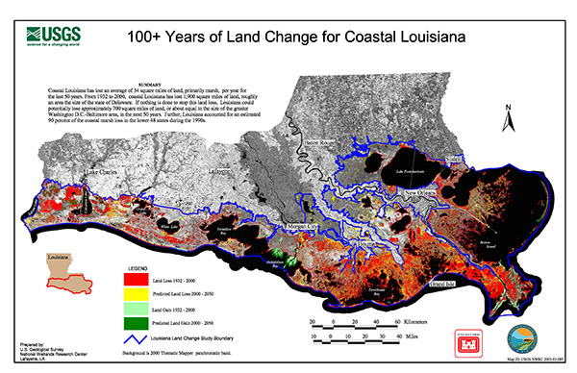

Slide 19
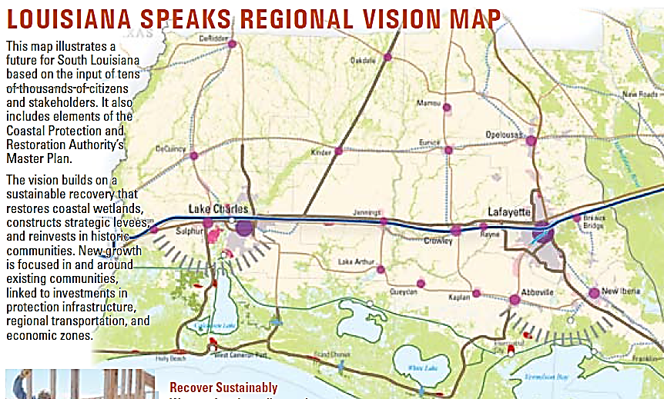

Slide 20
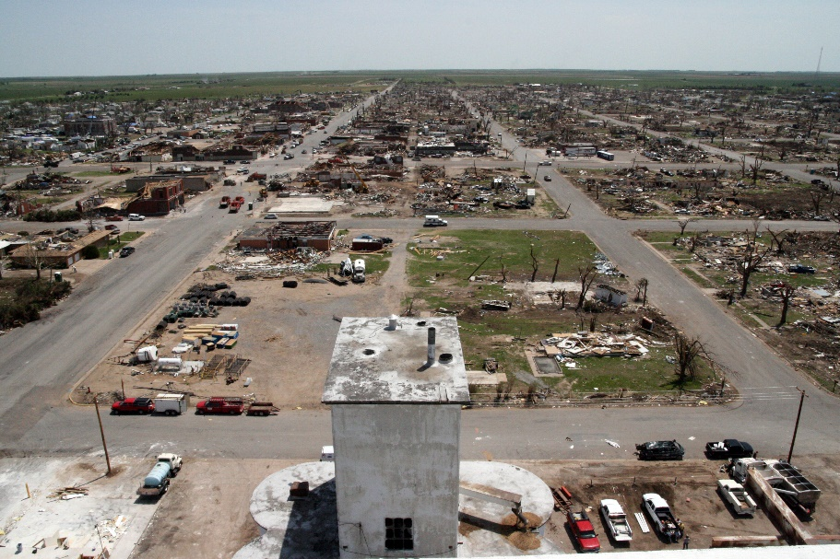
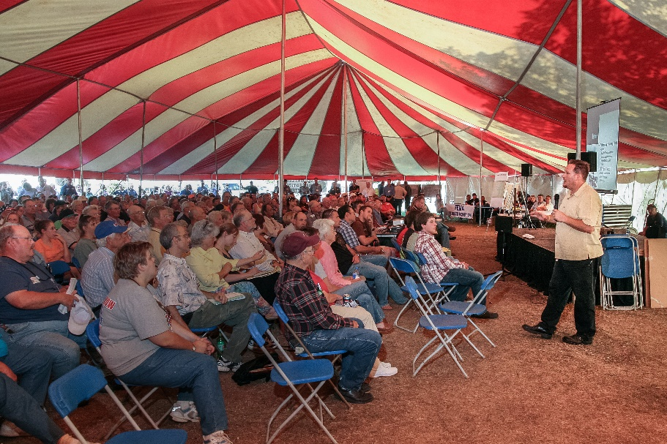
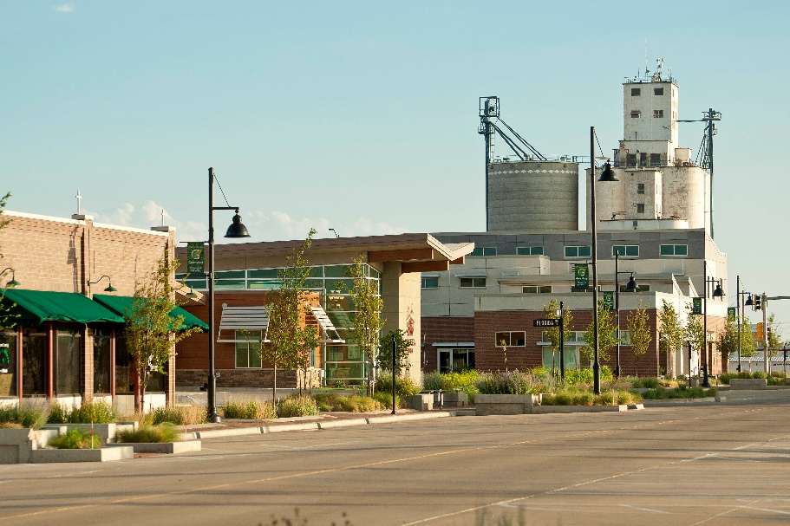
Greensburg, Kansas: Long Term Community Recovery Plan & Rebuilding an Energy Efficient Green Town
Local Leadership – Outside Support - Participation - Cohesive Vision – Multiple Levels of Plans – State Support - Resources

Slide 21
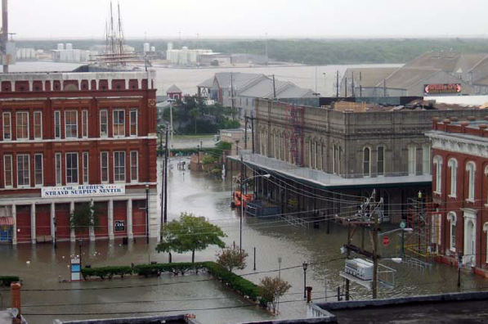
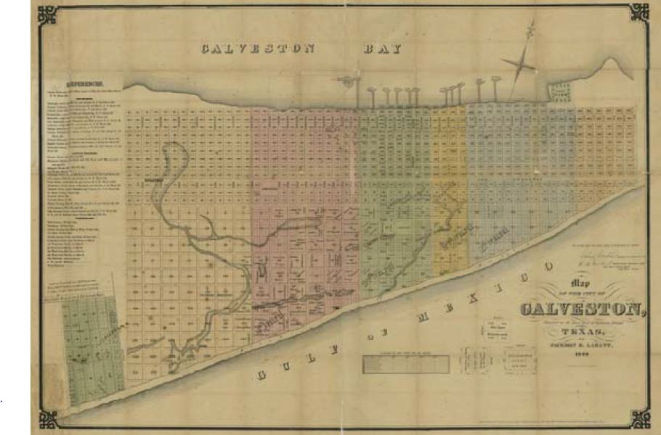
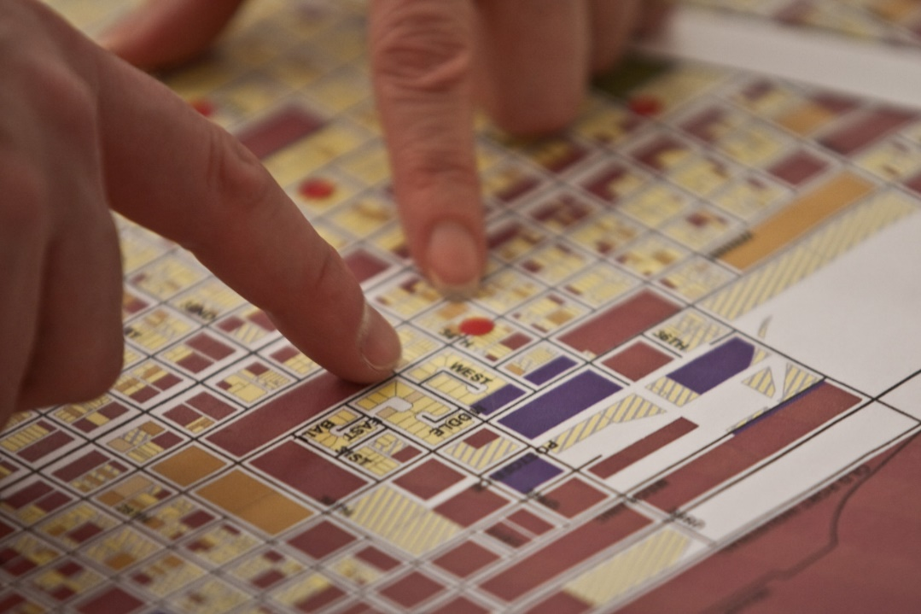
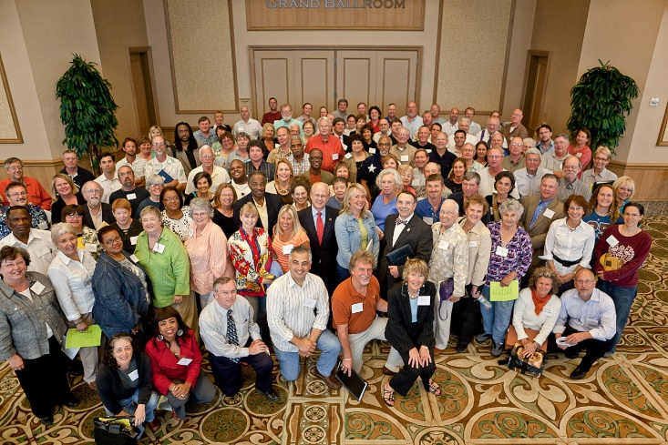
Galveston Texas Long Term Community Recovery Plan and Historic District Redevelopment Plan
Hurricane Ike – Major city-wide flooding
Historic downtown 6-8’ of water
Long Term Community Recovery Planning Committee of 300
  Cast Iron Façade Repair and Preservation
  Downtown Redevelopment Plan
  Gateway and tourism plan
  Historic homes rehabilitation

Slide 22

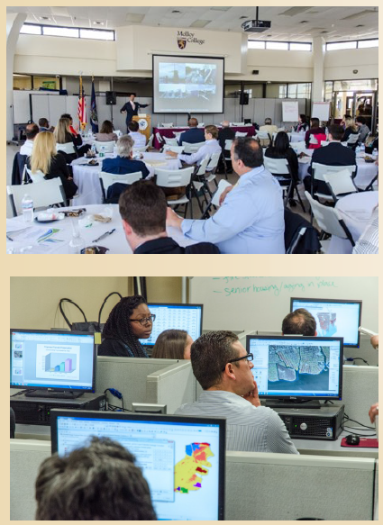

Long Island Smart Growth Partnership
Intergovernmental coordination and planning
Resilient building and zoning codes
Training for health impact assessment, scenario planning tools
Ecosystems services valuation
Notes:
Use snapshot from 2014 report

Slide 23
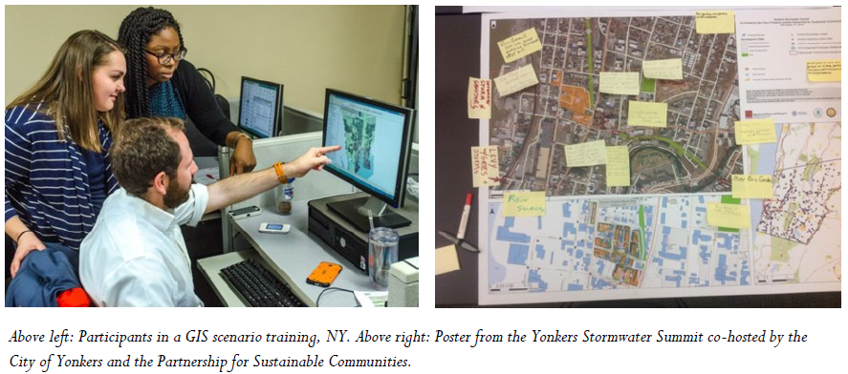
Geographic Information Systems and Scenario Planning

Slide 24
Thank you!
Matt Campbell
FEMA
Matt.Campbell@fema.dhs.gov

Slide 26
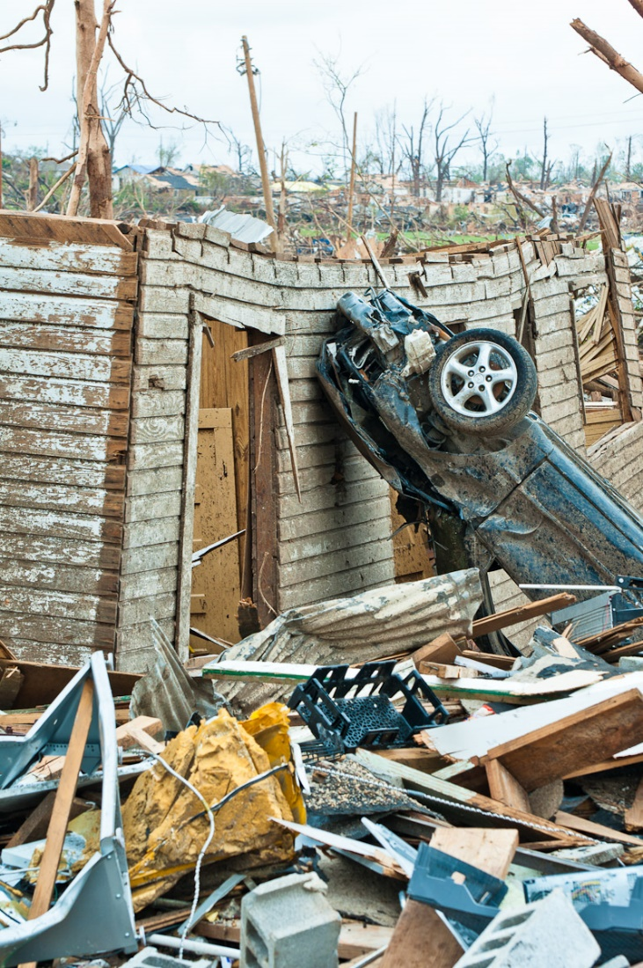
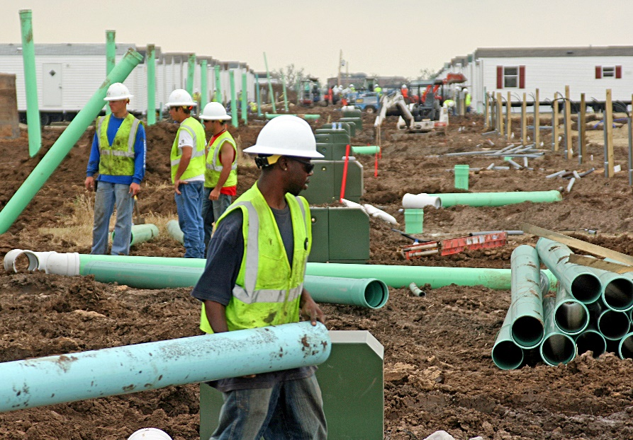
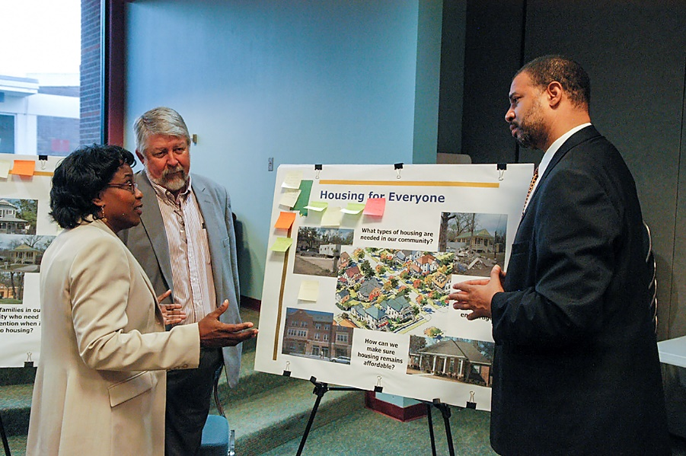
Long Term Housing Recovery Planning

Slide 27
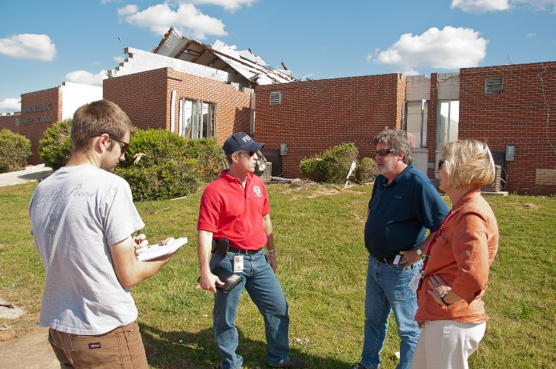
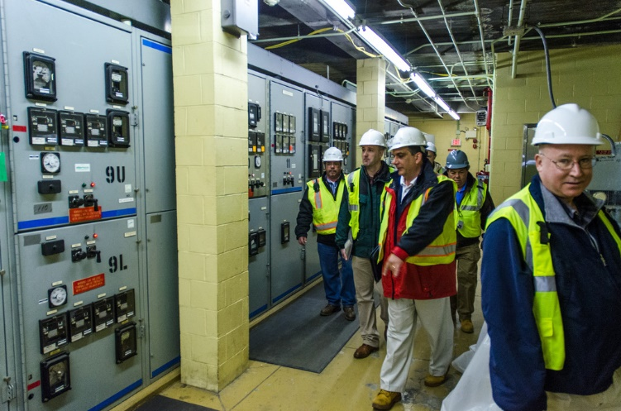
Infrastructure Recovery Planning

Slide 28
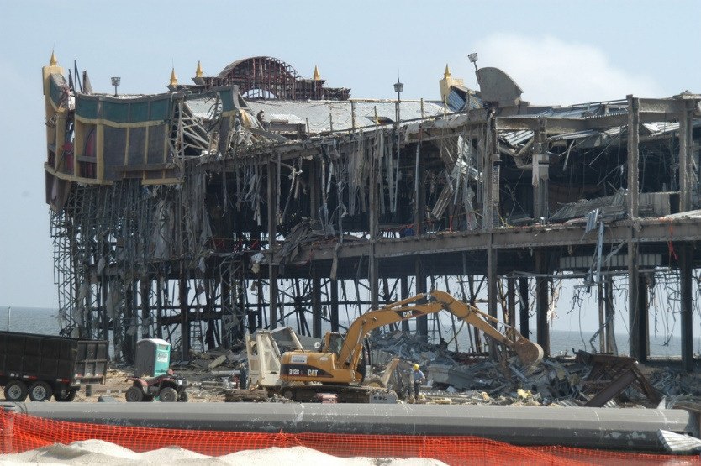
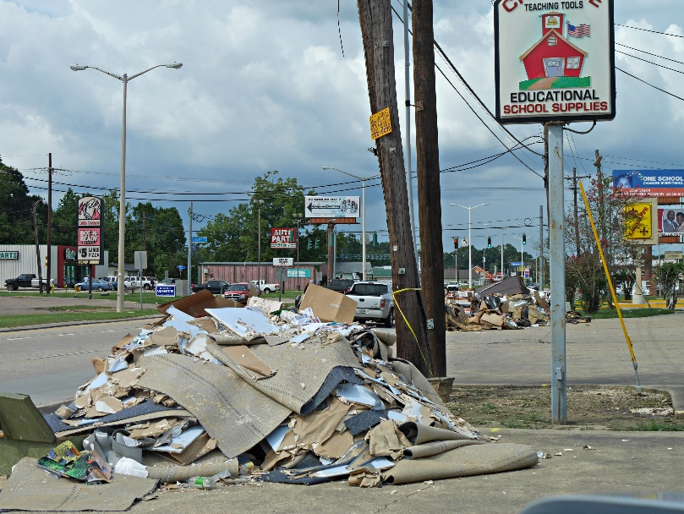
Economic Recovery Planning

Slide 29
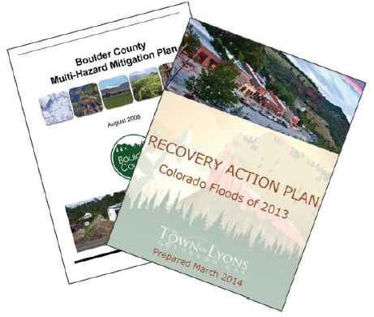
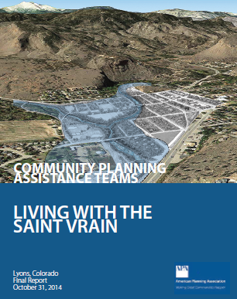
Lyons, Colorado recovery planning, FEMA and American Planning Association

Slide 30
Natural and Cultural Resource Recovery Planning

Slide 31
Why Plan After a Disaster: Key objectives for Community Recovery Planning
Systematic, strategic, and inclusive
Inclusive, accessible, culturally and linguistically appropriate local stakeholder engagement process
Incorporate resilience, mitigation, and sustainability and long-range considerations
Ensure a more effective and efficient use of state, Federal, nongovernmental, and private sector funds;
Community-wide support and understanding of sustainability and resiliency principles
Shorten and better communicate the recovery timeline and improve specific recovery outcomes through more effective locally based decision-making and management.

