Slide 1

INVESTING IN URBAN RESILIENCE:
Consultation for World Bank Flagship Report
Dr. Joe Leitmann
Team Leader, Urban Resilience
GFDRR/World Bank

Slide 2
Structure of Presentation
Overview of session
Flagship report: why do we care?
Flagship report: the urban poverty dimension
Flagship report: financing needs and obstacles
Flagship report: how the World Bank can add value
Questions for discussion

Slide 3
1. Context of Session
Share the objectives and audience of the flagship report on “Investing in Urban Resilience: Making the Urban Poor and Cities More Resilient”
Review key messages
Seek feedback and discussion

Slide 4
1. Context of Session
Objective = highlight the need and potential for investing in urban resilience
Audiences:
  Stakeholders in vulnerable cities in the developing world
  Potential financiers who can invest in urban resilience
  Existing and future partners working on resilient cities
  World Bank community of development practitioners
Venue and timing: Habitat III Conference, Oct. 2016

Slide 5
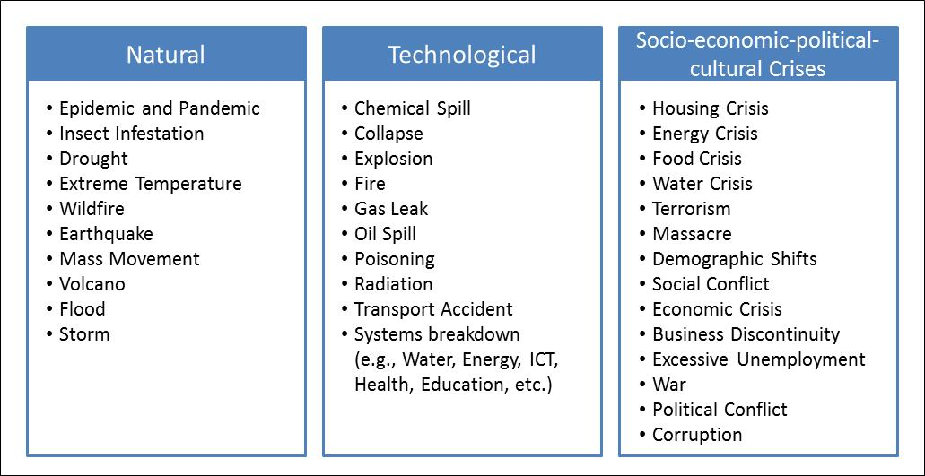
1. Context of Session
What is a resilient city?
A resilient city can adapt to a variety of changing conditions and withstand shocks and stresses while still providing essential services to its residents (UNISDR/SFDRR definition).
Starting point = disaster risk management and adaptation to climate change
Classification of Urban Hazards
Notes:
This report uses the same definition of resilience as the Sendai Framework: “the ability of a system, community or society exposed to hazards to resist, absorb, accommodate to and recover from the effects of a hazard in a timely and efficient manner, including through the preservation and restoration of its essential basic structures and functions” (UNISDR 2009).

Slide 6
2. Why Do We Care About Urban Resilience?
Losses associated with natural events have been on the rise
  Disaster losses expected to grow from current range of $250-300 billion/year to $415 billion in 2030
  Losses from sea-level rise and subsidence in 136 largest coastal cities could reach $1 trillion/year by 2050
World is rapidly urbanizing
  1.4 million people added to urban areas each week
  90% of growth in sub-Saharan Africa and Asia
  Increased exposure of people and assets

Slide 7
2. Why Do We Care About Urban Resilience?
Physical growth of cities
  60% of land projected to become urban by 2030 has yet to be developed
  Nearly 1 billion new housing units will need to be constructed by 2060
Window of Opportunity
  International agreements (SFDRR, UN SDGs, COP21, New Urban Agenda) recognize urban resilience
  World Bank: emerging portfolio of 77 urban resilience projects ($9.3 billion invested in 39 countries)

Slide 8
3. Why Resilience Matters for the Urban Poor
Poverty is urbanizing
  881 million urban residents currently live in slums – an increase of 28% since 2000
  Slums have lower levels of infrastructure and services, and greater exposure to risks
Risks faced by urban poor are related to:
  Limited economic base
  Location
  Low access to infrastructure and services
  Inadequate governance and DRM

Slide 9
3. Why Resilience Matters for the Urban Poor
Failure to invest in urban resilience can reverse development gains
  Worst case scenario – up to 215 million urban residents could fall back into poverty by 2030 if there is inadequate investment in urban adaptation
  Primary drivers of increased urban poverty = higher food prices and increased incidence of diarrheal diseases
Urban poverty-resilience linkages increasingly recognized:
  DRM literature
  IPCC
  Urban poverty literature

Slide 10
3. Why Resilience Matters for the Urban Poor
Number of urban dwellers falling into the specified income brackets due to the impacts of climate change

Slide 11
4. Financing Needs and Overcoming Obstacles
Significant financing is needed to invest in urban resilience
  Marginal cost of making new infrastructure investment low-carbon and climate resilient: $400 billion – 1 trillion/year
  Annual infrastructure spending needs range from 10% of GDP in MICs to 35% in fragile low-income countries
Mobilizing private capital is best bet for closing the financing gap
  $106 trillion of institutional capital is currently available
  However, only 1.6 percent is currently directed to infrastructure

Slide 12
4. Financing Needs and Overcoming Obstacles
Obstacles to investing in urban resilience include:
  High costs and complexity of doing business
  Low capacity to develop bankable projects
  Inadequate access to financing/creditworthiness
  High upfront costs of developing resilience investments
  Political uncertainty
World Bank can help overcome obstacles through:
  Improved fiscal management & revenue generation
  Enhanced creditworthiness
  Improved capital investment planning
  Preparation of investor-ready projects

Slide 13
5. How Can World Bank Add Value?
WBG comparative advantages in this area are:
  Depth and breadth of experience in urban development, DRM and climate adaptation
  Mandate to focus on poverty and shared prosperity
  Demonstrated capacity to work across sectors, improve policy environment, leverage resources, and use global knowledge
Use powerful financial products to enhance city resilience
  Individual/household level
  Community level
  City level
  Regional/country level

Slide 14
5. How Can World Bank Add Value?
World Bank Group Methods of Attracting Additional Capital for Urban Resilience Financing
Bond Issuance: Green Bonds Infrastructure Bonds Sukkuk (Islamic Bonds) Frontloading (ex. International Finance Facility for Immunization) | Investment Platforms and Pooled Vehicles Asset Management Company (IFC) Global Infrastructure Facility (GIF) Managed Co-Lending Portfolio Program (MCPP) (IFC) Prototype Carbon Fund (PCF) | Donor Contributions Climate Investment Funds | TA and Analytics City Resilience Program Small Island States Resilience Initiative (SISRI) Doing Business Report | Partnership Building Medellin Collaboration for Urban Resilience (MCUR)

Slide 15
5. How Can World Bank Add Value?
Scale up City Resilience Program to expand co-financing, lending, guarantees, risk management
Aspirations over next two decades:
  Crowd in $500 billion of private capital to finance resilience
  Do so in 500 cities to benefit one billion people and enable 50 million urban residents to escape poverty
Make urban resilience a formal business product
Work via internal and external partnerships

Slide 16
6. Areas for discussion
Is the rationale sound?
Is the poverty focus correct?
How can financial leveraging be achieved?
What should be the role of the World Bank?
Which partnerships would be most productive?
What references and good practices should be included?
What are the risks?

Slide 17
Thank You.
Key Contacts:
Niels Holm-Nielsen, Global Lead and Lead Disaster Risk Management Specialist (Resilient Cities Program) (nholmnielsen@worldbank.org)
Marc Forni, Senior Disaster Risk Management Specialist (City Resilience Program) (mforni@worldbank.org)
Luis de la Plaza Bringas, Lead Financial Officer (City Risk Transfer Program) (ldelaplaza@worldbank.org)
Maria Angelica Sotomayor, Lead Urban Specialist (City Strength Coordinator) (msotomayor@worldbank.org)
Xueman Wang, Senior Carbon Finance Specialist and Coordinator for Cities and Climate Change (Sustainable Cities Integrated Approach Platform) (xwang5@worldbank.org)
Joshua Gallo, Senior Municipal Finance Specialist (City Creditworthiness Initiative) (jgallo@worldbank.org)
Valerie Joy-Santos, Senior Urban Specialist (report co-author) (vsantos@worldbank.org)
Joe Leitmann, Lead Disaster Risk Management Specialist and Team Leader for Resilient Recovery and Urban Resilience (GFDRR) (jleitmann@worldbank.org)

