Slide 1

Internalizing and Integrating Cybersecurity Approaches
“How cyber is laying the groundwork for Smart Cities”
TIEMS 2016 Annual Conference
San Diego, California

Slide 2

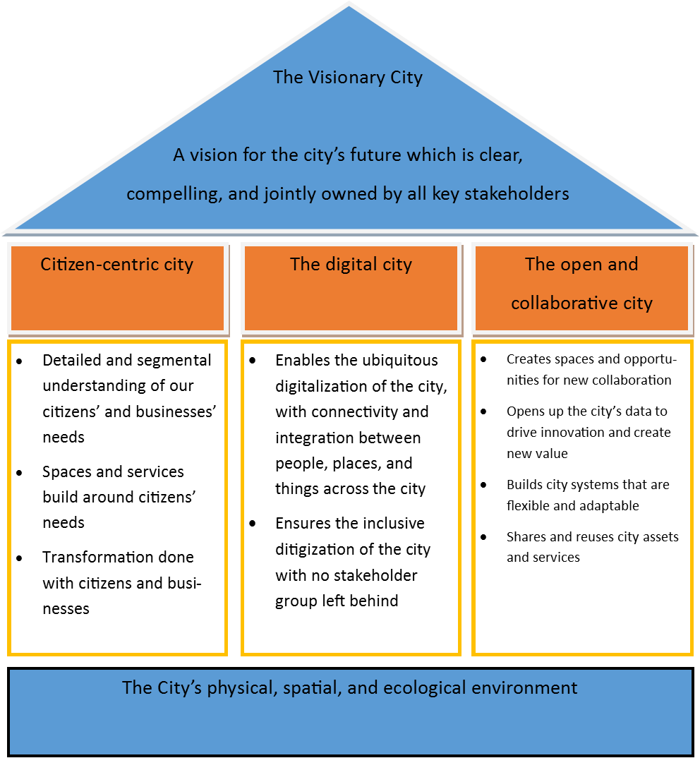
Office of
Homeland Security
Smart Cities
What is a Smart City?
Smart Cities are urban developments that enable and integrate city systems (physical, cyber, and human) to deliver services more efficiently and effectively to residents, making the area move livable, workable, and sustainable
Notes:
Figure from ISO/IEC JTC 1: Smart Cities Figure A.3: Smart Cities concepts and outcomes (BSI PAS 181)

Slide 3
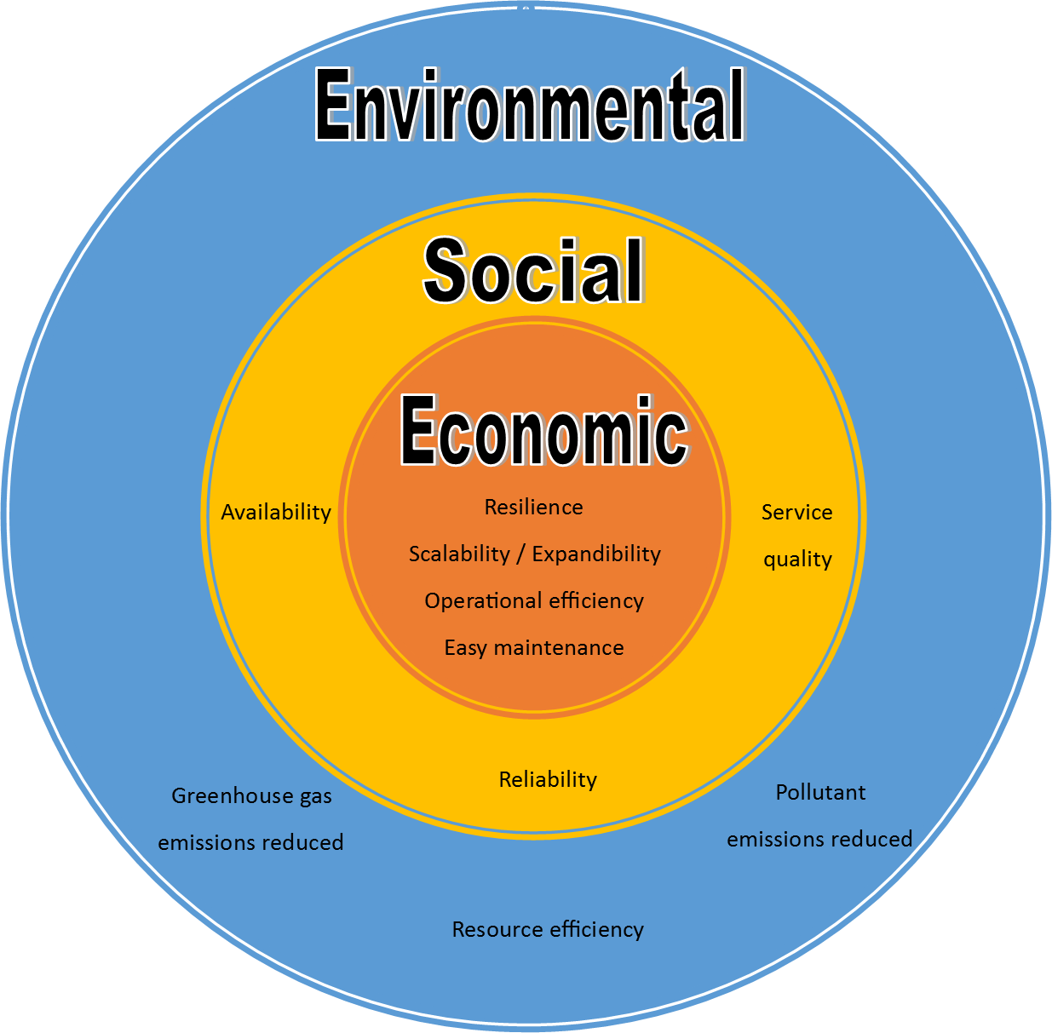
Office of
Homeland Security
Smart Community Infrastructure
Why Build a Smart Community?
Notes:
Economic development / job creation aspect
Increased competitiveness
Resource efficiency / mitigates climate change
Better and more convenient services for citizens

Slide 4
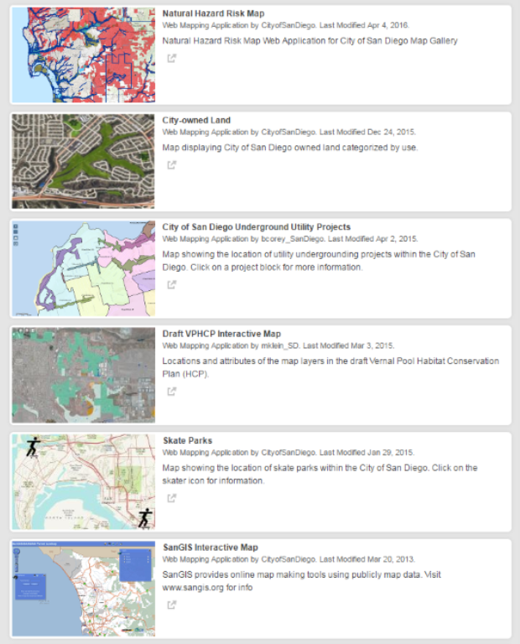
Office of
Homeland Security
San Diego:
Leading Smart Cities
Climate Action Plan (e.g. smart grid, renewable technologies)
Road traffic management and intelligent transport systems
Service-Oriented Architecture / Human Factors Engineering
  Interoperability over a multitude of systems
  Shifting from proprietary systems to flexible, share model
E-Government / 3-1-1 San Diego
Big data management and analysis
Open data
Notes:
National Geographic recognized San Diego as part of their “World’s Smart Cities” program
Envision America
City of San Diego is partnering with UCSD to participate in the White House’s MetroLab Network, which brings together university researchers and city decision makers to research, develop, and deploy technologically- and analytically-based solutions to improve our infrastructure, services, and other public sector priorities.

Slide 5
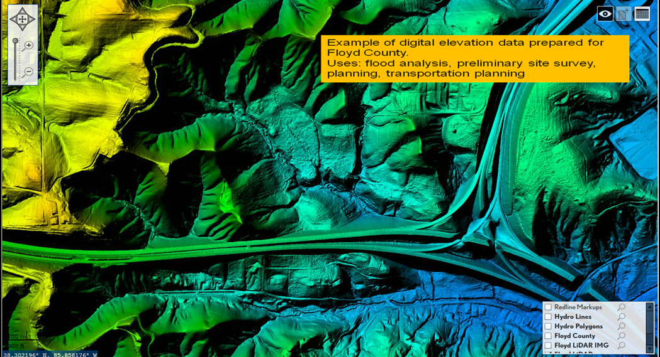
Office of
Homeland Security
Emergency Management in
Smart Cities
Data visualization tools (FEMA, CalOES, City)
USGS and ESRI GIS tools
BioWatch
Computer Aided Dispatch (CAD)
Mixed/augmented reality technology
and training
HSIN
CalCOP and Insider
Remote sensing technology (LiDAR)
AlertSanDiego Emergency Alert System
OnScene Patient Care Records System
PulsePoint
NextGen 911
Earthquake early warning and tsunami warnings
ISS CubeSats to explore and track weather and solar flares
Unmanned systems for situational awareness and hazard suppression
Notes:
Emergency service call centers, dispatch services, first responders, resource allocation, GIS
FEMA tool: http://www.fema.gov/data-visualization
OnScene – electronic patient care records system used by SDFD and EMS

Slide 6


Background
Gary Hayslip, CISO
Started with computers in early 1980’s as a teenager.
Served 20 years in US Navy working with computers and cyber security. (1986-2007)
Spent 6 years as a Federal Civil Servant for the US Navy as a CISO.
In 26 years I worked numerous positions: developer, network administrator, network engineer, security architect, security auditor and security forensic investigator.
Worked on and audited federal and military networks from all over the world. (architecture, security controls, policies)
Why this background is important – Cyber security in the Federal Government is totally different than private/municipal.
In 2013, I resigned from Federal service and accepted a position with the City of San Diego, California.
I had no idea what I was walking into or how it would fundamentally change my view on Cyber Security.

Slide 7
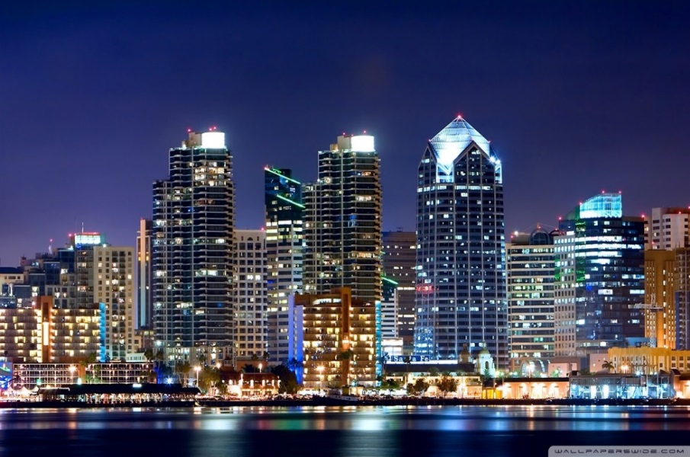
San Diego Trivia
City of San Diego
by the Numbers
11,000+ employee’s
14,000+ desktops & laptops
500+ tablets and mobile devices
1000+ City issues cell phones
City has over 24 networks with an estimated 35,000+ endpoints.
Sensitive data types such as PII, PCI, HIPAA, & Financial
Installed technology ranges from 1980’s type hardware to state of the art cyber security analytics software.
Internet-of-Things (IoT) in large scale enterprise deployments
Average 1 million attacks on its networks per day

Slide 8

Changing Mindset on viewing risk - longterm
Risk is everywhere
Over 40 departments with different business requirements & needs.
Matching citizens expectations with reality.
Risk Management = Its all about the grey.
Environment is constantly changing
Collaboration or die

Slide 9
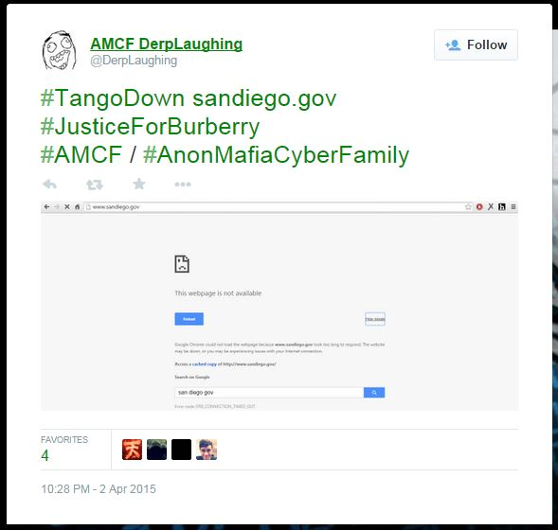
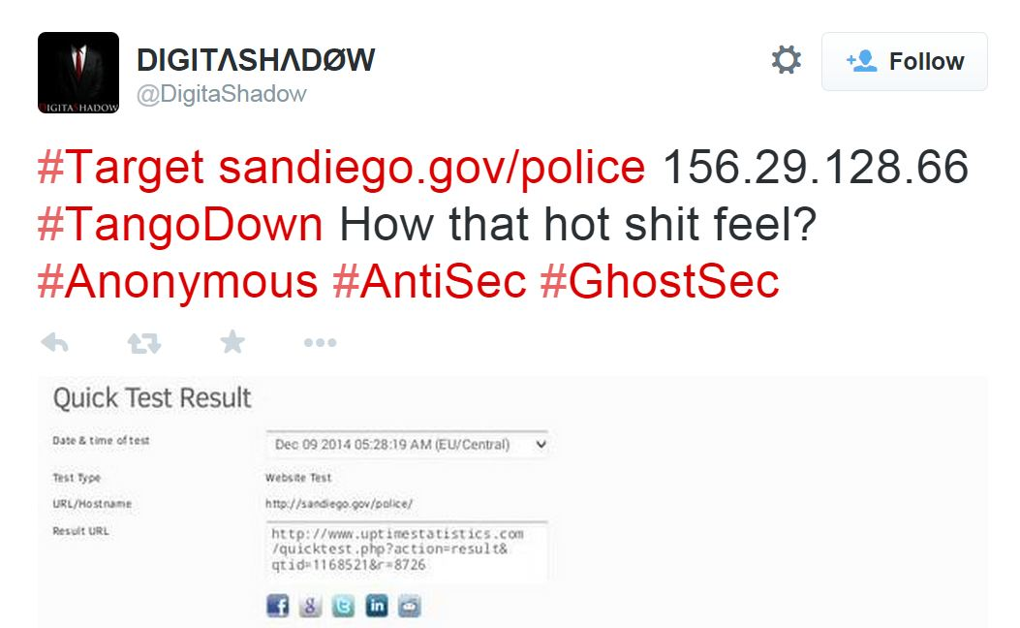

Current Threats
Threats - Hacktivism
The City of San Diego has been attacked several times by Hacktivist groups over the last two years. The FBI reports attacks on municipalities has increased by 60% since 2013.
XXXXXXXXXXXX
XXX

Slide 10
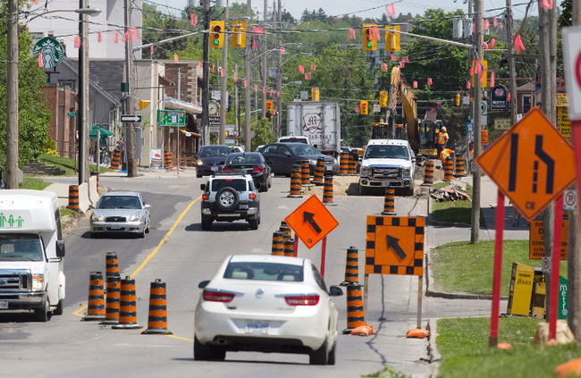
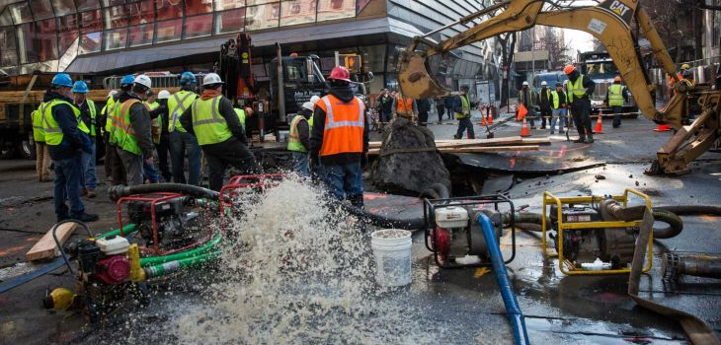
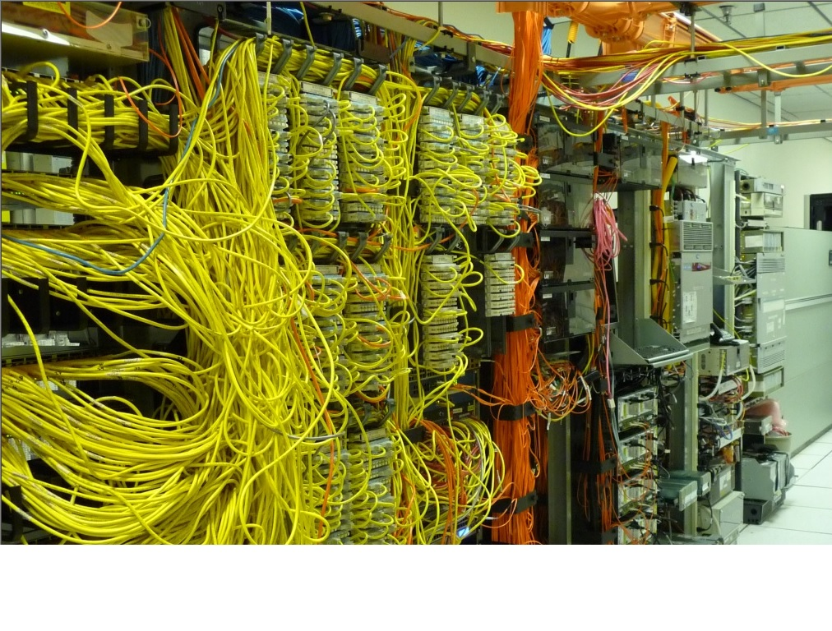
Challenges
Legacy Infrastructure & Disparate Technologies
The City of San Diego expecting 49% growth in population between now and 2050.
Growth will impact municipal services such as water, power, transportation and employment opportunities.
IT infrastructure in constant use, municipal governments do not rotate technology like public traded organizations.
Technology changes for municipalities have intertwined “legacy” and “new” technologies.

Slide 11
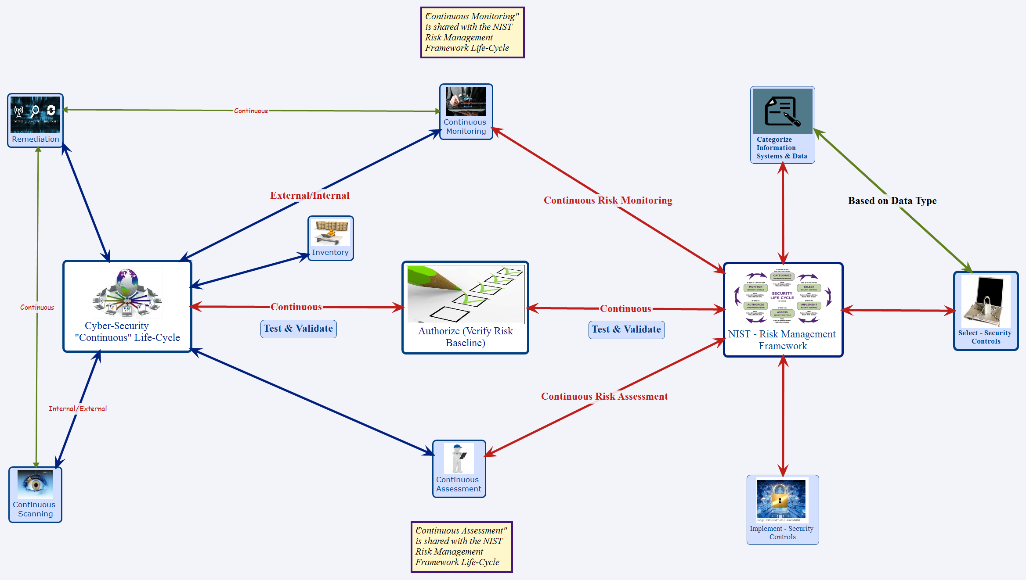
Cyber, its alive!
Cyber Security is a life-cycle
https://app.box.com/Cyber-LifeCycle

Slide 12
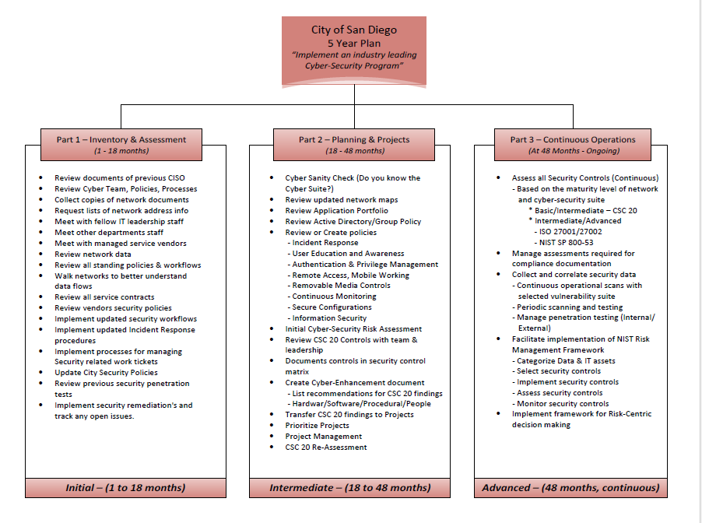
You need a plan
To be effective, you need a plan

Slide 13

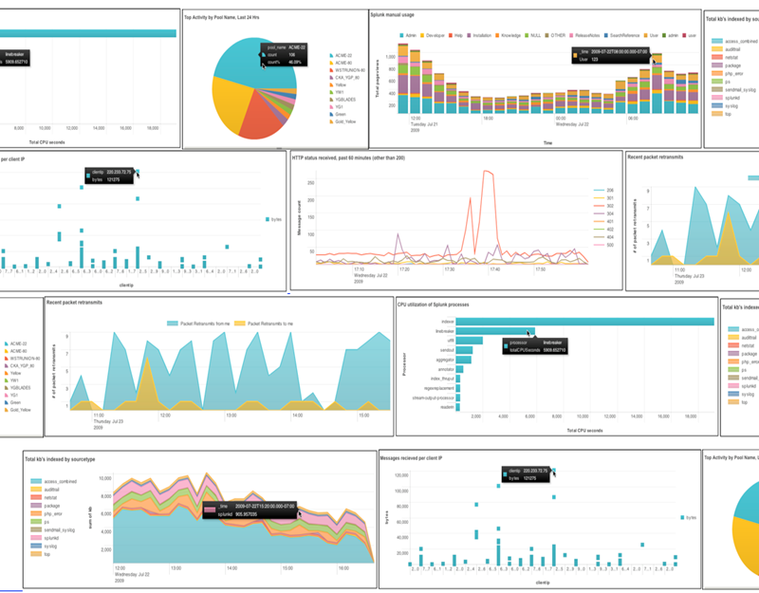
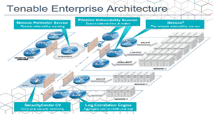
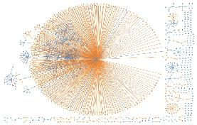
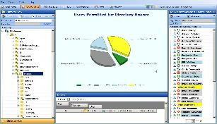
Building a Security Program
Cyber – Ongoing Projects
Daily Operations
Continuous Scanning, Remediation, Monitoring
Network Behavior Analytics
Data Governance

Slide 14

Understanding technology has risk
Understanding our risk
Application | Valuation Components |  |  | Total Valuation
 | Revenue | Asset Value | Data Liability
Business Tax | $7,600,000 | $850,000 | $1,425,000 | $9,875,000
Computer Aided Dispatch | $0 | $4,200,000 | $1,425,000 | $5,625,000
Landfill | $43,000,000 | $400,000 | $1,425,000 | $44,825,000
Permit Tracking System | $65,000,000 | $85,000 | $36,000,000 | $101,085,000
SAP | $343,000,000 | $32,250,000 | $528,000 | $375,778,000
SANS 20 Controls Defensive Posture
Business Tax 12.4 out of 20
Computer Aided Dispatch 12.6 out of 20
Landfill 12.5 out of 20
Permit Tracking System 12.6 out of 20
SAP 12.6 out of 20
Business Applications | SANS 20 Critical Controls
 | SCS1 | SCS2 | SCS3 | SCS4 | SCS5 | SCS6 | SCS7 | SCS8 | SCS9 | SCS10 | SCS11 | SCS12 | SCS13 | SCS14 | SCS15 | SCS16 | SCS17 | SCS18 | SCS19 | SCS20
Business Tax | 0.4501 | 0.1959 | 0.388 | 0.6789 | 0.8724 | 0.7486 | 0.4927 | 0.625 | 0.5325 | 0.2 | 0.6875 | 0.8567 | 0.8464 | 0.6838 | 0.2125 | 0.9198 | 0.8575 | 1.0 | 0.7 | 0.4875
Computer Aided Dispatch | 0.4501 | 0.3626 | 0.3875 | 0.6789 | 0.8724 | 0.7486 | 0.4927 | 0.625 | 0.5325 | 0.2 | 0.6875 | 0.8567 | 0.8464 | 0.6838 | 0.2125 | 0.9198 | 0.8575 | 1.0 | 0.7 | 0.4875
Landfill | 0.4501 | 0.2876 | 0.3875 | 0.6789 | 0.8724 | 0.7486 | 0.4927 | 0.625 | 0.5325 | 0.2 | 0.6875 | 0.8567 | 0.8467 | 0.6838 | 0.2125 | 0.9198 | 0.8575 | 1.0 | 0.7 | 0.4875
Permit Tracking System | 0.4501 | 0.3626 | 0.3875 | 0.6789 | 0.8724 | 0.7486 | 0.4927 | 0.625 | 0.5325 | 0.2 | 0.6875 | 0.8567 | 0.8464 | 0.6838 | 0.2125 | 0.9198 | 0.895 | 1.0 | 0.7 | 0.4875
SAP | 0.4501 | 0.3626 | 0.3875 | 0.6789 | 0.8724 | 0.7486 | 0.4927 | 0.625 | 0.5325 | 0.2 | 0.6875 | 0.8567 | 0.8464 | 0.6838 | 0.2125 | 0.9198 | 0.8575 | 1.0 | 0.7 | 0.4875
Confidence levels (control weight * scaling factor) were asserted for controls that have been adopted and implemented by the City of San Diego.

Slide 15
Risk Baseline
Cyber – Establishing the Risk Baseline
Summary Findings
Total Overall Exposure | $537,188,000
Severe Potential Loss | $74,019,393
Average Potential Loss | $3,963,707
Definitions:
Total Overall Exposure – the overall value of the cyber assets
Severe Potential Loss – the 5% Value At Risk
Average Potential Loss – most likely loss over the next 12 months

Slide 16

What is to come
So why is this important?
Increase in population in both the city and county of San Diego.
Increase in traffic & transportation costs
Limited amount of housing for population
Increased costs in infrastructure projects
  Street repair
  Fiber and new communication conduits
  Upgrades to electrical and emergency service systems
  Increase of alternative energy technologies
  Continued conservation of water and natural resources
Financial resources & planning required for capital improvement projects that will be used for decades.

Slide 17
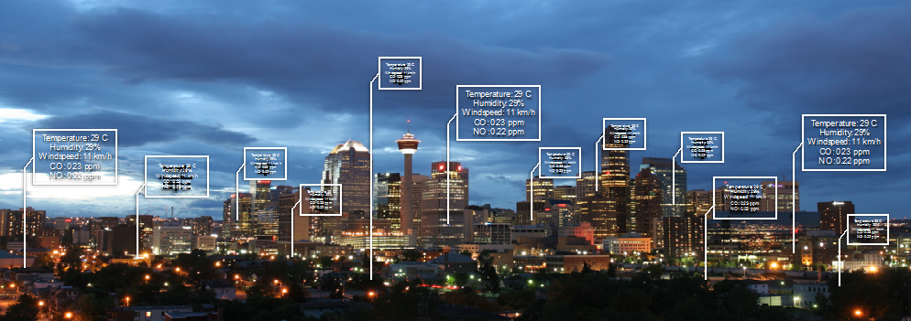
Why are we doing this?
The Rise of Smart Cities
Smart Cities are high-density creators of rich data and new protocols.
Location information is a major enabler of Smart City technology benefits.
Benefits of smart technology will be judged by the services they provide to our citizens.
Reuse and repurpose is vital to urban resilience, smart data is needed to make this work efficiently.
Open standards are needed for interoperability, efficiency, application innovation and cost effectiveness. (ISO 37150, 37151 & 37120)

Slide 18
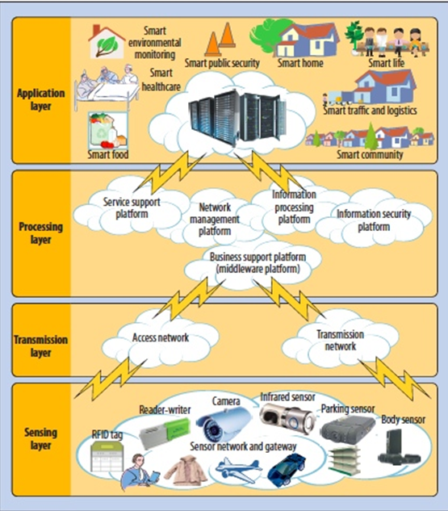
Smart Cities will provide targeted services
Smart City Services
Utilities - Smart Grid, Smart Water, Smart Waste etc.
Intelligent Buildings
Intelligent Transportation
Public Safety and Security
Environmental Protection
Public Health
Education
Urban Planning
Open Data
Mobile Services

Slide 19




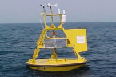
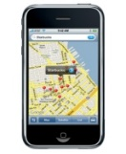

Smart Cities will drive a new technology stack
Smart City Infrastructure
Elected Officials
Municipal Employees
Public
Application
Layer
Health
Intelligent buildings
Intelligent transportation
Open data
Public safety and security
Environmental Protection
Urban planning
Emergency Services
Utilities
Sanitation
Education
Business
Layer
Analytics
and Models
Visualization and
Decision Support
Catalogs,
Semantics
Metadata
Data Access
Security System
Cloud hosted resources
Data
Layer
Urban/Municipal Database
Other
Data
Enterprise
Data
Economic
Data
Population
Data
Geospatial Data
Data Ingest and Quality Checking
City Sensor Webs
Crowdsourcing
Sensing
Layer
Sensor networks
Phones, Wearables

Slide 20

What is the City of San Diego doing?
San Diego’s Smart City Initiatives
Sempra Smart Grid
Google Fiber
Sensor/GPS for trash vehicles
Street sensors - intelligent parking
Intelligent Infrastructure
  LED based street lights
  Intelligent building (New library)
  HVAC systems (43 libraries)
Port Authority sensor network around bay
City of San Diego Climate Action Plan – Smart City Hackathon
Deployment of resilient emergency communications
Sempra HQ building downtown
City of San Diego – solar panels
City of San Diego – EAM Project
  New mapping of park spaces
  Mapping of all City owned tree’s

Slide 21

Concerns we must address
Dark side to Smart City Initiatives
Increased complexity (Legacy & Converged)
Cascading effect - simple issues cause large impact on intertwined systems.
Patch deployments - system updates become troublesome with large disparate networks.
Lack of threat models – threat on this scale is unique.
  Accurate data & threat models designed for this infrastructure profile is required.
New Attack Surfaces**
Traffic Control Systems
Smart Street Lighting
City Management Systems
Sensors
Smart Grid
**Based on research conducted by IOActive ICIT
Public Safety Systems
Location Based Services
Public Transportation
Cameras / Video
Cloud/SaaS Solutions

Slide 22

How Cyber will lead the way
Cyber as a Service – leading the way
Need to understand what is important to organization
  Data, Applications, Processes
Deploy a Cybersecurity Framework
  Cyber Hygiene
Work with business units to implement security controls that don’t hinder
  Continuously inventory, assess, monitor,
  scan and remediate
Through innovation look for secure solutions to aide the business
  SSO, 2FA
  MDM
  Cloud solution's
  Data Governance
Resilient, modular, flexible architecture to be the norm
  Security by design
Allow cities to be innovative & deploy smart city technologies securely

Slide 23


Department of I.T. – Cybersecurity Division
Questions, Rants, Discussions?
Gary Hayslip
Deputy Director, Chief Information Security Officer
ghayslip@sandiego.gov
@ghayslip
https://www.linkedin.com/in/ghayslip

