Slide 1

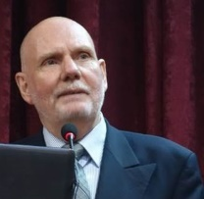


TIEMS Worldwide Operations and
Activities
Toward More Resilient Societies
By
K. Harald Drager, TIEMS President

Slide 2
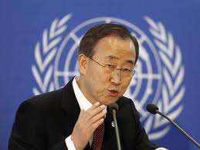
“We cannot eliminate disasters, but
We can mitigate risks,
We can reduce damage, and
We can save more lives”
Ban Ki-moon
UN Secretary General

Slide 3
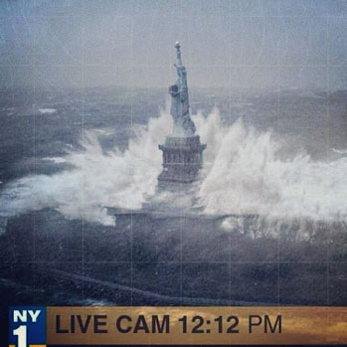
World at Risk
During 1995-2015, weather-related disasters accounted worldwide for 90% of major disasters, 71% of total losses, and 606,000 lives lost¹
Climate Change may increase the frequency and consequences of such events
Between 2010 and 2050 the number of people over 65 in less developed countries is expected to increase more than 250 percent²
By 2050, 66% of the world’s population will reside in cities³
80 % of the ten largest cities are at risk of being severely affected by an earthquake, and 60% are vulnerable to storm surge and tsunami waves⁴
Vulnerability introduced by local conditions such as poverty, government corruption, poorly planned development, and environmental degradation are adding to the risk

Slide 4
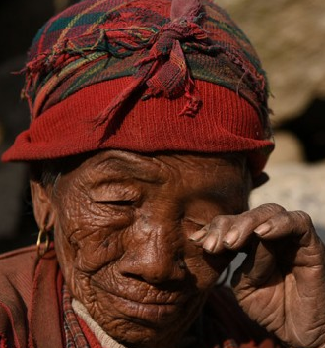
Cost of Disasters
In the 10 years since Hurricane Katrina, the world has seen an annual average of 260 major natural disasters, with average annual economic losses of US$ 211 billion, insured losses of US$ 63 billion, and 76,000 lives lost
In 2014, 72 percent of global disaster losses were caused by extreme weather events
In 2015 the devastating Nepal earthquake resulted in close to 9000 lives lost alone.
These figures do not include any of the many smaller-scale floods, storms, earthquakes and other localized disasters

Slide 5

Sumatra Tsunami 2004
240 000 death

Slide 6
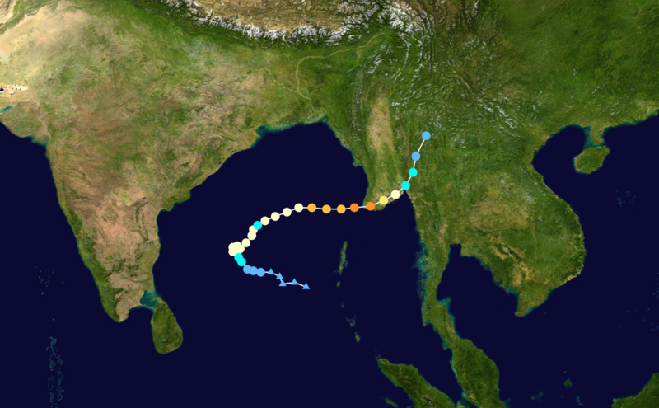
Nargis Cyclone 2008
120 000 Death

Slide 7
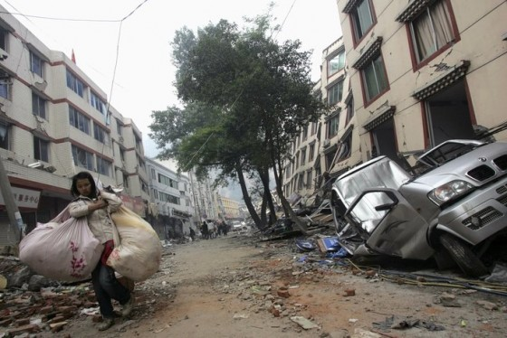
Sichuan Earthquake 2008
80 000 Death

Slide 8
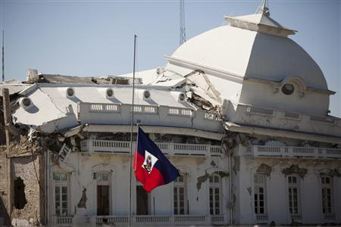
Haiti Earthquake 2010
316 000 Death

Slide 9
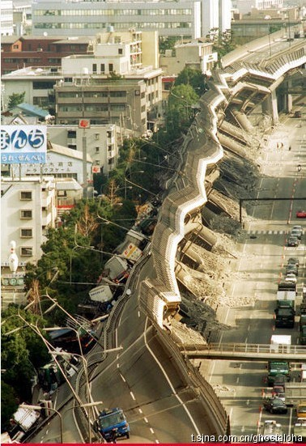
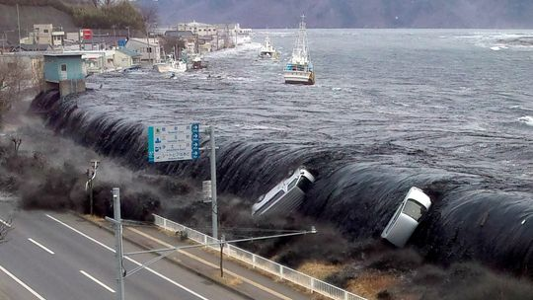
Japan Earthquake & Tsunami 2011
23 000 Death

Slide 10
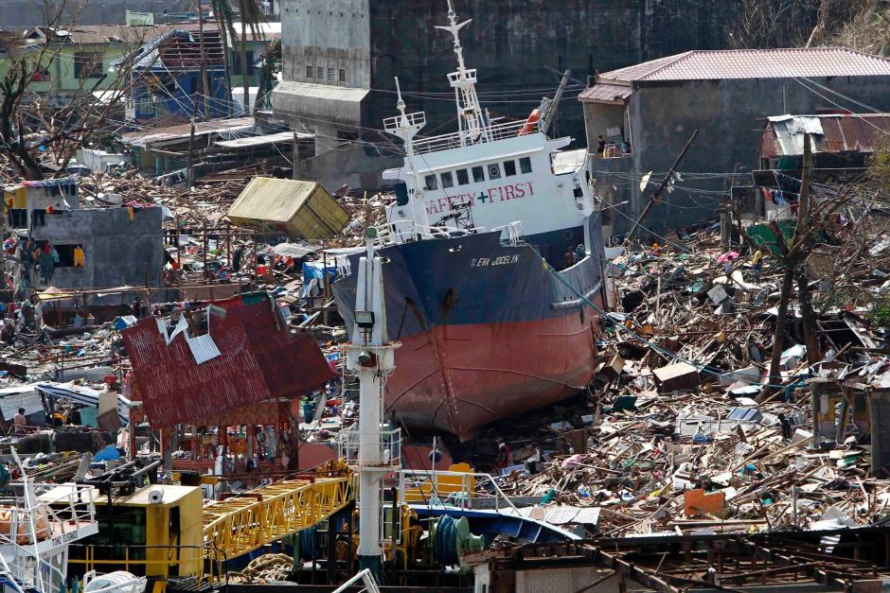
Philippines Taifun 2013
6 000 Deaths

Slide 11
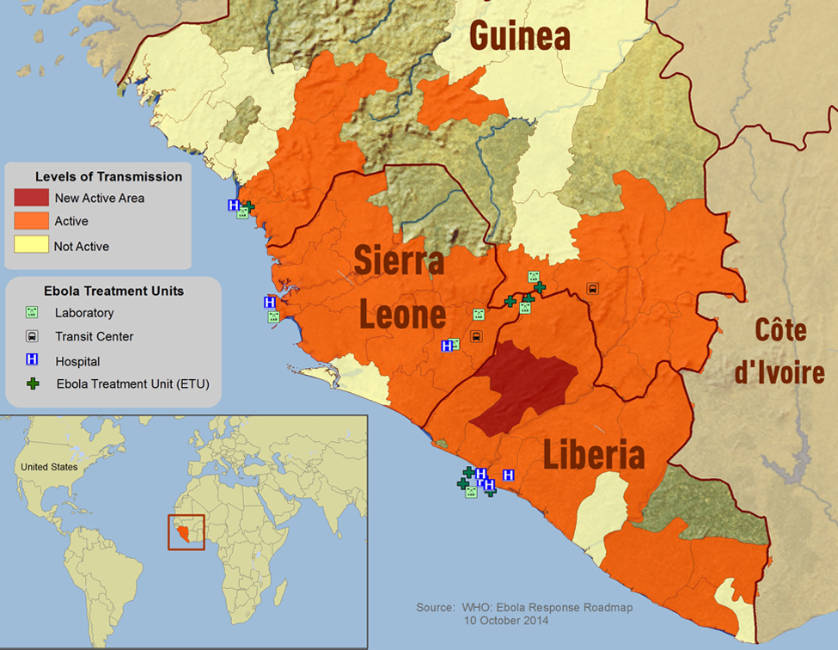
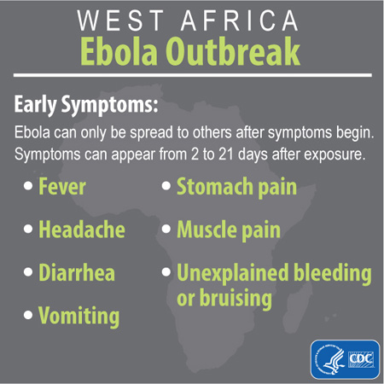
Ebola Outbreak 2013
Until now 11 300 Death

Slide 12
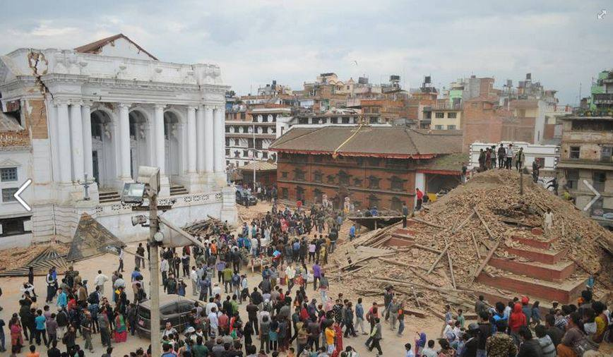
Nepal Earthquake 2015
8 896 Death

Slide 13
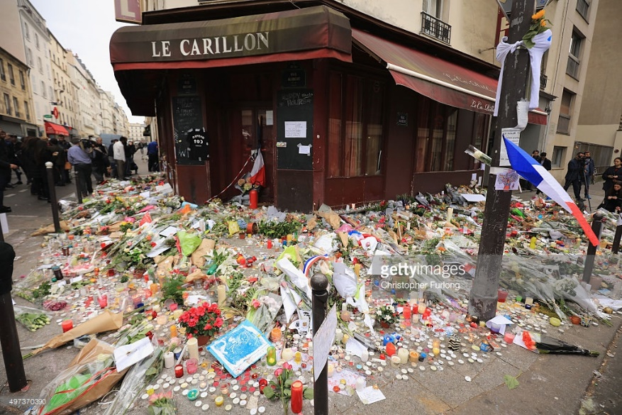

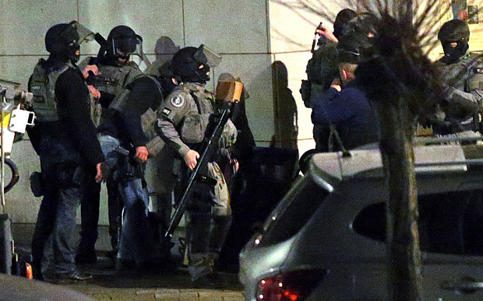
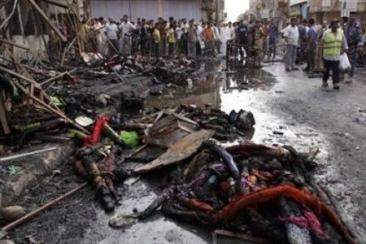
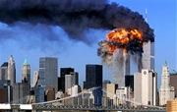
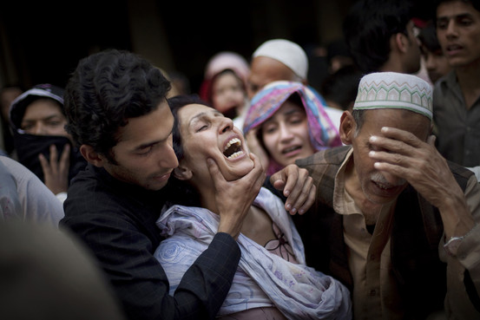
Terrorism 2015 - 2016
Paris, Iraq, Pakistan, Belgium, etc.

Slide 14
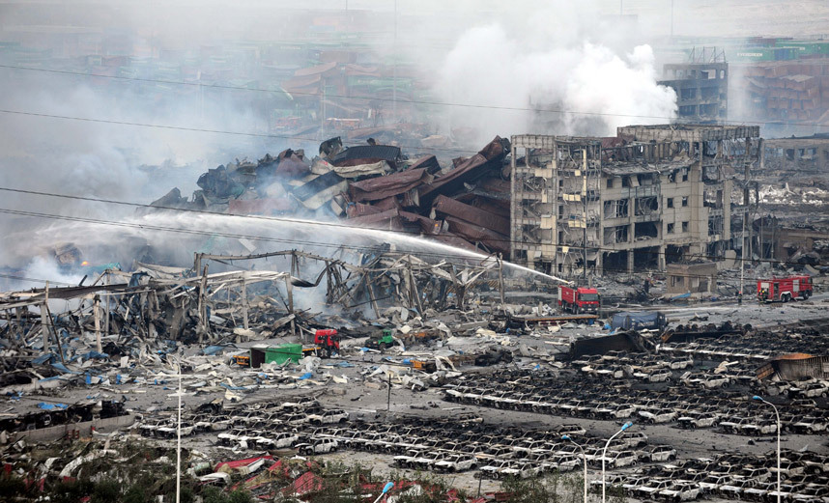
Tianjin Explosion 2015
173 deaths

Slide 15
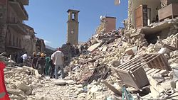
Italian Earthquake 2016
292 deaths

Slide 16
How to Prepare
Move Focus from Response to Preparedness!
Learn from Others
    USA Emergency Management/State of Preparedness
Research and Development Projects
    Example of EU R&D Projects
Education & Training
    TIEMS Education Programs, GENERATE & QIEDM Certification

Slide 17


EU’s Research Funding
Between 2014 and 2020, the EU will provide almost €80bn in funding for research, mainly through its flagship research programme Horizon 2020. This funding usually takes the form of grants, to part-finance a broad range of research projects.
Horizon 2020

Slide 18

The ASSET EU PROJECT
TIEMS is a partner in the EU project ASSET (Action plan in Science in Society in Epidemics and Total pandemics), which is a 48 month Mobilisation and Mutual Learning Action Plan (MMLAP), which aims to:
Forge a partnership with complementary perspectives, knowledge and experiences to address affectively scientific and societal challenges raised by pandemics and associated crisis management
Explore and map SiS (Science in Society)-related issues in global pandemics
Define and test a participatory and inclusive strategy to succeed
Identify necessary resources to make sustainable the action after the project completion
ASSET combines public health, vaccine and epidemiological research, social and political sciences, law and ethics, gender studies, science communication and media, in order to develop an integrated, transdisciplinary, strategy, which will take place at different stages of the research cycle, combining local, regional and national levels.

Slide 19

The HERACLES EU PROJECT
HERACLES main objective is to design, validate and promote responsive systems/solutions for effective resilience of Cultural Heritage (CH) against climate change effects, considering as a mandatory premise an holistic, multidisciplinary approach through the involvement of different expertise (end-users, industry/SMEs, scientists, conservators/restorators and social experts, decision, and policy makers).
This will be operationally pursued with the development of a system exploiting an ICT platform able to collect and integrate multisource information in order to effectively provide complete and updated situational awareness and support decision for innovative measurements improving CH resilience, including new solutions for maintenance and conservation.
HERACLES system will be designed and developed by accounting for the economic sustainability and future acceptance by the market and for the social and economic impact for public and local communities while respecting the integrity of CH and the value it hold for communities.

Slide 20

The HERACLES EU PROJECT

Slide 21
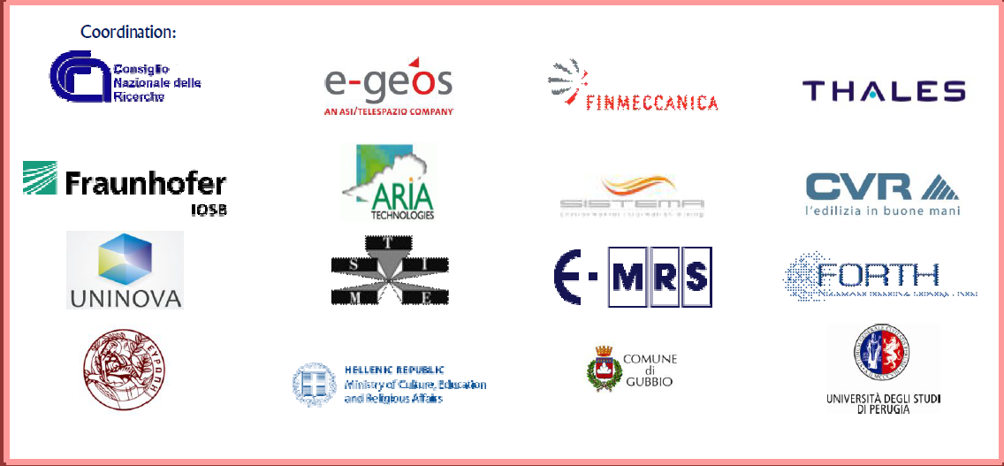
The HERACLES EU PROJECT

Slide 22

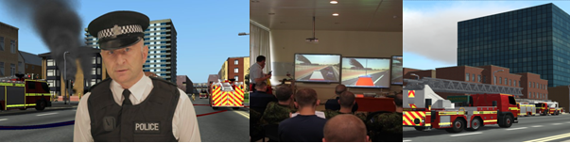
The TARGET EU PROJECT
The mission of TARGET is to develop, trial and assess a comprehensive open distributed pan-European Platform for serious gaming leveraging state-of-the-art decision support tools, for the training and competence assessment of Security Critical Agents (SCA) including counterterrorism units, border guards and first responders (police, firefighters, ambulance services, civil security agencies or critical infrastructure operators). TARGET favours joint development of serious gaming Training Content (TC) and collaborative transnational training. TARGET will trigger the emergence of a marketplace for sharing, licensing and paying for serious TC between SCA, leveraging the existing European wealth of exercises.

Slide 23

The POP-ALERT EU PROJECT
POP-ALERT is a two-year project financed by the European Commission’s Seventh Framework Programme. It has carried out behavioural research and a series of empirical studies, taking into account new issues related to targeting both local populations and visitors such as expats or tourists (cultural differences, language barriers, etc.). A portfolio of case studies on social networking and community self-reliance initiatives has been developed and POP-ALERT has identified the best ways to blend contemporary tools with existing practices in order to create flexible and easily deployable toolkits for preparing and alerting the European population in case of a crisis. The project has focused on improving current practices around the use of messaging and cultural sharing technologies that offer the best form of accessibility and use by citizens and authorities.
.

Slide 24

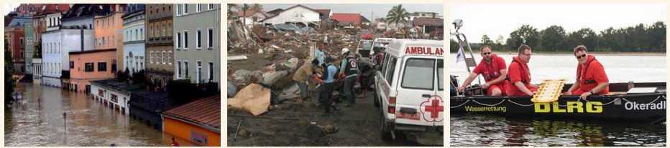
The DRIVER EU PROJECT
Improving civil society resilience so that local communities are better prepared to respond to, and recover from, a disaster
Strengthening first responders in terms of the crisis management solutions they have available to them
Training and learning solutions designed to enhance the capacities and capabilities of trainers and human resources professionals dealing with those involved in crisis management
The DRIVER consortium consists of 36 organizations from 13 EU Member States and two associated countries

Slide 25
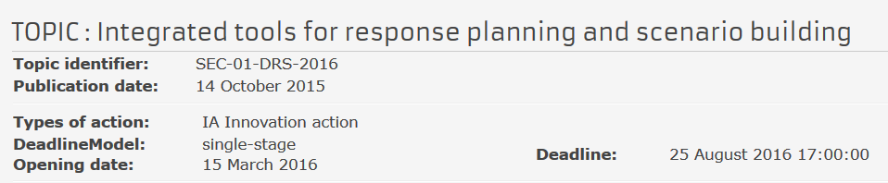
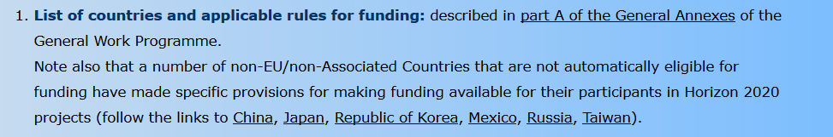
EU Security Call 2016

Slide 26
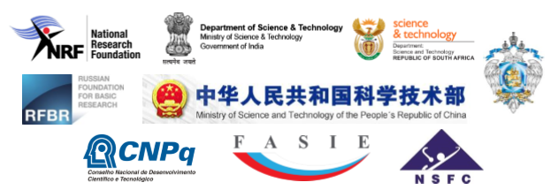
BRICS STI Framework Programme Coordinated call for BRICS multilateral projects – Pilot call 2016
Call is open
until 25th August 2016, 17:00 Moscow Time (UTC+3)
The BRICS STI Framework Programme aims to support excellent research on priority areas which can best be addressed by a multinational approach. The initiative should facilitate cooperation among the researchers and institutions in the consortia which consist of partners from at least three of the BRICS countries
As part of the initiative the following research funding organizations from the BRICS countries have agreed to jointly establish a new scheme for funding multilateral cooperative activities:
Brazil: National Council for Scientific and Technological Development (CNPq)
Russia: Foundation for Assistance to Small Innovative Enterprises (FASIE) Ministry of Education and Science (MON) Russian Foundation for Basic Research (RFBR)
India: Department of Science and Technology (DST)
China: Ministry of Science and Technology (MOST) National Natural Science Foundation of China (NSFC)
South Africa: Department of Science and Technology (DST) National Research Foundation (NRF)
Aim of the Joint Call and Thematic areas
Collaborative multilateral basic, applied and innovation research projects in the following thematic areas can be submitted in response to the call:
(a) Prevention and monitoring of natural disasters (b) Water resources and pollution treatment (c) Geospatial technology and its applications (d) New and renewable energy, and energy efficiency (e) Astronomy (f) Biotechnology and biomedicine including human health and neuroscience (g) Information technologies and high performance computing (h) Ocean and polar science and technology

Slide 27
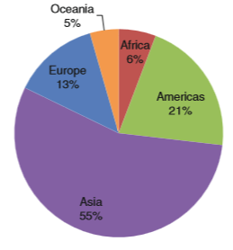
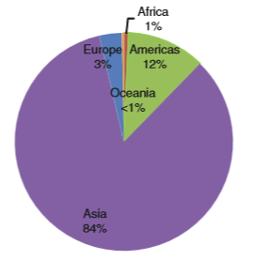
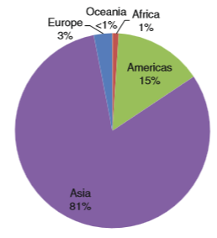
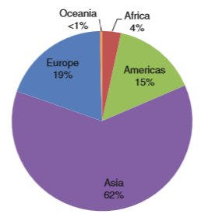
THE PRIORITY (THEMATIC) AREAS ADDRESSED IN THIS CALL FOR PROPOSALS IN THE BRICS IS AS FOLLOW:
1. UNDERSTANDING DISASTER RISK
It is critically important to make unflinching efforts for understanding hazards expected to happen and for reducing vulnerability of our infrastructure and society. To make the efforts bear fruit, each country should be supported in
Collecting and archiving hazard event records and characterizing them with relevant information on land use and socio-economic activities
Producing wide-area hazards and its impact data and information with the utilization of satellite observation and numerical modeling
Producing reliable disaster statistics will be conductive to allowing each country to make well-informed decision making for disaster risk reduction.
Improving assessment of disaster risks, monitoring and prediction of changes in disaster risks levels,
Conducting data integration, analysis and visualization supporting a holistic understanding of disaster processes and consequences.
2. STRENGTHENING DISASTER RISK GOVERNANCE TO MANAGE DISASTER RISK
in order to Strengthen Disaster Risk Governance, Initiatives should provide support in • How society may curb the increase in disaster vulnerability arising from misguided development activities in land use, construction of infrastructure and housing. • How individuals, communities and authorities may behave appropriately and be better informed before and during emergencies for protecting their lives, livelihoods and health. Meanwhile, It is urgent to strengthen international cooperation in the development of monitoring, systems (in situ and from satellite technology), early warning networks and enhanced emergency cooperation during disasters, such as the International Disaster Charter by space agencies.
BRICS should also
Support initiating a forum to discuss practical solutions to reduce disaster risks in line with the Sendai Framework, with all types of stakeholders from all over the world.
D. Guha-Sapir and F. Vos, Chapter 2 Earthquakes, an Epidemiological Perspective on Patterns and Trends in Book: R. Spence et al. (eds.), Human Casualties in Earthquakes, Advances in Natural and Technological Hazards Research 29, DOI 10.1007/978-90-481-9455-1_2, © Springer Science+Business Media B.V. 2011
Earthquake occurrence (%) by continent 1970–2008
Earthquake fatalities per continent (%) 1970–2008
Earthquake victims per continent (%) 1970–2008
Earthquake damage costs (%) by continent 1970–2008

Slide 28
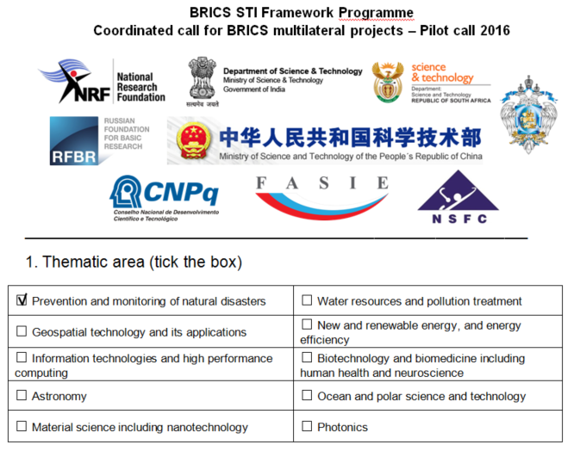
3. Abstract
Within the joint project:
3.1 The current state of earthquake impact data management and acquisition patterns indicates a great need for interconnection of dispersed scientific data in order to access, analyze vulnerability and mitigate seismic risk will be analyzed. The objective is to prepare the construction and initial development (structure and content) of a database on earthquake impact data, first of all, to work out the conditions to be met to organize a useful distributed database for BRICS countries. Data infrastructure for usage in emergency mode will be specified; crowd-sourcing based disaster data sharing system to extend the collection of data contribution will be developed (all three BRICS countries teams participate).
3.2 The software in order to accumulate and analyze the information about the well-documented past earthquakes: social and economic losses will be developed; the mechanism for access requests and activities related to knowledgebase maintenance will be identified (Russian and Chinese teams).
3.3 The regional vulnerability functions for different elements at risk with application of knowledge base on physical and socio-economical consequences, remote sensing and web technology will be developed; sensitivity of seismic risk assessments by applying several different sets of damage curves will be assessed; the procedure for high resolution space image application for verification the earthquake loss estimations in emergency mode will be developed (Teams of Russia and South Africa).
3.4 The influence of different factors on the reliability of earthquake loss estimation in “emergency mode” and ways to increase the reliability of loss simulation at global scale will be studied; methods for calibration “global” near real earthquake loss estimation systems in order to increase the reliability of loss computations in “emergency mode” will be developed (Russian team).
3.5 Real-time rapid macro damage assessment of earthquake, main objective and heavy damaged area assessment after earthquake with incompletely on-site disaster information as well as heavy building damaged and collapsed area assessment with high resolution images of remote sensing, these rapid real-time damage information will be very useful for emergency response of the governments and life search and rescue for USARs.
3.6 The Himalaya-Zagros-Alps seismic belts where with high seismic risks will be the pilot area to make a monitoring network for the seismic risks monitoring and disasters quick assessments after the earthquake with high resolution images of remote sensing and above objectives.
2. Title of Cooperative Research Project:
KNOWLEDGE BASE ON PHYSICAL AND SOCIO-ECONOMICAL CONSEQUENCES OF DAMAGING EARTHQUAKES FOR IMPROVING ASSESSMENT OF SEISMIC VULNERABILITY AND RISK
Earthquakes are increasing the risks faced by populations living in vulnerable areas of BRICS countries. Although we have increased scientific knowledge and technology, we have not yet been successful in anticipating and effectively coping with unprecedented damaging earthquakes. We need to identify potential risks, evaluate seismic vulnerabilities of elements at risk, take action from lessons learnt from past strong earthquakes and improve emergency preparedness and capacities to manage crises. At present, international collaboration in seismic risk reduction is not sufficient

Slide 29
TIEMS
TIEMS was founded in 1993 in Washington, USA, and is today registered as an international, independent, non political, not for profit NGO in Belgium
TIEMS is a Global Forum for Education, Training, Certification and Policy in Emergency and Disaster Management
TIEMS provides a platform for all stakeholders within the global emergency and disaster management community to meet, network and learn from each other and exchange knowledge and experience
TIEMS aims to influence policy makers worldwide to improve global cooperation and to establish global standards within emergency and disaster management

Slide 30
TIEMS ACTIVITIES
International Conferences, Workshops and Exhibitions, focusing on different Emergency Management and Disaster Topics
Electronic Newsletter with latest News and Articles of Interest and Monthly Messages from TIEMS President
Research & Development Project Initiatives and Coordination of RTD Projects
International Education, Training and Certification Programs (GENERATE)
Global Young Scientist Network
Local Chapter Activity to Stimulate Local Initiatives and Build a Global Expert Network where different Cultural Practises are added value
Task Force Groups

Slide 31
TIEMS Chapters
Think Globally and Act Locally
Romania Chapter
BeNeLux Chapter
China Chapter
South Korea Chapter
India Chapter
USA
7. MENA Chapter
8. Finland Chapter
9. Iraq Chapter
Japan Chapter
Italy Chapter
Nigeria & West Africa Chapter
Ukraine Chapter (under establishment)

Slide 32
TIEMS Event Program 2016 - 2017
TIEMS 2016 Annual Conference in San Diego, USA, September 13 - 15
TIEMS 2016 Conference on Disaster Control and Emergency Management, Kyiv, Ukraine, October 12 - 13
TIEMS 2016 International Conference on Emergency Medicine, Shaoshan, China, October 15 - 16
TIEMS China Chapter 2016 Annual Conference, Zuhai, China, November 4 - 5
TIEMS Korea Chapter 2016 Annual Conference in Korea, dates TBD
TIEMS Japan Chapter 2016 Annual Conference in Japan, Dates TBD
TIEMS Iraq Chapter 2017 Conference on Emergency & Disaster Management in Erbil, Iraq, March 28 - 30
TIEMS Finland Chapter 2017 Conference on Smart and Safe Cities, Helsinki,
March 29 - 31

Slide 33
TIEMS Task Force Groups
TIEMS Emergency Medical Committee (TEMC)
TIEMS Education and Training Task Force Group (GENERATE)
TIEMS Disaster Early Warning Task Force Group
TIEMS Community Emergency Response Team (CERT) Task Force Group

Slide 34
TIEMS Education, Training and Certification Program Objectives
Put International Focus on the Profession of Emergency Management and Disaster Response
Contribute to an Internationally Shared Understanding in Education, Training and Certification in Emergency Management and Disaster Response
Contribute to Education in Emergency Management and Disaster Response in order to Promote the State of the Art in Technology, Systems and Methods available in the Field
Contribute to Education at all Levels, from Policy Documents to Courses in Primary School Education
Establish a TIEMS Certification of Qualifications in International Emergency Management and Disaster Response (TIEMS QIEDM)
Contribute to Capacity Building in Countries where little or no Education and Training in this field is available
Recruit International Teachers and Trainers in this field to TIEMS Pool of International Teachers and Instructors

Slide 35
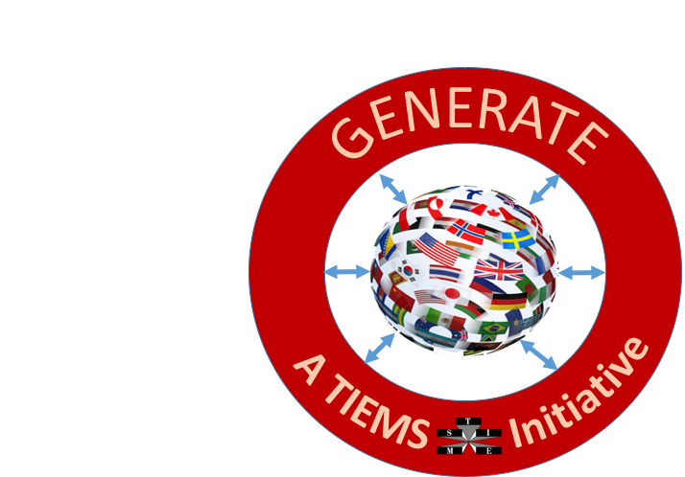
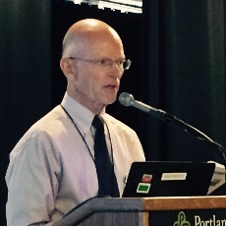



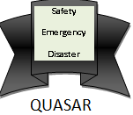
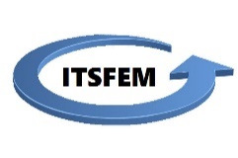
A TIEMS RTD Project Proposal
GENERATE
Global Education Network for Emergency Resilience and Training Excellence
Developed and Sponsored by:
Thomas Robertson
K. Harald Drager
Connie White
ITSFEM

Slide 36

Increasing need for
Disaster Preparedness Worldwide
Resilience to Emergencies is a Global Problem
Education is the Foundation for Resilience
A RTD Proposal to Improve Access to Education
Resources to Build Upon

Slide 37
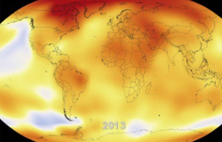

We are Interconnected
Climate Change
Global Economy
Energy Interdependence
Cyber Connectivity
Global Travel and Epidemics and Pandemics

Slide 38

We can learn from each other
Some Nations may have more Experience with the Disasters we may Face in the Future than Others
Vast Worldwide Experience can be used to Develop an Education and Certification Scheme Useful to All
Shared Knowledge and Terminology makes International Cooperation Easier
New Lessons are Learned every Day

Slide 39
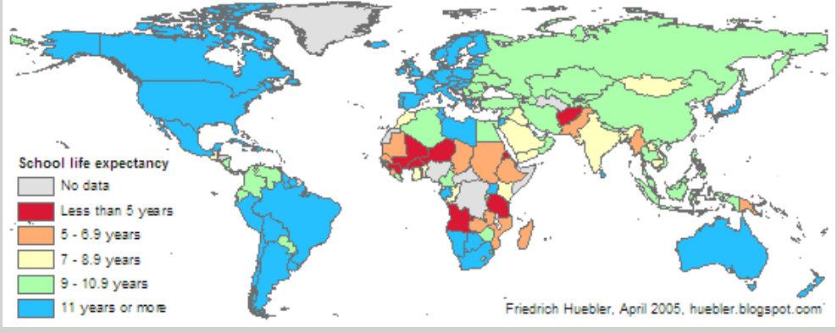
The education access problem

Slide 40
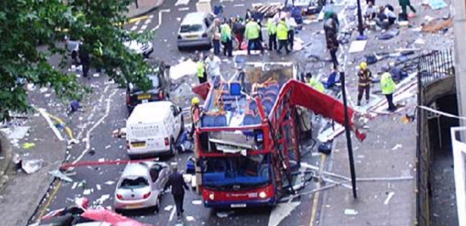
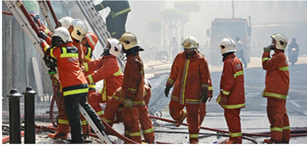
GENerate project objectives
Develop an Internationally Shared Understanding of Emergency Management Elements, Qualifications and Terminology
Help Students Find and Connect with Useful Online and Live Education Resources
Make Increasing Amounts of Emergency Management Knowledge Available Online, Especially to Vulnerable Societies
Provide a Platform to Share Critical Lessons Learned

Slide 41
What is GENERATE?
An International Community of emergency management organizations, educators, practitioners, and students
  GENERATE Centers of Excellence
An eLearning and Certification platform promoting shared understanding of EM elements, standards and terminology
A Directory of live and online degree programs, courses, workshops, and knowledge bases
An online Community of Practice to share lessons learned
TIEMS International Centre of Excellence Module
TIEMS
Universities/
Training Institutions Catalogue
Module
GENERATE Global Education Network
TIEMS WEB-Site
GENERATE Core Module
TIEMS Comunity of Practise
COP
Module
GENERATE Nucleus, Community of Practise and Mobile application
TIEMS On-line, Education, Exam and Certification Module
TIEMS Wikipedia of Lessons Learned Module
GENERATE On-line Learning and Education, Exam and Certification
TIEMS Mobile Application

Slide 42
GENERATE Development Plan
WP0
WP2
WP3
Start-up
Development
Finalization
WP1
Kick-Off
WP6
WP4
WP5
WP6
WP6
WP7
WP6
Structure
and
Design
University
Network
Documentation
And
Workshop
Preparations
And
Workshop
GENERATE
System
Management
And
Control
GENERATE
Administration
Student
Tests
12 Months

Slide 43
GENerate project ORGANIZATION STRUCTURE
Project Board
(Including those giving financial support to the project)
Advisory Board of Partners
(Including those participating in the project as partners, like universities)
Advisory Board of Supporters
(Including those supporting the project and its outcome without actively participating in the project)
Project Management
Project Responsible
Project Manager
Quality Manager
WP 5
WP 3
WP 2
WP 0
WP 1
WP 4
WP 7
WP 6
Advisory Group of Students

Slide 44
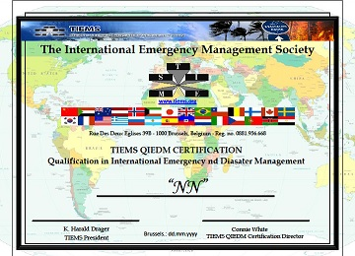
TIEMS QIEDM CERTIFICATION
Application Requirements
QIEDM – Qualifications in International Emergency and Disaster Management
Being Certified in Emergency Management/Disaster Response or Similar by Another Certifying Institution Approved by TIEMS
Document a Practical or Theoretical Background in Emergency and Disaster Management for a minimum of 4 years
Provide a Letter of Recommendation to TIEMS QIEDM Program from a Current or Former Employer
OR

Slide 45
QIEDM Certification OBJECTIVES
Availability Globally
Web-based On-Line
Low Cost
A Common Understanding of Emergency and Disaster Management
The Common Language is English, but local language adaption in TIEMS Chapter Countries
Lessons Learned Focus
State-of-the-Art and Up-to-Date

Slide 46
TIEMS Membership Benefits
As a member of the TIEMS, you are part of an international community of leaders and practitioners in emergency management, with diverse backgrounds in engineering, science, government, academics, military, and industry - working together to make the world a safer place. Membership affords unique opportunities to
Learn, Serve, and Network

Slide 47
TIEMS Membership Benefits
Learn
From the multi-disciplinary, multi-national TIEMS community, and through special TIEMS programs
Serve
By helping TIEMS in its mission to reduce the impacts of disasters and emergencies worldwide
Network
With local and international colleagues to develop valued personal and professional relationships, and enhanced opportunities

Slide 48

TIEMS Global Approach
The International Emergency Management Society – TIEMS, Focus on Cultural Differences to be Understood and Included in the Society’s Events, Education and Research Programs

Slide 49

Thank You for Your Attention!

