Slide 1

“Relationships AND the Road to Resiliency”
Ellis M. Stanley, Sr., Chair, Global Board
International Association of Emergency Managers
Managing Partner – Ellis Stanley Partners, LLC
ellisstanleysr@gmail.com
International Association of Emergency Managers

Slide 2
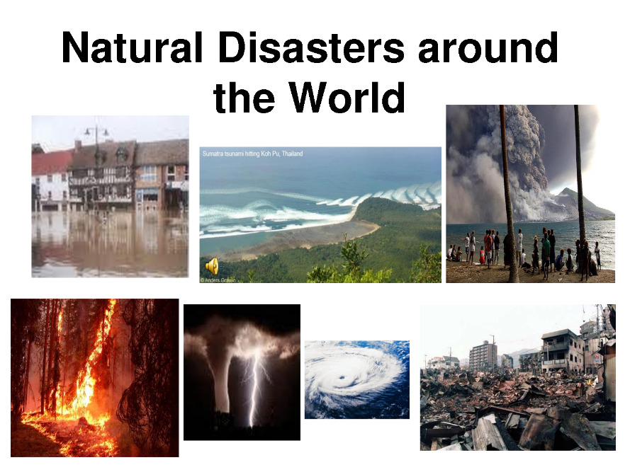

Slide 3
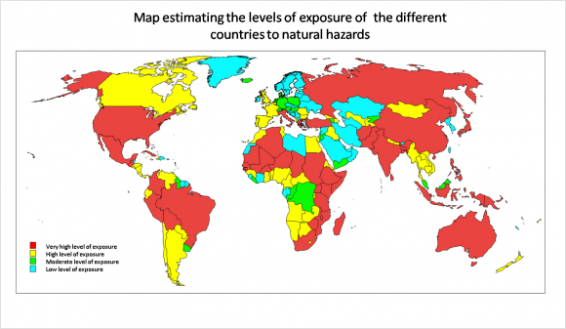

Slide 4
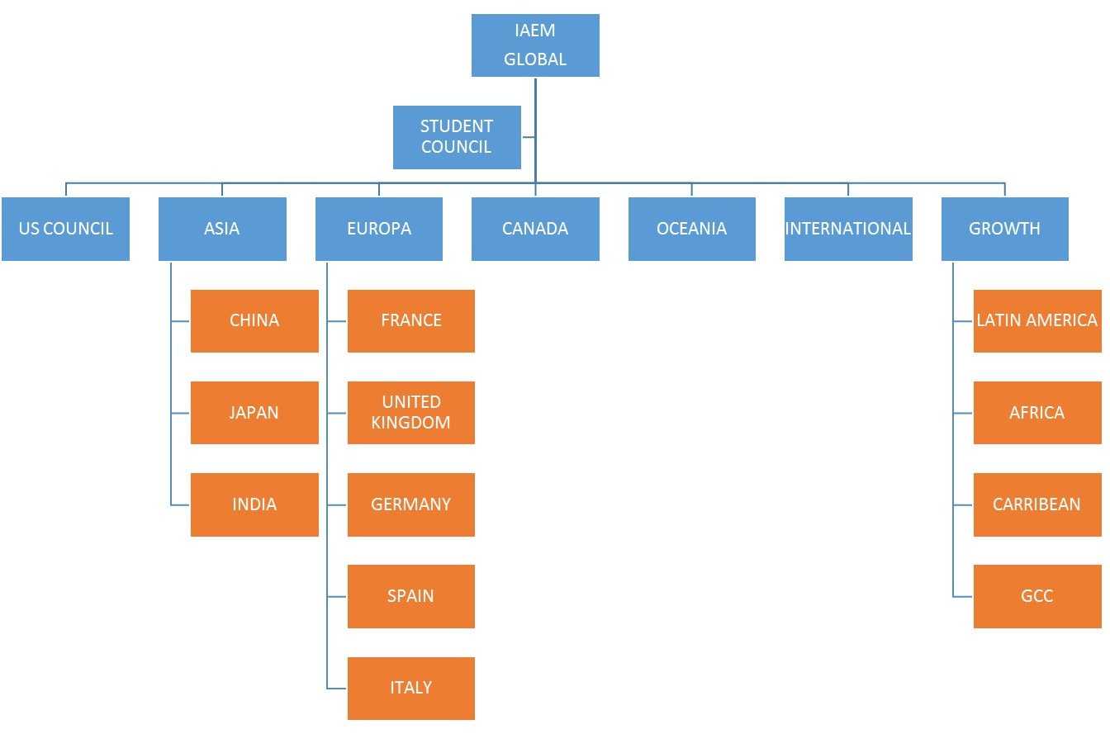
INTERNATIONAL ASSOCIATION OF EMERGENCY MANAGERS, GLOBAL
Currently, there are seven council, which includes a student council. The goal is to grow as the organizational chart reflects.
Latin America is a key opportunity for IAEM.

Slide 6
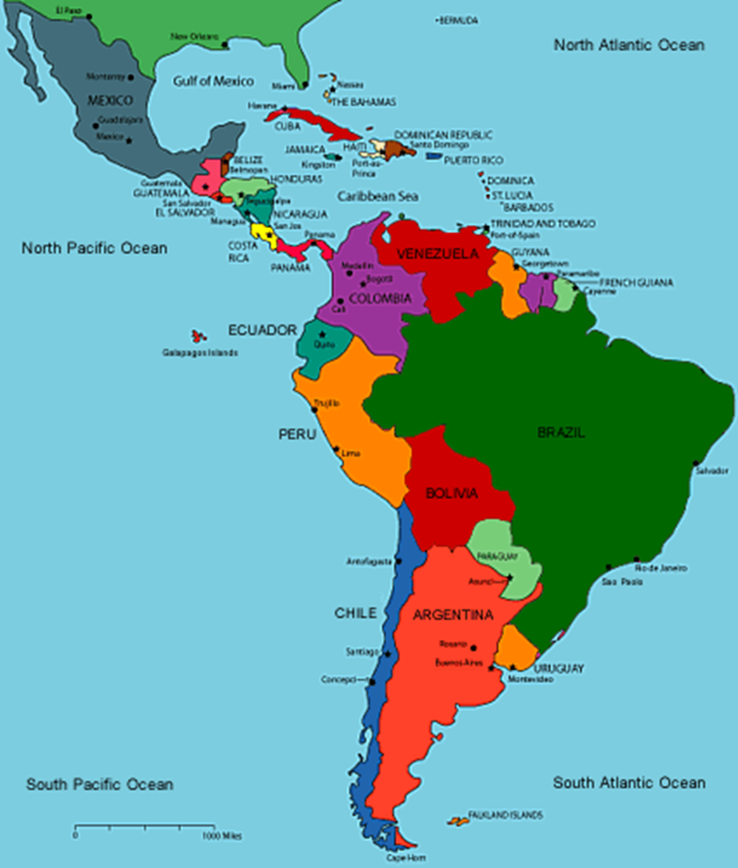
LATAM COUNCIL
The Latin American Council is the next frontier for IAEM.
An opportunity to network on a global basis.
Build Resiliency on a global basis.

Slide 7

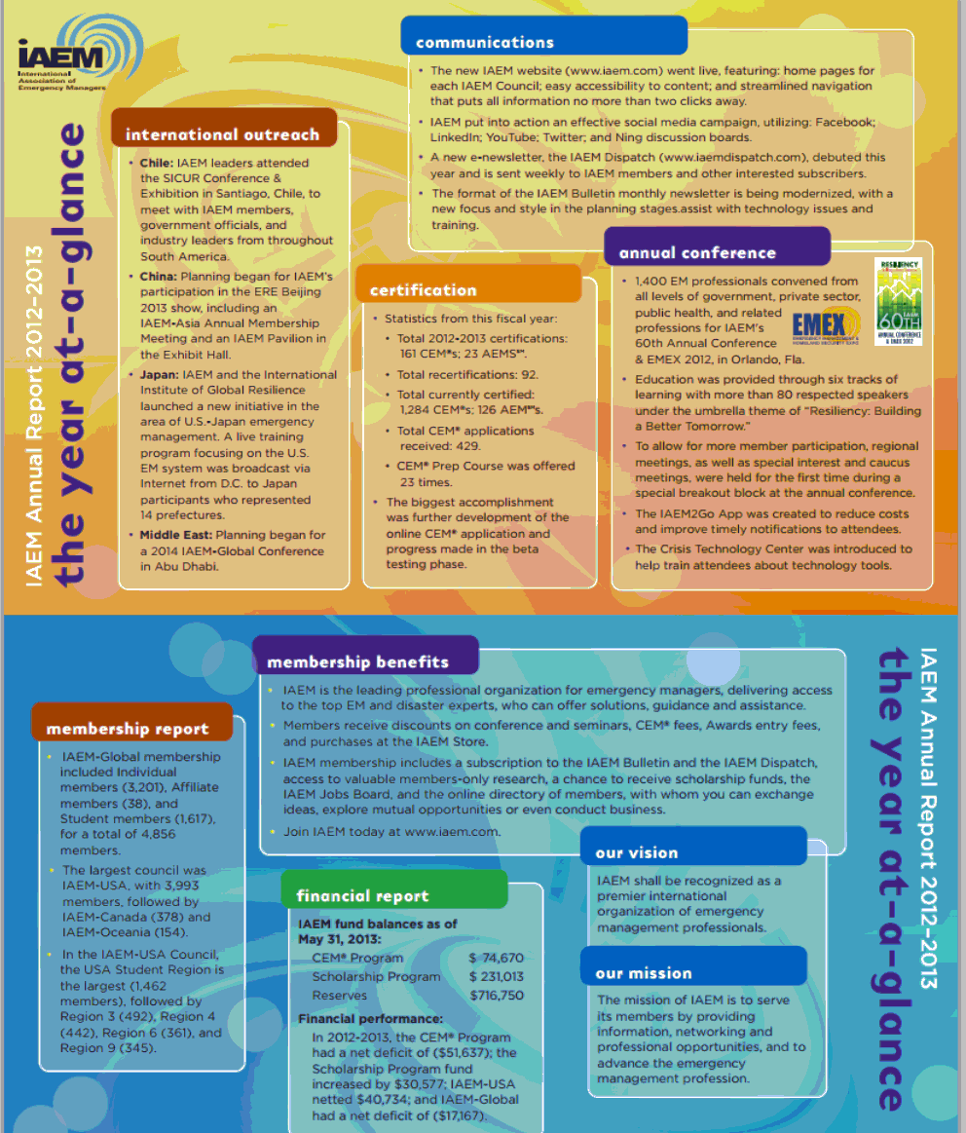
Principles; Emergency management must be:
1
Comprehensive
2
Progressive
3
Risk-driven
11
4
Integrated
5
Collaborative
11
6
Coordinated
7
Flexible
8
Professional

Slide 8

PRINCIPLES
Principles provide guidance
Emergency management lacked a set of principles agreed upon by the practitioners
The principles must be capable of standing the test of time and use
They can be contrasted with “stuff and things”

Slide 9

PRINCIPLES
Stuff and things are often difficult to fit into neat categories or “cubbyholes”
Principles provide that order- stuff and things now have a place to fit
When on point, the stuff and things reinforce and provide the details of the principle

Slide 10
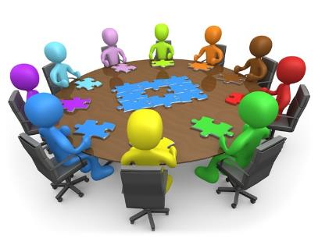
COLLABORATIVE
Emergency managers create and sustain broad and sincere relationships among individuals and organizations
  to encourage trust
  advocate a team atmosphere,
  build consensus,
  facilitate communication

Slide 11

COLLABORATIVE
Collaboration must be viewed as an attitude or an organizational culture that characterizes the degree of unity and cooperation that exists within a community.
In essence, collaboration creates the environment in which coordination can function effectively

Slide 12
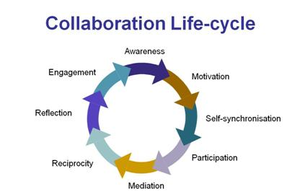
COLLABORATIVE
One factor that is consistently credited with improving the performance of a community
  is the degree to which there is an open and cooperative relationship among those individuals and agencies involved

Slide 13
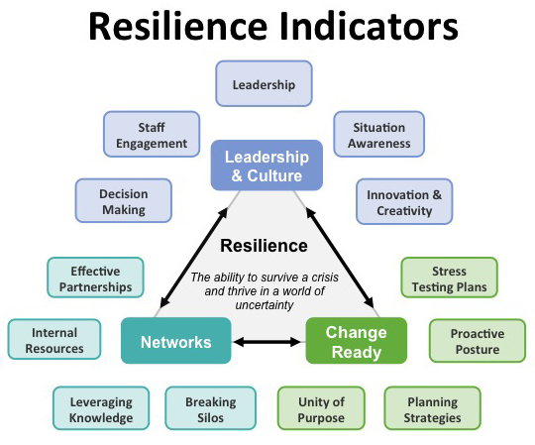

Slide 14
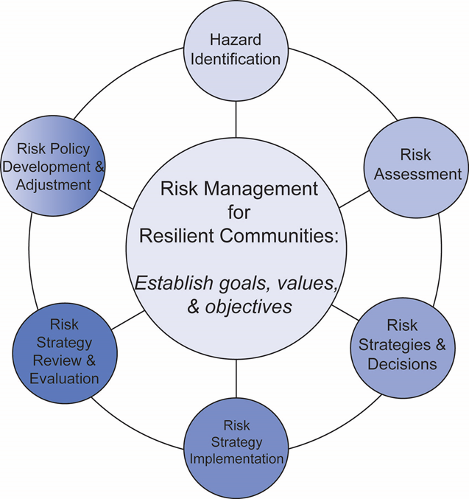
RESILIENCE
Natural disasters are having an increasing effect on the lives of people throughout the world.
Every decade, property damage caused by natural disasters and hazards doubles or triples in the United States.
More than half of the U.S. population lives within 50 miles of a coast, and all Americans are at risk from such hazards as fires, earthquakes, floods, and wind.

Slide 15
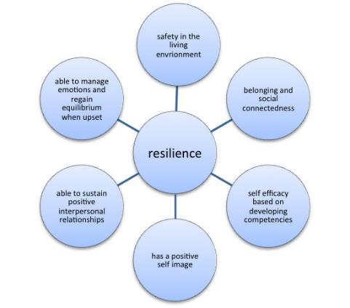
RESILIENCE
The year 2010 saw 950 natural catastrophes around the world--the second highest annual total ever--with overall losses estimated at $130 billion.
The increasing impact of natural disasters and hazards points to increasing importance of resilience, the ability to prepare and plan for, absorb, recover from, or more successfully adapt to actual or potential adverse events, at the individual , local, state, national, and global levels.

Slide 16
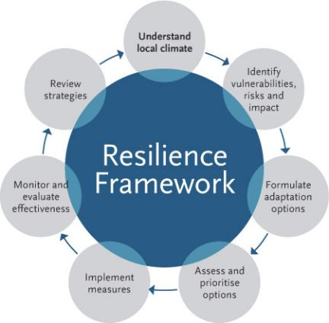
RESILIENCE
No person or place is immune from disasters or disaster-related losses.
Infectious disease outbreaks, acts of terrorism, social unrest, or financial disasters in addition to natural hazards can all lead to large-scale consequences for the nation and its communities.
Communities face difficult fiscal, social, cultural, and environmental choices about the best ways to ensure basic security and quality of life against hazards, deliberate attacks, and disasters.

Slide 17
RESILIENCE
“Communities today face an increasing number of challenges,
Ranging from natural and man- made disasters to environmental hazards and economic declines,”
“We know that a community will be resilient when it can bring together the people, processes, and technology that helps them anticipate risk and build an executable plan.
Transportation
Global Issues
Utilities
Weather
Terrorism
Communications
Cyber-Terrorism
Critical Infrastructure

Slide 18

LEADERSHIP
Individuals learn how and when to apply leadership
Meta-leadership tools and techniques, begin to identify resources and expertise across sectors and explore how collaboration can strengthen preparedness, response and recovery.
  Gaps: overall system deficiencies
  Gives: what your organization has to offer before or during a response
  Gets: what your organization needs to be of assistance

Slide 19
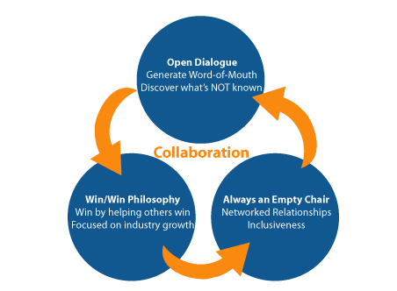
LEADERSHIP
Get to know each partner-in-preparedness really well.
  Learn about each other's capabilities as well as gaps. Most importantly, discuss your gives and gets
Figure out the boundaries.
  Talk about what you believe can and cannot be accomplished in a relationship.
  If something makes one of you uncomfortable, discuss that and figure out a compromise.
Treat all as you'd like to be treated.
  It's not fair for one team member/stakeholder to set boundaries and then not be expected to keep the same ones.
  If you make a margin then you need to keep it as well. It's black and white, there is no gray. Only make limitations you yourself can do.

Slide 20

LEADERSHIP
Communicate, communicate and communicate thoroughly.
  The more you are open with what you're up to and what you expect, the less guesswork needs to be done.
  When there's room for question or uncertainty that's where distrust can creep in.
Don't break boundaries and don't lie.
What to do if you have broken trust.
  So you've done something to breech the trust with your partner-in-preparedness, or are on the receiving end of the issue, it's going to take time for recovery.
  Of course you won't always agree, but it's better to agree to disagree than to have things hidden.

Slide 21

RESILIENT COMMUNITIES
A resilient community is knowledgeable and healthy.
  It has the ability to assess, manage and monitor its risks.
  It can learn new skills and build on past experiences.
A resilient community is organized.
  It has the capacity to identify problems, establish priorities and act.
A resilient community is engaged in the development of local policy for reducing risks

Slide 22

RESILIENT COMMUNITIES
A resilient community has infrastructure and services.
  It has a strong system in place to help mitigate for instance climate change.
  It has the ability to maintain, repair and renovate the system.
A resilient community has economic opportunities.
  It has a diverse range of employment opportunities, income and financial services.
  It is flexible, resourceful and has the capacity to accept uncertainty and respond (proactively) to change.

Slide 23
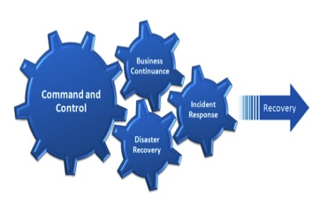
RESILIENT COMMUNITIES
A resilient community is connected.
  It has relationships with external actors, who provide a wider supportive environment, and supply goods and services when needed.
A resilient community can manage its natural assets.
  It recognizes their value and has the ability to protect, enhance and maintain them.

Slide 24
“Unlearning” & “New Learning”
NEW “PATTERNS” TO DEPLOY IN AN EMERGENCY
We Get
“INVESTED”
in a
Particular
Solution
Difficulty of
“UNLEARNING”
Something in
Which We Have
Invested
RESISTANCE TO CHANGE:
Difficulty of Incorporating
Something New
Notes:
24

Slide 25
Dis-Connectivity
The “SILO” Mentality
Notes:
25

Slide 26
BEYOND
Leadership
Dis-connectivity
The “Silo” Mentality

Slide 27
Meta-Leadership In Practice
FIVE DIMENSIONS
4. Lead Up
2. The
Event
The
Context
1. The Person
of the
Meta-Leader
The
Problem
The
Culture
5. Lead
Connectivity
3. Lead the Silo
Notes:
27

Slide 28

Your Brain: Amygdala Hijack
SHOCK
Go to the
“BASEMENT”
FAMILIAR
PATTERNS
Am
Am
Triple “F”
FREEZE
FLIGHT
FIGHT

Slide 29
Your Brain: Embedded Patterns
Go to Your
“TOOL BOX”
FAMILIAR
ACTION
PATTERNS
Drills
Exercises
Training
Connectivity
Mindfulness
ACTIVATE
What You
Have Prepared

Slide 30



Your Brain: The Meta-Leader
In
Preparedness
In
Crisis
Design &
Build Your
Policies &
Protocols
EMBED THE
PATTERNS
CLOSE
GAPS
“OODA”
LOOP
Observe
Act
Orient
Decide
WORKING WITH YOUR BRAIN

Slide 31
Dis-Connectivity
THE DILEMMA OF THE CUBE
Peep Hole
B
Peep Hole A
Peep Hole
A
Peep Hole B
Notes:
31

Slide 32
Connectivity
Beyond The “Silo” Mentality
META – LEADERSHIP
LEADERSHIP
Building
Connectivity
Notes:
32

Slide 33
Connectivity
Beyond The “Silo” Mentality
“GUIDING OPERATIONAL ASSUMPTIONS”
Guiding
Leadership
Influence
Leverage
Operational
Activities
Resources
Logistics
Assumptions
Beliefs
Experiences
Data
Notes:
33

Slide 34
Connectivity
Meta-Leaders Align
Guiding Operational Assumptions
GUIDING OPERATIONAL ASSUMPTIONS
“G.O.A.”
“G.O.A.”
Nonprofit
Business
“G.O.A.”
“G.O.A.”
Government
Philanthropic
Building
Connectivity
Notes:
34

Slide 35
Summit Issues: Meta-Leadership
Meta-Leaders Align
Guiding Operational Assumptions
GUIDING OPERATIONAL ASSUMPTIONS
“GAPS”
“GIVES”
“GETS”
Notes:
35

Slide 36

Ellis M. Stanley, Sr.
ellisstanleysr@gmail.com

