Slide 1
The Perception of Value
Lorraine Churchill
Lorraine.Churchill.EM@gmail.com

Slide 2
What is Value?
Websters: “: relative worth, utility, or importance <a good value at the price> <the value of base stealing in baseball> <had nothing of value to say>”

Slide 3
“Perception” is ???

Slide 4
“Perception”
Websters: “: the way you think about or understand someone or something”

Slide 5
Why does this matter?
Emergency Management is an industry?
Emergency Management is a social service?
Emergency Management is insurance?

Slide 6
Getting It Across The Table
Emergency Management
E M
ME
W E

Slide 7
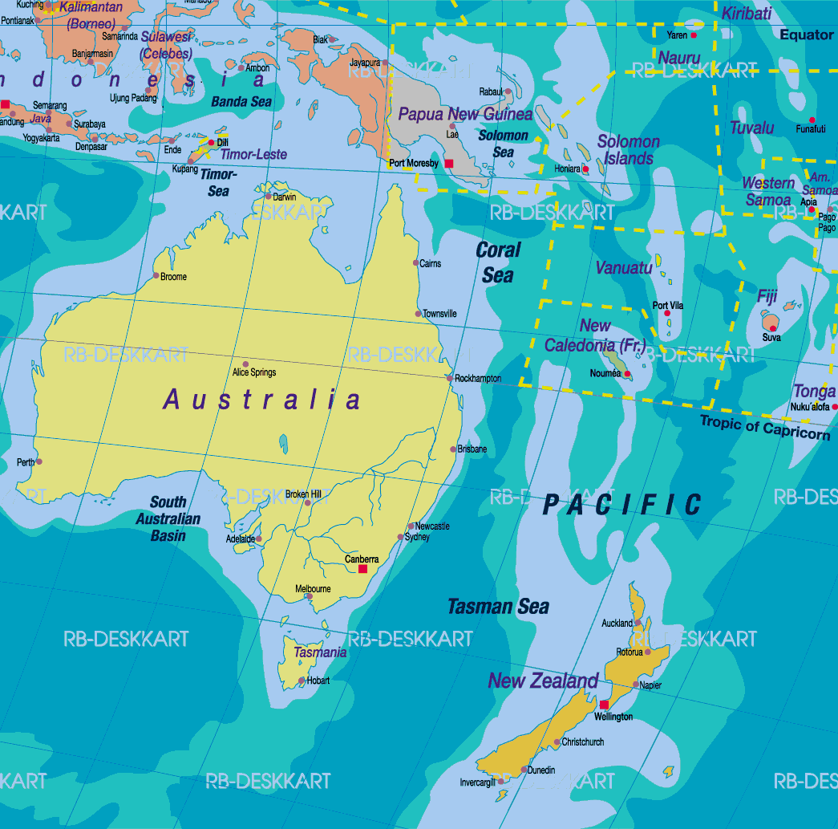
Getting It Across The Table

Slide 8
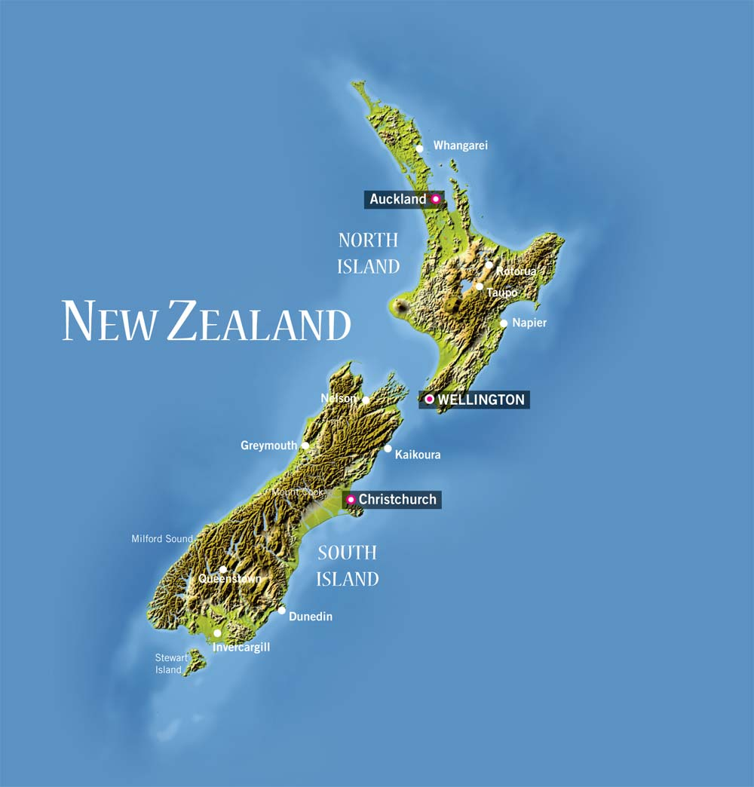
Getting It Across The Table

Slide 9
Auckland Sheltering
New Zealand’s largest, most complex city and urban area
Low-lying area; high volcanic and tsunami risk
Increasing storm activity

Slide 10
Fonterra Co-operative Group
New Zealand’s largest employer
A leading contributor to NZ’s economy
BioThreat Impact – 2013 Botulism Scare

Slide 11
2014 G20 Brisbane Summit
High risk, media intense event
Complex management
Long-term development and implementation process

Slide 12
“ W E “
Auckland: planning for the unexpected
Fonterra: required to plan for the “scare”
G20: planning for the event with predicted cascading incidents

Slide 13
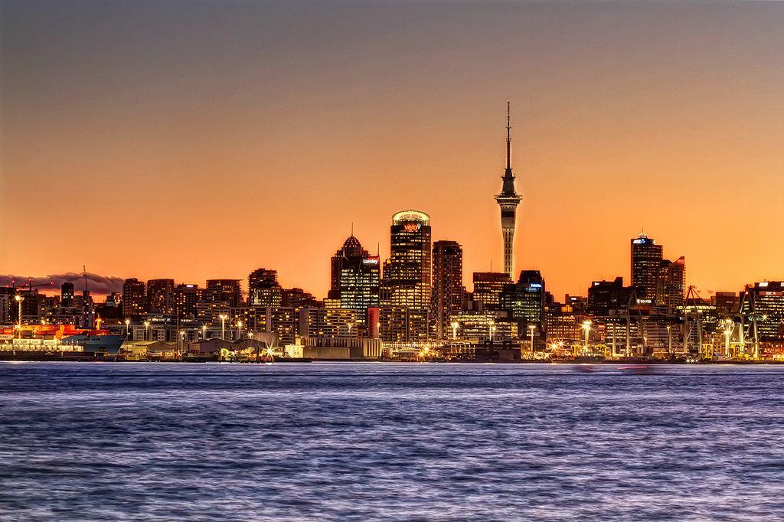

Slide 14


Slide 15
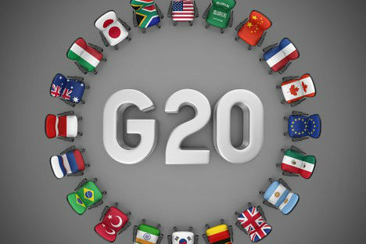

Slide 16
“ W E “ = Value

Slide 17
The Perception of Value
Lorraine Churchill
Lorraine.Churchill.EM@gmail.com

