Slide 1


Is Health Insecurity Infectious?
BETTER TOGETHER

Slide 2
MESH Mission
MESH is a not-for-profit private-public partnership that Enables healthcare providers to effectively plan for, mitigate and respond to emergency events and remain viable through recovery.
Single agencies struggle to maintain day-to-day awareness and capacity.
High levels of system usage and surge during critical routinely exceed the resources of single agencies and communities.
MESH’s was founded by the five Marion County hospital systems, with the VA and Department of Public Health.
BETTER TOGETHER
Notes:
MESH provides healthcare intelligence fusion services to the emergency management community by gathering, analyzing, and reporting on intelligence gathered from throughout the healthcare sector. Leveraging our work with hospitals and providers, MESH capitalizes on relationships with institutions and providers to provide up to date information to emergency managers, public health officials, and city executives.

Slide 3
ACCLIVITY Mission
Acclivity Associates: Planning, Program Management & Communications.
Key Clients and Projects:
FEMA Risk MAP- Mapping, Assessing & Planning the Nation’s Floodplains
FEMA HMTAP- Hazard Mitigation Technical Assistance
Numerous State and Local Governments- Resiliency Plans
Risk Communication via Disaster Exhibits and Communication Training
BETTER TOGETHER
Notes:
We map risks. Assess risks. Plan for risks. And communicate risks. We’re teamed with Booz Allen Hamilton, Ogilvy, IBM, AECOM….and more. To IDENTIFY, ASSESS, PLAN, & Communicate…

Slide 4
Health Insecurity
Personal
Community
Global
Shared economically
Shared behaviorally
BETTER TOGETHER
Notes:
MESH provides healthcare intelligence fusion services to the emergency management community by gathering, analyzing, and reporting on intelligence gathered from throughout the healthcare sector. Leveraging our work with hospitals and providers, MESH capitalizes on relationships with institutions and providers to provide up to date information to emergency managers, public health officials, and city executives.

Slide 5
Infectious
Defies temporal, geographic and social boundaries of most other threats
Infection has been adopted as metaphor in other arenas, e.g. cyber (watch out for simple models!!)
Susceptible to interception, mitigation and manipulation
Declared, perceived and assumed
BETTER TOGETHER
Notes:
MESH provides healthcare intelligence fusion services to the emergency management community by gathering, analyzing, and reporting on intelligence gathered from throughout the healthcare sector. Leveraging our work with hospitals and providers, MESH capitalizes on relationships with institutions and providers to provide up to date information to emergency managers, public health officials, and city executives.

Slide 6
Vulnerability in Floodplains
16.4 million
Approximate population residing in the coastal floodplain in 2010.
(5% of the U.S. population).
12
Percent of the population residing in the coastal floodplain that is below the poverty level (excluding U.S. Territories).
23
Percent of the population residing in the coastal floodplain that is under 5 and 65 and over (excluding U.S. Territories).
Source: NOAA, 2012
BETTER TOGETHER
Notes:
5% of US Population, but 12% of population is poor! 23% are of vulnerable age. Yet we continue to communicate as if the audience is us. How can we better adjust our message from the standard EDUCATE>

Slide 7
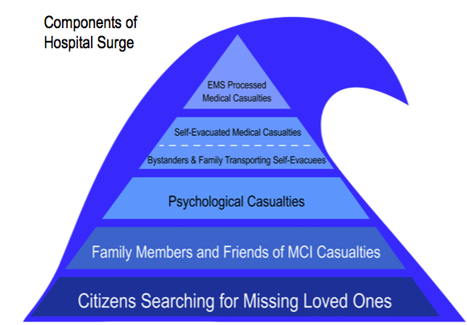
Surge
Source: Center for Disaster Epidemiology & Emergency Preparedness
BETTER TOGETHER

Slide 8
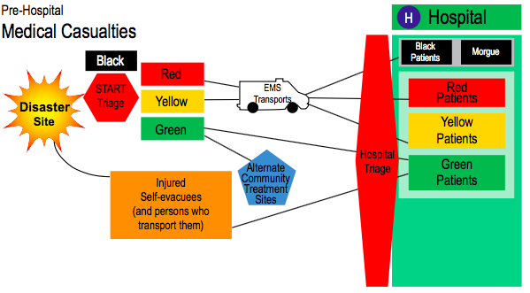
Surge
Source: Center for Disaster Epidemiology & Emergency Preparedness
BETTER TOGETHER

Slide 9
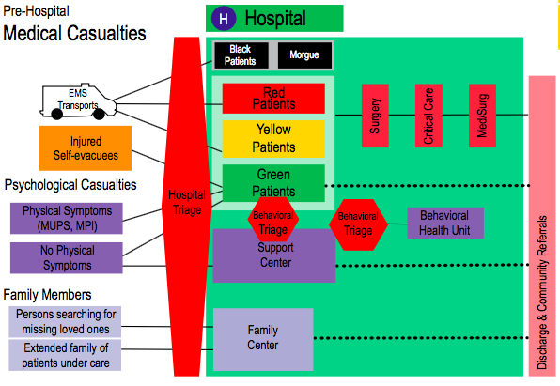
Surge
Source: Center for Disaster Epidemiology & Emergency Preparedness
BETTER TOGETHER

Slide 10
Lingering (Chronic?) Impacts
Hurricane Katrina: August 29, 2005- 10 Year Anniversary Coming Up…
  Recovery slow and uneven
    Persistent housing blight, homelessness, unemployment
  Disparate impacts on poor populations
    Loss of transportation, loss of safety nets, long-term stress impacts, food islands, loss access to medical facilities, more?
BETTER TOGETHER
Notes:
MESH provides healthcare intelligence fusion services to the emergency management community by gathering, analyzing, and reporting on intelligence gathered from throughout the healthcare sector. Leveraging our work with hospitals and providers, MESH capitalizes on relationships with institutions and providers to provide up to date information to emergency managers, public health officials, and city executives.

Slide 11
Ebola / SARS / MERS/ H1N1
One patient denies 99.9% for 8 days
Public health is a small component
Owners and operators (Parkland lost $750M in its ER last year; $2B+ “wasted” in U.S. Ebola preparation)
Workers (maids, security guards in SARS; teachers in Katrina)
BETTER TOGETHER
Notes:
MESH provides healthcare intelligence fusion services to the emergency management community by gathering, analyzing, and reporting on intelligence gathered from throughout the healthcare sector. Leveraging our work with hospitals and providers, MESH capitalizes on relationships with institutions and providers to provide up to date information to emergency managers, public health officials, and city executives.

Slide 12
Obesity & Chronic Disease
High correlation with poverty (133 million Americans live with one or more chronic diseases means a high level of vulnerability)
Housing stock is fragile
Generational food insecurity
HPAI, cost of eggs and monitoring workers
BETTER TOGETHER
Notes:
MESH provides healthcare intelligence fusion services to the emergency management community by gathering, analyzing, and reporting on intelligence gathered from throughout the healthcare sector. Leveraging our work with hospitals and providers, MESH capitalizes on relationships with institutions and providers to provide up to date information to emergency managers, public health officials, and city executives.

Slide 13
Hurricane Katrina
Changed health care in many communities
Changed demography in some
Altered our sense of community
Existential reach
Zeitoun (Eggers)
BETTER TOGETHER
Notes:
MESH provides healthcare intelligence fusion services to the emergency management community by gathering, analyzing, and reporting on intelligence gathered from throughout the healthcare sector. Leveraging our work with hospitals and providers, MESH capitalizes on relationships with institutions and providers to provide up to date information to emergency managers, public health officials, and city executives.

Slide 14
THANK YOU
Will@AcclivityAssociates.com
tstephens@meshcoalition.org

