Slide 1
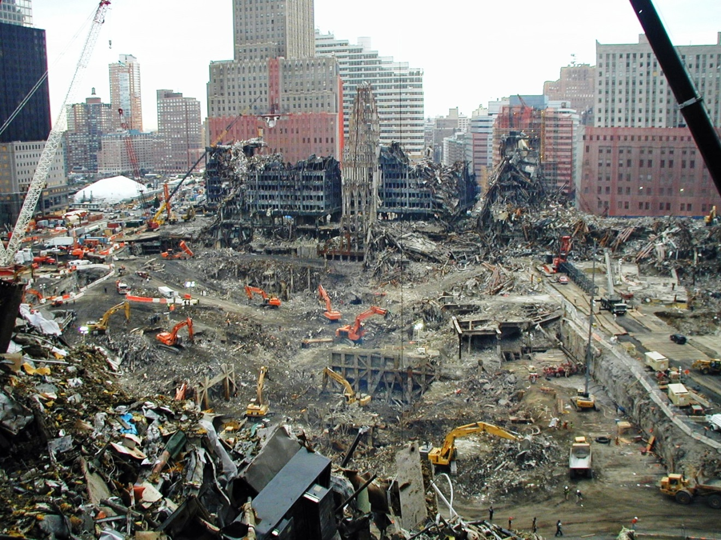
Recognizing and Removing Barriers Preventing Utilization of Skilled Demolition and Debris Removal Resources During a Disaster Response
Tom Stahr, Mark Shaurette, & Randy Rapp

Slide 2
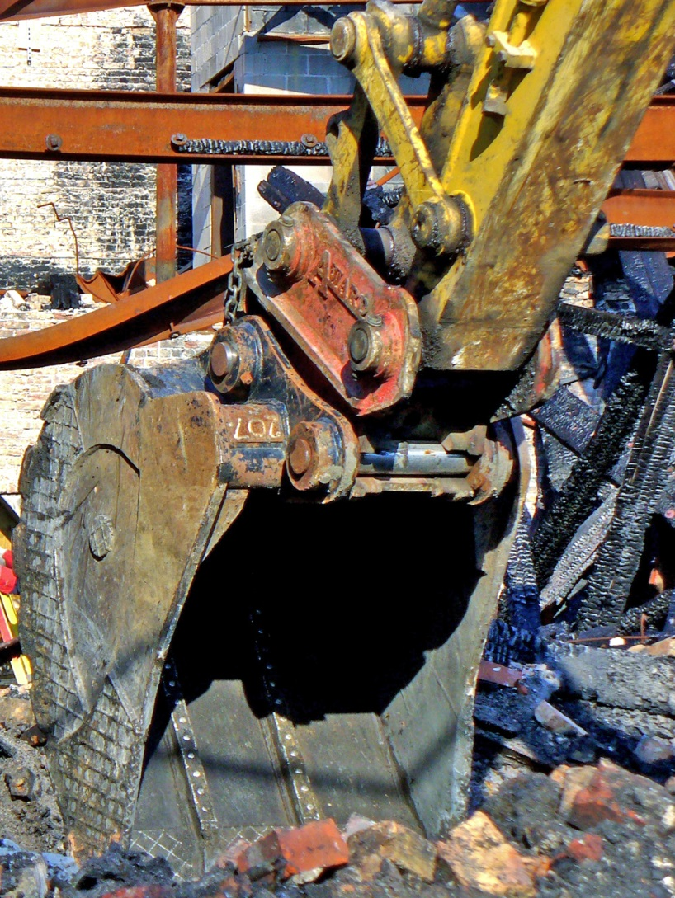
Outline
Industry Perspective
Industry Overview
Barriers
Action Steps
Qualities of a Model Agreement
Concluding Remarks

Slide 3
Perspective
First-responder capacity is quickly overwhelmed
Private contractors are needed for manpower, experience, and equipment.
Contractors chosen have a dramatic impact on long term health and safety issues, and the overall cost in time, money, and effort for a full recovery

Slide 4
Challenges
Resource identification and mobilization
  Time constraints
  Location of resources
  Lack of local pre-planning and preparation
Competence and Capacity
  In “construction business” + Desire
  Inexperienced with disaster site conditions
  Lack of proper PPE and the training to use it

Slide 5
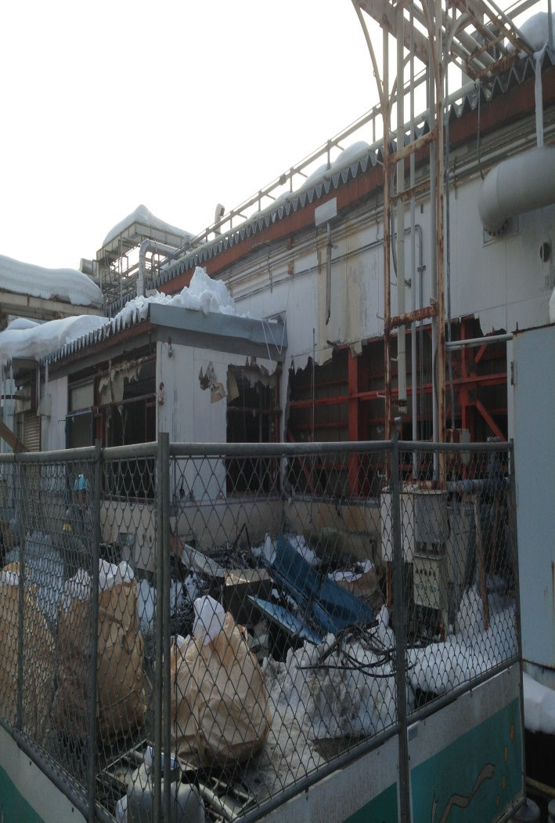
Typical Expectations
Typical Construction Project Qualification
  Demonstration of competence on task
    History of similar projects/work
    Testimonials, etc.
  Safety and Training Records
  Insurance ratings
  Bonding capacity
Typical disaster site qualifications
  Willingness to work
  Acclimation of competence
  State contractors license
Cost

Slide 6
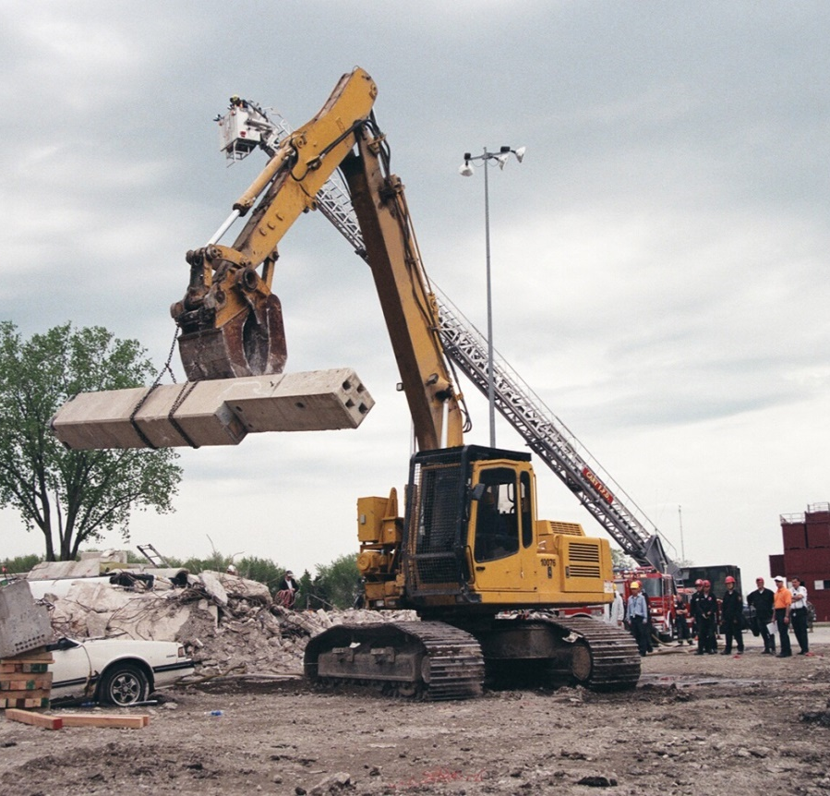
Demolition Industry Overview
Structure (buildings, tanks, etc.) and debris removal. Every day. 24/7 - 365
Own and maintain purpose built equipment and the means to mobilize it
Knowledge and experience handling and disposing of huge amounts of debris (C&D, special, hazardous)
Regularly work in hazardous environments and small-scale disaster sites
Baseline training includes basic and advanced PPE, Hazcom and Hazwoper standards, ACM, Lead, equipment, etc.
Baseline medical testing for lead and respiratory fitness is standard

Slide 7
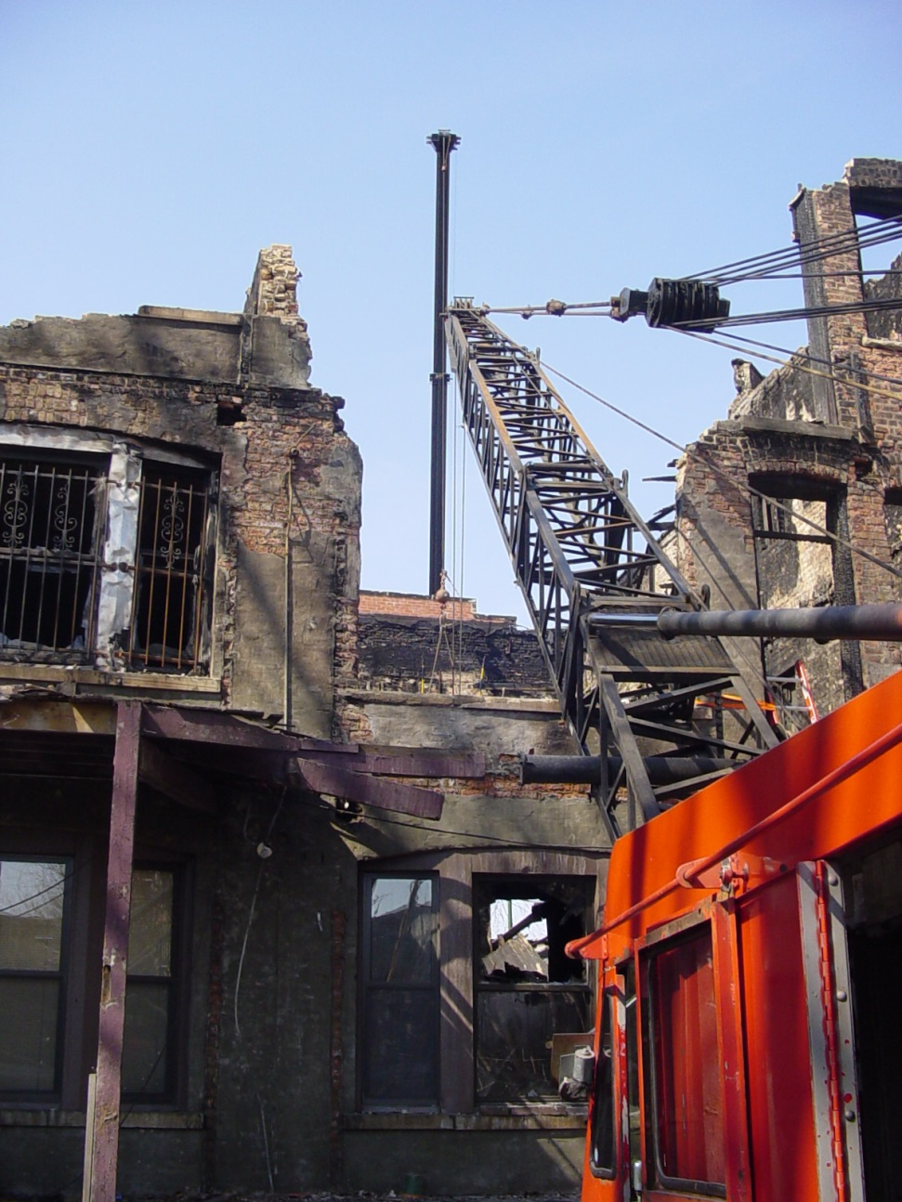
Barriers to participation
Politically derived requirements, e.g. local participation, state licensure, prevailing wage payments
Payment issues
  Rates
  Scope of payments (what is included)
  Length of waiting period
Legal liability (lack of limited liability shield similar to 1st responders)

Slide 8
What do we do?
Recognize the reality (i.e. gather data to enable more effective decisions about how we prosecute large-scale responses)
Work to remove barriers and create incentives:
  Improve and standardize contractor selection criteria
  Re-evaluate how and when contractors are compensated for labor, equipment, maintenance and expenses
  Protect contractors under the direction of public authorities from reasonable liability

Slide 9
Concluding Remarks
There is an entire industry in the US almost perfectly suited to assist after a disaster
The industry as a whole does not fully nor willingly participate in large-scale disaster recovery work in spite of participating regularly on a small-scale and for private industry, i.e. insurance companies
The barriers to the industry’s participation are largely artificial and oriented to short-term savings or political expediency
The cost of maintaining the status quo is extremely high compared to what it could be with a few changes
Legislatively, educationally - Focus should be on removing barriers to a safe and efficient response; not on creating more

Slide 10
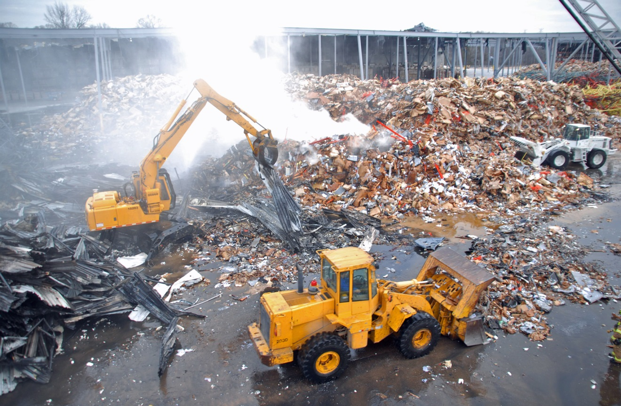
Questions & Comments

