Slide 1
Cybersecurity Risk and Remediation
Addressing the Growing Global Threat
Megan Levy, Pacific NorthWest Economic Region
TIEMS 2015

Slide 2


Who am I?
Public private partnerships for all economic issues
In 2001, began tackling P3s for infrastructure protection
In 2007, began to discuss cyber as emergency management/business continuity concern
Notes:
About me – Focus on infrastructure systems, approach cyber as the backbone of all CI
About PNWER
CRDR formation
Why cyber projects

Slide 3

What is “cyber security”?
Cybersecurity - TIEMS 2015
Notes:
Thought of as “keeping hackers out of our networks”
Actually the security of all our computers, devices, networks, and data.
Risks – loss of personal data, access to control systems.

Slide 4

Ground “Truth”
Privacy &
Accessibility
Security
Cybersecurity - TIEMS 2015
Notes:
Not just digital
Emphasize firewall, but cyber and information security are only as good as operational security
We want employees to have access, but that is a balance with security
We know how much power we have over our network when we’re sitting at our office and home computers

Slide 5


What is “cyber security”?
A bit like medicine…
  Behaviors
  Treatments
  Outcomes
Cybersecurity - TIEMS 2015
Notes:
Holistic cyber security requires every employee
Knowing what looks suspicious
Practicing good behavior
Understanding the steps to take if systems have been compromised – restoring systems without destroying evidence
Understand your systems
Cyber security choose your own adventure – you can try to protect every thing, but you’re asking to fail
Identify most information information or assests and adjust accordingly

Slide 6

Ground Rules
Hackers are not your enemy
The public is not your enemy
Your employees are not your enemy
Regulatory agencies are not your enemy
Criminals are your enemy!
Cybersecurity - TIEMS 2015
Notes:
It is not about acts, it is about intentions
Every one of these people can be an ally and partner in protecting your systems.
Partnerships are key
Many times malware and attacks are tested on smaller scale systems before attempts are made on large and more sophisticated organizations
60% of notifications come from outside the organization breached
243 The Avg. # days an attacker has been on a system before detection
Based on Emerald Down, recognized need to bounce ideas off folks to see who is experiencing some events.

Slide 7




Phishing
Scumbag
Cyber-Criminal
Fake / Spoofed E-mail
You
Cybersecurity - TIEMS 2015
Notes:
Phishing is the use of spoofed emails to gain access to networks.
General phishing – sending out of mass emails to try to get employee to click through a link or download a document
Spearphishing – targeted spoofed emails using information on the target to add legitimacy
Social media for spearfishing

Slide 8

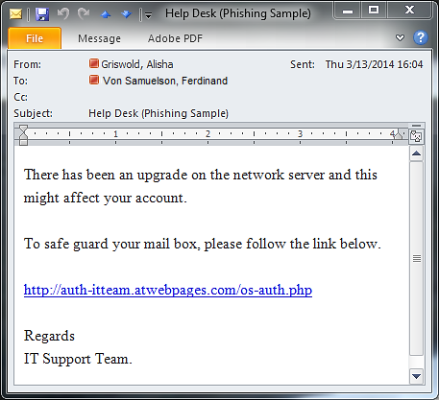
Phishing
Unknown sender
Sketchy link
Sender not a member of IT
Cybersecurity - TIEMS 2015
Notes:
Another area where employee training is the first and best defense to protect your system
Explain slide
Malware downloaded through phishing emails puts critical information at risk – depending on your business that could mean employee or customer financial data, blueprints to buildings, or even access controls to critical infrastructure systems.

Slide 9
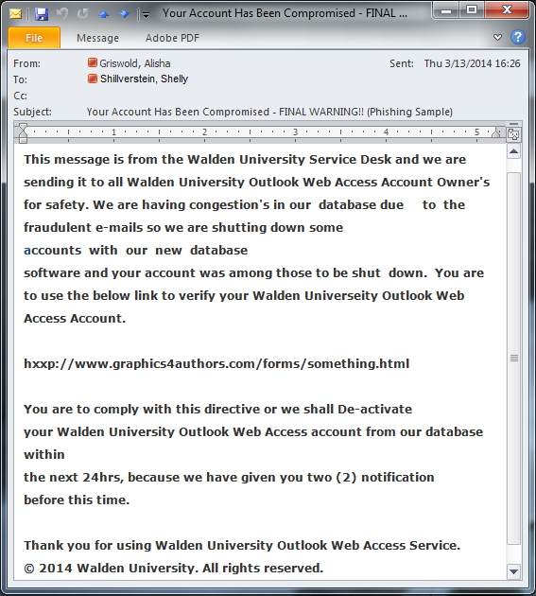
Phishing
Unknown sender
Weird spacing and bad grammar
Sketchy link
No contact information to verify authenticity
Cybersecurity - TIEMS 2015

Slide 10


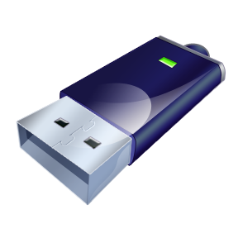

Malicious Code
Cybersecurity - TIEMS 2015
Notes:
Also physical access – USB inserted into a computer can spread malicious code
- The Avengers: Age of Ultron

Slide 11
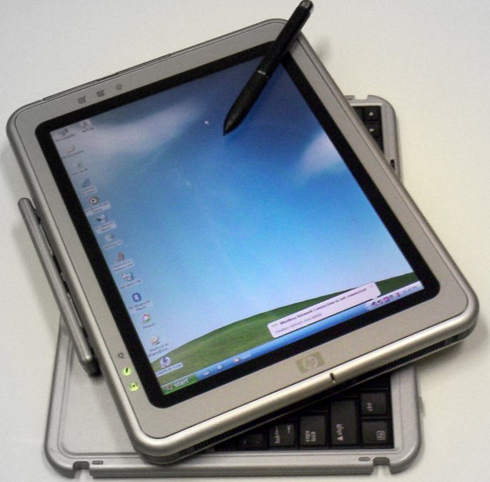

Infected Devices
wow
so tablet
FREE
iTHING!!!
such computer
you want
Cybersecurity - TIEMS 2015
Notes:
How many of you have ever installed additional security to your mobile phones?
Most of us don’t even know phones are susceptible to malware, let alone that our factory settings might leave a lot to be desired.
Operating system updates
Reading app permissions
Installing antivirus
The people you work with – bright, security minded folks – are your greatest line of defense, and can be your greatest risk. Most of us think nothing about connecting our personal devices to office networks.

Slide 12
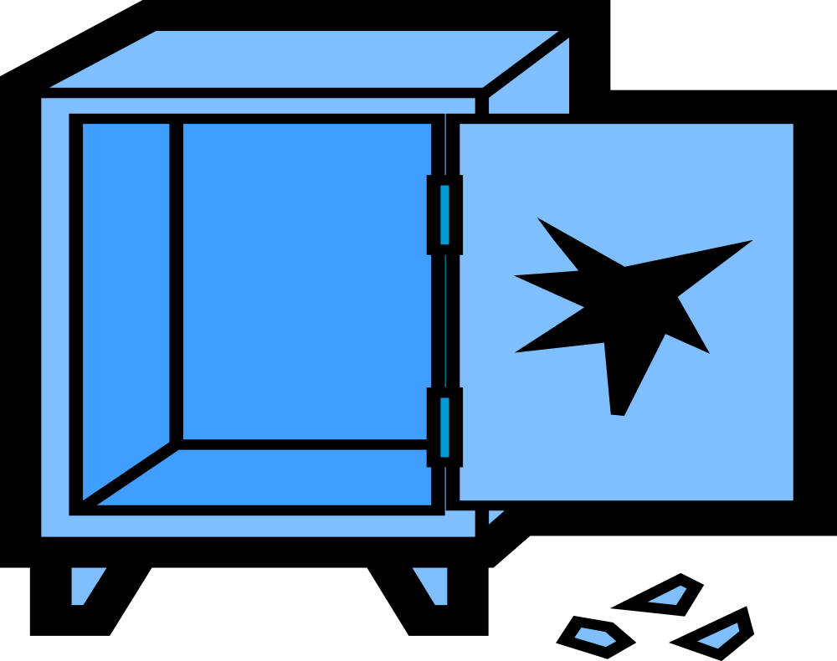


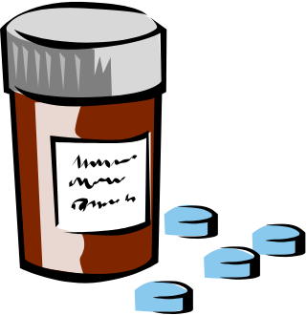
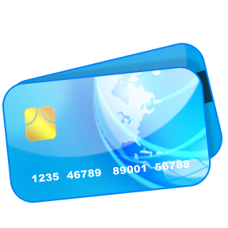
Data Compromise (PII / PCII)
Cybersecurity - TIEMS 2015
Notes:
Two of the biggest pieces of data at risk are the protected critical infrastructure information (PCII) and protected identification information (PII)
More and more old critical infrastructure control systems, legacy systems that were never meant for the internet, are being brought online
- allows for remote management
- creates vulnerability for our critical infrastructure
Personal data for employees and customers – worthy of being protected not only so you don’t lose trust, but to prevent legal difficulties. Breach not only in own state, but states those breached reside in.
So often we hear “it was a really sophisticated attack.” So many attacks are on vulnerabilities that have been known for months – they’re not actually that sophisticated.

Slide 13
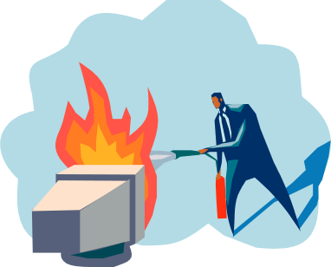


Cost of Cyber Attacks
2013 Study
Cybercrime costs orgs = $11.56M (annual average)
  Range was $1.3M - $58M
  Increase of 26% or $2.6M from 2012
Orgs experienced 122 successful attacks per week
Average resolution / recovery time was 32 days
  Average incurred cost for recovery was $1,035,769 total or approx $32,469 per day
Cybersecurity - TIEMS 2015
Notes:
Growing at 26% per year, average cost of approx $58.26 m annually by 2020 per organization
These are hard costs – what of loss of reputation? What if breach lead to loss of life? What is the cost of having failed to prepare?
Home Depot data breach compromised 56 million of its customers’ credit cards. The data popped up on black markets. Risk $3 billion in illegal purchases.
System forensics, updating security systems, hiring new security management – these were the hard costs
What about the loss of customer support? Your employees, the public you’re protecting, your customers – they don’t want to hear that leadership was told of major vulnerabilities and did nothing.

Slide 14


Cost of Cyber Attacks
2014 Report
Projected “pricetag” of cyberattacks: $3T by 2020
  That’s $3,000,000,000,000!
Data Accessibility vs. Data Security
Cyber risk is a CEO-level issue
Roadmaps for scalable cybersec operating model
Well-practiced set of skills for response
Trust is a necessary operating principle
Cybersecurity - TIEMS 2015

Slide 15

Opsec meets infosec
Researchers sent to 7 large corporations with 43 offices
All were given “Temporary Worker” badges
Only questioned:
  7 times when photographing a screen
  4 times when stealing confidential documents
  2 times when poking around on someone else’s desk
88% of attempts were successful
Cybersecurity - TIEMS 2015

Slide 16
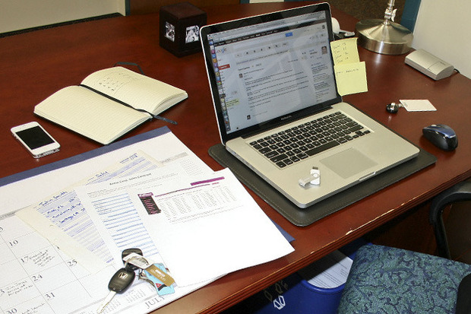
Opsec meets infosec
There is no cyber security without operational security!
Cybersecurity - TIEMS 2015

Slide 17
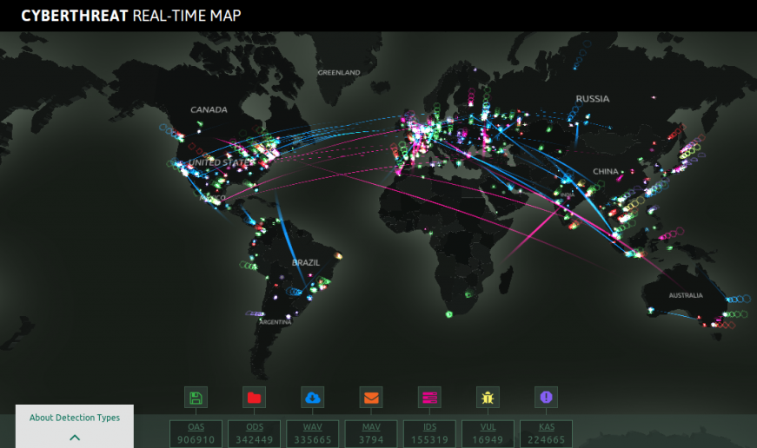
Kaspersky CyberThreat Map
Cybersecurity - TIEMS 2015
Notes:
Kaspersky cyber security map showing cyber attacks in real time. Each light represents a type of security protocol – from an anti virus kicking in to scan, to intruder detection
The U.S. is third most attacked country during the day. The U.S. is number one at night.
when the other side of the world is awake, where the majority of our attacks come from.
If you’re trying to get buy in with your organization, a visual like this is essential
What is the threat
- quick and easy visualization

Slide 18
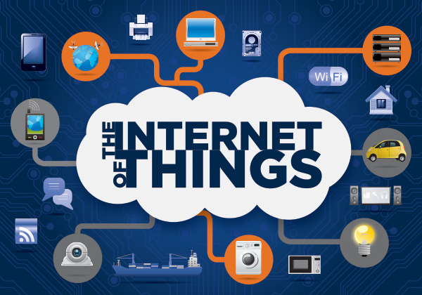

Cybersecurity - TIEMS 2015
Notes:
Complexity and interconnectedness are enemies of security
More and more systems being put on the internet
Doggy cams
Refrigerators
SCADA systems and industrial controls.

Slide 19
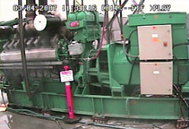

The Aurora Generator Test
Cybersecurity - TIEMS 2015
Notes:
Emergency managers often think cyber is an IT only issue. There can be no real world impacts. Even business continuity people working for certain large Redmond based software companies have said this.
Aurora Generator Test by INL
showing the real world physical impacts that can come from cyber attacks
in this case the complete destruction of a generator cause by a malware directive to overload itself.
For this test they destroyed the generator
need not be as extreme.
If a cyber attack caused a machine to corrupt in increments or at a slow rate, the machine may be functionally unusable without damaging it enough to flag its owners that they were under attack.

Slide 20
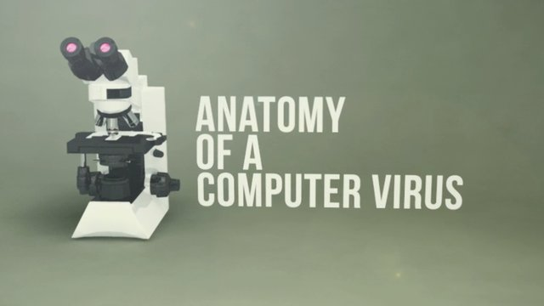

Stuxnet
Cybersecurity - TIEMS 2015
Notes:
Stuxnet, the first weapon made entirely out of code.
This computer worm^{[1]} was discovered in June 2010.
It was designed to attack industrial programmable logic controllers, which includes for instance the machinery of assembly lines, or as you’ll see in this video centrifuges for separating nuclear material
This video produced by Australian TV program HungryBeast on Australia's ABC1 in 2011 gives a good example of how cyber attacks can be used as weapons and to interrupt our critical infrastructure

Slide 21
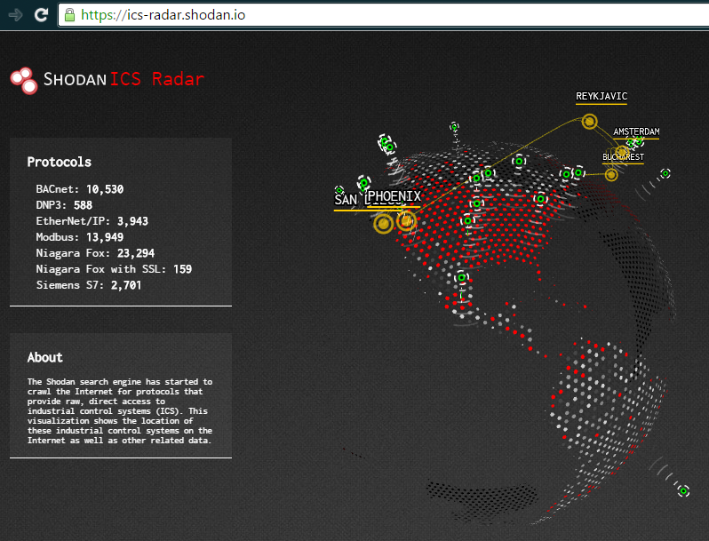
Cybersecurity - TIEMS 2015
Notes:
So…. What can you do to protect your organizations?
Firstly, know that you’re protecting yourself and not advertising your vulnerabilties.
Shodan search engine.
The displayed map of the globe on the Shodan front page shows industrial control systems that were accessible online. This kind of tool is useful when working with executives because it quickly displays information without a wall of text.
With shodan you can search your own systems to see if your control systems are accessible through the internet

Slide 22

Critical Infrastructure
Industrial Control System Architecture
Penetration Testing
Plans for response that include business continuity or emergency managers
Partnerships
Employee training
Cybersecurity - TIEMS 2015
Notes:
Build plans and make use of the resources that are out there.
Know what your ICS architecture looks like and whether you’re making it available online
Test your own systems – hackers can be your friends. Perform penetration testing to see how vulnerable your system is or what information or systems can be accessed before you detect an intrusion.
Have cyber security plans that acknowledge the business disruption and life safety risks. Too often IT tackles breaches without ever communicating outside of the department. They can’t report every attack – it would become white noise – but need to know when and how to engage other departments
Build partnerships with others. In security there is always reluctance to share vulnerabilities, especially with competitors. Cyber Incident Response and Analysis Sharing (CIRCAS) trusted partners.
Train your employees. Emails, access, helping to protect and report

Slide 23

Emergency Managers’ Role
Work with IT / CISO to make recovery plans
Identify resources in advance
  Network engineers
  Digital forensics specialists
  Cyber insurance
Exercise response ops
  Practice with sector peers!
Support education / outreach
Cybersecurity - TIEMS 2015

Slide 24
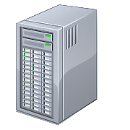

Additional Resources for Alerts + Guidance
International Cyber Security Protection Alliance
[US] National Institute of Standards and Technology “Cybersecurity Framework”
    Identify -> Protect -> Detect -> Respond -> Recover
US Computer Emergency Readiness Team
    Threat notifications
    Security walk-throughs (publications)
Cybersecurity - TIEMS 2015

Slide 25

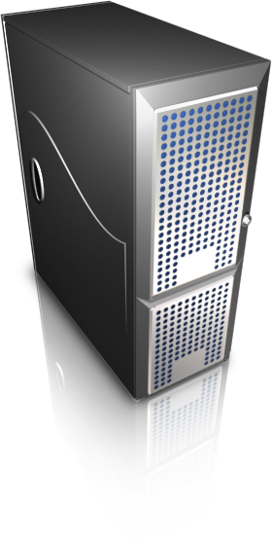
Measuring
Progress
Maturity models
Penetration testing / Defensive testing
Recurring review of policies and procedures
Peer-to-peer (intra-disciplinary) audits
3rd party audits (contractors)
Cybersecurity - TIEMS 2015

Slide 26
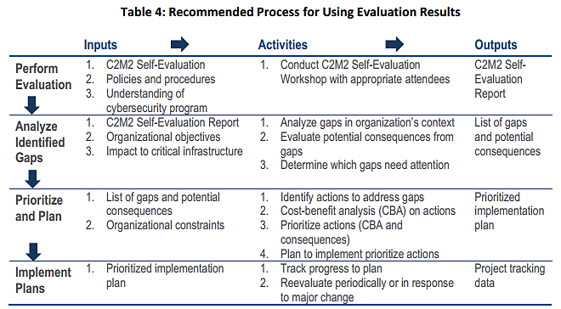
Cybersecurity Capability Maturity Model via Department of Energy
Cybersecurity - TIEMS 2015

Slide 27
Bringing it all together
The threats are real and imminent
Every stakeholder has a role to play
Build partnerships/share information
Now is the time to educate and practice
Vocalize and prioritize
Holistic approaches are the most impactful
Cybersecurity - TIEMS 2015
Notes:
Target, Home Depot, The IRS, The Office of Personnel Management, Stuxnet
Not just about IT. Every member of your team can help. Even helping them understand what to look for, and how to escalate. Esclate could mean a full organization response to a breach. It could also mean an employee takes the step of calling to verify a wire transfer requested via email.
Build relationships with others in the field, even your competitors. They are valuable sources of information. You don’t have to give away security data, but there is always something to be gained by being able to pick up the phone and ask “are you seeing this too?”
With cyber security, we are more likely to blame the victim then the perpetrator. Usually that’s because the victim is easily identified – the criminal not as easy. However, you don’t want your customer to hear that when staff told Home Depot management about their vulnerabilities, they were told “we only sell hammers.” Now is the time to build a culture of security in your organization. Get your board engaged. Check for your vulnerabilities.
Speak out in your organization
An overarching, full organization approach in the most effective. We cannot see this as an IT issue, because we can be a part of the education and preparation. We can be building plans for how IT and emergency managers can work together to address the impacts. Our whole organization should be thinking cyber security. We’re only as strong as our most poorly trained computer user.

Slide 28

Questions?
Cybersecurity - TIEMS 2015

Slide 29
Thanks!
Megan Levy
www.twitter.com/levymegan
Megan.Levy@pnwer.org
206-443-7723

