Slide 1
Overcoming Barriers to Effective Risk Communication During Pandemics
Thomas V. Robertson, Thinking Teams
The International Emergency Management Society 2015 ANNUAL Conference
October 1, 2015
Rome, Italy

Slide 2
Outline
Objectives of Risk Communication
Risk Communication challenges
Adapting Risk Communication to different contexts
Improving Risk Communication through education and training
Examples from the Ebola epidemic
Conclusions

Slide 3
Risk Communication
Objective: Efficiently and effectively reduce and prevent illness, injury, and death and return individuals and communities to normal
Risk Communication
Interactive exchange of information and opinions
Risk Assessment
Science Based
Risk Management
Policy Based

Slide 4
Challenges to Risk Communication
Worldwide risks are evolving
Emergencies have negative effects on individuals
Authorities can easily miscommunicate
Poor communication can have dire consequences

Slide 5
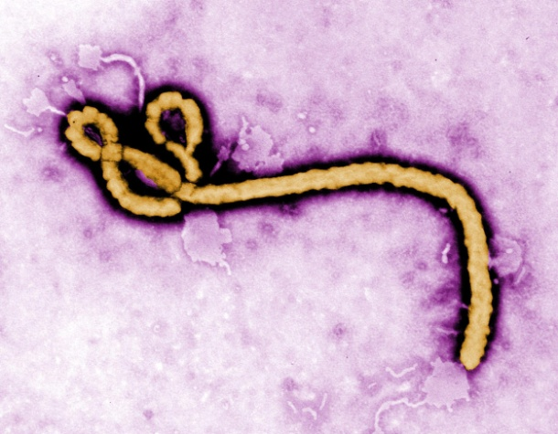
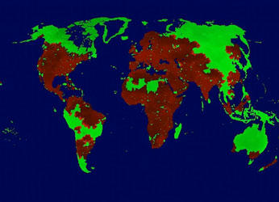
Evolving Risks
Increasing population density
Aging populations
Emerging infectious diseases and resistance
Increased international travel
Increased technological risks
Increased terrorism
Climate Change

Slide 6
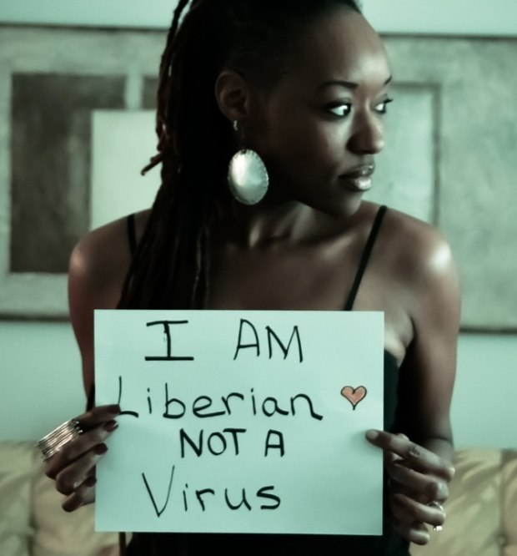
Emergencies’ Effects on People
Emotional: fear, anger, guilt, helplessness, …
Cognitive: impaired concentration and decision making, confusion, …
Physical: fatigue, hyper arousal, vulnerability to illness, …
Interpersonal: stigmatization, blame, over protectiveness, …

Slide 7
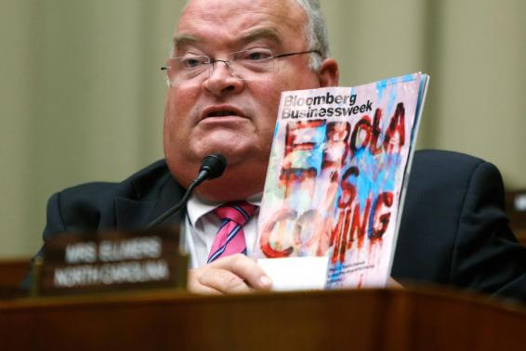
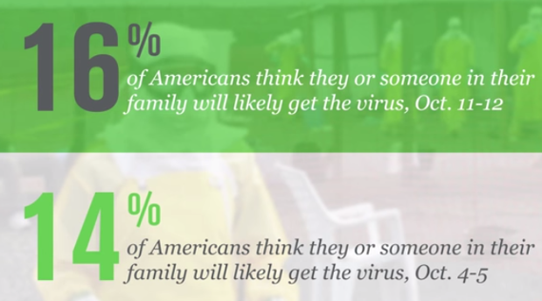
Authorities Can Easily Miscommunicate
Mixed messages
Information released late
Paternalistic attitudes
Failure to counter rumors and myths
Public power struggles

Slide 8
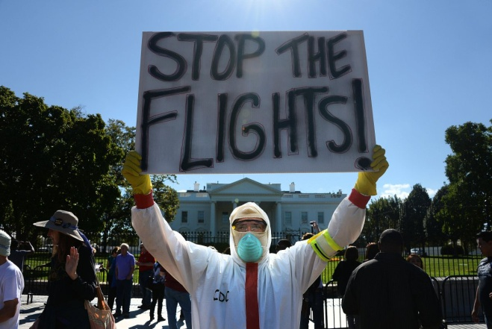
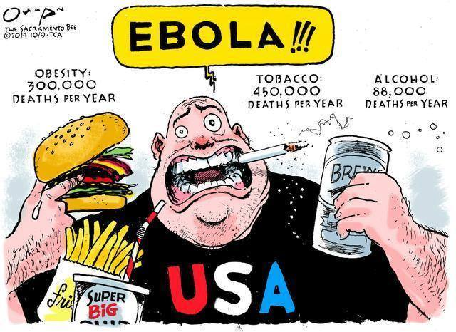
Consequences of Poor Communication
More illness and death
Panic and disorganized group behavior
Demand for unneeded treatment
Increased multiple unexplained physical symptoms
Unreasonable trade and travel restrictions
Erosion of trust and future preparedness

Slide 9
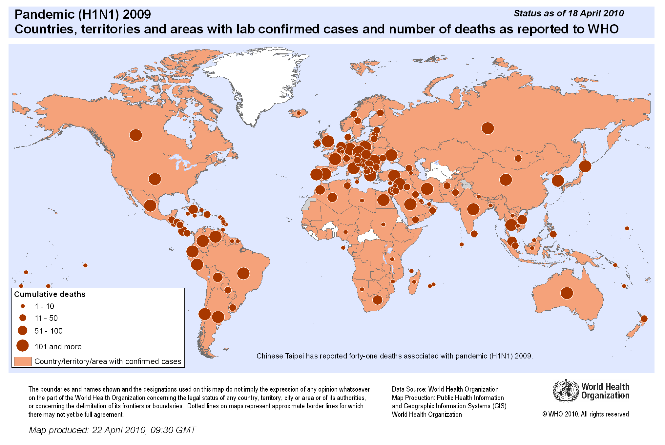
The 2009 H1N1 Pandemic
Alarming outbreak in Mexico;
soon in 73 countries
Authorities predict many deaths;
actual deaths like mild flu
78 million vaccine doses
delivered, too late
Confidence in health authorities
eroded; low public compliance
Influence of pharmaceutical
companies questioned
Mistrust fed by news coverage
and social media

Slide 10

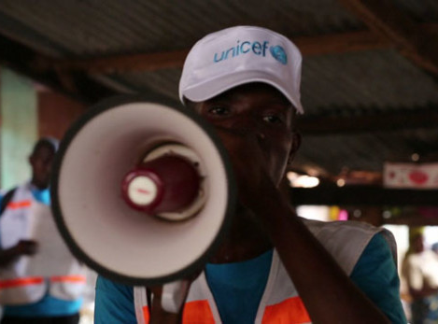
Effective Risk Communication
Communicate
Identify the
Issue and Its
Context
Monitor and
Evaluate Results
Manage reputational risk
Express empathy
Show competence and
expertise
Remain honest and open
Demonstrate accountability
and commitment
Assess Risks
and
Benefits
Involve
Interested
and Affected
Parties
Implement
the
Strategy
Identify and
Analyze Options
Select a
Strategy
Strategize

Slide 11
Communicating with the Public
10 Questions to Ask
Why are we communicating?
Who is our audience?
What do our audiences want to know?
What do we want to get across?
How will we communicate?
How will we listen?
How will we respond?
Who will carry out the plans? When?
What problems or barriers have we planned for?
Have we succeeded?

Slide 12
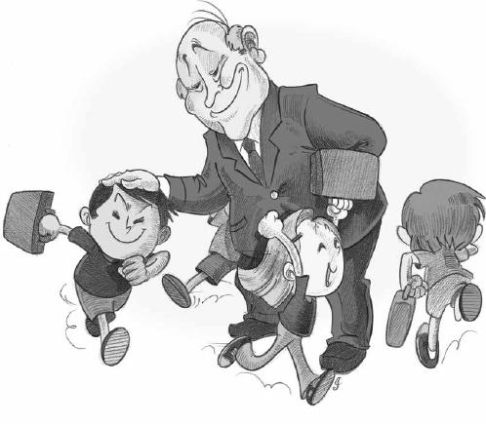

Contrasting Attitudes
VS

Slide 13
Context Affects Risk Communication
Personal context – education, knowledge and experience, age, language spoken/read, cultural norms, geography
Type of emergency – voluntary/involuntary, controlled by self/others, familiar/exotic, natural/manmade, statistical/anecdotal, fair/unfair, generated by trusted/untrusted institution
Surrounding events – outbreak stage, uncertainty, misinformation/misconception, trust/mistrust, spokesperson

Slide 14
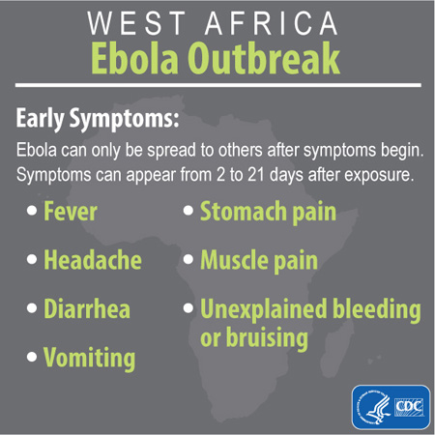
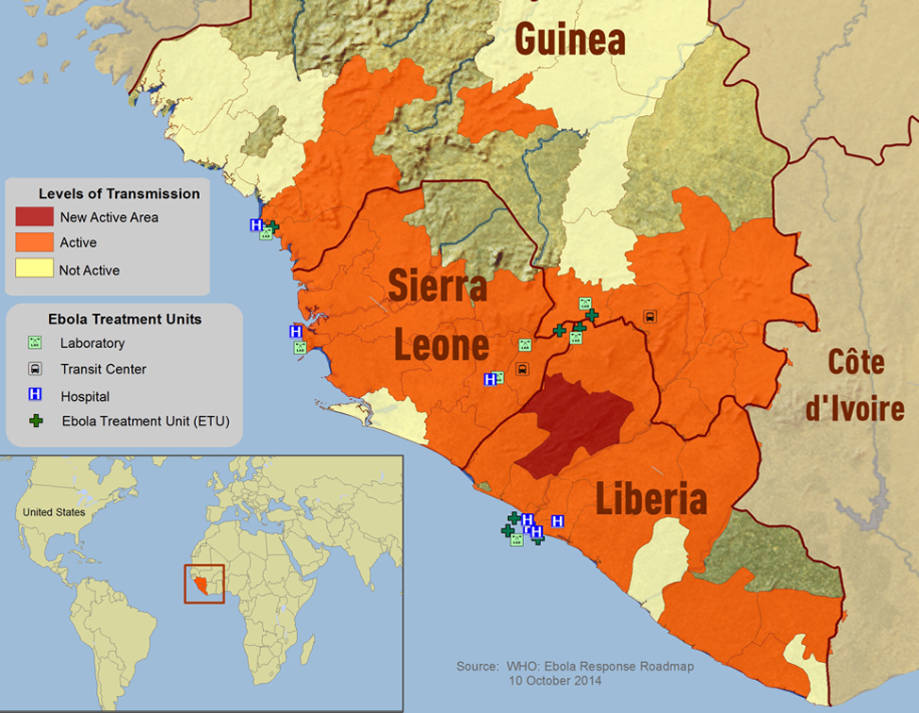
Ebola Outbreak 2013
Until 13 Sept. 2015, 11,306 Deaths – 28,256 Diagnosed with Ebola

Slide 15

Sensationalized Misinformation
The Hot Zone: The Terrifying True Story of the Origins of the Ebola Virus

Slide 16

Official Reaction
“Maine school board puts teacher on leave after she traveled to Dallas”
The teacher, who has not been named, attended a conference 10 miles from the hospital where Ebola patients have received care.
“Maine nurse defies state’s voluntary Ebola quarantine”
‘‘I’m not willing to stand here and let my civil rights be violated when it’s not science-based,’’

Slide 17
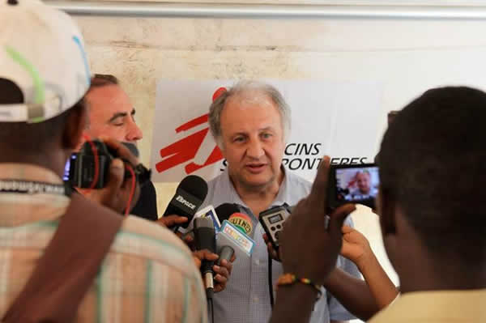

Digital Technology to Spread Good Information
Craig Manning edited Rollin’s presentation at the Embassy into 10 broadcast-ready, 30-second segments. He loaded them onto thumb drives and began distributing them to local radio stations.
CDC’s Dr. Pierre Rollin answers media questions about Ebola in Guinea

Slide 18
Sampling of Lessons Learned in Africa
Impact of mobile messaging low due to lack of trust, illiteracy
Sierra Leone posters too graphic for children
Constant reinforcement of messages and frequent interaction with volunteers important
Build trust by keeping victim friends and family in the loop
Tailor message, e.g., “Don’t eat bush meat”, or credibility killed
Get trusted community members to deliver message
Radio spots need local content, not just packaged news
Hard to get survivors to speak because of stigma
Notes:
https://www.devex.com/news/ebola-communication-what-we-ve-learned-so-far-84559

Slide 19
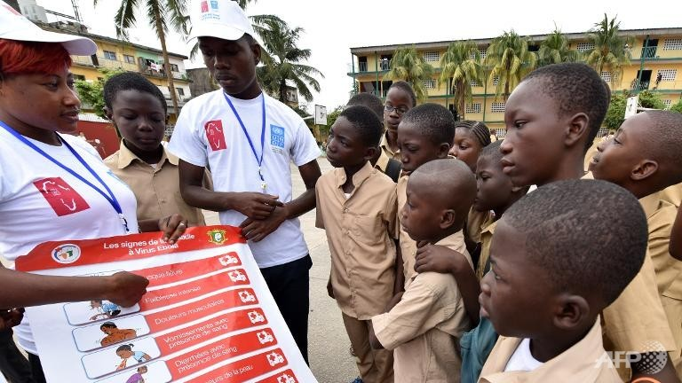
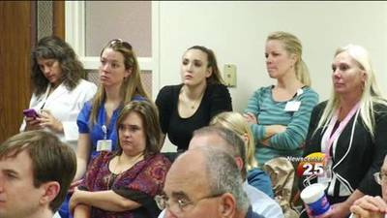
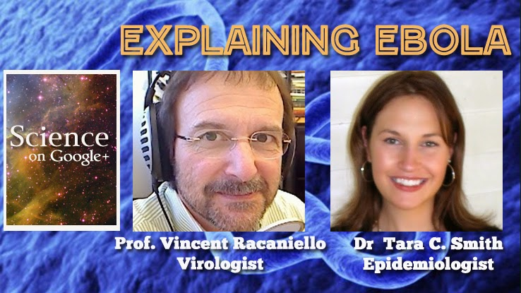
Education and Training for Risk Communication
Health professionals
  Science grounded
  Proper procedures
  Communicating with the public
  Research in risk communication
Authorities
  Science grounding
  Risk communications skills
Public
  Science grounding
  Preparedness part of public education

Slide 20
Conclusion
Risk communication greatly affects the impact of infectious disease outbreaks
Risk communication is complicated by human nature, official missteps, and world condition
Tailored education and training for the public, health workers, and authorities can have great benefits
Important lessons are being learned from the Ebola experience

