Slide 1
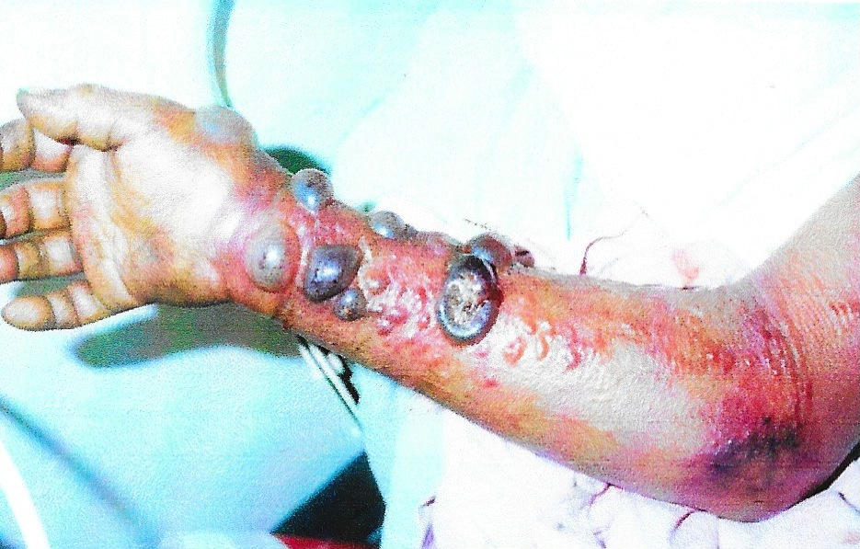
Management of Pandemic
Societal Response and
Effect of International Health Regulations
by James Hagen* and Connie White
*Author to whom correspondence should be addressed;
E-Mail: hagen@sxu.edu
The International Emergency Management Society (TIEMS-USA), Portland, OR, 2015

Slide 2
Topics to be Covered
Pandemic Disease in Today’s World
Societal Population Response to Infectious Disease Outbreak
Pharmaceutical Response
Non-Pharmaceutical Actions
Negative Societal Response
Governmental Response to Infectious Disease
International Response
Necessary Activities

Slide 3
Lest We Forget Global Realities
The Infectious Disease Killing Fields
300,000,000 to 500,000,000 cases of malaria occur every year, resulting in 2,500,000 deaths
There are 33.000.000 people living with HIV/AIDS, with 1.78 million who have
1/3 of the world’s population (over 2,000,000,000 people) is now infected with tuberculosis, and 2,000,000 die every year
HIV/AIDS, tuberculosis, and malaria are now the world’s major killers of children and young adults, causing more than 13,000,000 deaths per year

Slide 4
Biologic Disasters
Biologic Disasters have been documented throughout history in the form of plagues and “curses”.
  The Black Death - Plague
  The Black Goddess – Yellow Fever
  SmallPox
  Influenza
  Diphtheria
  Whooping Cough
  HIV / AIDS
  Mad Cow Disease?
  West Nile Virus?

Slide 5
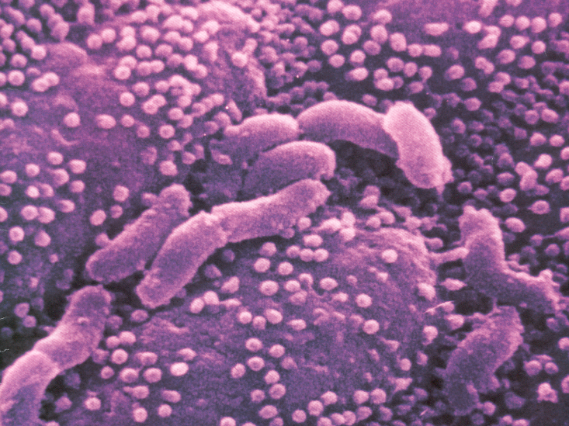
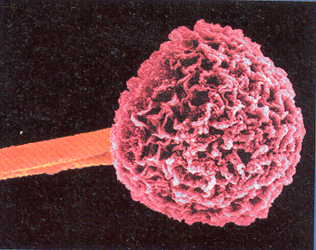
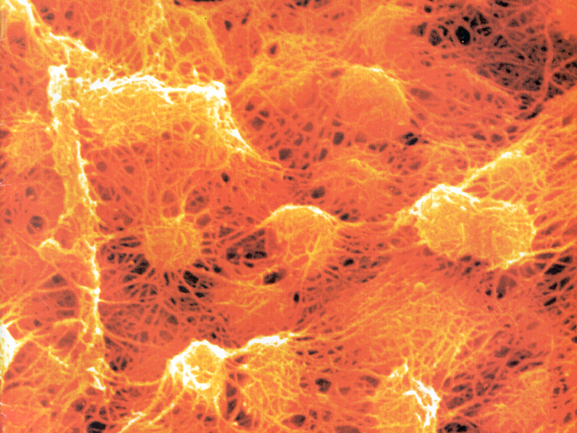
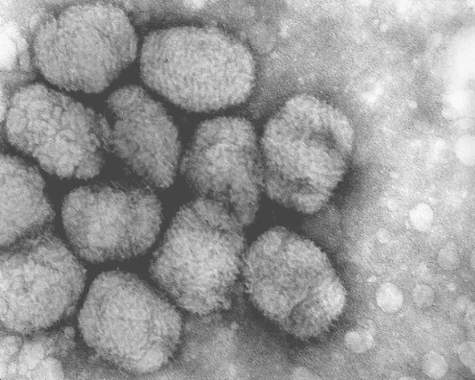
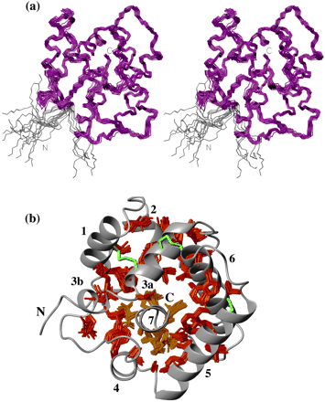
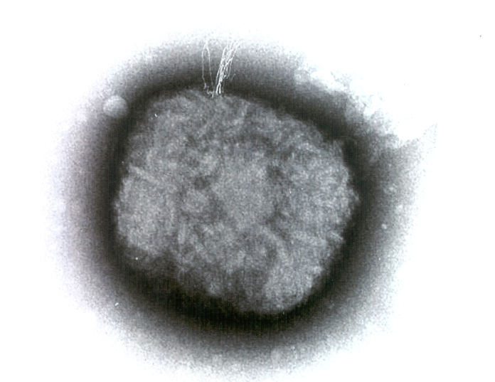
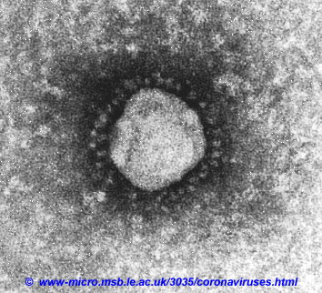
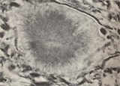

Slide 6

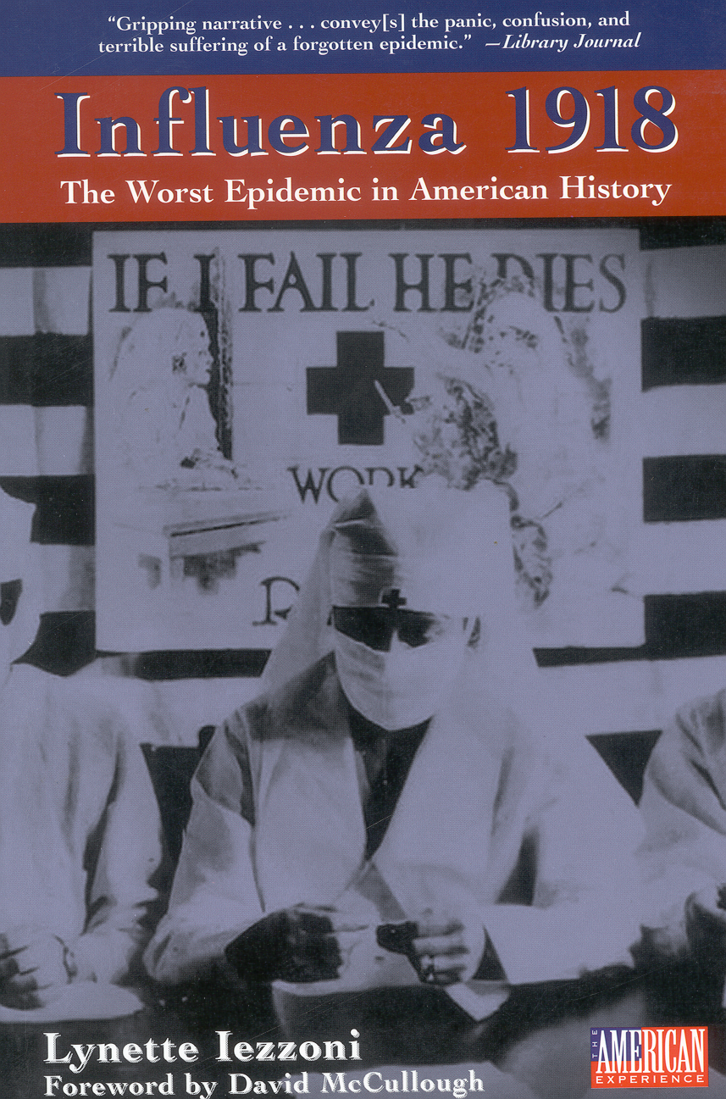





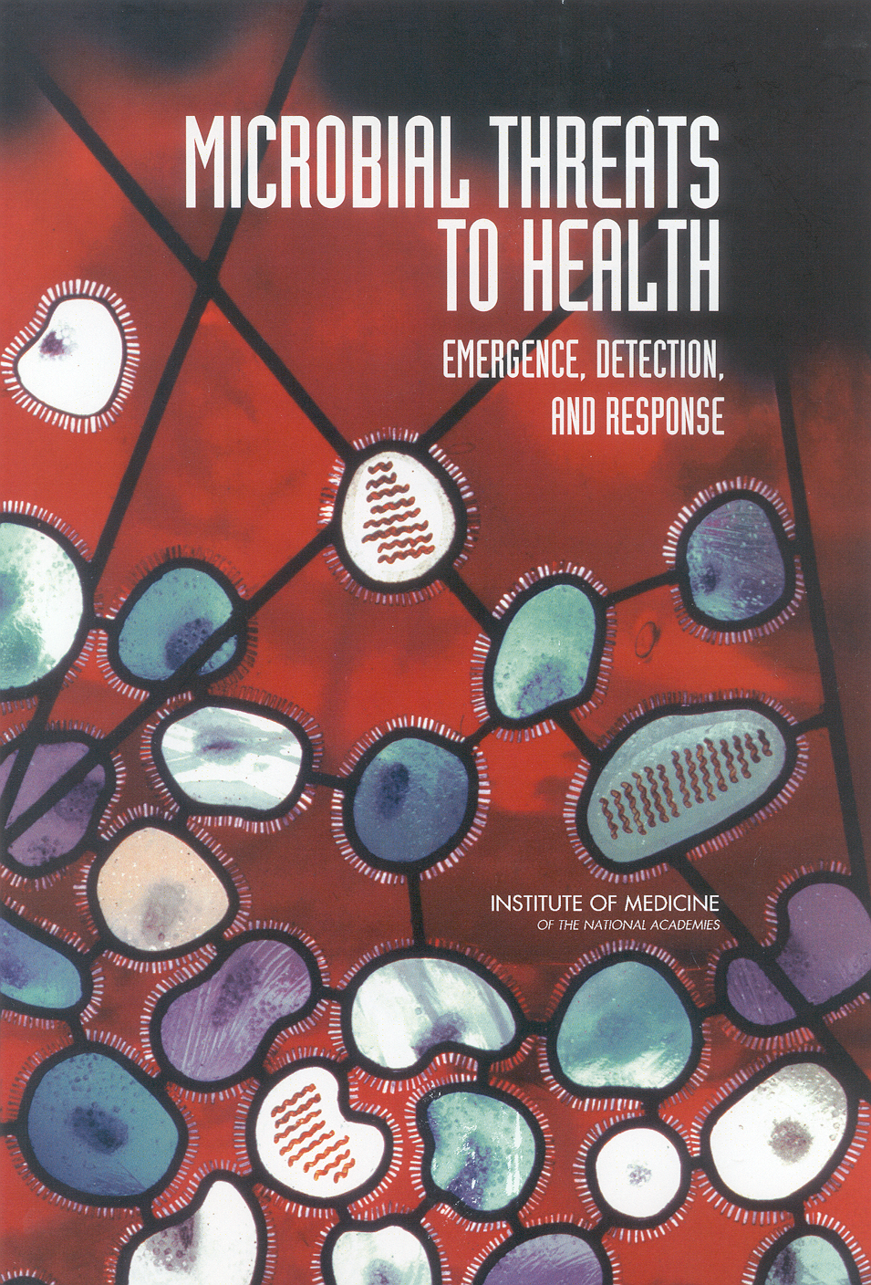


Slide 7
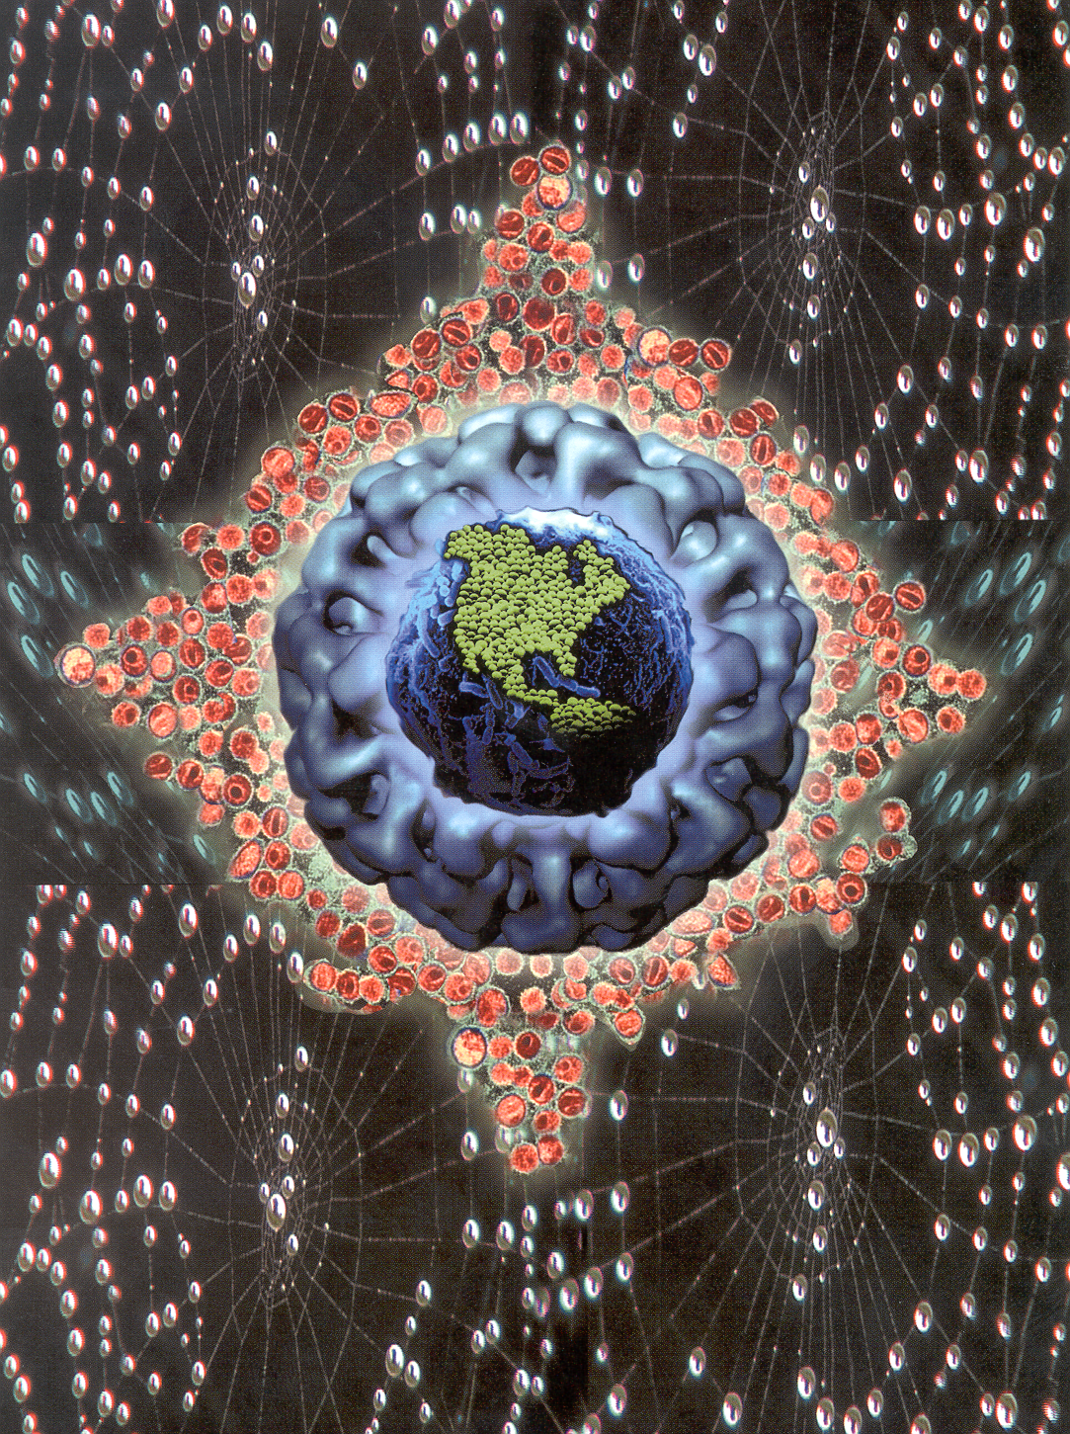
^{Intimate}
^{Strangers}

Slide 8
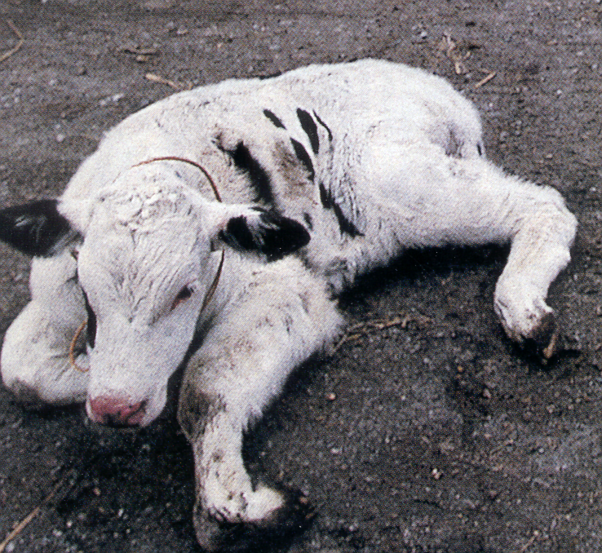
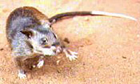
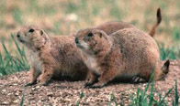
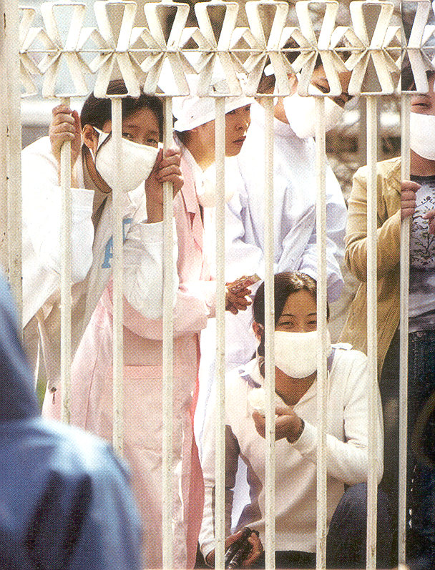
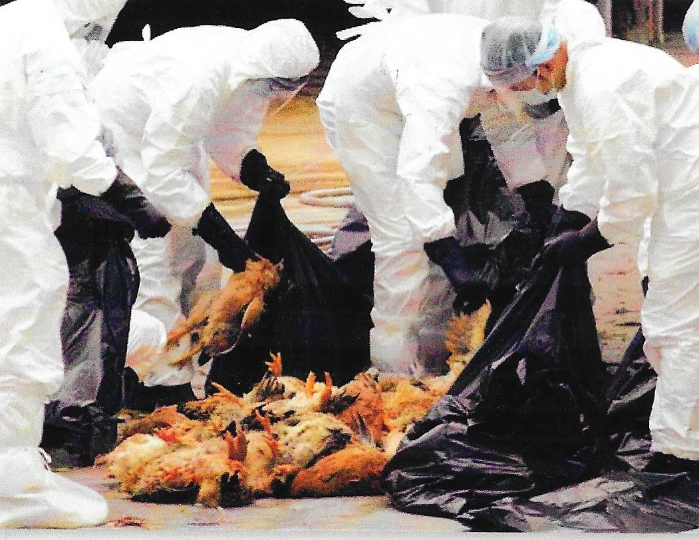
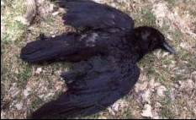
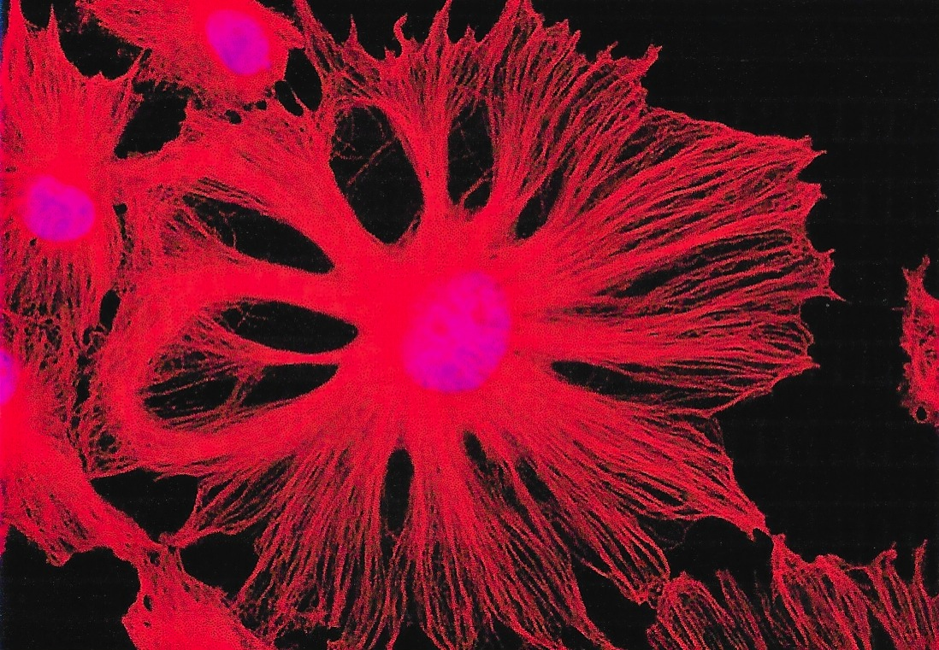
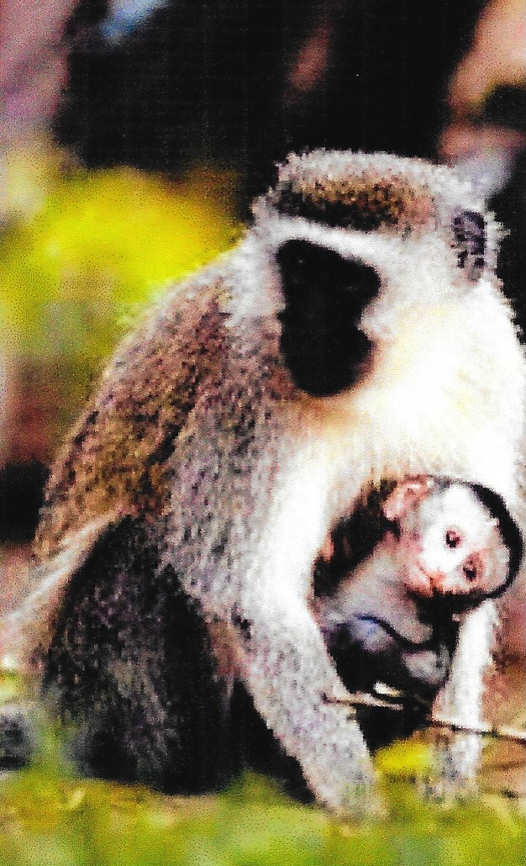
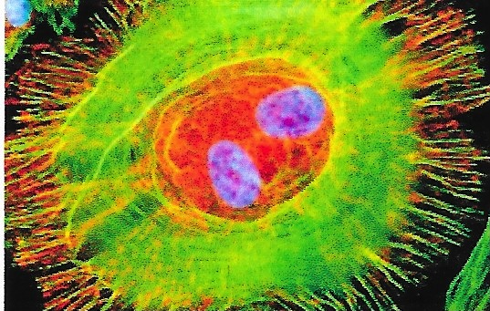
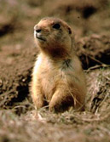
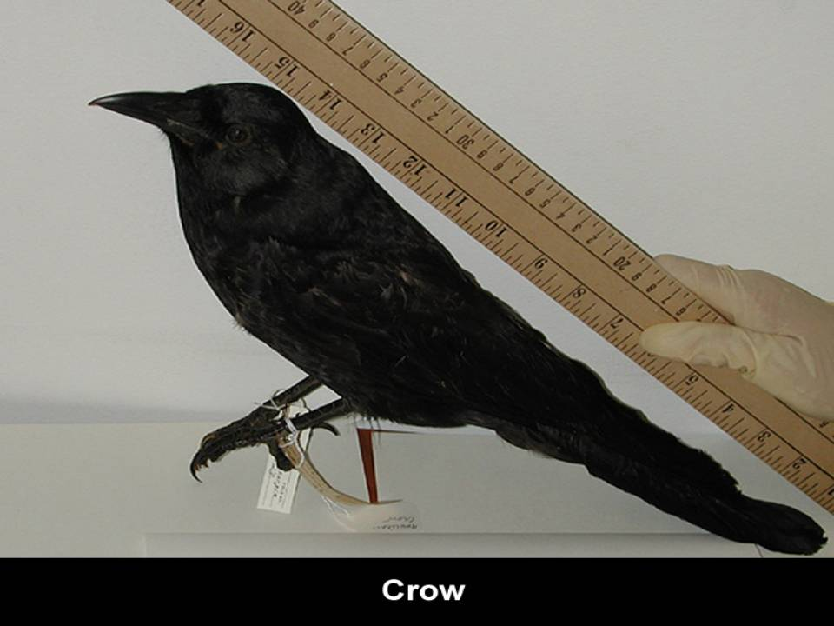

Slide 9
Re-Emerging Diseases
HIV/AIDS deaths continue at 17,000 annually, with emerging resistance to drugs and continued new infections sustaining the threat.
4 million Americans are chronic carriers of the hepatitis C virus. US death toll from the virus may surpass that of HIV/AIDS in the next five years.
TB has made a comeback....threat will be sustained by HIV and the growing number of new, particularly illegal, infected immigrants.
Influenza now kills 30,000 Americans annually, and epidemiologists generally agree that it is not a question of whether, but when, the next killer pandemic will occur.
Highly virulent and increasingly antimicrobial resistant pathogens, are major sources of hospital-acquired infections that kill some 14,000 patients annually.
Doubling of US food imports over last five years contributes to tens of millions of foodborne illnesses and 9,000 deaths that occur annually - the trend is up.

Slide 10
New Emerging Infectious Diseases
Cryptosporidium parvum
Ebola
Legionnaire’s Disease
Borrelia burgdorferi (Lyme Disease)
Mad Cow Disease
HIV/AIDS
West Nile Virus
SARS (Coronavirus)
Hantavirus
Marburg Disease
Creutzfeldt-Jacob Disease
Rotavirus (infantile diarrhea)

Slide 11
Convergence of Factors
Microbial adaptation and change
Human susceptibility to infection
Travel to equatorial nations
International travel and commerce
Climate and weather
Human demographics and behavior
Breakdown of public health
Poverty, social inequity, war, famine
Lack of political will
Intent to harm

Slide 12
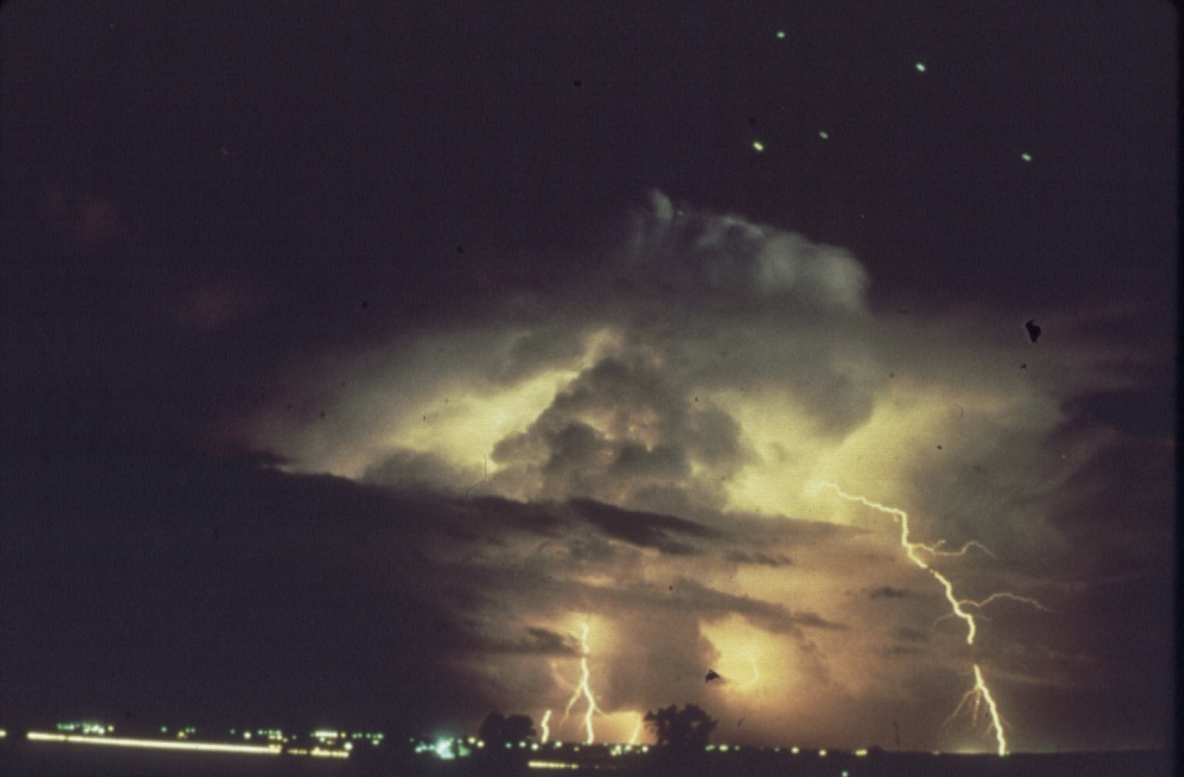
The Perfect Storm:
A convergence of factors, each feeding upon the other, until conditions exist for an unbelievably violent, unforgiving, force of nature that
man is helpless to prevent.

Slide 13
Factors in Microbial Threats
◘ Human demographics and behavior
◘ Human susceptibility to infection
◘ Economic development and land use
◘ Changing ecosystems
◘ International travel and commerce
◘ Microbial adaptation and change
◘ Breakdown of public health measures
◘ To be determined . . .

Slide 14
Early “Causes” of Outbreaks
Sin/Lack of Prayer
Wickedness
Miasma
Humours of the Body
Excess of Blood
Astrology

Slide 15

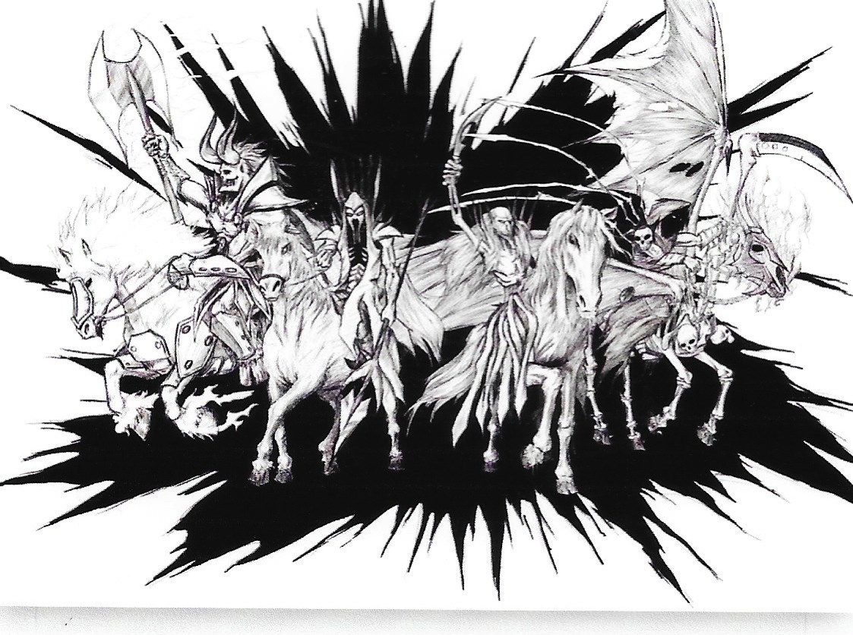
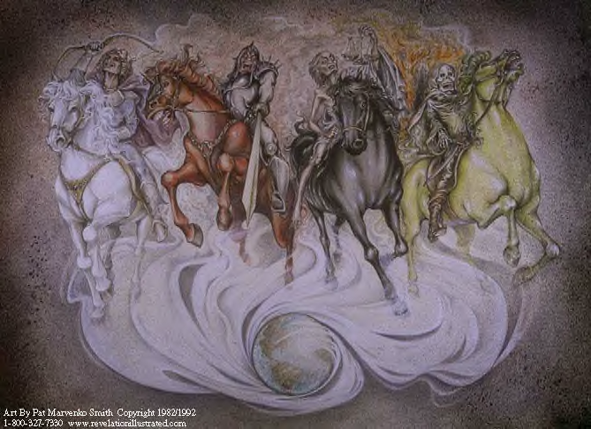

Slide 16
The Fourth Horseman of the Apocalypse
When the Lamb opened the fourth seal, I heard the voice of the fourth living creature say, "Come!" I looked, and there before me was a pale horse! Its rider was named Death, and Hades was following close behind him. They were given power over a fourth of the earth to kill by sword, famine and plague, and by the wild beasts of the earth.
Revelation 6:7-8

Slide 17
Unique Characteristics of
Pandemic Disease
Unknown cause
Invisible
Rapid disease progression
High mortality
Frightening symptoms or horrific deaths
Treatment unknown or untreatable
Easy transmission
No respect for social status or “worth”

Slide 18
DISEASES

Slide 19


Slide 20
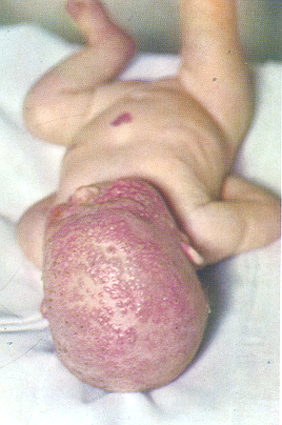
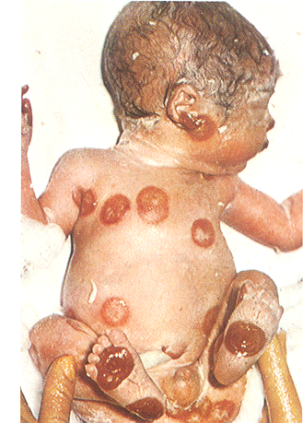
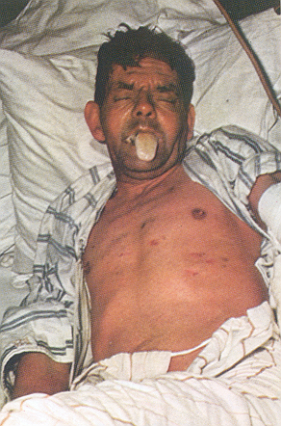
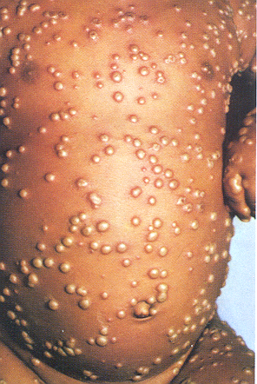
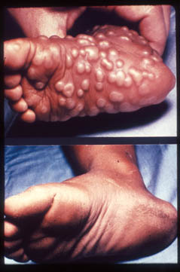
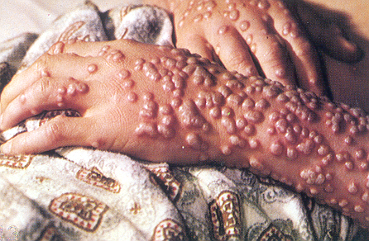

Slide 21
Influenza Statistics
Yearly, there are about 36,000 deaths from flu per year in the United States, and 250,000 - 500,000 deaths per year worldwide.
For pandemic influenza outbreaks:
  16,000 died worldwide from Swine flu 2009-10
  25 to 50,000,000 died from the 1918-19 Spanish flu

Slide 22
Influenza
There was a little girl and her name was “enza, she opened a window, and in flu enza
Yearly, there are about 36,000 deaths from flu per year in the United States, and 250,000 - 500,000 deaths per year worldwide.
For pandemic influenza outbreaks:
  16,000 died worldwide from Swine flu 2009-10
  In 1918-1919, 25,000,000 people died of influenza. The 1997 Hong Kong bird flu, other avian flus, and swine flu were just hints of what this virus can and will do.

Slide 23
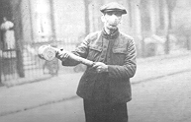

Slide 24
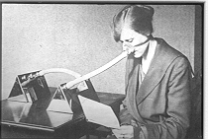

Slide 25
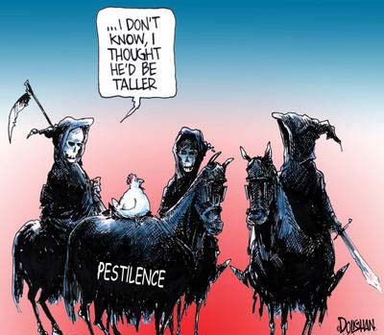

Slide 26
Monkeypox

Slide 27
Monkeypox Clinical Features
◘ Monkeypox illness
- similar to smallpox, usually milder
◘ Incubation period 7-21 days
◘ Febrile illness prodrome
- fever, chills/sweats, headache, myalgias
- sore throat, cough, shortness of breath
- lymphadenopathy
◘ Rash: typically 1-3 days after viral prodrome
- papules vesicles pustules crusting
- scab and fall off usually within 2 weeks
◘ Mortality: 1 – 10% in Africa
- no deaths in U.S.

Slide 28
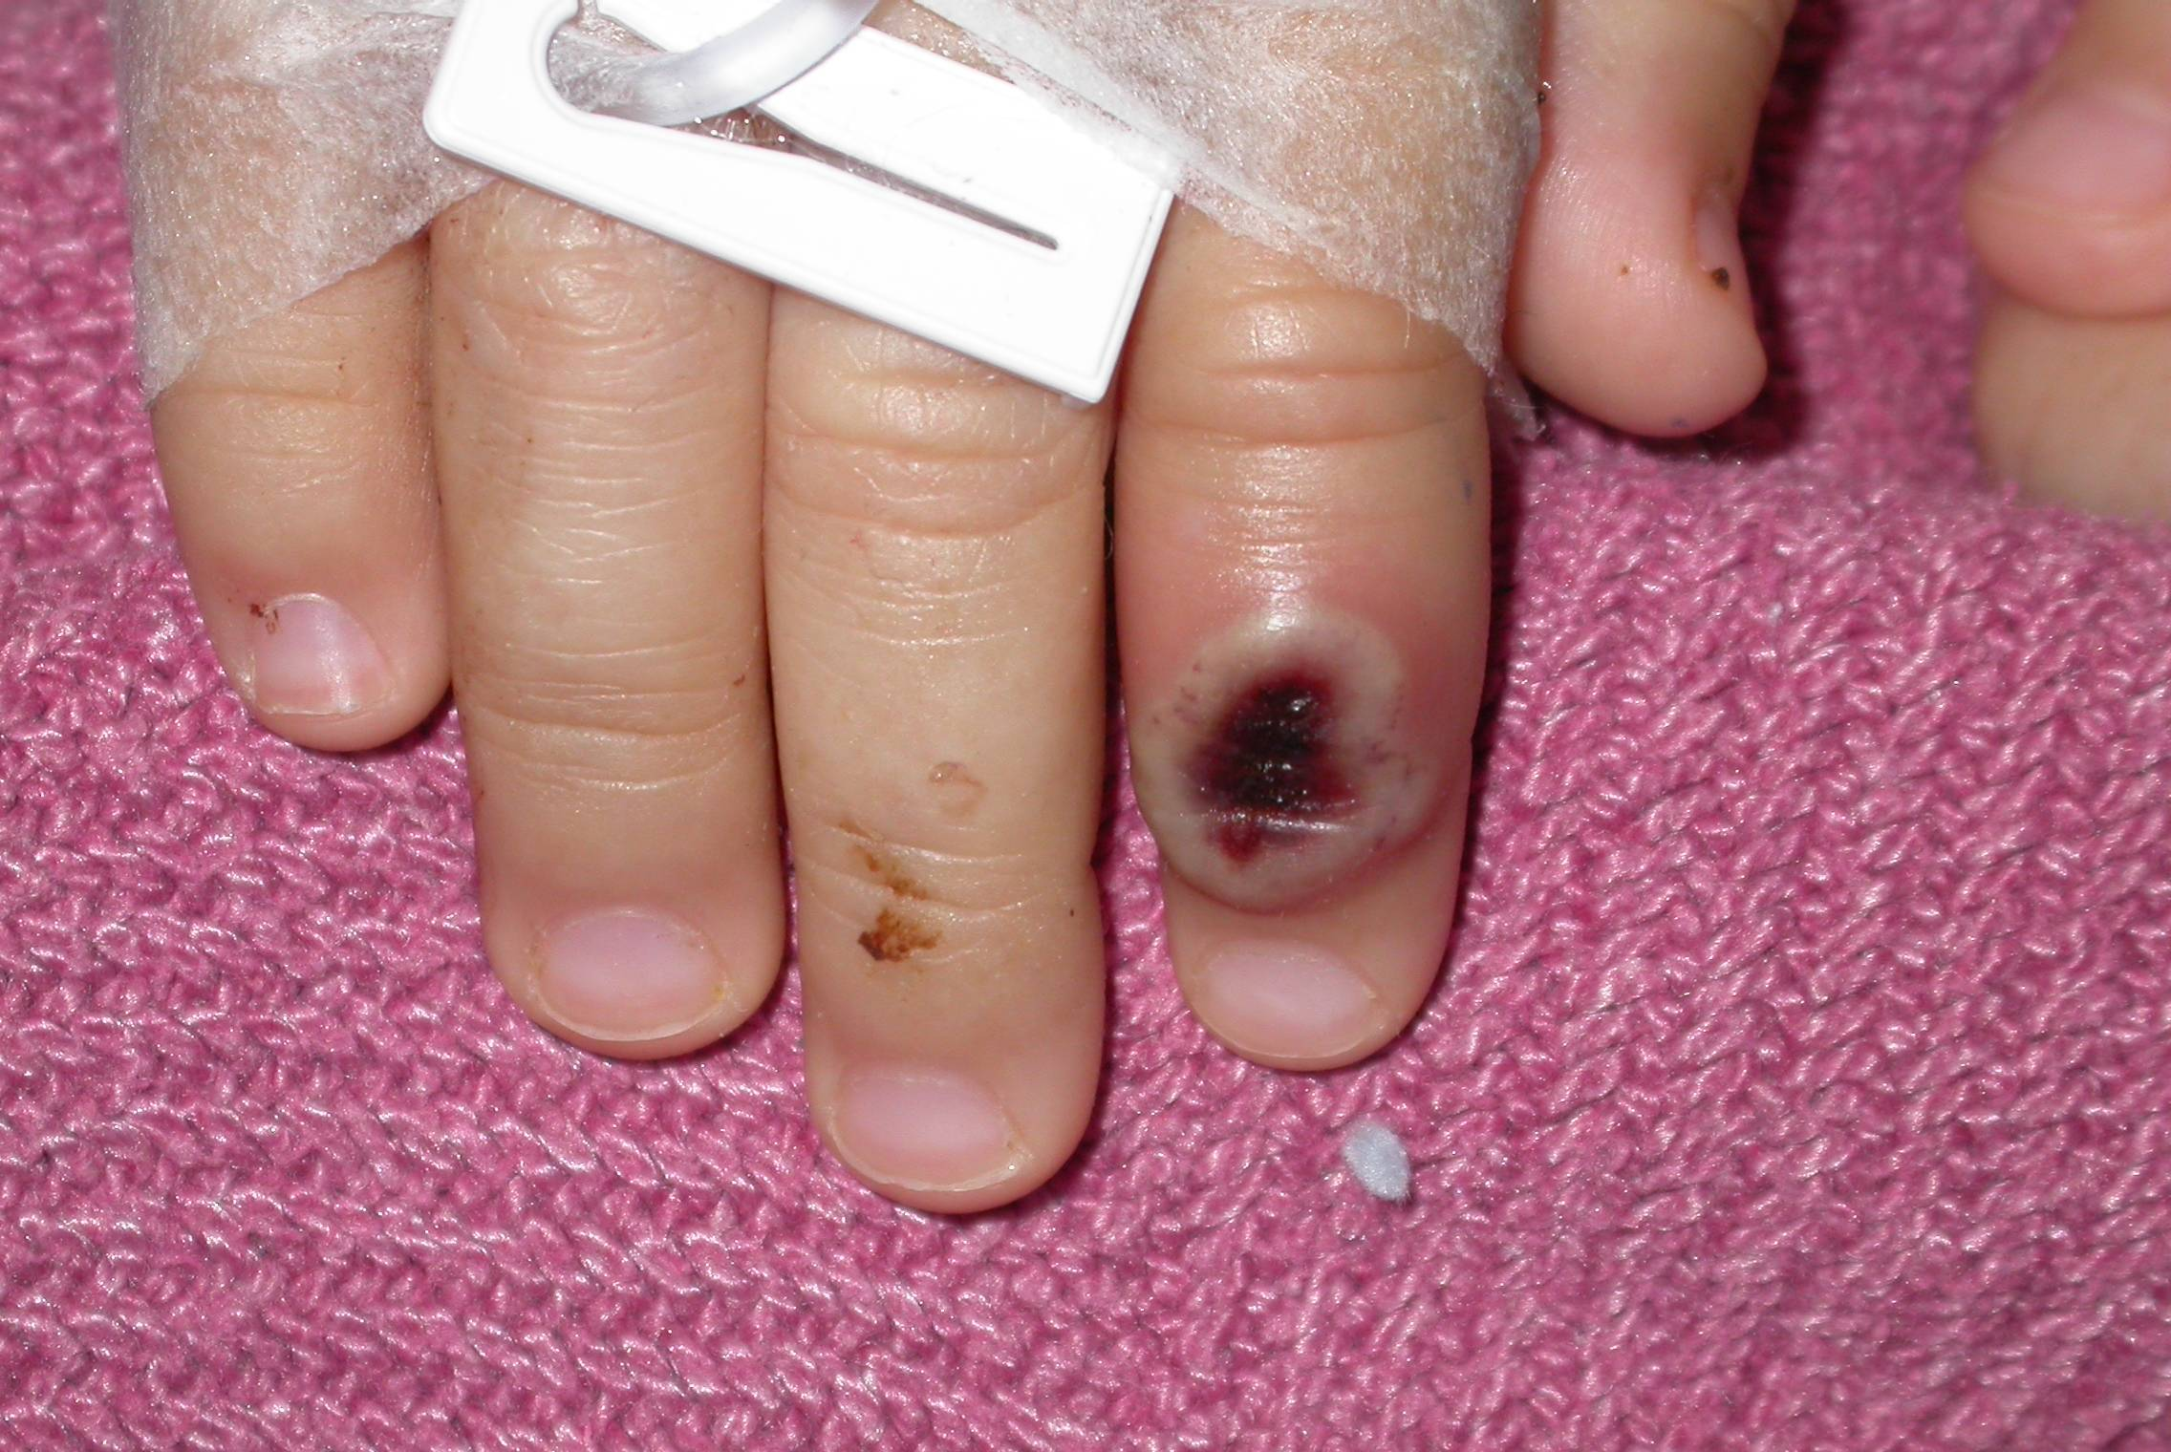
Primary inoculation site, Marshfield index case, 5/26/03
Hospital day 4, 13 days following prairie dog bite

Slide 29
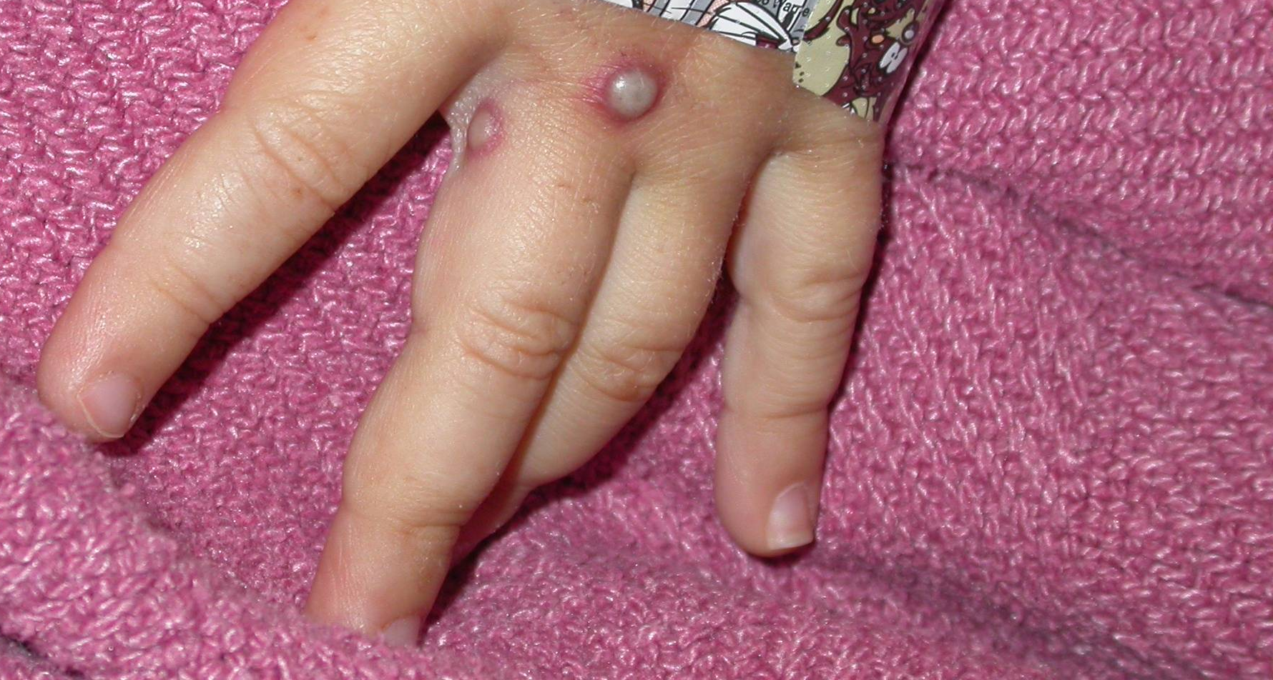
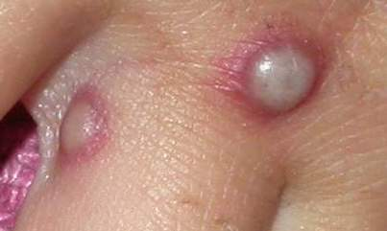
Marshfield index case, 5/26/03
disseminated lesions

Slide 30
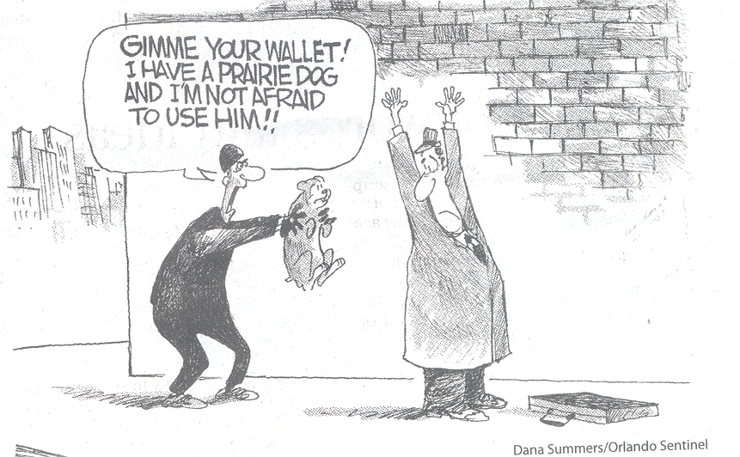

Slide 31
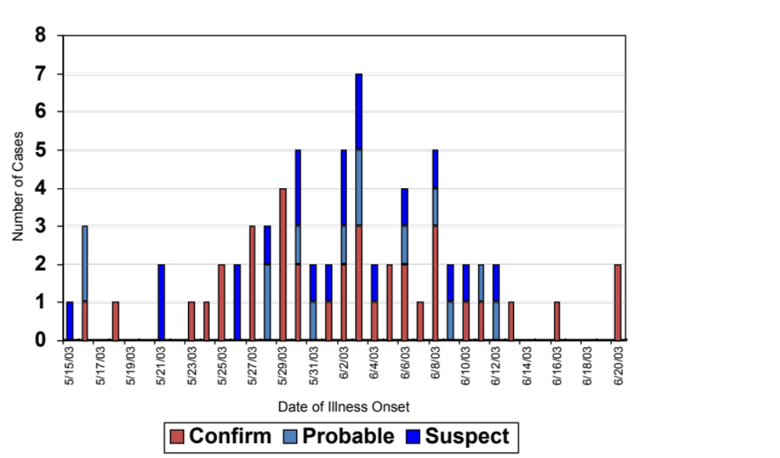
Epidemic Curve: Monkeypox Cases
By Known Date of Illness Onset
Illinois, Indiana, Kansas, Missouri, Ohio, Wisconsin
May 15 - June 20, 2003
N=70*
*70 of 72 cases had known date of onset of symptoms

Slide 32
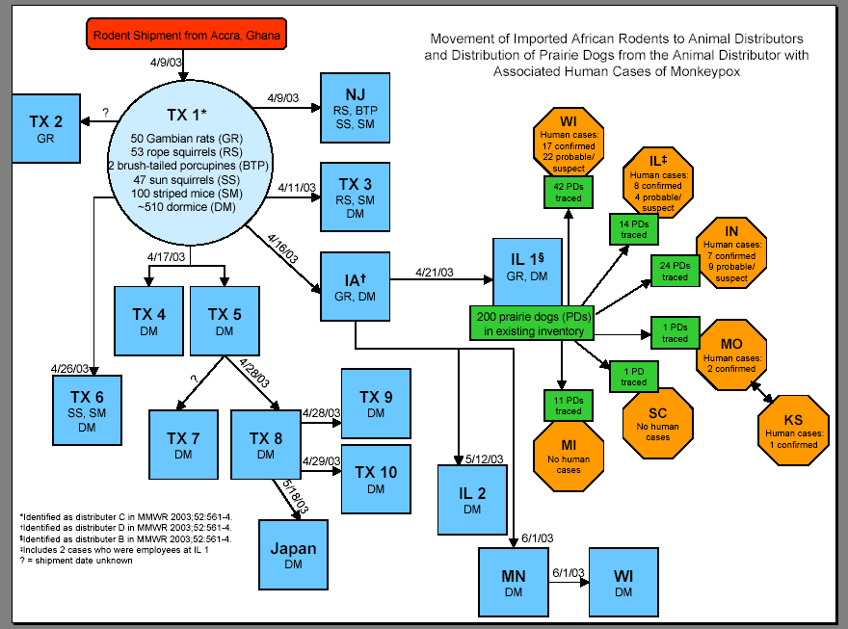

Slide 33
Monkeypox Virus
◘ 1958: discovered in laboratory monkeys
◘ 1970: first reported illness in humans
◘ Indigenous to Central and West Africa
- found in many rodent species
◘ Orthopoxvirus: Brick-shaped DNA virus
- variola (smallpox), vaccinia (smallpox vaccine),
cowpox, monkeypox, raccoonpox, skunkpox,
camelpox
◘ Monkeypox transmission
- primarily contact, human or animal
- droplet
- perhaps airborne

Slide 34
Control Measures
◘ Exotic pet trade from IL distributor in at least 17 states
- WI, IL, IN, MO, OH, KY,TX, SC, FL,TN, PA, MS, MA, MI, NJ, NY, KS
- Quarantine and ban on selling implicated exotic pets in U.S. – 6/11/03
◘ Embargo on importation of all rodents from Africa to U.S. – 6/11/03
◘ Smallpox vaccination for post-exposure to monkeypox human or animal cases – 6/11/03

Slide 35


Slide 36
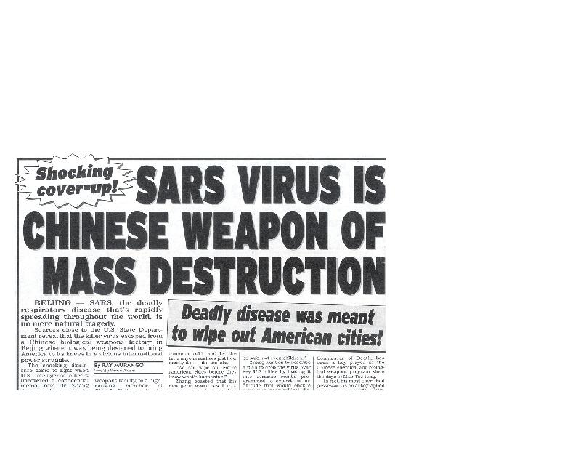

Slide 37

SARS
Suspected Case:
Respiratory illness of unknown etiology with onset since February 1, 2003, and the following criteria:
  Measured temperature greater than 100.4° F (greater than 38° C) AND
  One or more clinical findings of respiratory illness (e.g. cough, shortness of breath, difficulty breathing, hypoxia, or radiographic findings of either pneumonia or acute respiratory distress syndrome) AND
  Travel† within 10 days of onset of symptoms to an area with documented or suspected community transmission of SARS (see list below; excludes areas with secondary cases limited to healthcare workers or direct household contacts)
  OR
  Close contact* within 10 days of onset of symptoms with a person known to be a suspect SARS case.
DuPage County Health Department

Slide 38
Initial signs of a worldwide outbreak
February 11, 2003
  Respiratory illness in Guangdong province, China
  305 cases, 5 deaths since November 16, 2002
February 26—March 12, 2003
  Disease spreads to large number of health care workers in Hong Kong and Vietnam
March 12, 2003
  Global alert for Severe Acute Respiratory Syndrome (SARS)
  CDC offers assistance to the WHO
CDC
Notes:
[Slide 2] On February 11, the Chinese Ministry of Health acknowledged that an outbreak of respiratory illness had occurred in Guangdong province. They reported 305 cases including 5 deaths since mid-November 2002. They attributed the outbreak to Chlamydia pneumoniae and reported that it was over.
Between February 26th and March 12th, a large number of health care workers in Hong Kong and Vietnam developed respiratory symptoms after caring for patients with severe respiratory disease. The outbreak in Vietnam was first recognized after a businessman who had traveled to Hong Kong was admitted to a hospital in Hanoi on Feburary 26th. Tests for influenza and bacterial pathogens were negative in Vietnam and Hong Kong.
Recognizing the potential for rapid spread, on March 12th the WHO issued a rare global alert about a new entity they named Severe Acute Respiratory Syndrome, or SARS. The CDC offered assistance to WHO to control the outbreak and sent staff to assist Vietnam and Hong Kong authorities.

Slide 39
Efforts to Contain Spread
Locally
  Home quarantine
  Hospital closures
  School closures
Internationally
  Travel advisories
  Health Alert Notices
  Screening airline passengers
CDC
Notes:
[Slide 14] Several measures have been taken locally and internationally to contain the spread of SARS.
In several countries, exposed individuals have been asked to stay at home and monitor symptoms. Hospitals have been closed or limited to SARS patients. In Singapore and Hong Kong, schools have been closed due to public fears about possible spread among school children.
The WHO and the CDC have issued travel advisories and distributed health alert notices to travelers to and from affected areas. In the U.S. alone, 200,000 alerts have been distributed as of March 31st. The CDC has coordinated the translation of travel advisories into Vietnamese, Chinese, Korean and Japanese, and we are close to distributing 20,000 alerts daily at 23 points of entry.
In some destinations, airline personnel are screening passengers for symptoms of respiratory illness to prevent possible on-board transmission.
Effective quarantine is difficult when dealing with a new agent that appears highly infectious but for which the routes of transmission are still under investigation.

Slide 40
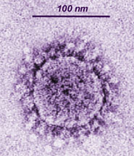
Coronaviridae – coronavirus (+) sense RNA
DuPage County Health Department

Slide 41
Spread from Hotel M
Reported as of March 28, 2003
Canada
18 HCW
Guangdong Province, China
F,G
A
F,G
11 close contacts
A
K
K
Ireland
0 HCW
A
Hotel M
Hong Kong
Hong Kong SAR
95 HCW
H,J
I, L,M
H,J
B
C,D,E
>100 close contacts
I,L,M
B
C,D,E
United States
1 HCW
Vietnam
37 HCW
Singapore
34 HCW
CDC
21 close contacts
37 close contacts

Slide 42


Slide 43
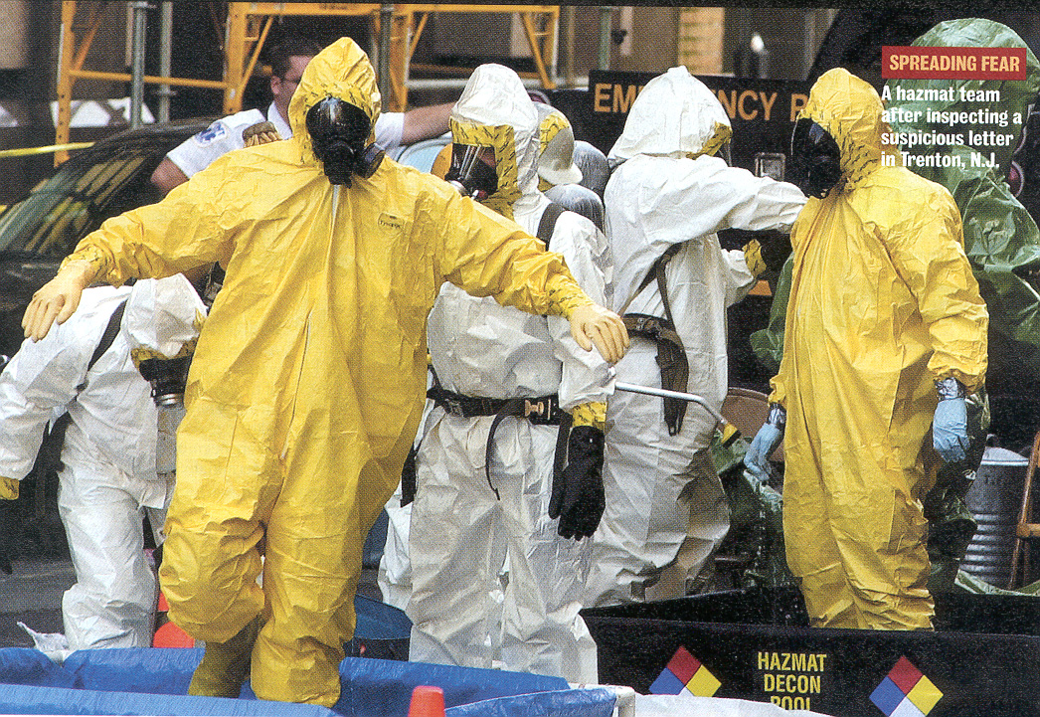

Slide 44
HEMORRHAGIC FEVERS
These highly infectious viruses lead to a potentially lethal disease syndrome characterized by fever, malaise, vomiting, mucosal and gastrointestinal (GI) bleeding, edema, and hypotension.
    Ebola
    Marburg
    Lassa Fever
    Machupo
    Rift Valley Fever

Slide 45
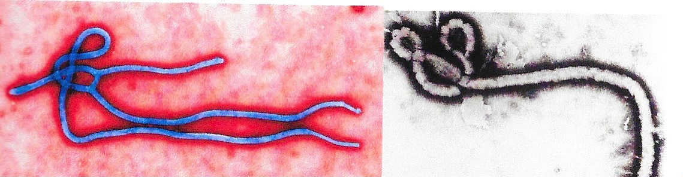
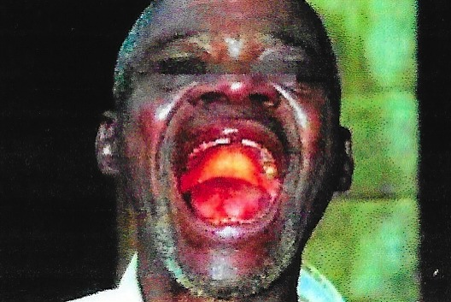
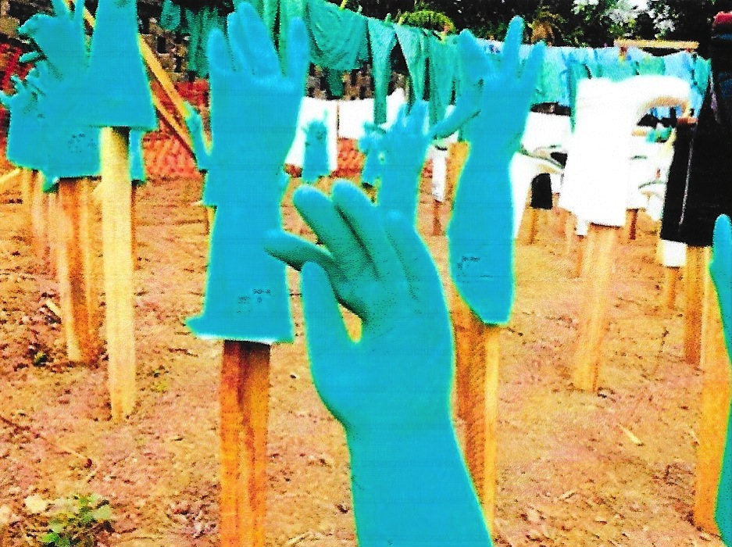
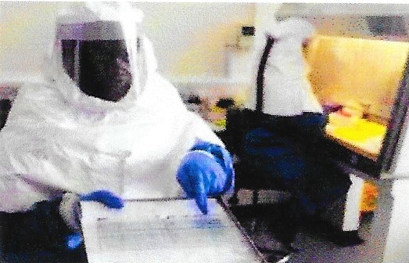

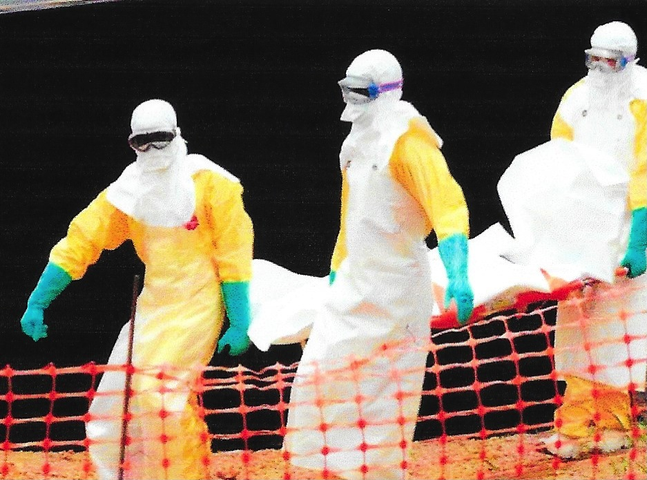
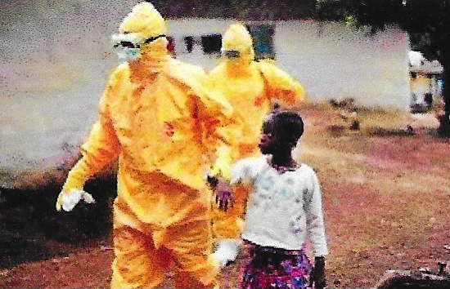

Slide 46

Nurse Defies Quarantine Order

Slide 47


Slide 48


Slide 49


Slide 50


Slide 51


Slide 52
SURVEILLANCE MECHANISMS

Slide 53


Slide 54

Existing Surveillance Systems
RABNET – for rabies
PACNET – Pacific Public Health Service Network
GPHIN – Global Public Health Intelligence Network
NEDSS/INEDSS
WHO-Related Sites
HIV-AIDS
FLUNET
TB Monitoring System
Global Salmonella Surveillance System
UNAIDS Country Sites ]
Disease/Rumor Outbreak List
INSPEAR – International Network for Study and Prevention of Emerging
Antimicrobial Resistance
WHONET – Used by 159 labs in 30 nations
RedBAT
Meditune
RODS Real-Time Outbreak and Disease Surveillance System

Slide 55
Presidential Decision Directive NSTC-7
June 1996
“I have determined that the national and international system of infectious disease surveillance, prevention, and response is inadequate to protect the health of United States citizens from emerging infectious diseases.”
“The mission of the DoD will be expanded to include support of global surveillance, training, research, and response to emerging infectious disease threats.”
“DoD will strengthen its global disease reduction efforts through: centralized coordination; improved preventive health programs and epidemiological capabilities; and enhanced involvement with military treatment facilities and United States and overseas laboratories.”
Notes:
In conclusion, these quotes are taken directly from a Presidential Decision Directive, signed by our Commander-In-Chief. While this is a non-traditional humanitarian assistance project, it is sustainable, locally and regionally identified as important and in full accordance with the Presidential Directive on Emerging infectious diseases.

Slide 56


Slide 57

USAID Surveillance Programs

Slide 58

The U.S.-Mexico Border Infectious Disease Surveillance Project: Establishing Bi-national Border Surveillance

Slide 59

APEC – EINET
Emerging Infections Network

Slide 60
Societal Response to Disease
Fear
Stigmatization
Violence
Quarantine
Search for someone to blame (someone or some group did something wrong)
Retribution

Slide 61
Pharmaceutical Response to Disease
Vaccination
Antivirals/anti-bacterials
Biologics
Supportive therapies (fluids, feeding, breathing, etc.)

Slide 62
Non-Pharmaceutical
Community Responses
Travel Restrictions (Advisories and Bans)
Border Closure
Mandatory Airport Screening and Testing
Quarantine
School Closure
Banning Large Gatherings
Other Social Distancing Measures

Slide 63
Governmental Response to
Infectious Disease
Imposing of social distancing measures
Quarantine
School Closure
Ban on Large Gatherings (sports, concerts, conventions, malls, etc.)

Slide 64
International Response to
Infectious Disease
Implementation of intergovernmental agreements concerning movement of citizens
Imposition of border screening
Issuance of travel advisories
Activation of international aid agreements concerning pharmaceutical interventions.

Slide 65
Are Our Medical Systems Prepared for Large Numbers of
Infectious Residents??
Are They Prepared to Implement Disaster Triage Procedures Involving Limited Supplies and Pharmaceuticals?

Slide 66
Has Our Readiness for Pandemic Disease Improved?
Is the Public Better Informed??
Are our Communication Systems Tested and Messages Prepared?

Slide 67
Conclusions
Each nation must strengthen their own procedures for surveillance an containment measures.
He WHO Global Influenza Preparedness Plan should be used as a guide to further create relationships necessary to share vital information rapidly concerning disease occurrence, spread and containment.

Slide 68
Develop and refine all communications mechanisms to citizens to assure proportional response by those at risk.
All nations should be made aware of the effect that containment measures would have on not only their citizens, but the citizens of other nations.
Carefully consider the value and effect of travel restrictions and quarantine measures, and make any actions evidence-based and in consultation with other nations.

Slide 69
Thank You for your Kind Attention!

