Slide 1

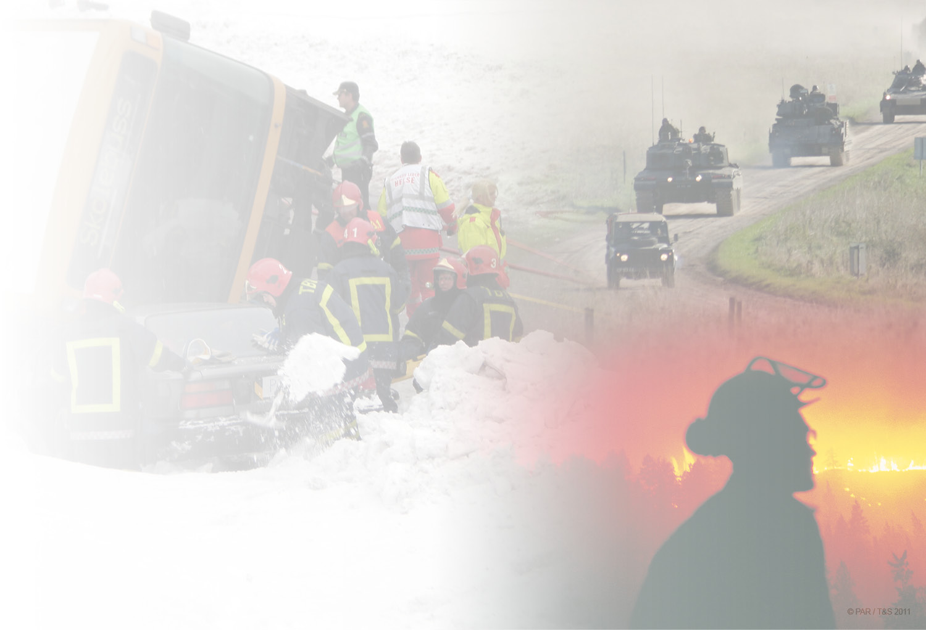
BUSINESS IDEA
Crisis Training AS
CTAS should be an international recognized company with unique learning and training methodology and supporting tools for planning, executing and evaluating exrecises to strengthen the partners ability to manage crisis.
Morten Wenstad
CEO
Crisis Training AS
Joseph Pollack
Business Development
Crisis Training AS
Side 1
Notes:
Firstly I would like to introduce my little Norwegian Company. Crisis Training AS provides knowledge intensive crisis-management training support services specifically for training inter-organisation collaborative response to mass-casualty incidents as a behaviour at the tactical and operational level. In this presentation I will introduce some of the thinking and technology produced by the BRIDGE Project and some further development under the COncORD consortium

Slide 2
Some Activities
Operatørenes Forening For Beredskap, March 2014
Table Top – University college of Stord og Haugesund, April 2014
Dragvoll, mai 2014.
Sola Airport (14)
Elverum (15)
Harbour Ex (15)
Exercises 2011-2014:
Exercise Jømna (2011)
SkagEx11
Flums (2012)
Boilex (2012)
Hell – tunellen (2013)
Fu Shan Hai (2013)
Risavika – Stavanger (April & September 2013)
Advisory:
Feasibility study – Virtual Training in Avinor
Emergency Management course Norway Cup
Risk and vulnerability studies for Elverum and Våler Municipalities
Other activities
  Emergency Management for the Norwegian Ski Federation
  Feasibility study – cross-agency training centre in Norway
Annet:
Prosjektoppgave for Master–student ved UiS (Bi-veileder)
A number of presentations in Norwegian conferences
Presentation in an international conference in Stavanger 26. september
Presentation of White paper in an international conference in Porto (23. – 24. oktober)
Collaboration with MsC and PhD students from different universities and university colleges in Norway
Rogaland Exercise Board:
CTAS has been a core actor for the exercise board in our task to establish an optimal learning and training process. CTAS has also acknowledged the exercise boards need for good evaluation processes to assure an optimal learning over time.
Side 2
Notes:
Although we’re a young company, we’ve had the opportunity to contribute in substance to a number of national and multi-lateral training exercises notably the Risavika Training Exercises, the Dragvoll exercise, and Harbour Ex 2015 where the BRIDGE project had the opportunity to demonstrate our System of Systems. ADD SOME REVIEW NOTES HERE.
SkagEx11 (2011): had the objective to train the civil protection resources in Norway, Sweden and Denmark, as well as the ability of these neighbouring countries to cooperate if a major ship disaster should occur in the Skagerrak basin. The exercise should train and improve plans and mechanisms within as well as between these countries in order to achieve the best possible preparedness for a “worst case scenario” in these waters.
CTAS was acting as an observer during the exercise and as an invited actor supporting the evaluation process. The findings from SkagEx 11 were mainly related to how evaluation of international exercises was performed.
Boilex11 (2011): The focus of BOILEX (Baltic Oil Spill Exercise) was on cross-border cooperation in the shoreline and was implemented jointly with an oil spill exercise within the Copenhagen agreement (CEX). CEX was taking place offshore while BOILEX was performed on and near the shore. In the shoreline a cooperation between operative units of Swedish Coast Guard, municipal rescue services, national depots and NGOs were working together.
CTAS was acting as an observer during the exercise and as an invited actor supporting the evaluation process. The findings from Boilex 11 were mainly related to how evaluation of international exercises was performed.
Demo 1 in FLUMS (2012): This live demonstration was based on how Firefighters could handle a real explosion and fire scenario in a busy road tunnel, adopting the technologies proposed in the BRIDGE Concept Cases.
The FRITS training concept supported the Analyse phase by defining the training objectives, the Planning phase by supporting the overall planning of the demonstration, Execution by instrumenting the exercise area and using TEMIS as an observation and evaluation tool. The CTAS training methodology was the back bone for the overall training process.
Hell tunnel (2013): This exercise was a regional inter-agency exercise with actors from the National Rail Road Authority, The Norwegian Road Authority, Emergency organisations and Municipalities. The objective was to assure optimal handling of an accident in tunnels.
Brage (2014): The purpose of this exercise was to demonstrate that the emergency response organisation for an oil operator can perform its tasks in accordance with the relevant emergency response plans and specific requirements for the activities. A table-top exercise was performed for this oil operator's 1st, 2nd and 3rd level emergency preparedness organisation.
The exercise was based on the MeTracker Concept and the use of TEMIS.
Sola Airport (2014): A regional inter agency training process based on a mass casualty aircraft accident. The training process consisted of an inter agency Table Top and a live exercise.
CTAS supported the table top exercise as an evaluator and by using the Virtual training simulator for scenario build up. The Virtual training simulator was demonstrated for a dedicated group of end users mainly for validation purposes.
HarborEx15: A full scale live exercise for a multi-dimensional incident in the Sjursøya area in Oslo. The main exercise will be held in May 2015.
CTAS developed a virtual training environment for HarborEx15 and a virtual training activity was performed for 18 incident commanders in March 2015. This, as a part of the incident commander's preparation for the live exercise.
Now, I would like to introduce the First Responder Intergrated Training System. The FRITS training concept has been Demonstrated, Validated and Exploited through participation in a number of exercises. In some exercises only the logic behind the methodology has been validated, in others some of the tools has been demonstrated. These activities together with other Domain Analysis activities in BRIDGE has given us a good understanding of how to develop a fully integrated training system for collaborative training.

Slide 3
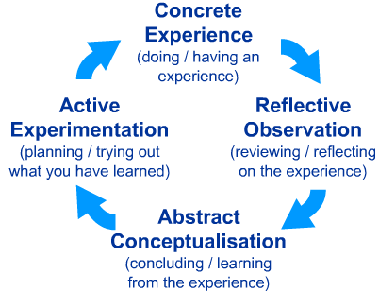
First Responder Integrated Training System
First Responder Integrated Training System
Learning & Pedagogies
The Training objective
Evaluation
Content
of training
Student
factors
Training
methods
-
Training conditions
Notes:
There are two types of theories we really need to be familiar with : learning and teaching theories. Here we see two types of learning approaches.
The Experience learning model on the left : The model is also often called "learning by doing".
The Dewey’s model is described in five steps:
The students experiences a problem and get motivation to solve it
Defining and analysing the problem
Collection of knowledge and other experiences
Creating one or more hypotheses based on the previous steps
Test the most likely hypothesis experimentally
Our experience helps us to deal with challenging situations. We all have different ways to solve a problem, and they are often un-reflected. We are neither aware of our own actions, or the consequences of our reactions. Theories and models that explain experiential learning can help us become more aware of how to handle problems. David A. Kolb (1939) has a model of experience learning, where he describes a learning cycle in four steps, as depicted in the figure on the left.
In 1978 the Norwegian phycologists Bjarne Bjorndal and Sigmund Lieberg introduced a model describing key elements of a teaching process. Their model was named the didactic relation model, because it emphasizes how all the elements must be in relationship with each other so that one can achieve a good learning process. The model consists of the following six elements:
The training objectives
Content of training
Training methods
Training conditions/framework
Student factors
Evaluations
The main choice for determining the teaching method lies with who has the ownership of the learning process. The deductive method is more teacher-oriented, in which students are directed on how activities and tasks should be performed. The inductive method is more student-oriented, in which the students determine themselves how activities and tasks can or should be performed. Hence, learning can be completed with both inductive and deductive methods, or by a combination of these two.
However, from a training perspective the context that the civil security organisation offers for learning is an important context.
David A. Garvin (2000) "A learning organization is an organization skilled at creating, acquiring, and transferring knowledge, and that its behaviour is modifying and reflecting new knowledge and insights." "Learning organizations", are according to Garvin skilled in five main activities:
Systematic troubleshooting
Experimentation
Learning from own experience
Learning by others
The ability to quickly and efficiently transfer knowledge throughout the organization
A challenge for learning organisations is that tools for benchmarking are likewise often very difficult to find. The consequence is that it makes it difficult for the practitioners to know what they should do to develop their business into "learning organizations". In a dissertation at the London School of Economics, however Phil Rosengarten (1999) made ​​a compilation of research in this area, and came to the following 10 characteristics of learning organizations;
Team work and team learning
Systematic thinking and mental models
Free flow of information vertically and horizontally
Education and training of the entire workforce
Reward System for Learning
Continuous improvement
Flexibility in business strategy and among employees
Decentralized hierarchy and participatory management
Learning laboratories and continuous experimentation
Supporting, learning corporate culture

Slide 4
CTAS Learning and Training Methodology
1. Analyse
a) Review of existing emergency plans
b) Experiences from training/missions
c) Training need analysis (TNA)
d) Define Training objectives
e) Verify the need for supporting elements
f) Process for evaluation/transfer of know how
4. Evaluate
a) Analyse gathered data
b) Evaluate training objectives and criteria
c) Perform evaluation process
d) Certification/approval
2. Plan
a) Establish training scenario
b) Establish storyboard/Execution plan
c) Secure resources for execution
d) Execute competence build up
3. Execute
a) Establish training area/training environment
b) Execute exercise/training
c) Dismount training setup
5. Lessons learned
a) Transfer experience to operational functions
b) Competence improvement
c) Revise emergency plans
Side 4
Notes:
To meet these challenges & in cooperation with the Competence Centre at Hedmark University College, which has a specialised education in crisis management, we have prepared a rehearsal and learning model. This ensures the optimal use of all collected data from our unique evaluation tool in the exercise. I want to emphasise how important it is to get a good evaluation of the exercise . This must begin as early as possible in the analysis phase in order to form a detailed and comprehensive picture of the areas you are going to practice. A good goal structure is essential to detail the planning exercise. Appropriate Scenario Development ensures optimal substrates for measuring value added and learning. Therefore train the trainers and capacity building is provided to ensure that participants are well prepared and capable of receiving the benefits of high-tech training.
CT must ensures that your training area and the participants are instrumented in an optimal way, so that you get the best possible evaluation through exercise. But our Experience from practice in Elverum revealed the need to further develop the technology - and the methodology – for a more efficient or rapid analysis of all collected data. This is the development area that our company is focussing on to optimize product and service portfolio for the future.
Another area our customers are recognizing that they can improve themselves is the implementation of the lessons learned from exercises into routines. Naturally this has been a challenge since there have often not been good evaluation documents as a starting point.
The five phases with it´s defined activities has been further optimised during the last period of the project. The reasoning behind the 5 phases is to emphasize the areas proven to be lacking focus and supporting tools - where the FRITS will make a differens. These phases are Analyse, Evaluate and Transfer og know how.

Slide 5
CTAS Learning and Training Methodology
Initiate
Analyse
Training Activities
Training activity 1
Training activity 2
Lessons Learned
Training activity N
Plan
Execute
Evaluate
Plan
Execute
Evaluate
Plan
Execute
Evaluate
a) Establish training scenario
b) Establish Execution plans/storyboard
c) Secure resources for execution
a) Establish training area/training environment
b) Execute exercise/ training activity
a) Analyze gathered data
b) Evaluate training objectives and criteria
c) Perform evaluation process
Notes:
Crisis training doesn’t replace native trainers but rather supports them therefore it’s
It is common that trainers (training managers) prepare their training sessions. Their competences and background will influence on the outcome of the training session. Therefore a basic understanding by the trainers is important of what the participants (the trainees) do on a regular basis and that they are in a position to relate to the end users needs (Bennett, 2010). Early in the pre-training phase one should identify the relevant plans/procedures that should be tested (Bennett, 2010). Further it is important to determine the prior knowledge of the trainees so that the exercise can be designed based on their needs. This is commonly known as a Training Need Analysis (TNA). To assure optimal learning outcome it is important that both the trainees (Main Training Audience (MTA)), and their stakeholders are involved in this phase. This assures ownership and commitment, which again results in better outcome (‘t Hart, 2002).
Based on the training needs, the Main Training Objectives (MTO) should be defined and as a main contribution for establishing the training activities framework. To assure a common understanding and acceptance of the MTOs, it is important to include the MTA, in the pre-training phase (Vogel-Walcutt et al., 2013). Without influence, lack of commitment can be crucial due to the fact that the participants don’t consider the MTOs as relevant and the probability of learning decreases (Sommer et al., 2013).
Focus on the MTOs prior to the defined training activity can increase the motivation for the MTAs and help them focusing on the most relevant material during training. It could also support in selecting appropriate learning strategies (Vogel-Walcutt et al., 2013). The training activity should not be predictable; pre-planned training activities with only a limited range of inputs can easily appear uninteresting to the participants and lead to a more automated process (t Hart, 2002). The exercise scenario represents parts of the context were the learning happens. A training scenario should appear relevant and interesting to the trainees, and if the exercise is too familiar one risks that the trainees lose interest and perform their tasks without reflection (‘t Hart, 2002).
The during-training phase can contain multiple training activities at different complexity levels.
Teaching abilities are considered of importance (Vogel-Walcutt et al. 2013) identifying three sub-categories to describe different strategies during training; 1) information presentation, 2) providing guidance and 3) practice.
The post-training phase consists of the analysis and evaluation of the exercise. From a cognitive learning perspective, the analysis and evaluation phases are more important than the exercise itself. Hence, sufficient time should be reserved for the post-training phase.
The results of the exercise should reflect the main training objectives. After the exercise a debriefing, After Action review, should be conducted. This can, for example, be a brief oral review right after the exercise, followed by a review meeting later. Written reviews by the observers and instructors are important in the evaluation of the exercise. They should therefore provide open, honest and fair feedback from the exercise. Their written reviews can be used as a checklist for the discussion during the debriefing meeting. The purpose of the meeting is to allow for honest assessment of everyone involved in the exercise. Leaders of the review should make it clear that the actions discussed during the meetings should not be taken personally (Bennett, 2010). The instructor should present for further discussions corrective and explanatory feedback, in addition to suggestions for performance improvement.

Slide 6
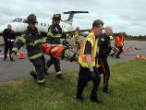

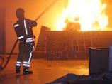



Structured Training
Learning and Training Methodology
Constructive
Live
Full scale exercises
Individual
Inter agency Collaboration
Group
Exercises to train functions
Virtual
Constructive
Live
Intra- and inter agency collaboration
Individual
Skills
Virtual
Live
Complexity and scope
Training Methodology
Individual
Group
Constructive
Virtual
Input - response
Collaboration
Group
Tabletop
Constructive
Intra- and Inter agency Collaboration
Group
Seminar/ workshop
Basic competence
Resources
Side 6
Notes:
Lessons learned from the Analyse phase
Collaborative training processes are very cost- and resource demanding, implying the importance of establishing a good coordinated foundation in the Analyse phase. In most cases the Analyse phase is managed in a premature way and not well coordinated, in which each of the involved organisations establishes its own baseline. To reduce the cost and the need for resources it would be advisable to establish a database with information from earlier exercises giving the management team the opportunity for reuse.
This is an overall view of potential training activities in an overall training process, the tools that can support each of the training activities and which Main Training Audience that each of these training activities can be used for. As an example, based on a training need analyses there could be a need for building up basic competence in how to establish the different functions in an incident area through a seminar/workshop. This could be further discussed in a table top prior to a collaboration exercise using simulators or in a live exercise. The earlier mentioned training methodology should be the backbone supporting such a training process.

Slide 7
First Responder Integrated Training System
FRITS main objective
Establish an optimal learning and training methodology, supported by an integrated portfolio of sub-systems that will improve the quality of emergency response and crisis management in intra-agency and inter-agency operations.

Slide 8
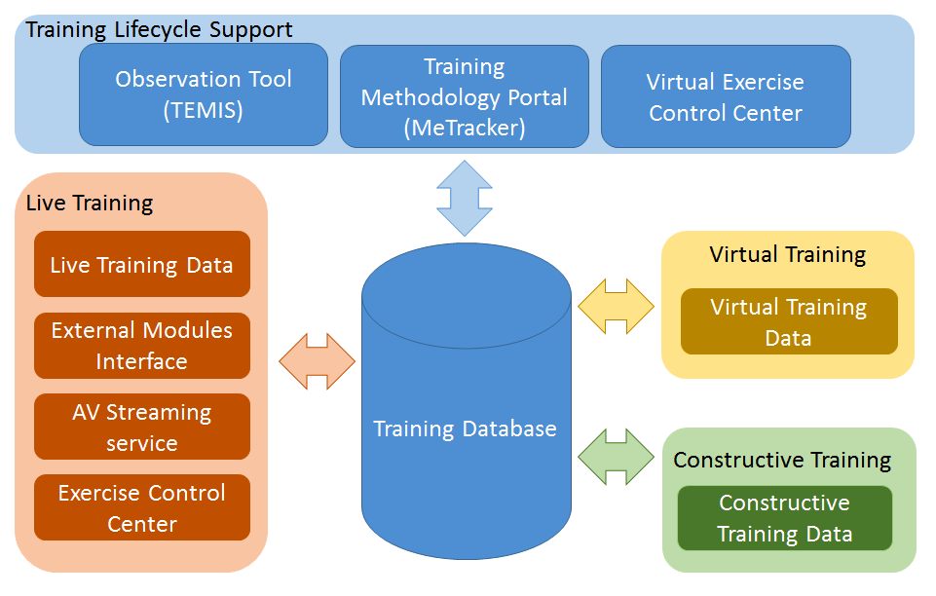
First Responder Integrated Training System
Supporting tools
Notes:
If we look at the FRITS toolbox, it consists of tools supporting the overall training life cycle, tools supporting the training activity, if it is live, virtual or constructive training. And finally a database or a repository that will be populated with all relevant information from the overall training process.
In BRIDGE we have mainly been focusing on the training methodology resulting in the MeTracker including the database, TEMIS, Live training tools and Virtual training. This last period the main focus has been on the MeTracker development, the External Modules Interface and Virtual training, and these are the areas we would like to present in more details today.

Slide 9
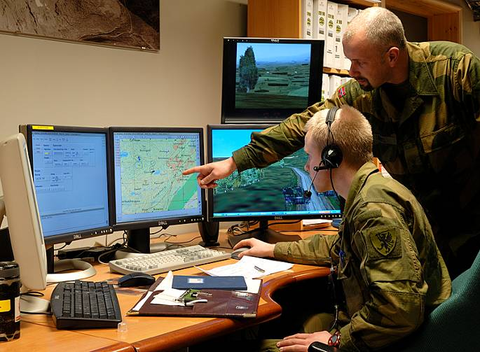
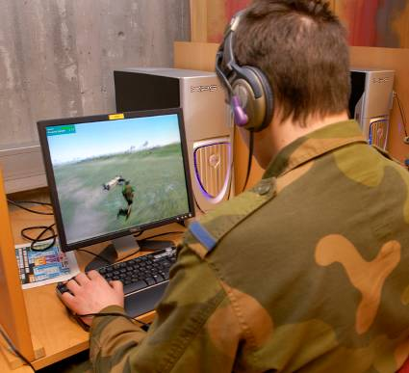
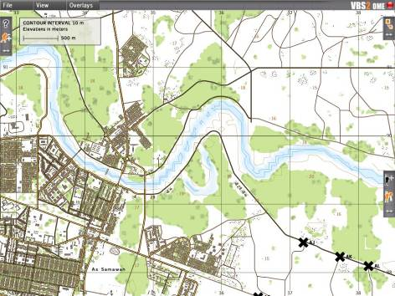
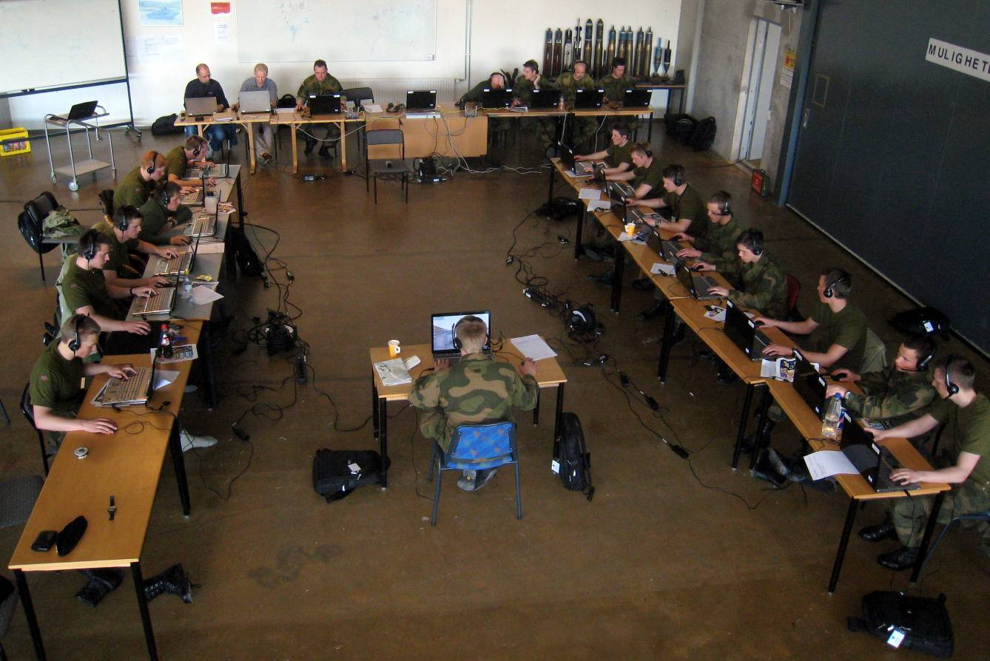
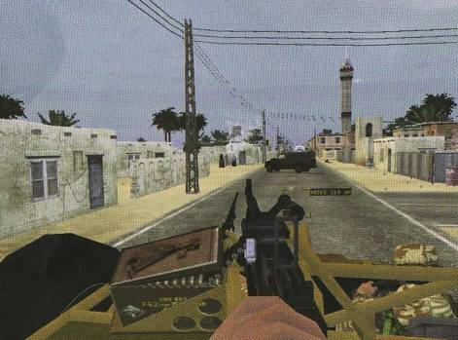
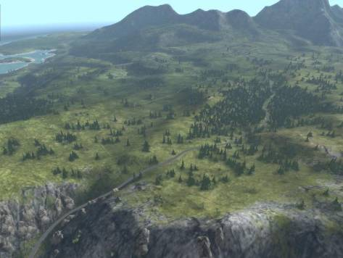
Virtual Training Concept
Skadested
Notes:
Et utsnitt av hvordan øvingsledelsen kan følge med på hver enkelt aktørs bevegelse og status.

Slide 10
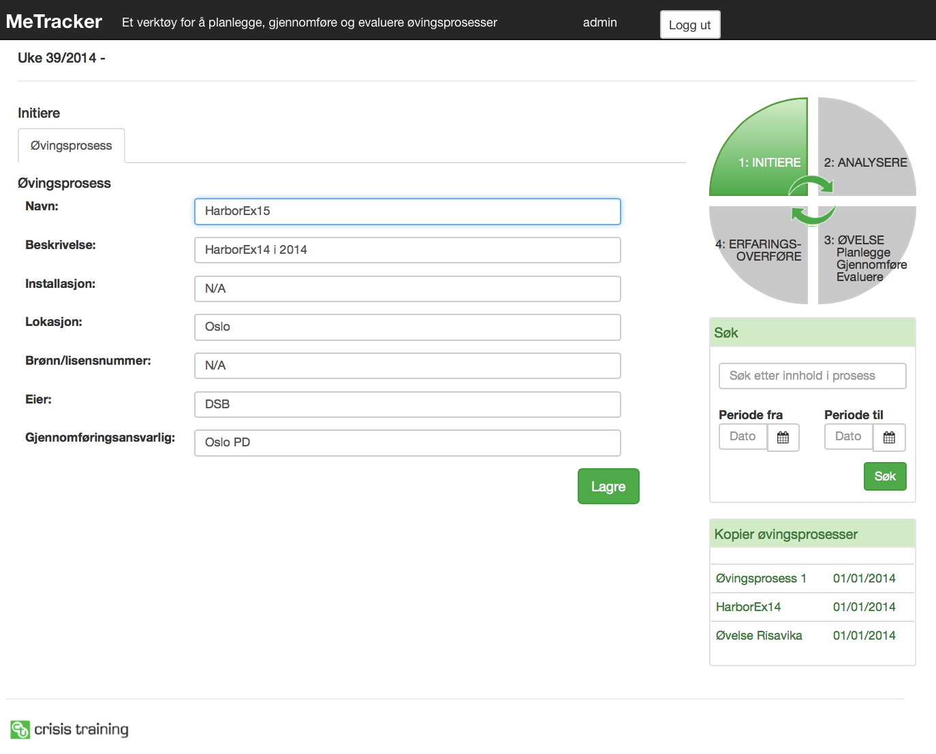
First Responder Integrated Training System
MeTracker
Notes:
The purpose of the MeTracker is to guide the Training staff through each of the 5 phases and tasks as defined in the Training methodology. MeTracker is a distributed dynamic tool for managing the activities in the training life cycle in a cost effective way, by others through reducing the need for resources throughout the overall training process. This picture shows the initate phase where you define your training process. You can start a new training process by using the repository from an earlier process.

Slide 11
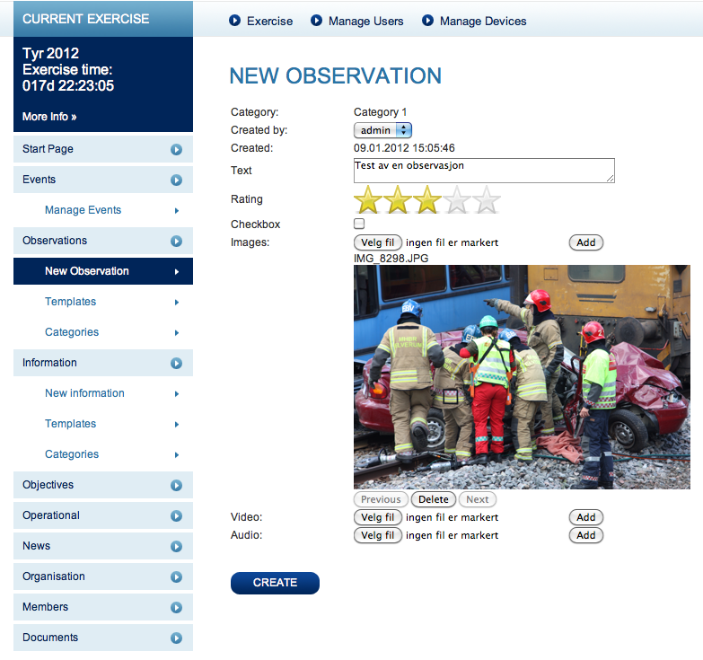
Observation template
Morten Wenstad
Daglig leder
Crisis Training AS
Side 11

Slide 12
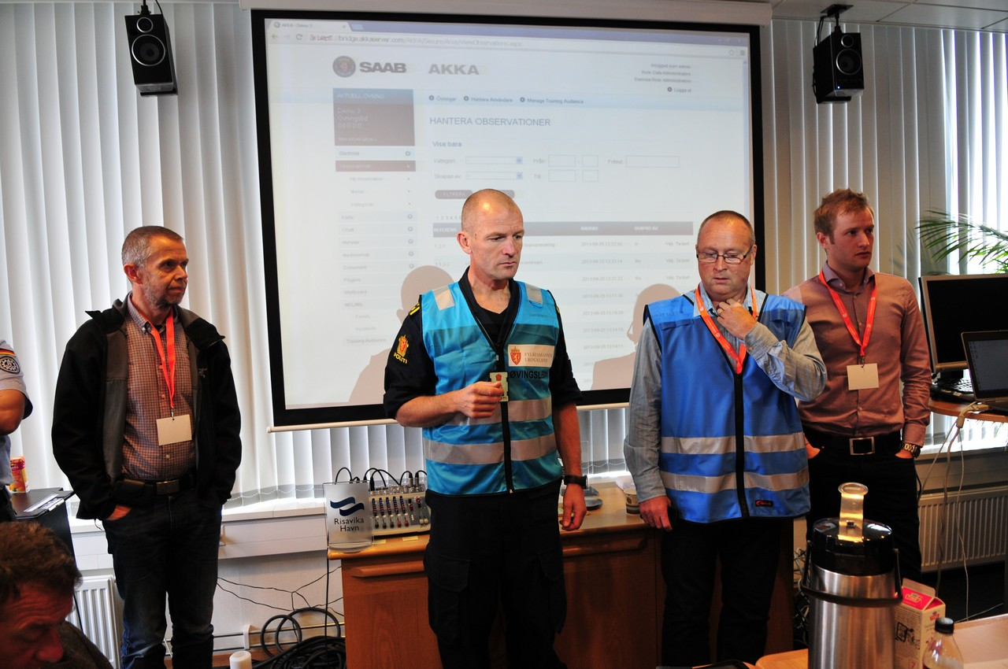
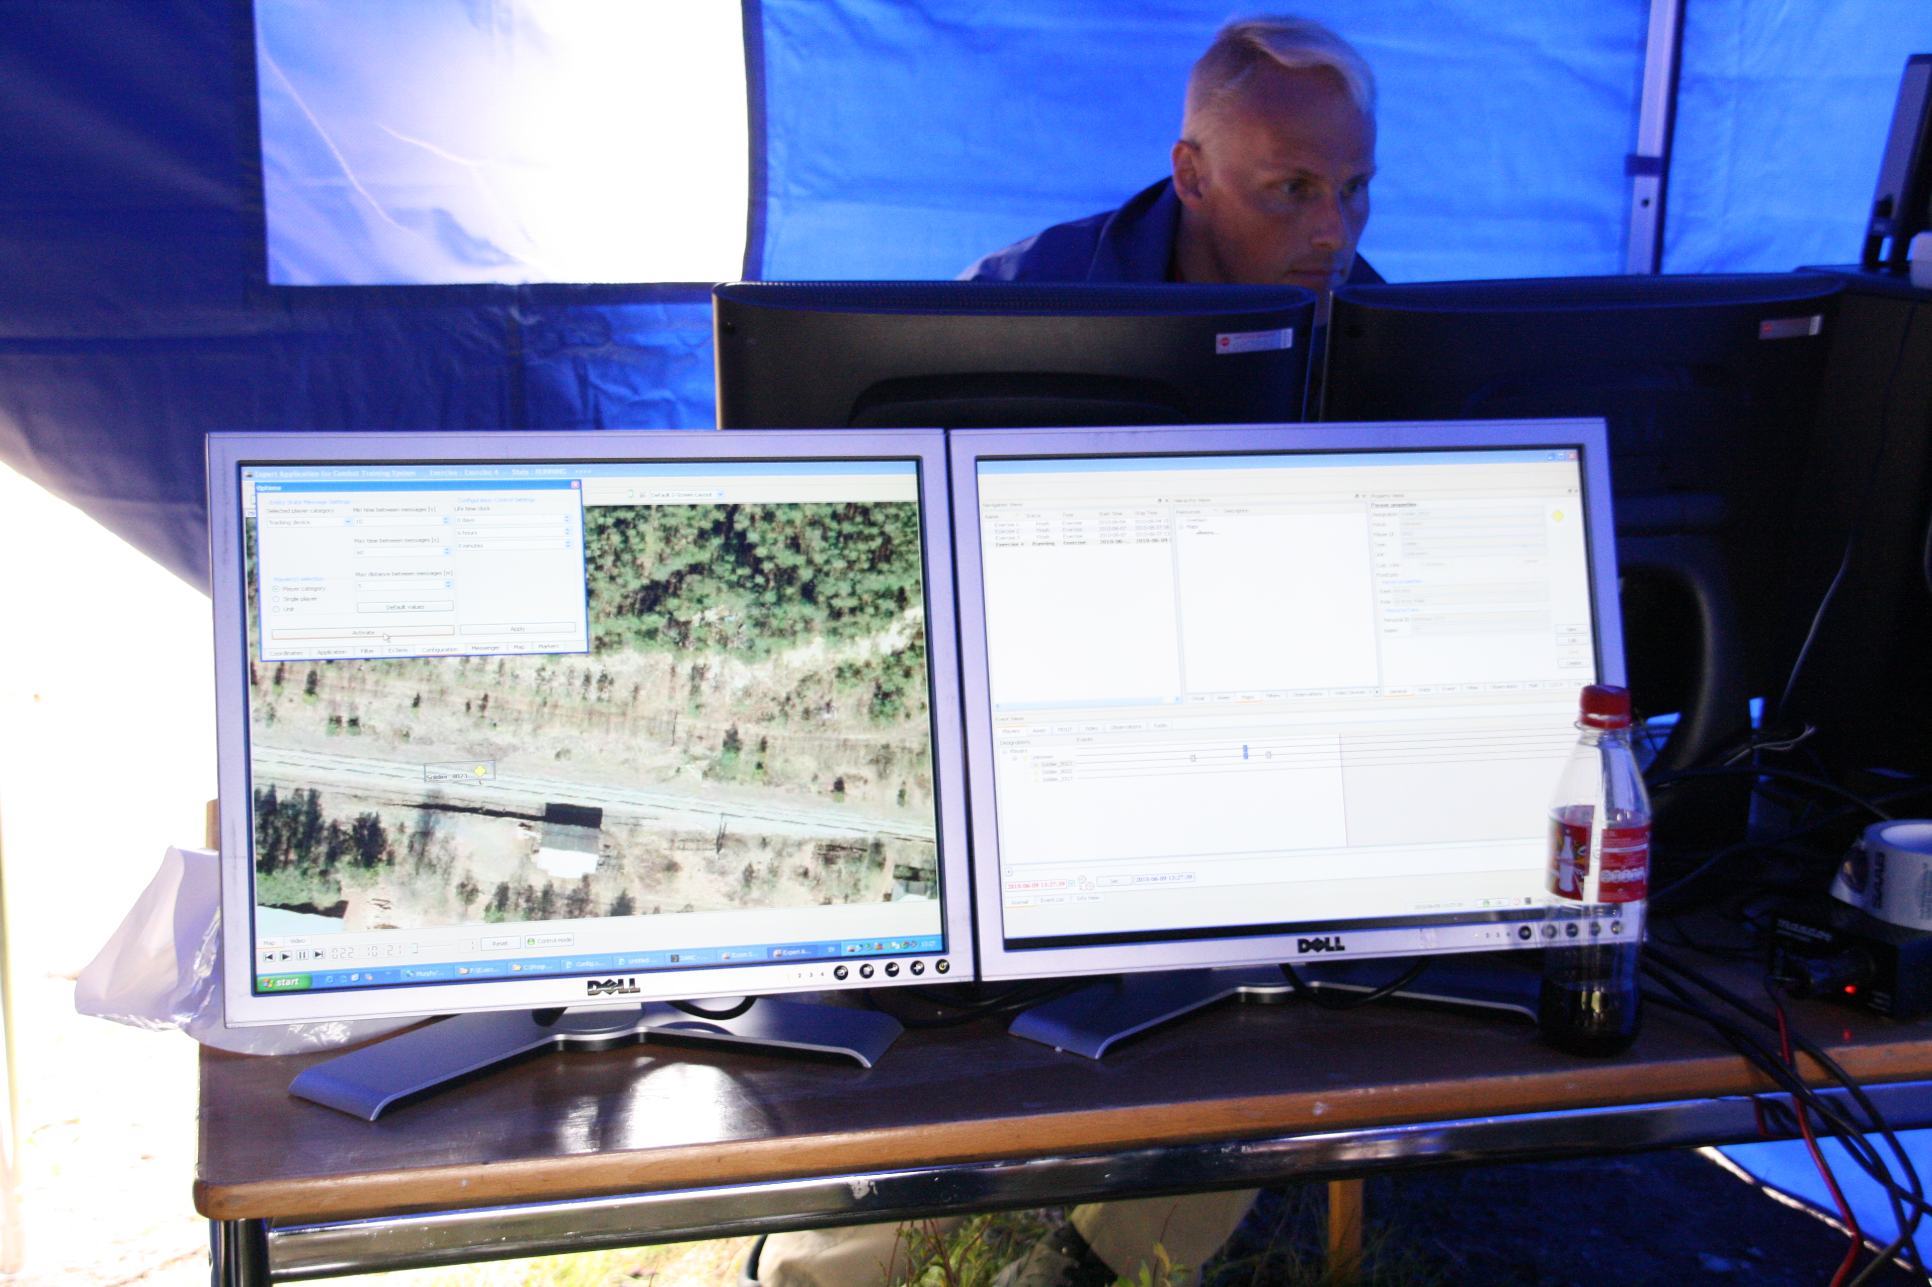
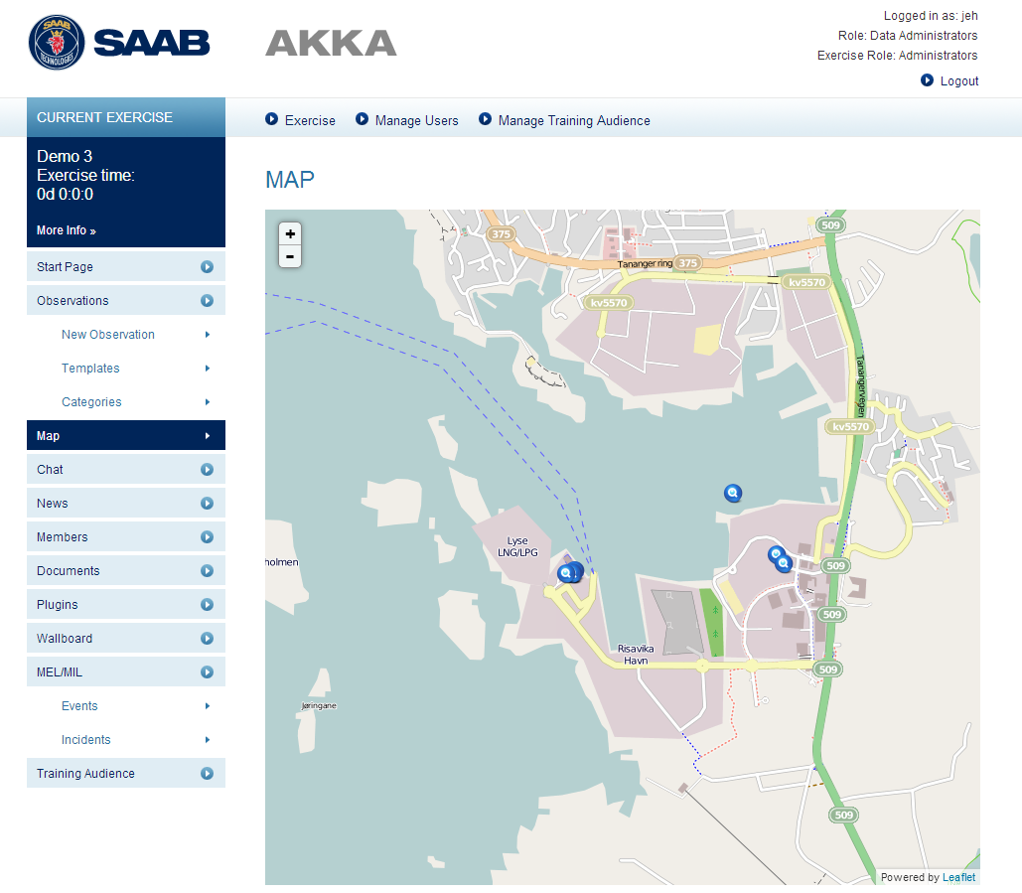

Exercise Control Centre
Skadested
Notes:
Inne i øvingslederko under øvelse Elverum

Slide 13
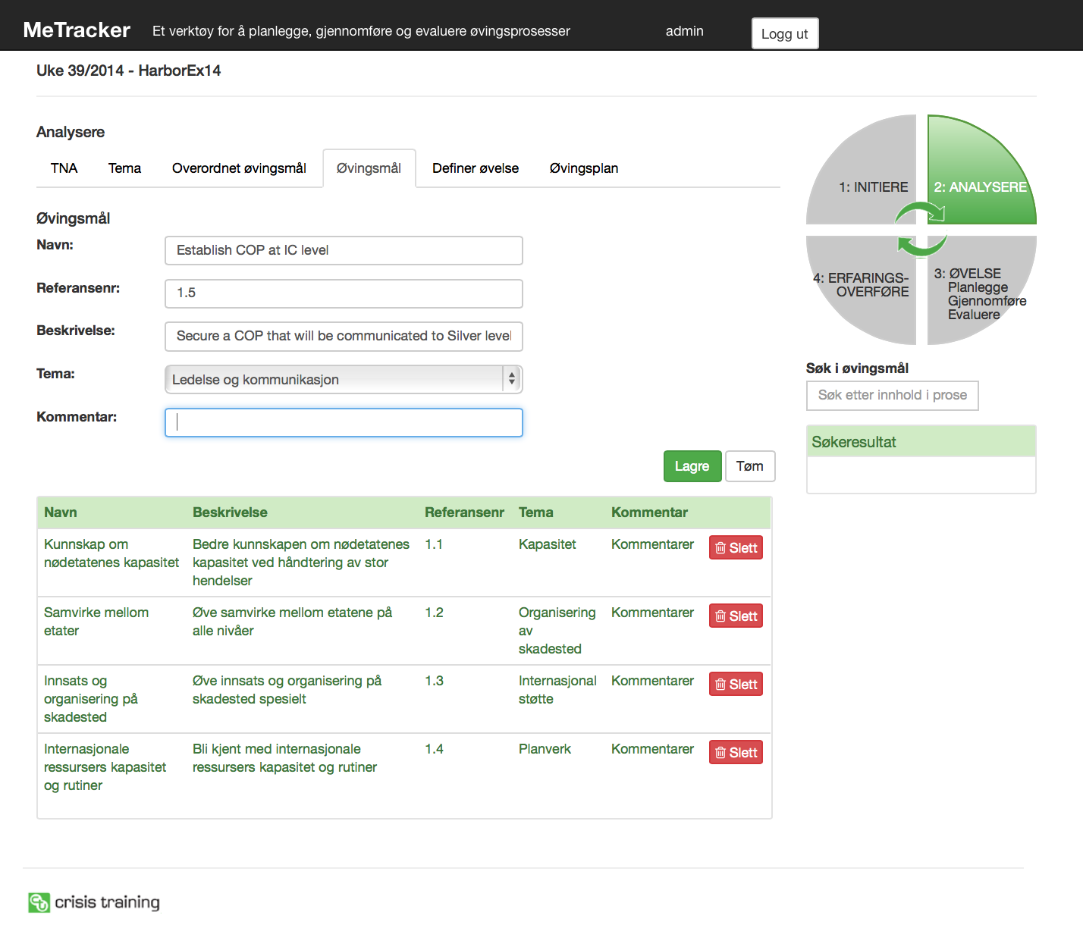
First Responder Integrated Training System
MeTracker – MTO definition
Notes:
Based on the TNA you will normally define the MTO. Since you have already decided to re-use the repository from an earlier exercise the MTO´s automatically pops up and you have to adjust these and define new ones. You can also search for other MTO´s from other exercises, based on a pre-defined list of relevant subjects here presented as ”management and communication”.

Slide 14
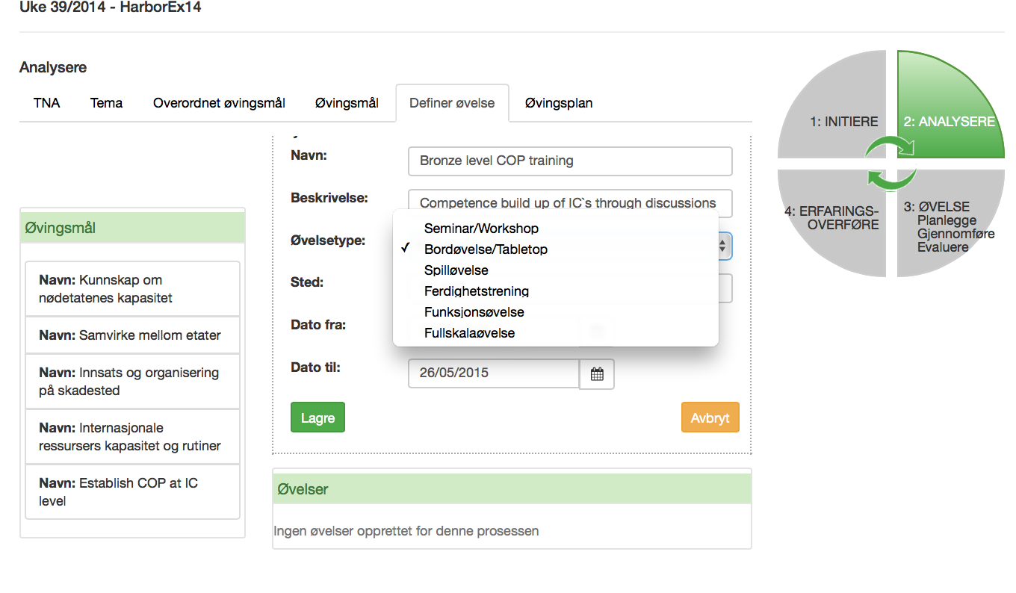
MeTracker – Training Activity planning
First Responder Integrated Training System
Notes:
When the MTO´s are finalised, you should define which training activities that are relevant assuring the right competence build up on each of the MTO´s.

Slide 15
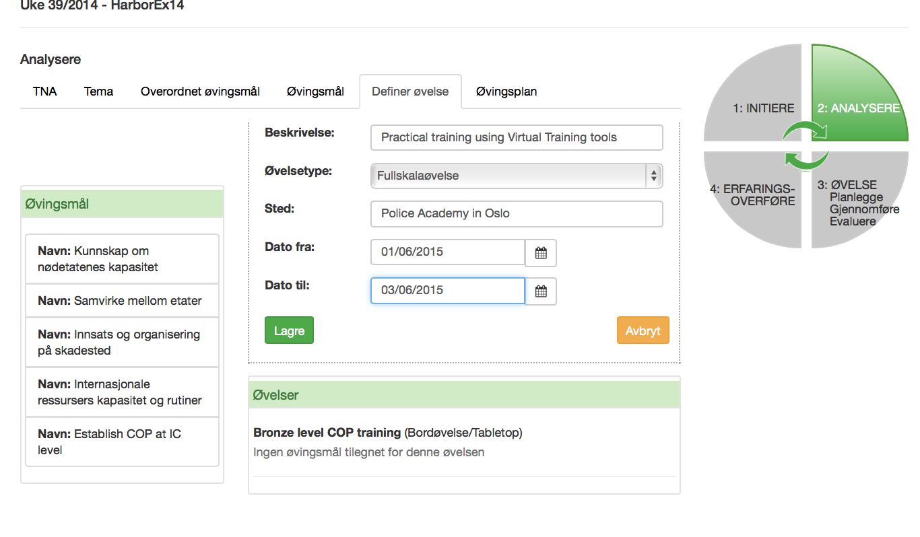
First Responder Integrated Training System
MeTracker – MTO Definition

Slide 16
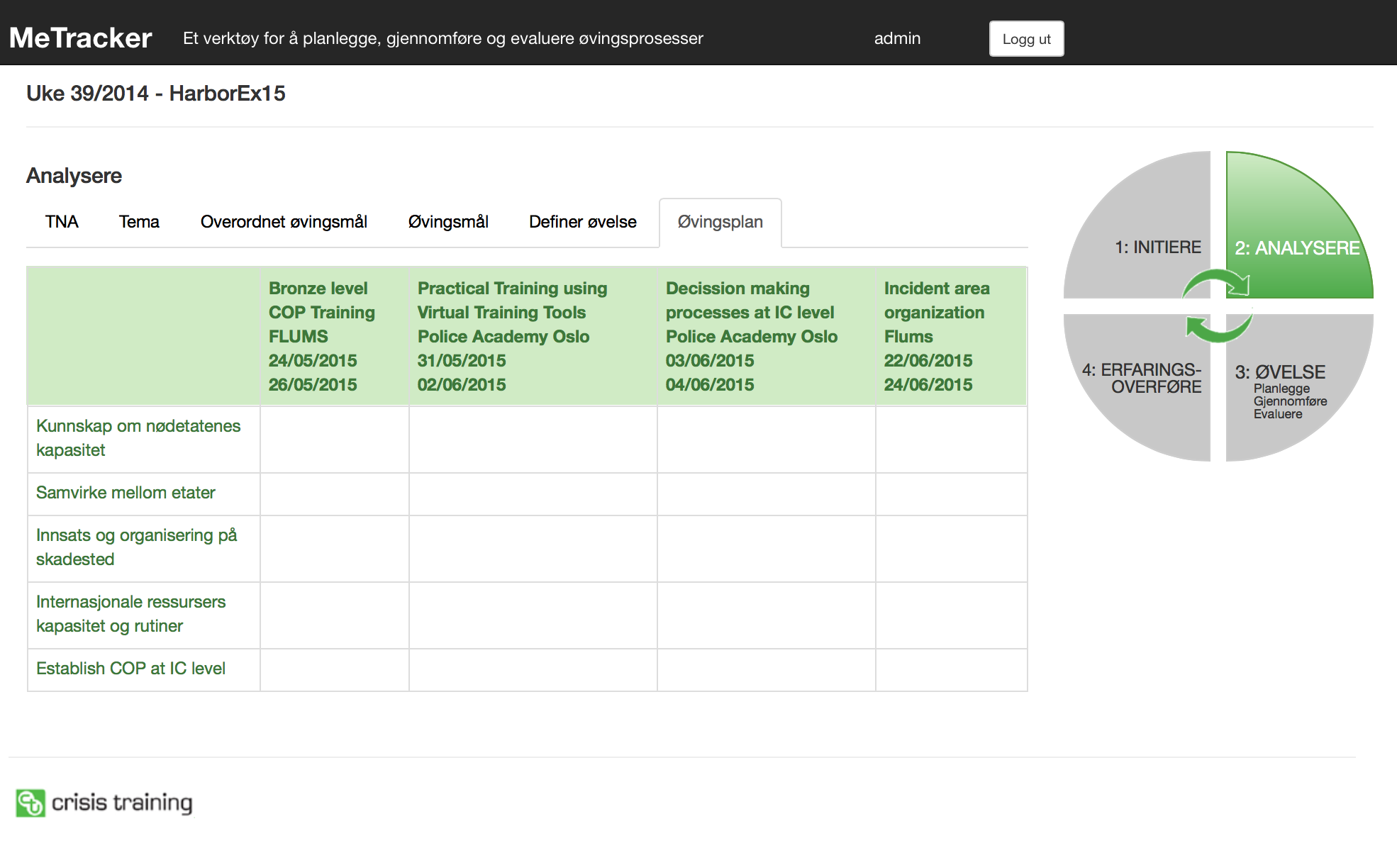
MeTracker – Training process plan
First Responder Integrated Training System
X
X
X
X
X
X
X
X
X
X
Notes:
Resulting in a matrix for each of the defined training activities and the MTO´s as a baseline for establishing an execution plan with a timeline, including needed resources and cost.

Slide 17

MeTracker – Evaluation
First Responder Integrated Training System
Notes:
The MTO´s broken down to detailed observation points are then exported to TEMIS used during the execution phase. Relevant information from the training activity is then imported to MeTracker again to be used for evaluation purposes and LL. This picture shows the overall results for each MTO as well as a matrix with all observations relevant for each MTO. This to be used by the evaluators for their review and then to be summariesed in an evaluation report.

Slide 18
Structured collection of observations
MTO
TO1
TO2
TO3
TO4
Side 18

Slide 19
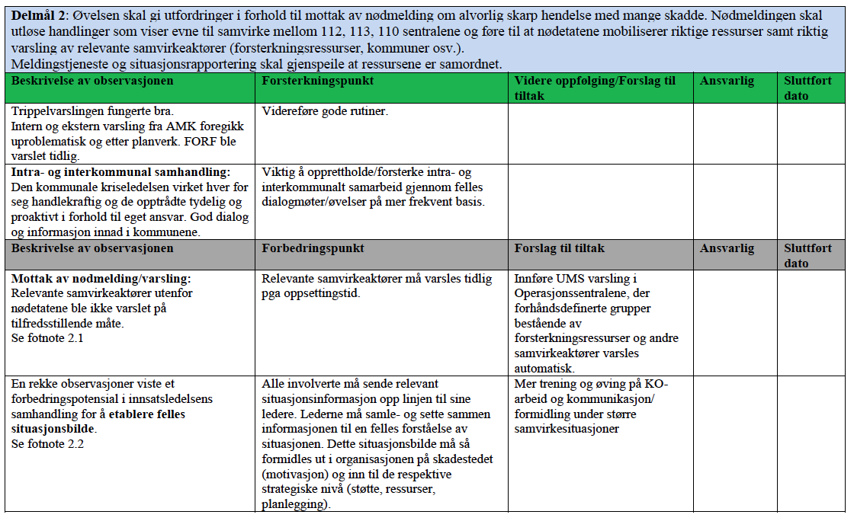
First Responder Integrated Training System
MeTracker – Evaluation Report
Notes:
This is a Matrix from the Risavika Evaluation Report.
Relevant information in the repository will then be alligned for use in lessons learned processe, like future certification processes, transfer of know how to existing operatning orgaisations and other relevant competence build up.
From an exploitation and business modelling point of view the MeTracker is now in a very interesting phase:
We have a close dialogue with a 2nd level or silver level emergency organisation for the oil industri, having over 100 training activities a year. We have developed a requirement specification and a system description for this organisation and they claim that MeTracker will reduce their need for resources/costs with 20 – 30 %. Negotiation for a customzed solution is planned after the summer.
We are also in the final negotiation with a University College for procurement of a customised MeTracker, to be used in the training & exercise module as part of a bachelor degree study in Emergency management. The students are the future decission makers in the EM domain so this isa part of CTAS market strategy.

Slide 20
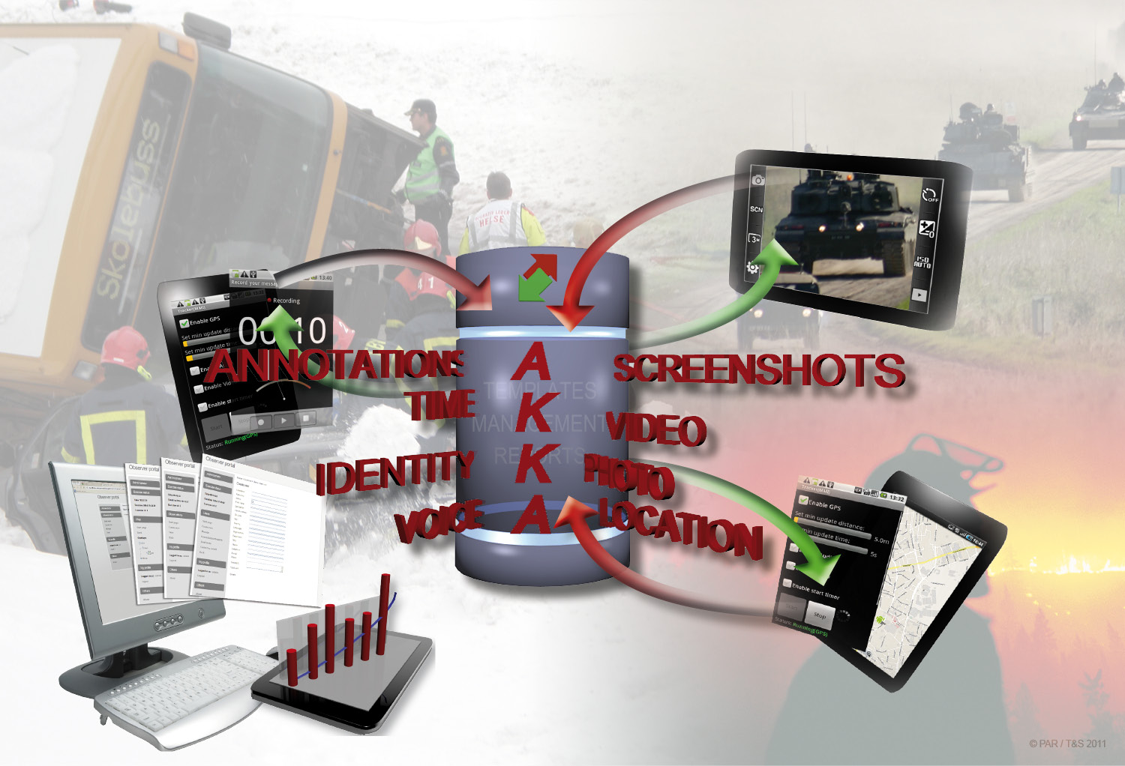
Observation & Exercise Management
Side 20

Slide 21
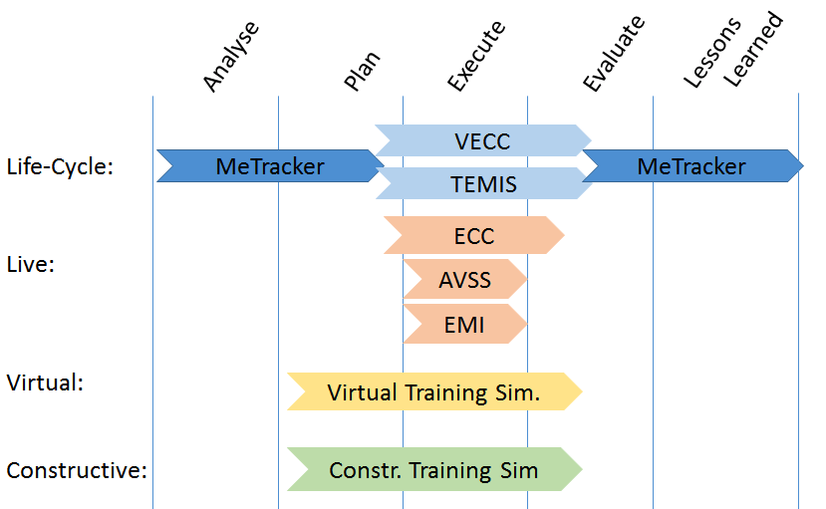
First Responder Integrated Training System
FRITS modules in a timeline
Establish an optimal learning and training methodology, supported by an integrated portfolio of sub-systems that will improve the quality of emergency response and crisis management in intra-agency and inter-agency operations.

Slide 22





COncORD Consortium
EMERGENCY MEDICAL SERVICES
Notes:
The COncORDE project investigates healthcare coordination mechanisms in different kinds of emergencies.
There are 5 main elements of medical emergency response:
The initial alert,
The emergency medical response,
Field management,
Patient transport,
The first receiver.
The COncORDE project is particularly interested in large scale emergencies, but recognises that the response to "every-day-emergencies” forms the basis of all responses.

Slide 23
COncORD Consortium
Early Results – Framework Architecture and Scenario Modelling
provide to domain stakeholders and healthcare service providers a conceptual and technical environment in a distributed, complex and heterogeneous operational setting fulfilling planning and foresight activities and decision making for quick responses
Notes:
Global features of the framework architecture:
sound distributed complex architecture model, that captures the dynamics of the inter-dependencies between the organisations/nodes in the healthcare services’ emergency response domain (system of systems)
understanding of the evolution of the collaborative processes, the establishment of performance measures and subsequently the assessment and decision making mechanisms
support the orchestration of the collaborative healthcare response services and data
deal with information communication to facilitate the interoperability between the involved services/components (software, hardware, humans, others)
Explore state-of-art tools and technologies for integration
The selections will be performed in the framework of WP2 and revised during the development phase as deemed necessary

Slide 24
COncORD Consortium
Ambulance
Beds
Food
Water
Resource
Supply
Hospital
Civil Defense
Volunteers
Service
EMS (112)
WHO
Aggregated
Service
Carambola Accident
Disease Outbreak
Flooding
Emergency
Resource
Demand
Casualties
Injuries
Tools
Shelters
Utilities
Food
Water
Notes:
Here we can see different events modeled by resource activation

Slide 25
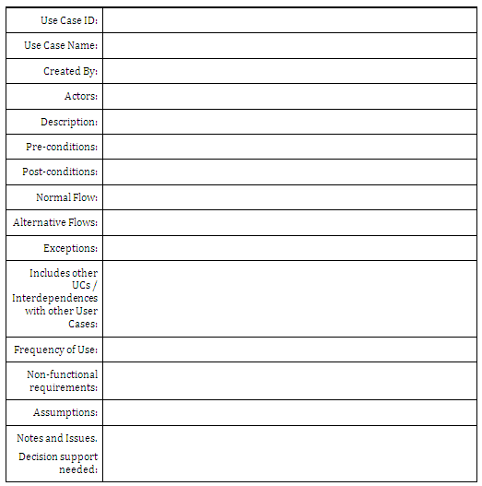
First Responder Integrated Training System
Use-case analysis
template
Notes:
Here we can see how a structured use-case analysis template can create a systematic way of producing a scenario.

Slide 26
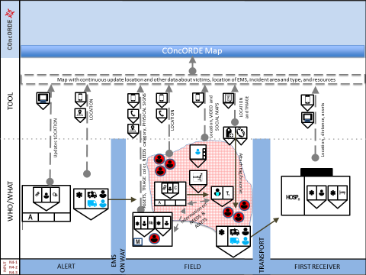
COncORD Consortium
COncORDE conceptual framework modelling
Notes:
Here is a presentation of interaction dynamics:
For example:
in order to be able to support the coordination and decision making, the actors’ individual dynamics and lower-level objectives for individual components must take into account a bigger system with a high-level objective to respond to an event
→ system-of-systems framework
The terms “component”, “subsystem”, “process” are used almost interchangeably to refer to processes of any type that involve one or more actors in an emergency response scenario
A subsystem may represent a single human actor, the operation of an organisation, the operation of a decision support entity/centre, a cyber or a physical service, etc.
Examples, assuming the model of a “receiving hospital”
State resources: i) the number of available emergency beds, ii) the number of available emergency nursing staff, iii) the number of available emergency doctors, iv) quantities of available supplies used in emergency rooms
Transitions with controlled firing: i) mechanisms of adding/removing resources/states described above, ii) mechanisms bringing victims in the emergency rooms, iii) mechanisms releasing the victims after being healed.
Transitions with uncontrolled firing: i) uncontrolled entry of victims in the emergency rooms (e.g. victims brought by bystanders without informing PSAP or an emergency operation centre if activated), ii) unavailability of resources due to reasons outside the control of the emergency manager of the hospital, etc.
Other parameters in the hospital model: its distance from the emergency event, the weather conditions, the expertise of the staff, etc.
Focus has first been given to the clear and unequivocal definition of components for the scenario modelling (interaction between medical emergency actors, resources, and tools)
The clarity of the overview is enhanced by supporting visual representations, utilizing international standards for general symbols used in emergency response and enhancing them with options for customisation to reach fine granularity such as the NATO sybology
Led also to the update of the Petri Net models, and the integration of the individual models of components into composite system models.
Scenarios of the use of the integrated models have been presented and simulated with Petri Nets.
In addition, example decision support capabilities for resource allocation have been created, aiming to show the potential of having sound modelling of system dynamics.
Symbols are as follows :
The rectangle with three squares at the bottom : C4 site, Square with a small triangle is an Asset, infrastructure is represented with a rectangle with a black rectangle on top, Cordon zones are shaded pink.
Flows are as follows :
Continuous black arrows are movements of objects and assets
Dashed arrows represent the movement of information
Dotted arrows represent the examination of a victim
[PRESENT FUNCTIONS, TASKS and POSITIONS in SPACE]
Placing all components in the basic application scenarios
N1 - The "Network of locatable components"
N2 - The "Network of transmittable victim/patient status parameters"
N3 - The complete emergency event "e-Form"
N4 - The "Joint operational map"
N5 - "Recording and replay" for evaluation, training and accountability
Triage

Slide 27
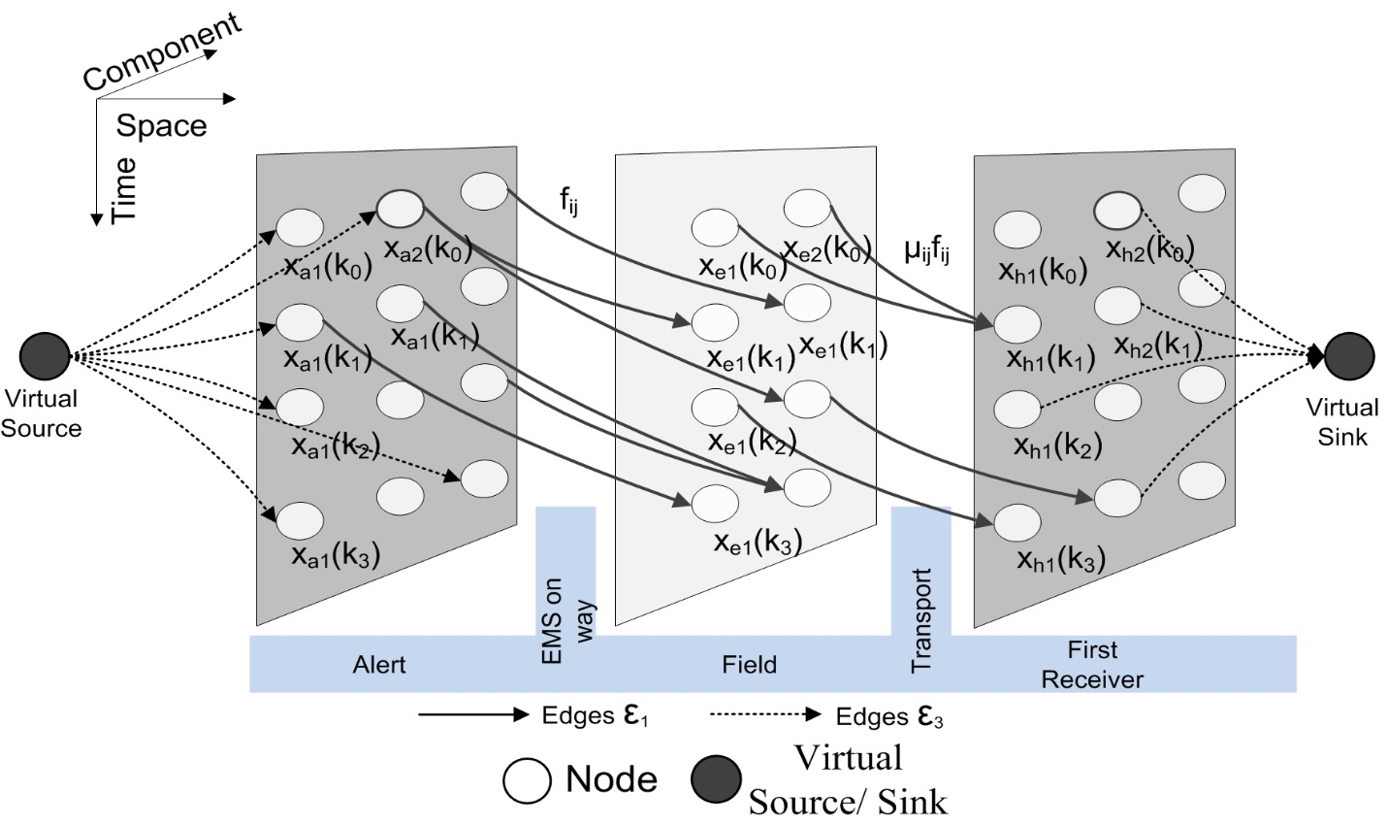
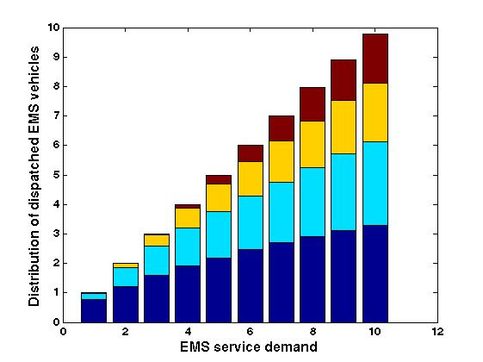
First Responder Integrated Training System
Approach to resource allocation decision-support
Notes:
Then, Decision support is quite simple really : the importance of a given action is mapped to it’s observed cost and benefit against a projected cost and this prioritises areas of improvement.

Slide 28
COncORD Consortium
Training as a vehicle to realise collaborative value propositions
Research Gap & Need | Required Remedy | Proposed Training Actions | Expected Outcomes
Lessons identified should be translated into learning | To support the native knowledge management of trainers | Analyse responses to create learning opportunities at the individual level | Offer tailored learning to each participant and inter-agency collaborative learning
Realistic scenarios imply too many events to fathom | Record different data per sub-event | Instrument both participants and trainers | Allow multi-media evaluation at highly granular levels
DSS and other technology requires training | Facilitate uptake of new technology | Create living labs | Ease the adoption and evaluation of new technology

Slide 30
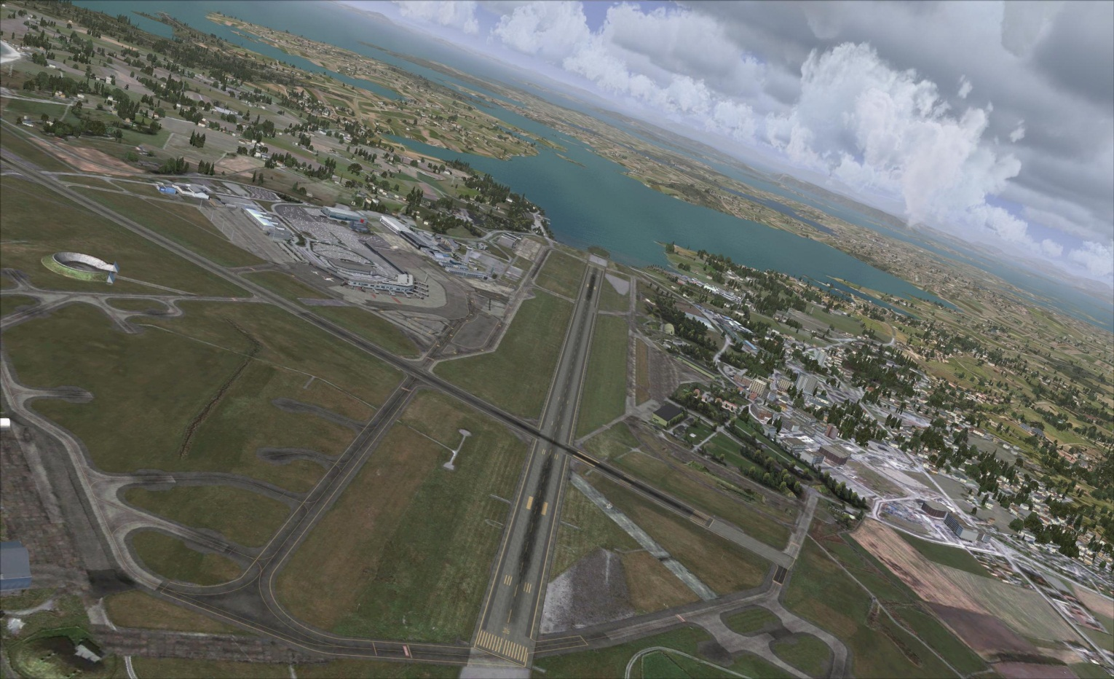
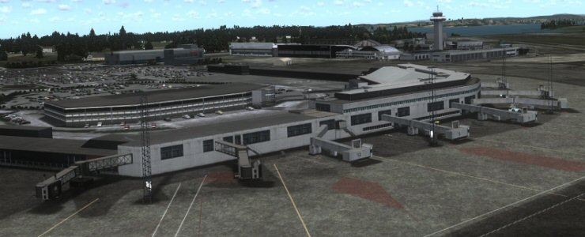
Virtual Training using game engines
ENZV Sola
Notes:
Eksempel på hvordan lydfiler og video gir et helhetlig bilde av en sekvens under øvelsen som det er naturlig å benytte i evalueringsøyemed.

Slide 31
Virtual Training using game engines
Sola Airport – for Avinor 2012/2013
Notes:
Eksempel på hvordan lydfiler og video gir et helhetlig bilde av en sekvens under øvelsen som det er naturlig å benytte i evalueringsøyemed.

Slide 32














INTEGRATED TRAINING ENVIRONMENT
Virtual Exercise
Operation Center
Learning & Training Methodology
External modules
Audio/video
Streaming services
Integrated Training Environment HUB
Observation and
Evaluation tool
Virtual simulator
Constructive simulator
Live exercise
Exercise control center
Side 32
Overview of the ITE concept; various components on the left hand side and
human interactions to the right

Slide 33
Structured way
Main Training Objective | TO 1 | Observationpoint 1.1 | Observation 1.1.1
 |  |  | Observation 1.1.2
 |  |  | Observation 1.1.3
 |  | Observationpoint 1.2 | Observation 1.2.1
 |  |  | Observation 1.2.2
 | TO 2 | Observationpoint 2.1 | Observation 2.1.1
 |  |  | Observation 2.1.2
 |  |  | Observation 2.1.3
 |  | Observationpoint 2.2 | Observation 2.2.1
 |  |  | Observation 2.2.2
 | TO 3 | Observationpoint 3.1 | Observation 3.1.1
 |  |  | Observation 3.1.2
 |  | Observationpoint 3.2 | Observation 3.2.1
 |  |  | Observation 3.2.2
 |  |  | Observation 3.2.3.
Morten Wenstad
Daglig leder
Crisis Training AS
Side 33

Slide 34
Risavika Exercise
Stavanger Harbour
Police
Main Training Objective
Fire Fighters
NGO`s
Paramedics
Training Objective 1
OP1.1
OP1.2
Training Objective 2
OP2.1
OP2.2
Training objective 3-9
OP3.1
OP3.2
County Governor/ Municipalities
Hospital
Municipalities
Civil Defence
JRCC
Side 34

Slide 35
Main findings from exercises
Need to establish common plans and procedures
Existing supporting ICT systems do not have relevant functionality and capacity
Major challenges in establishing and communicating a COP
Need for better coordinated leadership in the incident area
Need to strengthen the alarming procedures and to optimize the use of supporting organisations (Resource Management)
Notes:
Eksempel på hvordan lydfiler og video gir et helhetlig bilde av en sekvens under øvelsen som det er naturlig å benytte i evalueringsøyemed.

Slide 36
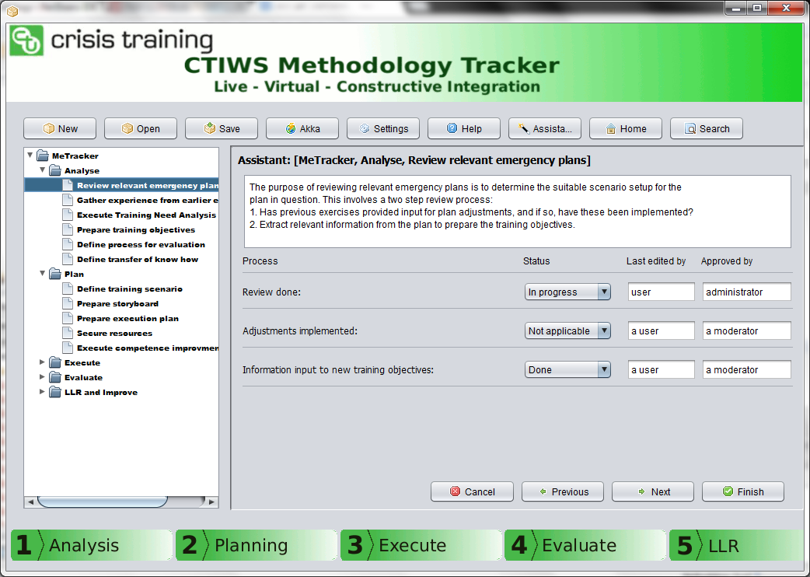
Structured process for data collection
ØM1
OP1
OP2
OP3
OP4
Øvelse Elverum
ØM1
OP1
OP2
OP3
OP4
ØvelseBoilex
Lessons Learned Repository
ØM1
OP1.1
OP1.2
ØM2
OP2.1
OP2.2
ØM3
OP3.1
OP3.2
ØM1
OP1
OP2
OP3
OP4
Øvelse Hell-tunellen
ØM1
OP1
OP2
OP3
OP4
Øvelse Risavika
Notes:
Example of how audio and video provides a comprehensive picture of a sequence during exercise as it is natural to use in evaluation purposes.

Slide 37
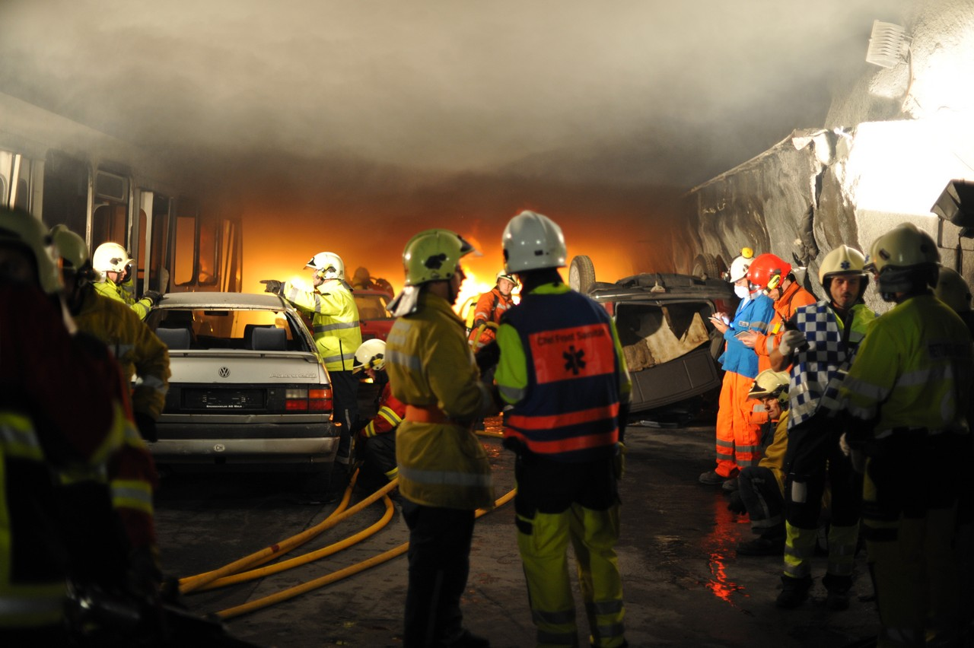
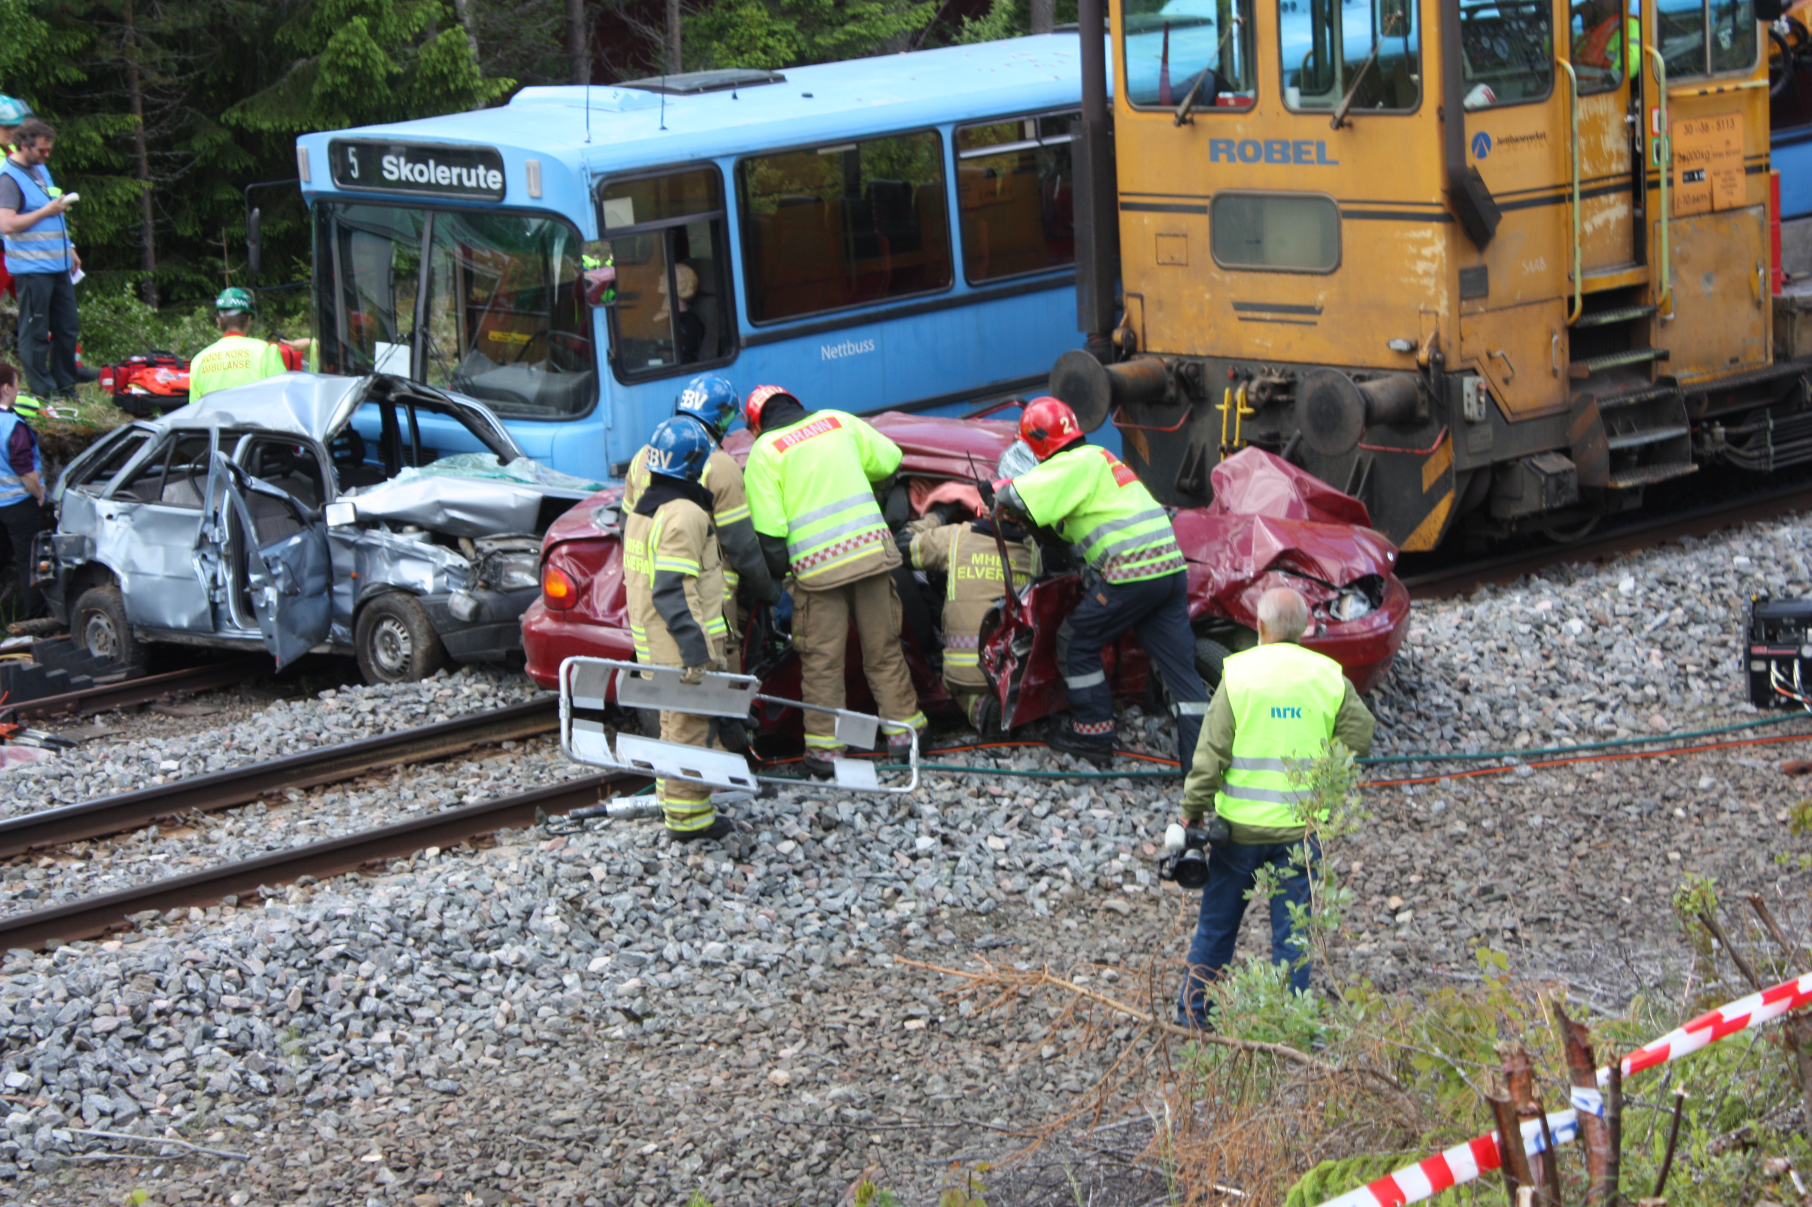

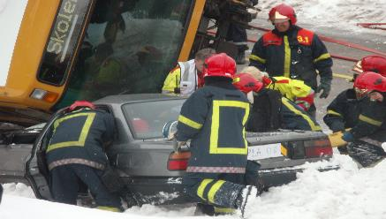
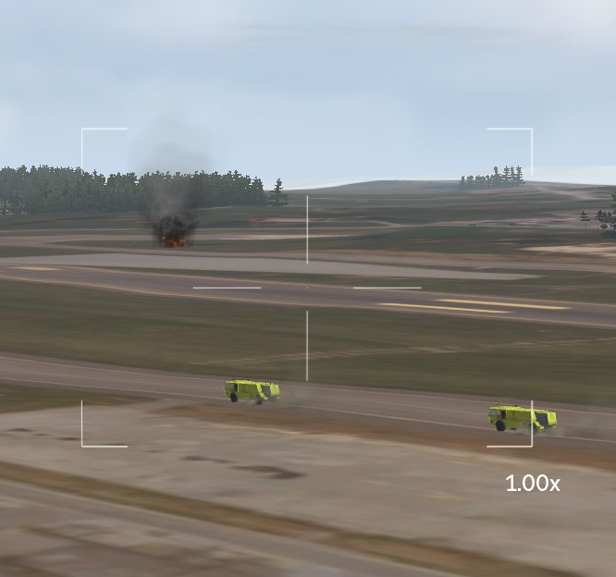
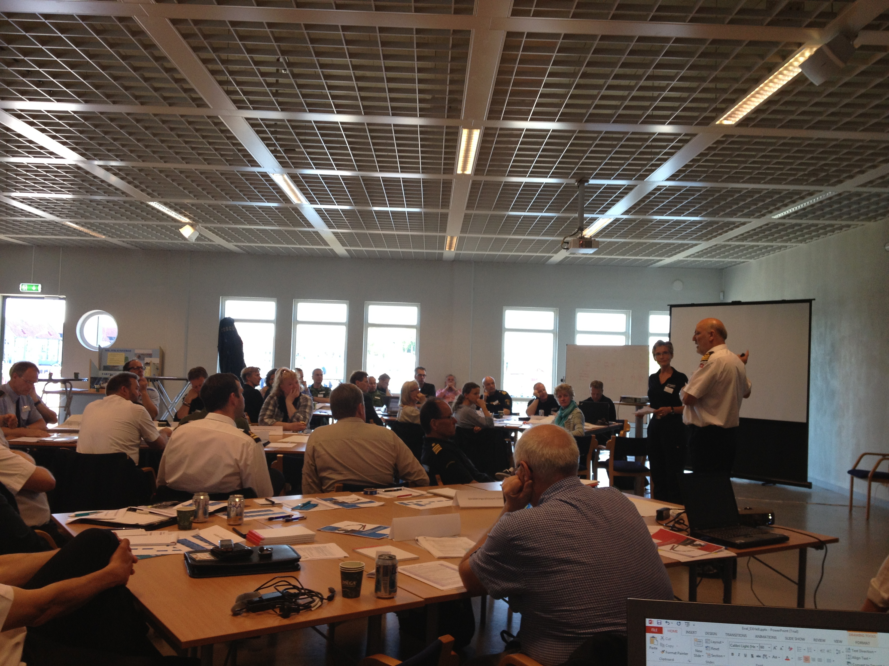
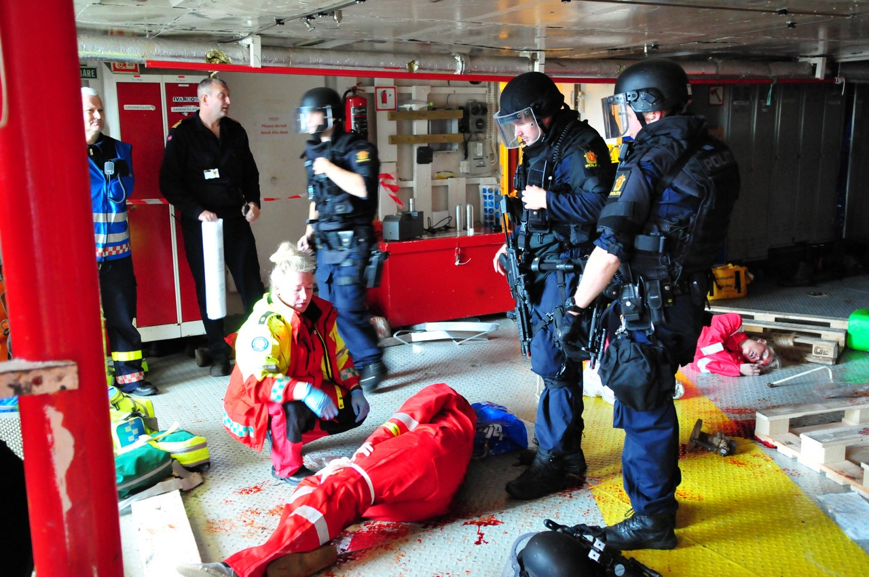
MeTracker information structure
MeTracker Database
Boilex
SkagEx
Dragvoll
OFFB++
Hell tunellen
Øvelse Elverum
Sola Flyplass
Øvelse Trysilknut
Analyse
Existing Plans
Experience
Plan
Establish Plans
Configure Training System
Execute
Establish Training Scene
Execute
Evaluate
LLR
MTO
TNA
Acceptance
Establish Infrastructure
Execute Competence build up
Clear Area
Analyse Collected data
Prepare Evaluation
Execute Evaluation
Prepare for lessons learned
Establish Lessons Learned process
Competence Build Up
Revise plans
Certification
Fu Shan Hai 13
Risavika
Notes:
Example of how audio and video provides a comprehensive picture of a sequence during exercise as it is natural to use in evaluation purposes.

Slide 38
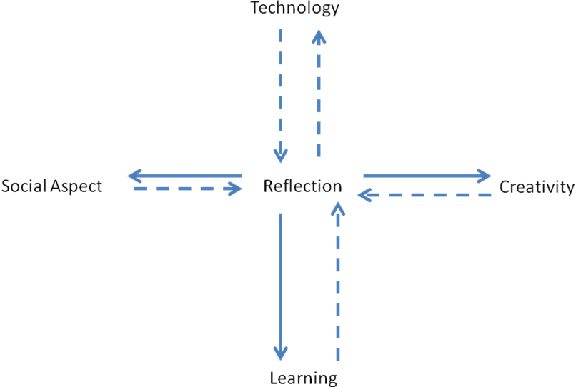
Conceptual Model
Notes:
Often, the objective(s) of inter-agency collaborative exercises are the simulation of information exchange, knowledge extraction, dialogue, generating ideas, creating awareness, and skill training. The purpose of the exercise could be to have participants see things differently (and act differently) from their standard operating procedures. Crises are characterized by the absence of obvious solutions, the scarcity of reliable information when it is needed, the lack of adequate time to reflect on and debate alternative courses of action. While simulations can help the crisis management team to find the optimal responses to the crises, training can help them exercise the art to optimize the limited time that they have to develop creative responses to the crisis. Corti (2006), considers that Game-based learning –i.e. techniques and tools that apply the principles of game design to the learning process - and serious games have the potential of improving training activities and initiatives by virtue of, e.g., their engagement, motivation, role playing, and repeatability: failed strategies etc. can be modified and tried again. Analyses have been conducted over the years, consistently showing that such activities promote learning (Szczurek, 1982; Van Eck, 2006).
The literature highlights two mechanisms in particular that promote learning pertinent to inter-agency exercising: (i) rewarding creativity and (ii) emphasizing reflection. According to Resnick (2007), creativity and reflection can be seen as forming part of an iterative learning cycle (imagine, create, play, share, reflect, imagine, and back). Thus, learning requires both reflection and creative thought, just as creativity requires reflection as part of the process of incubating new ideas, and ultimately entails learning of new solutions. Reflection also underpins and occurs throughout creative processes (Schön, 1983). Reflection is not only an individual cognitive process, but it has also a strong social dimension (Senge, 1990; Raelin, 2001; Hoyrup, 2004; Reynolds, 2004). The process of reflection is often accomplished collaboratively by a team or working unit which has a joint task to perform and therefore share work-related experiences.
Based on the litterature, we discovered the conceptual model offered on this slide. Dotted lines indicate influence, and solid lines indicate a causal relationship.

Slide 39
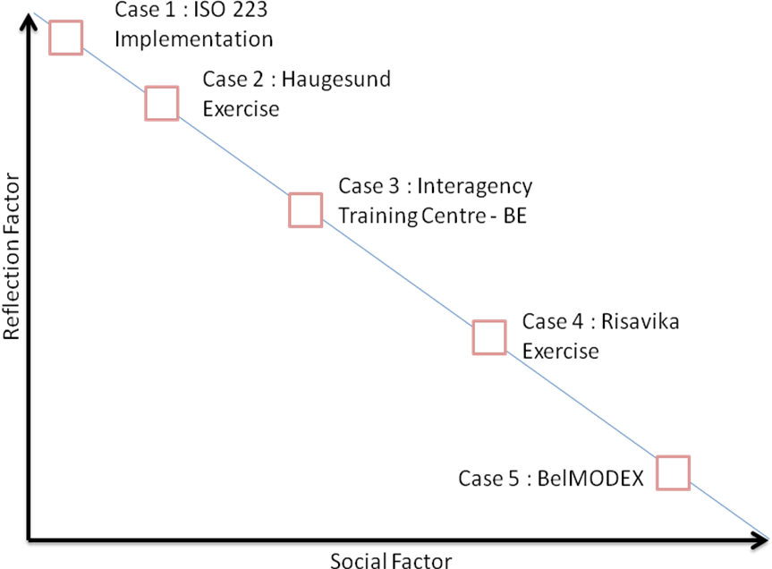
Trends in High Tech Training
Notes:
Based on a detailed case-study analysis of various training exercises along the dimensions of our conceptual model, we find that larger exercises include less reflection and therefore learning. This would allow each participant and each organiser to reflect and therefore learn the practical and epistemological lessons of each exercise.
In essence we argue that the place of high-tech training is to enhance the reflection capability of participants through tailored-multi-media action reviews based on highly granular sensor data.

Slide 40
BRIDGE PROJECT - High-Tech Training
Methodology Diversity
    Semi-structured interviews
    Ethnographic interviews
    Critical Decision Method
    Ethnographic work
    participant observation
    mobile ethnography
    Virtual Ethnography
    Crisis informatics
    living laboratories
    Crisis informatics
Notes:
Science, Technology and Society (STS)–scholar, Suchman, makes the distinction between formal and informal aspects of orderly cooperative work in order to increase “peripheral awareness” (COP) during disaster. This distinction is at the heart of the methodological challenge of addressing innovation during disasters: she argues that new forms of digital work imply a need to understand how the working practices will change and we need to start from looking at current practices. Furthermore the mode of adoption of digital work is important to design new technology. Yet, even cursory analyses of the decision-support systems literature yields an overwhelming number of studies that use quantitative methods for system requirements discovery. This means that in the overwhelming majority of decision support systems research there has been no attempt to discover the cognitive requirements of the user before the system is proposed, which may be one reason for the low adoption rates of such systems. Anthropologist Scott Paige argues powerfully that diversity of perspectives makes for stronger and more robust academic communities. The BRIDGE project contributes to the remedy of this lack of diversity with the complementary perspective on cognitive requirements discovery of sensemaking practices to inform the more common systems engineering approaches for decision support systems through Cognitive Task Analysis (Hoffman & Militello, 2008). Therefore a diverse set of methods are applied in order to address the natural decision making of current practices.

Slide 41
^{[1]} See definition in Annex
BRIDGE PROJECT - Training
Category | Ethical Quality
Rights/obligations | Autonomy; inclusiveness ; fairness ; responsibility
Values | Dignity ; humanity ; solidarity
Abilities | Cooperation ; leadership ; prudence
Embedded Ethics
Cognitive Requirements
Disclossive Ethics
System Design and Implementation
The development of new technological solutions
will not significantly improve interoperability
if the human factors that drive the use of that
technology are not well understood. Communication
is more than just the ‘C’ of ICT. (Cole 2010)
Embedded Ethics
Cognitive Requirements
Disclossive Ethics
System Design and Implementation
Notes:
Ethics is about the values that we have in society. In terms of emergency response ethical considerations translate into saving lives. If technologies that we make do not allow us to enact the ethical values that we have the technologies may fail. Therefore these values may be valuable as criteria along which to anchor case-study analysis. These may be called ‘ethical qualities’ and categorized into three groups :

