Slide 1
The Problem of Bugs, Barriers and Borders
Carl Taylor

Slide 2
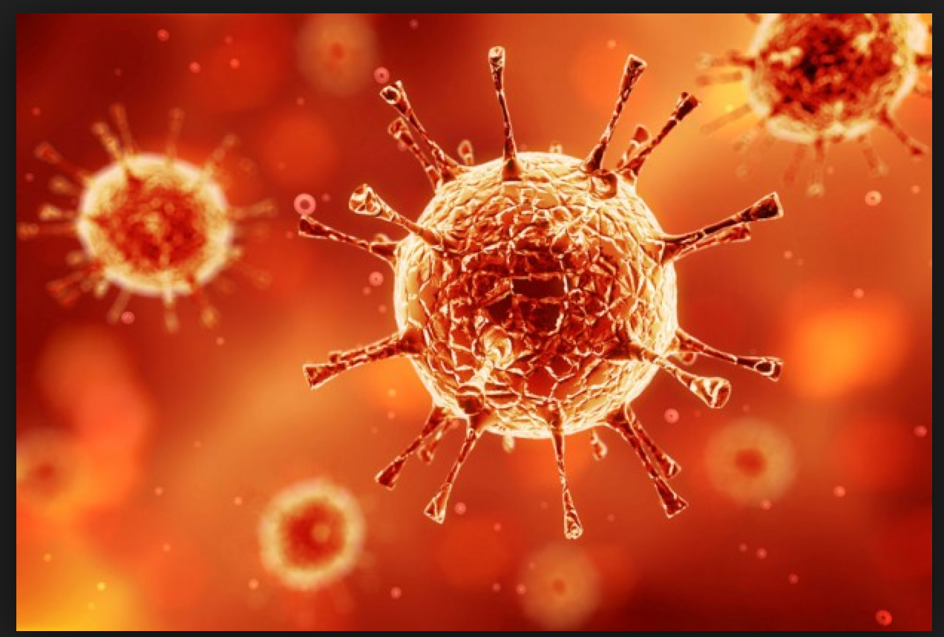
An Unseen Enemy

Slide 3

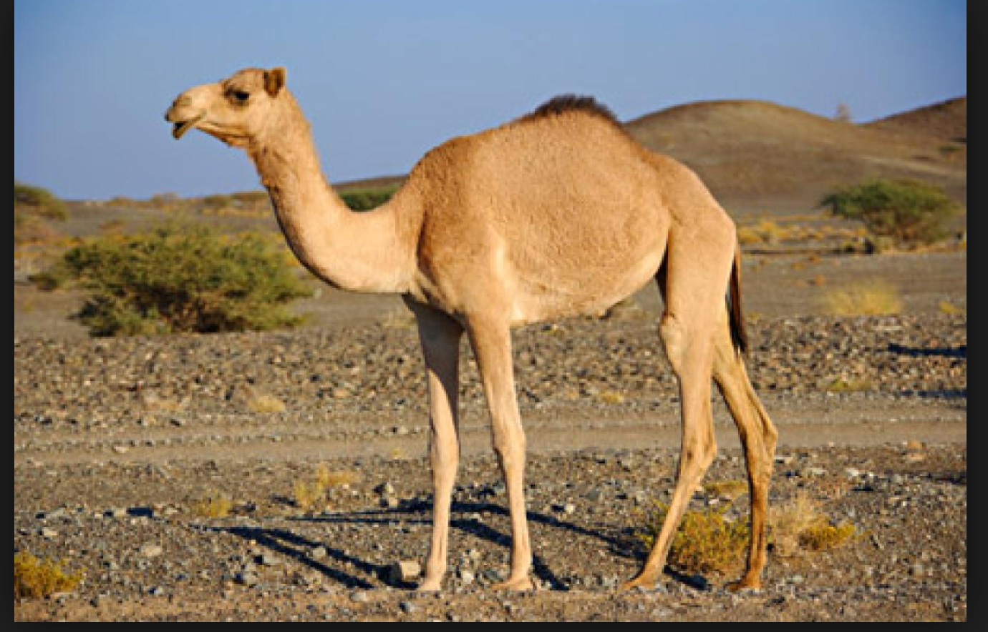
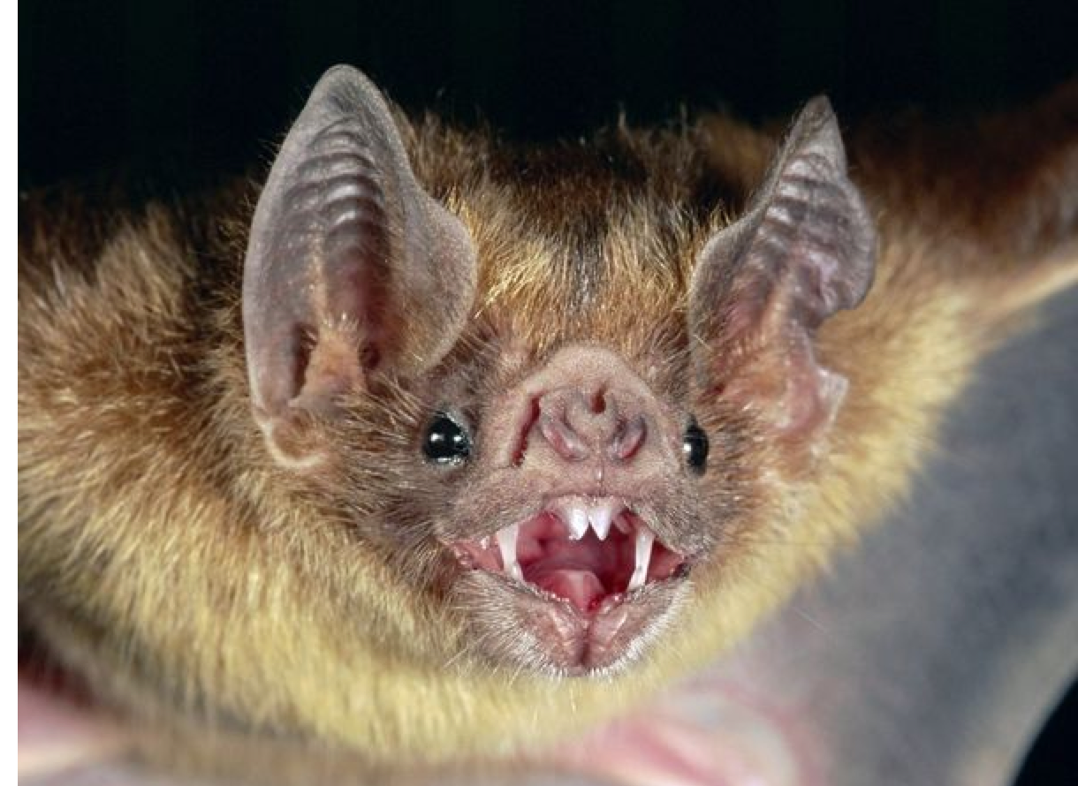
From An Uncertain Source

Slide 4
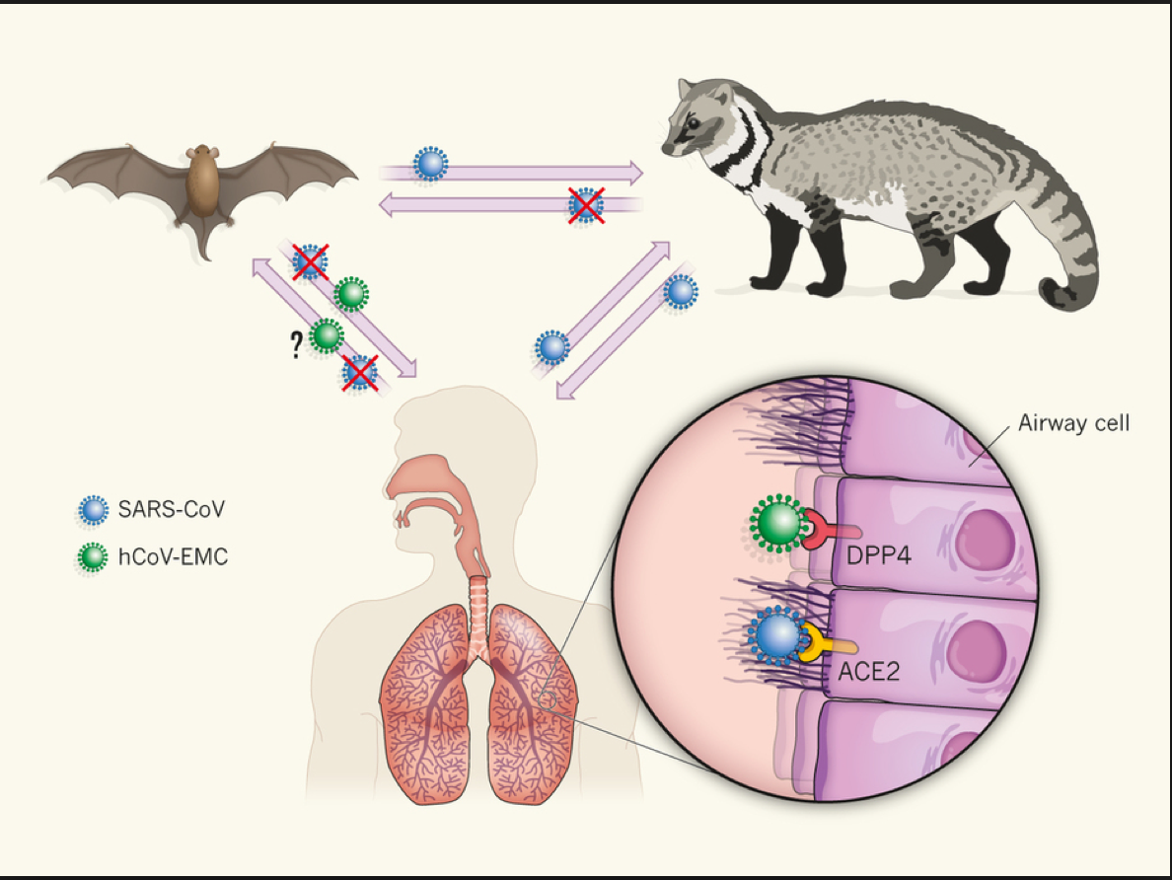
Developing The Capability To Spillover?
We Conclude MERS is a Slowly
Growing Epidemic at or Near
Human to Human Transmission

Slide 5
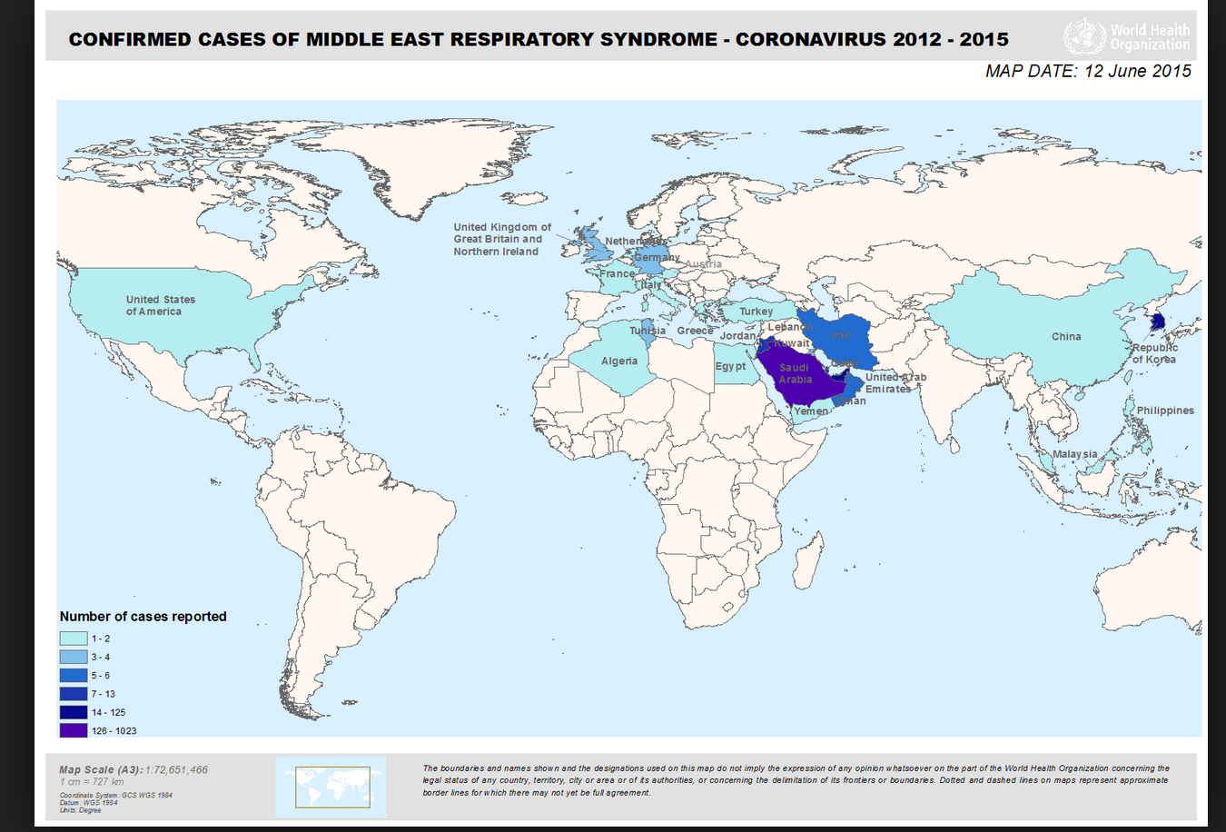
With Seven Certainties
First-Disease Spread (unlike storms or other natural disasters) is unpredictable

Slide 6
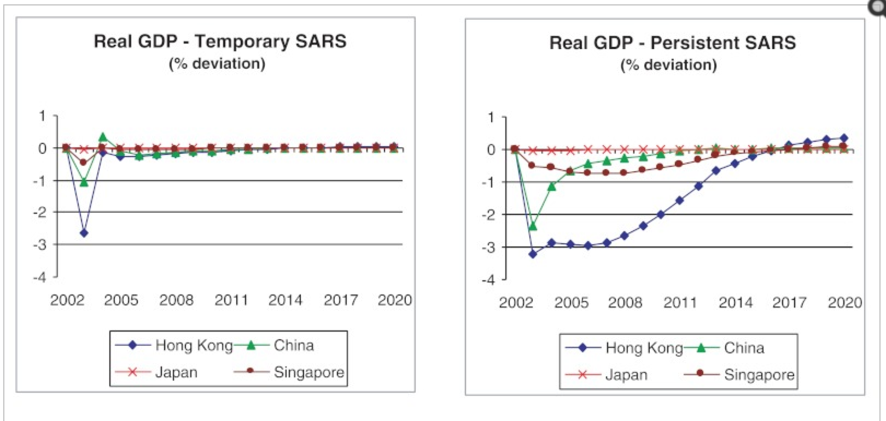
Second: The Most Devastating Impact May Be Financial

Slide 7
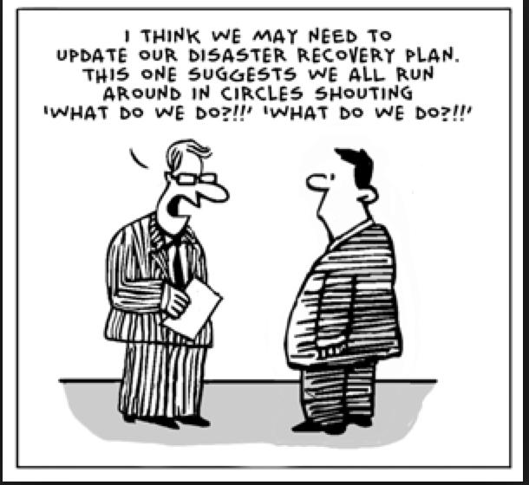
Third: A Virus Is More Nimble Than Your Disaster Plan

Slide 8
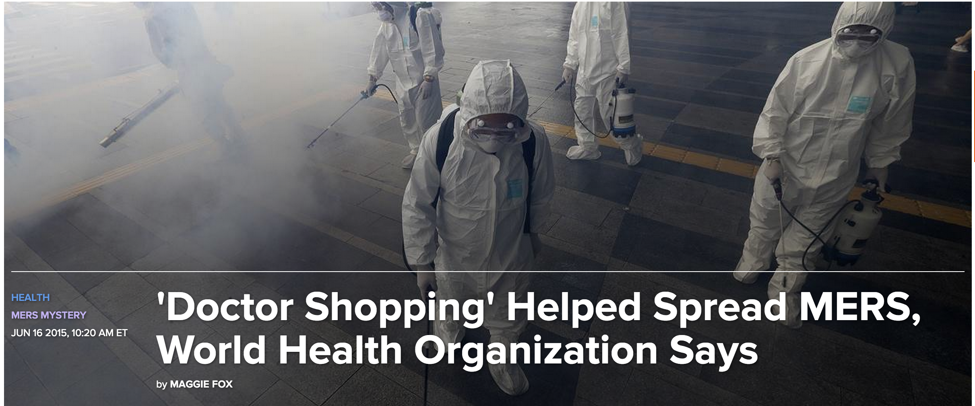
Fourth: If This Is Your Only Battleground You Have Lost

Slide 9
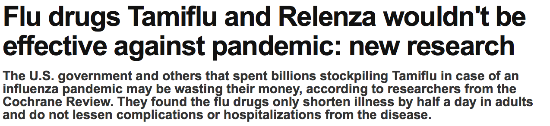
Fifth: The Experts Will Be Wrong (often)

Slide 10
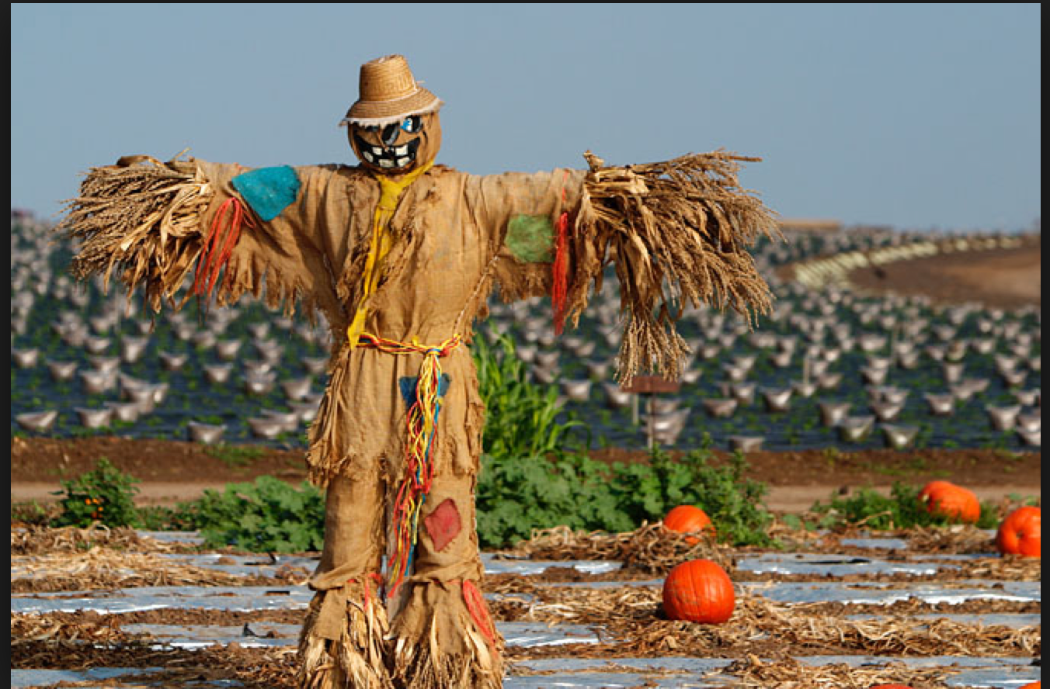
Sixth: Your Advice Will Have To Sound Certain When The Facts And Science Are Not

Slide 11
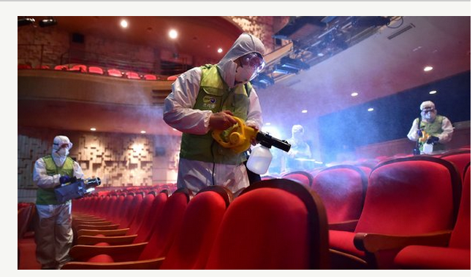
Seventh: In The Absence of Advice Your Community Will React
Travel and Tourism threat: Killer virus is spreading

Slide 12
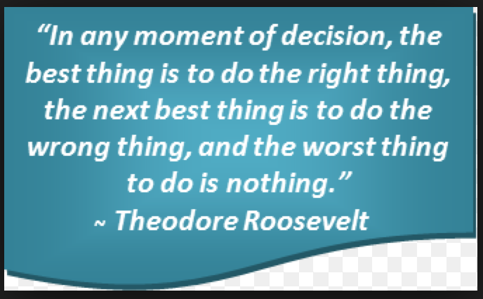
Crisis Risk Management Is
A commitment to a process to make the best decision in a highly uncertain environment

Slide 13
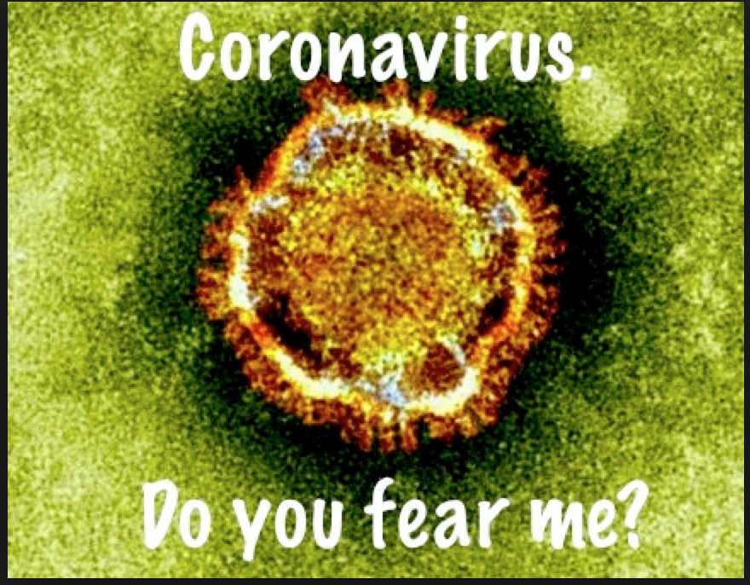
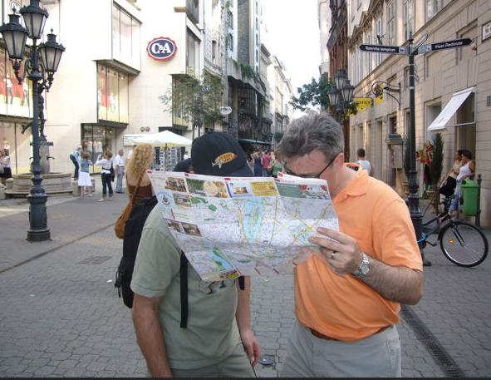
Dealing With Outbreaks and Preparedness

Slide 14
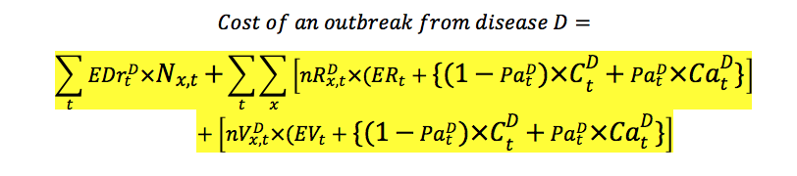
Planning Begins With Economics

Slide 15
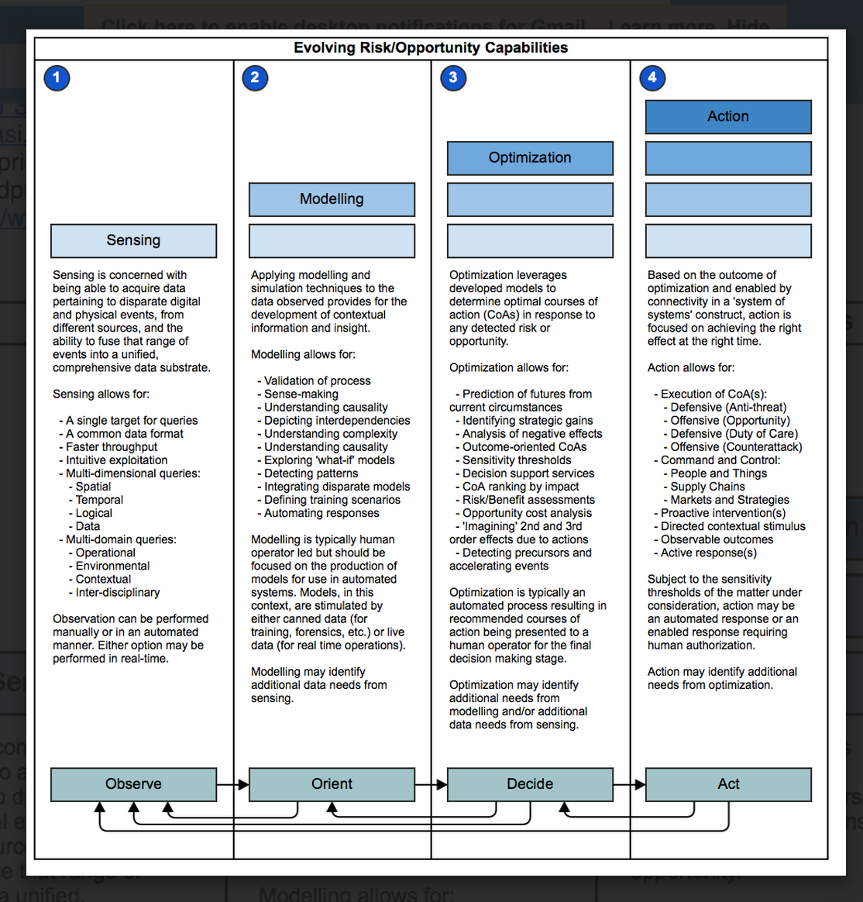
Have A Plan To Manage Risk-
Four Pillars

Slide 16
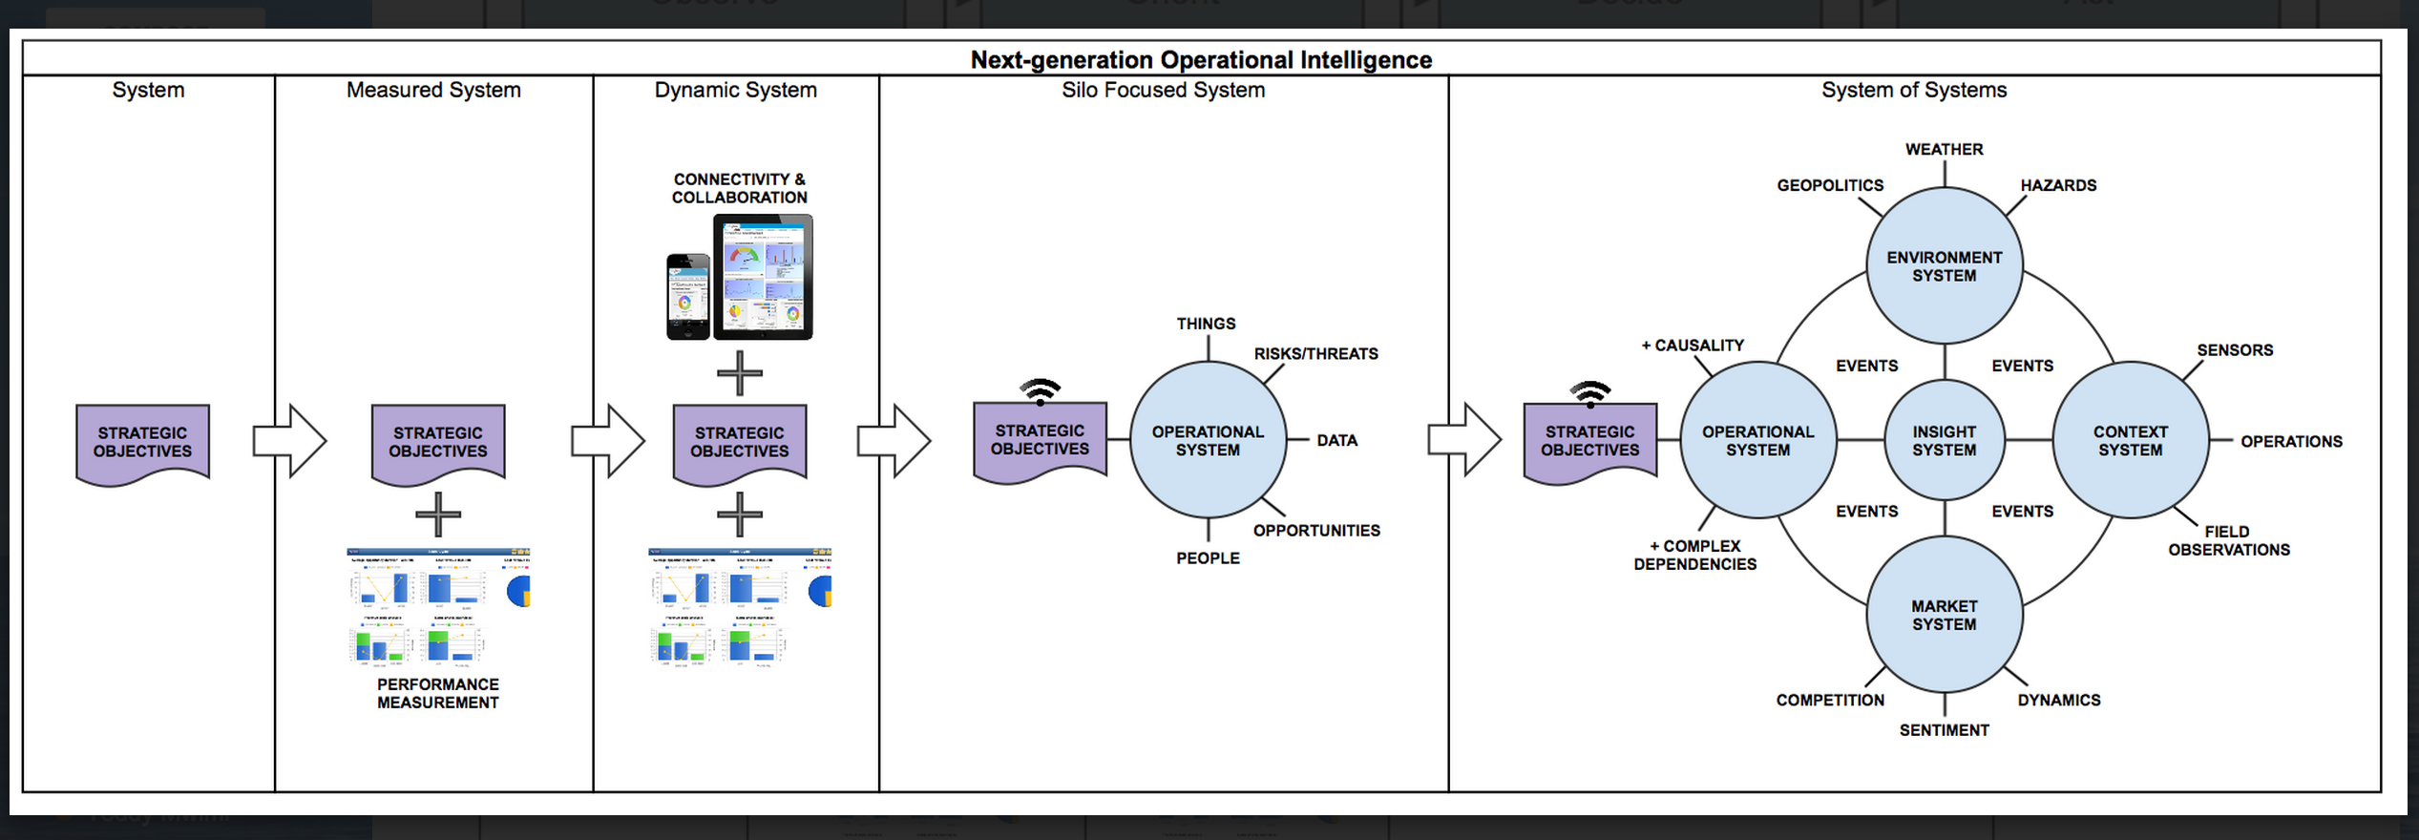
First- Practice Community Inclusion (Systems of Systems Sensing)

Slide 17
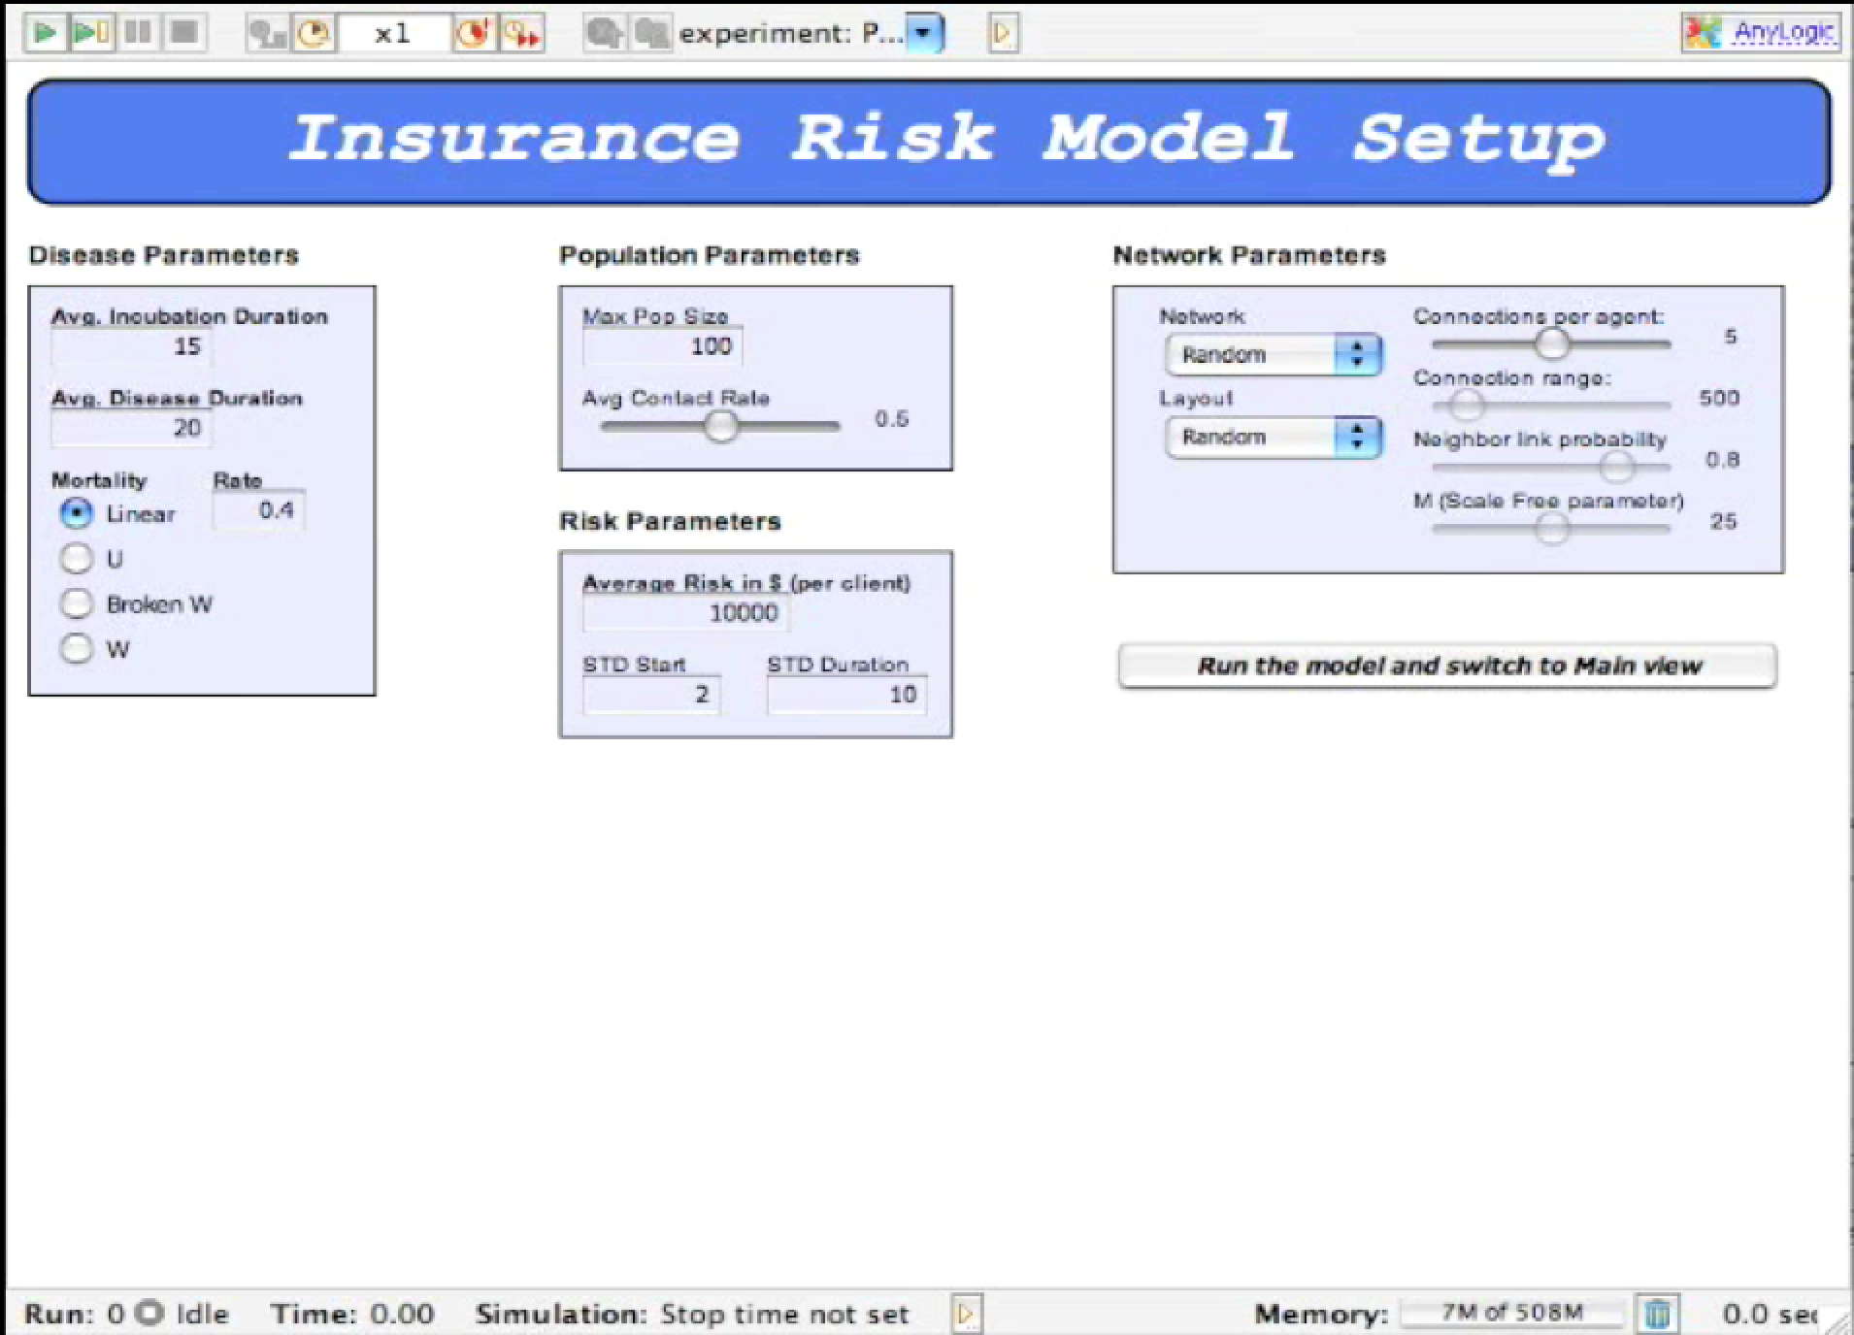
Second- Develop Models To Determine Risk Parameters

Slide 18
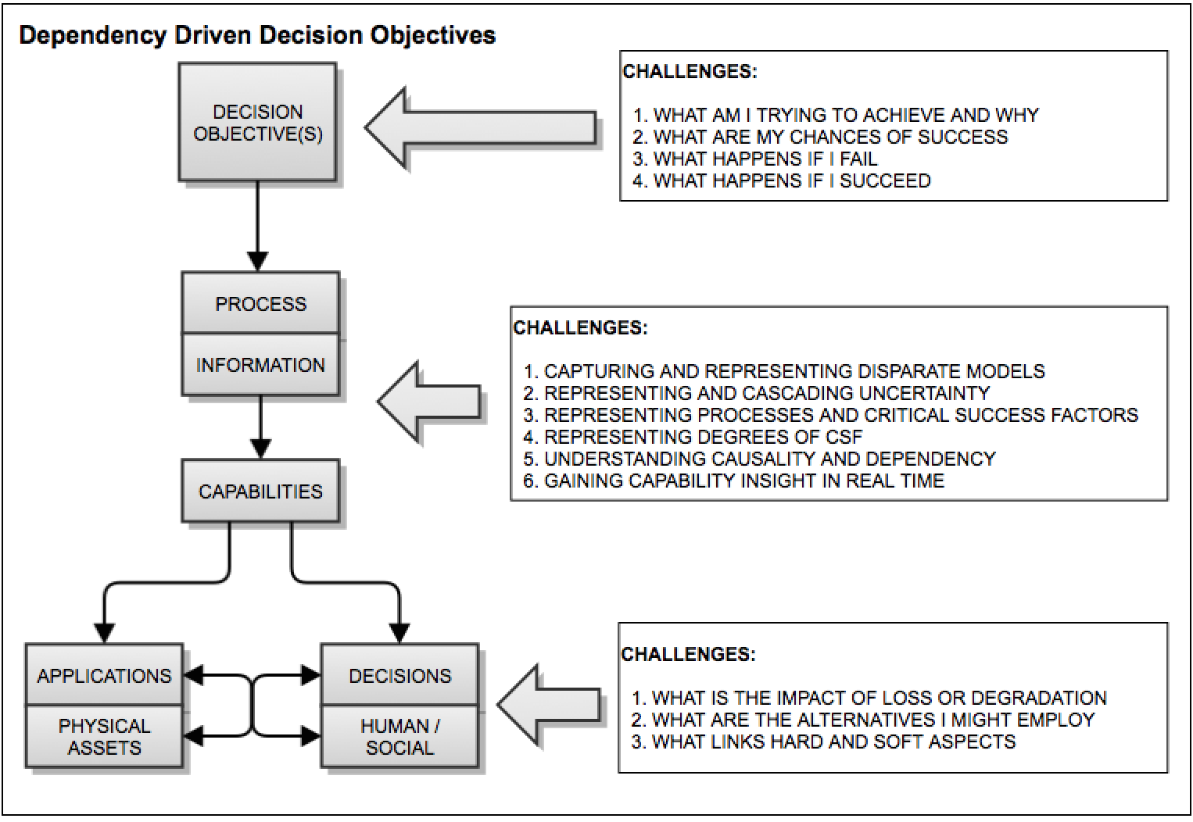
Third- Optimize Decision Support

Slide 19
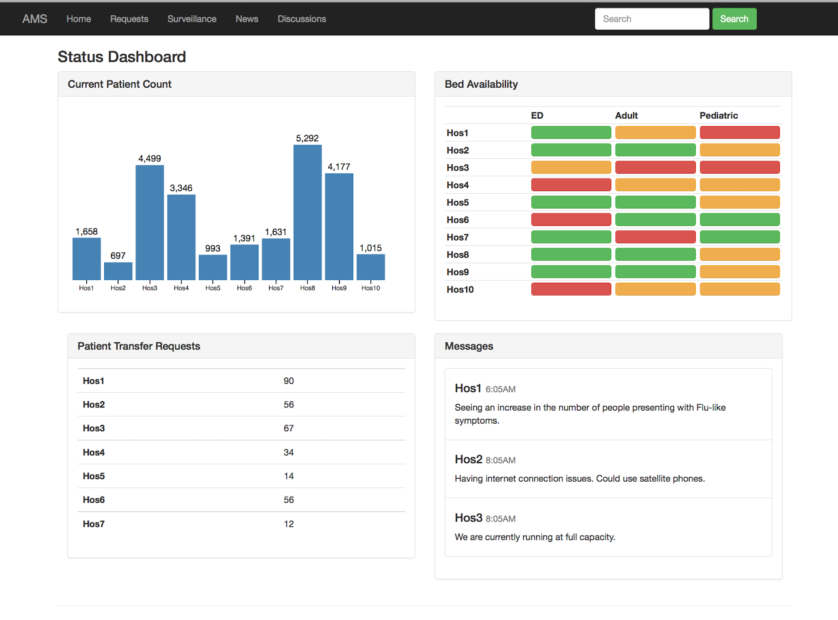
Fourth- Manage Actions

Slide 20
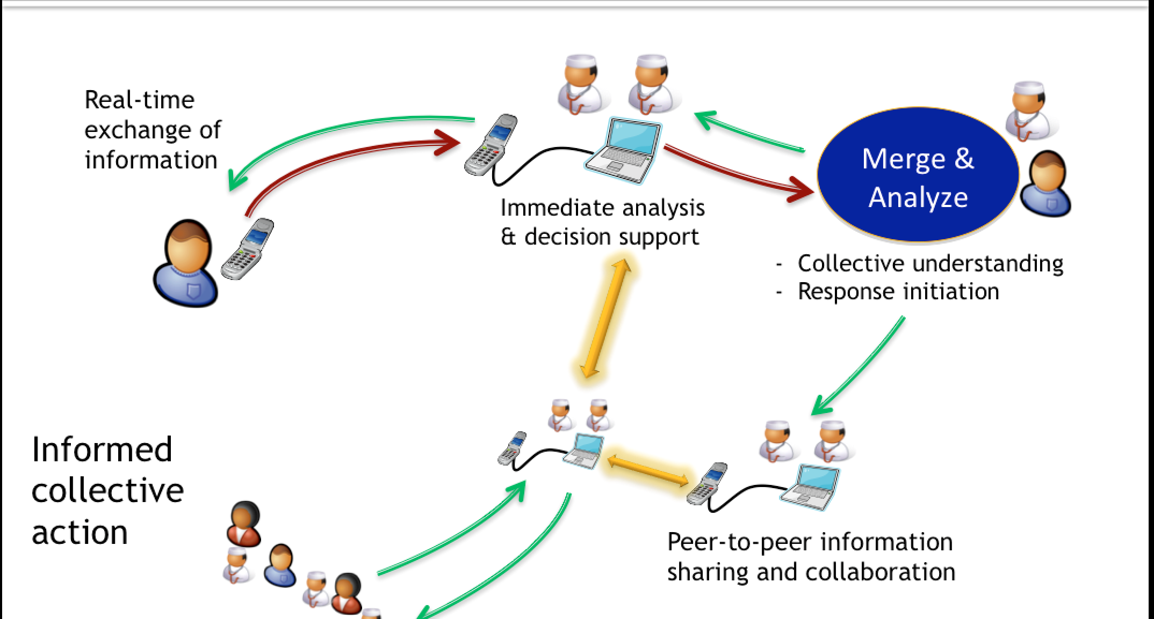
With An Ending Goal of Enhanced Response

Slide 21
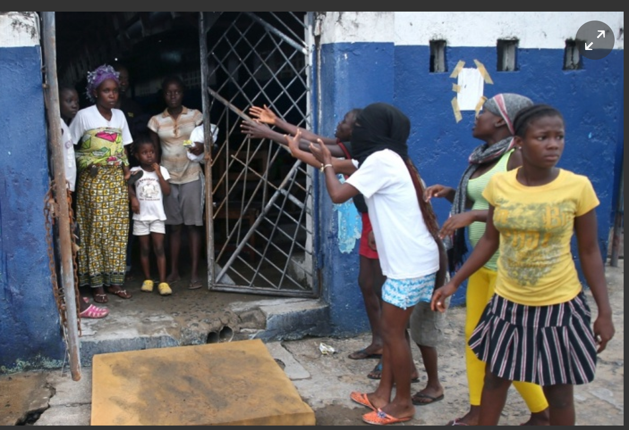
Where to Begin?

Slide 22
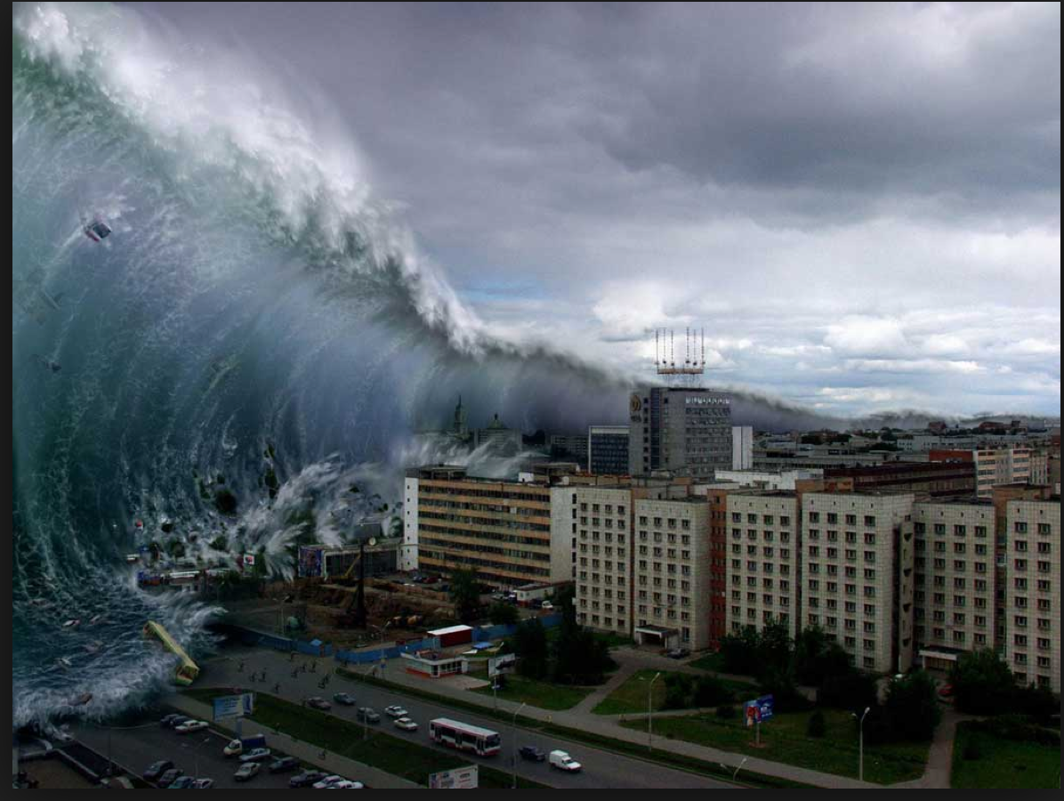
Questions
Contact: Carl Taylor
Fraser Institute for Health
and Risk Analytics
cwtaylor1@gmail.com
carl.taylor1226 Skype

