Slide 1
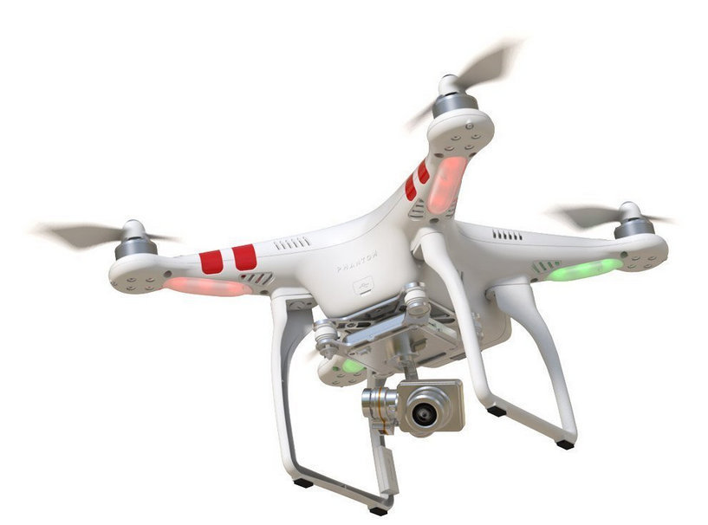
Technological Advances Leveraging Use of
Small Unmanned Aerial Vehicles
in Emergency Management
by Connie White, James Hagen, Michael West, Edward Dearman
*Author to whom correspondence should be addressed;
E-Mail: connie.m.white@gmail.com
The International Emergency Management Society (TIEMS-USA), Portland, OR, 2015

Slide 2
Types of “Drones”
Fixed wing
Rotary wing
Tilt-rotor
Ducted fan
Airships

Slide 3
Main Uses for Drones
Agriculture
Mines
Construction Sites
Wildlife Research
Prospecting
Environmental Monitoring
Infrastructure Inspection
Emergency Response
Storm Tracking/Monitoring
Search and Rescue
https://www.sensorsandsystems.com/dialog/perspectives/30861
-what-are-the-top-ten-civilian-uses-of-drones-that-don’t-impin

Slide 4
Through the first few months of 2015, the government approved drone operations in 43 disasters in 13 countries (23 were ground based operations).

Slide 5
Past Disaster Use
UAVs have been used in
2009 Typhoon Morakot in Taiwan,
L'Aquila in 2009,
Haiti in 2010,
The Great Earthquake of Japan, Fukushima in 2011
Nepal Earthquake 2015
Adams, Stuart M. and Friedland, Carol J. A Survey of Unmanned Aerial Vehicle (UAV) Usage for Imagery Collection in Disaster Research and Management, Louisiana State University, 2011.

Slide 6
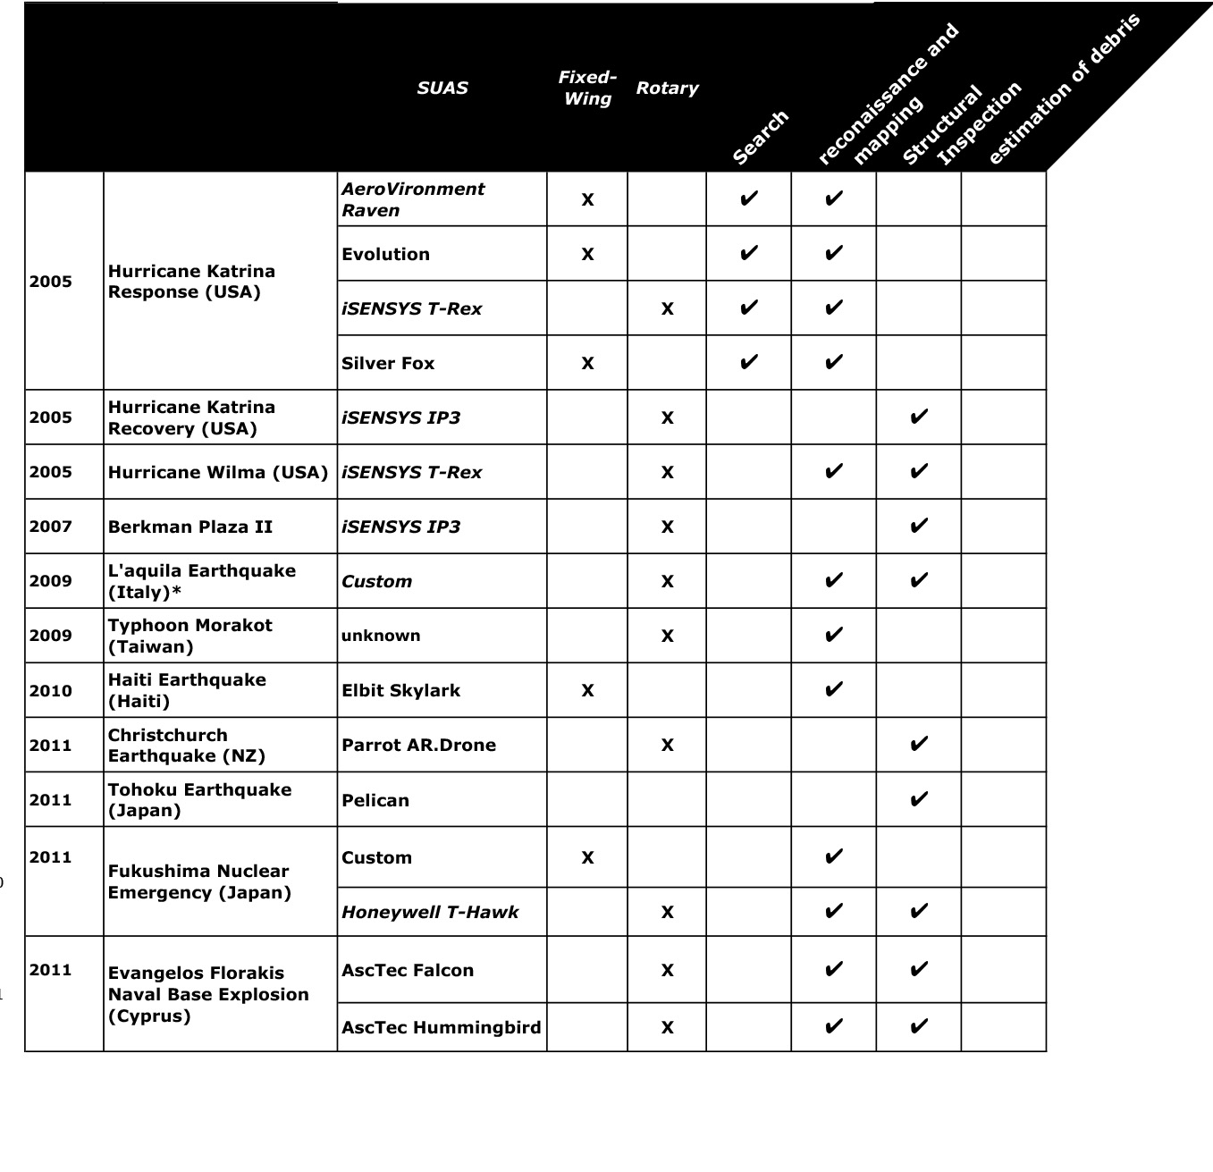

Slide 7
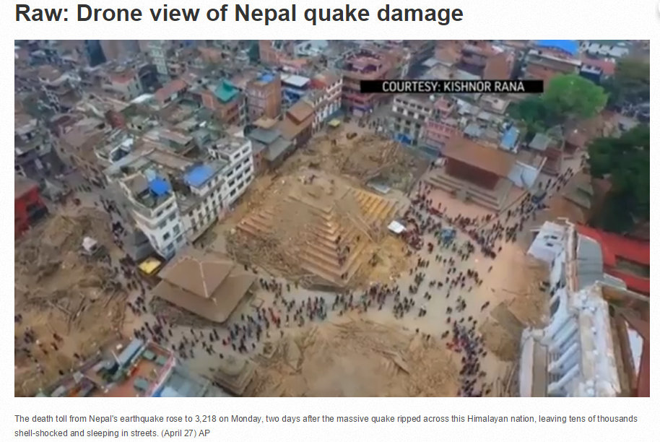
Nepal Drone Video

Slide 8
Drone Uses
  a) Reconnaissance and Mapping
  b) Structural Integrity
  c) Temporary Infrastructure / Supply Delivery
  d) Wildfire Detection and Extinguishing
  e) High-Rise Building Fire Response
  f) Chemical, Biological, Radiological, Nuclear, or Explosive (CBRNE) Events
  g) Search and Rescue Operations
  h) Insurance Claims Response and Risk Assessment
  i) Logistics Support
Drones for Disaster Response
and Relief Operations, APRIL 2015

Slide 9
Present Disaster Application
Images can be analyzed to use to
produce hazard maps,
dense surface models,
detailed building renderings,
comprehensive elevation models, and other disaster area characteristics.
Coordinate rescue efforts,
record building responses to the disaster,
detect building failures,
investigate access issues,
and verify experimental disaster modeling
Adams, Stuart M. and Friedland, Carol J. A Survey of Unmanned Aerial Vehicle (UAV) Usage for Imagery Collection in Disaster Research and Management, Louisiana State University, 2011.

Slide 10
Communications
FM Repeater
UHF/VHF Radio Communications
IP Network Relays
Cellphone Tower Capability

Slide 11
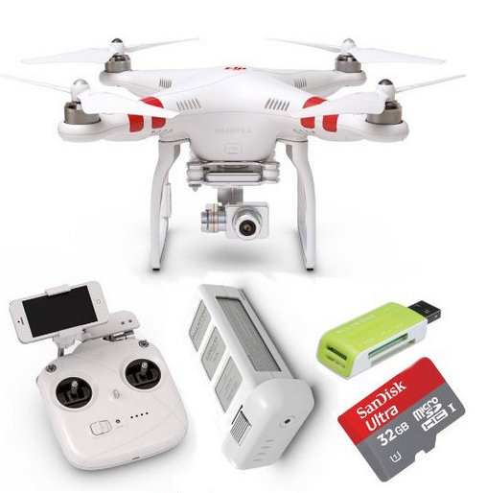
3 Primary Components:
(1) Aircraft (2) Sensor Payload (3) Ground Station

Slide 12
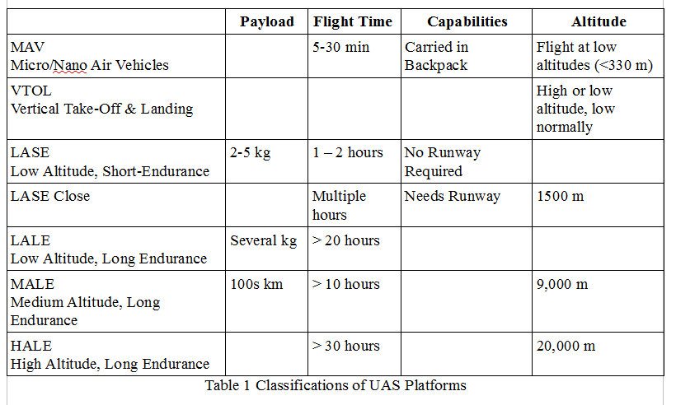
Classifications based on: Size, Flight Endurance & Capabilities
Watts, A.C., Ambrosia, V.G., and Hinkley, E.A. Unmanned Aircraft Systems in Remote Sensing and Scientific Research: Classification and Considerations of Use. Remote Sensing ISSN 2072-4292, 2012, 4, 1671-1692.

Slide 13
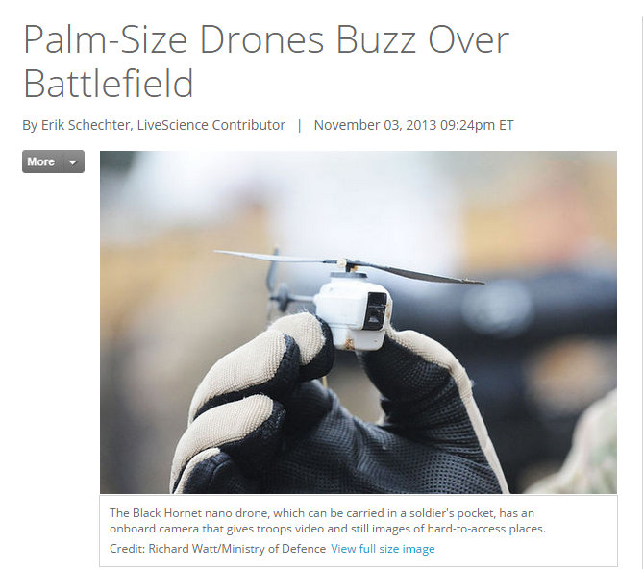

Slide 14

UAV integration into EM Phases
Response
Exercises
(Mitigation)
Recovery
Preparedness

Slide 15
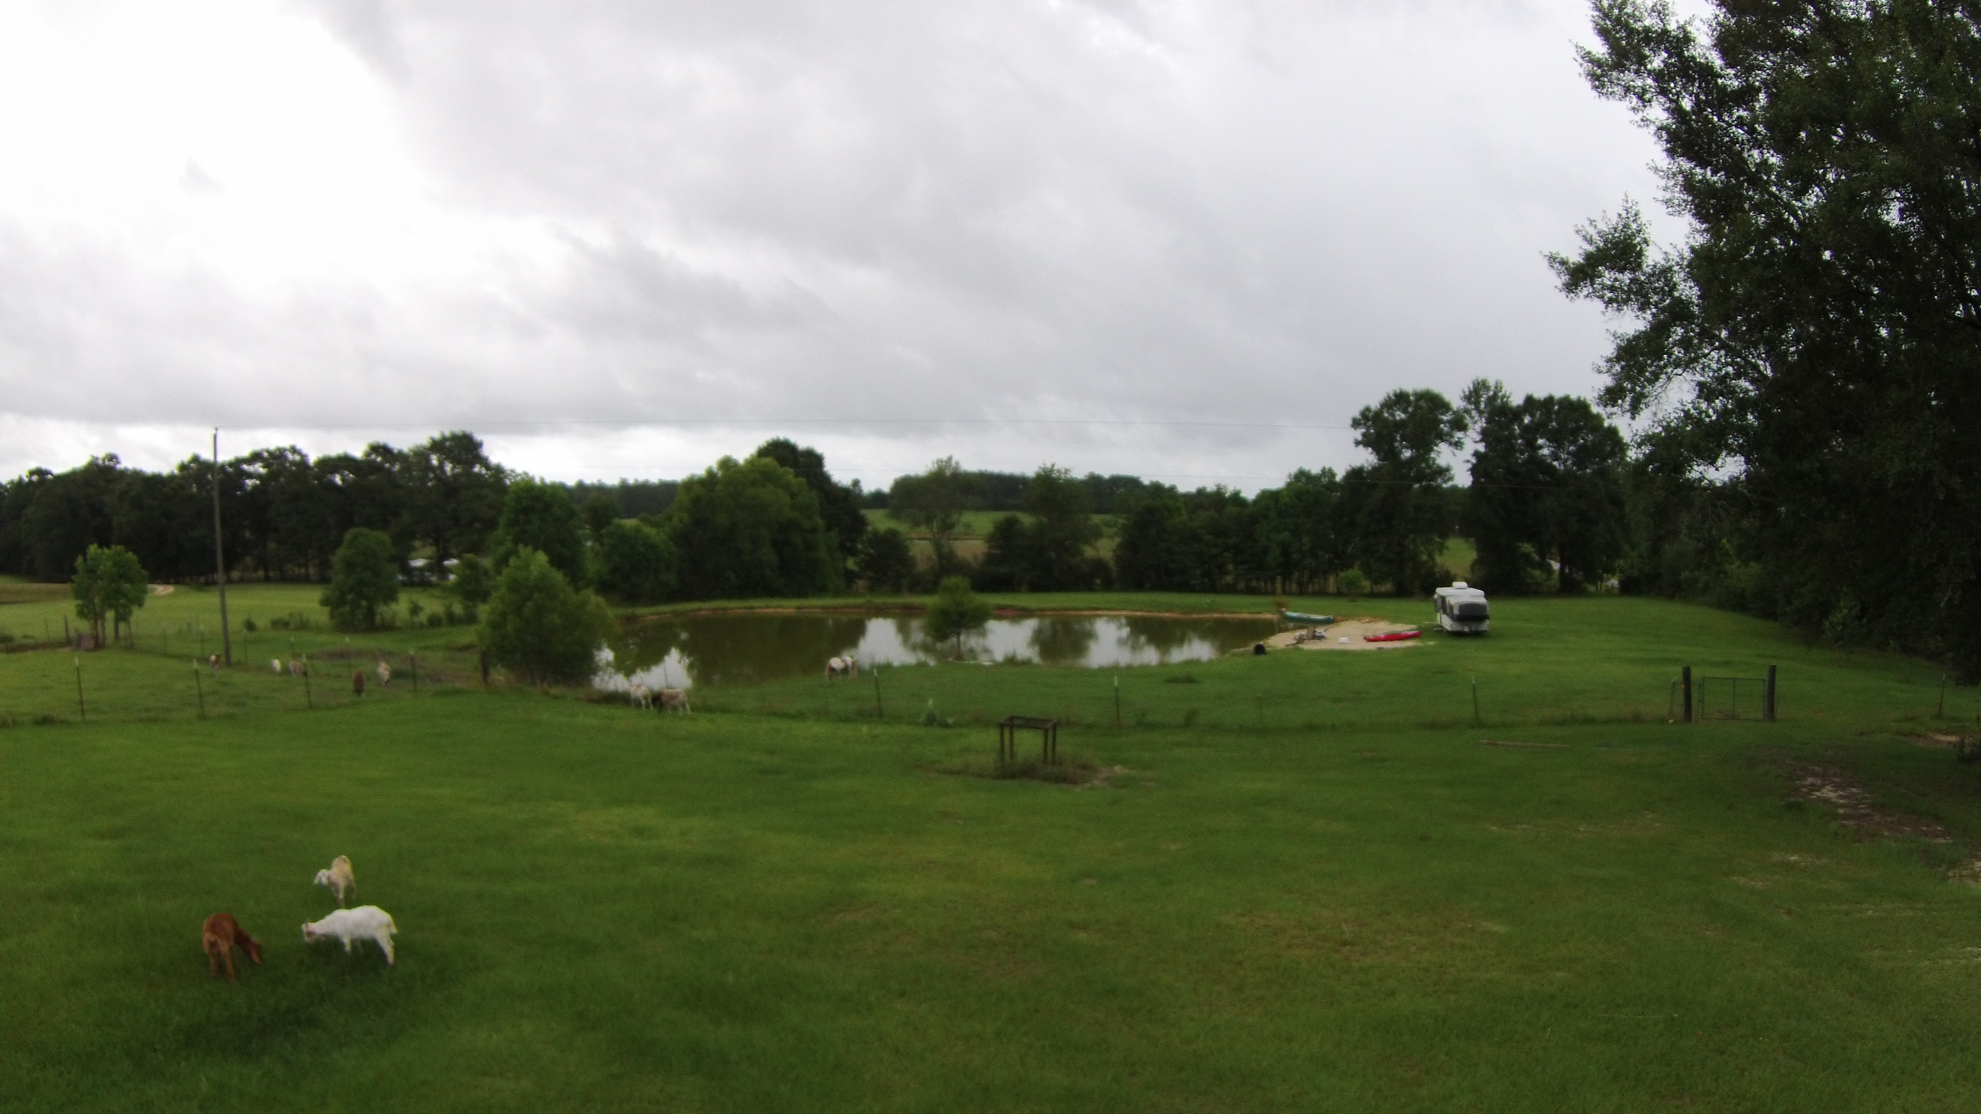
Physical Barriers
  Trees
  Buildings
  Power Lines
  Goats
  Water
  *need committed pilot and dedicated spotter on location per UAV

Slide 16

Natural Barriers
  Weather
  Distance – line of site
  Bird Attacks – both in flight, on ground
  Disaster Debris (volcanic ash)

Slide 17

Man-made Barriers
  Pilot Training & Certifications
  Monetary
  Rules & Regulations (FAA - USA)

Slide 18
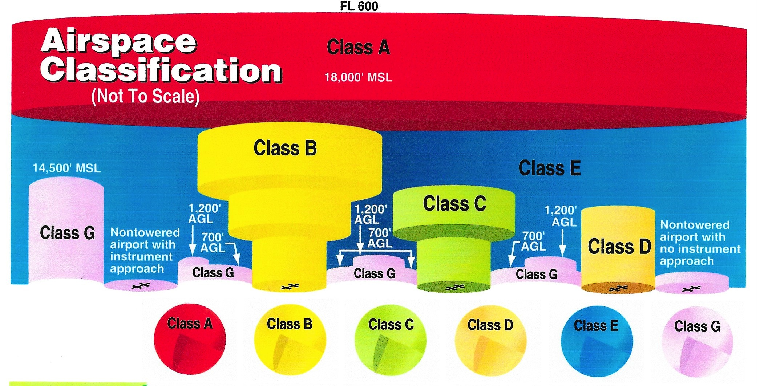

Slide 19
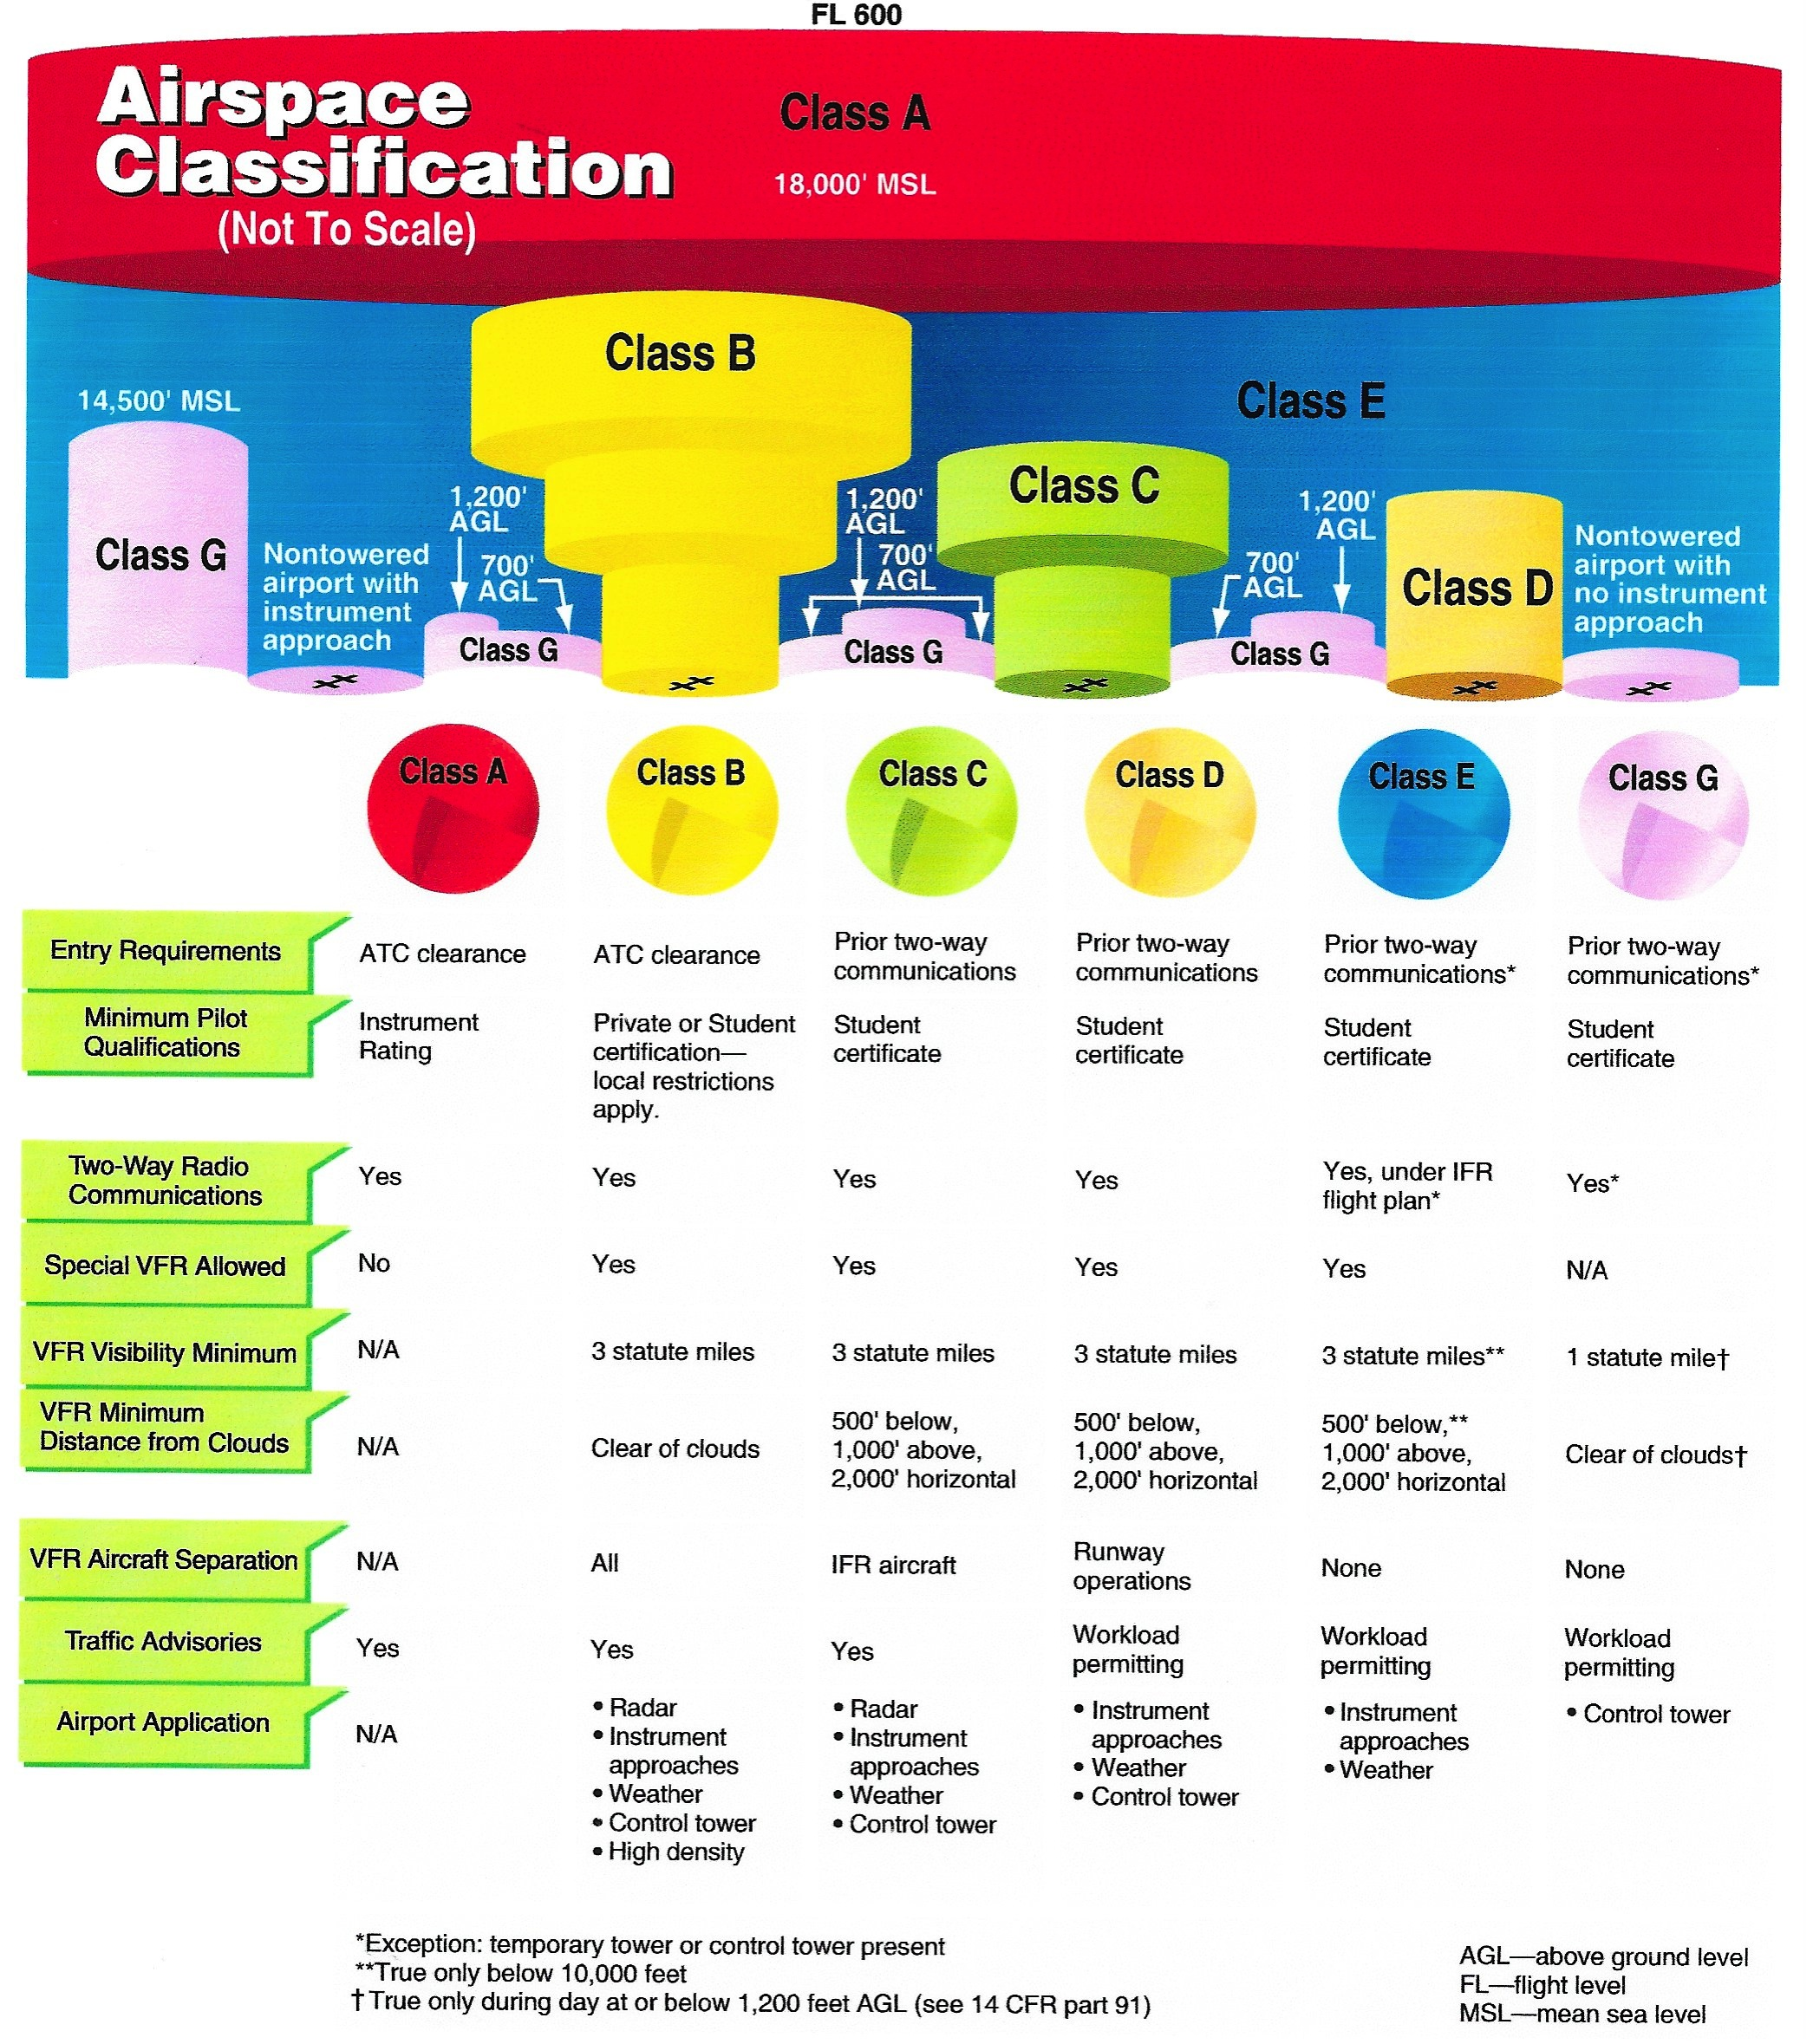

Slide 20
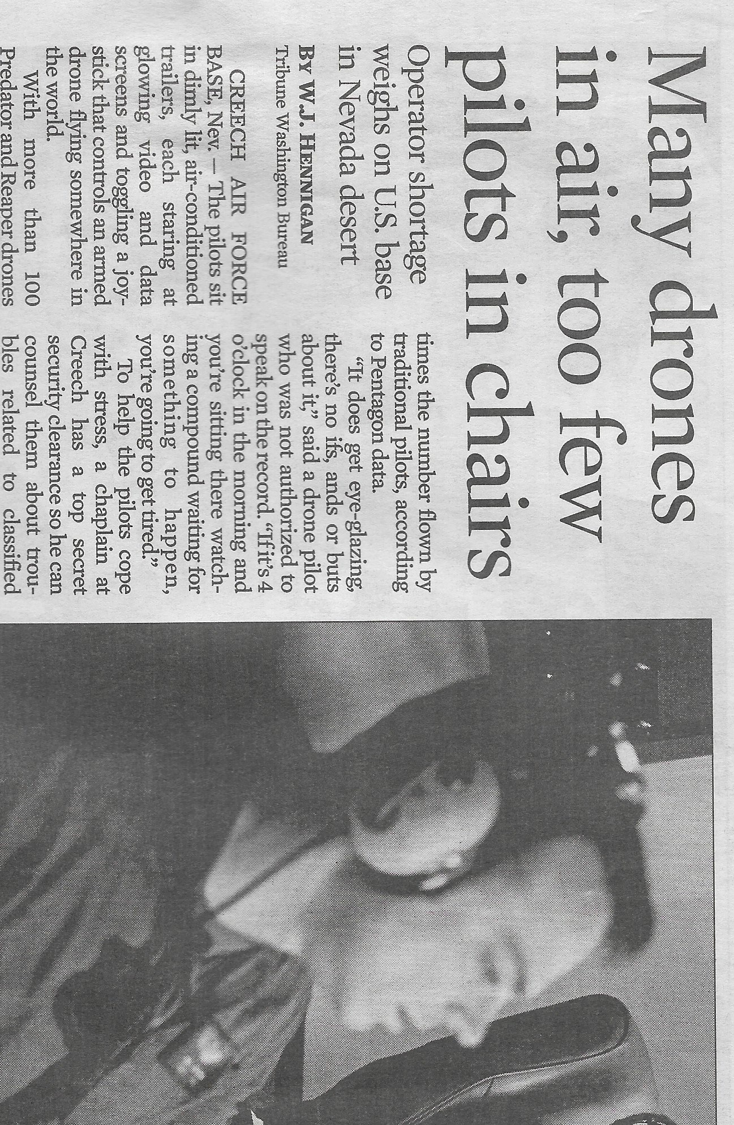
Entry of the Academic World!

Slide 21
Hinds Community College - Mississippi
The Unmanned Aerial Systems (UAS) concentration offers a 2-year Associates of Applied Science degree plus industry and government certifications. This program prepares students for careers as operators and/or coordinators of Unmanned Aerial Vehicles (UAV), also known as “drones”.
  - Hands on operation of fixed-wing and rotary aircraft
  - Full-scale simulator software/hardware systems
  - From basic stages to the advanced stages
  - Launch and recovery techniques, and, autopilot operation
  - Construction and repair of UAVs
  - Risk awareness
  - Data links and sensors
  - Commercial applications –
  - Aerial photography, agriculture, surveying, mapping
  - Monitoring – ecological, livestock
  - Inspection – towers, buildings, real estate

Slide 22
Lewis University – Romeoville, Illinois
Unmanned Aircraft Systems, B.S.
Learn to pilot and operate Unmanned Aircraft Systems (UAS) for commercial applications.
The demand for Unmanned Aircraft Systems has moved from military drone usage and created a whole new world of civilian applications just waiting to be operated.
Quickly Growing Commercial Drone Market for UAS/UAV Applications
From expedited package delivery to precision agriculture, the commercial potential for unmanned aircraft drone system applications has only just begun to be imagined, including:
  Aerial/field mapping (GIS)
  Agriculture and crop scouting, irrigation and fertilization
  Disaster and emergency management
  Environmental research
  Law enforcement and photogrammetry (crime scene preservation)
  Parcel delivery
  Photography/videography

Slide 23
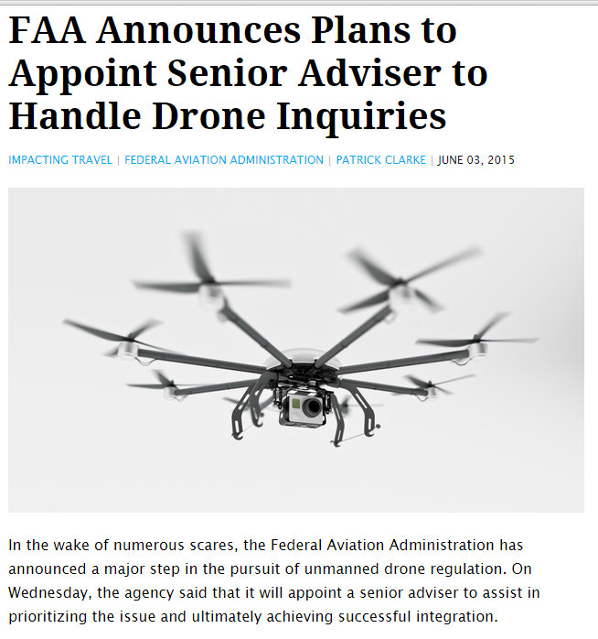

Slide 24
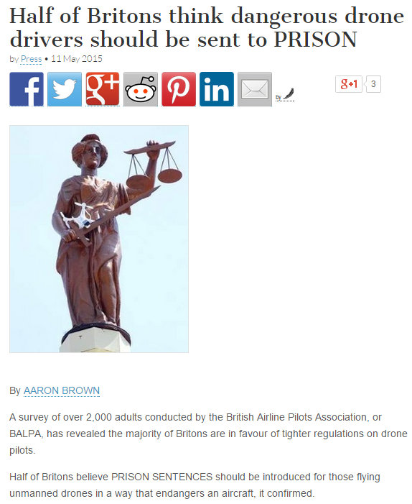

Slide 25
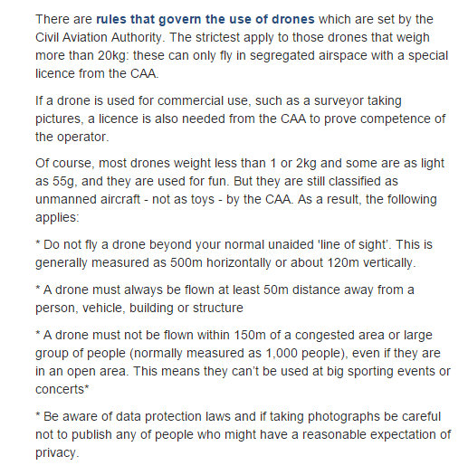
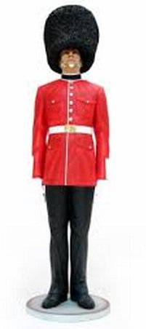

Slide 26
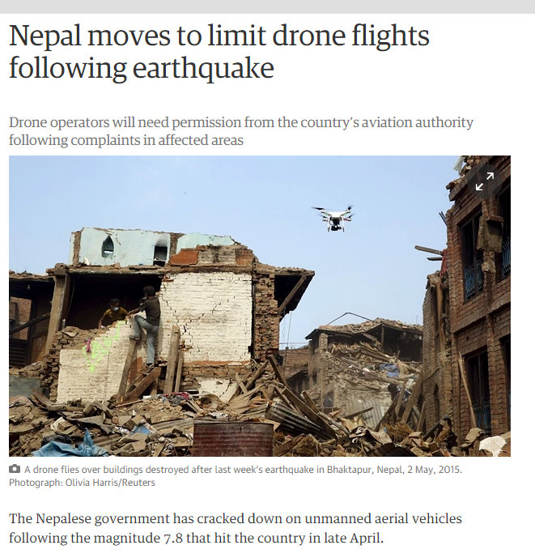

Slide 27
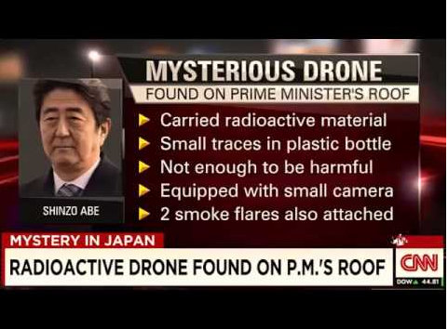
The Dark Side of Drone Use

Slide 28
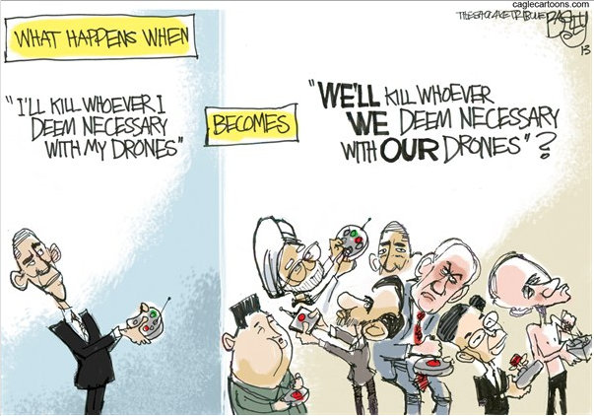

Slide 29
Phantom 2 Vision + Quadcopter
The Phantom 2 Vision + Quadcopter has been rated one of the top drones for 2015 and the best camera drone.

Slide 30
Our System's Components
Phantom 2 vision+ $1399.00 (Phantom 3 is $1179.00)
camera included otherwise GoPro Hero4 Black $500.00
FLIR One - $330.00
iPhone5s (with no service) $699
64GB memory cards $50
HPRC Phantom protective case $250.00
BenQ RP652 Interactive Flat Panel $3500 - $6000
training/paying the pilot ?$
government regulated certification ?$

Slide 31




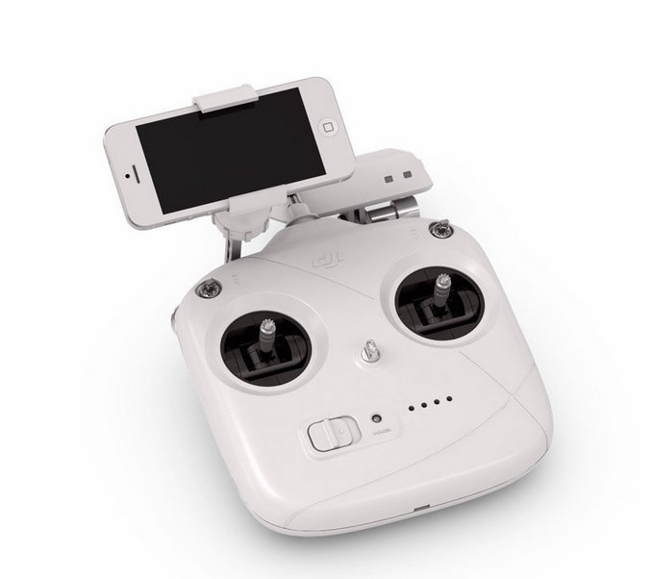










On Location
Spotter
Dedicated Pilot
Live stream to anyone, anywhere on Internet
Command & Control directing tasks, live streaming, subject domain experts, etc.

Slide 32

Future Sensors & Capabilities flower under UV
2014. Published by The Company of Biologists Ltd | Biology Open (2014) 3, 221–230 doi:10.1242/bio.20146445
http://bio.biologists.org/content/3/3/221.full.pdf+html

Slide 33
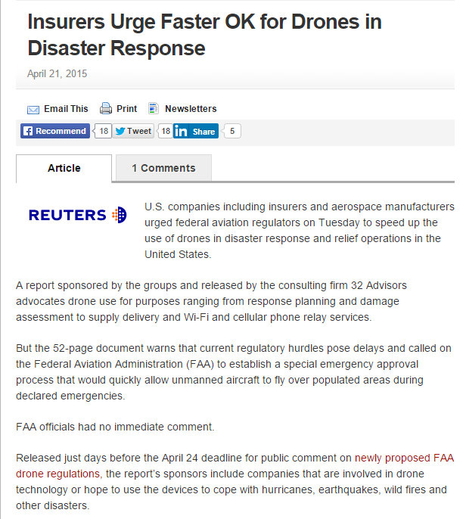

Slide 34
Entry of the Academic World!

Slide 35
Hinds Community College - Mississippi
The Unmanned Aerial Systems (UAS) concentration offers a 2-year Associates of Applied Science degree plus industry and government certifications. This program prepares students for careers as operators and/or coordinators of Unmanned Aerial Vehicles (UAV), also known as “drones”.
  - Hands on operation of fixed-wing and rotary aircraft
  - Full-scale simulator software/hardware systems
  - From basic stages to the advanced stages
  - Launch and recovery techniques, and, autopilot operation
  - Construction and repair of UAVs
  - Risk awareness
  - Data links and sensors
  - Commercial applications –
  - Aerial photography, agriculture, surveying, mapping
  - Monitoring – ecological, livestock
  - Inspection – towers, buildings, real estate

Slide 36
Lewis University – Romeoville, Illinois
Unmanned Aircraft Systems, B.S.
Learn to pilot and operate Unmanned Aircraft Systems (UAS) for commercial applications.
The demand for Unmanned Aircraft Systems has moved from military drone usage and created a whole new world of civilian applications just waiting to be operated.
Quickly Growing Commercial Drone Market for UAS/UAV Applications
From expedited package delivery to precision agriculture, the commercial potential for unmanned aircraft drone system applications has only just begun to be imagined, including:
  Aerial/field mapping (GIS)
  Agriculture and crop scouting, irrigation and fertilization
  Disaster and emergency management
  Environmental research
  Law enforcement and photogrammetry (crime scene preservation)
  Parcel delivery
  Photography/videography

Slide 37

Conclusion
Given all of the barriers – one will be lucky to use drones at all. Given the rate of development, technology will explode with opportunity.

