Slide 1


TIEMS 2015 USA Conference,
Portland, Oregon, 23 – 25 June 2015
TIEMS Worldwide Operations and Activities towards Resilient Societies
By
K. Harald Drager
TIEMS President
The International Emergency Management Society

Slide 2

“We cannot eliminate disasters, but
We can mitigate risks,
We can reduce damage, and
We can save more lives.”
Ban Ki-moon
UN Secretary General

Slide 3
NATURAL DISASTERS 2013
3

Slide 4
Worldwide Threats and Risks 1
During the 1980-2013 period, weather-related or hydro-meteorological disasters accounted worldwide for 87% of total disasters, 74% of total losses, and 61% of lives lost
Climate Change may increase the frequency and consequences of such events
Older people are a particularly vulnerable group, and between 2010 and 2040 the number of people over 65 in less developed countries is expected to nearly triple
By 2030, 60% of the world’s population will reside in cities, bringing all the ills of crowding and overpopulation
4

Slide 5
Worldwide Threats and Risks 2
Eighty percent of the ten most populous cities in the world are at risk of being severely affected by an earthquake, and 60% are vulnerable to storm surge and tsunami waves
Increasing risks associated with disasters is also vulnerability introduced by local conditions such as poverty, government corruption, poorly planned development, and environmental degradation
5

Slide 6
MEANS TO IMPROVE GLOBAL RESILIENCE THROUGH FOCUS ON Preparedness
Education – to spread best practices, establish a common language, and promote a global Community of Practice of emergency management practitioners
Research Projects – improve methods and systems for a better prediction and response
Communication across borders – to better coordinate organizations and actors
Community engagement – to extend the emergency management Community of Practice to include ordinary citizens and volunteers is essential to disaster preparation and response
6

Slide 7
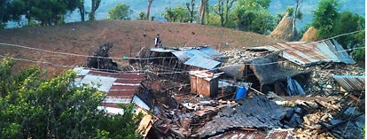
The Nepal Earthquake
It has happened again!
A poor and vulnerable population has been struck by a devastating disaster, which was predicted by the scientist experts!
7

Slide 8
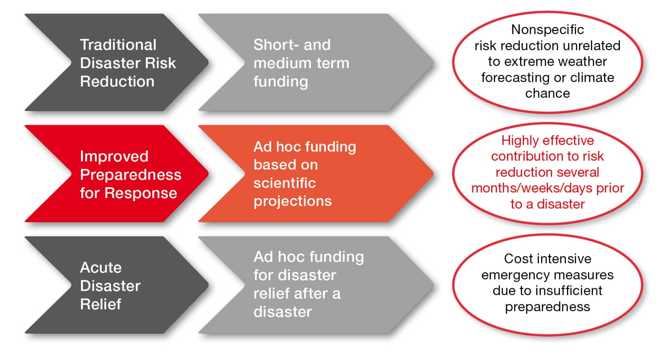
Anticipatory humanitarian system?

Slide 9


Forecast based financing (of preparedness)
7 pilot countries: WFP and GRC
Development of Fbf methodology
Forecasts: Decision on thresholds
Development of a funding mechanism
Decisions on probability – acting in vain?
Improved cooperation with scientists – Dialogue Platform Geneva
Standard Operating Procedures
Ultimate goal: Paradigm shift towards
DRR triggered by forecasts!
Climate Risk Analysis

Slide 10
TIEMS
TIEMS was founded in 1993 in Washington, USA, and is today registered as an international, independent, non political, not for profit NGO in Belgium
TIEMS is a Global Forum for Education, Training, Certification and Policy in Emergency and Disaster Management
TIEMS provides a platform for all stakeholders within the global emergency and disaster management community to meet, network and learn from each other and exchange knowledge and experience
TIEMS aims to influence policy makers worldwide to improve global cooperation and to establish global standards within emergency and disaster management

Slide 11
TIEMS Activities
International Conferences, Workshops and Exhibitions, focusing on different Emergency Management and Disaster Response Topics
Research & Technology Development (RTD) Project Initiatives and Coordination or Participation in RTD Projects
International Education, Training and Certification Programs
Task Force Groups

Slide 12
TIEMS Services
TIEMS Secretariat Function in Brussels
Newsletter with Latest News and Articles of Interest
Global Young Scientist Network
TIEMS Library with Proceedings and Activity Reports from TIEMS events
Summer Schools
Research and Development Member Service

Slide 13
TIEMS 2015 Program
International Symposium on Emergency Medicine in Guangzhou, China
TIEMS First International Workshop in Jeddah, Saudi Arabia
TIEMS Workshop on Oil & Gas Exploration Safety in Croatia
TIEMS USA Chapter 2015 Conference in Portland, USA
TIEMS Finland Chapter 2015 Workshop
TIEMS 2015 Annual Conference in Rome, Italy
TIEMS Nigeria & West Africa Chapter 2015 Conference
TIEMS China Chapter 2015 Annual Conference in Qingdao

Slide 14
TIEMS Chapters
(Think Globally and Act Locally)
Romania Chapter
BeNeLux Chapter Belgium/Netherlands/Luxemburg
China Chapter
South Korea Chapter
India Chapter
USA
7. MENA Chapter
Middle East and North Africa
8. Finland Chapter
9. Iraq Chapter
Japan Chapter
Italy Chapter
Nigeria & West Africa Chapter

Slide 15
TIEMS International Education Programs
TIEMS International Education and Training Programs in Emergency and Disaster Management is TIEMS Contribution to Increased Global Preparedness
Preparedness Saves Lives!

Slide 16
TIEMS International Education, Training and Certification Program Objectives
Put International Focus on the Profession of Emergency Management and Disaster Response
Contribute to an International Standard in Education, Training and Certification in Emergency management and Disaster Response
Contribute to education in Emergency Management and Disaster Response in order to promote the state of the art in technology, systems and methods available
Contribute to education at all levels, from policy documents to courses in primary school education
Establish a TIEMS Certification of Qualifications in International Emergency Management and Disaster Response
Contribute to Capacity Building in Countries where little or no Education and Training in this field is available
Recruit International Teachers and Trainers in this field to TIEMS Pool of International Teachers and Trainers

Slide 17
TIEMS Education, Training and Certification Structure
TIEMS Pool of International Teachers and Trainers
TIEMS Courses in Emergency Management and Disaster Response
TIEMS Training Workshops
TIEMS QIEDM Certification of Qualifications in International Emergency Management and Disaster Response

Slide 18
TIEMS International Certification
TIEMS - QIEDM
TIEMS - QIEDM – is a Certification of Qualifications in International Emergency and Disaster Management and Response
Candidates need to have sufficient background education and practise in emergency management and disaster response
The QIEDM Curriculum to comprise both theoretical and practical courses and hands on training
Courses to be offered by TIEMS in cooperation with Universities and Training Institutions worldwide
The Certification exam/test to be passed
The Certification to be given in cooperation with national and international Certification Authorities
TIEMS Chapters will be responsible for adding local/national/cultural competences

Slide 19
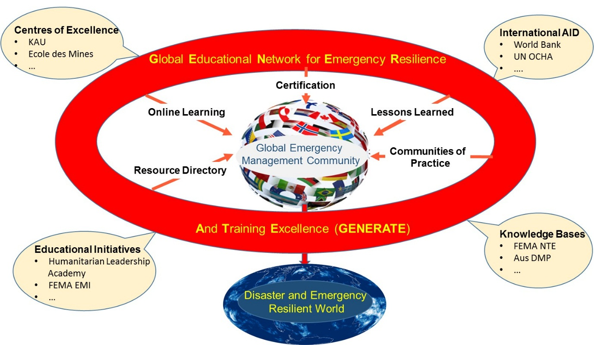
Global Educational Network for Emergency Resilience and Training Excellence
19

Slide 20
TIEMS RTD Projects and Activities
TIEMS Research and Technology Development (RTD) Projects and Member Service is an initiative to stimulate advancement in technology, methods, operations, systems and organizational aspects of the emergency management and disaster response discipline for a safer world
RTD for a Safer World!

Slide 21
TIEMS Members
TIEMS members constitute a large international multidisciplinary group of experts, with different educational background and various experience in the field of emergency management and disaster response. They represent an unique source of expertise and ideas, which are important assets for research and technology development activities

Slide 22










It all started with the NARTUS project where TIEMS had the responsibility for consensus building and establishing the
Public Safety Communication Europe Forum.
Since then TIEMS has been invited to become a member of advisory or user boards/groups in a number of EU projects, including:
Status of TIEMS RTD Involvement
ACRIMAS
Opti – Alert
CRISMA
Archimedes
DRIVER
EDEN
PHAROS
TAWARA_RTM
RESCUER

Slide 23


EU Project ASSET
ASSET (Action plan in Science in Society in Epidemics and Total pandemics) is to create the blueprint for a better response to epidemics and pandemics, through improved forms of dialogue and better cooperation between science and society at various stages of the research and innovation process. ASSET is a four-year, European Commission funded Mobilization and Mutual Learning Action Plan (MMLAP) project, which started 1st January 2014 and will end on 31st December 2017
http://asset-scienceinsociety.eu/

Slide 24
EU Project ASSET Background
The background for this project is that in 2009 the H1N1 influenza pandemic revealed a breakdown in the communication between decision makers, their scientific institutions and the European public. This communication failure led to unwanted effects, such as the failure of a large part of the population to adopt adequate preventive measures, and the scientific sector not taking into account important information coming from the population.

Slide 25
TIEMS Activities in ASSET
TIEMS is a Consortium Partner in ASSET with the following responsibilities
Task T2.3 - Report on participatory governance in epidemics and pandemics
2. WP3 - Action Plan Definition
3. Task T3.4 - Toolbox
4. Task T6.1 - High Level Policy Forum

Slide 26
TIEMS TASK Force Groups
Each Task Force Group would comprise qualified TIEMS scientists in different fields. These task groups could cooperate with UNOCHA, and/or with local emergency management government agencies and directly join to the operation during the emergency issues occurred

Slide 27
TIEMS TASK Force Groups Plan
Disaster Integrated Risk Assessment Task Force
Disaster Scenario Simulation and Preparedness Task Force
Emergency Response and On-site Life Rescue Task Force
Early Warning and Decision-making Sub-Task Force
On-site Communication, Commanding and Coordination Sub-Task Force
Emergency Medical Care and Public Health Task Force
Emergency Engineer Rescue and Equipment Task Force
Allocation of Homeless People and Disaster Recovery Task Force
Emergency management and SAR Theory Task Force
High-Technology (Robots) and Applications Task Force
Disaster Cases Analysis and Database Construction Task Force
Training, Exercise and Certification Task Force

Slide 28
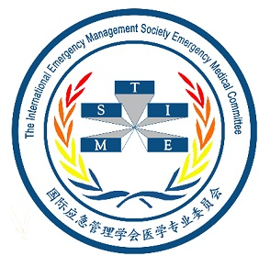
TIEMS Emergency Medical Committee
TEMC
TIEMS Emergency Medical Committee (TEMC), was established in Guangzhou, China in November 2013, and arranged its first conference in April 2014 in Chengdu, and its second conference in Guangzhou in March 2015. The success of these conferences opened new windows and pathways for The International Emergency Management Society, and also provided fresh thoughts and ideas for promoting the improvement of international rescue and health management in China and worldwide

Slide 29
Rewarding Excellence in
Emergency and Disaster Management
TIEMS Rohrmann Scholarship Fund
Best Paper Awards
          Awards from Korea Chapter
          Awards from China Chapter
          Awards from Japan Chapter
Best Exhibition Award
TIEMS President Outstanding Achievement Award

Slide 30

The International Emergency Management Society
www.tiems.org
Rue Des Deux Eglises 39B - 1000 Brussels, Belgium - Reg. no. 0881.936.668
TIEMS AWARD
“Institution or Individual”
TIEMS President
TIEMS Director

Slide 31
TIEMS Structure
Annual General Meeting (AGM)
(TIEMS Membership)
TIEMS
Advisory
Board
TIEMS
Board
of Directors
TIEMS
Secretariat
TIEMS Chapters and Members

Slide 32
TIEMS Membership Benefits
As a member of the TIEMS, you are part of an international community of leaders and practitioners in emergency management, with diverse backgrounds in engineering, science, government, academics, military, and industry - working together to make the world a safer place. Membership affords unique opportunities to
Learn, Serve, and Network

Slide 33
TIEMS Membership Benefits
Learn
From the multi-disciplinary, multi-national TIEMS community, and through special TIEMS programs
Serve
By helping TIEMS in its mission to reduce the impacts of disasters and emergencies worldwide
Network
With local and international colleagues to develop valued personal and professional relationships, and enhanced opportunities

Slide 34

The International Emergency Management Society Focus on Cultural Differences to be Understood and Included in the Society’s Events, Education and Research Programs

Slide 35

TIEMS 2015 Annual Conference in Rome
30 September – 2 October 2015
Call for Papers deadline is: 30th June2015

Slide 36
Thank You for Your Attention!
Questions?

