Slide 1
AMPERE and GEOScan: Utilizing Commercial Space Infrastructure for Disaster Mitigation, Planning and Response
Lars Dyrud

Slide 2
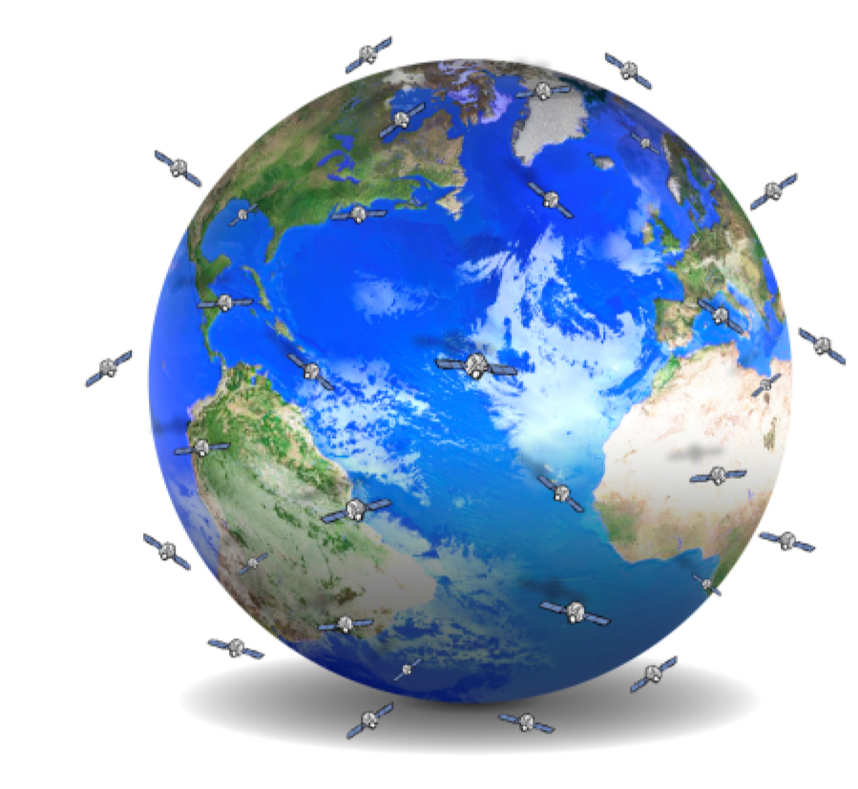

Space Weather Hosted Payloads: Benefits?
• Solve known problems at dramatic cost savings
Solve new problems not previously thought possible, like total Space Weather Now-casting
Utilize modern and COTS, not yesterdays, technology
A new and more flexible view of risk in scientific space missions
Fundamentally change the paradigm of science from space, for the better!
Actionable real-time space weather data system at a fraction of current costs.

Slide 3


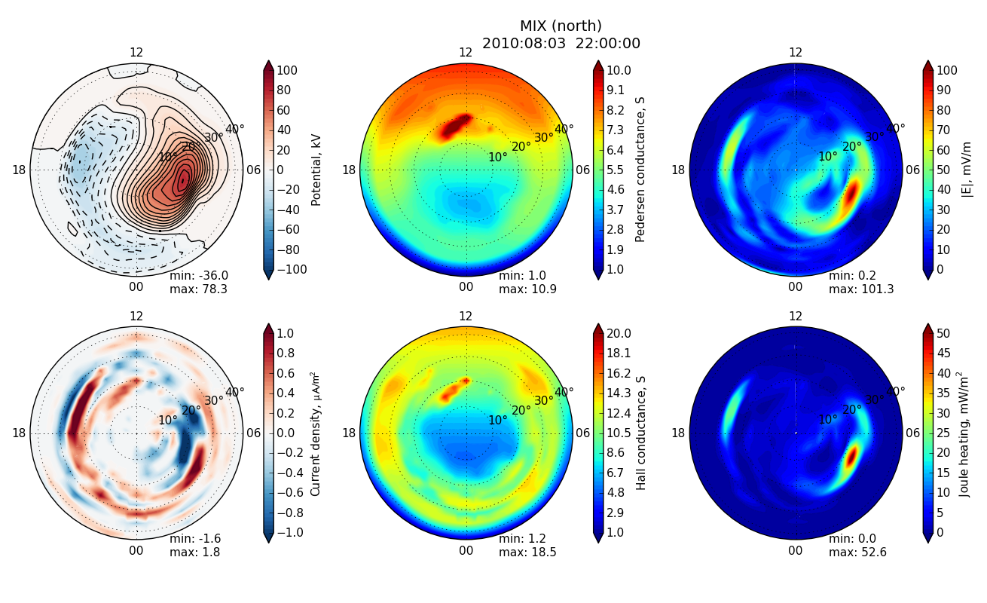
AMPERE and models
E-field, convection
Intense ~keV e⁻ precipitation
Ionospheric turbulence (strong E-field)
AMPERE currents
~10 keV e⁻ precipitation
Joule heating drag

Slide 4

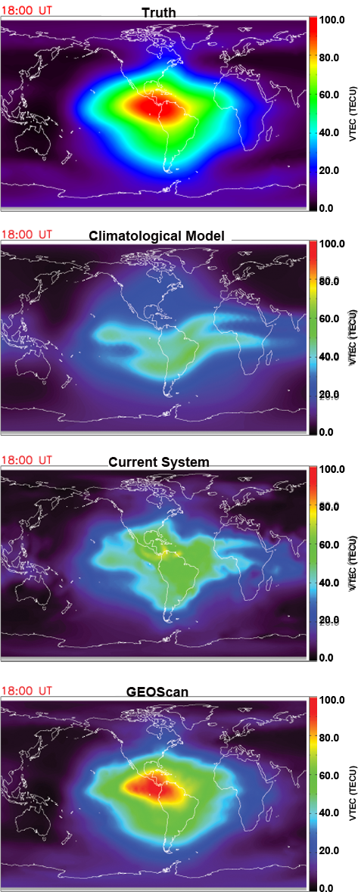
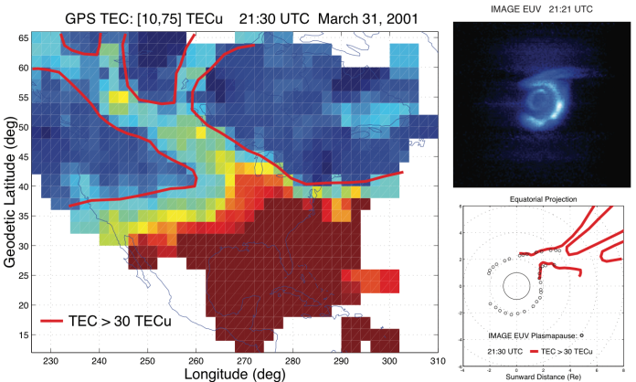
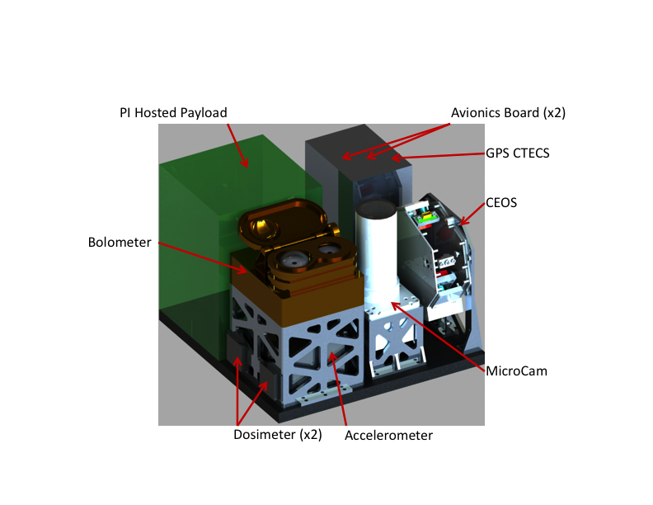
Poorly understood, major geospace reconfigurations occur during storms- GEOScan images plasma in 3D and radiation belts in 2D

