Slide 1


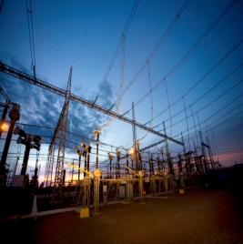
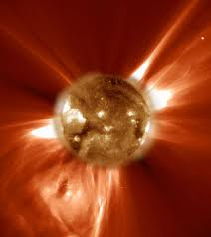
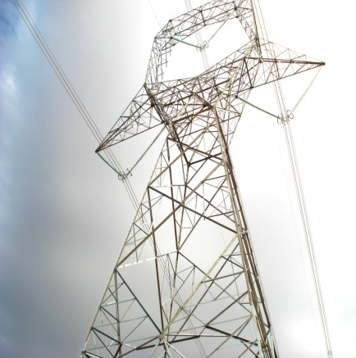
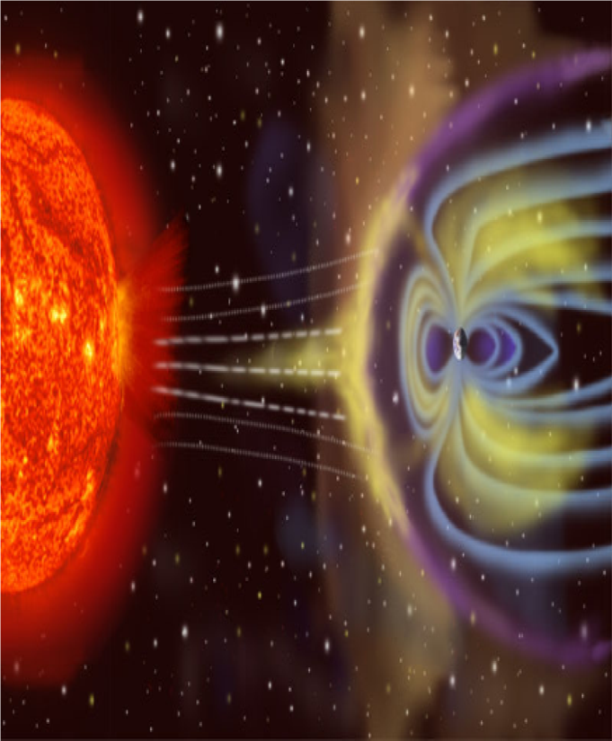
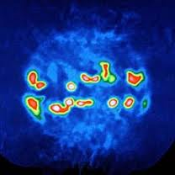
Draft 1
Corporate Affairs Division
November 2011
Solar Storm Resilience
Resilience to Geomagnetic Induced Currents
Utility Perceptive
"How do we become more Resilient in light of uncertainty?"
TIEMS 2012 – Oslo
22 – 24 October 2012
23 October 2012
Malcolm Van Harte – Project Leader
Carol Allers – Crisis and Stakeholder Management Stream Lead
Dr Richard Candy – Monitoring and Detection Stream Lead
Eskom Holdings SOC Limited
Images Courtesy: NSA

Slide 2
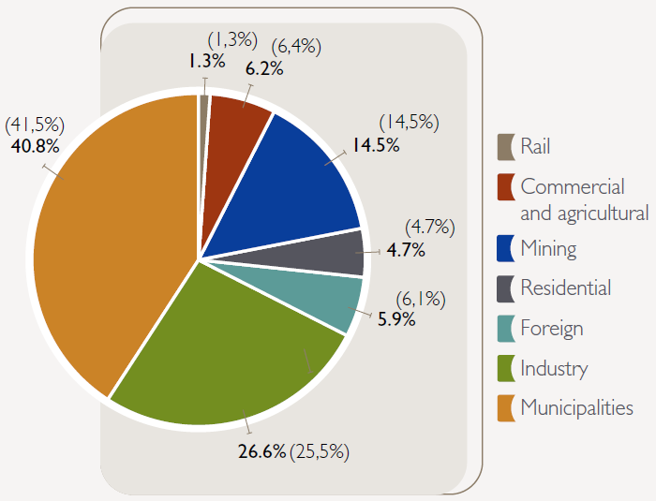
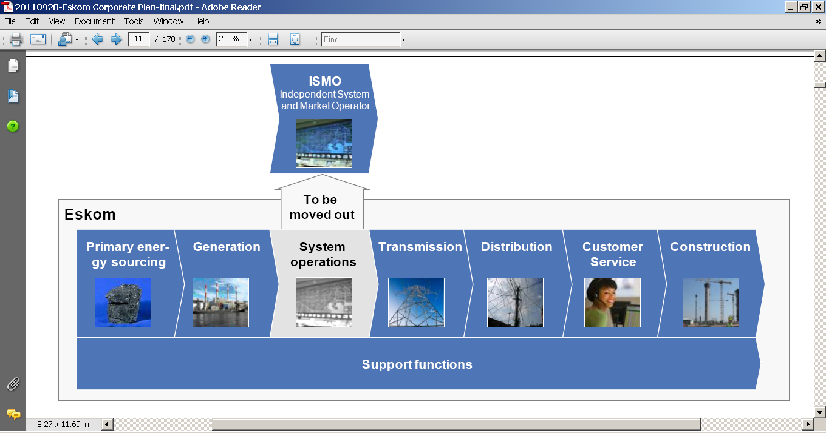
Eskom at a glance
Strategic 100% state-owned electricity utility, strongly supported by the government
Supplies approximately 95% of South Africa’s electricity and more than 40% of Africa’s electricity
41 778 employees as at 31 March 2011
Serves 2 857 industrial, 1 110 mining, 49 090 commercial, 84 393 agricultural and more than 4.5 million residential customers
27 (including 1 nuclear) operational power stations with a net maximum capacity of 41 194MW as at 31 March 2011
Total electricity sales of 224 446GWh and gross electricity revenues of R90.38bn for the year ended 31 March 2011 (R69.83bn for the year ended 31 March 2010)
Infrastructure includes 395 419km of power lines and cables (all voltages) as at 31 March 2011
Committed to build 17.1GW new generation capacity expected by 31 March 2018. This includes 5.2GW already commissioned as at 31 March 2011
Eskom electricity sales by customer for the year ended 31 March 2011 (31 March 2010)
Eskom’s net capacity mix – 31 March 2011
In support of
Source: Eskom Annual results June 11

Slide 3
Draft 1
Corporate Affairs Division
November 2011
Setting the Context of challenges experienced within our Electricity Supply Industry
Images Courtesy: NSA

Slide 4
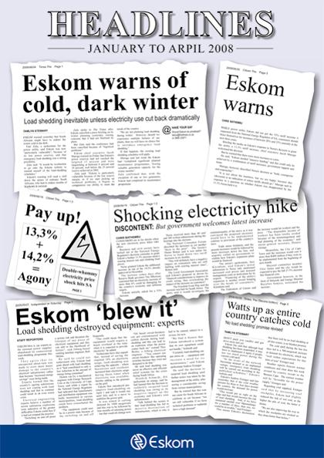
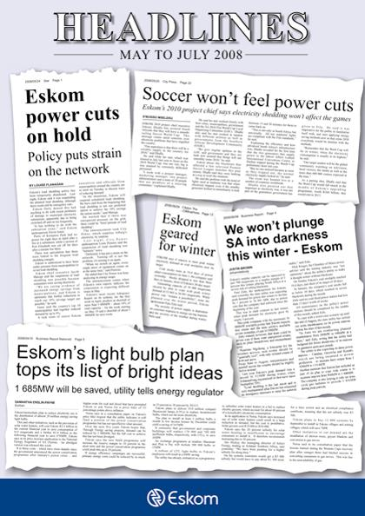
Damage to Eskom’s reputation was severe ….
Reflecting on the power crisis

Slide 5
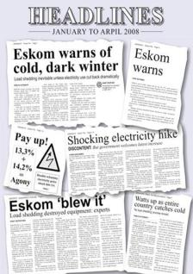
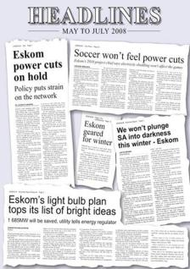
“Crises are terrible things to waste …it has enabled us to think deeply about our role …. you can’t buy that experience.”
“I think when things are going well you may not even understand sometimes how the thing works.
When things go wrong you appreciate how the things go wrong. It’s like a car when things go wrong:
you have to take out the engine and look at the pistons.”

Slide 6
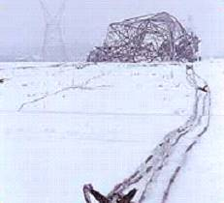
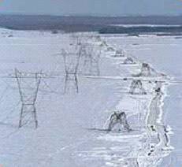
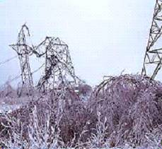
“The ability to deal with a crisis situation is largely dependent on the structures that have been developed before chaos arrives.
The event can in some ways be considered as an abrupt and brutal audit: at a moment’s notice, everything that was left unprepared becomes a complex problem, and every weakness comes rushing to the forefront.”
Pat Lagadec, “Preventing Chaos in a Crisis: Strategies for Prevention, Control, and Damage Limitation”,
London, McGraw-Hill International, 1993, p.54

Slide 7
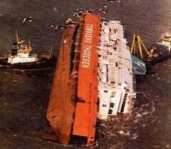
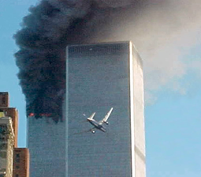
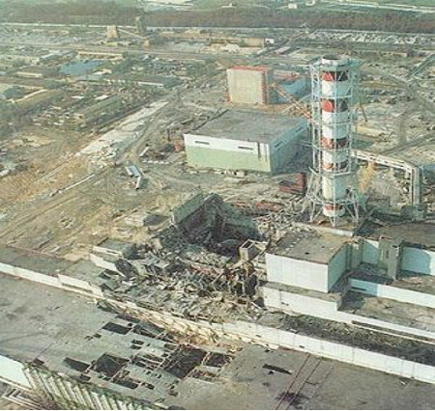
“ High reliability organisations exist where the potential of error and disaster is overwhelming - they have no choice but to function reliably…
The hallmark of a HRO is not that it is error-free but that errors don’t disable it.”
Examples: nuclear aircraft carriers, air traffic control systems, hostage negotiation teams, nuclear power generating plants, fire-fighting crews
Karl Weik & Kathleen Sutcliffe, “Managing the Unexpected: Resilient Performance in an Age of Uncertainty”,
2nd Edition, San Francisco, John Wiley & Sons, 2007

Slide 8

DISASTERS WE SHOULD HAVE SEEN COMING
Common characteristics of “predictable surprises”
(Harvard Centre for Public Leadership):
Leaders knew a problem existed – and would not resolve itself
The problem shows signs of getting worse
Fixing the problem requires significant cost today
Fixing also involves incurring a certain cost now to avoid a cost that is uncertain - but likely to be much larger
A natural human tendency to maintain the status quo
A small vocal minority benefits from inaction – and is motivated to subvert the actions of leaders for their own benefit
Case studies: September 11, Enron, Hurricane Katrina, (SA Electricity Crisis?)
Max H. Bazerman & Michael D. Watkins “Predictable Surprises – The disasters you should have seen coming
and how to prevent them”, 2nd Edition, San Francisco, John Wiley & Sons, 2007, p.ix / p 14

Slide 9
Draft 1
Corporate Affairs Division
November 2011
What is Resilience for Eskom?
Images Courtesy: NSA

Slide 10
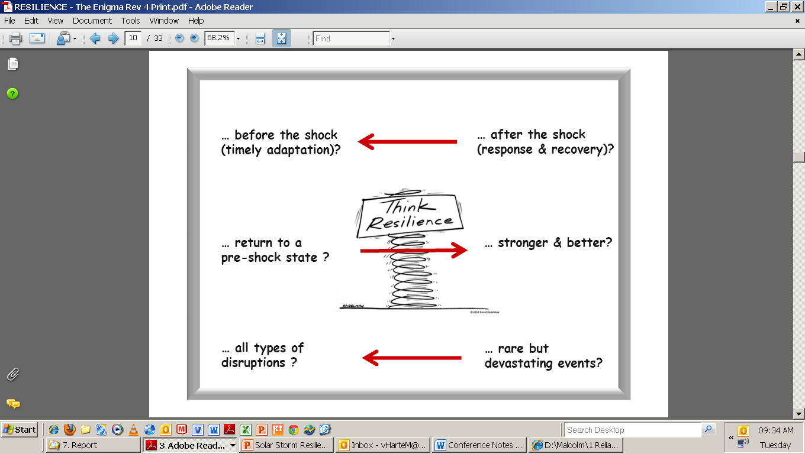
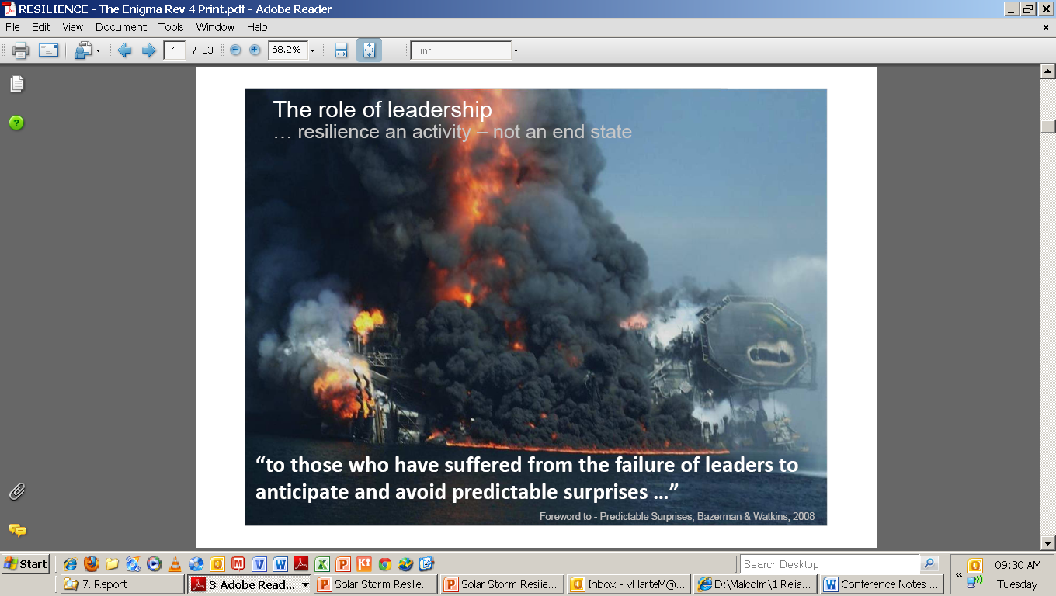
Think Resilience
BBC News 23 Oct 12 06:46 – Italy quake scientists convicted …”Six Italian scientists and an ex-government official have been sentenced to six years in prison over the 2009 deadly earthquake in L’Aquila.”…
“…killed 309 people…”

Slide 11
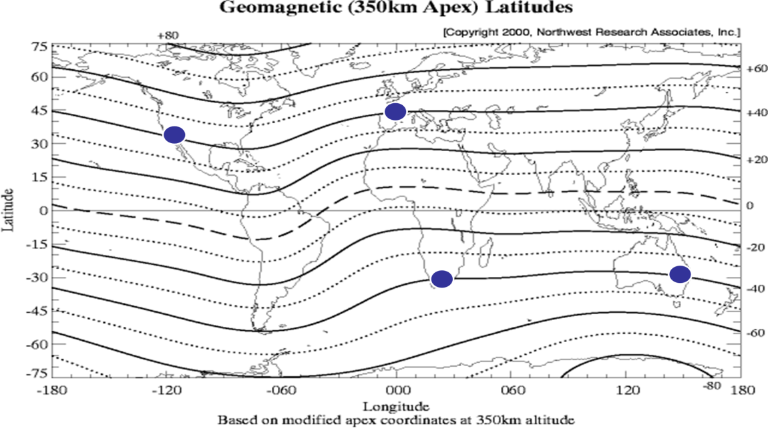
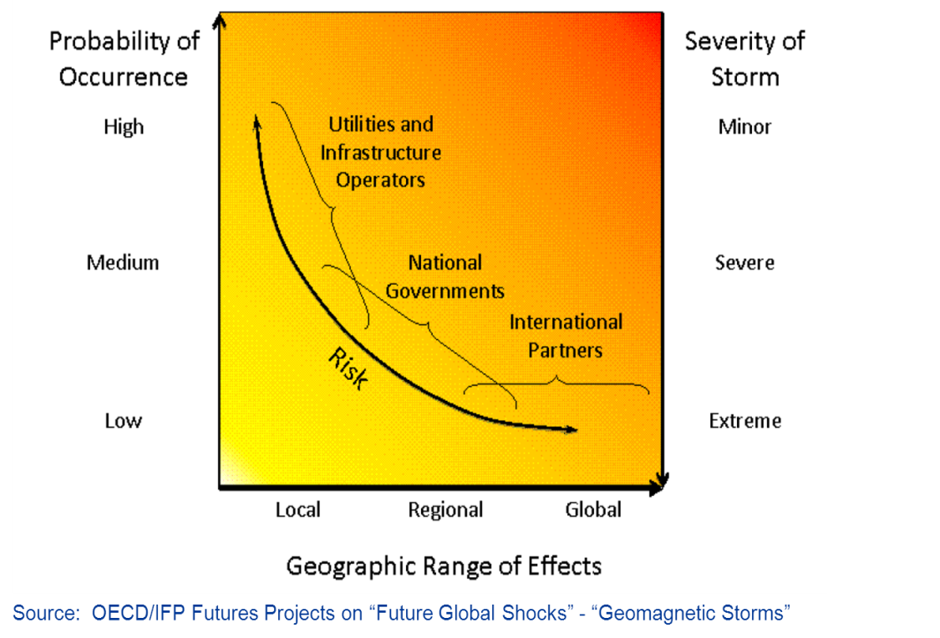
Resilience perceptive
An extreme geomagnetic storm (GMS) leading to geomagnetic induced currents within earth will impact the integrated power system within Southern Africa (at lower latitude “below 50 deg”) and has a low probability however a extremely high impact (HILF)
Minor GMS occurs constantly and has no impact on countries below 50 deg latitude, however during a extreme storm the worst reasonable scenario is that these countries will be vulnerable BECAUSE of inadequate:
  Infrastructure consideration within hardening of IPS ;
  Clear operating procedure to minimum impact and process alert received and
  Emergency and stakeholder/ crisis management exercised to understand the decision required (speedy of decision is crucial)
Notes:
Shell – more (5 leed) – height (majority in SA)
Core –
Difference flux path – reactance
Single vs three path
Single is more sever than three phase units

Slide 12
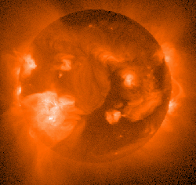

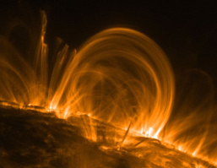
The required response
A risk intelligent & resilient organisation
A risk intelligent and resilient organisation (and country)
Resilience: the ability to:
New state
Internal /
external
environment
Anticipate, identify, and adapt rapidly to threats, vulnerabilities, and opportunities
Operate
under stress
without failure for extended periods of time
Respond
rapidly to
contain the
impact (severity/duration) of an incident / threat
Recover rapidly
in a coordinated manner
Deliberately evolve to a higher state of resilience in response to changes in the environment, near misses, incidents
Current state
Shock
Time
Real-time situational awareness: space weather, system response, power system, customers, supply chain, …
Business Continuity &
Disaster Planning
(supply chain, processes)
National Exercise(s)
Recovery Protocols & Governance
Incident Management Plan
Strategic Resilience Project –
power system operations,
hardening, monitoring, …
Integrated Emergency Response Structures
Strategic / Tactical / Operational & Crisis Comm’s
(National / Provincial / Internal)
Organisational learning
(exercises, case studies,
Near incidents)
Understanding how our business risks increase our vulnerability (constrained system, transformer health, … )
Solar flares identified as a corporate risk

Slide 13
Organisational Resilience
R⁶
KPI
Potential
Threat
System Vulnerability
Vulnerability
Adaptive
Capacity
Time
System Adaptive Capacity
Recognise
Reduction
Readiness
Response
Recovery
Reflect
Shock
Resilience is not a function but an organisational trait

Slide 14
Risk vs Resilience
Try to prevent the event from occurring
Understand that risk occurs and ensure we establish structures to manage consequence and frequency (intended or unintended)
RISK
RESILIENCE

Slide 15
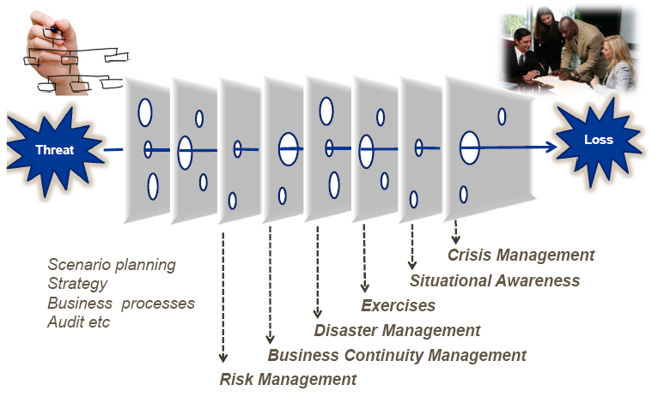
Organisational Resilience
….a “macro Swiss” model

Slide 16
Draft 1
Corporate Affairs Division
November 2011
Solar Storm Resilience Project Team
Images Courtesy: NSA

Slide 17
What do we what to achieve?
Research
Known and
Not Known
Operation
Make Decision
Resilience Project
How do manage the uncertainty?
Prioritisation
initiatives
Recognise Threat
Short Term
Mobilise
Organisation &
Country
Medium Term
Long Term

Slide 18




Eskom position options
Do nothing
Response
Moderate Response
Full Response
Time for implementation
Cost Implications

Slide 19
Resilience project
Project charter - solar Storm Resilience Project
Objectives
● Develop a clear short-term operational response guideline in the event of a notified severe event.
● Develop a medium and long-term system hardening solutions (power system & telecoms)
● Ensure effective reputation management & stakeholder communications
● Ensure effective business continuity planning ● Ensure readiness of emergency structures
Research &
Catalogue
System
Vulnerabilities
Monitoring,
Detection &
Triggers
National
Control
Response
Plan
Technology /
Hardening
Plan
Reputation
Management
&
Stakeholder
Comm’s
Emergency
Response
Readiness
1
2
3
4
5
6
Project Streams
A
Project Management Office
B
Documentation management
Support functions
C
Integrated Risk Management
D
Audit
E
Legal
F
19
Business Integration (including: Process)
23/10/2012

Slide 20
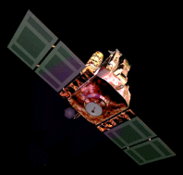

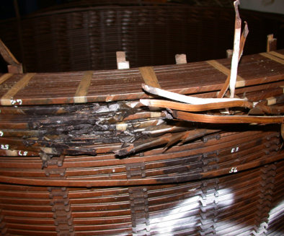
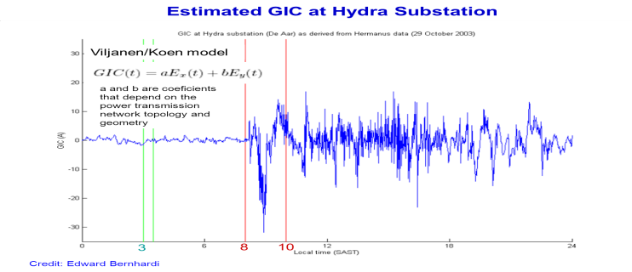
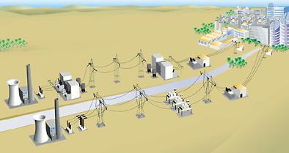
Resilience project
The chain of preparedness
What national and international monitoring can be incorporated into Eskom’s monitoring and response plan?
NC requires “interpreted” data as a trigger or alarm – e.g. formal pro-active warning from SANSA.
Verification is required between the Alarm initiator and NC for it to be fool proof.
Given the short time-frame for decision-making, a well thought-through response plan must be documented (SOG).
What communication is required in response to current media questions ?
What crisis communications is required if an event occurs ?
Solar Event
How should Eskom process the data (detect/trigger) ?
What solar activity monitoring is in place?
What specific responses are required?
What interaction is required with stakeholders?
CME
GIC → IPS
Response
GMS
System
Organisational
Country
Stakeholder
Eskom
Eskom
How vulnerable is the current power system?
What can be done to make it less vulnerable?
What is being done in other countries ? (Currently measurement are available )
Impact on Interconnected Power System

Slide 21
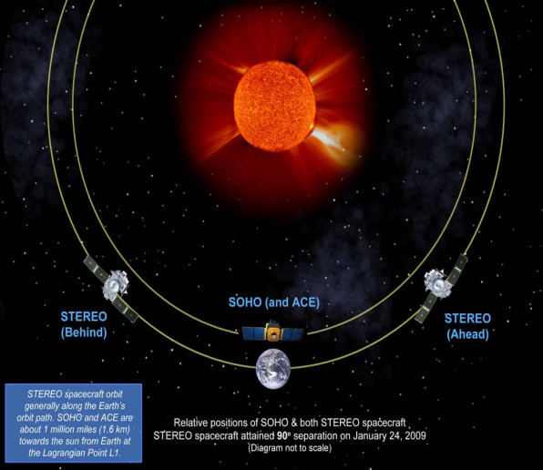
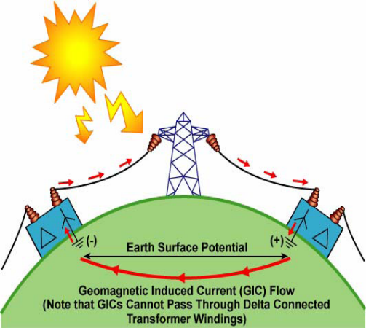
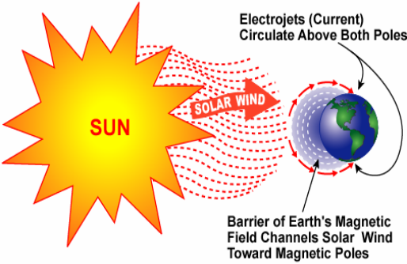
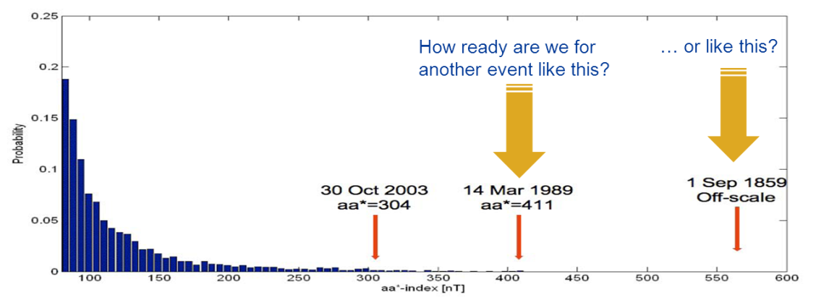
Solar Storms
Overview of the phenomenon (key facts)
● Solar activity peaks every 11 years
● An extreme 1-in-200yr event could result in an
unprecedented impact on modern technology
systems … even in “mid-latitude” countries,
normally considered less vulnerable to solar
storms.
● A real-time response requires rapid decision
making – potentially at country level.
● A CME reaches earth in 14-96 hours
● The impact can be quantified 20 min before.
Note: On a quiet spring morning it took < 2.5 min for the Canadian system to collapse in 1989.
● Quasi-DC currents are indiced via neutrals
● These give rise to half-cycle saturation.
● What operating procedures can be applied?
● What hardening measures can be deployed
and at what cost?
Transformers damaged (ZA)
Canadian
System Collapse
The 1-in-200
year event
Increasing likelihood
Increasing severity

Slide 22
Risks
The need for resilience – more than an engineering response
Scope Considerations Required (Treatment)
Legal & Compliance
Negligence
Compliance to NDMA
Nuclear Regulator
PFMA
Post disaster enquiry
Fukushima incident
Disaster Management Plan
Assumptions sheet
Peer review
Reputation
2012 Media interest
Solar Storm events
Solar Storm incident (local / national loss)
SANSA media engagement
Over-reaction vs. under-reaction
Holding statement
Eskom spokesperson briefed / process
Eskom/SANSA (MOU/SLA)
Safety
During storm
Post storm failures
Impact on customers
Deep level mines
Koeberg
Situational Awareness
SOG & incident management plan
Condition monitoring
Critical load protocols
Supply
Continuity
Local supply interruptions
Loss of generator trfs
System collapse
Telecommunications failure
System Ops Guide (SOG)
Hardening plan
Design/Planning Review
Financial
Limited transformer loss (insurance)
Massive loss – super storm
Claims
Insurance
Review insurance conditions
Legal / Compliance
Notes:
22

Slide 23
Draft 1
Corporate Affairs Division
November 2011
Eskom Experience
Images Courtesy: NSA

Slide 24
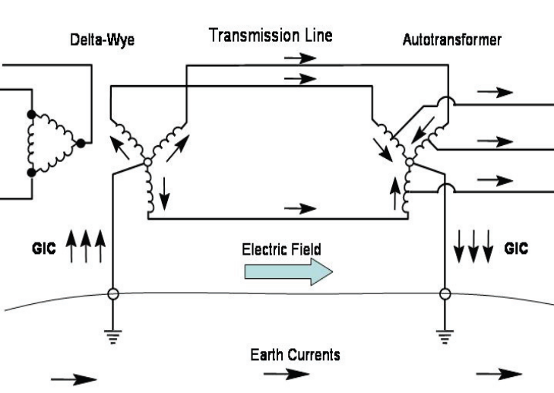
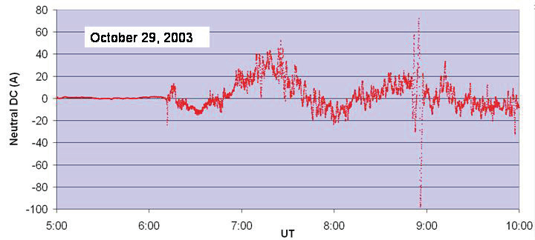
The impact on power systems
How do GIC’s enter the power system ?
GIC’s enter the power system through transformer neutral connections to earth.
Transmission lines provide a low resistance loop circuit for GICs via the transformer & reactor neutral connections at either end of the line.
The GI current is a quasi-DC current that changes in response to the changes in the magnetic field (1-10mHz and up to 100A have been measured).
Time plot of measured GICs on the neutral of a bank of three phase transformers during the start of the Halloween Storm in 2003.

Slide 25
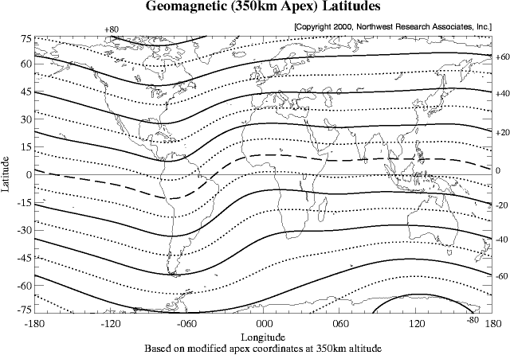
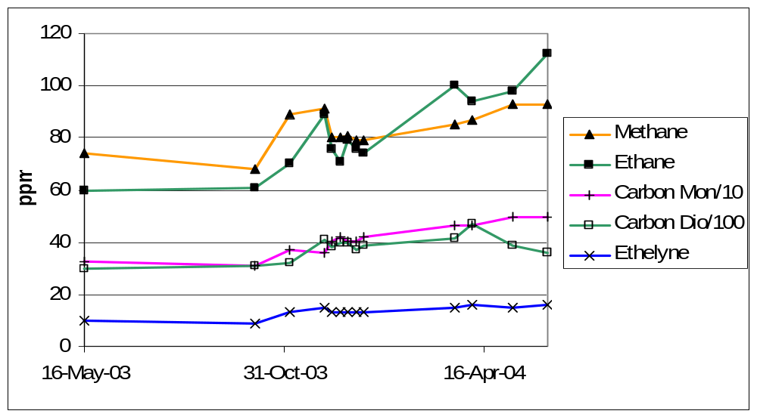
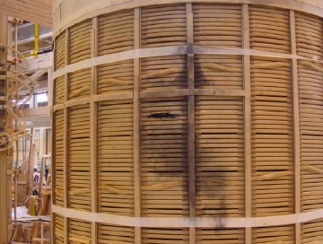
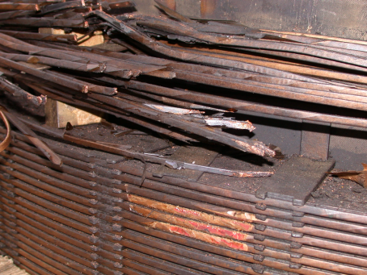
The impact on power systems
Have we been affected?
Whilst there is a general perception that mid-latitude countries are less affected, depending on the severity of the storm, how the the solar plasma is deflected,a nd the factors impacting the power system – significant GIC’s can occur.
Dissolved Das Analysis - Matimba #1 (Halloween Storm 2003)

Slide 26
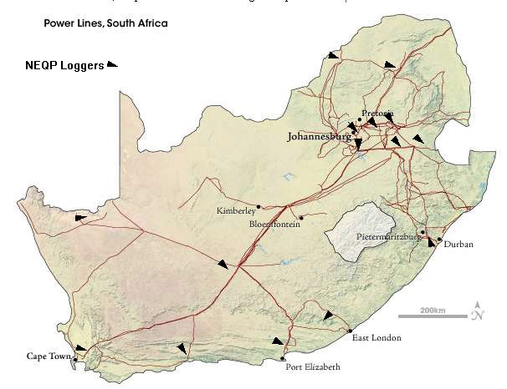
Location of existing loggers
15 loggers are installed across the IPS
    Loggers are installed at Power Stations – Arnot, Kendal, Lethabo, Matimba and Tukuka
Project will be initiated to install additional logger:
  New installation at PS – Duvha, Majuba, Camden, Drakensberg, Koeberg
  New prioritised MTS = 19

Slide 27
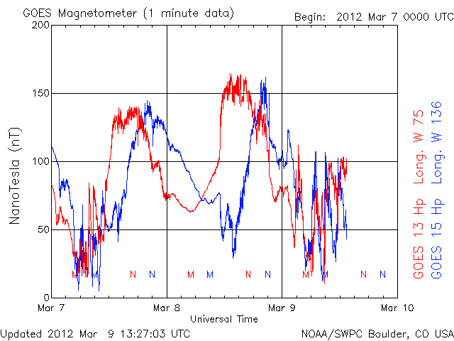
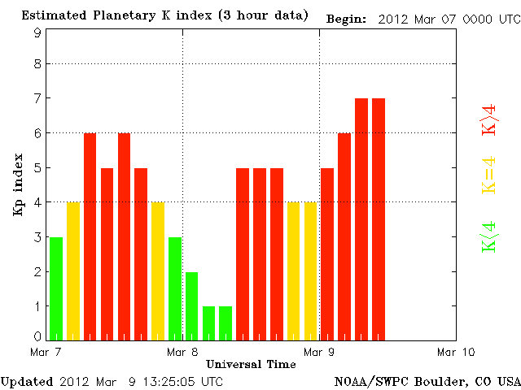
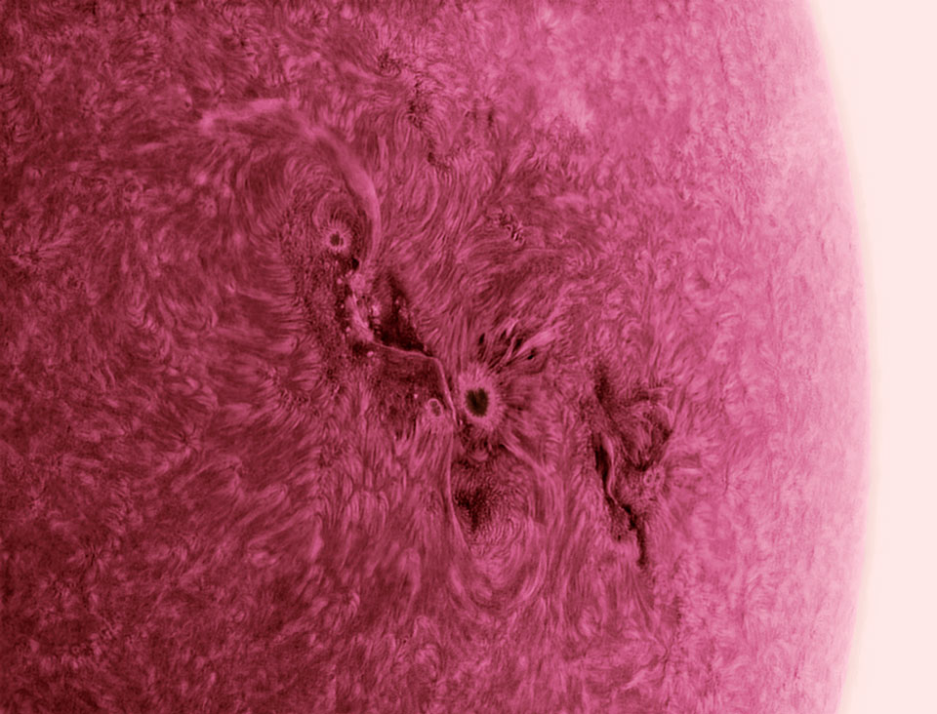
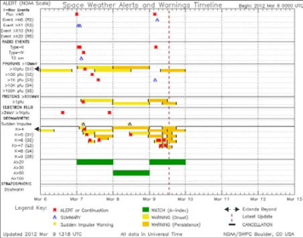
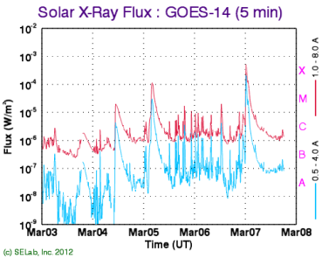
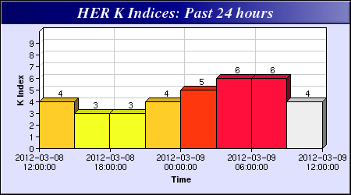
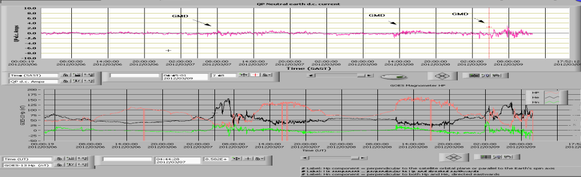
Significant Solar Event – 07 – 09 March 12
Sunspot 1429 has been active
07/03/2012 - Start time of noticeable induced neutral earth currents from this GMD was at about 06:20 2012/03/07 (SAST) with a peak of -1.4 ampere.
08/03/2012 - Start time of noticeable induced neutral earth currents from this GMD was at about 13:01 2012/03/08 (SAST) with a peak of -1.8 ampere .
09/03/2012 - Start time of noticeable induced neutral earth currents from this GMD was at about 03:02 2012/03/09 (SAST) with a maximum peak of +3Amp.
GMD warning from NOAA maximum of Kp7(G3)
None of the other generation sites (Arnot, Lethabo, Kendal and Tutuka) indicated any GIC currents that can be directly related to a GMD activity.
MATIMBA

Slide 28
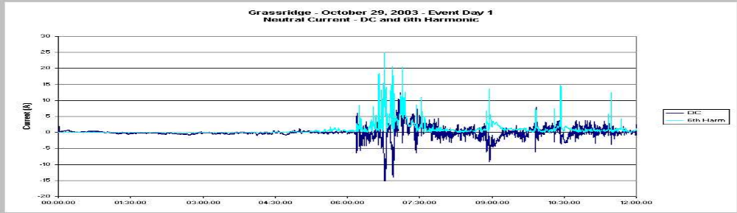
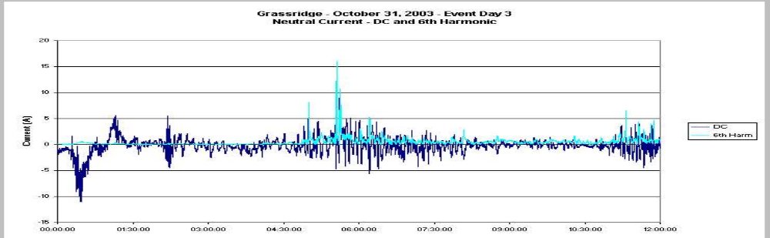
Sunburst program EPRI – Grassridge MTS

Slide 29
Draft 1
Corporate Affairs Division
November 2011
Eskom Resilience Response
Images Courtesy: NSA

Slide 30
Decision Options
Short-term response
No accurate models available yet
No certainty in space weather prediction
No probabilistic model (reliability)
How certain can we be?
Who has the authority?
Do Nothing
Reinforce
Isolate critical
plant
Extreme response
Monitor only
Maximum redundancy
(IEEE)
Remove / separate
7 GW 7 Islands 7 hrs
Notify spokesperson
Monitor GIC’s
Monitor trf condition
Stop maintenance on plant
Maximise VAR support
Bring in lines out of service
Bring generation online
Implement specific contingencies
e.g. isolate Koeberg Auto Start (Acacia PS)
National Incident Management Plan
Studies
EPRI
Research (UCT)
Current status
Loadshedding
G1 - G3 G4 – G5 SUPERSTORM
Notes:
30

Slide 31
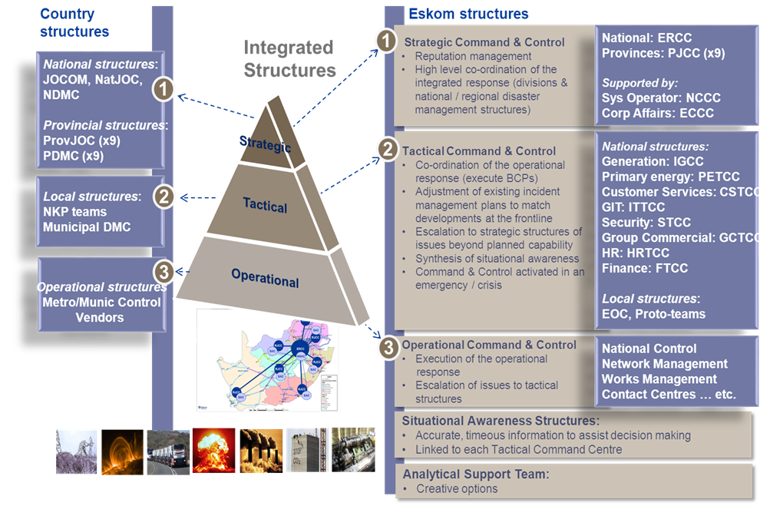
Emergency Protocol

Slide 32
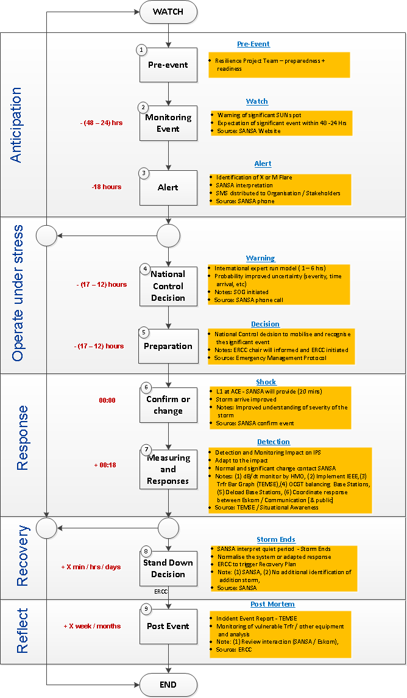
Initial Incident Management Plan
Anticipation
Resilience Project Team
Monitoring and Solar activity
Operate under stress
National Control is alert and decision made to implement SOG
Response
Event impact the Earth and power system is experience geomagnetic influence
Recovery
Reflect
At L1 storm predication
SANSA measure a reduction GMD
Identification of significant events
Decision taken to prepare the IPS for possible impact
Solar Storm arriving
Detection of intensity of storm on IPS
Adapt operational procedure
Observed on further activity on SUN
ERCC stand down and network respond

Slide 33
Conclusions
The Solar Storm project aims at addressing the range of aspects of the threat posed by a major solar flare incident.
  i.e. the preparedness of emergency structures, situational awareness, the operational response by the system operator, technical hardening of the system, and both general and crisis communications .
The key next steps are to:
  Finalise a detailed list assumptions and implications for Eskom decision making – based on Eskom’s investment in research in this area in past years.
  Implement situational awareness and appropriate triggers via SANSA.
  Identify key vulnerabilities and developing hardening proposals for Technology to specify, cost etc
  Finalise the communication strategy – incl. the ability to respond to media requests.
Going forward, an ERCC exercise will be undertaken to on-board the Executive.
Formal engagement with key customers and various industry sectors will be conducted through the Energy Technical Task Team established under the National Disaster Management Advisory Forum (and chaired by the DoE).
Eskom would like to host a
Solar Storm Conference in 2014 (South Africa - Cape Town)

Slide 34





Thank You – Any Questions

