Slide 1
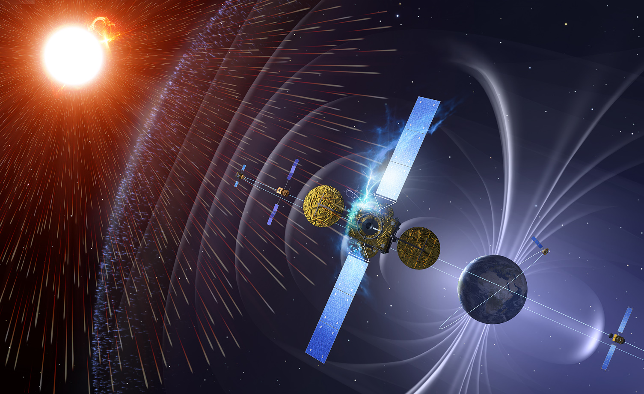
Effects of a Super Storm on Vital Satellite Systems, and other Critical Infrastructure
-
How do we maintain Public Awareness and Improve our Protection?"
TIEMS Oslo Conference 2012: Space Weather and Challenges for Modern Society
22-24 October 2012
Juha-Pekka Luntama
Space Weather Segment Manager
ESA Space Situational Awareness Programme

Slide 2
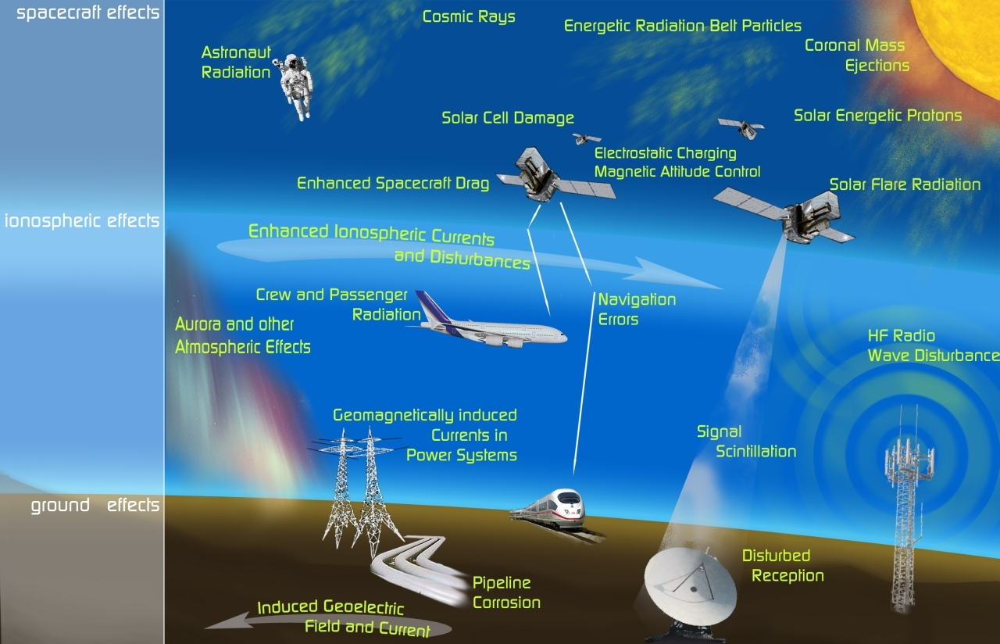
Space Weather Impacts on Infrastructure

Slide 3
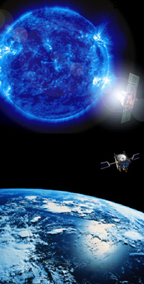
Space weather impacts on satellites
Space weather can damage a satellite or a spacecraft in many different ways:
  Degradation of satellite solar panels
  Charging of the satellite structure causing electrostatic discharges => damage in the structure or electronics
  Radiation damage to the satellite electronics => Single Event Upsets (SEU) or permanent damage
  Disturbances in the satellite sensors (telemetry and payload)
  Disturbances in the satellite operations, especially onboard software patching
These impacts can happen individually or in combination

Slide 4
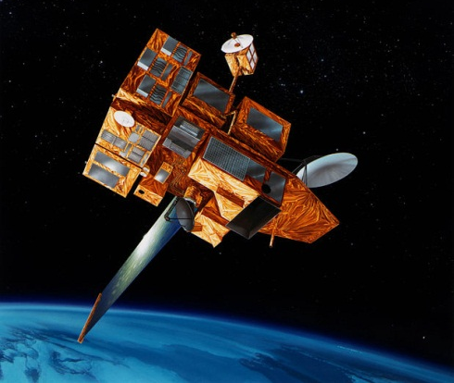
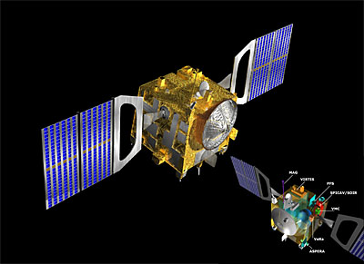
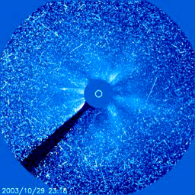
Examples of Space weather impacts
Space weather damage is very difficult to verify => correlation of SWE events with anomalies
Cases of total loss of a mission:
  INSAT 2D
  ADEOS-2
Substantial anomalies
  Loss of MetOp-A power amplifier
  Loss of control of Galaxy 15
  Anik E1 and E2 anomalies with E2 out for 5 months
Frequent disturbances
  Venus Express star sensors blurred by solar protons
  ACE solar wind monitor saturated by solar protons
  SOHO coronagraph image disturbances
  SEUs in many other satellite missions

Slide 5
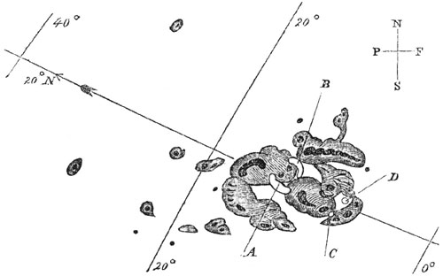
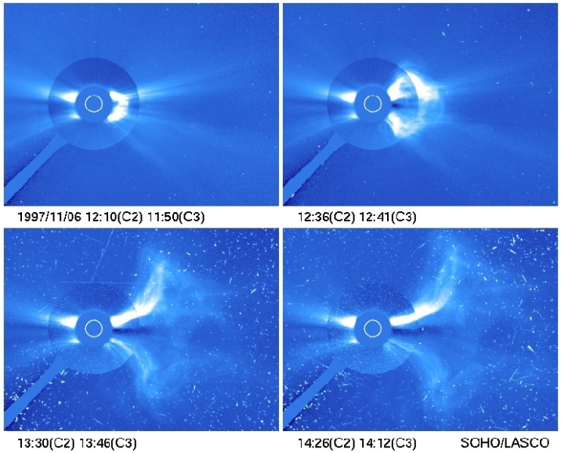
What would be a solar super storm?
1859 Carrington event is usually considered as a major solar storm
Some characteristics of the storm reverse engineered
  Flare >X10 [Cliver and Svalgaard, 2005], while 4 November 2003 flare was X28
  Most significant solar proton event (SPE) of the last 450 years [McCracken et al., 2001]
  Very fast CME (arrival within 17.6 hours)
  => a good super storm candidate
A storm like this would certainly impact satellite systems
Several statistical assements of the potential impact published [e.g. Odenwald et al., 2005]

Slide 6
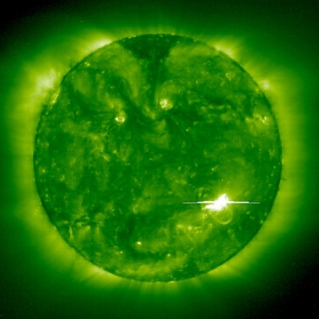
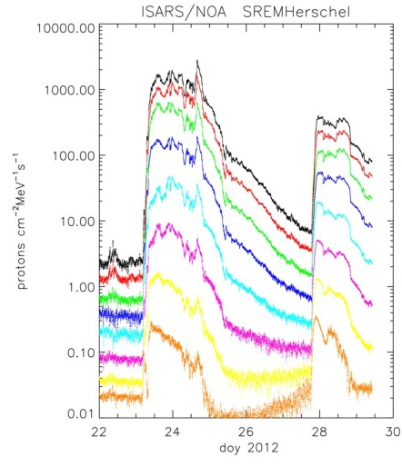
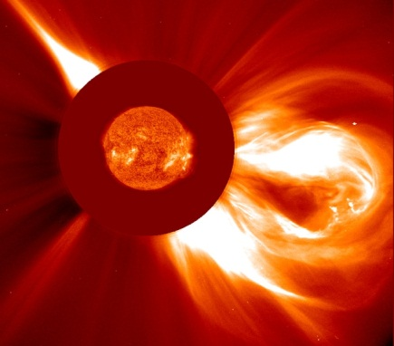
Solar storm: satellite operator perspective
Flare
  We can not forecast flares well => detected by monitoring
  Impact on Earth space at the time of detection
SEP
  Forecasting an SEP is a challenge
  Models can provide about 5 hour warning time
  From detection in L1 the warning time is a few minutes
CME
  Detectable by a coronagraph (if available)
  Warning time for a fast CME less than 20 hours
  From verification in L1 the impact will come in 10 minutes
Potental extended storm period
  Repeated flares, SPEs and CMEs <=> 2003 Halloween storm

Slide 7
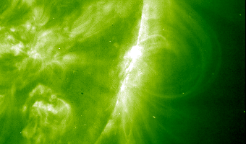
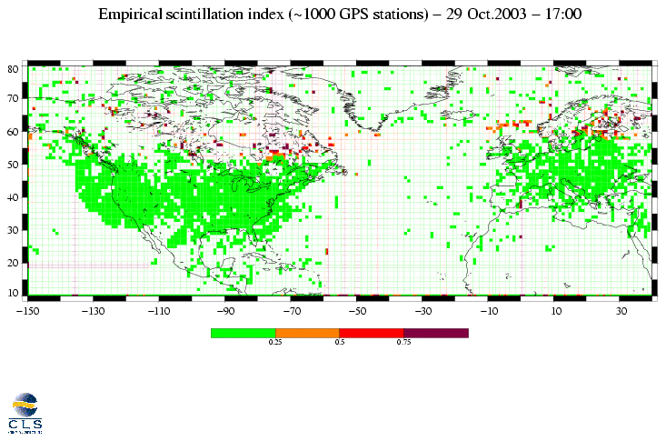
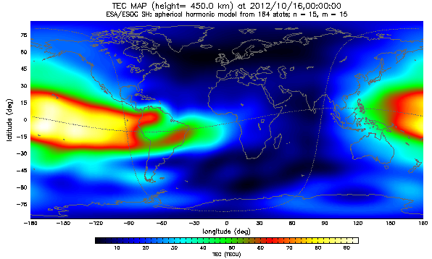
Spacecraft impacts of a solar flare
Direct impact of a flare on space systems is limited
  Solar cell degradation beyond normal levels
  => can push older satellites to EoL
  X-ray or (E)UV sensitive sensors can be damaged
  Increased atmospheric drag impacts on LEO missions
Ionospheric disturbances can make space systems temporarily non-accessible
=> especially an issue for repeated flares
=> main impact on dayside at low-mid latitudes
=> impact of a single flare disappears in 2-3 hours
Image: CLS

Slide 8
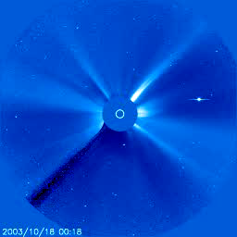
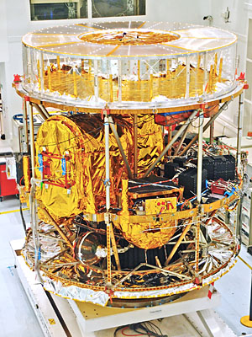
SEP event impacts on spacecraft
Damage predominantly by high energy protons
=> GEO and interplanetary space most vulnerable
Small SEP events interfere with satellite sensors
=> additional maintenance due SEUs,
=> potential safe modes
=> risk of loss of control of the spacecraft
Major SEP events can cause permanend damage and a loss of a mission
  Increase of the frequency of SEUs to non-maintenable levels
  Solar cell degradation comparable to 1 year with single event
  Radiation damage to electronics and semiconductors also due to secondary particles inside the satellite
  SEPs with very hard spectrum can also impact MEO and LEO
Increased risk when combined with flares and CMES

Slide 9
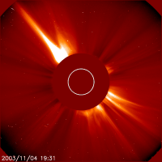
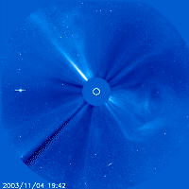
Impacts from a fast CME
Two impacts in space:
  Energetic electrons in GEO and LEO
  Increased atmospheric drag in LEO
Energetic (killer) electrons
  SEUs, logic errors, data corruption, phantom commands, ...
  Charging of the spacecraft materials => risk of electrostatic discharges
Combined impact of SEP and CME
  => multiple mission critical anomalies/satellite/day
=> challenging battle for operators
Orbit decay
  impacts on orbits below 600 - 700 km
  satellites below 300 km could risk an imminent re-entry

Slide 10
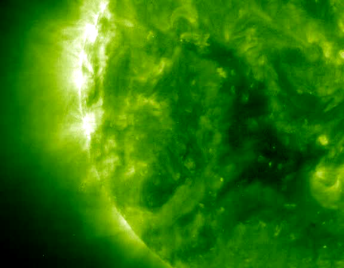
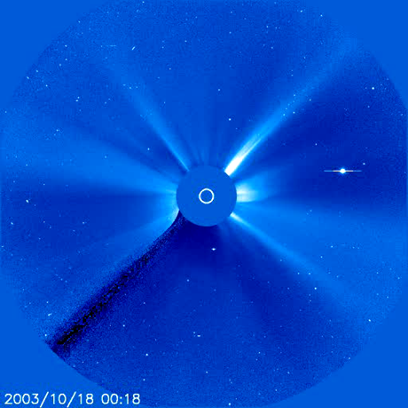
What if there is more than one event?
Each individual element of a major storm is dangerous
Combination of impacts including ionospheric disturbances make satellite operations and recovery
very challengin
Halloween storm 19 Oct – 5 Nov 2003
  18 X-ray events: M5.0 – X28.0
  18 radio blackout events: R1 – R5
  5 CMEs with geoimpacts: Kp 6 – 9
  5 > 10 MeV proton events
  => approaching a super storm
Continuing disturbances will cause
  accumulated damage e.g. on solar arrays
  increasing risk of permanent radiation damage
  complications in the satellite recovery
  secondary effects on satellite depending ground systems

Slide 11
Satellite impacts during Halloween storm
Mars Odyssey: Safe mode during radiation storm. Memory error and loss of MARIE instrument
Stardust: Safe mode due to read errors
SMART-1: Automatic shutdown due to high radiation levels
Mars Explorer Rover: “Sun Idle” mode due to excessive star tracker error
Mars Express: Gyroscope stabilization due to blinded star tracker
ADEOS-2: Satellite lost
ACE: EPAM instrument permanently damaged
SOHO: Instrument in safe mode, CDS/GIS anomalies
CHIPS: Computer offline and contact lost for 18 hours
DMSP F16: SSIES sensor lost data twice, microware sounder damaged
GOES-9, 10 and 12: High bit error rates (9,10) and magnetic torguers disabled (12)
Inmarsat: two satellites had momentum wheel anomalies, one had CPU offline
More anomalies: TV and Pay Radio satellites, US DoD satellite operatons, ...
[Source: NOAA Technical Memorandum OAR SEC-88]

Slide 12
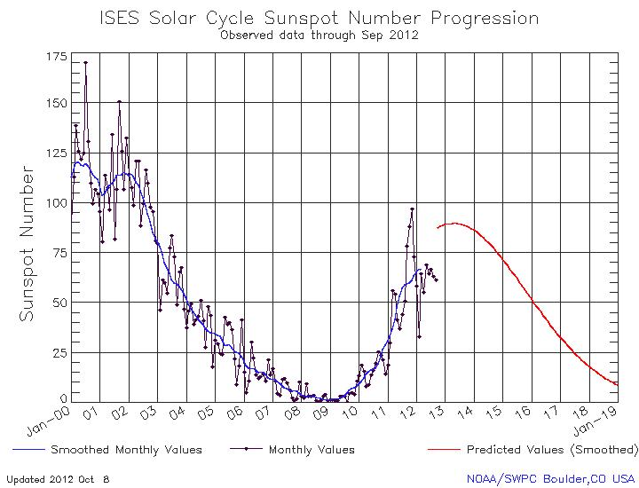
Where are we in the solar cycle now?

Slide 13
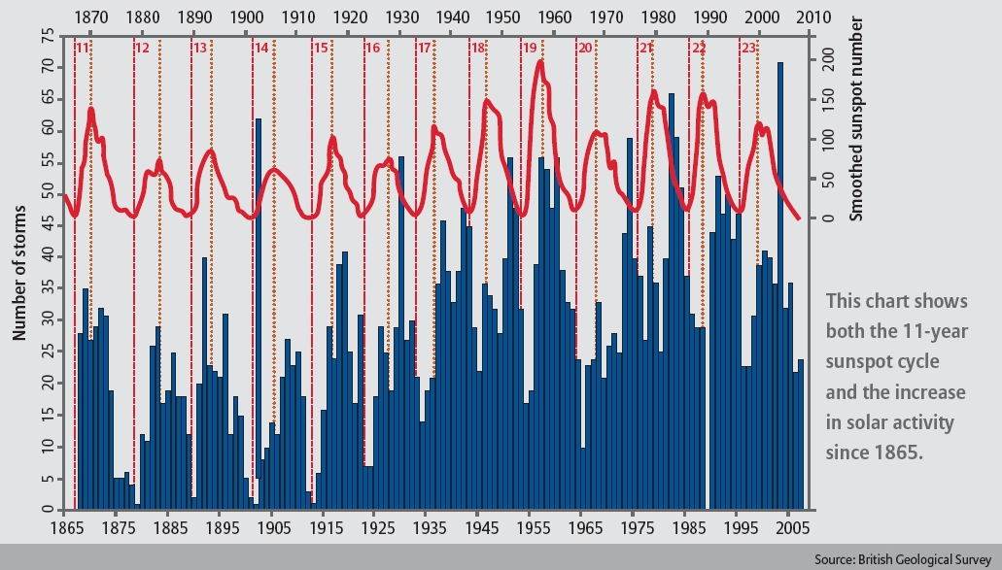
Major Geomagnetic Events since 1865
3.9.1859
Carrington event
images: (ESA & NASA)

Slide 14
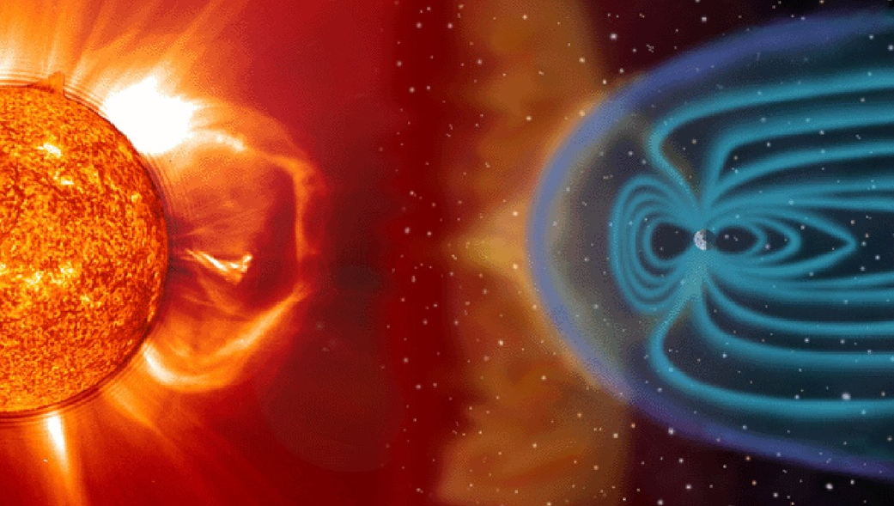
Why are we concerned now?
Space weather has not become more dangerous that it has been in the past => not a direct danger to any form of life on Earth
However, our infrastructure has become more sophisticated and more dependent on space based systems
  Satellite telecommunication
  Earth observation
  Satellite navigation including a global time reference
  Ground based system depending on satellite links
A major solar storm could
  disable temporarily a large number of satellites
  damage permanently or push to EoL up to 80 satellites due to ACS or EPS failures [Odenwald et al., 2005]
  => recovery would take from days (recovery of disabled satellites) to years (replacements) and cost several billions of Euros

Slide 15
What can we do to mitigate the risks
Space weather monitoring
  Right information to right people at the right time
  Reliable and timely warnings and alerts
  Databases and tools for anomaly analysis and design of future space systems
Space weather forecasting
  Scientific challenge
Maintaining Awareness
  Awareness should not follow the solar cycle
  Both operational actors and public
Analysis of the risk for new infrastructure
  New systems are more efficient, but sometimes increasingly sensitive to disturbances
Long term planning to maintain capability and assets
  Replacement of aging assets with sufficient overlaps – especially in space

Slide 16
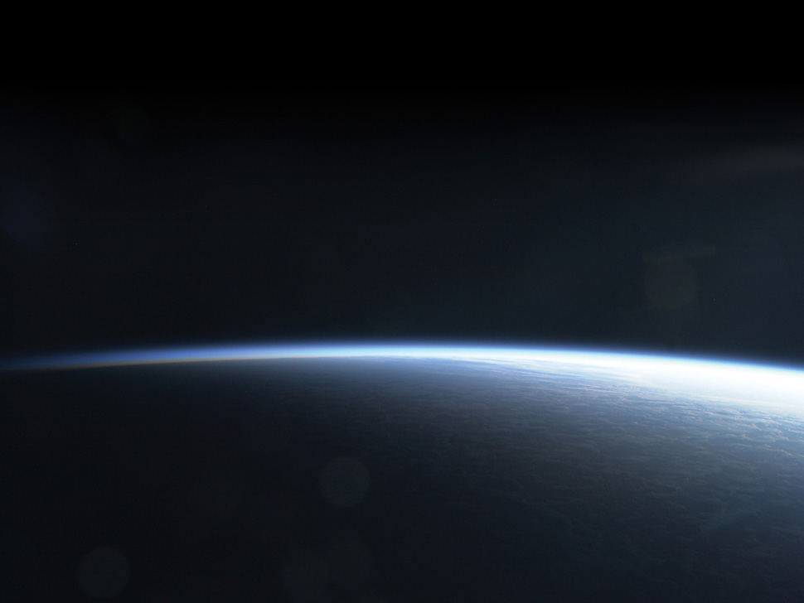

THANK YOU FOR YOUR ATTENTION

