Slide 1


Building Space Weather Preparedness and Resilience in Europe
Mike Hapgood mike.hapgood@stfc.ac.uk
© 2012 RAL Space
Notes:
1

Slide 2
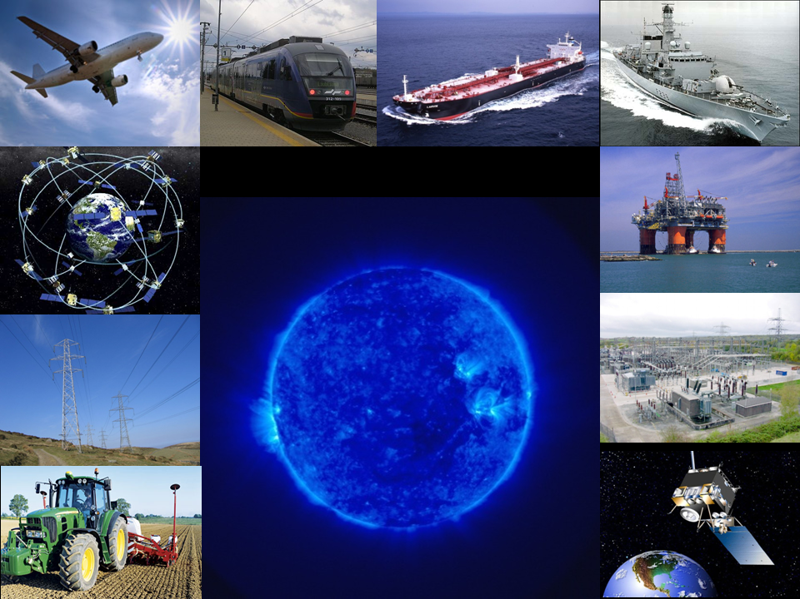
What is space weather?
Severe disturbances of the upper atmosphere and near-space environment that can disrupt technology

Slide 3
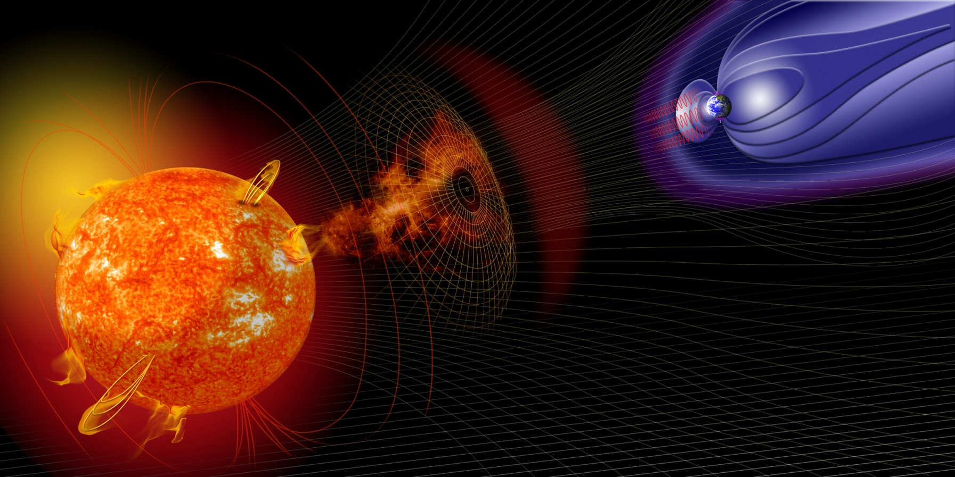
Sun-Earth connection
Solar X-rays & radio
(8 mins)
Solar wind: keV plasma + mag field
(1-4 days)
Solar energetic particles: MeV – GeV (10 - 60 mins)

Slide 4
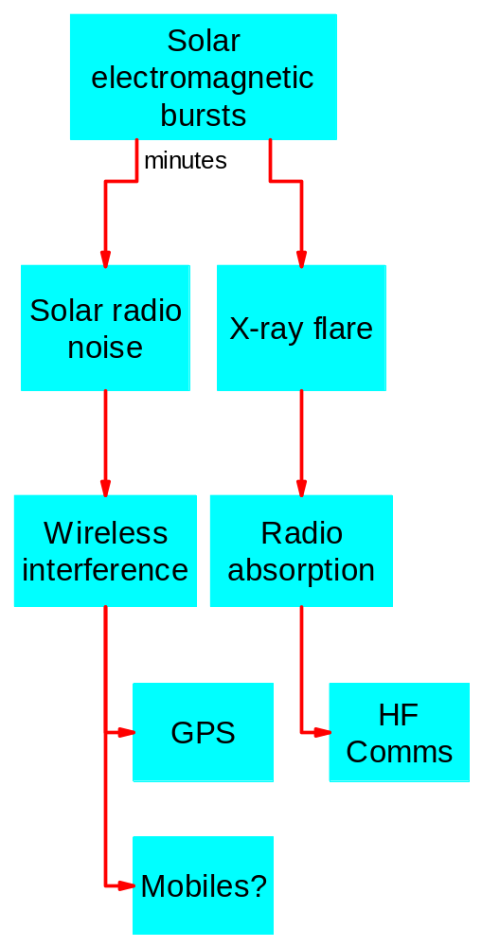
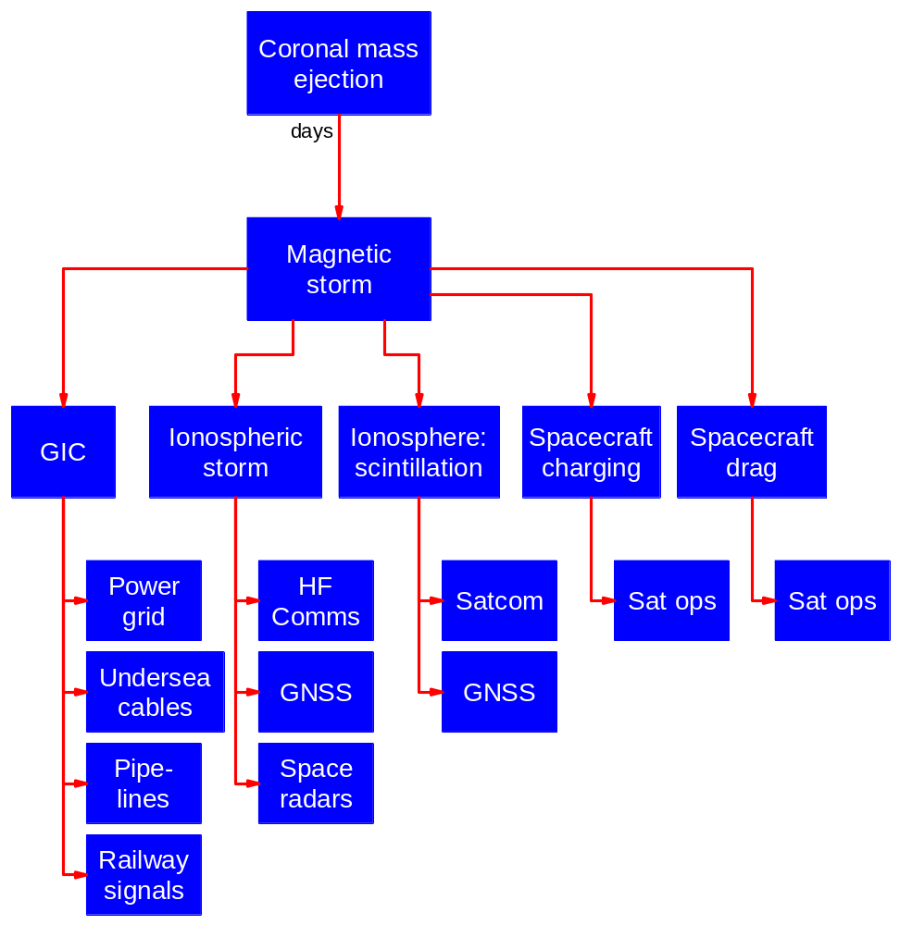
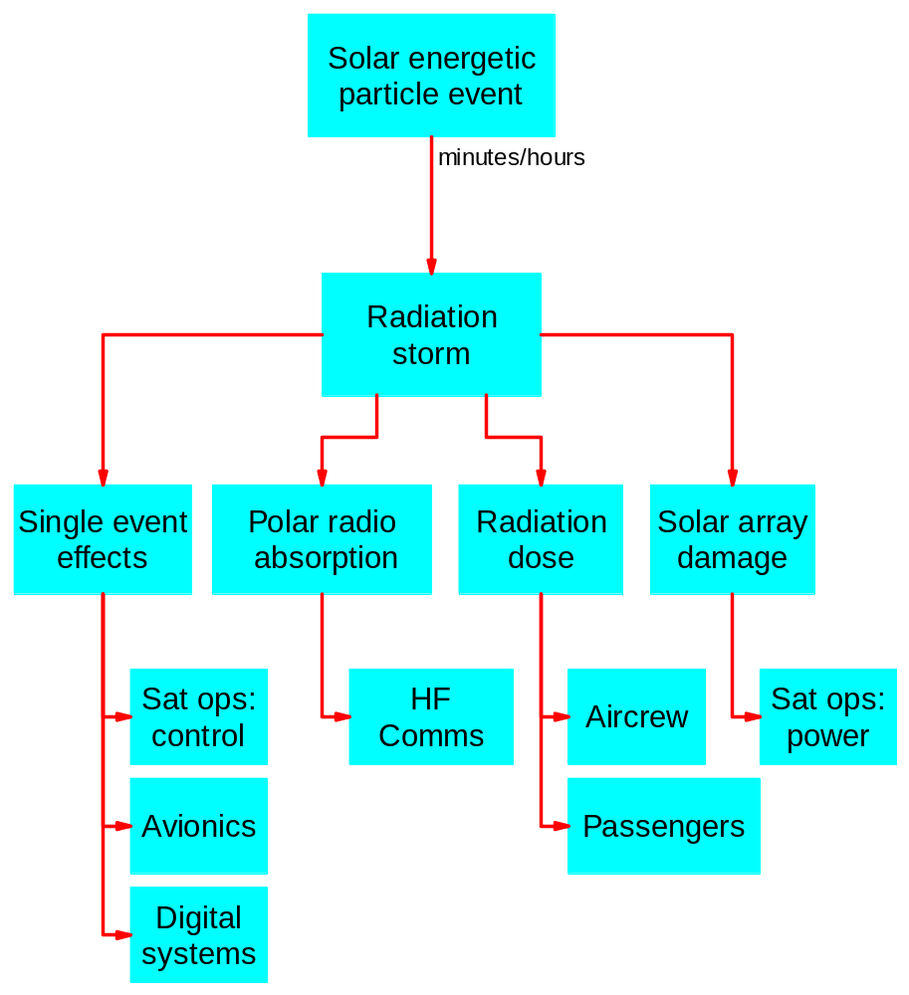
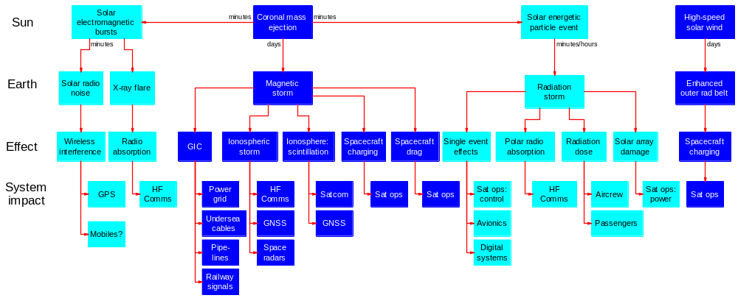
A diversity of effects

Slide 5
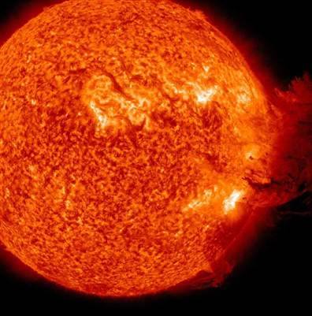
A range of impacts
Nuisance effects are common
  For example power grid congestion (spot price > 24h-head price)
  Businesses need awareness and mitigation (e.g. Lloyds report)
Severe effects rare
  But transcend personal & organisational experience, science is vital
  Many historical examples: e.g. Sep 1859, May 1921 & Mar 1989
  Have potential for high impact on critical infrastructures
  Main aim of this talk
Media coverage conflates these extremes!
  especially given superb images

Slide 6
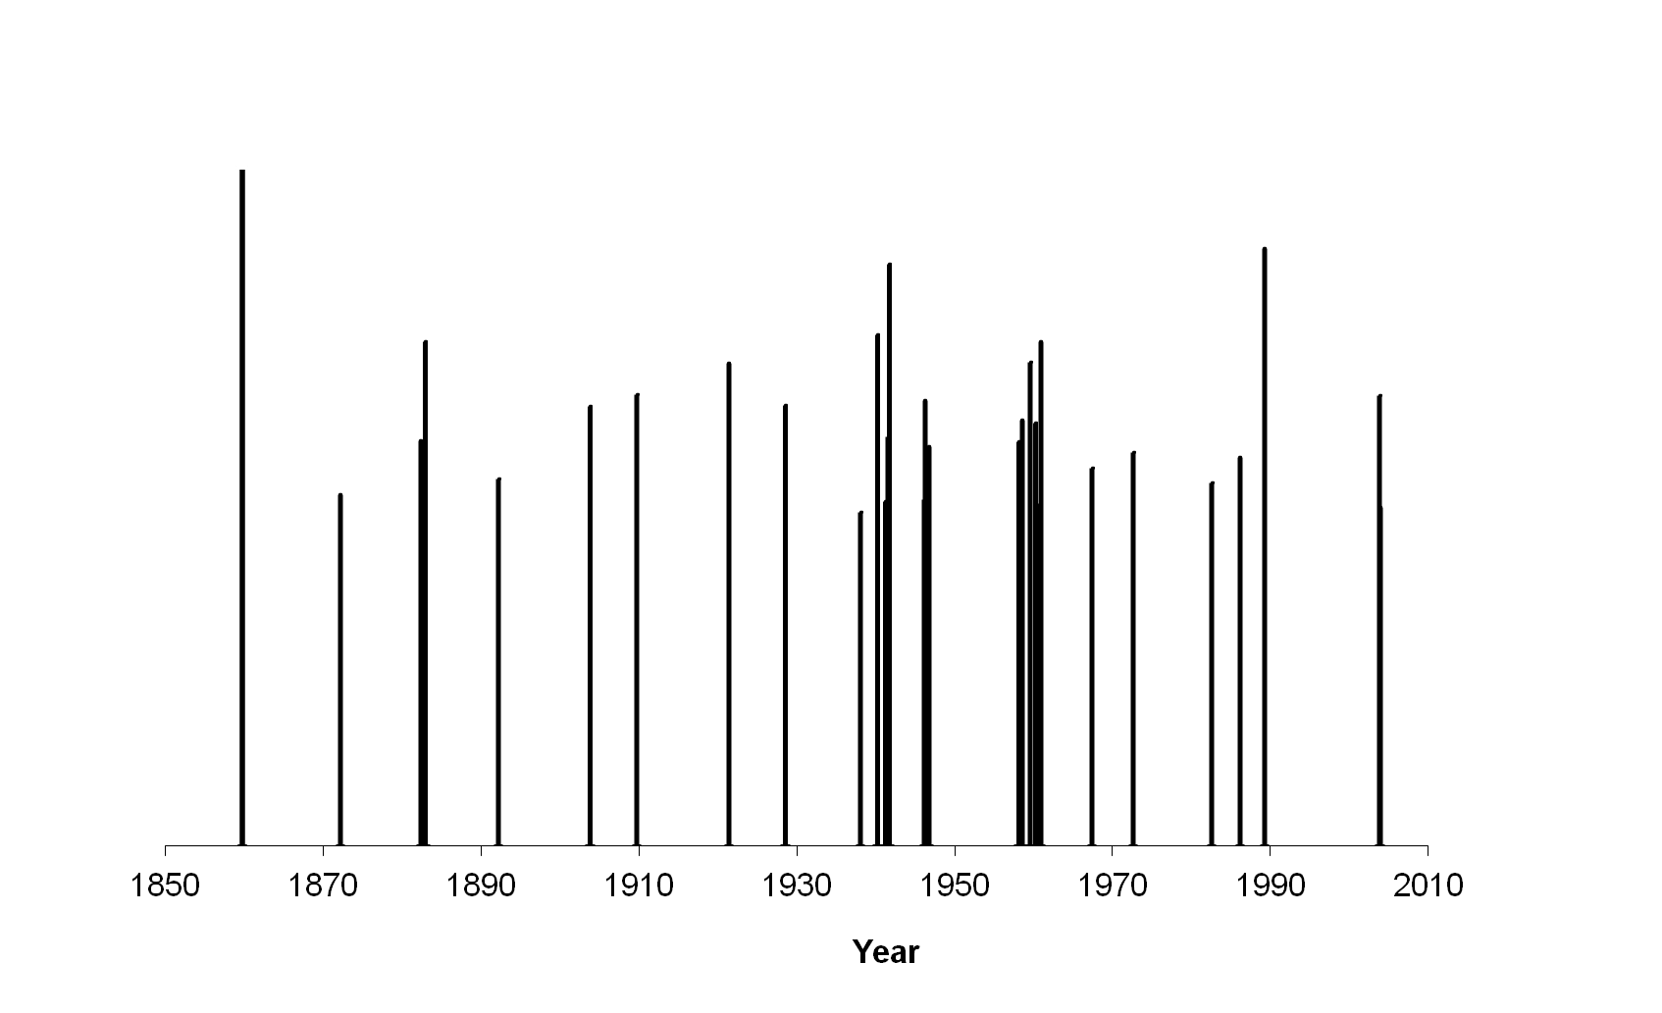
Bad space weather 1859 - 2003
Power grid disruption in Canada, US, UK, ..
Railway signal disruption in UK
Phone exchange burns down
UK radars jammed by Sun
Power grid disruption in South Africa, Sweden, ..
Comms disruption: telegraph/phone
Railway signal disruption in Sweden
Railway signal disruption in Russia
Satellite
services disruption
Comms disruption: HF radio
GPS disruptions in US

Slide 7
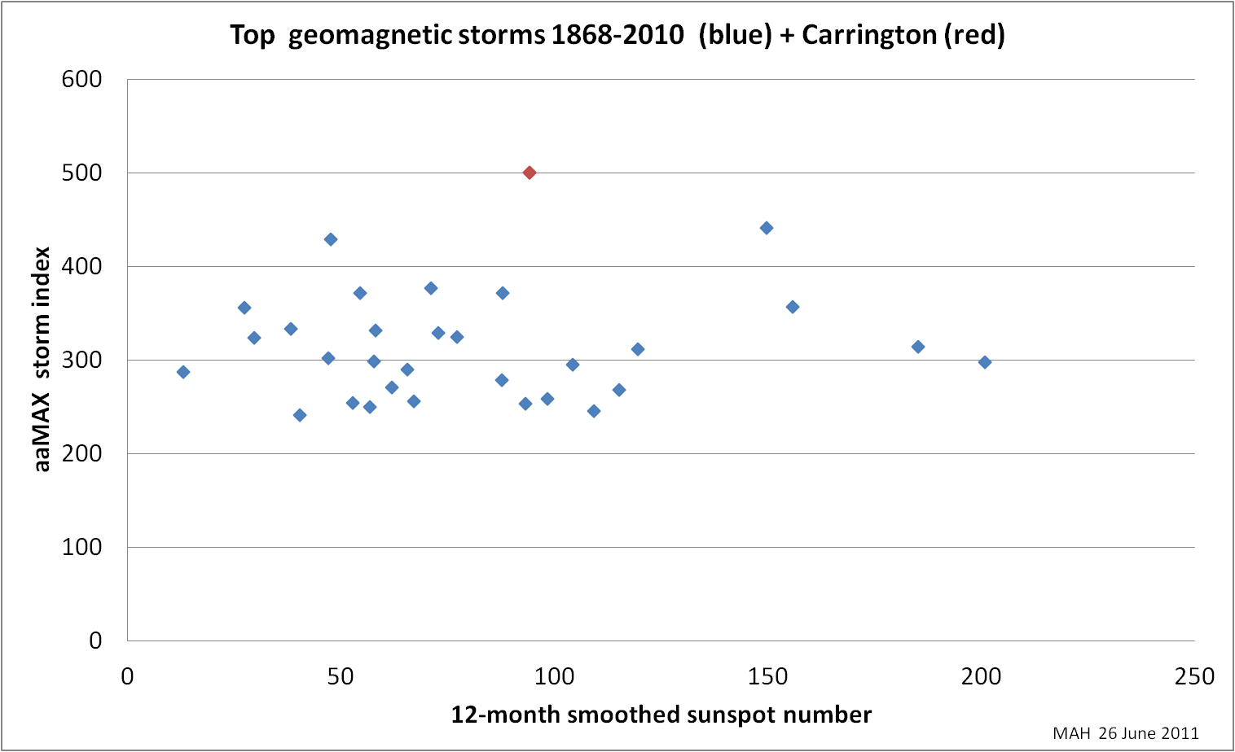
Bad space weather can happen anytime
Complacency about solar minimum is a risk!

Slide 8
Learn from near-misses
Have seen Carrington-like events? Probably …
4 Aug 1972: event at Earth
  14.6 hour CME transit from Sun (fastest known)
  huge radiation event
  magnetopause inside GPS/Galileo orbit,
  CME magfield mostly north, so only modest magstorm
23 July 2012: event on solar farside
  Reaches Earth’s orbit (STEREO-A spacecraft) in 19 hrs
  huge radiation event
  huge magnetic field, north then south (potential to drive magstorm)
  luckily well away from Earth (120 = 9 days)
Others: May 1921?, …
  Need to dig further into old data and historical records (as for climate change)

Slide 9
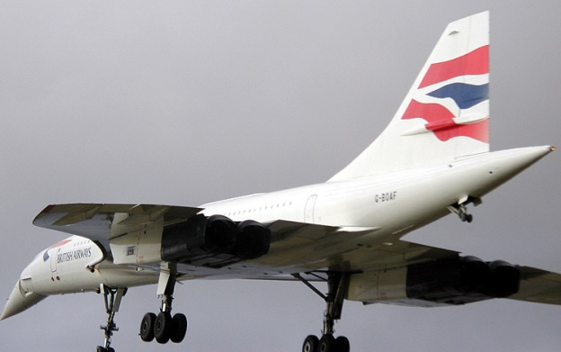
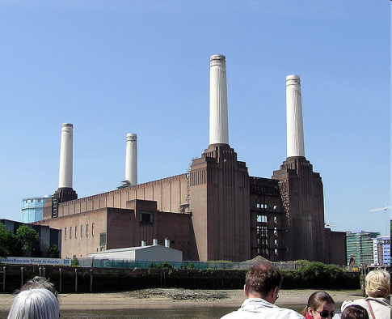
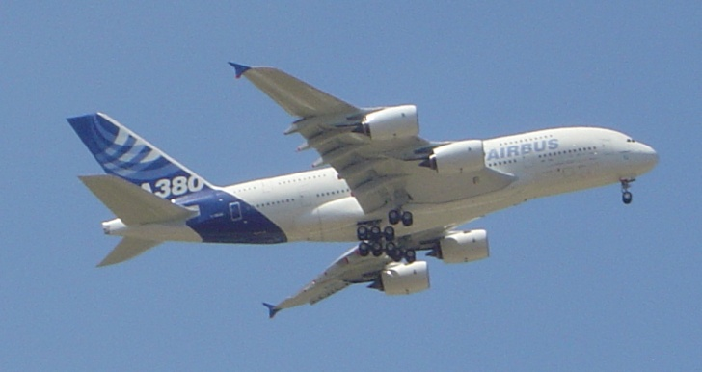
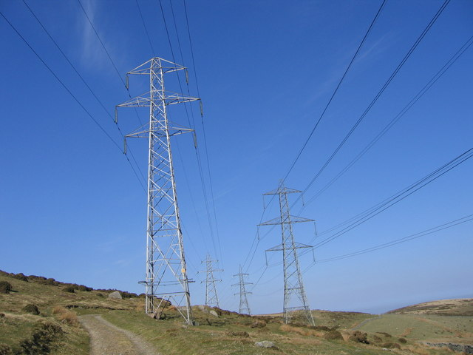
WHY WORRY NOW?
Space weather is as old as the Earth – but advanced technologies expose sensitivity to effects from space
No sensitivities
Limited sensitivities
No sensitivities
Power, control & comms
Comms, navigation, radiation, digital systems
Power & control

Slide 10
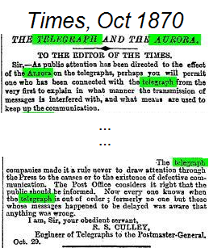
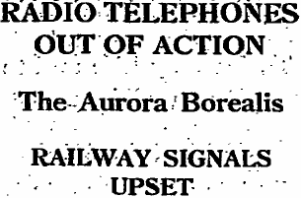
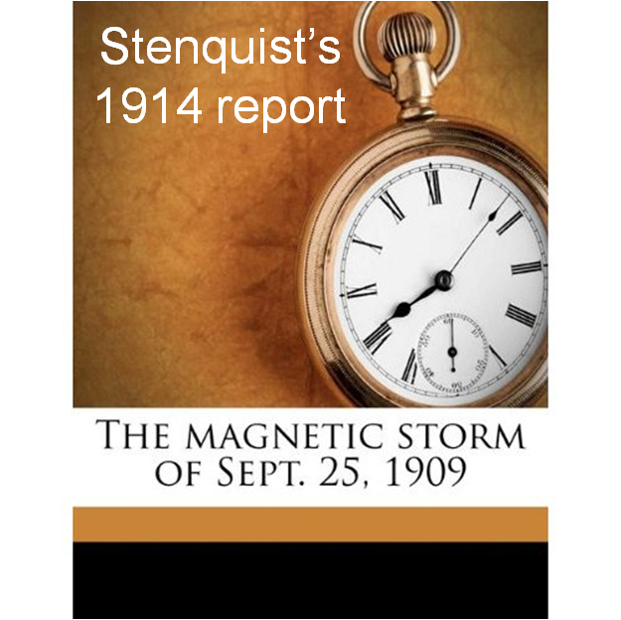
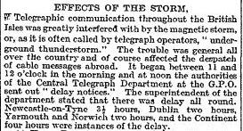
It was a source of fascination …
Destruction of Karlstad telephone exchange, May 1921:
“…suddenly smoke issued from the test and change-over switch and the night trunk service positions. In the cross-connexion room, parts of cables between the lightning conductors and the ceiling had caught fire. Before the fire could be brought under control it had devastated large parts of the equipment”, David Stenquist, quoted in 1959.
Times, September 1909
Manchester Guardian 27 Jan 1938
… but a minor nuisance

Slide 11
But now we have an interconnected world
Space weather affects key infrastructures
  Power
  Location, navigation & timing => communications
  Transport
Links into wider issue of interconnectivity
  Economic and societal systems are highly interconnected
  Disruption spreads out across those systems
Space weather fits in resilience agenda:
  How to mitigate both natural hazards & human threats that can disrupt our societies and our economies?
  And how to tell the difference!

Slide 12
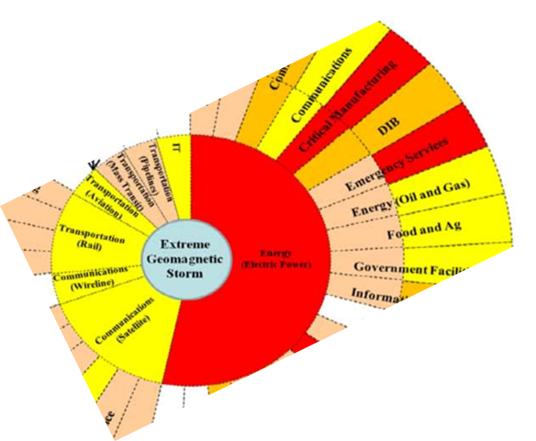
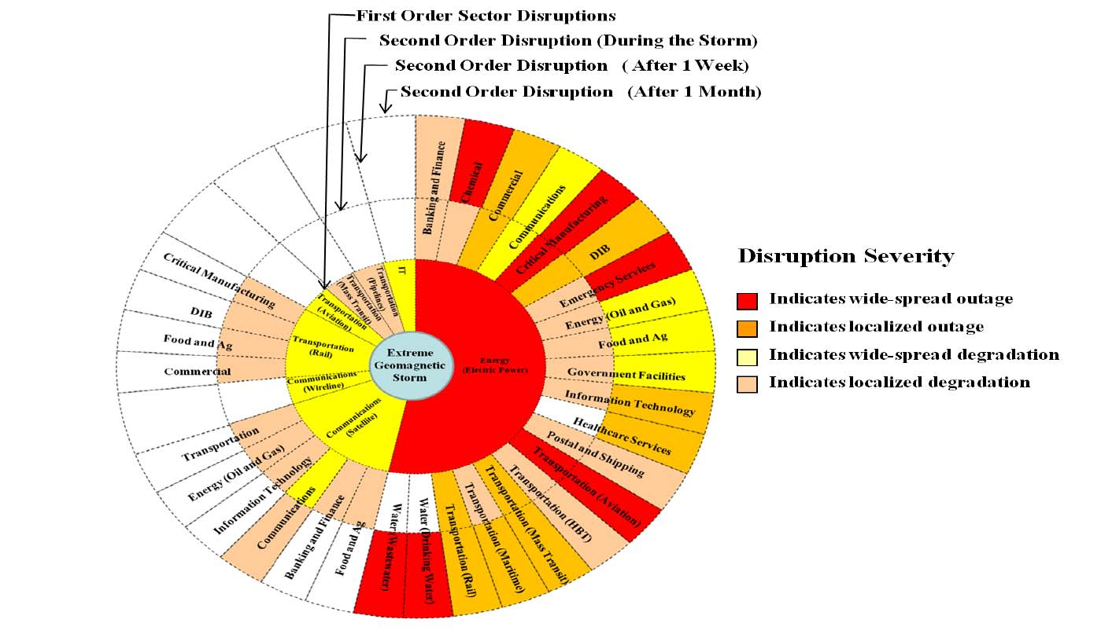
Critical Infrastructure Disruptions from a severe geomagnetic storm
Disruption can escalate e.g. as short-term resources are depleted
Source: OECD Geomagnetic Storms report

Slide 13
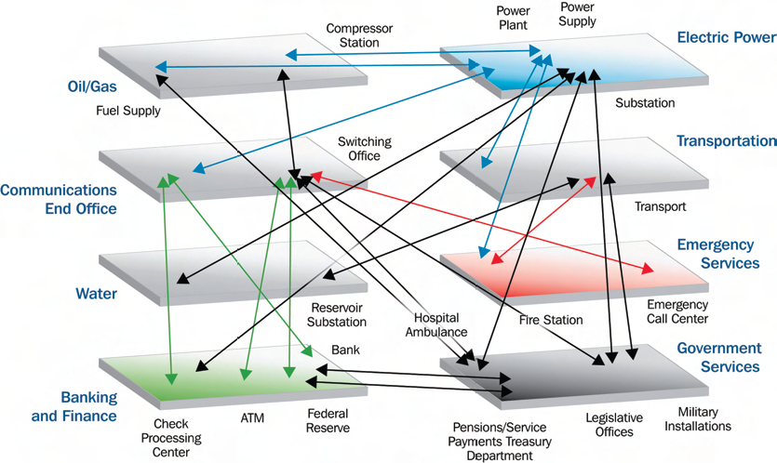
Interconnectivity across the economy
Source: US Dep Homeland Security

Slide 14

People are interconnected
Many activities now require rapid dialogue across the world
So people can work together
Communications ever more critical
    internet, phone, …
At risk in an extreme event:
  power, timing

Slide 15
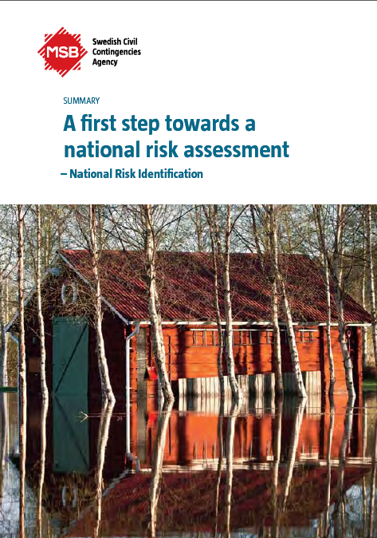
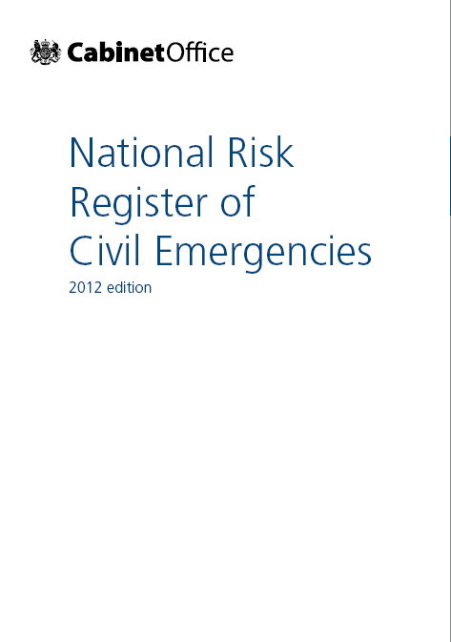
Assessing the risk
Growing trend for governments to make integrated risk assessments of:
  Natural hazards & major accidents
  Malicious threats
Can then target resources more effectively, i.e. prioritise
And identify generic and specialist responses
Need to include space weather as a natural hazard
  Underway in Swedish and UK assessments
  Drive to integrate space weather into all-hazards approach
  So need to link space weather research & operations with other natural hazards (floods, hot & cold weather, flu, volcanoes, …)

Slide 16
Example: UK experience
Space Weather brought into National Risk Register Assessment process
  discussions started May 2010
  Space Environment Impacts Expert Group formed Nov 2010
  SEIEG provides independent scientific advice, much appreciated by policy-makers
  strong emphasis on (peer reviewed) scientific evidence
  Space weather risk formally recognised with publication of NRR in Jan 2012

Slide 17
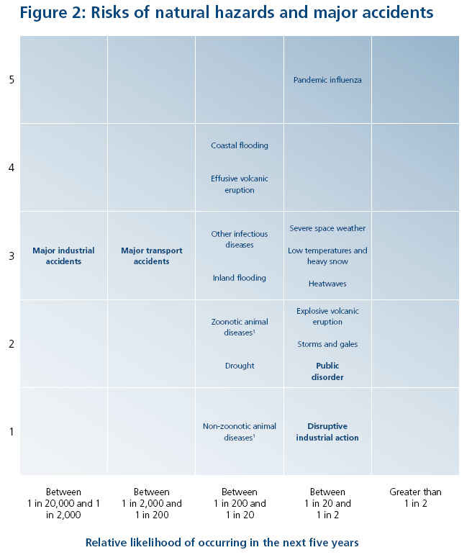
NRR risk matrix non-malicious risks
Impact score based on
Fatalities
Injuries/illness
Social disruption
Economic harm
Psychological impact
http://www.cabinetoffice.gov.uk/resource-library/national-risk-register

Slide 18
Next steps
NRR recognises space weather is young field
  So significant work still needed
To better understand impacts of a severe event:
  More detailed assessments
  Where are knowledge gaps?
  Raise awareness across government, industry, media and public as a whole
And to plan for those impacts
  How to respond to a major event?
  What monitoring & forecast capabilities are needed?

Slide 19
Conclusions
Encourage more countries to integrate space weather into national resilience planning
  Needs SpW outreach at national level
Wider collaboration between national activities
  Need EU dimension, build on Oct 2011 EU dialogue
  Sustain and grow links with US & other programmes
  Also global dimension, build on initiatives by WMO, Society and Space Weather concept in US
Clarify and advocate role of space activities
  Stress most SpW impacts falls on terrestrial activities
  But space is a critical enabler for better SpW resilience

