Slide 1

Severe Space Weather
NATO Relevance
Civil Emergency Planning Operational
Relationships Focus on Communications

Slide 2
Contents
What is NATO
Functions of NATO in International Emergency Management
Why NATO is needed for Communications recovery
Solar weather Impacts to NATO Operations
What matters – language of Interoperability
Communications Disaster Planning tools
Notes:
Topic

Slide 3
Partnerships and
Contact Countries
3
Notes:
Map of countries that make up NATO.

Slide 4
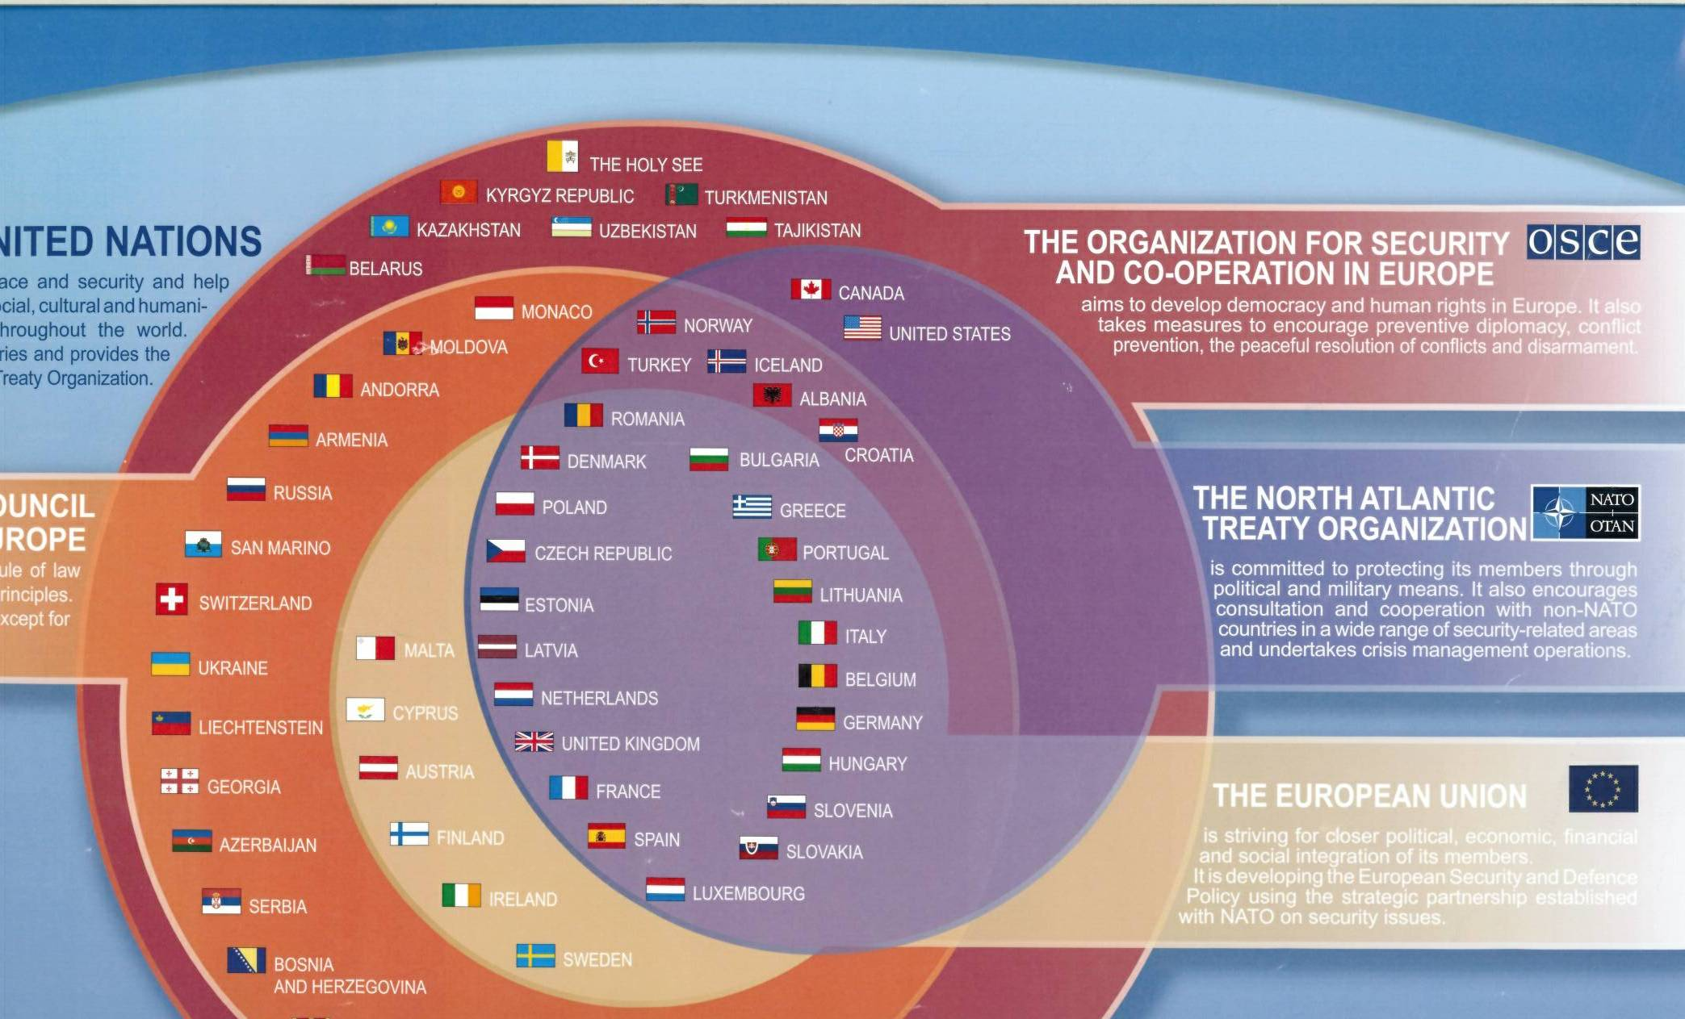
Notes:
Relationship of Political Organizations in Europe.

Slide 5


NATO supports Nations civil-military engagement for emergencies in sectors necessary for defense of populations.
NATO prepares for disasters requiring interoperability with civil support for Alliance operations and Crisis Response operations.
Notes:
Role: NATO has an obligation to defend its Allies.

Slide 6
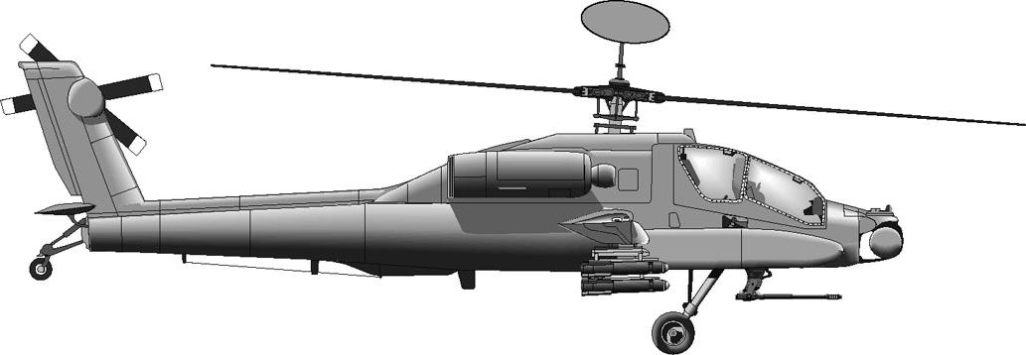
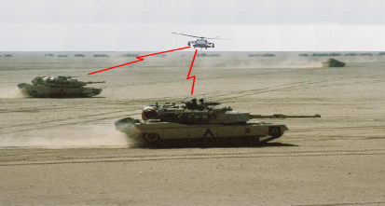
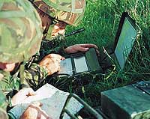
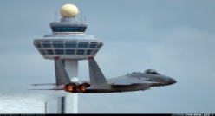
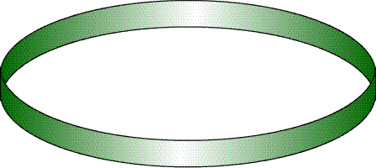


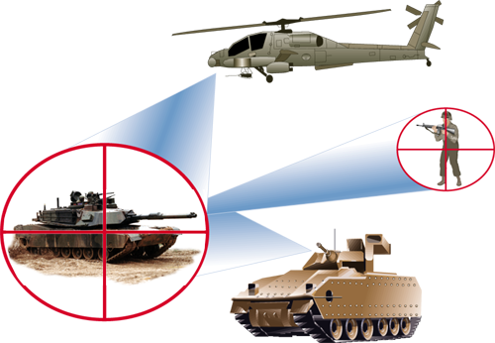
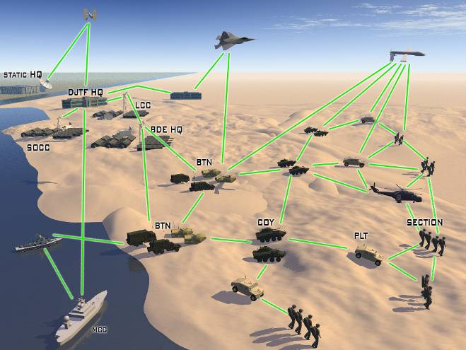
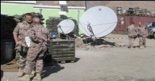

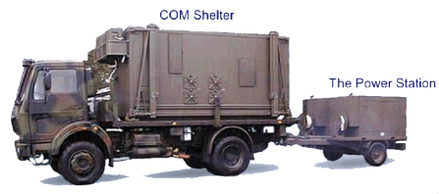
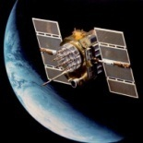

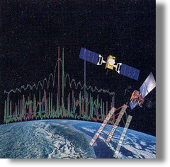
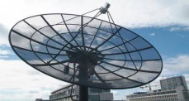
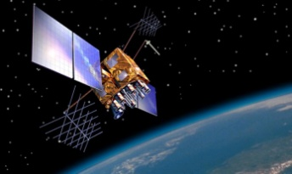
NATO Networks Use Space
RF Interrogation
Laser Range
Identification
Spectrum management
Communications
navigation
Notes:
NATO is very interested in space weather for its operations.

Slide 7
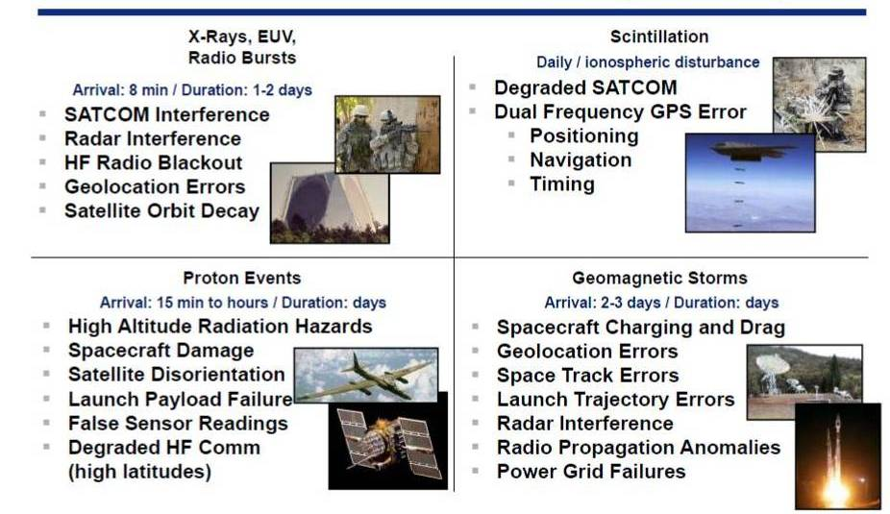
Military and Civil Planners Need to Time Space Weather Impacts
Notes:
Both NATO war fighters and civilians need to be aware of the time and location of solar impacts. This is an Air Force perspective, relevant to commercial networks.
Three types of bombardments vary in speed: radio waves (i.e. X-rays 8 minutes), proton particles (commonly 1 million miles per hour), magnetic storm (slower). Initial strong storm wave fronts arrive between 1 million miles per hour, and 5 million mph.

Slide 8
Civil Disaster Roles NATO Supports
Planning Operations reduce damage and loss of life in the common phases of a disaster.
  Communications are necessary for all activities.
Warning
Mitigation
Response
Recovery
Notes:
What makes up a disaster. Severe space weather.

Slide 9
Necessary for Disaster Recovery
These three requirements are mandatory for emergency recovery by all communications service providers.
Access
Security -> NATO’s function and value
Fuel
Notes:
Recovery is the last phase, but NATO’s role is best tested and recognized after a disaster.

Slide 10
Civil Emergency Planning Structures
EADRCC (Euro-Atlantic Disaster Response Coordination Centre)
  Located at NATO HQ, Brussels
  Partnership instrument (MD/ICI countries can use the tool)
  Liaison arrangements (UN-OCHA; National Military Authorities)
  Role:
    Coordination of Allied and partner nations’ assistance (68 total) to each other in case of natural or technological disaster.
    Not command and control
Notes:
Euro-Atlantic Disaster Response Coordination Centre EADRCC, Advisory Support Team, Rapid Reaction Teams, Civil Emergency Action Plan are tools.

Slide 11
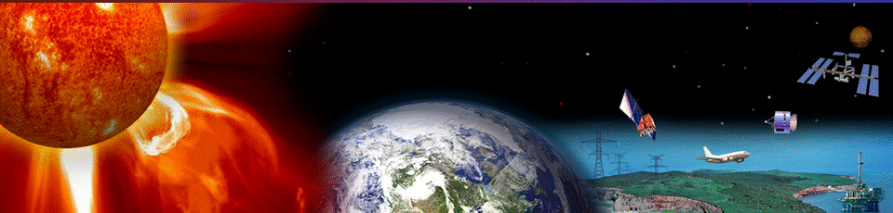
Common threats - Solar extremes
Interoperability requires common terms for communication.
Space Weather types
  Solar Flares Radio Blackouts (R Scale)
  Radiation Storms (S Scale)
  Geomagnetic Storms (G Scale)
Notes:
NATO starts with establishing a common language for interoperability.

Slide 12
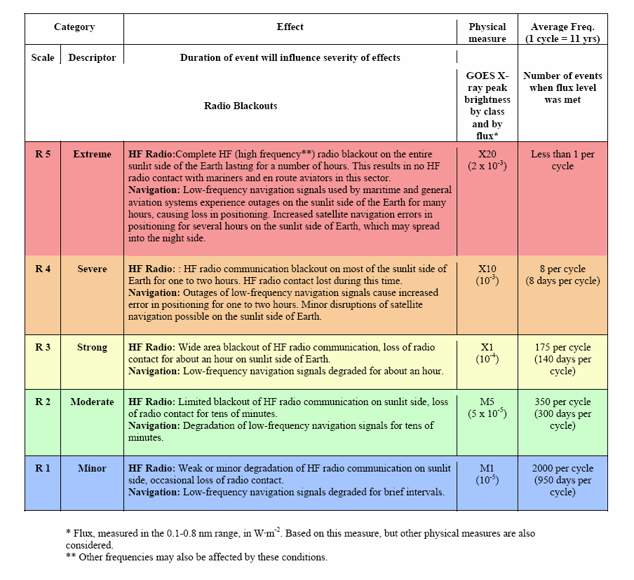
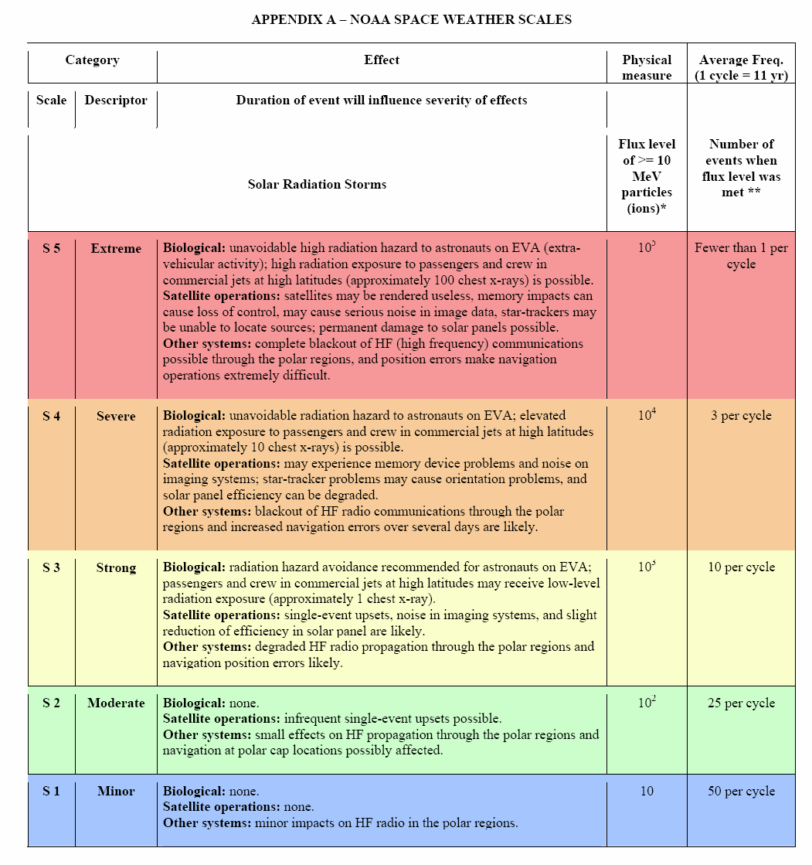
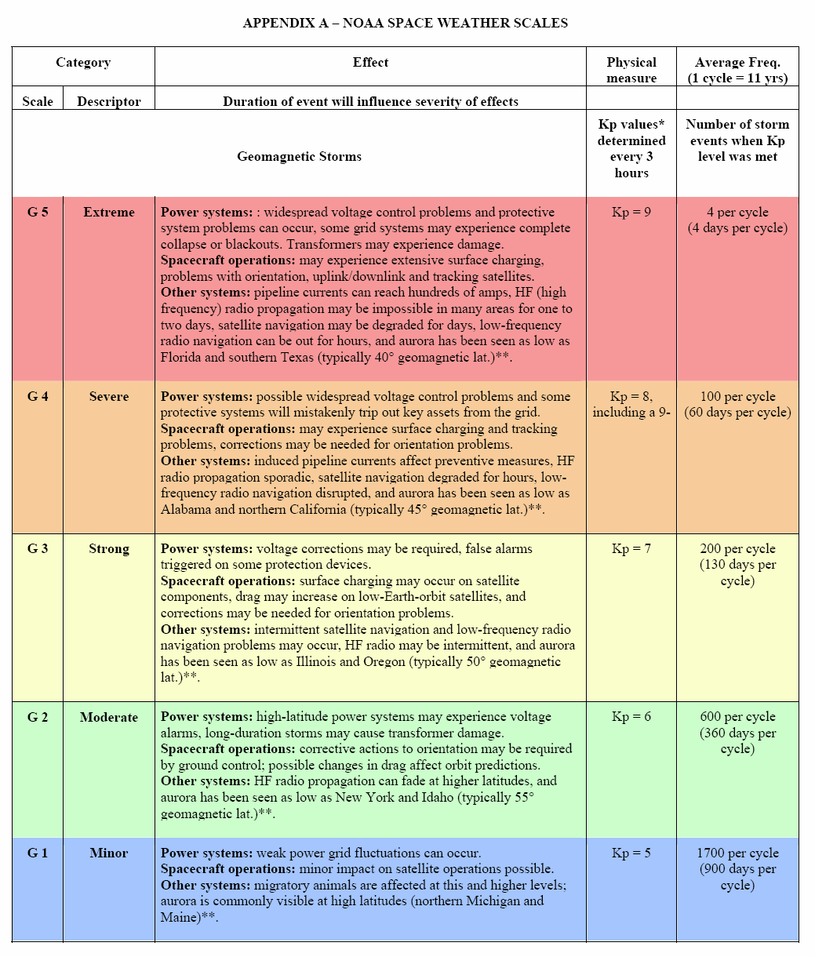
NOAA Space Weather Scales
http://www.swpc.noaa.gov/NOAAscales/
Radio Blackouts
Radiation Storms
Geomagnetic Storms
Notes:
These three classes of storms have defined scales for severity.

Slide 13
Solar Flare Radio Blackouts
R-scale
Arrival: 8 minutes from Sun to Earth (speed of light)
Duration: minutes to 3 hours
Daylight-side impact only
Notes:
We have little warning time to react

Slide 14
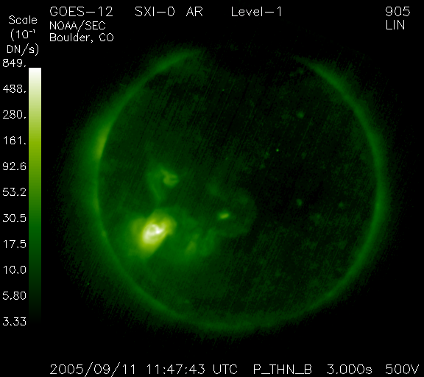
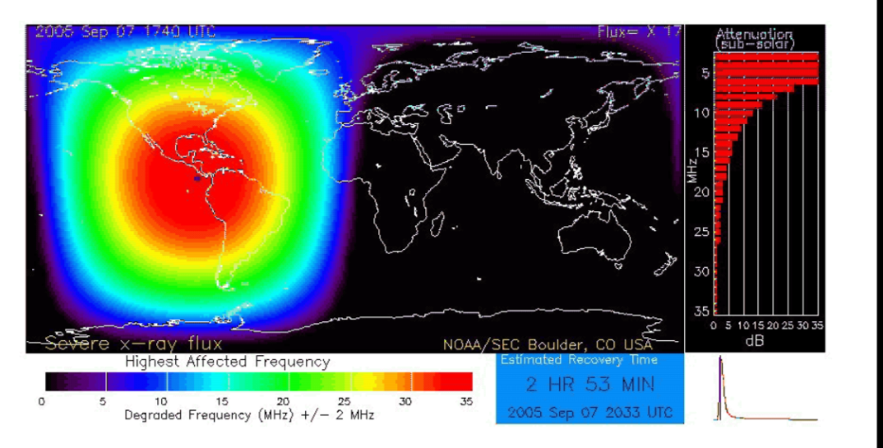
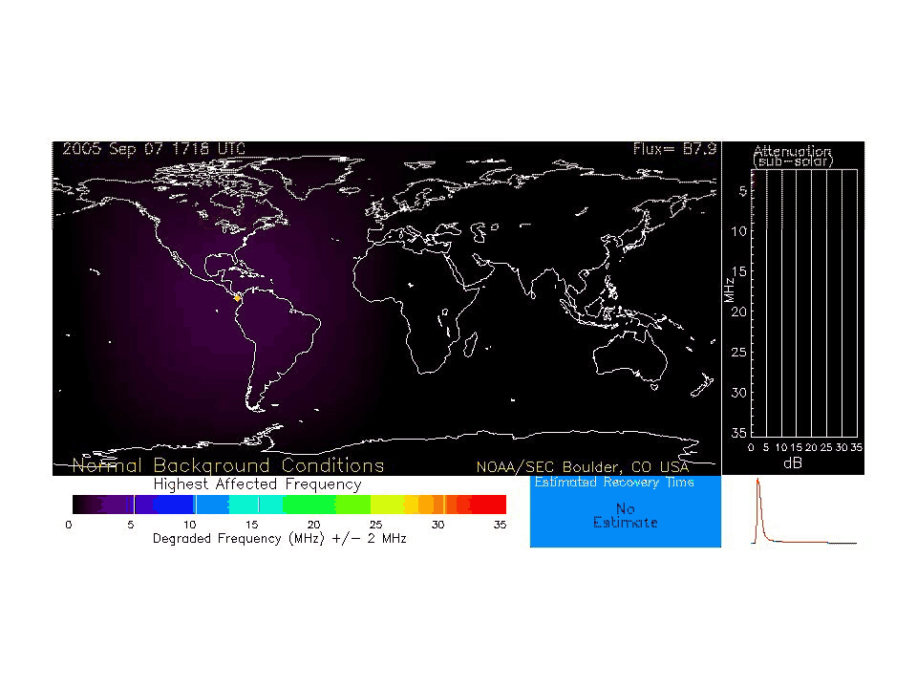
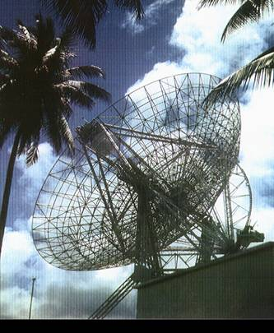
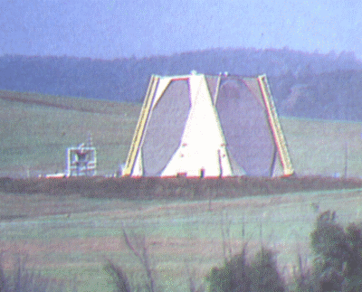
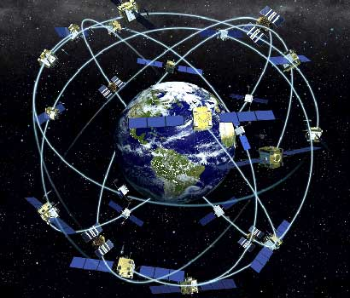
Solar Flare Radio Blackouts
ALERT: X-ray Flux exceeded M5
Issue Time: 2005 Sep 11 1710 UTC
Threshold Reached: 2005 Sep 11 0915 UTC
Location: S17E90
Region Number: UNK
NOAA Scale: R4 - Severe
Radar
GPS Network
Communications and Space-based
Notes:
Communications are the primary vulnerability to this form of storm.

Slide 15
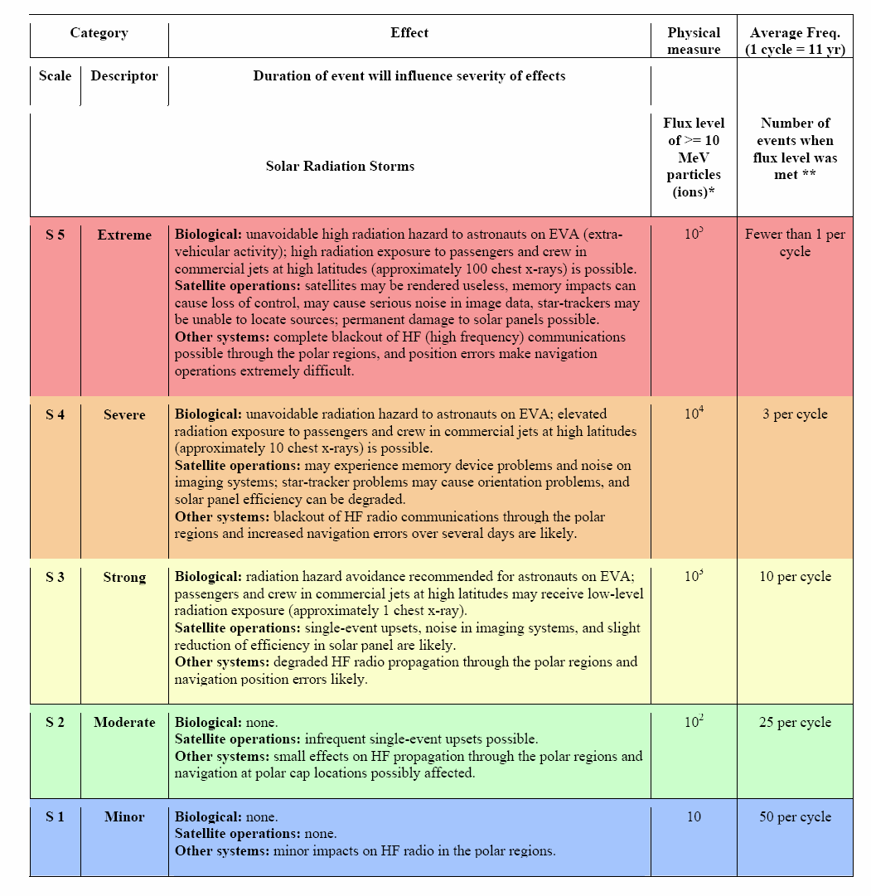
Radiation Storms
S-scale
Arrival: 30 minutes
to several hours
Duration: hours to
days
Notes:
The speed of these storms vary considerably as does the particle effects.

Slide 16
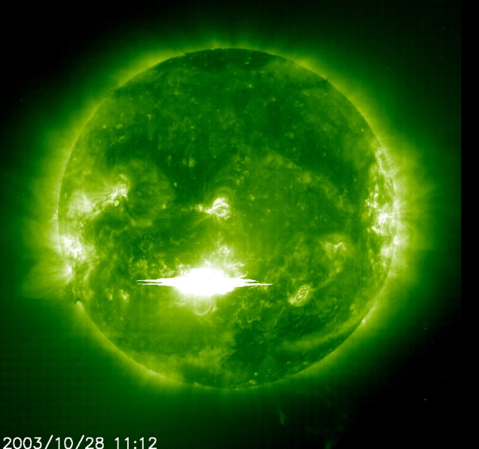
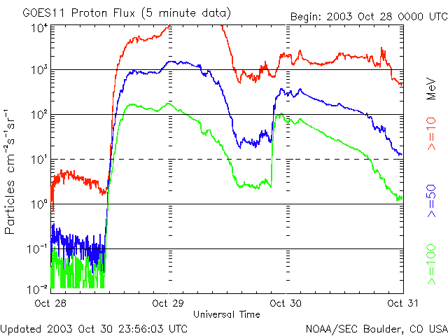
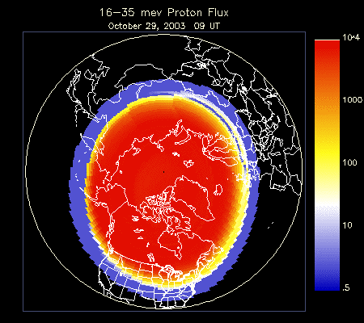
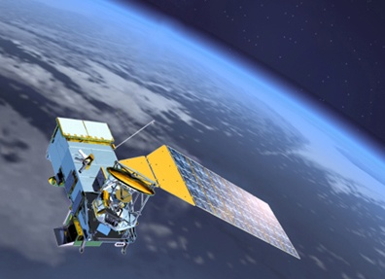
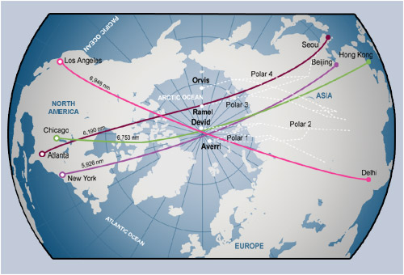
Radiation Storms – Systems Impacted
Satellite Operations (range from loss of
data to loss of satellite)
HF Outage at high latitudes
Aviation (communications and exposure
concerns)
Notes:
Consider the S type storm later when I mention the Global Navigation Position satellites.

Slide 17
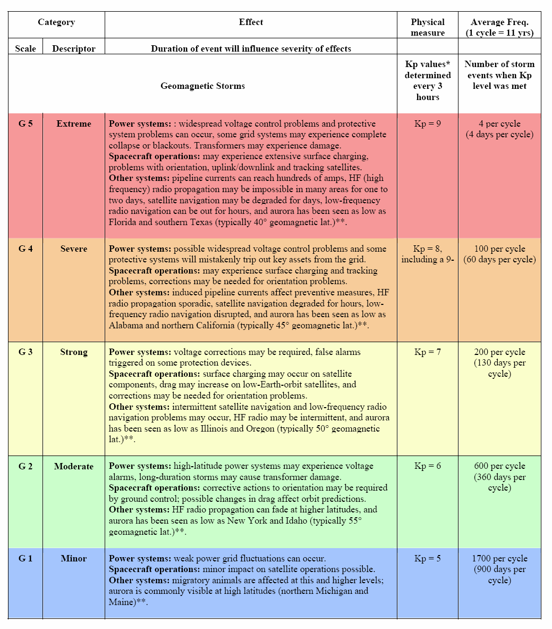
Geomagnetic Storms
G-scale
Arrival: 18 - 90
hours
Duration: hours to
1-2 days
NOTE: High levels of solar activity can produce prolonged periods (several days) of geomagnetic storming.
Notes:
Fast moving mass with magnetic orientation has the largest potential impact.

Slide 18
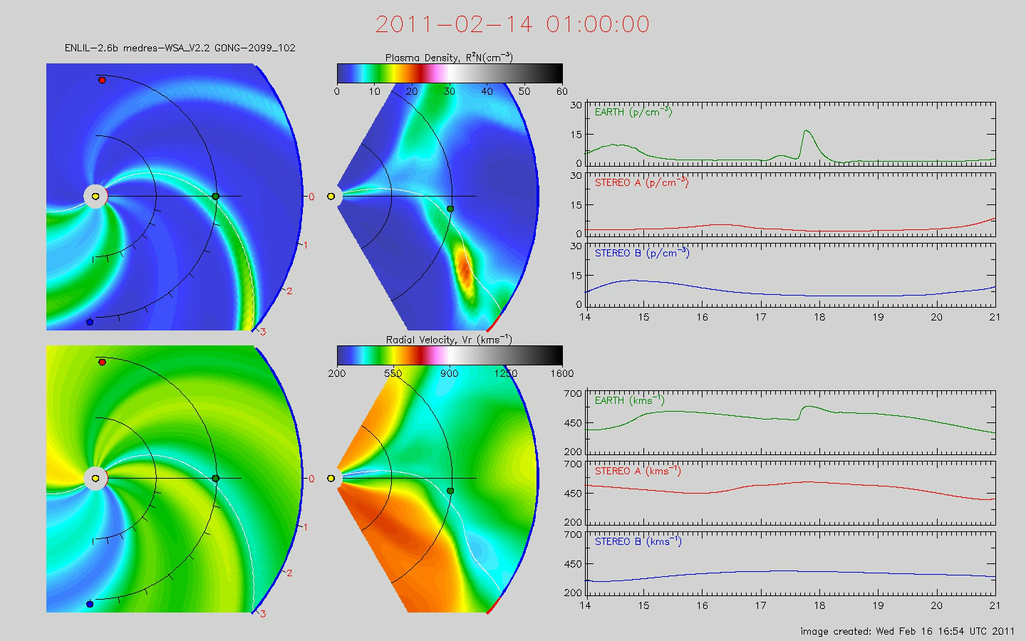
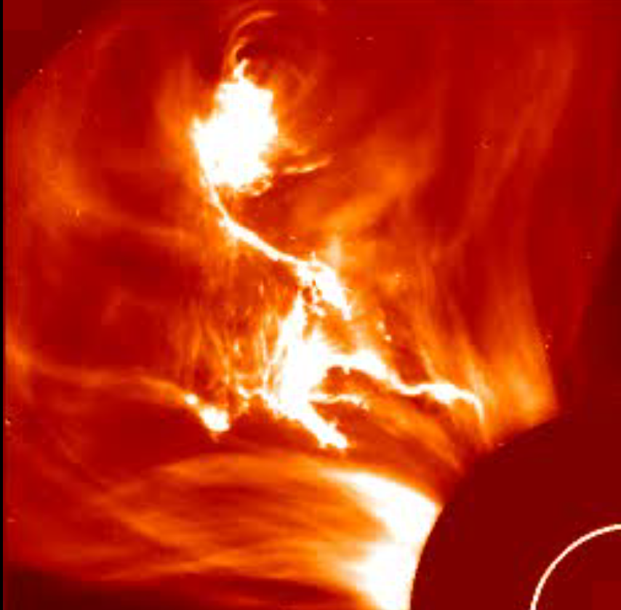
Geomagnetic Storms (G Scale)
Coronal Mass Ejections (CMEs) create geomagnetic storms
WATCH: Geomagnetic A-index of 50 or greater predicted
NOAA Scale: Periods reaching the G3 (Strong) Level Likely

Slide 19
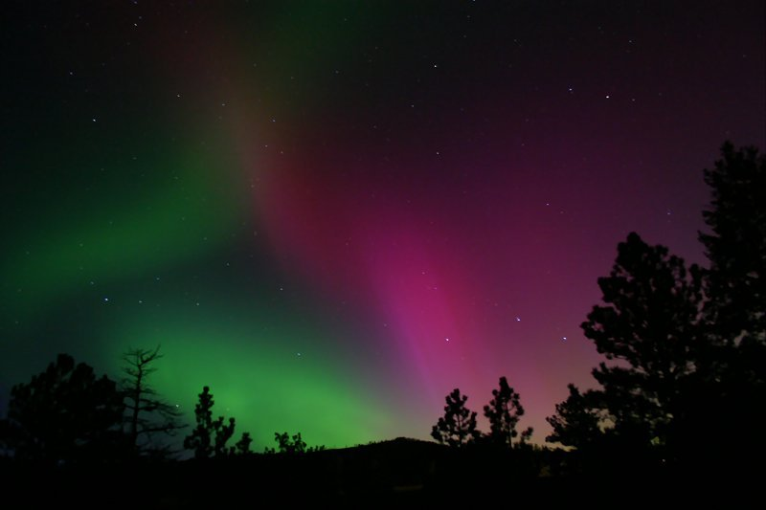

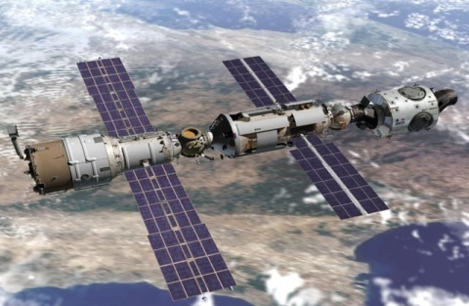
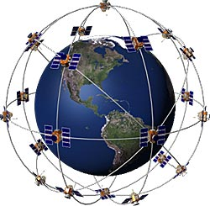
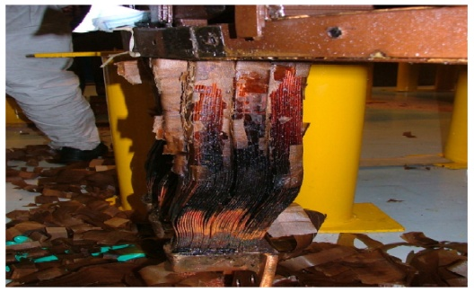

Earth-directed CMEs result in Geomagnetic Storms
Impacts from geomagnetic storms are wide-ranging with potentially significant consequences.
Satellite Operations
Manned Spaceflight
GPS
Power Grid Operations
Aircraft Operations
Notes:
Planning preparations for the severe G5 CME is the responsibility of more than NATO.

Slide 20

Notes:
Community of Interest in Stabilization Reconstruction

Slide 21
Space Weather Alerts and Notifications
Alert
Conference Call
Subscriber Email Alerts
Notification Action
FOC
FAOC West
ENS to Watches
FAOC East
NAWAS / WAWAS
S 5, G 5 only
Notify
Leadership
S 5
G 5
S 4
G 4
R 5
S 3
G 3
Solar Radiation Storms
Geomagnetic Storms
R 2
Radio Blackouts
S 2
G 2
No notifications recommended at these levels
S 1
G 1
Notes:
It is important to only warn people when there is a severe storm threat.

Slide 22
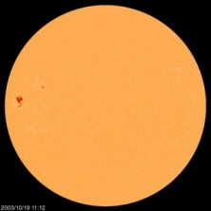
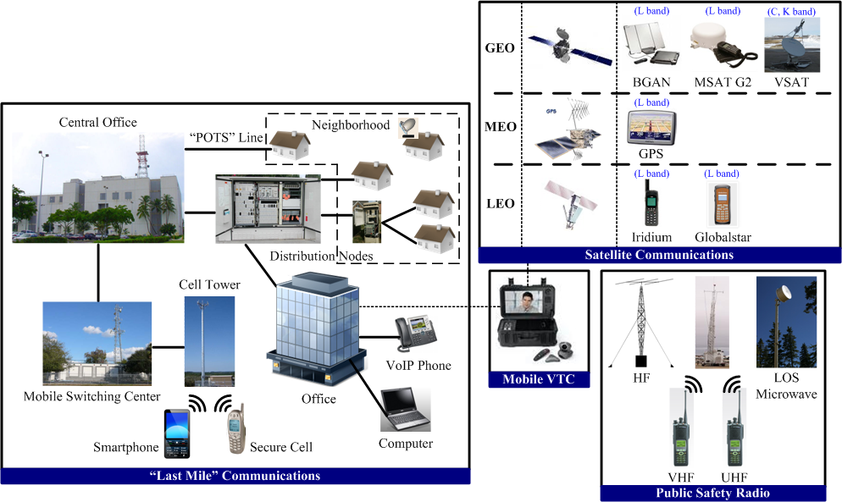
Scenario: (Baseline)
A very large, complex sunspot group emerges near the solar equator
-5 -4 -3 -2 -1 0 1 3 8 30
Days
“Last Mile” photos courtesy of AT&T
Notes:
Planning disaster scenario, This tool was provided to NATO to show the expected effects on the communications infrastructure.
On the left we have what is known as “last mile communications” which includes everything from the telecommunications or cable central office to the end user. That includes the telephone on your desk or at your home, the internet, cable TV, and mobile and smart phones.
The top right box shows satellite communications from: geosynchronous orbit or GEO, which includes many common L-band satellite systems, and C- and Ku/Ka-band very small aperture satellite terminals; mid-earth orbit or MEO which includes the GPS satellites; and, low-earth orbit or LEO which includes common satellite services. [Legal disclaimer] The products and services represented here are examples of common products and services used by government and public safety organizations but this does not represent an endorsement of these products or services by FEMA or the Department of Homeland Security.
At the bottom right is public safety radio to include High Frequency or HF, Very High Frequency or VHF, Ultra High Frequency or UHF to include the 700/800 MHz public safety and 4G LTE systems, and line-of-sight microwave communications systems. Together, these represent the radio systems most commonly used in public safety organizations.
Finally, we include mobile video teleconferencing because many agencies use this capability.
As we walk through this, it is important to look not only at what is impacted, but also what is still working so that we know which communications systems we can use during and after this perfect storm. Okay, our scenario begins with the appearance of a large, complex sunspot group near the limb of the sun.

Slide 23
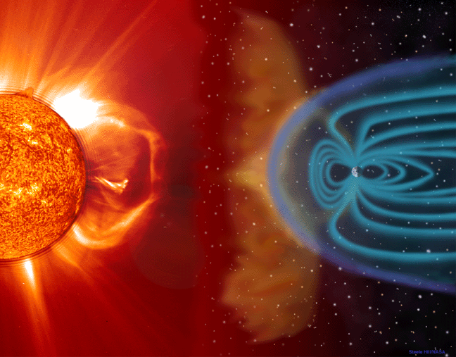
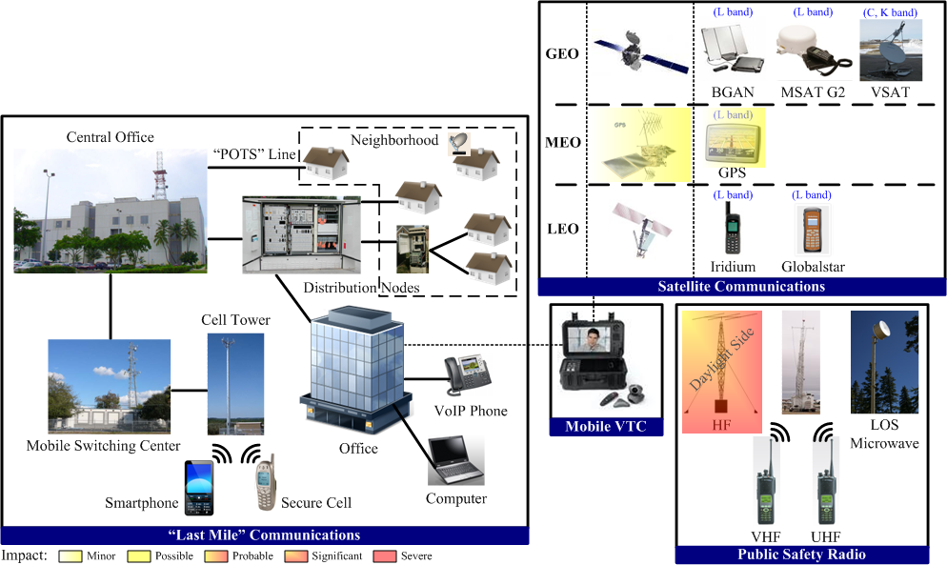
Scenario: R5 Radio Blackout Event
Massive solar flare erupts above near-center-disk sunspot group.
- HF: Several hours (daylight side)
- GPS: Seconds to 15 Minutes
-5 -4 -3 -2 -1 0 1 3 8 30
Days
Notes:
On day 5 of our scenario, a massive, Carrington-scale solar flare erupts on the sun, releasing electromagnetic energy, high-energy particles, and a coronal mass ejection. We’ll deal with each of these in turn.
Traveling at the speed of light, the electromagnetic energy from the flare arrives first and without warning, causing an extreme Radio Blackout event.
HF communications are severely disrupted, if not impossible, on the daylight side of the Earth, with some possible bleed-over onto the night side of the planet.
This disruption can last for several hours.
GPS signals may also be severely disrupted.

Slide 24
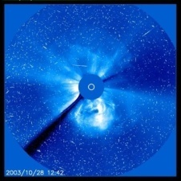
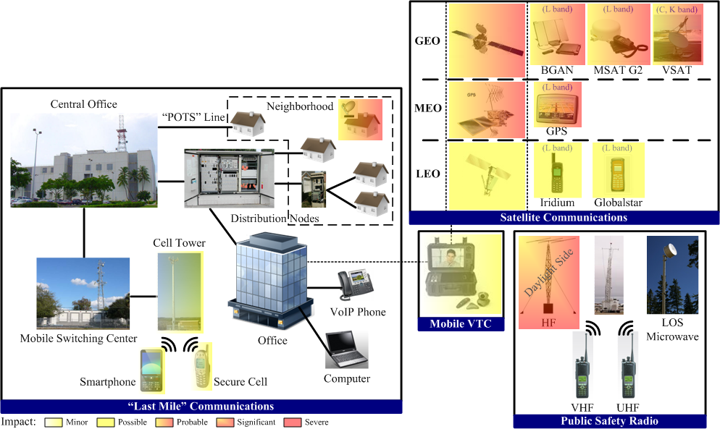
Scenario: S5 Solar Radiation Storm
Solar radiation storm arrives twenty minutes after solar flare. Radio blackout event continues.
- 3-24 hours (various effects)
≈ 15% of satellite fleet lost due to solar panel damage
≈ 50 times normal satellite anomalies
-5 -4 -3 -2 -1 0 1 3 8 30
Days
Notes:
Only 20 minutes after the start of the Radio Blackout event in our scenario, the extreme Solar Radiation storm arrives.
Showers of energetic particles, accelerated to near the speed of light, damage satellites, primarily at GEO and MEO. The solar radiation superstorm adds 3-5 years worth of exposure to solar panels, degrading many older satellites below their minimum operating power. This could result in the loss of approximately 15% of the satellite fleet, and premature aging of the remaining satellites. The superstorm may also cause 50 times the normal number of satellite “anomalies” from minor “single event upsets” such as command failures, all the way up to the complete loss of satellites.
Satellites at LEO are more protected by the Earth’s atmosphere and are expected to fair better, though there is no guarantee.

Slide 25
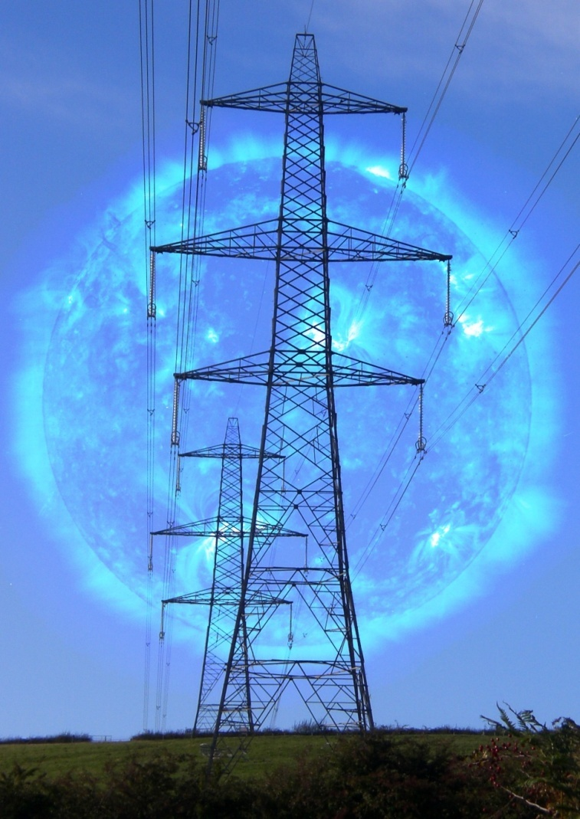
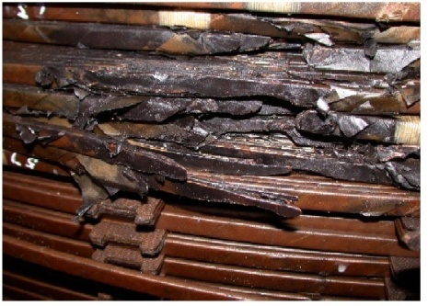
Power is the fundamental for NATO
Almost all modern technology relies on the reliable delivery of electric power
Communications networks and Information transactions cut across all critical sectors.
(Credit: K. Turnbull / J. Wild / ESA)
Notes:
While this presentation focuses on communications systems, the simple truth is that those systems will not function without power. Hence the GIC current spike is a concern.
Electrojet potentials will induce large currents in the Earth which can exceed 2000 amps.
These geomagnetically induced currents can cause widespread damage to power grids on regional and even continental scales.

Slide 26
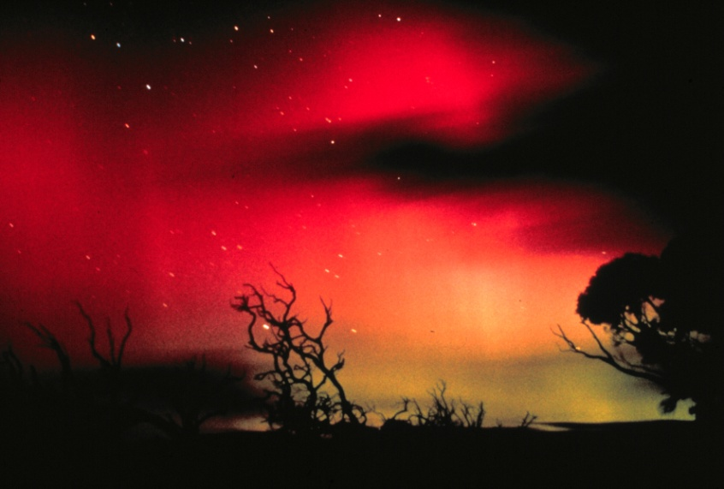
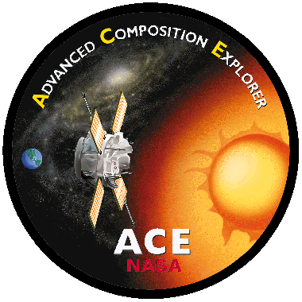
Scenario: G5 Geomagnetic Storm
NASA ACE satellite provides approximately 15 minutes warning of the southward interplanetary magnetic field orientation of the coronal mass ejection.
Approximately 17 hours after the initial solar flare, the massive, fast-moving CME arrives at the Earth.
The physical shock of the CME pushes the daylight side of the magnetosphere inside the geostationary orbit, exposing GEO satellites on the daylight side directly to the solar plasma.
Notes:
The coronal mass ejection arrives at the Earth approximately 17 hours after the initial flare. However, the magnetic orientation of the CME won’t be known until it passes the NASA ACE satellite—which in our scenario occurs only 15 minutes before it strikes the Earth. So, Mitigation Strategy #2: Don’t wait for the ACE data to start preparing for a really bad day.
For those on the Earth who may have missed the NOAA space weather warnings, the first indication of the geomagnetic superstorm may be a deep red aurora in the nighttime sky. Observers in 1859 reported deep, blood-red auroras shot through with spears of white light as far south as the Caribbean.
Now, the physical shock of the fast moving CME pushes the daylight side of the magnetosphere inside the geostationary orbit, exposing GEO satellites directly to the solar plasma. This will mean additional satellite anomalies on the daylight side at GEO, possibly including loss of additional satellites. However, we were unable to locate data or predictive analyses that would suggest the extent of the potential damage for an event of this magnitude.

Slide 27
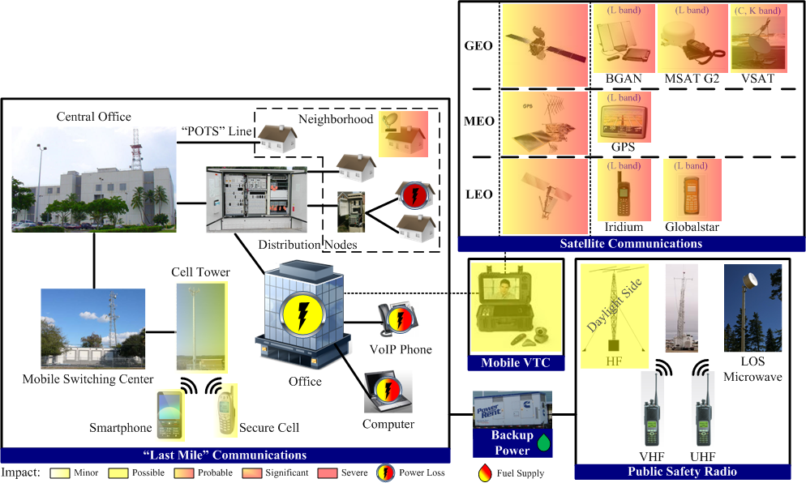
Scenario: G5 Geomagnetic Storm
CME with southward magnetic orientation arrives at Earth causing extreme geomagnetic storm.
- 12-24 hours (various effects)
- SATCOM/GPS severely disrupted due to scintillation
- HF may be possible
-5 -4 -3 -2 -1 0 1 3 8 30
Days
Notes:
Okay, bringing it all together, what is the impact on communications?
Satellite loss and satellite anomalies will cause disruption of satellite communications at GEO. Remember, this is in addition to losses and anomalies already suffered during the solar radiation storm. Scintillation will severely disrupt satellite communications, especially at the lower L bands, which includes most of the systems commonly used by government agencies and first responders.
HF communications may be possible. This brings up Mitigation Strategy #3: test communications systems throughout the event so that you know which of your systems work and which don’t. And, the status of systems could change during the event, so keep trying.
Now, collapse of regional or continental power grids will have both immediate and cascading impacts on last mile communications. Any home or office without backup power, and that is not connected directly to the local central office over a “plain old telephone service” or POTS line—the old copper wires many of us grew up with—will immediately lose phone, internet, and cable or satellite television. So, if you’re like me and have one of those bundled phone, internet, and cable TV packages in your home, you could lose all of them immediately. Mitigation Strategy #4: Uninterruptable Power Supplies are your friend and can give you 10-45 minutes of power for your communications devices at home or at the office. Backup generators or solar, wind, or fuel cell power would be even better.
Also, cellular towers may lose GPS timing signals and go into island mode after 1 or 2 hours.

Slide 28
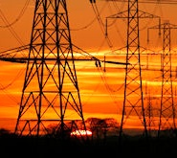

Scenario: G + 8 Hours
Loss of power begins to effect “last mile” communications
- Numerous cellular towers begin to fail
- Battery backup fails in homes and offices
- HF communications intermittent for next three days
-5 -4 -3 -2 -1 0 1 3 8 30
Days
Notes:
Though the geomagnetic storm is not over, from this point forward the availability of power becomes the single greatest concern.
Battery backup power for neighborhood distribution nodes that distribute cable, phone, and internet begin to run out. Home and office uninterruptable power supplies and batteries run out. The same is true for radios, repeaters, and other communications equipment. Many cellular towers have backup battery power for only 2 to 8 hours and begin to fail.
The operating life of communications systems can be extended through the use of backup generators, solar power, and the like.
Notice that, at this point, C and Ku, K, and Ka band frequencies are beginning to clear up. Very small aperture satellite terminals using these frequencies should be able to communicate provided their satellite has survived and is functioning.

Slide 29


Scenario: G + 24 Hours
Loss of power begins to effect critical systems
- Telecommunications distribution nodes begin to fail; may impact Land Mobile Radio repeater towers
- Power required to recharge equipment batteries
-5 -4 -3 -2 -1 0 1 3 8 30
Days
Notes:
24 hours after the geomagnetic storm starts, it is over, but the effects linger on.
Without power, larger distribution nodes fail. Notice that only the house with the POTS line still has phone and dial-up communications, since the phone is getting its power from the central office, which itself is running on generator backup power. Unfortunately, copper wire from the central office to the end user is rapidly going away. Most connections today are over fiber optic cables, which require local power. Remember the comment that we’re actually getting more vulnerable, not less, as our technology advances.
Fuel for generators, and backup power to charge portable equipment, is now becoming a larger concern, and even if YOUR device has power and a connection, the person you are trying to contact may not—what we in the communications field call “trouble with the distant end” or “It’s the other guy’s fault.” Additionally, damage to the GPS network effects some satellite communications. For example, BGAN terminals require a GPS fix in order to log into the network. This is also true of some other systems.
Which brings us to Mitigation Strategy #5: read the fine print for your communications equipment.

Slide 30


Scenario: G +72 Hours
Backup power begins to fail without resupply
- Surviving satellites may be usable
-5 -4 -3 -2 -1 0 1 3 8 30
Days
Notes:
At 72 hours, things are starting to look bad. Many public safety organizations, commercial providers, and cellular towers that have generator backup may only have fuel for 1-3 days.
With no power to pump fuel at gas stations or from storage tanks, normal distribution networks for fuel, water, and food break down. Without resupply, backup power fails.

Slide 31


Scenario: G +8 Days
Without fuel and water, the Public Switched Network begins to fail.
- Widespread failure of telecommunications infrastructure; Internet “cloud” fails
- Any system that relies on the PSN cannot talk
- Widespread failure of operations centers
-5 -4 -3 -2 -1 0 1 3 8 30
Days
Notes:
Whether the collapse of the power and telecommunications infrastructure will occur like this, or this rapidly, is not known. This maximum of maximum scenario has never happened before. But the information that follows is based on expert opinion from multiple disciplines.
Without restoration of fuel and water distribution networks or resupply by other means, the Public Switched Network begins to fail after about 7 days. As the Public Switched Network fails, the internet dies. Any communications system that relies on the PSN becomes unusable.
Line-of-sight public safety radio and HF radio will work if they have power. Point-to-point satellite communications may be possible if the satellite remains operational and your equipment supports satellite terminal-to-satellite terminal links. In-network Iridium calls may also be possible if the Iridium phones have power.

Slide 32
Conclusion
Diversify
  Redundant and resilient satellite, radio, and terrestrial communications systems can provide critical communications throughout a superstorm. HF radio could be key to long term critical communications.
Plan
  Know what communications systems will work and when they will work. Know where and how to get fuel, water, and other consumables. Don’t forget your people.
Power, Power, Power
  Have backup power available—and don’t forget that generators need maintenance. If you can, consider renewable sources such as solar, wind, or fuel cells.
Advocate
  If you don’t, who will. Many solutions to extreme solar weather also solve for other hazards.
Notes:
The slide says it all.

Slide 33
Backup Slides for Discussions
Scenarios
Systems
References

Slide 34

What is the worst storm?
Launched from near the center of the Sun onto a trajectory that will cause it to impact Earth’s magnetic field
Fast (≥1000 km/s) and massive, thus possessing large kinetic energy
Have a strong magnetic field whose orientation is opposite that of Earth’s
Contain all three primary types of space weather
SOHO image of 2003 “Halloween Storm” flare
“Solar superstorms cannot be predicted, but the conditions that give rise to them can be foreseen.”
Notes:
“Maximum of Maximums”—the worst case
We adopted the definition from the National Academy of Sciences, with one addition.
First, a perfect solar storm would be launched from near the center of the sun, as you can see in the NASA SOHO satellite image of a 2003 Halloween Storm flare. Note for emergency managers: This means we should pay particular attention to any complex sunspot groups near the solar equator 40 degrees west of the center of the solar disk to 20 degrees east of center as shown on the slide.
Second, a perfect storm will be massive and fast.
Third, the coronal mass ejection—the solar plasma launched from the sun—must have a predominantly southward interplanetary magnetic orientation to cause the greatest impact.
Finally, we added that it must contain all three primary types of space weather: a Radio Blackout event, a Solar Radiation Storm, and a Geomagnetic Storm.

Slide 35

Extreme Solar Weather Has Happened Before
1847 – “Anomalous current” noted on telegraph line between Derby and Birmingham. First recorded impact of solar weather on technology.
August 28-29, 1859 – Telegraph service disrupted worldwide by geomagnetic superstorm.
September 1-2, 1859 – Carrington-Hodgson event is largest geomagnetic storm in 500 years.
May 16, 1921 – The “Great Storm” disrupted telegraph service, caused fires, burned out cables. Storms like this may occur roughly every 100 years.
March 13, 1989 – Geomagnetic storm collapsed Quebec power grid. Northeast U.S. and Midwest power grid came within seconds of collapse.
October 19 – November 7, 2003 – “Halloween Storms” interrupted GPS, blacked out High Frequency (HF) radio, forced emergency procedures at nuclear power plants in Canada and the Northeastern United States, and destroyed several large electrical power transformers in South Africa.
Morse Telegraph Table
Photo from www.telegraphlore.com
Notes:
First, we must understand that solar weather has impacted communications before, from the first recorded impact on telegraph systems in the United Kingdom in 1847, to the 1859 superstorms that disrupted telegraph systems—the “internet” of their day—on a global scale, to the “Great Storm of 1921,” and more recent storms in 1989 and 2003.
Like other disasters, extreme solar weather has happened before, and it will happen again.

Slide 36

Scenario: Power
Electrojet magnetic fields induce currents in the Earth.
Geomagnetically-induced currents (GICs):
  Are quasi-DC currents – effects electrical transformers
  Can affect power systems at all latitudes
  Can affect many power transformers simultaneously at multiple points across regional and continental scale power networks
  Can reach in excess of 1000-2000 amps?
  Seek “path of least resistance” – high-voltage power lines and pipelines have very low resistance
  Enter power networks through ground connections
Image courtesy of John G. Kappenman
Notes:
While this presentation focuses on communications systems, the simple truth is that those systems will not function without power.
Electrojet potentials will induce large currents in the Earth which can exceed 2000 amps.
These geomagnetically induced currents can cause widespread damage to power grids on regional and even continental scales.

Slide 37






Scenario: ESKOM Transformers Damaged
Station 4 Transformer 6 HV winding failure
Station 3 Transformer 6 LV exit lead overheating
Station 5 Transformer 2 HV winding failure
Station 3 Gen Transformer 4 damage
Station 3 Gen. Transformer 5 overheating

Slide 38


Scenario: Scintillation
Image courtesy of solar-center.stanford.edu
Image courtesy of Windows to the Universe
Southward magnetic orientation of the CME creates immense currents in the ionosphere called “electrojets.”
These currents cause scintillation, which can change the amplitude, phase, polarization, and angle-of-arrival of signals. Scintillation can become so severe that it represents a practical limitation for communication systems.
Scintillation can degrade or even prevent signals to and from satellites for 12-24 hours.
HF communications may be helped during this period due to enhancement of the ionosphere F Layer that could improve reflectivity, though HF will remain spotty for 1-2 more days .
Notes:
The geomagnetic storm creates immense currents called “electrojets” in the ionosphere, which in turn causes scintillation that can degrade or even prevent signals that must pass through, or be reflected off of, the ionosphere. This effect can last for 12-24 hours.
Scintillation can severely disrupt communications to and from satellites, especially at lower frequency bands like the L band, and can impact VHF and UHF radios that rely on atmospheric propagation. However, most VHF and UHF radios in use by public safety organizations in the United States rely on direct line-of-sight transmissions and should not be seriously effected.
Counter intuitively, HF communications may actually be helped during the geomagnetic storm due to enhancement of the ionosphere F layer—though HF will probably remain spotty for the next day or two.

Slide 39
Scenario: Global Positioning System
The Global Positioning System constellation provides location and timing information for users worldwide and requires a minimum of 24 MEO satellites to provide complete global coverage.
Current GPS fleet consists of 30 operational satellites.
    All 11 surviving Block IIA satellites are well past their designed lifetimes.
    6 of the 19 Block IIR satellites are now beyond their designed lifetime.
  Block IIF GPS Satellites are 3 ½ years behind schedule.
    GPS network could fall to 25 usable satellites by the end of 2012 and 24 satellites by late 2014, if no further program.
  Should the network fall below the required 24 satellites, position information may not be available for portions of the day when the requisite 4-6 satellites are not above the horizon for specific geographic locations. Impacts E911.
    Loss of GPS timing could cause some cellular towers to go into “island mode” where they are unable to hand off calls from one cell tower to another, resulting in dropped calls for users moving between tower coverage areas.
Notes:
There is a special concern here with the Global Positioning System network.
More than half of the GPS satellites are currently beyond their designed lifetimes. This event could reduce the GPS network below the required 24 satellites, causing gaps in coverage for both location data and timing.
Loss of GPS location data could impact E 911 dispatchers trying to respond to emergency calls from mobile devices.
Loss of GPS timing could impact some cellular communications towers, causing them to go into “island mode.” Towers in island mode cannot hand off mobile calls from one tower to another if the caller is moving between coverage areas.

Slide 40

Examples of historical Solar Storm
Solar Storms Damage Critical Infrastructure
age to infrastructure
  Satellites
    1994: Anik E1 & E2 damaged (TV and data services lost to 1600 communities)
    1998: PanAmSat's Galaxy IV satellite (disrupted pager service)
    2003: Extensive satellite upsets and damage due to a solar storm
  Power grid (especially Extra High Voltage (EHV) transformers)
    1958 & 1972: Transformer failures at British Columbia Hydro and Power Authority
    1989: Hydro Quebec power interrupted/damaged; Salem NJ nuclear plant transformers failed
    2003: 14 transformers damaged in South Africa
  Long communications lines 1859, 1882, 1909, 1921, 1926: Telegraph lines disrupted, operators shocked, fires started
    1940 and 1958: Landline and undersea lines disrupted and/or damaged
    1972: US and Canada’s telephone system damaged/disrupted
  HF radio paths
    1991 upset of HF radio support Gulf War
  Global Positioning System (GPS) (disruption)
Notes:
Bright auroras are merely a visible sign that the balance of electrical and magnetic energy in Earth's magnetosphere has been upset. The average CME dumps about 1500 Gigawatts of electricity into the atmosphere (double the power generating capacity of the entire United States). Here are some recent effects…
For the satellites orbiting in and out of the (van Allen) radiation belts, CMEs and magnetic storms can be perilous. For instance, a series of flares and ejections in March 1989 produced a potent magnetic storm. After the particles and energy from the Sun bombarded the Earth, more than 1500 satellites slowed down or dropped several miles of altitude in their orbits due to increased drag.
…
But atmospheric drag isn't the only effect CMEs can have on satellites. When excited and accelerated by a storm, high-energy electrons can degrade the solar panels used to power satellites and can upset and even shut off computers on spacecraft. The increased flow of electricity in Earth's space also can cause electrical charge build up on the surface of a spacecraft. That charge can eventually be released as a damaging spark (a spark not unlike the one you get when you touch metal or a friend after you drag your feet on a carpet).
In 1994, two Canadian satellites listed were shut down when each was electrically shocked during magnetic storms; as a result, telephone service across Canada was disrupted for months. Similarly, in January 1997, an American satellite went dead just hours after a CME struck the magnetosphere. The loss of that satellite disrupted television signals, telephone calls, and part of a U.S. earthquake monitoring network.
Magnetic storms also play havoc with radio signals, which are bounced off Earth's ionosphere (the outermost layer of our atmosphere, made up mostly of plasma) as a sort of natural relay station. In March 1989, listeners in Minnesota reported that they could not hear their local radio stations, but they could hear the broadcasts of the California Highway Patrol. In the extreme, magnetic storms can completely wipe out radio communication around Earth's North and South Poles for hours to days.
On the ground, magnetic storms can affect the strength of Earth's magnetic fields. Changes in magnetic fields can produce surges in power lines and strong electrical currents in gas and oil pipelines. The extra current can cause pipelines to corrode and deteriorate faster than they would naturally; in power lines, the extra electricity can burn out transformers and cause brownouts and blackouts. During the March 1989 storm, a transformer burned up at a power plant in New Jersey, and a whole system was blown out at a power station in Quebec, leaving 6 million people without electricity for hours, some for months. Since so much modern information is relayed by satellites and other advanced technology-from automated teller machines and broadcast signals to the Global Positioning System and disaster warning systems-CMEs pose a natural and technological hazard to life on Earth.
from: http://istp.gsfc.nasa.gov/istp/outreach/cmeposter/blackout.html (June 2008)

Slide 41

Civil Emergency Planning vulnerabilities beyond communications
Microelectronics at altitude: computer errors degrade data/control
Aviation: Irradiation of people and equipment, reroute polar flights
Telecom long lines: i.e. sea cables
Geographically distributed systems:
Pipelines (gas, oil, water) and pumps
Railway signals
SCADA systems i.e. water management
Notes:
Graphic: (Intelligence Surveillance Reconnaissance) detection, tracking systems…Mobile communications are particularly susceptible.
Remote precision dependent activities should be assessed for vulnerability.
Other Planning Boards should consider impacts to their sectors from extreme storms.

Slide 42
Source Acknowledgements
Mark H. MacAlester National Response Coordinator, Disaster Emergency Communications Division
Federal Emergency Management Agency
William (“Bill”) Murtagh, the Program Coordinator for NOAA's Space Weather Prediction Center in Boulder, CO, and his staff for their assistance with space weather physics and effects on communications, and especially for the scenario timeline used in this paper.
The members of the Communications Infrastructure Information Sharing and Analysis Center (Comm ISAC) and the Federal Communications Commission (FCC) for their assistance in understanding the effects of extreme solar weather on the telecommunications industry.
Kevin Briggs of the National Communications System (NCS).
Kenneth Friedman and John Greenhill of the Department of Energy (DOE).
The communications technicians of the FEMA Mobile Emergency Response Support (MERS) Detachment in Denver, CO, for understanding the challenges and potential solutions for HF and satellite communications.
Vincent Boyer and Gregory Boren, FEMA Regional Emergency Communications Coordinators for FEMA Regions 4 and 6, for their assistance on Scintillation and HF.
Notes:
For printed versions only

Slide 43
Subject References
Bell, T. & Phillips, T. (2008, May 6). A super solar flare. Retrieved from
http://science.nasa.gov/headlines/y2008/06may_carringtonflare.htm
Boteler, D. H. (2006). The super storms of August/September 1859 and their effects on the telegraph system. Advances in Space Research,
(38)2, 159-172. doi:10.1016/j.asr.2006.01.013
Bowen, K. D. & Underhill, H.W. (2010, December). The last mile. In Chatry, P. (Chair), ESF-2 training conference. Breakout session
conducted at the National Communications System Winter Workshop, Washington, D.C.
Carrington, R. C. (1860). Description of a singular appearance seen in the sun on September 1, 1859. Royal Astronomical Society, 20, 13-
5. Retrieved from http://www-spof.gsfc.nasa.gov/Education/whcarr.html
Cliver, E. W. (2006). The 1859 space weather event: Then and now. Advances in Space Research, (38)2, 119-129.
doi:10.1016/j.asr.2005.07.077
Crystal Communications. (2007). About Globalstar. Retrieved from
http://www.crystalcommunications.net/satellite/globalstar/about_globalstar.htm
Gaunt, C. T., & Coetzee, G. (2007, July). Transformer failures in regions incorrectly considered to have low GIC-risk. Power Tech, 2007
IEEE Lausanne, 807-812. doi:10.1109/PCT.2007.4538419
Government Accountability Office. (2010, September). Global positioning system: Challenges in sustaining and upgrading capabilities
persist. Retrieved from http://www.gao.gov/new.items/d10636.pdf
Green, J. L., & Boardsen, S. (2006). Duration and extent of the great auroral storm of 1859. Advances in Space Research, (38)2, 130-135.
doi:10.1016/j.asr.2005.08.054
Green, J. L., Boardsen, S., Odenwald, S., Humble, J., & Pazamicka, K. A. (2006). Eyewitness reports of the great auroral storm of 1859.
Advances in Space Research, (38)2, 145-154. doi:10.1016/j.asr.2005.12.021
Grubesic, T. H., & Murray, A. T. (2006). Vital nodes, interconnected infrastructures, and the geographies of network survivability. Annals of
the Association of American Geographers, 96(1), 64-83. doi:10.1111/j.1467-8306.2006.00499.x
Humble, J. E. (2006). The solar events of August/September 1859 – Surviving Australian observations. Advances in Space Research, (38)2,
155-158. doi:10.1016/j.asr.2005.08.053
Iridium. (2010). Iridium Next satellite constellation. Retrieved from http://www.iridium.com/solutions/library/Brochures.aspx
Kappenman, J. G. (2005). Great geomagnetic storms and extreme impulsive geomagnetic field disturbance events – An analysis of
observational evidence including the great storm of May 1921. Advances in Space Research, (38)2, 188-199.
doi:10.1016/j.asr.2005.08.055
Notes:
For printed versions only

Slide 44
References (Cont.)
Kappenman, J. G., Warner, P., & Radasky, W.A. (2007). An assessment of the threat potential to the US electric power grids from extreme
space weather storms – analysis of the US power system impacts from large geomagnetic storm events. Report prepared by Metatech
Corp. for contract HSFEMW-06-0302.
Kos, T., Botinčan, M., & Dlesk, A. (2009). Mitigating GNSS positioning errors due to atmospheric signal delays. Pomorstvo / Journal of
Maritime Studies, 23(2), 495-513. Retrieved from Academic Search Complete database.
Koskinen, H. E., & Huttunen, K. E. (2006). Geoeffectivity of coronal mass ejections. Space Science Reviews, 124(1-4), 169-181.
doi:10.1007/s11214-006-9103-0
Lanzerotti, L. J. (2001). Space weather effects on communications. Retrieved from http://128.235.88.54/preprints/lanzerotti1284.pdf
North American Electric Reliability Corporation. (2010, June). High-impact, low-frequency event risk to the North American bulk power
system. Retrieved from http://www.nerc.com/files/HILF.pdf
National Academy of Sciences. (2008). Severe space weather events--understanding societal and economic impacts: A workshop report.
Retrieved from http://www.nap.edu/catalog.php?record_id=12507#toc
National Aeronautics and Space Administration. (2008). Advanced Composition Explorer (ACE). Retrieved from
http://www.srl.caltech.edu/ACE/ace_mission.html
National Aeronautics and Space Administration. (2003, October 23). Solar superstorm. Retrieved from
http://science.nasa.gov/headlines/y2003/23oct_superstorm.htm
National Oceanographic and Atmospheric Administration. (2010). A primer on space weather. Retrieved from
http://www.swpc.noaa.gov/primer/primer.html
National Oceanographic and Atmospheric Administration. (2005, March 1). NOAA space weather scales. Retrieved from
http://www.swpc.noaa.gov/NOAAscales/
Odenwald, S., Green, J., & Taylor, W. (2005). Forecasting the impact of an 1859-calibre superstorm on satellite resources. Advances in
Space Research, (38)2, 280-297. doi:10.1016/j.asr.2005.10.046
Pireau, S., Defraigne, P., Wauters, L., Bergeot, N., Baire, Q, & Bruyninx, C. (2009). Influence of ionospheric perturbations in GPS time and
frequency transfer. Advances in Space Research, (45)9, 1101-1112. doi:10.1016/j.asr.2009.07.011
Pirjola, R. (2002). Fundamentals about the flow of geomagnetically induced currents in a power system applicable to estimating space
weather risks and designing remedies. Journal of Atmospheric and Solar-Terrestrial Physics, (64)18, 1967-1972. doi:10.1016/S1364-
6826(02)00228-6
Notes:
For printed versions only

Slide 45
References (Cont.)
Pulkkinen, T. (2007). Space weather: Terrestrial perspective. Living Reviews in Solar Physics, 4(1), 1-60. Retrieved from Academic Search
Complete database.
Pulkkinen, A., Pirjola, R., & Viljanen, A. (2008). Statistics of extreme geomagnetically induced current events. Space Weather, (6).
doi:10.1029/2008SW000388
Silverman, S. M. (2005). Low latitude auroras prior to 1200 C.E. and Ezekiel’s vision. Advances in Space Research, (38)2, 200-208.
doi:10.1016/j.asr.2005.03.158
Silverman, S. M., & Cliver, E. W. (2001). Low-latitude auroras: The magnetic storm of 14–15 May 1921. Journal of Atmospheric and
Solar-Terrestrial Physics, 63(5), 523-535. doi:10.1016/S1364-6826(00)00174-7
The New York Times. (1921a, May 17). Cables damaged by sunspot aurora. Retrieved from http://query.nytimes.com/mem/archive-
free/pdf?res=9407E2D61E3FEE3ABC4F52DFB366838A639EDE
The New York Times. (1921b, May 17). Electric disturbances affect French wires. Retrieved from http://query.nytimes.com/mem/archive-
free/pdf?res=FB0A14FE345B1B7A93CAA8178ED85F458285F9
Thomson, A. W. P., Gaunt, C. T., Cilliers, P., Wild, J. A., Opperman, B., McKinnell, L.-A., Kotze, P., Ngwira, C. M., & Lotz, S. I. (2010). Present day challenges in understanding the geomagnetic hazard to national power grids. Advances in Space Research, (45)9, 1182-1190.
doi:10.1016/j.asr.2009.11.023
Tulunay, Y. K., & Bradley, P. A. (2004). The impact of space weather on communication. Annals Of Geophysics, 47(2-3 Sup.). Retrieved
from http://www.annalsofgeophysics.eu/index.php/annals/article/view/3279/3325
United States Naval Observatory. (2010). Block II satellite information. Retrieved from ftp://tycho.usno.navy.mil/pub/gps/gpsb2.txt
Welling, D. (2010). The long-term effects of space weather on satellite operations. Annales Geophysicae (09927689), 28(6), 1361-1367.
doi:10.5194/angeo-28-1361-2010
Notes:
For printed versions only

