Slide 1

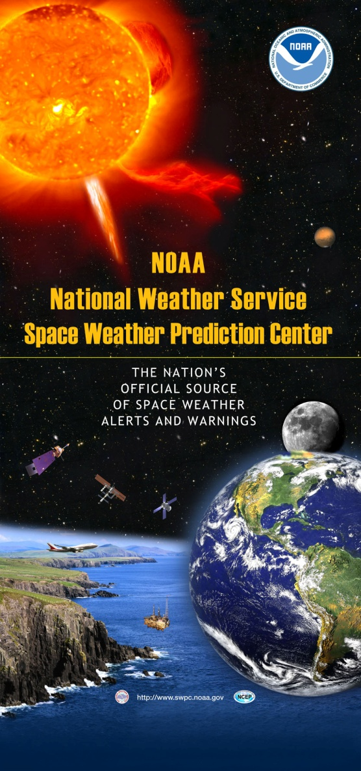
Preparing the U.S. to Respond to Space Weather Events
Dr. Genene Fisher
Senior Advisor for Space Weather
NOAA National Weather Service
TIEMS Oslo Space Weather Conference
24 October 2012

Slide 2

Outline
Customers & Service Trends
Improving Operational Services for a Weather Ready Nation
Interagency Activities
International Collaborations

Slide 3
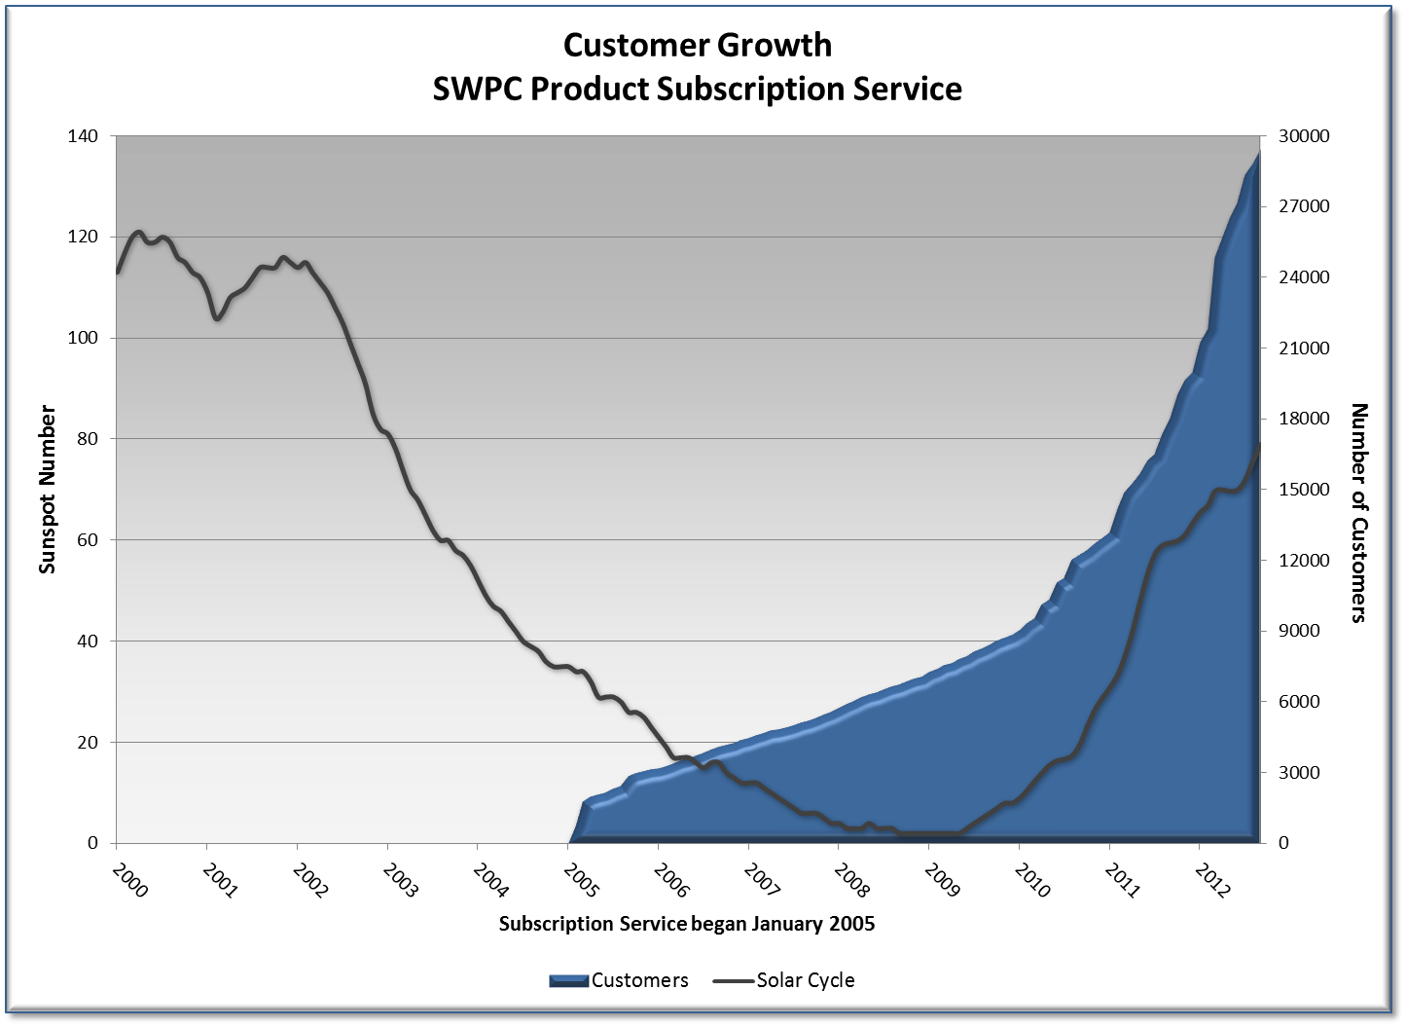
All major airlines
Drilling and oil exploration
Satellite companies
Transportation sector
Emergency responders
subscription service begins

Slide 4
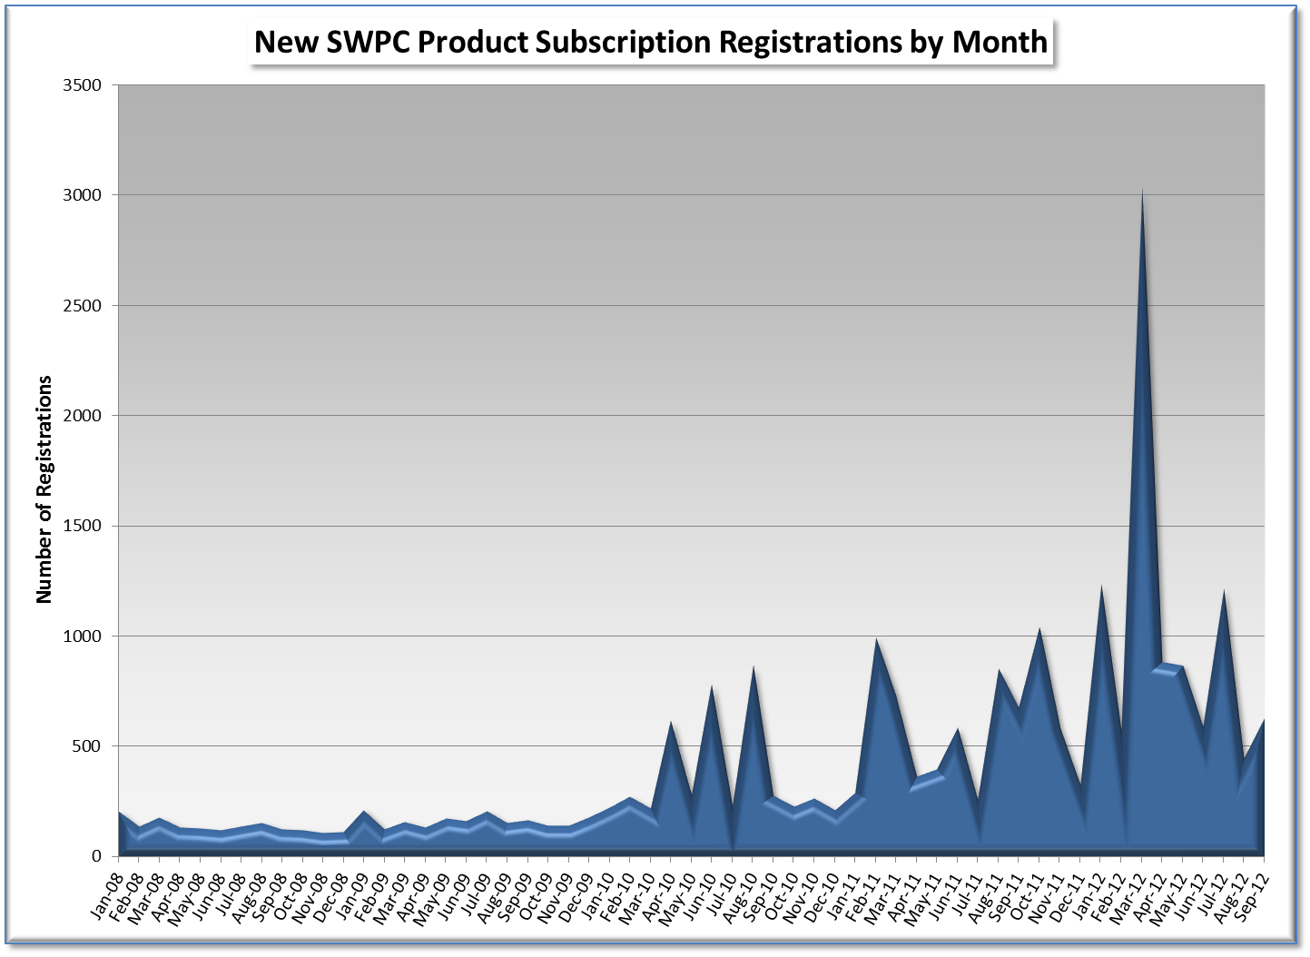
Mar 2012 (X5)
Number of Registrations
Jan 2012 (X2)
Mar 2011 (M5)

Slide 5
Customers & Service Trends
Improving Operational Services for a Weather Ready Nation
Interagency activities
International collaborations

Slide 6
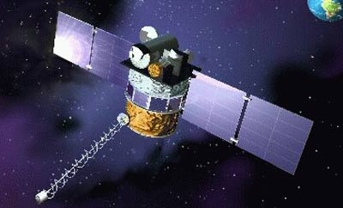
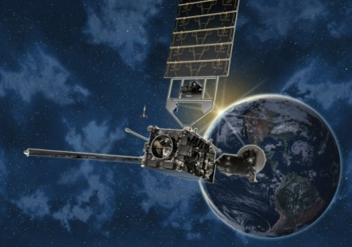
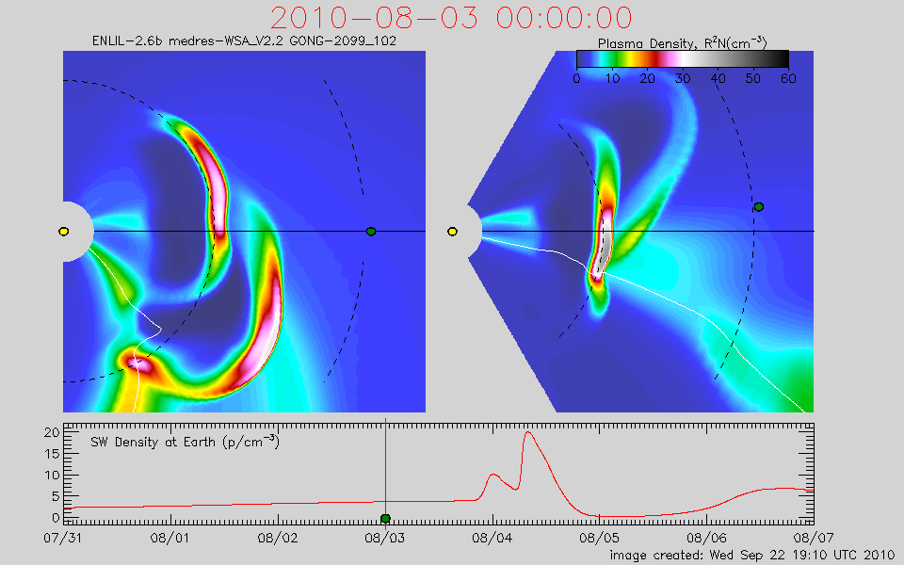
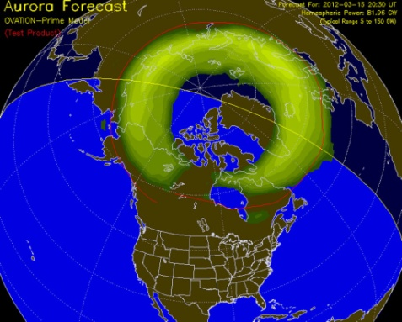

NOAA’s commitment to improved operations
Observations
  DSCOVR launch 2014
  GOES-R launch FY2016
Model transition
WSA-Enlil model
Ovation – auroral forecast model
Space Weather Prediction Testbed
Geospace Model
The Whole Atmosphere Model
Upgrade operational product suite – critical new data sets
Geomagnetic Storm Products
USGS and INTERMAGNET data
International Partners – magnetometer data
DSCOVR
GOES-R
WSA-ENLIL Model

Slide 7
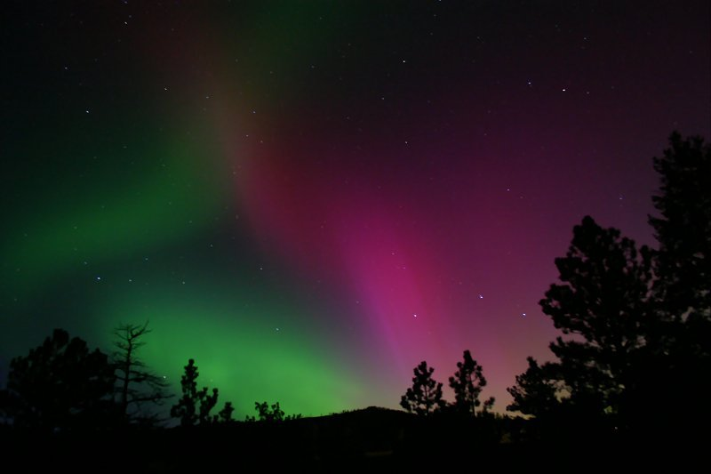
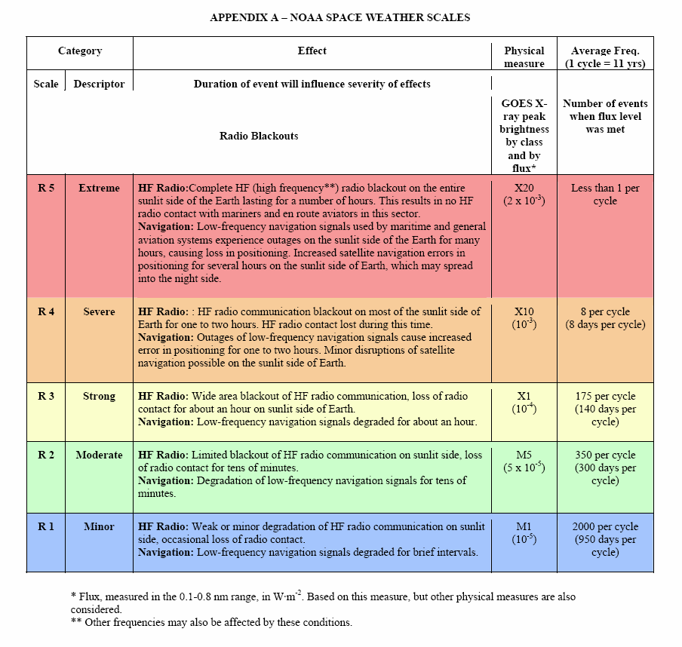
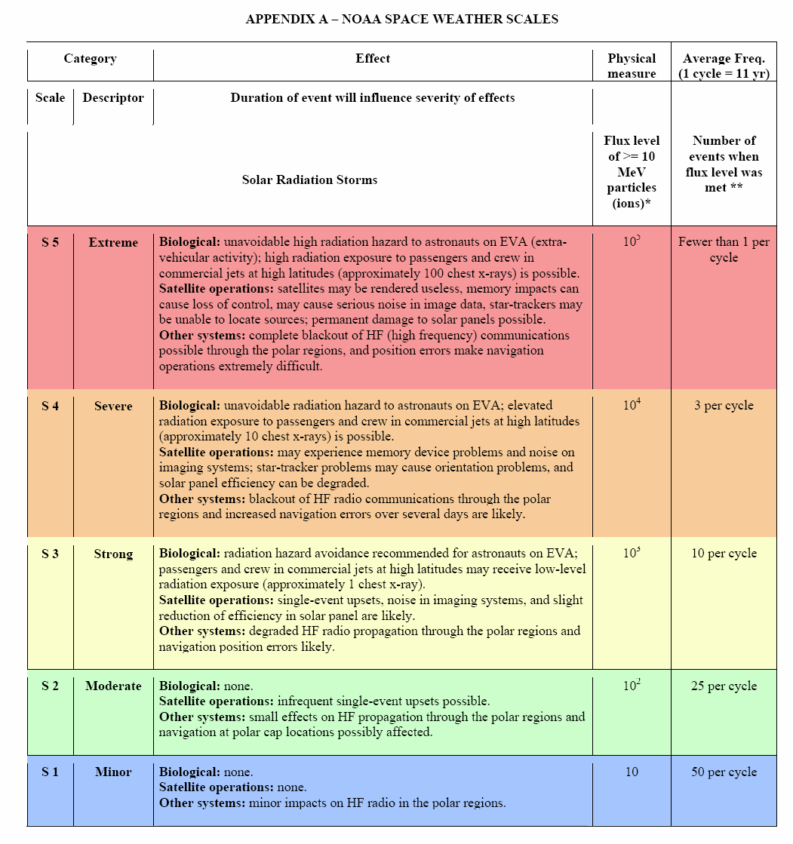
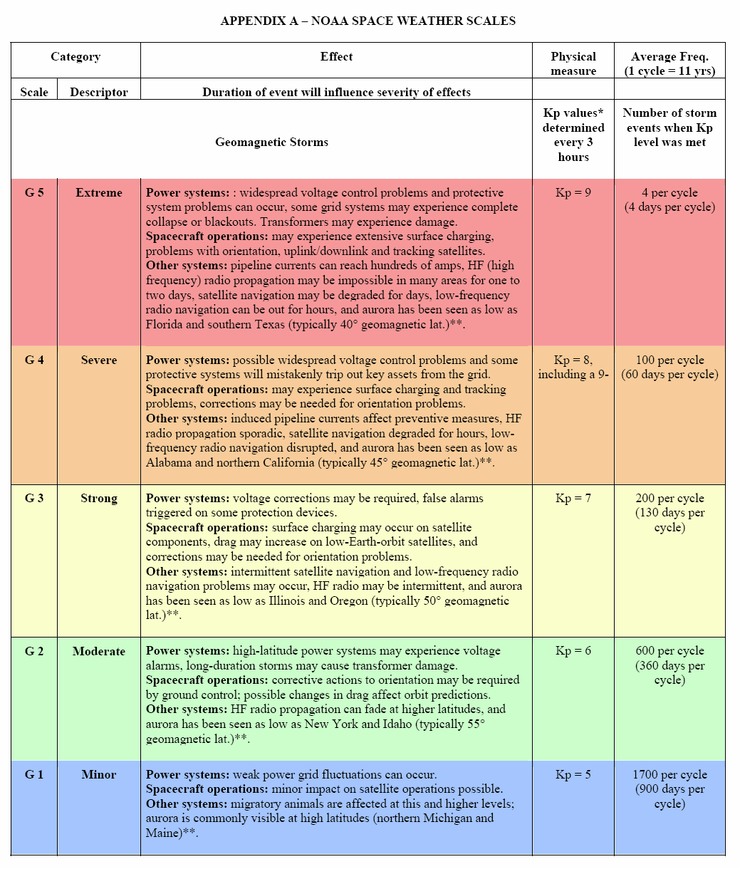
NOAA Space Weather Scales
http://www.swpc.noaa.gov/NOAAscales/
Radio Blackouts
Radiation Storms
Geomagnetic Storms

Slide 8
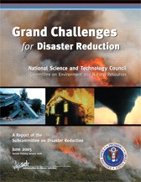
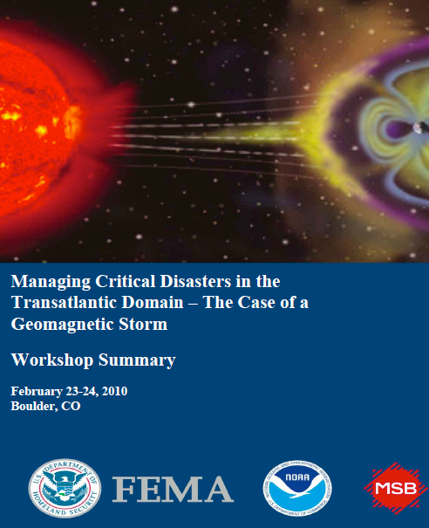
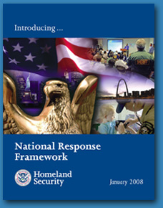
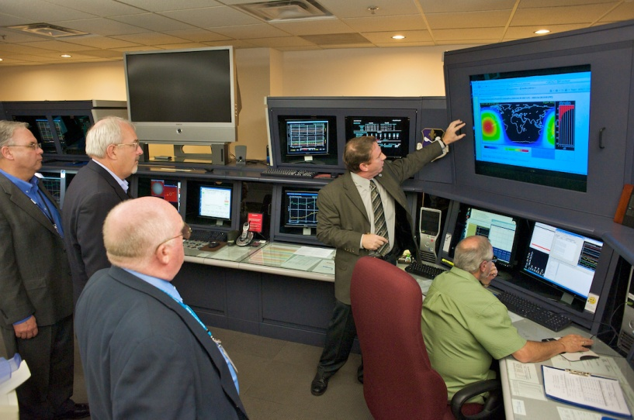
Contributing to Federal Level Activities
Space weather being addressed at all levels of government.
Government working on ways forward to develop and implement mitigation strategies to safeguard critical infrastructure from the impacts of severe space weather.

Slide 9
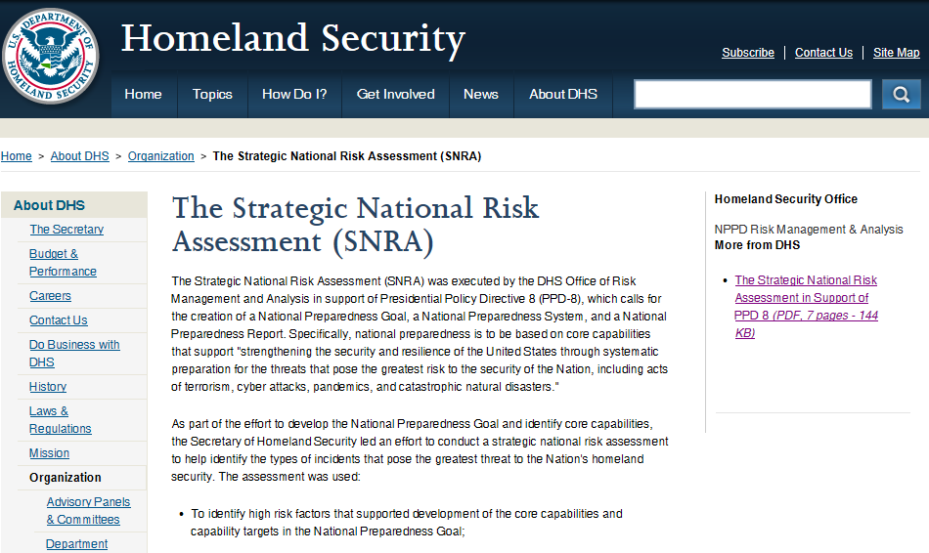
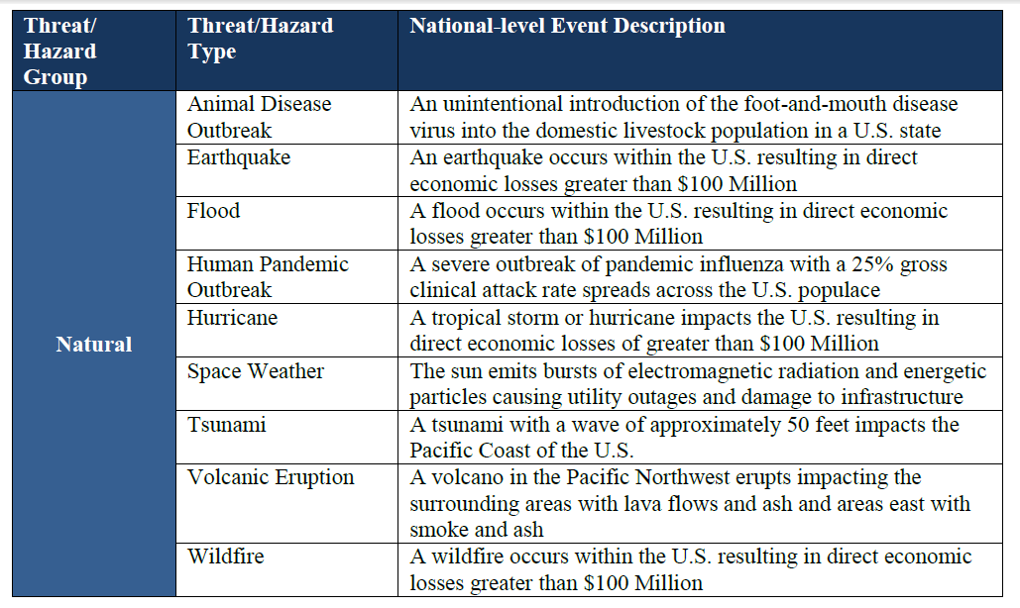
Strategic National Risk Assessment

Slide 10


Space Weather Event Alert & Notification – Federal Emergency Management Agency (FEMA)
Directly or indirectly cause or exacerbate a major disaster or emergency
Interfere with or seriously degrade FEMA’s response & recovery capability
Notification / Action
FAOC- West
ENS to MOCs & Watches; Send Plain Language Email
FAOC- East
NAWAS / WAWAS
(S5, G5 only)
Notify
Leadership
NRCC-RWC
Notify NOC; Broad Distro Plain Language Email
FOC
S4-S5 Radiation Storms
G4-G5 Geomagnetic Storms
E-mail alert via Subscription Service
FEMA Operation Centers
Situational Awareness
R2, S3, G3

Slide 11
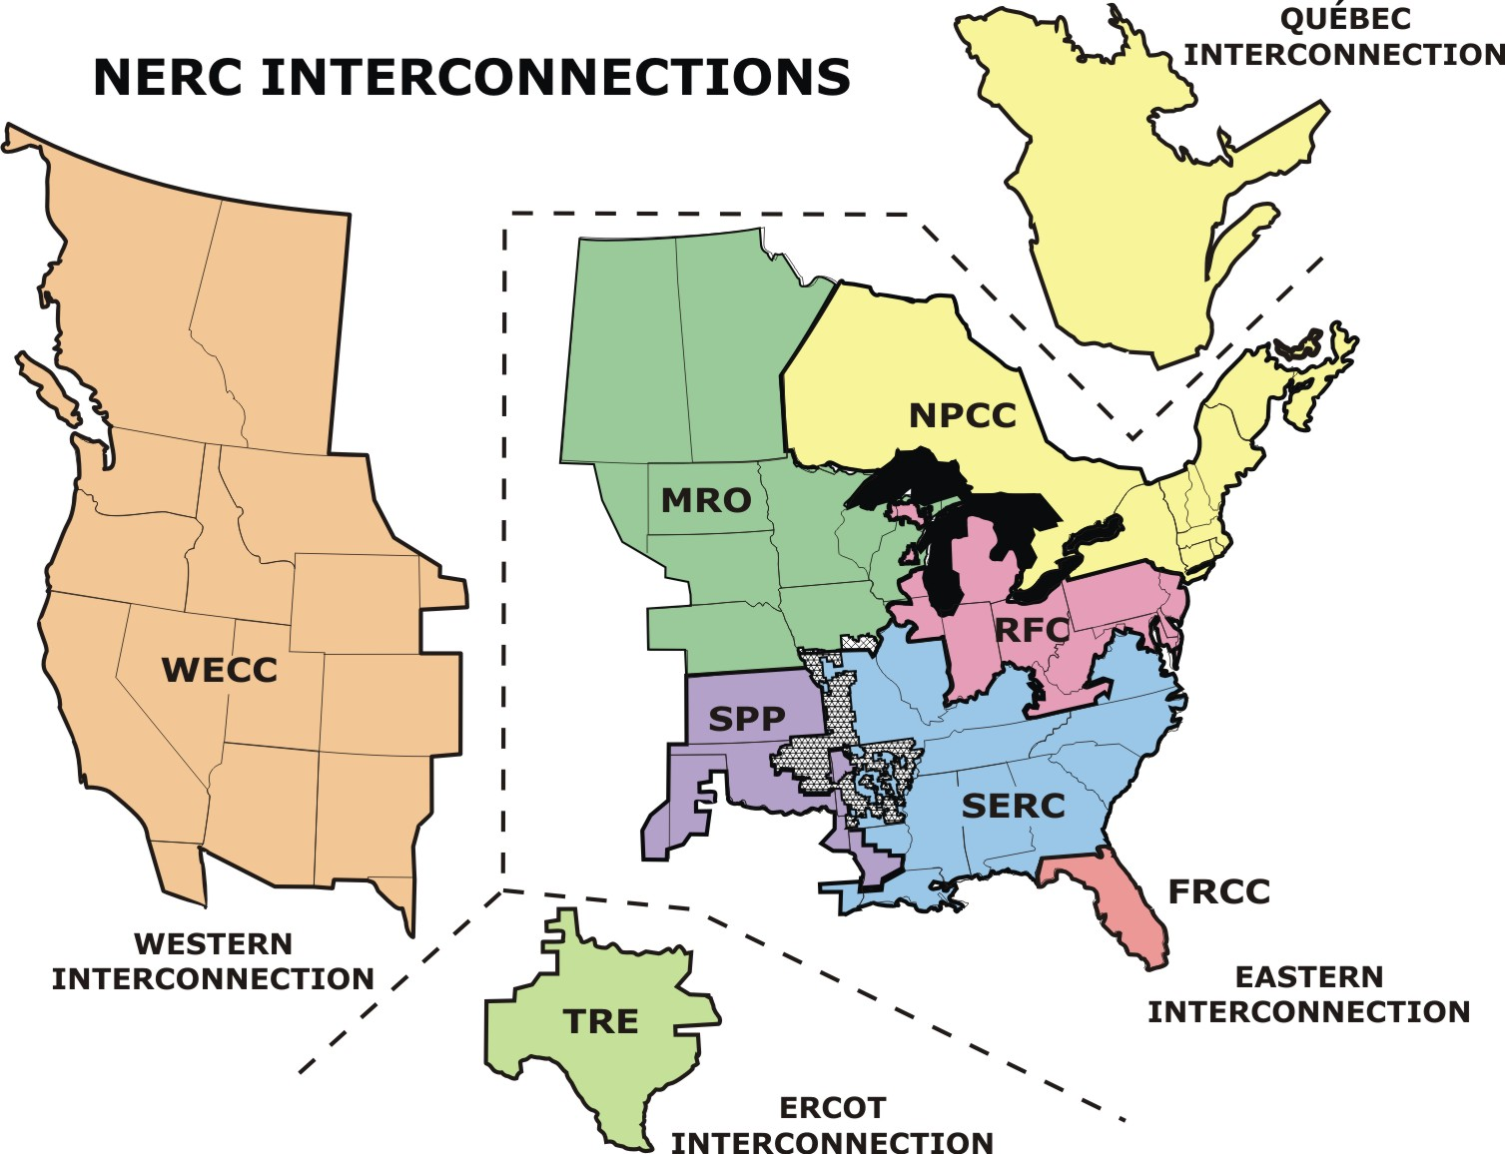
SWPC product distribution
WECC Reliability Coordinator, Vancouver
Midwest ISO, St. Paul
WECC Loveland, CO
NYISO
SWPC G2 Alerts and Warning dissemination

Slide 12
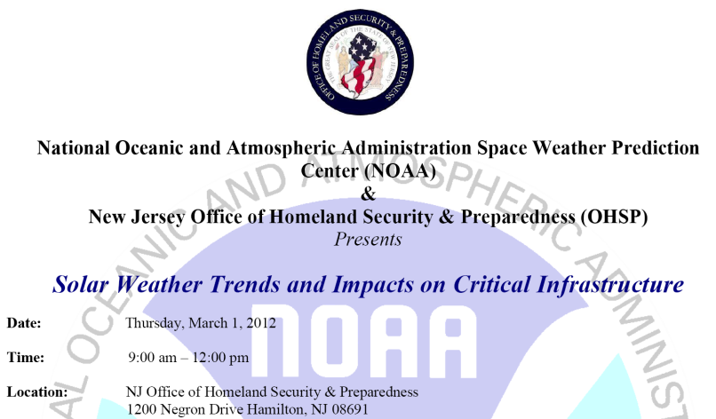
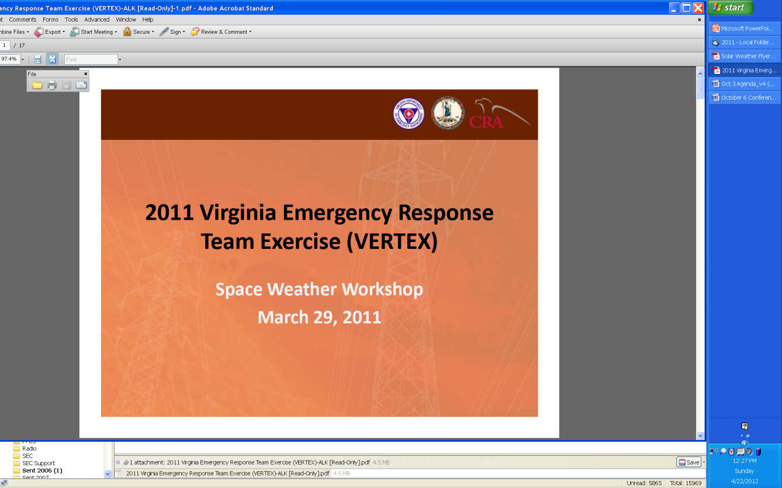
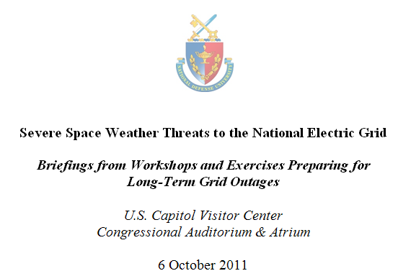
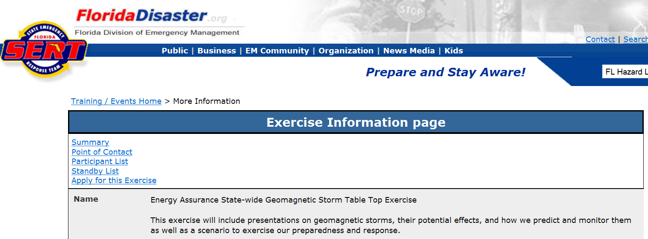
Contributing operational support to national and state exercises on space weather
National & State Exercises
  Table top exercises to discuss space weather and how to incorporate into planning documents
Emergency Planning
  Integrating into plans and procedures
  Training
  Response and preparation documentation
The overarching purpose of the 2011 (VERTEX) series is to develop and test a statewide strategy to respond to and manage the effects of Geomagnetically Induced Currents on the Commonwealth’s electrical power and communications systems,

Slide 13
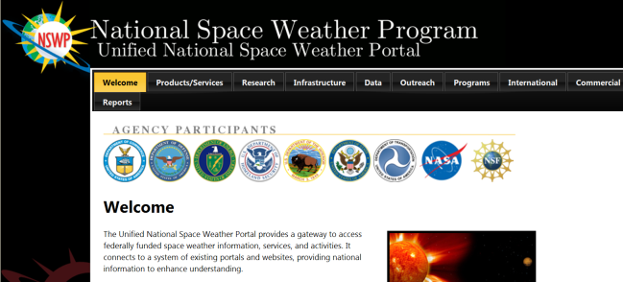
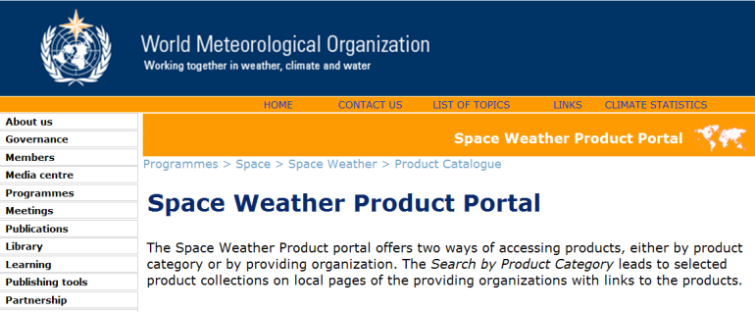
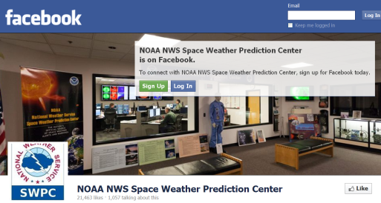
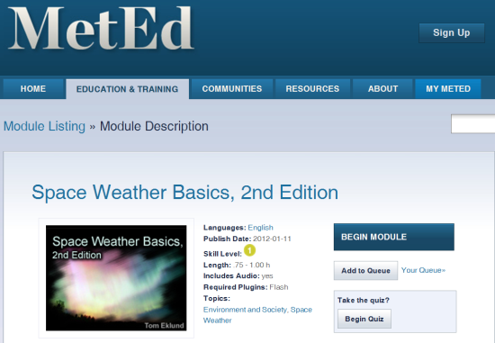
Education & Outreach
National Space Weather Portal
NWS Training Center just released module for NWS Weather Forecast Offices
WMO Space Weather Product Portal
  WMO Training Modules developed via NWS Training Center (2013)
Social Media – Visit SWPC on Facebook
Overhaul of SWPC Web Page – in progress
Training developed via COMET
  SWx Basics Module
  SWx Impacts on Aviation Module

Slide 14
Customers & Service Trends
Improving Operational Services for a Weather Ready Nation
Interagency activities
International collaborations

Slide 15









Unified National Space Weather Capability
Federal agencies working together to develop a unified approach to understand and mitigate impacts of space weather on our Nation
Improve use and integration of available space weather observations into operations
Improve and accelerate research to operations
Develop new and improved mission-tailored space weather products and services
Improve collaboration between National Space Weather Program agencies
Improve coordination & cooperation with international community

Slide 16
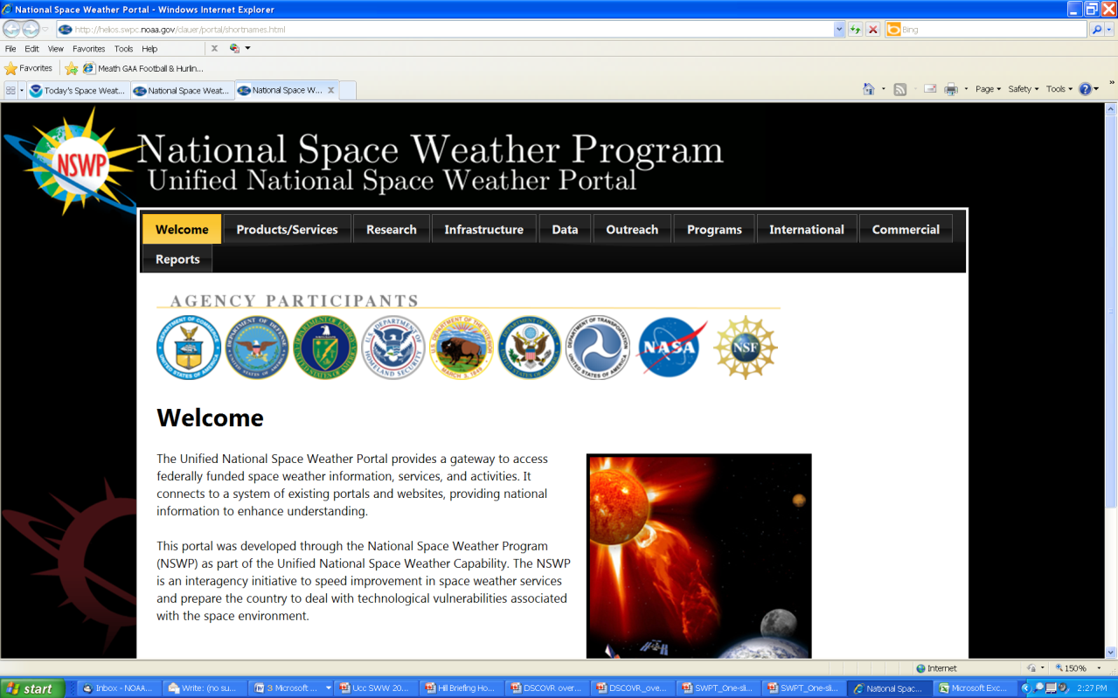
National Space Weather Portal
www.spaceweather.gov/portal
Coordinated through the National Space Weather Program
Provides a gateway to access federally funded space weather information, services, and activities
Connects to a system of existing portals and websites, providing national information to enhance understanding

Slide 17
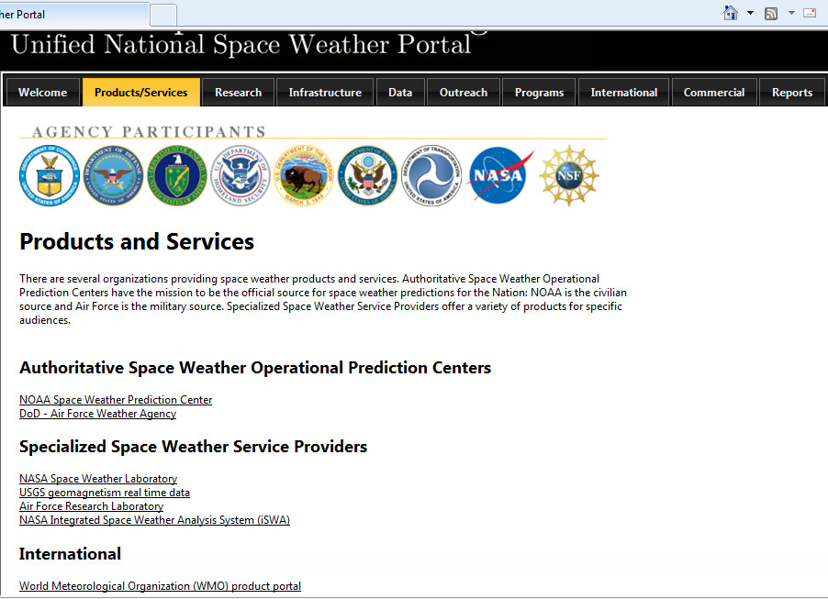
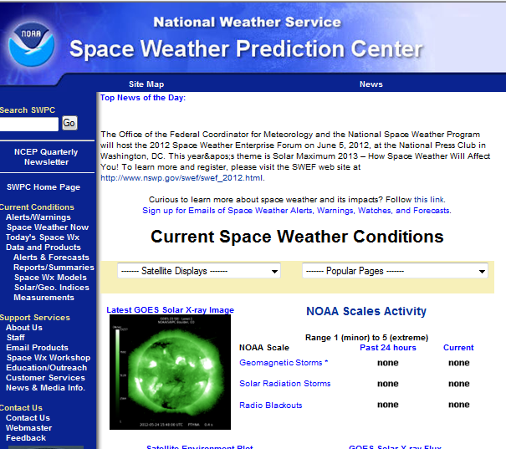
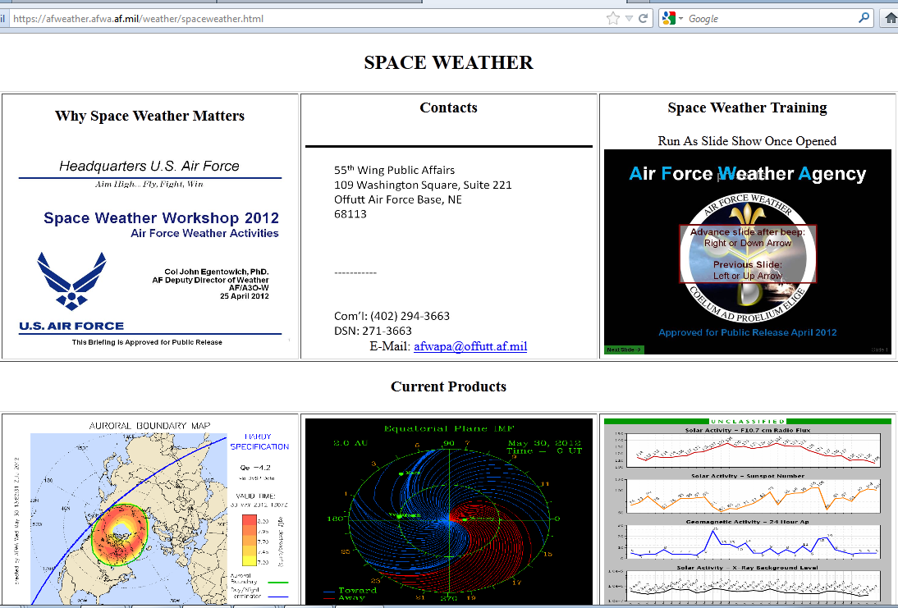

Slide 18
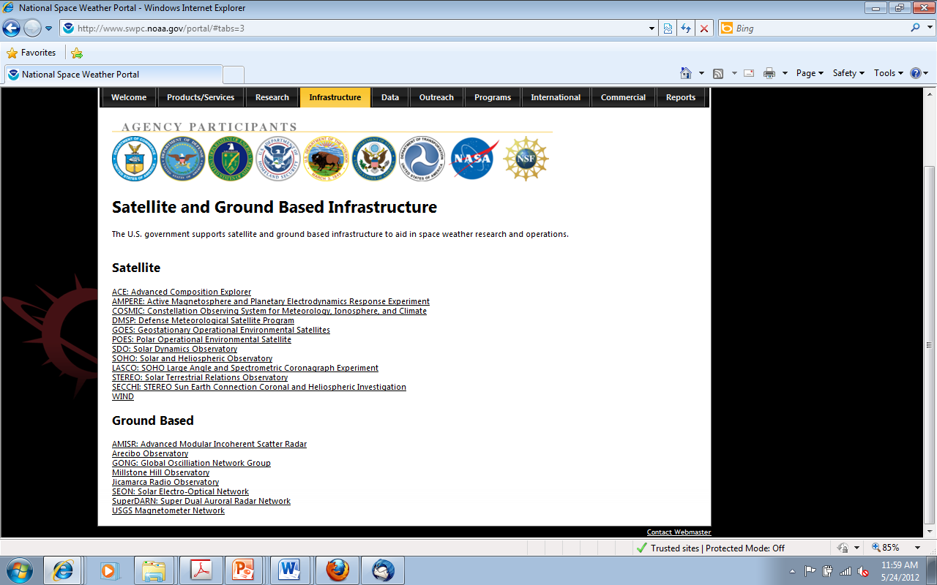





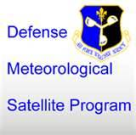
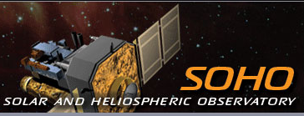

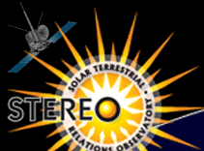
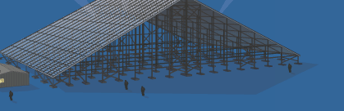
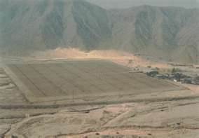
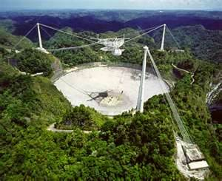
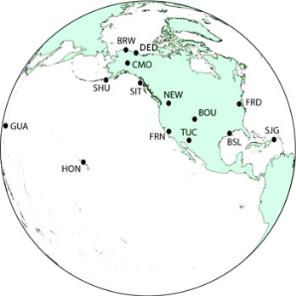

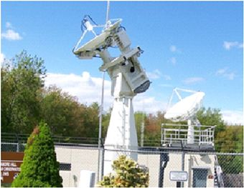

Slide 19
Customers & Service Trends
Improving Operational Services for a Weather Ready Nation
Interagency activities
International collaborations

Slide 20
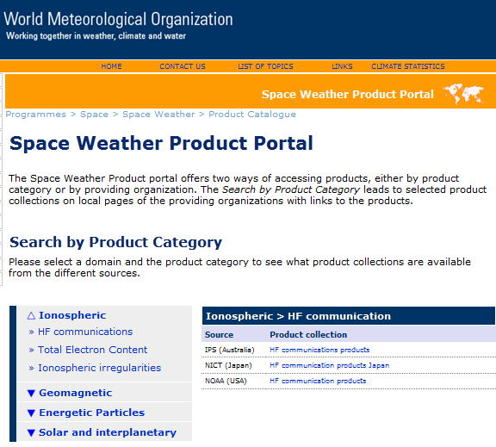




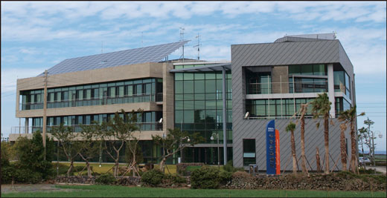
NOAA engaged in many international activities with many organizations
Increased Global Interaction
Korea Radio Research Agency

Slide 21



NOAA’s Contribution to International Space Weather
Global Threat – Global Response
Space Weather at the UN
World Meteorological Organization
International Civil Aviation Organization
UN Committee on the Peaceful Uses of Outer Space
International Space Weather Operations
United Kingdom
  Partnering on model development, forecaster training, and collaborative operational concepts, R2O
Korean Radio Research Agency
  Providing key real-time data from ACE
European Space Agency
  Plans to build upon respective capabilities

Slide 22
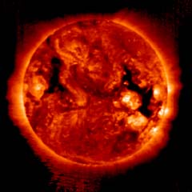

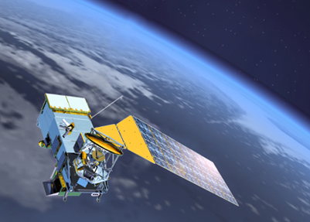
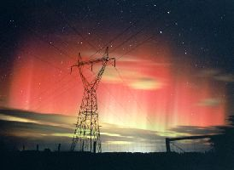
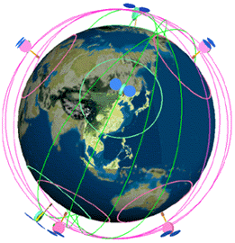
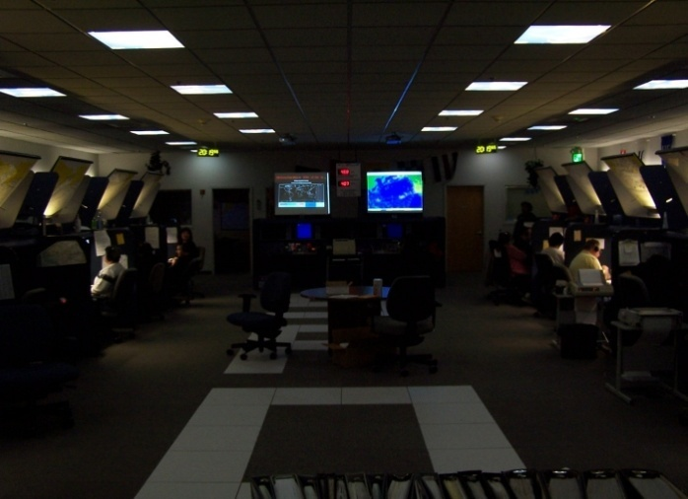

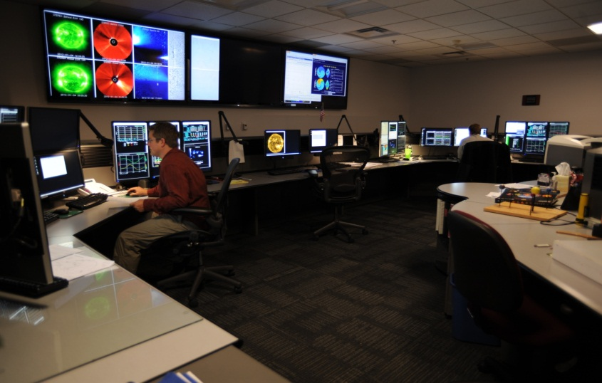
Global Impact – Global Challenge – Global Response
Provide the right information… in the right format... at the right time… to the right people… to make the right decisions!
Notes:
22

