Slide 1



How to
Deal with Geomagnetic Storms in Directional Drilling
Inge Edvardsen
PhD Candidate/Survey Management Engineer

Slide 2
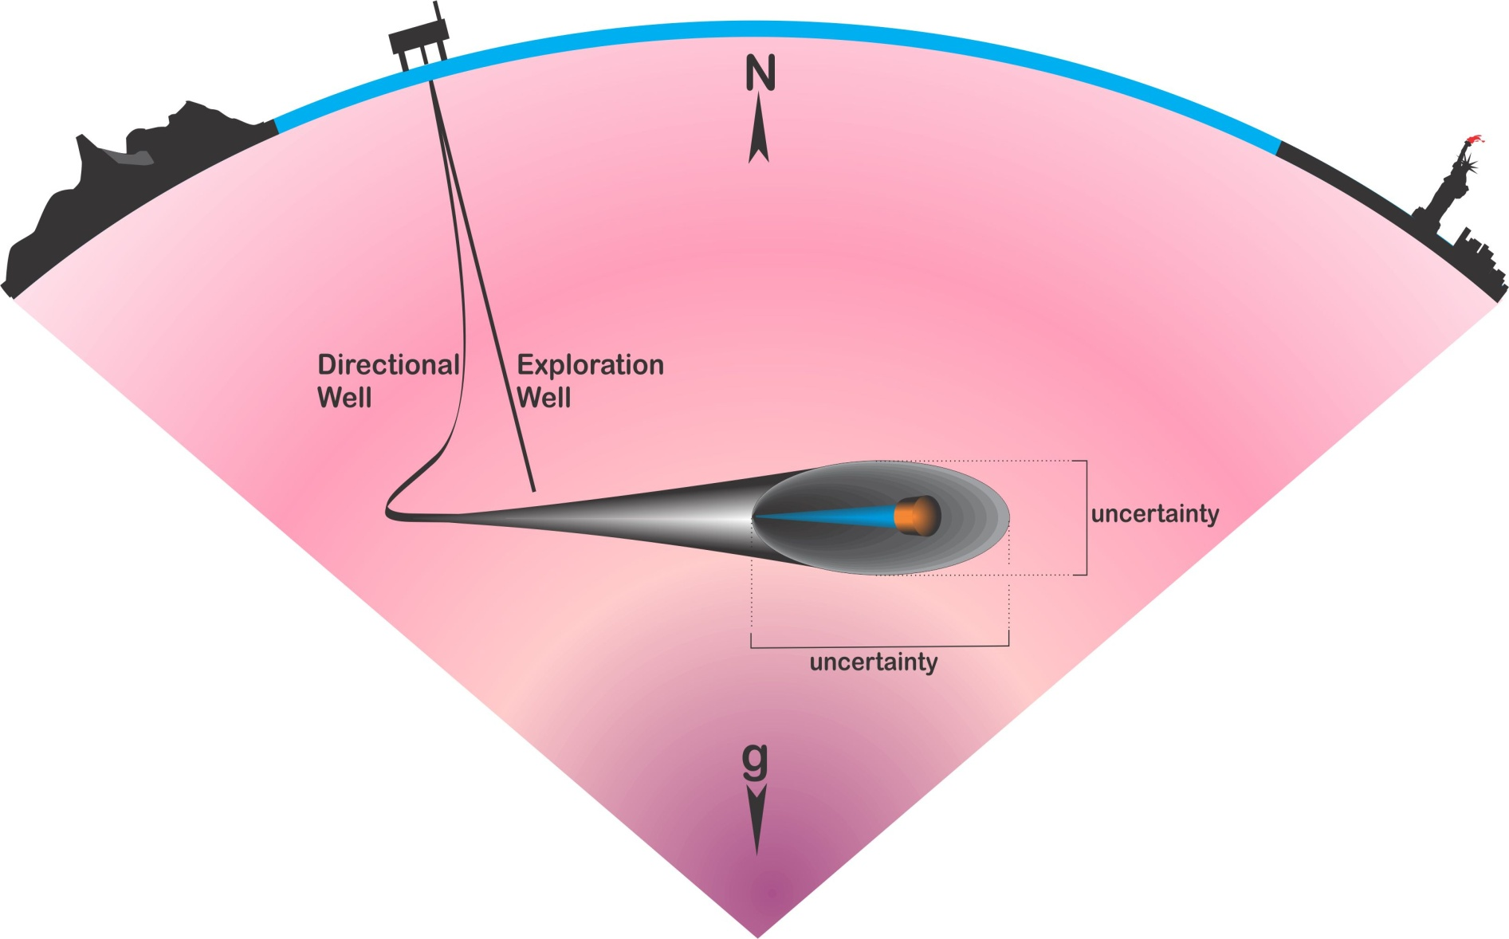
Directional Drilling
Wellpath
MD [m] | INC° | AZI°
0 | 0 | 0
30 | 0 | 0
...
1000 | 90 | 180
...
5000 | 90 | 90
Directional drilling is the practice for drilling non-vertical wells.

Slide 3
Magnetic Directional Surveying
The accuracy of magnetic azimuth decreases with increasing latitude due to:
  Magnetic north is more difficult to resolve because of smaller signal strength.
  Increased time dependent fluctuations in the orientation of the magnetic field, magnetic storms (The disturbance field).

Slide 4
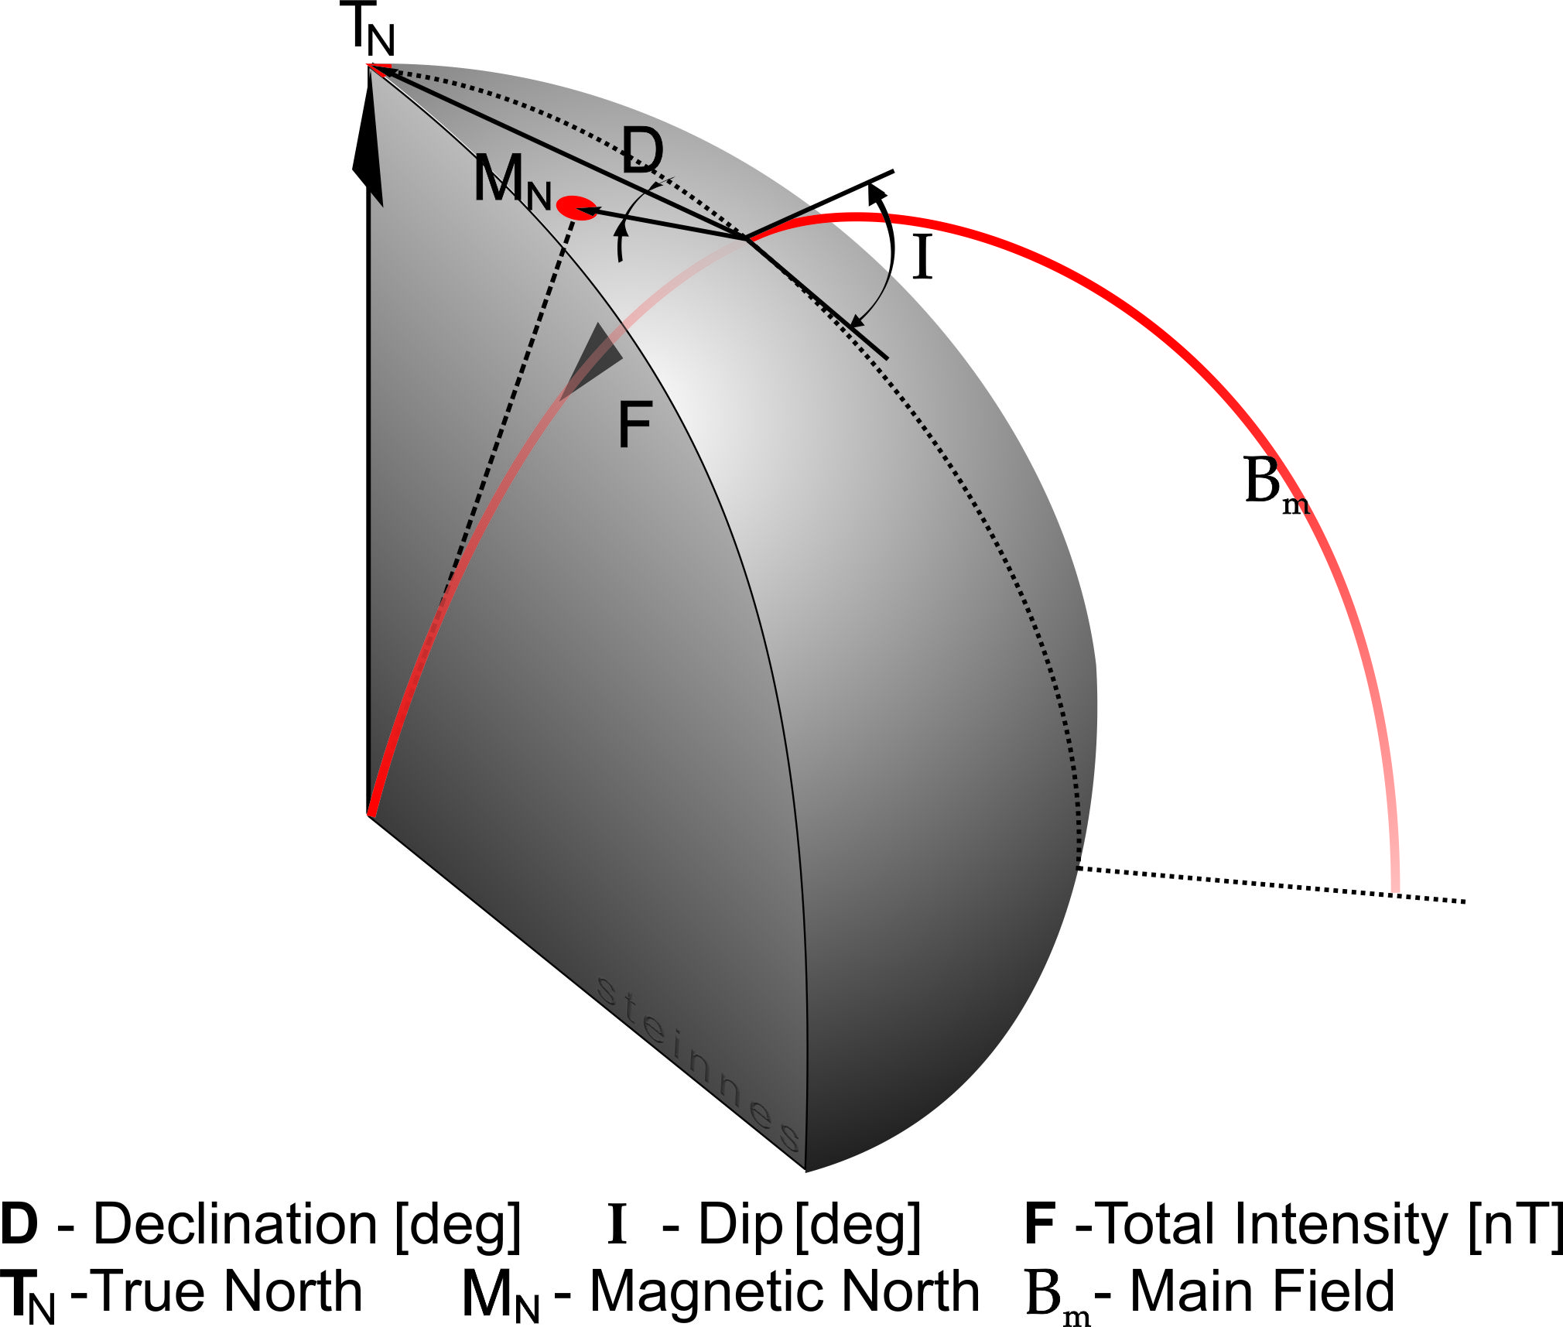
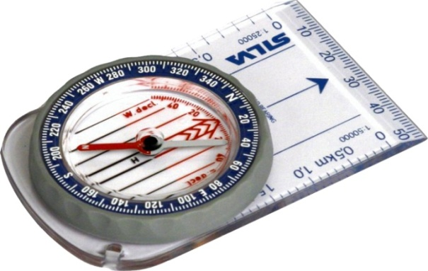
Earth’s Magnetic Field - Main Characteristics

Slide 5
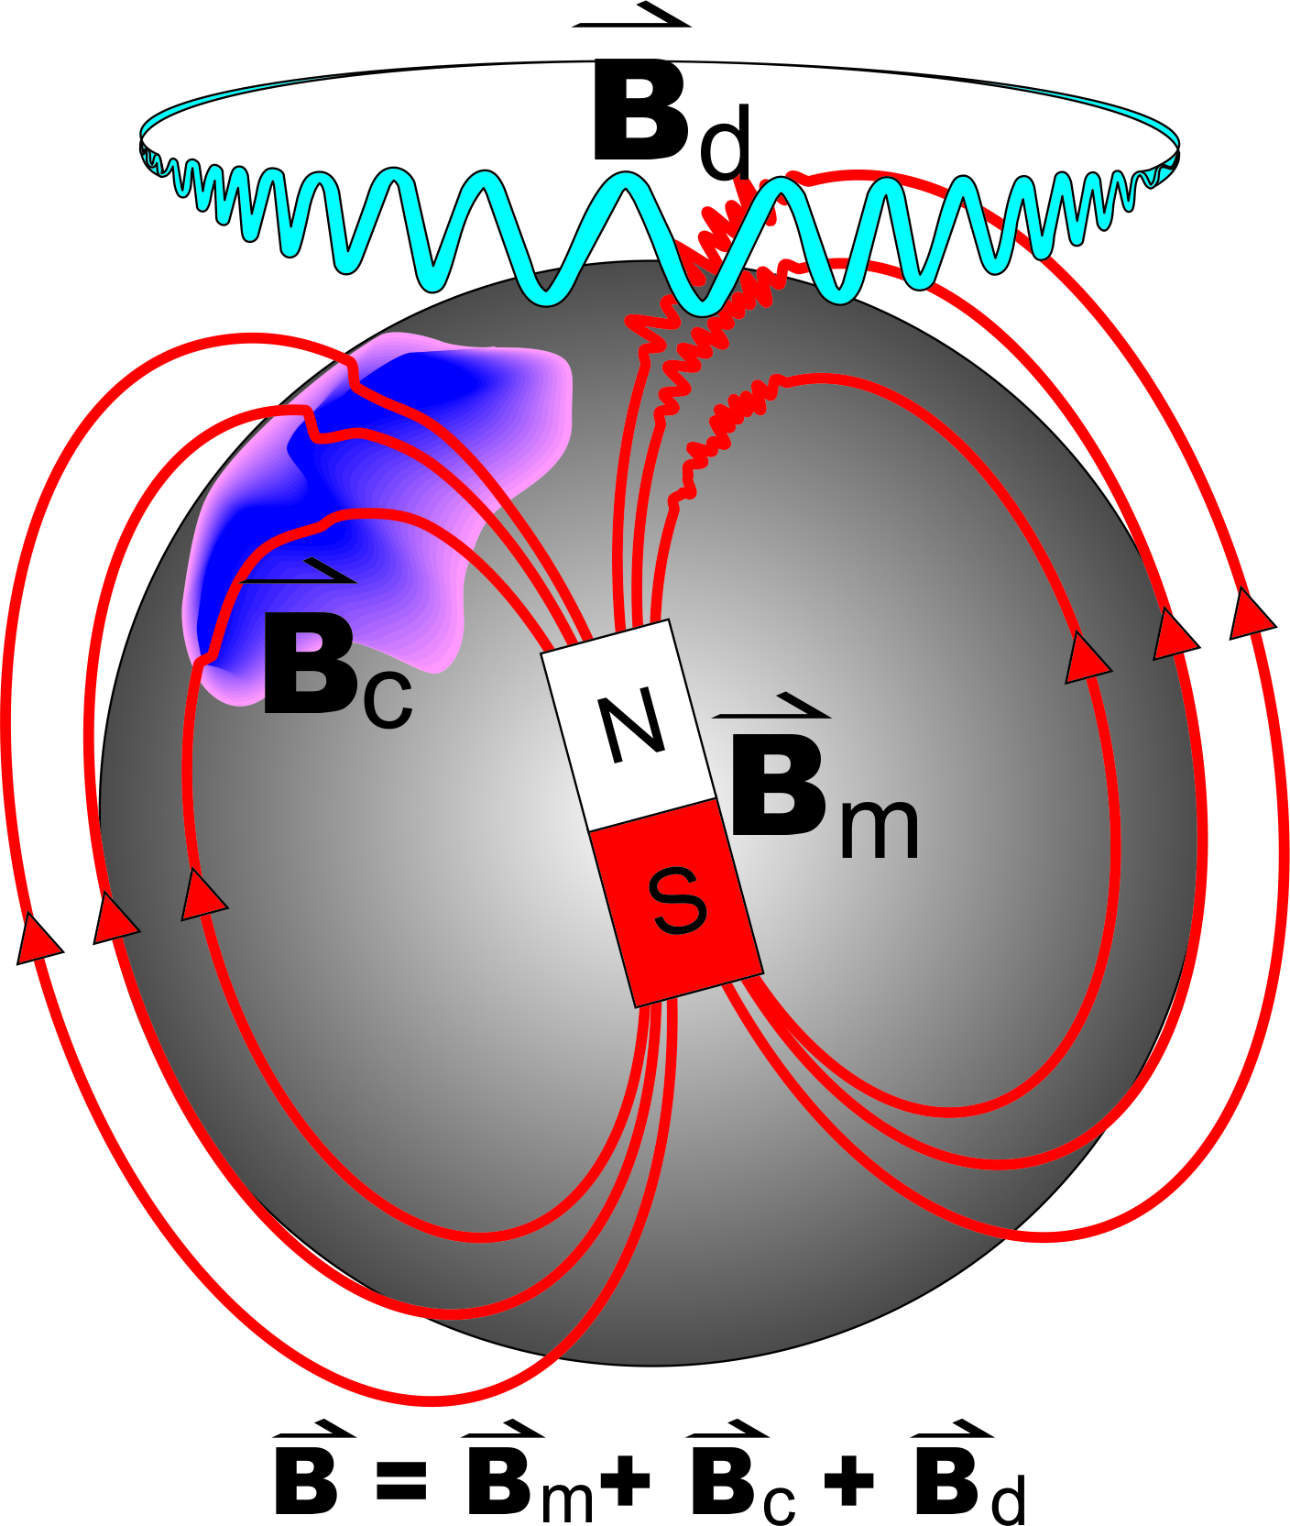
Earth’s Magnetic Field - Components
B_{m} - Main field
B_{c} - Crustal field
B_{d} - Disturbance field

Slide 6
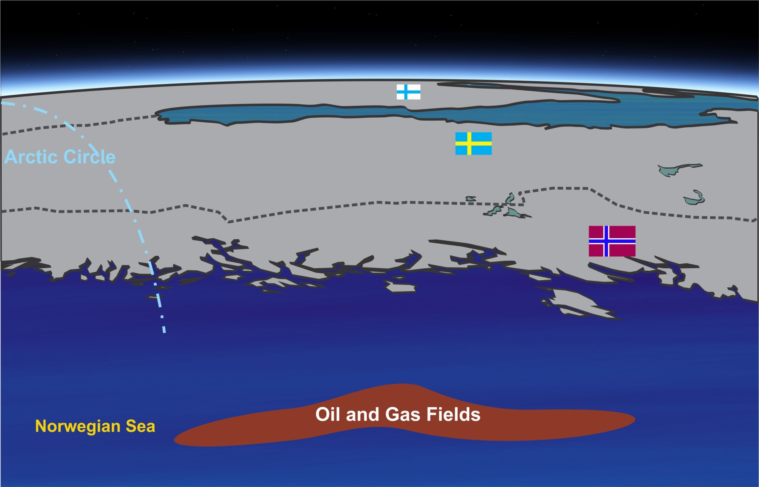
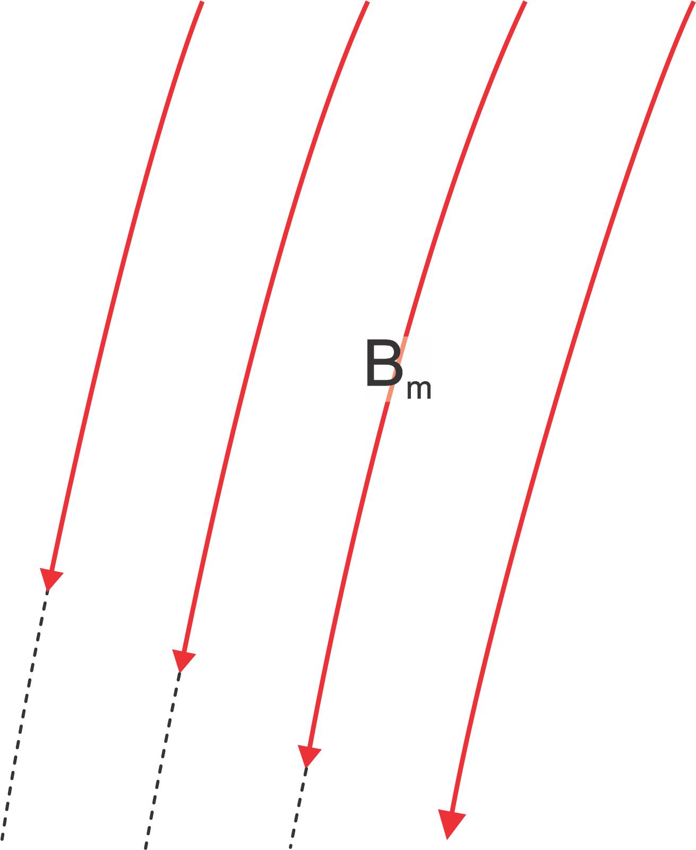

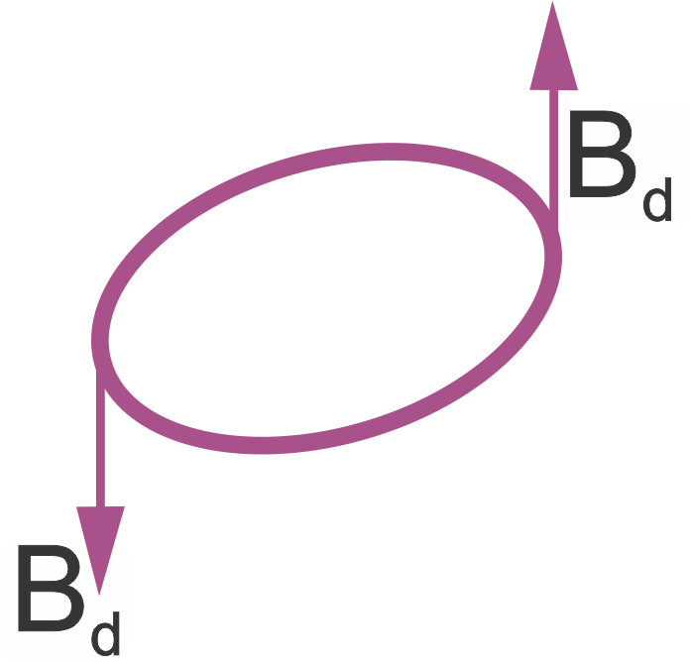
The Disturbance Field –
The Auroral Electrojet
B_{m} - Main field
I - Auroral Electrojet
B_{d} - Disturbance Field

Slide 7


Monitoring the Disturbance Field
Jäckvik
Dønna
Rørvik
- Variometer station
B_{m} - Main field
I - Auroral Electrojet
B_{d} - Disturbance Field

Slide 8
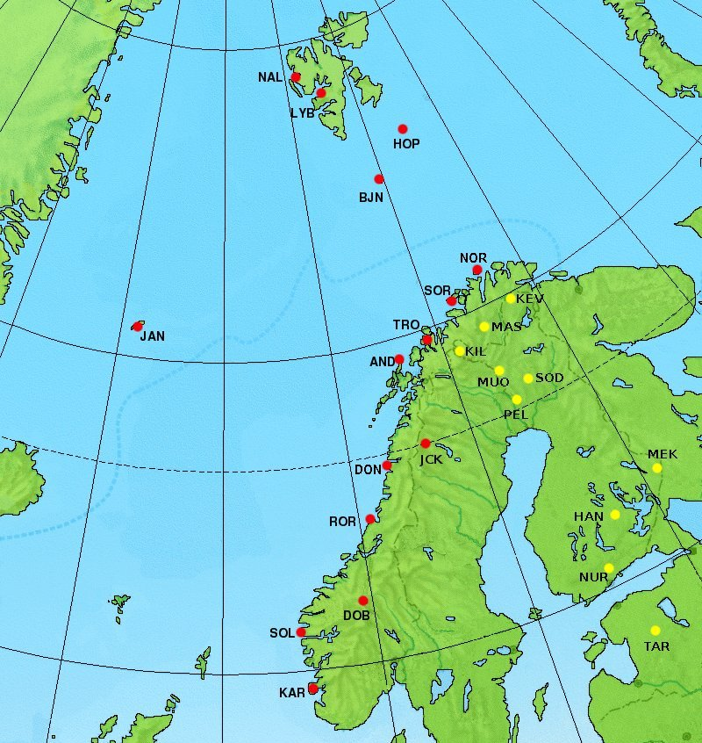
Monitoring the Disturbance Field
Finnish geomagnetic observatories and stations
Norwegian geomagnetic observatories and stations

Slide 9
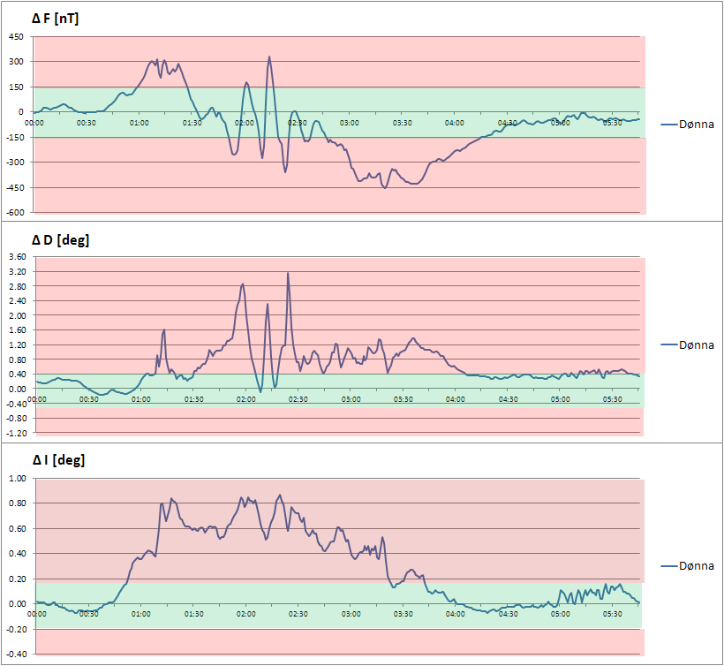
The Disturbance Field – Magnetic Storm
Magnetic storm at Dønna
6th August 2011
The green area indicates the MWD error model disturbance limits.
F [nT] | D [deg] | I [deg]
+/- 147 | +/- 0.45 | +/- 0.18

Slide 10

UIT Warning System
When any of the error model disturbance limits are exceeded:
  A sms and an e-mail is transmitted to service companies.
  The Survey Management engineer evaluates the situation og gives recommendations to the offshore rig sites.

Slide 11
Why Deal with the Disturbance Field
It is neccessary to manage such disturbances to have directional control while drilling.
  Hit the geological target and maximize the recovery
  Avoid other wells
Survey QC tests may identify an out of spec condition, and monitoring of the field can differentiate between tool failure and field disturbance.
  Avoid unnecessary pull outs
Accurate monitoring may allow correction for disturbance effects.

Slide 12
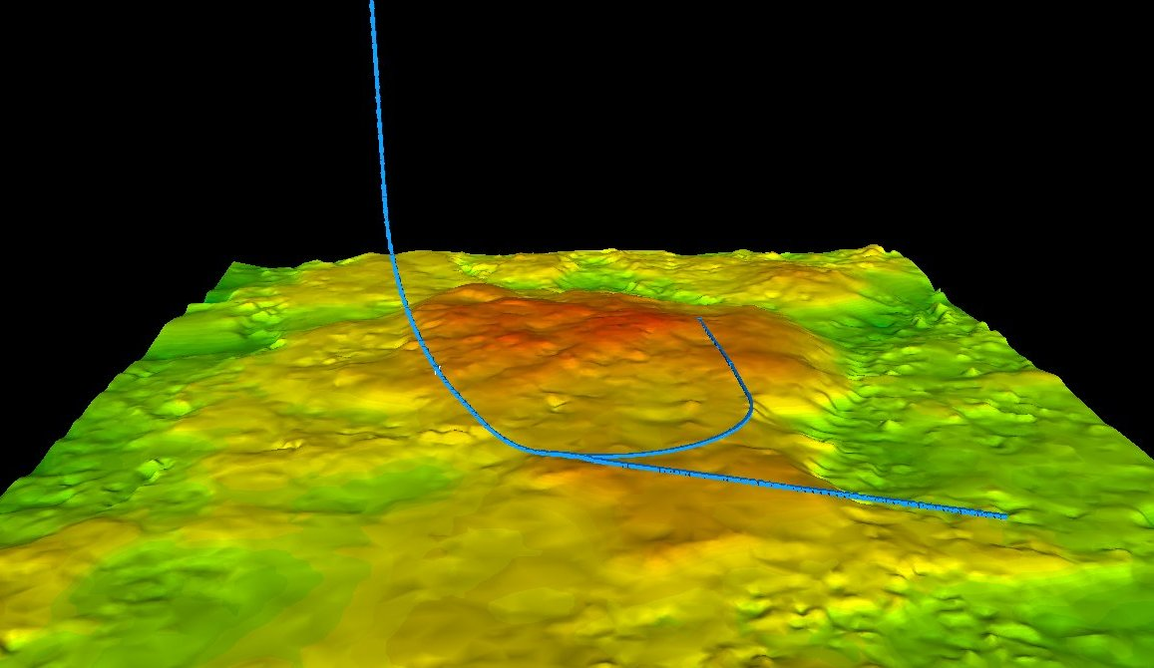
Hit the Geological Target

Slide 13
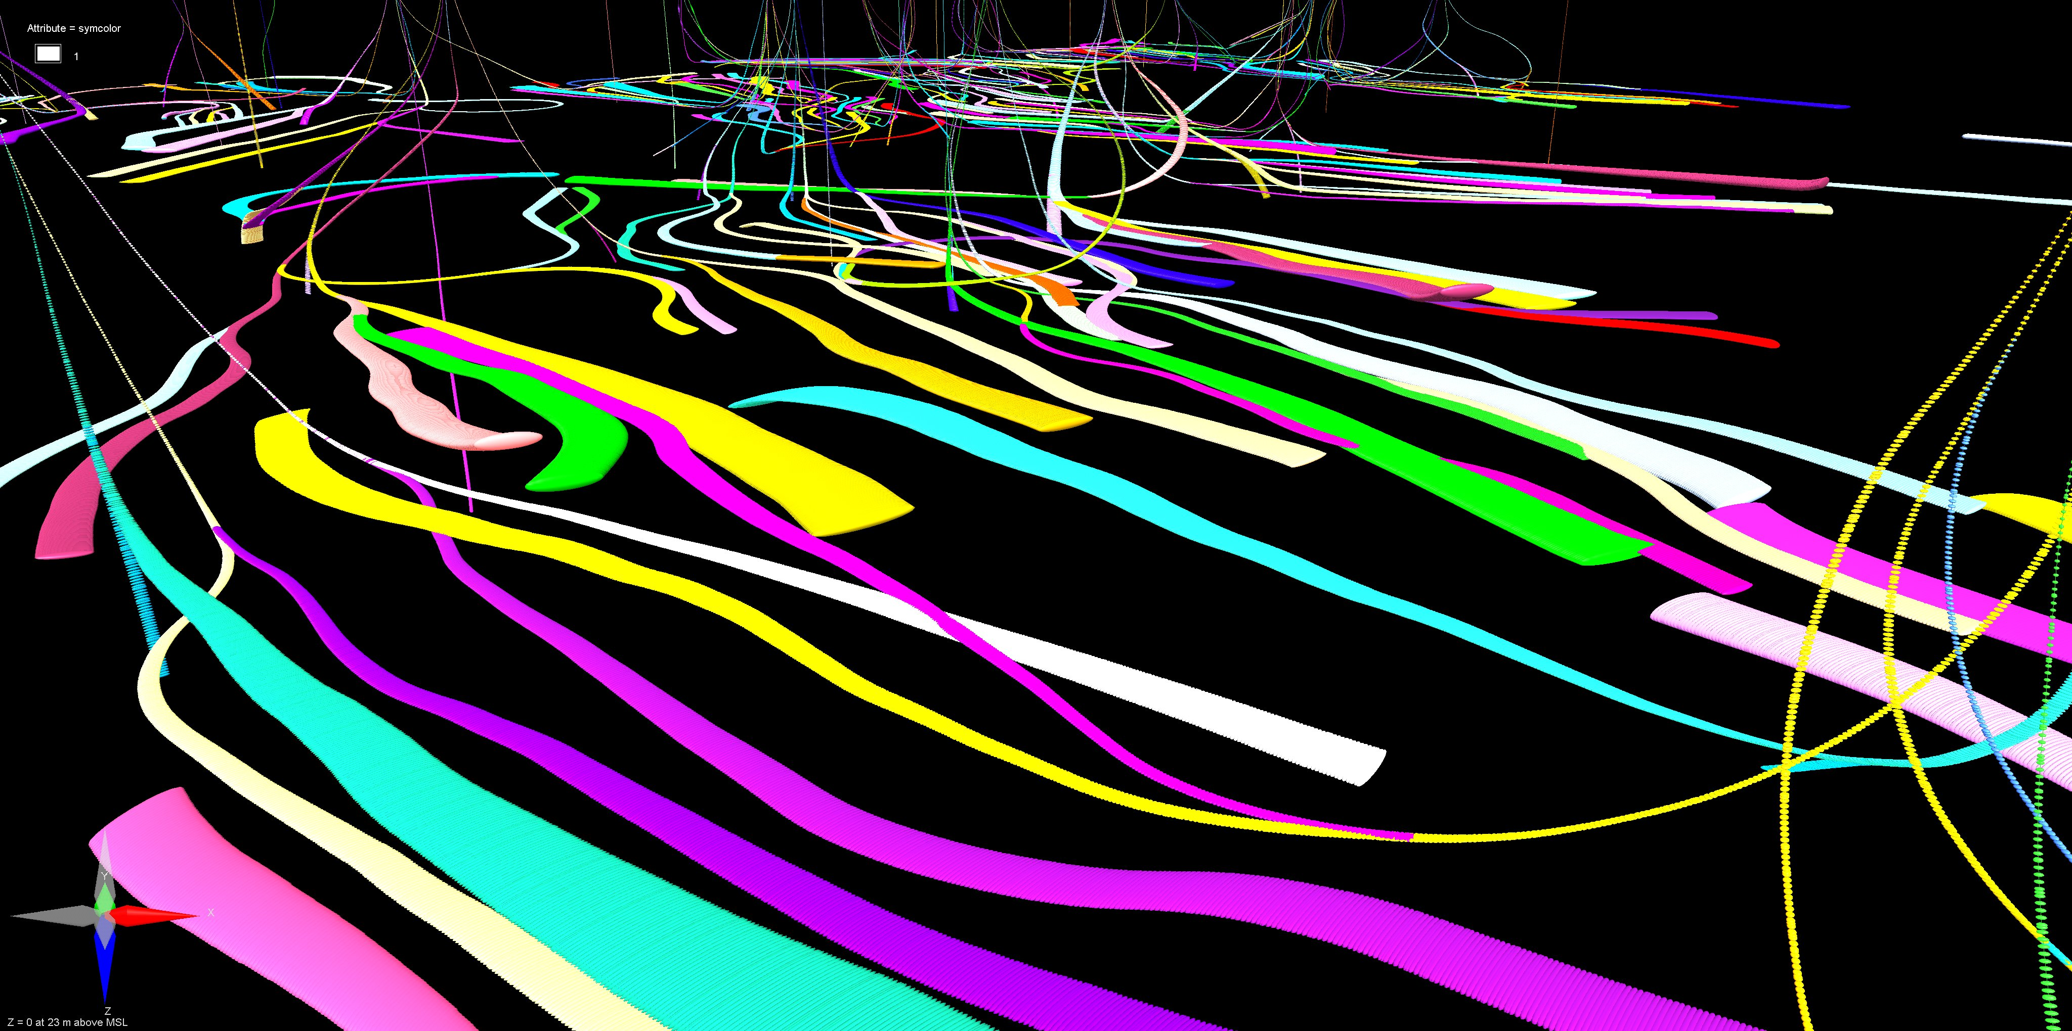
Avoid Other Wells

Slide 14
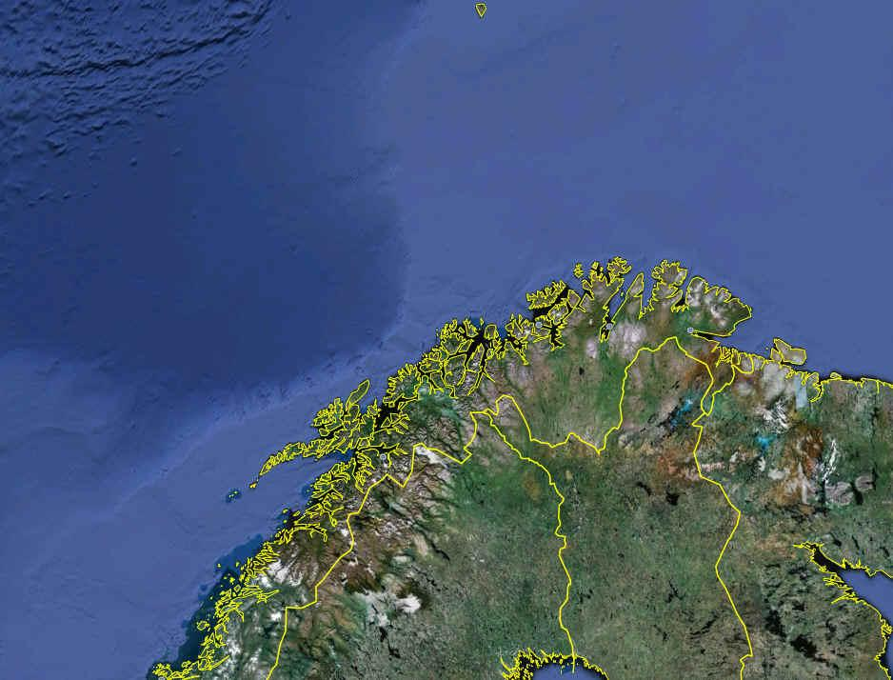
Monitoring in the Norwegian Sea
Barents Sea
- Monitoring Station (Variometer)
- Oil & Gas Fields
Norwegian Sea
200 km
DØN
JAC
RØR

Slide 15
Conclusions
To have directional control while drilling is important for several reasons:
  Hit the geological target and maximize the recovery
  Avoid other wells
  Avoid unnecessary pull outs
Monitoring the external magnetic field is vital for achieving this.

Slide 16
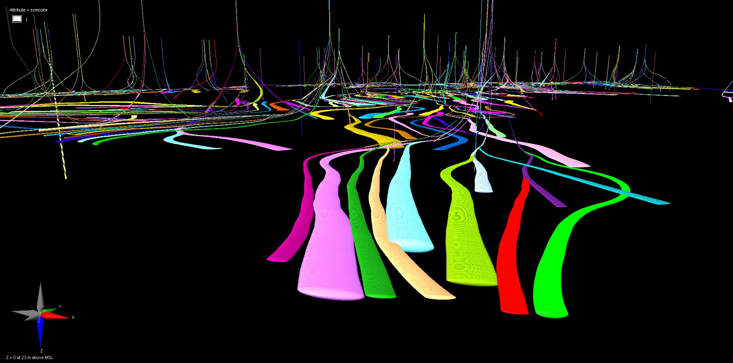
Thank You for Listening

