Slide 1


Reducing uncertainty –
an electricity utility’s response to severe solar storms
CT Gaunt

Slide 2
Hypothesis
Lack of preparation causes emergencies.
Increased understanding reduces surprise.
Risk can be managed.
Need to know processes, exposure and consequences.
Risk awareness ≠ preparedness.

Slide 3
Space physics
SYSTEM
CME
5 sub-systems
Geomagnetic storm & induction
Transformer engineering
Network analysis
GIC
Transformer response
Other threats
System response
Mitigation
Network reliability and cost
Decision support

Slide 4
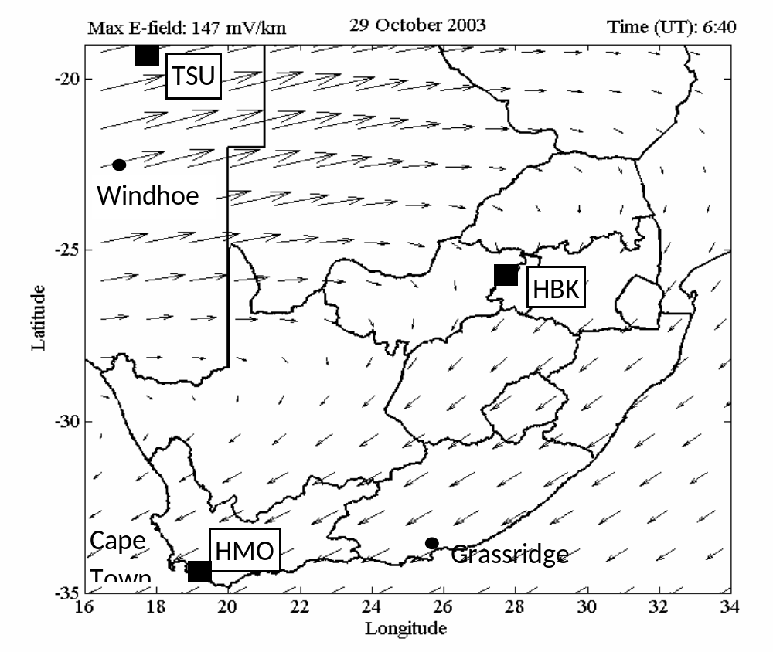
Space physics
Sun’s CMEs induce fields at the Earth’s surface:
Want forecasts of time of arrival, magnitude and duration – ahead of real-time measurements.

Slide 5
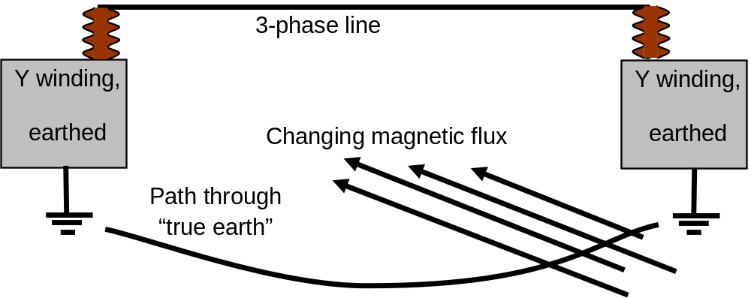
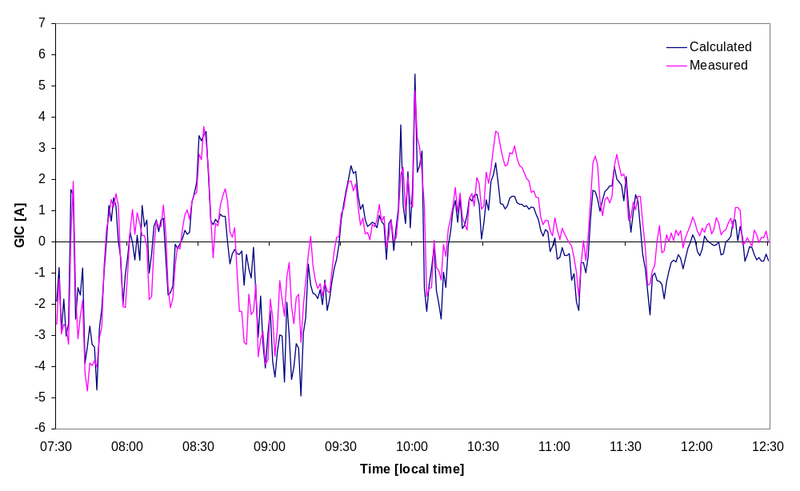
Network analysis
Y winding, earthed neutral
Y winding, earthed neutral
Most existing models ignore network time constants (inductance).

Slide 6
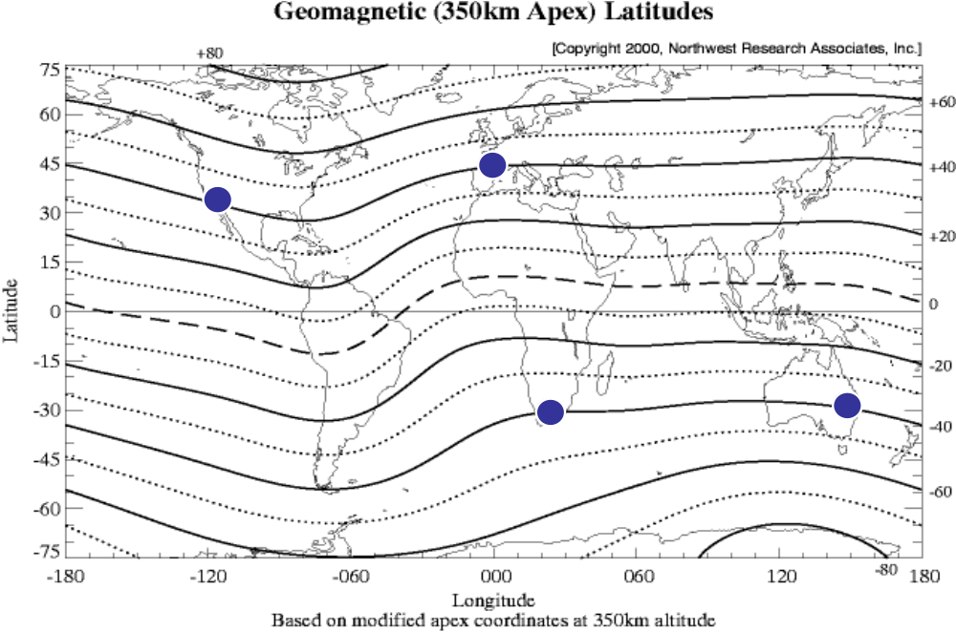
GIC exposure

Slide 7
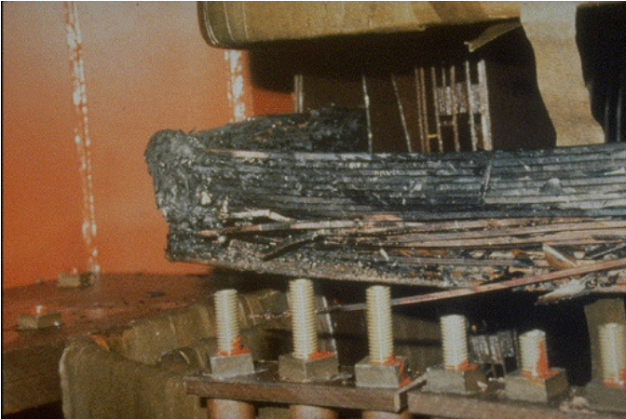
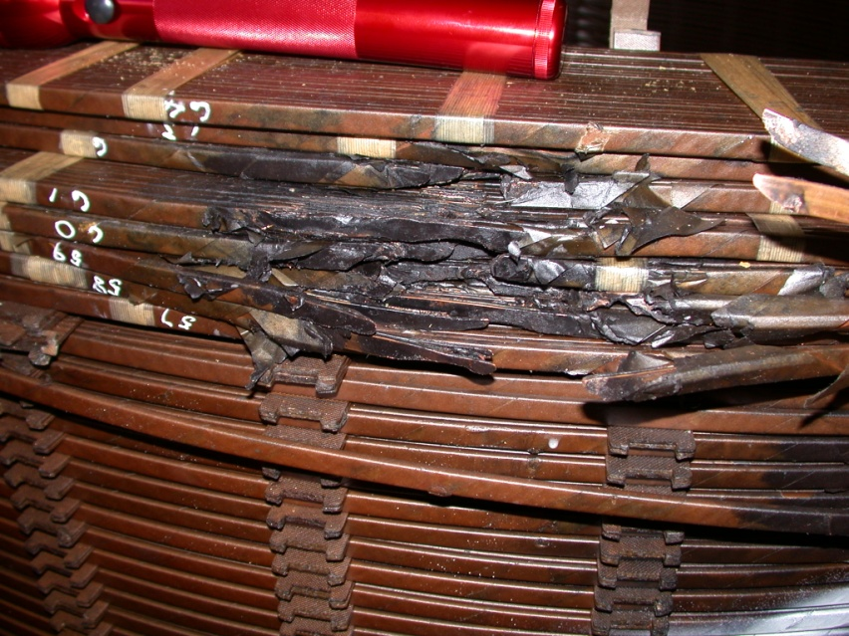
Three types of GIC risk
Risk of immediate power system collapse. (Hydro Quebec, Malmö)
Risk of immediate transformer failure, without causing power system collapse. (Salem, National Grid)
Risk of damage to transformers, not immediately evident. (Allegheny Power, Eskom)

Slide 8
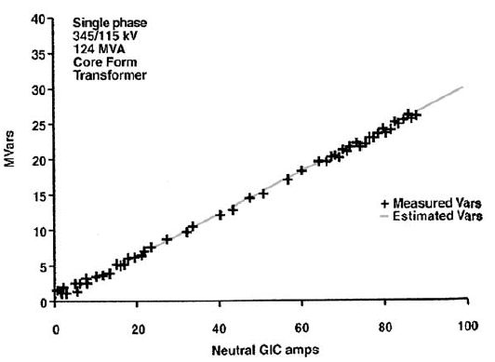
Power system collapse
GICs generate harmonics in transformers, and increase ‘reactive power’ load of transformers
► Harmonics - sensitive relays trip to remove equipment from damage, typically capacitors
+ Loss of ‘reactive power’ support (capacitors) just when even more is needed (for transformers) initiates system voltage collapse.
Need to know the summated harmonics generation and ‘reactive power’ demand resulting from GICs in all the nodes.

Slide 9
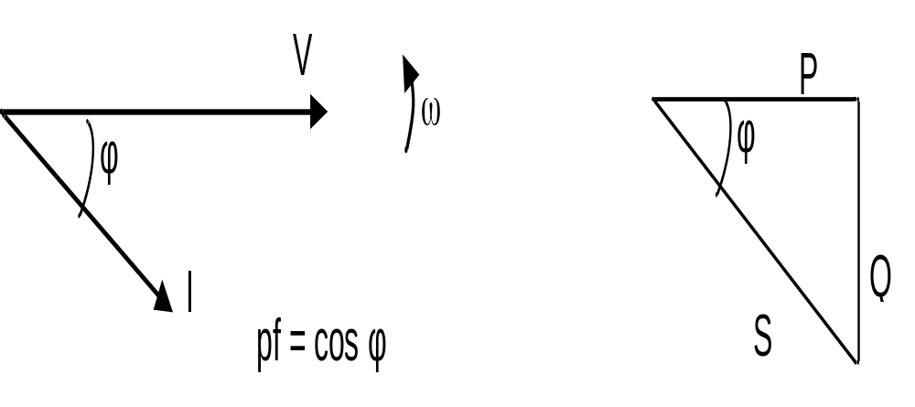
Power triangle defines reactive power
1-ph phasor representation, current lags voltage
Power triangle: Q ² = S ² – P ²
Q?
Power factor?

Slide 10
Distortion power
Out-of-balance current in phase wires flows in neutral. Neutral current adds to total losses.
Non-sinusoidal load current (non-linear loads) reduces efficiency:
Cyclical distortion = harmonics.
Reactive power associated with L and C,
Distortion power with unbalance and harmonics,
→ S ² = P ² + Q ² + D ²
Q ² + D ² not right angle triangle, so non-active power not uniquely defined.

Slide 11
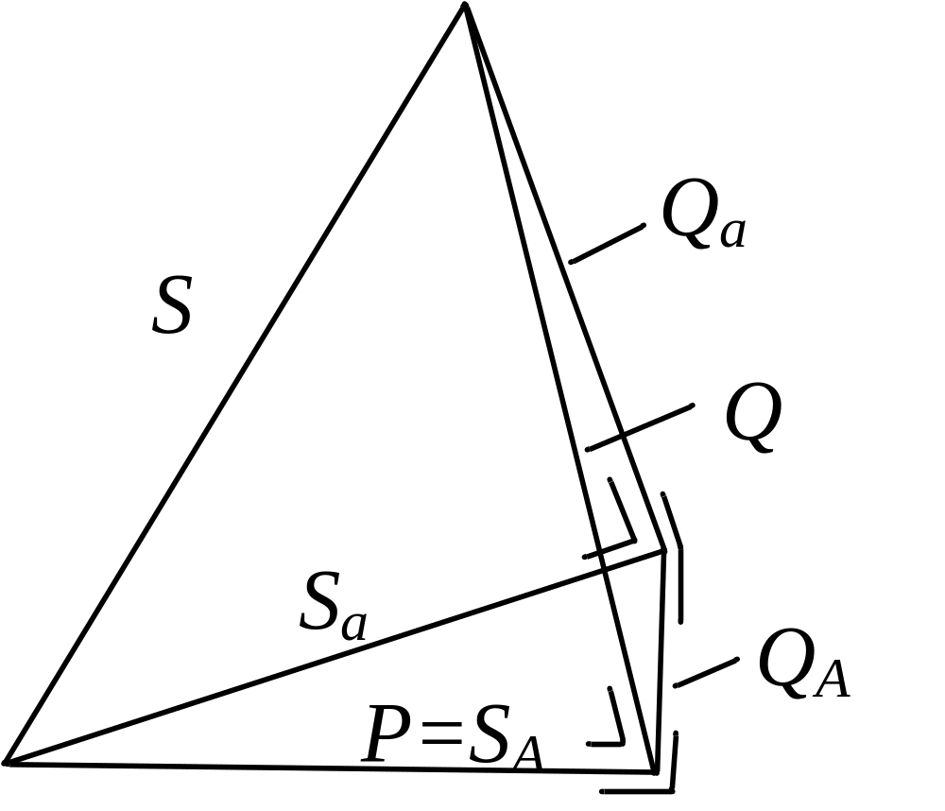
General Power Theory: 3-D power triangle
4 recent papers by Michel Malengret and Trevor Gaunt
Components of non-active power are orthogonal.
Q = total non-active power
Qa = component compensated without energy storage
QA = component needing energy storage for compensation
S = apparent power without compensation
Sa = apparent power after comp without energy storage
SA = apparent power after complete compensation,
so SA = P
Power factor is index of efficiency.

Slide 12
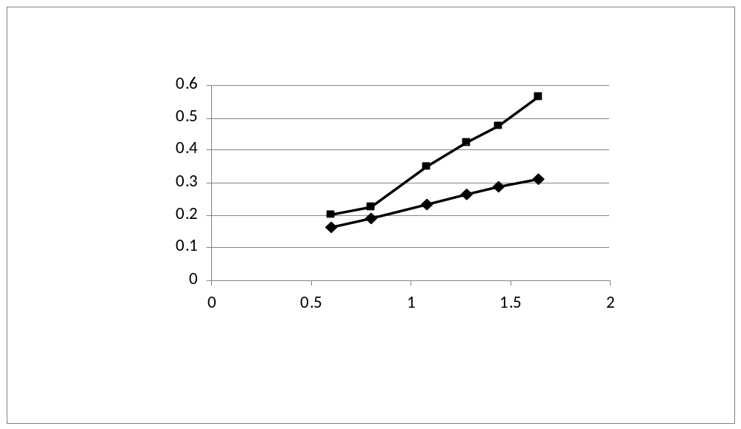
Effect of DC injection
Laboratory, bench scale test
1) Non-active power is not the same as reactive power.
2) GICs reduce the efficiency (pf) of transmission more than expected using conventional approach.
Non-active power Qin vs neutral Idc
Conventional power theory
General power theory

Slide 13
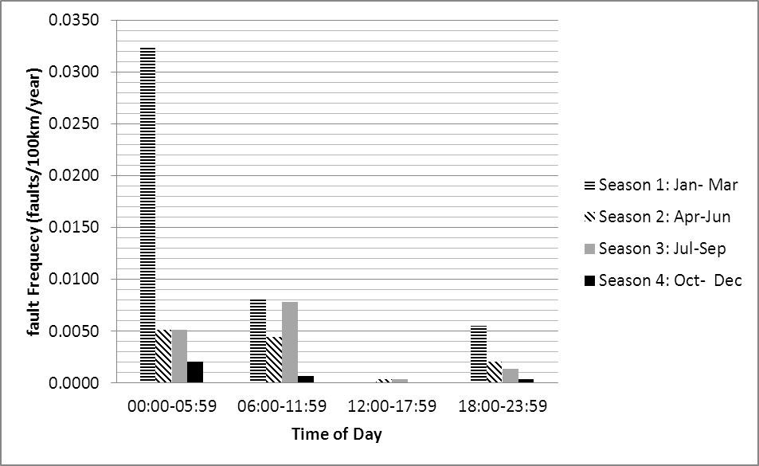
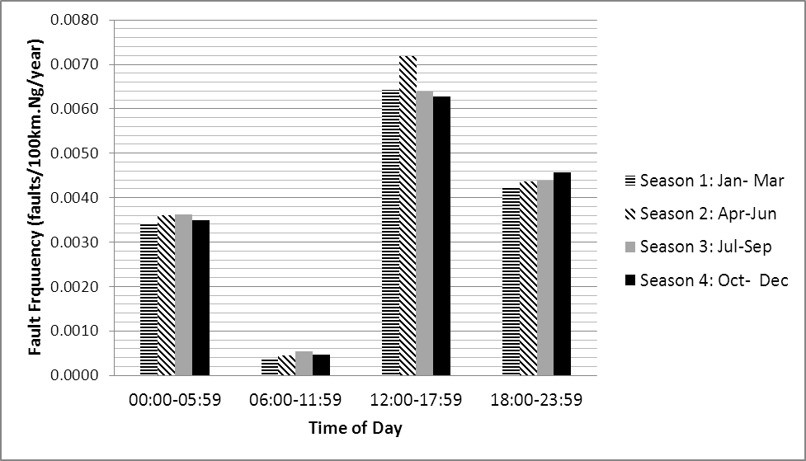
Network failure modelling
GIC events occur at same time as ‘normal’ system faults.
Mitigation based on ‘value at risk’.
Reliability analysis for planning and long term mitigation actions, based on probability functions.
Short term reliability (contingency) analysis for operations, based on adjusted values of same failure probability data.
Requires probability-based reliability simulation.
Pollution
Lightning (Ng=1)

Slide 14
Immediate transformer failure
Very rare (only Quebec storm)
  - Salem transformers – part of core (yoke) melted
  - Two National Grid transformers at different substations – on Buchholz gas
  ~ One Allegheny transformer – very hot tank
May be attributed to weaknesses in transformer design – but these transformers exist.

Slide 15
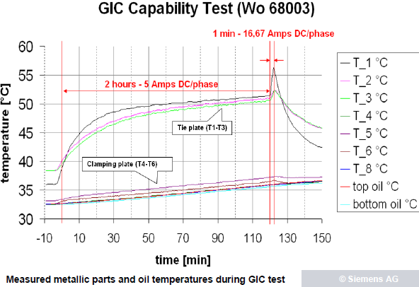
Delayed transformer failure
Often stated a 3-limb unit can sustain 200A GIC.
Also stated the damaged Eskom GSUs could not have been exposed to GICs ‘high enough to cause much winding overheating’ [Girgis et al, 2012].
But recent Siemens test indicates rapid heating is possible with 50A (neutral) dc.

Slide 16
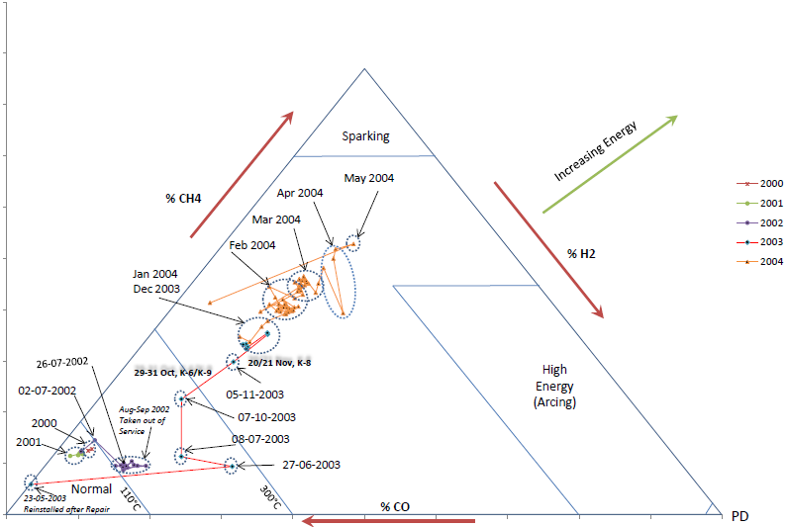
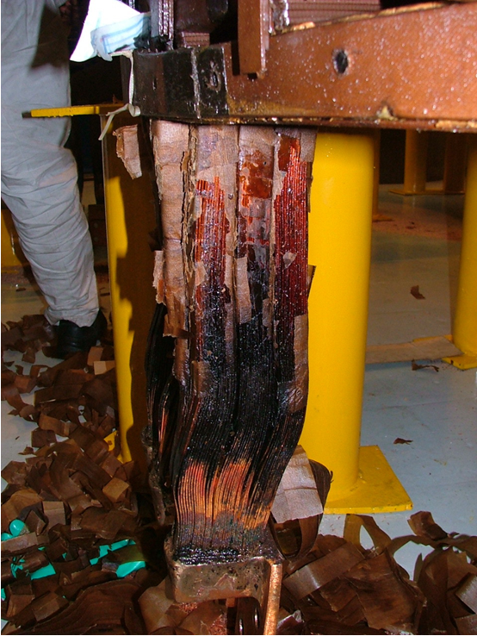
Transformer monitoring
Low Energy Degradation Triangle clearly shows degradation of transformer insulation coincided with geomagnetic storms. Consistent pattern for more than one transformer.
Moodley and Gaunt: IEEE PowerAfrica 2012

Slide 17
Small GICs can damage transformers
Even short, rapid, relatively low magnitude heating can cause hot spots that start the deterioration process.
Rapid heating generates gas bubbles
PD initiated by very small direct currents reported [ISH 2011]
Slight over-heating initiates sulphur deposits
Condition monitoring data shows very clear patterns towards failure
Risk may be sensitive to accuracy of local model

Slide 18
Managing the risk
Power system failure is an immediate response – harmonics and non-active power.
Transformer degradation to failure is not immediate –GIC initiates overheating, starts on-going damage.
Even small GICs (Ineutral < 50A?) cause problems.
Decision support Avoid
Mitigate
Respond

Slide 19
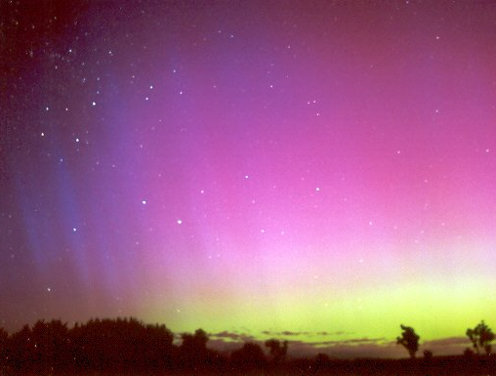
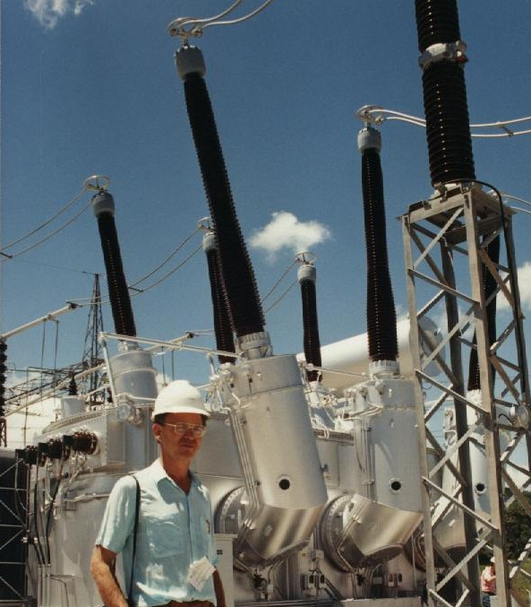
Application
Innovation
Development
Applied research
Basic science

Slide 20
Emergency management of GIC events
Provided electricity utilities:
understand the effects of GICs on their systems,
understand the failure of the components and the reliability of the network under uncommon conditions,
have adequate warning of storm time and intensity, and
have a response plan,
… then GICs will not be emergencies.
Reduce uncertainty !

