Slide 1

Investor
Presentation
TIEMS Oslo Conference 2012
GIC in Norway – Past, Present and Future
We are building the
next generation main grid
Alf Olaussen
Vice President Grid Operations

Slide 2
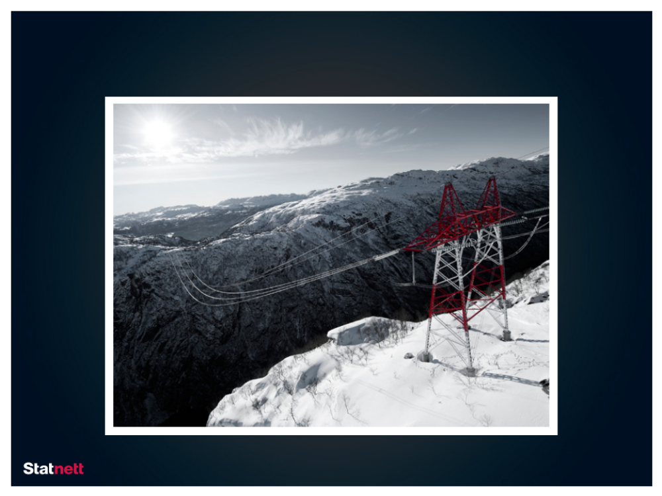
This is Statnett

Slide 3
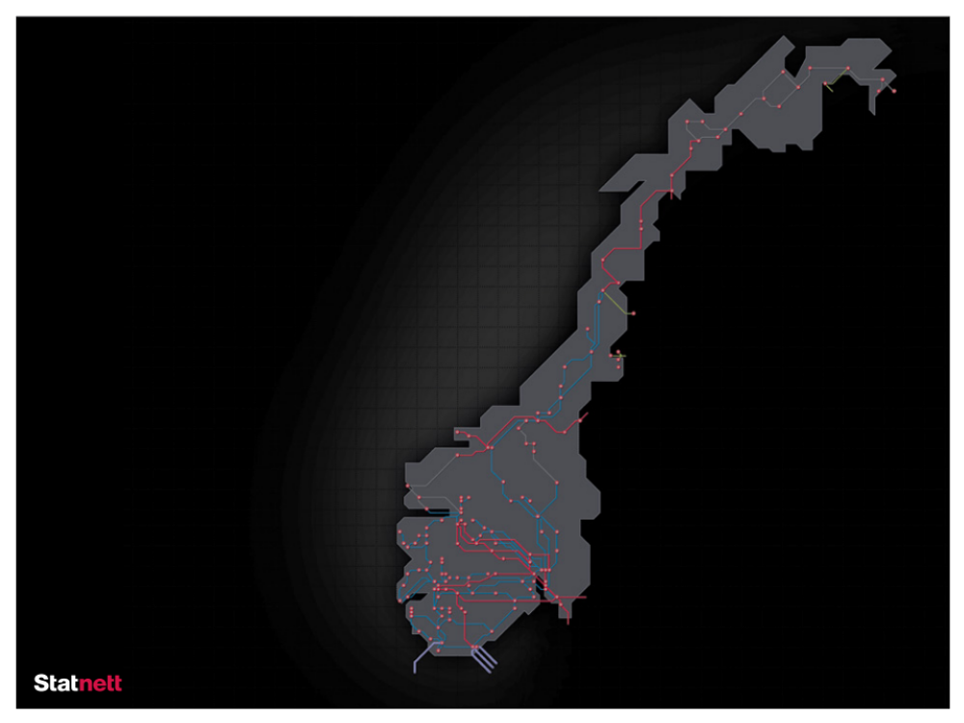
Facts about Statnett
TIEMS Oslo Conference 2012
Statnett is the Transmission System Operator
in the Norwegian energy system
Statnett operates and owns about 10 000 km of power
lines and cables and approximately 140 transformer stations
throughout Norway
Operations are monitored 24/7/365 from
one national control centre and three regional control centres
Statnett is also responsible for interconnectors
to Russia, Finland, Sweden, Denmark and the Netherlands
420 kV
300 kV
220 kV
132-150 kV
HVDC interconnector

Slide 4
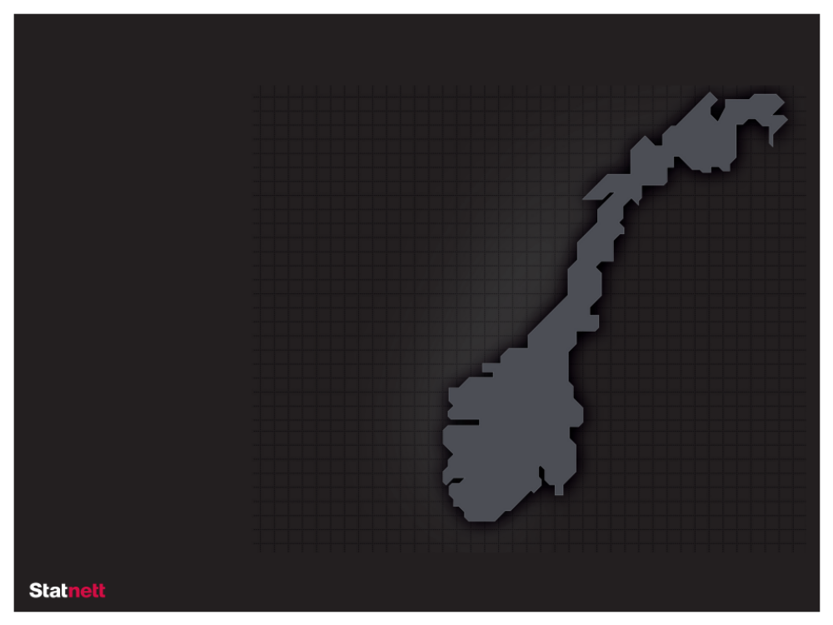




TIEMS Oslo Conference 2012
In short
Everything is dependent on electricity
Our society is already electrified. Electricity is perhaps our most important infrastructure.
The future is electric
Electricity is the energy carrier of the future – it is both climate and user friendly.
The power system – a balancing act
The power system is constantly put to the test.
Operational reliability is our number one priority.
Next generation main grid
The grid needs updating and developing. We are building the main grid of the future.
Notes:
Øverst til venstre: Group presentation, 1 December 2012

Slide 5
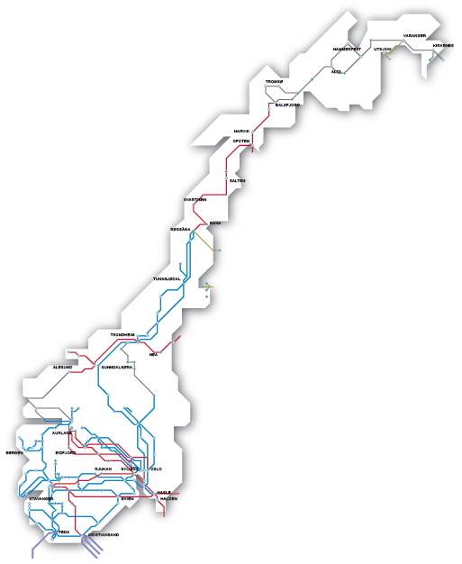
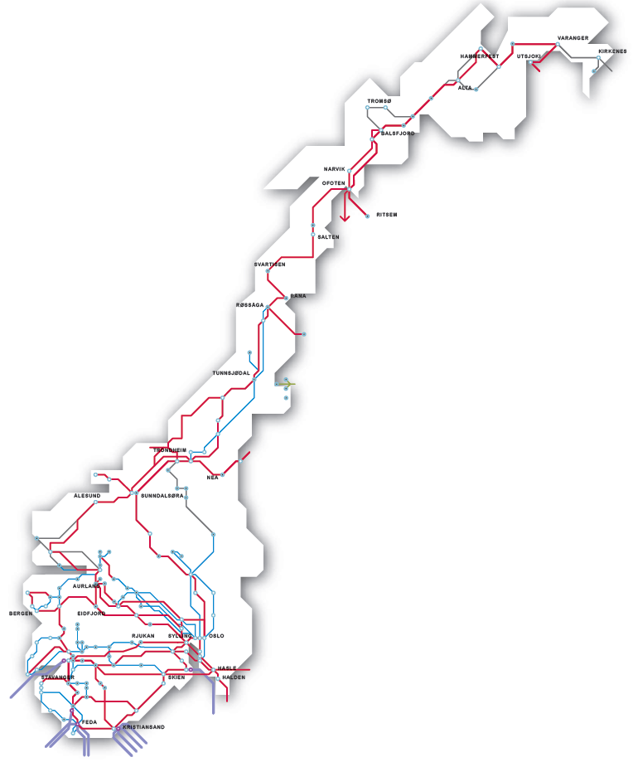
Statnett is building the next generation grid
2010
2030
A national 420 kV grid
Fully connected Nordic grid
More interconnectors

Slide 6
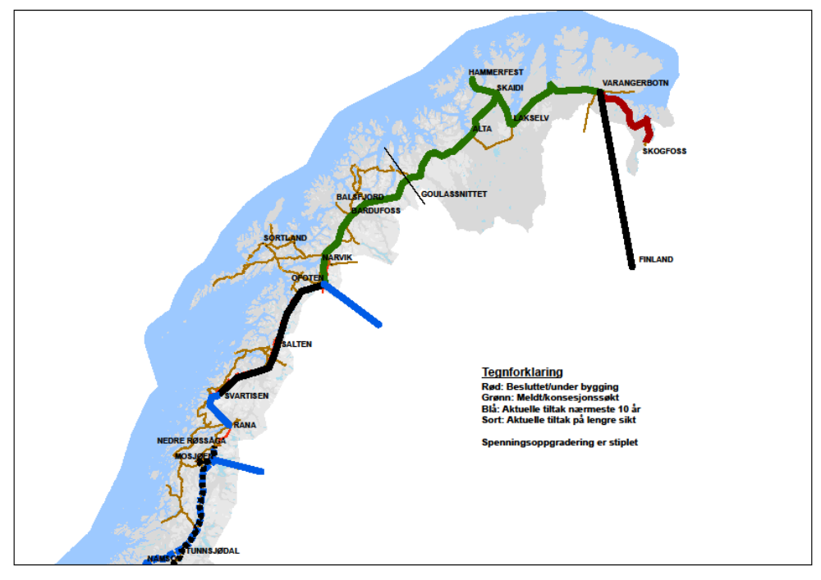
Grid development strategy for Northern Norway
New 420 kV line Ofoten-Balsfjord
and Balsfjord-Hammerfest
420 kV line Skaidi-Varangerbotn
Varangerbotn-Finland
Reinforce Ofoten/Rana south and/or to Sweden
”Arctic Circle”

Slide 7
1. Exerperiences with GIC in the Norwegian Main Grid
2. What do we do to protect against GIC?
In short:
No serious malfunctions or incidents caused by GIC so far
No physcial protection measures implemented – R&D programmmes including GIC-mearsurements
Why Worry ?
Future "superstorms" – to little knowlegde of consequences
Increasing demand for reactive power (in case of high GIC-levels)
Increased extent of interconnected 420 kV network towards 2030
Aging power transformers

Slide 8
Past
R&D project in 1999 og 2000.
Cooperation with SvK (Swedish TSO), OKG AB og Metatech
Background.
Increased concern about solar cycle 23 ( 1999 - 2001 )
Effects on the transmission grid ?
Is GIC a real threat for the electrical power system ?
Notes:
Vet mer i dag, som følge av arbeidet som ble gjort i 1999-2000. GIC-strømregistrering i transformator var noe helt nytt.

Slide 9
Past
Activities 1999 - 2000
Measurements in the transmission network
Voltage and transformer zero current in 4 substations
GIC study of the Swedish and Norwegian power system
Performed by Metatech Corporation USA.
Established a ”GIC model” of the Swedish (132kV - 400kV) and Norwegian (300kV - 420kV) network.
Worst case studies and benchmarking against previous (registered) solar storms.
Participation in Nordic GIC cooperation
Established a network with among others SvK, Fingrid, OKG, Stakraft, Vattenfall, Eltra and Elkraft.
"Nordic GIC meetings”.
Litterature studies
Update on international activities (regarding GIC)
Notes:
"Nordic GIC meetings" – 2 møter..

Slide 10
Present
On-going monitoring of current in transformer neutrals at selected substations, situated North, South, East, West and Central in the power grid.
Performing new system studies regarding GIC in the Norwegian power grid. - Models for present power grid, and for the power grid of 2030.
Review of technical spesifications for power transformers, to make the transformers less vulnerable to GIC.
Review of trip settings of relay protection for shunt capacitors, to avoid unwanted de-energising during a GIC incident.
Involvement and contact with international organisations, projects and working groups, like EurisGic, NERC, Entso-E, Cigre and Doble.

Slide 11
Future
Continue monitoring of current in transformer neutrals.
Improved GIC forecast services, a reliable early warning system will be available.
Emergency plan and procedures regarding extreme magnetic storms are established.
Training of the personnel at the control centres
Notes:
Improved GIC forecast services: Forventer dette.. Bedre og tidligere varsling.. Beredskapsplaner..
Physical measures in power transformers necessary.

